Slide 1

MGM603
Managing People and Organizations
Prepared by Dr. Ayman El-Moesrawy
Lecture 7
Chapter 6. Motivating Behavior with Work and Rewards

Slide 2

CHAPTER 6
Motivating Behavior with Work and Rewards
Learning Outcomes:
After studying this chapter, you should be able to:
Identify and describe different approaches to job design and relate each to motivation.
Discuss employee participation, empowerment, and flexible work arrangements and identify how they can impact motivation.
Describe the goal-setting theory of motivation and discuss broader perspectives on goal setting.
Discuss performance management and its role in motivation.
Describe how organizations use various kinds of rewards to motivate employees.

Slide 3
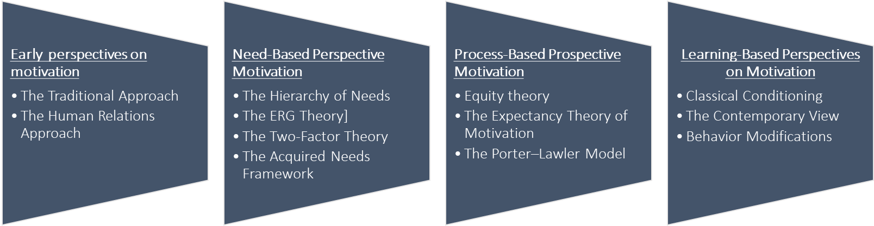
CHAPTER 6
Motivating Behavior with Work and Rewards
Chapter 5 summery:
Chapter 5 introduced the following :
Nature of motivation , The importance of motivations, and motivation framework.
Different types of perspective motivations as following :

Slide 4
CHAPTER 6
Motivating Behavior with Work and Rewards
Real-World Challenge
Orchestrating Outcomes:
Reviewing a concert by the Orpheus Chamber Orchestra, New York Times music critic Vivien Schweitzer wrote that the orchestra played Robert Schumann’s Symphony No. 2 “with remarkable coordination”;
”; the “balance among strings, winds, and brass,” she added, “was impressively well proportioned.” Was Schweitzer, as we sometimes say, damning with faint praise? Isn’t a symphony, which means “harmony of sounds,” supposed to be played with remarkable coordination? Aren’t the various sections of the orchestra supposed to be well balanced? Had the conductor, whose job is to ensure a consummate performance of the music, achieved little more than coordination and balance? Actually, New York-based Orpheus doesn’t play with a conductor, and Schweitzer was remarking on the fact that the orchestra had “bravely—and successfully—attempted” such a complex work without the artistic and managerial leadership of someone who directs rehearsals and stands at a podium waiving an authoritative baton.
“For us at Orpheus,” explains executive director Graham Parker, “it’s the way we make the music that’s the difference.”

Slide 5
CHAPTER 6
Motivating Behavior with Work and Rewards
Real-World Challenge
Orchestrating Outcomes:
Orpheus holds to the principle that its product—the music performed for audiences—is of the highest quality when its workers—the musicians—are highly satisfied with their jobs. All professional orchestra musicians, of course, are highly trained and skilled, but make no mistake about it: A lot of them are not very happy workers.
An organizational psychologist at Harvard surveyed workers in thirteen different occupational categories, including orchestra players, to determine relative levels of job motivation and satisfaction. On the one hand, musicians ranked at the top in motivation, “fueled by their own pride and professionalism,” according to this study. But when it came to general satisfaction with their jobs, orchestra players ranked seventh (just below federal prison guards and slightly above beer sales and delivery teams).
On the question of satisfaction with growth opportunities, they ranked ninth (again, below prison guards, though a little higher than O.R. nurses and hockey players). An orchestra leader has asked you how to imitate the Orpheus’s success.

Slide 6

CHAPTER 6
Motivating Behavior with Work and Rewards
Real-World Challenge
Orchestrating Outcomes:

Slide 7
CHAPTER 6
Motivating Behavior with Work and Rewards
Sequence of Chapter 6:
Chapter 5 described a variety of perspectives on motivation, a manager might still need to translate that theory into operational terms.
managers may need to take certain steps to translate the potential for motivation directed at enhanced performance into real motivation and enhanced performance.
Chapter 6 presents the more common methods used to enhance performance.
The chapter covers six methods: job design, employee participation and empowerment, flexible work arrangements, goal setting, performance management, and organizational rewards.

Slide 8
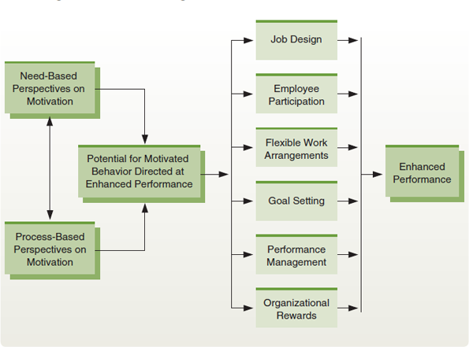
CHAPTER 6
Motivating Behavior with Work and Rewards
Sequence of Chapter 6:
Figure 6.1 Enhancing Performance in Organizations
Managers can use a variety of methods to enhance performance in organizations. The need- and process- based perspectives on motivation explain some of the factors involved in increasing the potential for motivated behavior directed at enhanced performance. Managers can then use such means as goal setting, job design, flexible work arrangements, performance management, rewards, and organizational behavior motivation to help translate this potential into actual enhanced performance.

Slide 9
CHAPTER 6
Motivating Behavior with Work and Rewards
1. Job Design in Organizations:
Job Design: | Defined as How organizations define and structure jobs When work design is addressed at the individual level, it is most commonly referred to as job design The first widespread model of how individual work should be designed was job specialization. For example, a worker who applies safety decals to a piece of equipment as that equipment moves down an assembly line is performing a specialized job.

Slide 10
CHAPTER 6
Motivating Behavior with Work and Rewards
1. Job Design in Organizations: (job specialization)
Job specialization: | Breaking jobs down into small component tasks and standardizing them across all workers doing those jobs Frederick Taylor, the chief proponent of job specialization, argued that jobs should be scientifically studied, broken down into small component tasks, and then standardized across all workers doing those jobs Taylor’s view grew from the historical writings about division of labor advocated by Scottish economist Adam Smith. Specialization paved the way for large-scale assembly lines and was at least partly responsible for the dramatic gains in output U.S. industry achieved for several decades in the early 1900s.

Slide 11

CHAPTER 6
Motivating Behavior with Work and Rewards
1. Job Design in Organizations: (job specialization)
Job specialization involves carefully studying jobs, breaking those jobs down into small component tasks, and then standardizing how those tasks should be performed across all workers performing the jobs. These workers are following standard procedures in how they perform their specialized jobs.

Slide 12
CHAPTER 6
Motivating Behavior with Work and Rewards
1. Job Design in Organizations: (job specialization)
Job specialization: | On the surface, job specialization appears to be a rational and efficient way to structure jobs. The jobs in many factories, for instance, are highly specialized and are often designed to maximize productivity. In practice, however, performing those jobs can cause problems, foremost among them the extreme monotony of highly specialized tasks. Ex. Consider the job of assembling toasters. A person who does the entire assembly may find the job complex and challenging, albeit inefficient. If the job is specialized so that the worker simply inserts a heating coil into the toaster as it passes along on an assembly line, the process may be efficient, but it is unlikely to interest or challenge the worker. may be less motivated to work hard and more inclined to do poor-quality work or to complain about the job.

Slide 13
CHAPTER 6
Motivating Behavior with Work and Rewards
1. Job Design in Organizations: (job Rotations)
Basic Alternatives to Job Specialization
Job Rotations: | Systematically moving workers from one job to another in an attempt to minimize monotony and boredom When job rotation is introduced, the tasks themselves stay the same. However, the workers who perform them are systematically rotated across the various tasks. if a rotation cycle takes workers through the same old jobs, the workers simply experience several routine and boring jobs instead of just one. Although a worker may begin each job shift with a bit of renewed interest, the effect usually is short-lived. Rotation may also decrease efficiency. For example, it sacrifices the proficiency and expertise that grow from specialization. At the same time, job rotation is an effective training technique because a worker rotated through a variety of related jobs acquires a larger set of job skills.

Slide 14

CHAPTER 6
Motivating Behavior with Work and Rewards
1. Job Design in Organizations: (job Rotations)
Basic Alternatives to Job Specialization
Job rotation involves systematically shifting workers from one job to another. While job rotation was intended to sustain motivation and interest, it really does little to address the problems of monotony and boredom created by job specialization. The TSA rotates airport screeners regularly, in an effort to keep them focused on their jobs.

Slide 15
CHAPTER 6
Motivating Behavior with Work and Rewards
1. Job Design in Organizations: (Job Enrichment)
Basic Alternatives to Job Specialization
Job Enrichment: | Entails giving workers more tasks to perform and more control over how to perform them Job enrichment is based on the two-factor theory of motivation, That theory contends that employees can be motivated by positive job-related experiences such as feelings of achievement, responsibility, and recognition. To achieve these, job enrichment relies on vertical job loading—not only adding more tasks to a job, as in horizontal loading, but also giving the employee more control over those tasks

Slide 16
CHAPTER 6
Motivating Behavior with Work and Rewards
1. Job Design in Organizations: (Job Enrichment)
Basic Alternatives to Job Specialization
Job Enrichment: | For example; AT&T utilized job enrichment in a group of eight people who were responsible for preparing service orders. Managers believed turnover in the group was too high and performance too low. Analysis revealed several deficiencies in the work. The group worked in relative isolation, and any service representative could ask them to prepare work orders. As a result, they had little client contact or responsibility, and they received scant feedback on their job performance. The job enrichment program focused on creating a process team. Each member of the team was paired with a service representative, and the tasks were restructured: Ten discrete steps were replaced with three more complex ones. In addition, the group members began to get specific feedback on performance, and their job titles were changed to reflect their greater responsibility and status. Because of these changes, the number of orders delivered on time increased from 27 percent to 90 percent, accuracy improved, and turnover decreased significantly.

Slide 17

CHAPTER 6
Motivating Behavior with Work and Rewards
1. Job Design in Organizations: (Job Enrichment)
Basic Alternatives to Job Specialization
Job enrichment involves both giving workers more tasks to perform and more control over how to perform them. This clothing designer, for example, gets to select fabrics, develop new designs, and then tailor the designs into new clothing.

Slide 18
CHAPTER 6
Motivating Behavior with Work and Rewards
1. Job Design in Organizations: (Job Enrichment)
Basic Alternatives to Job Specialization
Job Enrichment: | At the same time, we should note that many job enrichment programs have failed. Some companies have found job enrichment to be cost ineffective, and others believe that it simply did not produce the expected results Ex. Several programs at Prudential Insurance, for example, were abandoned because managers believed they were benefiting neither employees nor the firm. Some of the criticism is associated with flaws in the two-factor theory of motivation on which job enrichment is based. Because of these and other problems, job enrichment is not as popular as it was a few years ago. The efforts of managers and academic theorists ultimately have led to more complex and sophisticated viewpoints. Many of these advances are evident in the job characteristics theory,

Slide 19
Thanks

