Slide 1
Cyber Security Threat Hunting Through Log Analysis Using LLM with Agentic Action
Presenter: OMAR SALEM ALMUTAIRI
Student ID: 251002148
Program: Master of AI Program
Institution: MIDOCEAN UNIVERSITY

Slide 2
Introduction
The Evolving Threat Landscape
-Cyber Threats on the Rise: We're seeing more sophisticated and frequent cyber attacks.
Shift to Proactive Security: The industry is moving from simply reacting to attacks to actively hunting for them.
-Limitations of Traditional Methods:
  Manual log analysis is slow and time-consuming.
  Traditional methods struggle against new or evolving threats.
  The sheer volume of data overwhelms current security systems.

Slide 3
Introduction
-The Promise of LLMs in Cybersecurity
Large Language Models (LLMs): These models are great at processing and understanding huge amounts of unstructured data.
-Revolutionizing Log Analysis:
  LLMs can spot subtle patterns and anomalies.
  They can generate smart insights beyond what traditional rules can find.
  This allows us to move toward behavior-based anomaly detection.
-Our Focus: This project will leverage LLMs and prompt engineering to enable proactive threat hunting with agentic actions.

Slide 4
Problem Statement
Current LLM Limitations: Many LLM-based systems can detect threats but stop at simply sending an alert.
The Critical Gap: We still need to manually translate high-fidelity alerts into concrete, timely security responses.
Consequences:
  This introduces delays and human error.
  It limits how scalable incident response can be.
  Analysts are burdened with the cognitive load of both interpreting and executing responses.
Core Problem: There's no integrated system for LLM agents to autonomously propose or execute context-aware
response actions.

Slide 5
Motivation
why this research matter
Enhance Proactive Detection: Our goal is to overcome the limitations of reactive security.
Leverage LLM Potential: We want to fully utilize LLMs for context, pattern identification, and actionable insights.
Address Agentic Action Gap: We're moving beyond static analysis to iterative, intelligent investigation.
Practical & Accessible Solution: This research will demonstrate how to effectively adapt LLMs using prompt
engineering, avoiding the need for costly fine-tuning.

Slide 6
Project Scope
What we will deliver
Basic Agentic System: A basic for an LLM-powered threat hunting system with agentic actions.
Data Focus: We will use publicly available security log datasets, such as Windows Event Logs and Sysmon logs.
LLM Approach: We will use an off-the-shelf, open-source LLM, with a primary focus on prompt engineering.
Core Functionality: The system will identify anomalies and threats using LLM-driven agentic actions,
like data retrieval, hypothesis testing, and enrichment.

Slide 7
Research Questions
RQ1:
How to design and build a functional agent-based system that uses an open-source
LLM and prompt engineering to analyze a given set of security logs?

Slide 8
Research Questions
RQ2:
What are the most effective prompts and agentic actions needed to enable the LLM
to perform specific threat hunting tasks,
retrieving additional log data, and enriching findings for a human analyst?

Slide 9
Research Questions
RQ3:
What specific metrics (e.g., precision, recall, F1-score)
should be used to measure the system's performance?

Slide 10
Project Objectives
Core Contribution
Our project goes beyond static log analysis. We're empowering LLMs to perform intelligent, iterative steps.
Proactive Hypothesis Testing: The system will automatically fetch and analyze contextual logs to test hypotheses.
Generating Actionable Insights: It will produce precise, actionable findings, which helps reduce false positives.
Improved Efficiency & Scalability: This will reduce the workload for analysts and make threat hunting operations
more efficient.
Practical Prompt Engineering: We will showcase how to effectively adapt general LLMs for specialized
cybersecurity tasks.

Slide 11
Project Methodology
Overall Approach
Iterative Design: We will continuously refine prompts and agentic logic based on evaluation feedback.
Off-the-Shelf LLM: We'll use a readily available, open-source Large Language Model.
Prompt Engineering is Key: This is the core of our approach to guide LLM behavior and enable complex
reasoning for cybersecurity tasks.
Agentic Actions: We will empower the LLM to dynamically interact with data, fetch more context, and
test hypotheses, moving beyond simple Q&A.
Experimental Evaluation: We will use a rigorous, data-driven comparison against a baseline to validate
our system's effectiveness.

Slide 12
Project Methodology
Key phases
Data Preparation: Acquiring and transforming raw security logs into LLM-ready "log narratives."
LLM Integration & Baseline: Selecting an open-source LLM and establishing a simple detection
baseline for comparison.
Prompt Optimization: Iteratively designing and refining prompts to achieve desired detection and
agentic behaviors.
System Prototyping: Building the core inference pipeline and integrating agentic tools to create a
Minimum Viable Product (MVP).
Comprehensive Evaluation: Quantitatively and qualitatively assessing the system's performance
against defined metrics.

Slide 13
Project Architecture

Slide 14
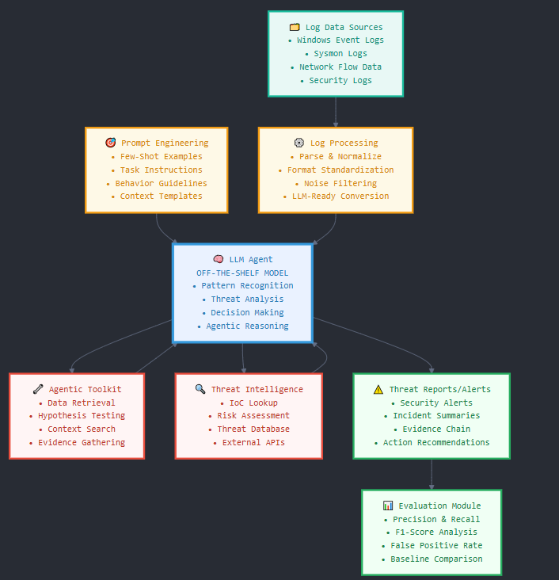

Slide 15
Related Work
Anomaly Detection: Projects like LogLLM and LogRAG leverage LLMs for semantic understanding and reducing false positives.
Log Parsing & Embedding: LLMeLog enriches log events, and other hybrid approaches use LLMs to generate REGEX for event embedding.
Multi-Agent Collaboration: The Audit-LLM framework uses a multi-agent system for insider threat detection, employing a debate mechanism for explainability.
Our Distinction: While existing work uses LLMs for analysis, our project uniquely focuses on LLM-driven agentic actions via prompt engineering for active, iterative investigation with off-the-shelf models.

Slide 16
Project Plan
A 12-Week Approach Total Duration: 12 Intensive Weeks Phase 1 (Month 1): Data Preparation & LLM Integration
Phase 2 (Month 2): Prompt Optimization & System Prototyping
Phase 3 (Month 3): Evaluation, Analysis & Thesis Drafting
Final Week (Week 12): Thesis Discussion & Finalization

Slide 17
Expected Results
Functional Prototype: A working LLM-driven threat hunting agentic system .
Enhanced Detection: Superior precision and a lower false positive rate compared to the baseline.
Optimized Prompt Framework: A clear methodology for LLM interaction and agentic actions.
Quantitative Metrics: Measurable improvements in precision, recall, and F1-score.
Identified Limitations: An honest assessment of project constraints and avenues for future work.

Slide 18
Conclusion
Summary: This project aims to advance cybersecurity threat hunting by leveraging LLMs with agentic actions
through prompt engineering, creating a more proactive and efficient detection system.
Impact: We expect to reduce the analyst's burden, improve threat detection, and provide a practical framework
for future LLM applications in security.
Next Steps: Rigorous testing, detailed analysis, and comprehensive thesis documentation.

Slide 19
Thank You!
Questions?

