Slide 1

CCNA (200-301) Cisco Certified Network Associate
Prepared by Eng. Taghreed Elsayed
Lecture 9
Access Control List (ACL)

Slide 2

Chapter
04
ACL (Access Control List)
The default behavior of a router is to input a packet on an interface, determine the route, and forward the packet out of the exit interface.
His behavior can be changed by implementing ACLs on the router.
An ACL is a router configuration script that controls whether a router. permits or denies packets to pass based on criteria found in the packet header.
ACLs operate at the network and higher layers.
ACLs can be configured on routers to enable the admin to control a user’s access to network resources.
Can be used to create a simple firewall.

Slide 3
Chapter
04
ACL (Access Control List)
Applying ACL
In bound Access List: Permit or deny the packets from entering the router before any routing operation.
Out bound Access List: Permit or deny the packets from exciting the router interface that will done after routing operation.

Slide 4
Chapter
04
ACL (Access Control List)
Types of ACLs :
There are two types of ACLs
Standard ACLs :permit or deny traffic based on source IP addresses
Extended ACLs: permit or deny traffic based on:
Source information→ Source IP address
→ source port number
2.Destination information → Destination IP address
→ Destination port number

Slide 5
Chapter
04
ACL (Access Control List)
3.Protocol type →TCP/UDP/ IP/EIGRP…………….. .
You can configure ACLs on an interface to filter inbound traffic, outbound traffic, or both.
You can configure one ACL per protocol, per direction, per interface.
Standard IP ACLs
Standard ACLs allow you to permit or deny traffic based solely on the source IP address of each packet.
The following ACL will permit access to everyone except users on network 192.168.10.0/24, with the exception of one particular user:

Slide 6

Chapter
04
ACL (Access Control List)
Each line of the ACL is entered at the global config level in the order it is to be applied to the packet.
The ID of a Standard IP ACL must be in the range 1-99
Syntax for Standard IP ACLs 
1.number - the ID of the ACL in range 1 -99
2.Deny - filter the packet if a match
3.Permit-forward the packet if a match

Slide 7
Chapter
04
ACL (Access Control List)
4.SouurceIP - to be compared to the packet source IP address
5.Wildcard - wildcard mask to be used in the comparison
access-list number {deny |permit } source IP [wildcard]
Editing Standard ACLs
Note that the order of the access-lines is important to the meaning of the ACL
Any new access-line added can only be added to the end of the list
You are advised to always type ACLs into a text file and paste the ACL into the router .

Slide 8
Chapter
04
ACL (Access Control List)
To remove all access-lines of an ACL with ID n, simply enter:
no access-list n
Then re-paste the modified ACL statements from the text file.
Numbered IP ACLs
The ID number of an ACL determines what type it is:
1-99→ → Standard IP ACL
100-199→ Extended IP ACL

Slide 9

Chapter
04
ACL (Access Control List)
Syntax Abbreviations
A number of abbreviations can be used when writing ACLs, in order to make them more readable.
host ip _ address→ replaces ip _ address 0.0.0.0
Any→ replace 0.0.0.0 255.255.255.255
Omitting a wildcard mask will assume 0.0.0.0
SO the previous ACL could be written:

Slide 10

Chapter
04
ACL (Access Control List)
A Common Error
Note that every ACL ends with an implicit deny any statement
To allow everyone except 192.168.10.1 user to access a network, you could write:
This would be an error. Why?
It should be:
Note that every ACL must have at least one permit statement

Slide 11


Chapter
04
ACL (Access Control List)
Applying the ACL
Having defined the ACL, it must be applied to an interface:
Each IP packet entering the s0/0 interface will be permitted or denied by the ACL before the router attempts to route the packet.
Alternatively the ACL could be applied to the outward traffic flow:
Here, each IP packet routed out of the s0/1 interface will be permitted or denied by the ACL.

Slide 12
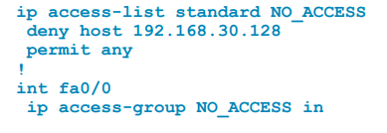
Chapter
04
ACL (Access Control List)
Named ACLs
Named IP ACLs allow you to delete individual entries in a specific ACL.
You can use sequence numbers to insert statements anywhere in the named ACL.

Slide 13
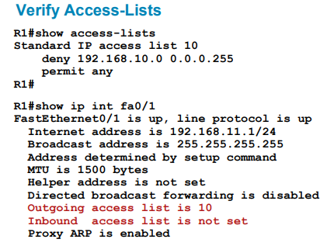
Chapter
04
ACL (Access Control List)

Slide 14
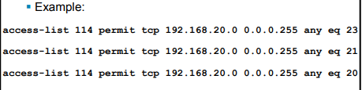
Chapter
04
ACL (Access Control List)
Extended ACLs
access-list number {deny | permit } protocol source IP [source-wildcard] [operator op] [port port-number] destination IP [destination-wildcard] [operator op] [port port-number]

Slide 15
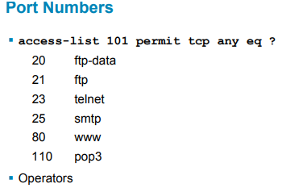
Chapter
04
ACL (Access Control List)
Eq= equal

Slide 16
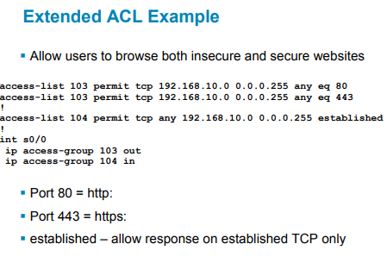
Chapter
04
ACL (Access Control List)

Slide 17
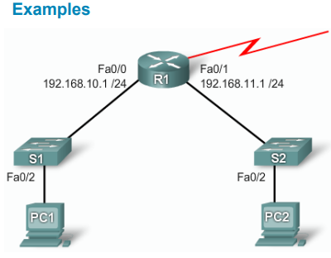
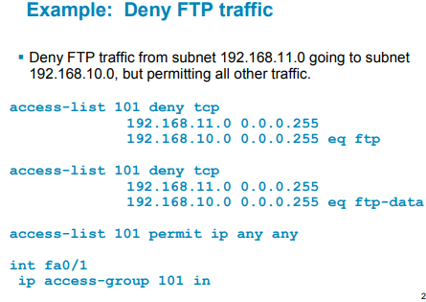
Chapter
04
ACL (Access Control List)

Slide 18
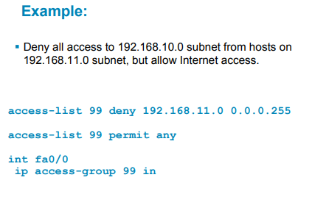
Chapter
04
ACL (Access Control List)

Slide 19
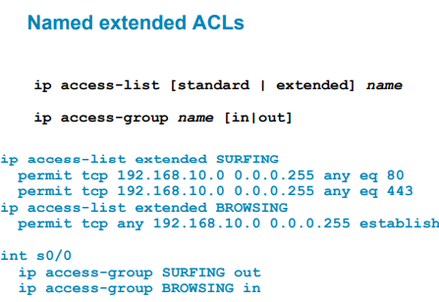
Chapter
04
ACL (Access Control List)

Slide 20
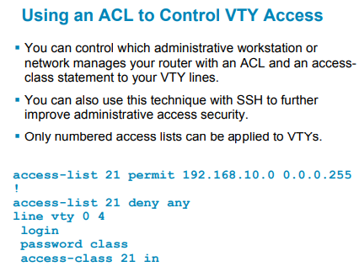
Chapter
04
ACL (Access Control List)

