Slide 1


Slide 2
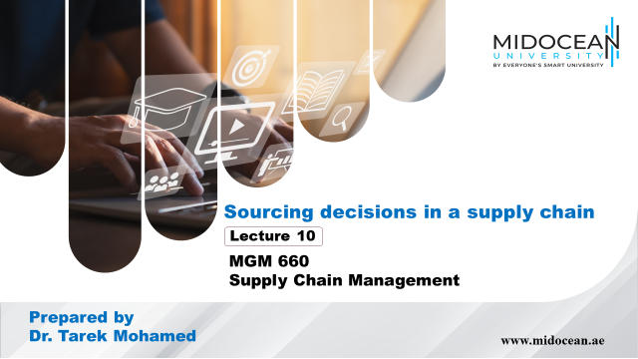

Slide 3


Learning Objectives
Understand the role of sourcing in a supply chain
Discuss factors that affect the decision to outsource a supply chain function
Identify dimensions of supplier performance that affect total cost
Structure successful auctions and negotiations
Describe the impact of risk sharing on supplier performance and information distortion
Design a tailored supplier portfolio
www.midocean.ae

Slide 4

The Role of Sourcing in a Supply Chain
Purchasing, is the process by which companies acquire raw materials, components, products, services, or other resources from suppliers to execute their operations.
Sourcing is the entire set of business processes required to purchase goods and services.
For any supply chain function, the most significant decision is whether to outsource the function or perform it in-house.
Outsourcing results in the supply chain function being performed by a third party.
Outsourcing decisions are important and tend to vary across firms and industries.
www.midocean.ae

Slide 5
The Role of Sourcing in a Supply Chain
Outsourcing questions
  Will the third party increase the supply chain surplus relative to performing the activity in-house?
  How much of the increase in surplus does the firm get to keep?
  To what extent do risks grow upon outsourcing?
www.midocean.ae

Slide 6
The Role of Sourcing in a Supply Chain
Recall that the supply chain surplus is the difference between the value of a product for the customer and the total cost of all supply chain activities involved in bringing the product to the customer.
Outsourcing makes sense if it increases the supply chain surplus (assuming we get to keep some of the increase) without significantly increasing risks.
A sourcing decision should aim to increase the net value created by the supply chain.
www.midocean.ae

Slide 7
The Role of Sourcing in a Supply Chain
For example, P&G has historically outsourced retailing of its products to others.
The third parties increase the supply chain surplus by aggregating many products that customers need (not just P&G products) in a single retail store.
This aggregation allows them to spread facility costs, selling costs, personnel costs, and transportation costs across many consumer goods manufacturers.
This aggregation also allows the retailer to increase customer value by allowing them to purchase many products they need in a single visit to the store.
www.midocean.ae

Slide 8
The Role of Sourcing in a Supply Chain
Clearly, outsourcing retailing to a third party increases the value created by the supply chain to a greater extent than if P&G managed its own retailing.
Good sourcing decisions grow value by assigning each activity within the supply chain to the party that can add the most value.
Effective sourcing processes within a firm can improve profits for the firm, as well as total supply chain surplus, in a variety of ways.
The drivers of improved profits must be identified when making sourcing decisions
www.midocean.ae

Slide 9
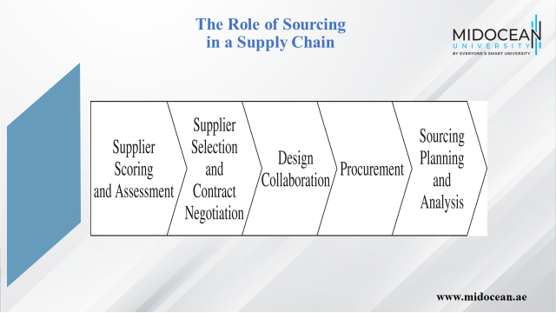

Slide 10
Supplier Scoring and Assessment
Supplier performance should be compared on the basis of the supplier’s impact on total cost.
There are several other factors besides purchase price that influence total cost.
www.midocean.ae

Slide 11
Supplier Selection
Identify one or more appropriate suppliers
Contract should account for all factors that affect supply chain performance
Should be designed to increase supply chain profits in a way that benefits both the supplier and the buyer
www.midocean.ae

Slide 12
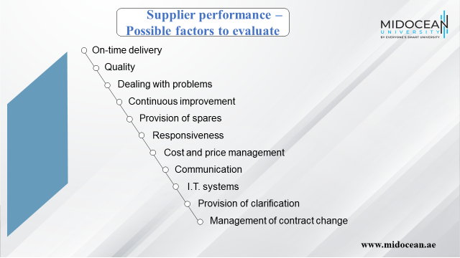

Slide 13
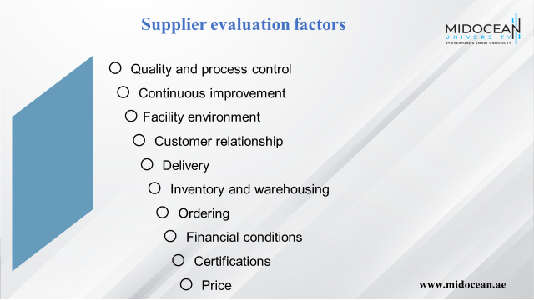

Slide 14
Design Collaboration
About 80% of the cost of a product is determined during design
Suppliers should be actively involved at this stage
ESI has been defined as:
A practice that brings together one or more selected suppliers with a buyer’s product design team early in the product development process.
The objective is to utilise the supplier’s expertise and experience in developing a product specification that is designed for effective and efficient product roll-out.
www.midocean.ae

Slide 15
Procurement
A supplier sends product in response to orders placed by the buyer
Orders placed and delivered on schedule at the lowest possible overall cost
www.midocean.ae

Slide 16
Sourcing Planning and Analysis
Analyze spending across various suppliers and component categories
Identify opportunities for decreasing the total cost
www.midocean.ae

Slide 17
Cost of Goods Sold
Cost of goods sold (COGS) represents well over 50 percent of sales for most major manufacturers.
Purchased parts a much higher fraction than in the past.
Companies have reduced vertical integration and outsourced.
www.midocean.ae

Slide 18
Benefits of Effective
Sourcing Decisions
Better economies of scale through aggregated more efficient procurement transactions
Design collaboration can result in products that are easier to manufacture and distribute
Good procurement processes can facilitate coordination with suppliers
Appropriate supplier contracts can allow for the sharing of risk
Firms can achieve a lower purchase price by increasing competition through the use of auctions
www.midocean.ae

Slide 19
In-House or Outsource
Increase supply chain surplus through
  Capacity aggregation
  Inventory aggregation
  Transportation aggregation by transportation intermediaries
  Transportation aggregation by storage intermediaries
  Warehousing aggregation
  Procurement aggregation
  Information aggregation
  Receivables aggregation
  Relationship aggregation
  Lower costs and higher quality
www.midocean.ae

Slide 20
Factors Influencing Growth of Surplus by a Third Party
Scale
  Large scale it is unlikely that a third party can achieve further scale economies and increase the surplus
Uncertainty
  If requirements are highly variable over time, third party can increase the surplus through aggregation
Specificity of assets
  If assets required are specific to a firm, a third party is unlikely to increase the surplus
www.midocean.ae

Slide 21
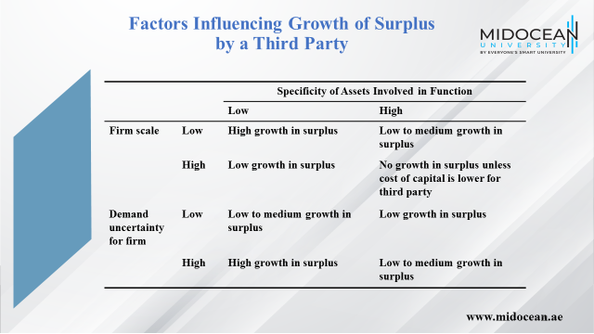

Slide 22
Risks of Using a Third Party
The process is broken
Underestimation of the cost of coordination
Reduced customer/supplier contact
Loss of internal capability and growth in third-party power
Leakage of sensitive data and information
Ineffective contracts
Loss of supply chain visibility
Negative reputational impact
www.midocean.ae

Slide 23
Third- and Fourth-Party
Logistics Providers
Third-party logistics (3PL) providers performs one or more of the logistics activities relating to the flow of product, information, and funds that could be performed by the firm itself
A 4PL (fourth-party logistics) designs, builds and runs the entire supply chain process
www.midocean.ae

Slide 24
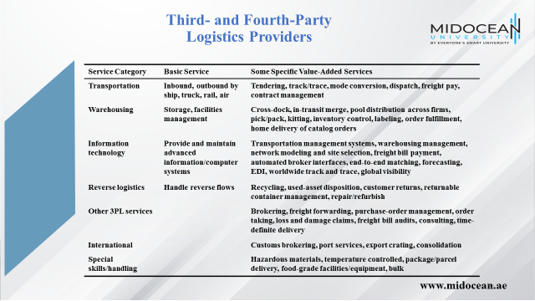

Slide 25
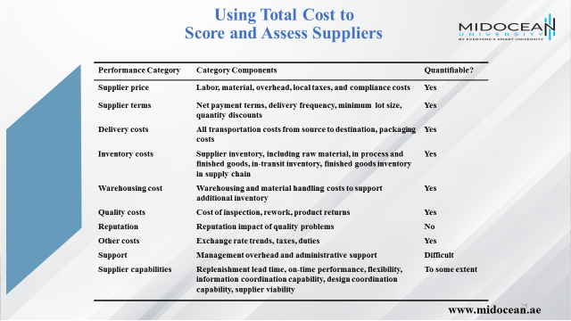

Slide 26
Supplier Selection –
Auctions and Negotiations
Supplier selection can be performed through competitive bids, reverse auctions, and direct negotiations
Supplier evaluation is based on total cost of using a supplier
Auctions:
  Sealed-bid first-price auctions
  English auctions
  Dutch auctions
  Second-price (Vickery) auctions
www.midocean.ae

Slide 27
Supplier Selection –
Auctions and Negotiations
Factors influence the performance of an auction
  Is the supplier’s cost structure private (not affected by factors that are common to other bidders)?
  Are suppliers symmetric or asymmetric; that is, ex ante, are they expected to have similar cost structures?
  Do suppliers have all the information they need to estimate their cost structure?
  Does the buyer specify a maximum price it is willing to pay for the supply chain?
www.midocean.ae

Slide 28
Supplier Selection –
Auctions and Negotiations
Collusion among bidders
Second-price auctions are particularly vulnerable
Can be avoided with any first-price auction
www.midocean.ae

Slide 29
Basic Principles of Negotiation
The difference between the values of the buyer and seller is the bargaining surplus
The goal of each negotiating party is to capture as much of the bargaining surplus as possible
  Have a clear idea of your own value and as good an estimate of the third party’s value as possible
  Look for a fair outcome based on equally or equitably dividing the bargaining surplus
  A win-win outcome
www.midocean.ae

Slide 30
Contracts, Risk Sharing, and
Supply Chain Performance
How will the contract affect the firm’s profits and total supply chain profits?
Will the incentives in the contract introduce any information distortion?
How will the contract influence supplier performance along key performance measures?
www.midocean.ae

Slide 31
Contracts for Product Availability and Supply Chain Profits
Independent actions taken by two parties in a supply chain often result in profits that are lower than those that could be achieved if the supply chain were to coordinate its actions
Three contracts that increase overall profits by making the supplier share some of the buyer’s demand uncertainty are
  Buyback or returns contracts
  Revenue-sharing contracts
  Quantity flexibility contracts
www.midocean.ae

Slide 32
Buyback Contracts
Allows a retailer to return unsold inventory up to a specified amount at an agreed upon price
The manufacturer specifies a wholesale price c and a buyback price b
The manufacturer can salvage $s_{M} for any units that the retailer returns
The manufacturer has a cost of v per unit produced and the retail price is p
www.midocean.ae

Slide 33
Buyback Contracts
Holding-cost subsidies
  Manufacturers pay retailers a certain amount for every unit held in inventory over a given period
  Encourage retailers to order more
Price support
  Manufacturers share the risk of product becoming obsolete
  Guarantee that in the event they drop prices they will lower prices for all current inventories
www.midocean.ae

Slide 34
Revenue-Sharing Contracts
Manufacturer charges the retailer a low wholesale price c and shares a fraction f of the retailer’s revenue
  Allows both the manufacturer and retailer to increase their profits
  Results in lower retailer effort
  Requires an information infrastructure
  Information distortion results in excess inventory in the supply chain and a greater mismatch of supply and demand
www.midocean.ae

Slide 35
Quantity Flexibility Contracts
Allows the buyer to modify the order (within limits) after observing demand
Better matching of supply and demand
Increased overall supply chain profits if the supplier has flexible capacity
Lower levels of information distortion than either buyback contracts or revenue sharing contracts
www.midocean.ae

Slide 36
Contracts to Coordinate
Supply Chain Costs
Differences in costs at the buyer and supplier can lead to decisions that increase total supply chain costs
A quantity discount contract may encourage the buyer to purchase a larger quantity which would result in lower total supply chain costs
Quantity discounts lead to information distortion because of order batching
www.midocean.ae

Slide 37
Contracts to Increase Agent Effort
In many supply chains, agents act on behalf of a principal and the agents’ efforts affect the reward for the principal
A two-part tariff offers the right incentives for the dealer to exert the appropriate amount of effort
Threshold contracts increase information distortion
Offer threshold incentives over a rolling horizon
www.midocean.ae

Slide 38
Contracts to Induce
Performance Improvement
A buyer may want performance improvement from a supplier who otherwise would have little incentive to do so
A shared-savings contract provides the supplier with a fraction of the savings that result from performance improvement
Effective in aligning supplier and buyer incentives when the supplier is required to improve performance and most of the benefits of improvement accrue to the buyer
www.midocean.ae

Slide 39
Design Collaboration
50-70% of spending at a manufacturer comes from procurement
80% of the cost of a purchased part is fixed in the design phase
Design collaboration with suppliers can result in reduced cost, improved quality, and decreased time to market
Design for logistics, design for manufacturability
Modular, adjustable, dimensional customization
www.midocean.ae

Slide 40
The Procurement Process
The process in which the supplier sends product in response to orders placed by the buyer
Main categories of purchased goods
  Direct materials
  Indirect materials
Procurement process for direct materials should be designed to ensure that components are available in the right place, in the right quantity, and at the right time
Focus for indirect materials should be on reducing transaction cost
www.midocean.ae

Slide 41
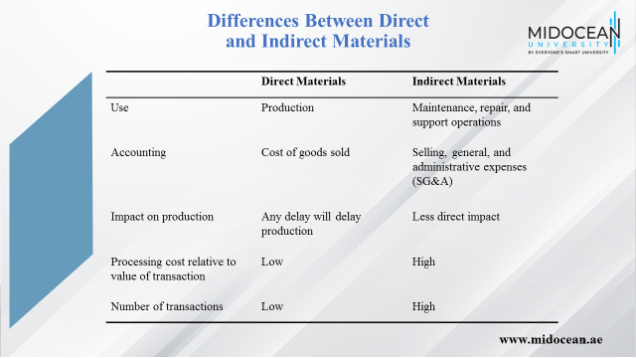

Slide 42
Designing a Sourcing Portfolio:
Tailored Sourcing
Options with regard to whom and where to source from
  Produce in-house or outsource to a third party
  Will the source be cost efficient or responsive
  Onshoring, near-shoring, and offshoring
Tailor supplier portfolio based on a variety of product and market characteristics
www.midocean.ae

Slide 43
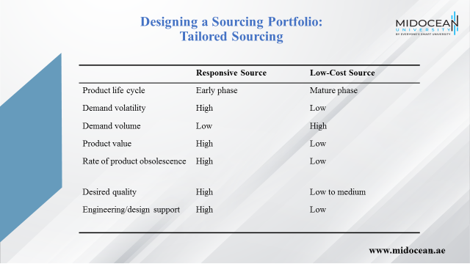

Slide 44
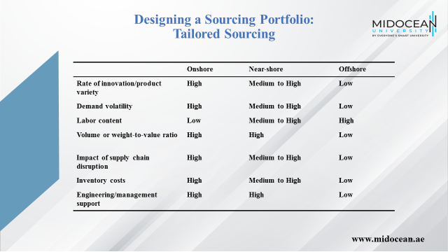

Slide 45
Risk Management in Sourcing
Inability to meet demand on time
An increase in procurement costs
Loss of intellectual property
www.midocean.ae

Slide 46
Making Sourcing
Decisions in Practice
Use multifunction teams
Ensure appropriate coordination across regions and business units
Always evaluate the total cost of ownership
Build long-term relationships with key suppliers
www.midocean.ae

Slide 47
Summary of Learning Objectives
Understand the role of sourcing in a supply chain
Discuss factors that affect the decision to outsource a supply chain function
Identify dimensions of supplier performance that affect total cost
Structure successful auctions and negotiations
Describe the impact of risk sharing on supplier performance and information distortion
Design a tailored supplier portfolio
www.midocean.ae

Slide 48
Essential Reference
Chopra, S., & Meindl, P. (2016). Global Edition. Pearson Education Limited
Chapter 15.
www.midocean.ae

Slide 49



Thank You

