Slide 1



Business Data Analysis
MGM509
Lecture 1
From Business Challenges to Data Science Solutions
Prepared by
Eng. Ahmed Hussein, MBA, PfMP©, PMP©, CMP APMG

Slide 2

Lecture
What we will cover
01
Understand the types of business problems data science can solve
Learn about common data mining tasks and when to use them
Understand the full data mining process life cycle
Differentiate supervised vs unsupervised methods with examples
1 – 2

Slide 3
Why Data Science Needs a Structured Process?
Lecture
01
Data Mining Bridges the Gap
Converts business objectives into analytical questions
Uses a structured, iterative process to guide success
Business Problems Are Not Always Well-Defined
Real-world business challenges are often ambiguous, multi-faceted, and data-poor.
Jumping directly into modeling risks:
  Building irrelevant models
  Wasting time on the wrong problem
  Producing untrustworthy results
Data Mining Bridges the Gap
Converts business objectives into analytical questions
Uses a structured, iterative process to guide success
1 – 3

Slide 4
Lecture
The Role of Data Science in Business
01
Aims of Data Science in Business
Improve decisions with data
Reduce guesswork by making evidence-based predictions
Align technical outputs (models, insights) with actionable business needs
Turning Business Problems into Analytical Tasks
Effective data science is goal-directed:
Understand what decisions need to be improved
Identify what data can support these decisions
1 – 4

Slide 5
Examples of Business Problems Solved with Data Science
Lecture
01
Customer retention and churn management
Fraud and anomaly detection
Forecasting and risk analysis
Recommendation systems and personalization
1 – 5

Slide 6
Lecture
From Business Problems to Data Task
01
The Core Challenge
Business problems are often vague or high-level.
Data science reframes them into precise analytical tasks.
Key question:
“What do we need to predict, classify, group, or discover?”
Begin with a clear business question
Identify the data needed
Match the question to a data mining task (e.g., classification, clustering)
1 – 6

Slide 7
Lecture
8 Canonical Data Mining Tasks (1/2)
01
Classification
Regression
Clustering
Similarity Matching
Assign labels to predefined categories (e.g., spam vs. not spam)
Predict numeric outcomes (e.g., revenue, prices)
Group similar records (e.g., customer segmentation)
Finding items/entities similar to a target (e.g., recommender systems)
1 – 7

Slide 8
Lecture
8 Canonical Data Mining Tasks (2/2)
01
Co-occurrence Grouping
Profiling
Link Prediction
Data Reduction
Discover patterns in frequently co-occurring items (e.g., market basket analysis)
Identify typical characteristics or behaviors of groups (e.g., loyal customers)
Anticipate connections between entities (e.g., friend recommendations)
Simplify datasets to essential variables (e.g., dimensionality reduction)
1 – 8

Slide 9
Lecture
Example – Predicting Churn
01
Translated to Data Science Task
  Task Type: Classification
  Target Variable: Will churn (Yes/No)
  Output: Probability or binary prediction
Business Problem
“Which customers are likely to leave when their contracts expire?”
Translated to Data Science Task
  Task Type: Classification
  Target Variable: Will churn (Yes/No)
  Output: Probability or binary prediction
1 – 9

Slide 10
Example – Customer Value Forecasting
Lecture
01
Translated to Data Science Task
  Task Type: Regression
  Target Variable: Predicted customer lifetime value (CLV)
Business Problem
“Which customers are likely to generate the most revenue?”
1 – 10

Slide 11
Lecture
Matching Problem Types to Tasks
01
Business Need | Data Mining Task
Predict churn | Classification
Segment Customers | Clustering
Estimate Product Demand | Regression
Recommend Products | Similarity Matching
Identify abnormal transactions | Anomaly Detection
1 – 11

Slide 12
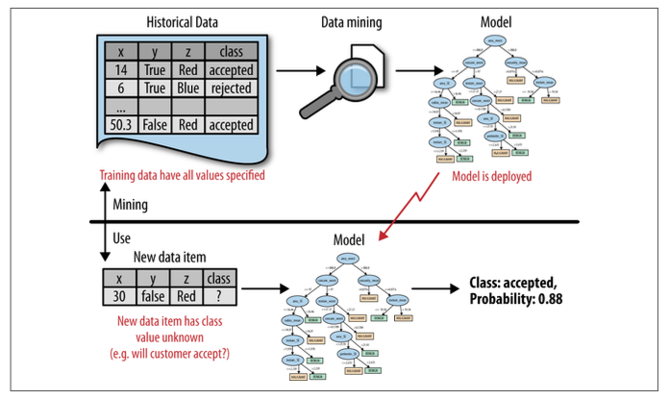
Data Mining Vs. Using Data Mining Results
Lecture
01
1 – 12

Slide 13
Lecture
Data Mining Results
01
Result ≠ Just a Model
Not Just Models but Insights and Actions
It could be:
  A set of rules
  A ranking
  A cluster definition
  A probability estimate
The form of the result should match the business goal
1 – 13

Slide 14
Lecture
Examples of Types of Results
01
Prediction Scores
E.g., “Customer A has a 78% chance of churning.”
Class Labels
E.g., “This transaction is classified as fraudulent.”
Segments or Clusters
E.g., “These 3 customer types differ in spending behavior.”
Action Rules
E.g., “Offer Plan B if usage drops below 500 mins.”
1 – 14

Slide 15
Lecture
Why Result Format Matters?
01
Tailored to Business Needs
Always ask:
“How will this output be used in real-world decision-making?”
A good result should:
Support a decision or action
Be easy to implement or integrate
Reflect operational constraints
1 – 15

Slide 16
Supervised vs. Unsupervised Learning
Lecture
01
Supervised Learning
Learns from labeled examples
Unsupervised Learning
Finds structure without labeled outcomes
Two approaches define how the model learns from data.
1 – 16

Slide 17
Supervised vs. Unsupervised Learning
Lecture
01
 | Supervised Learning | Unsupervised Learning
Characteristics | Training data includes known outcomes (labels) Goal: Learn a function that maps input features to an output | No labeled outcomes provided Goal: Discover patterns, groupings, or structures in data
Common Tasks | Classification (e.g., fraud/no fraud) Regression (e.g., sales forecast) | Clustering (e.g., customer segmentation) Association rule mining (e.g., market basket analysis) Anomaly detection (e.g., finding outliers)
1 – 17

Slide 18
Supervised vs. Unsupervised Learning Examples
Lecture
01
Supervised Learning
Unsupervised Learning
Predict customer churn using historical activity
Detect fraud in banking transactions
Score customer credit risk based on demographics
Group customers based on purchase behavior
Identify underlying topics in documents
Reduce variables to core factors
1 – 18

Slide 19
Lecture
Why a Process Framework?
01
Data Mining Is Iterative, Not Linear
Successful projects follow a structured yet flexible process
Helps teams:
  Align technical work with business needs
  Avoid common pitfalls
  Plan for evaluation and deployment
Solution: Use a proven process model like CRISP-DM (Cross Industry Standard Process for Data Mining)
1 – 19

Slide 20
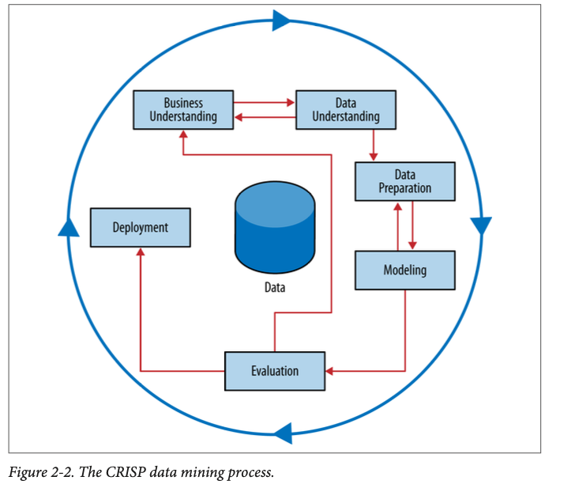
Data Mining Process Overview (CRISP-DM)
Lecture
01
Cross Industry Standard Process for Data Mining
Not strictly sequential; often involves loops and iteration
1 – 20

Slide 21


Lecture
Phase 1: Business Understanding
01
Clarify What the Business Needs
Define project objectives and success criteria
Understand:
  What decision needs support
  Constraints and expectations
  How results will be used
Technical success is meaningless without business value
1 – 21

Slide 22

Lecture
Phase 2: Data Understanding
01
Get Familiar with the Data
Identify relevant data sources
Examine:
  Data quality
  Completeness
  Unexpected patterns
Example: Are “churn” labels complete and timely?
1 – 22

Slide 23

Lecture
Phase 3: Data Preparation
01
Prepping Raw Data for Modeling
Most time-consuming phase
Crucial to prevent data leakage or biased models
Tasks may include:
  Data cleaning (e.g., missing values)
  Feature selection or engineering
  Data transformation and integration
1 – 23

Slide 24
Lecture
Data Preparation Pitfalls & Iteration
01
Avoid ”Data Leakage”
Leakage: when future data unintentionally influences training
Example: Including a churn-related event that happens after the prediction point
Clean, accurate, and time-respectful data is critical to trustworthy models
Iteration is the Norm
Not a Waterfall Process
You may revisit:
  Business understanding after initial modeling
  Data preparation after evaluation
Key: Stay flexible but methodical
“Most data mining is 80% data prep, 20% modeling — and 100% learning.”
1 – 24

Slide 25
Lecture
Phase 4: Modeling
01
Building Predictive or Descriptive Models
Select modeling techniques:
  Decision trees, logistic regression, clustering, etc.
Iterate to improve:
  Feature choices
  Model parameters
Models should be aligned with the business question and data structure
1 – 25

Slide 26
Lecture
Modeling Techniques
01
Choosing the Right Tool for the Task
Technique depends on task type, data type, and business context
Classification | Decision Trees, Random Forests, Logistic Regression
Regression | Linear/Nonlinear models, Gradient Boosting
Clustering | K-Means, Hierarchical clustering
Association | Apriori, FP-Growth
1 – 26

Slide 27
Lecture
Modeling with a Purpose
01
Always Link Models to Decisions
Ask: What will this model enable us to do better?
Consider:
  Interpretability vs. accuracy
  Deployment complexity
Risk of error
A model is only useful if it improves real-world decisions
1 – 27

Slide 28

Lecture
Phase 5: Evaluation
01
Is the Model Really Useful?
Technical accuracy ≠ business success
Evaluate with:
  Holdout/test datasets
  Business impact metrics (e.g., ROI, lift, cost savings)
Ask:
  Does the model solve the right problem?
  Is the performance sufficient for action?
  Practical constraints (e.g., speed, interpretability)
Don’t skip evaluation—poor models can harm decisions
1 – 28

Slide 29
Lecture
Common Pitfalls in Evaluation
01
Avoid Misleading Results
Always validate with realistic test conditions and business logic
Overfitting
Leakage
Biased metrics
Model performs well on training data but fails on new data
Future data mistakenly used in training
Accuracy can be misleading on imbalanced data
1 – 29

Slide 30

Lecture
Phase 6: Deployment
01
Making the Model Operational
Examples:
  Integrate into CRM system
  Generate daily customer rankings
  Create dashboards or alert systems
Doesn’t require full automation:
  Sometimes simple “rules on paper” are enough
The real value of a model is realized only when deployed
1 – 30

Slide 31
Lecture
Putting Models to Work
01
Turning Insight Into Action
Deployment options:
  Manual: score lists, reports
  Automated: embedded into apps, websites, CRM
Example:
  Use churn model to trigger retention offers
  Feed product scores into a recommendation engine
A model that sits unused has ZERO business value
1 – 31

Slide 32
Lecture
Deployment Considerations
01
Operational Success Factors
Deployment is not the end— it’s the beginning of real-world testing
Monitoring | Does the model still work overtime?
Maintenance | Is retraining needed as data changes?
Integration | How easily can it plug into systems or workflows?
1 – 32

Slide 33
Beyond Data Mining– Supporting Tools
Lecture
01
Many Tools Work Alongside Data Science
Data science is powerful, but not isolated
Other techniques often play supporting roles:
The right combination depends on the problem and the context
Statistics
Database querying
Data warehousing
Machine learning
Regression analysis
1 – 33

Slide 34
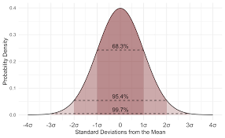
Lecture
Statistics
01
Foundation of Inference and Uncertainty
Helps with:
  Hypothesis testing
  Confidence intervals
  Probability estimation
Often used before or after model building:
  To explore data patterns
  To interpret model outcomes
Statistics is complementary, not competitive, with data mining
1 – 34

Slide 35
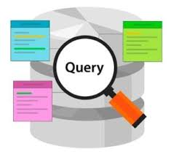
Lecture
Database Querying
01
Asking Questions Directly from the Data
Uses structured query languages (e.g., SQL)
Great for:
  Exploratory analysis
  Counting events or frequencies
  Filtering or aggregating data
Querying is often the first step in building an understanding of the data
1 – 35

Slide 36
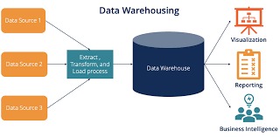
Lecture
Data Warehousing
01
Centralized Storage for Analytics
Supports:
  Long-term data collection
  Enterprise-wide access
  Efficient querying and reporting
Enables:
  Consistency across departments
  Reliable inputs to data science projects
Think of it as the infrastructure layer beneath analytics
1 – 36

Slide 37
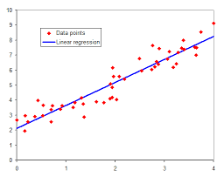
Lecture
Regression Analysis
01
A Time-Tested Predictive Tool
Models relationships between variables
Types:
  Linear regression: Predict numeric outcomes
  Logistic regression: Predict binary classes
Still widely used for its:
  Interpretability
  Speed
  Simplicity
A go-to method when transparency is as important as accuracy
1 – 37

Slide 38
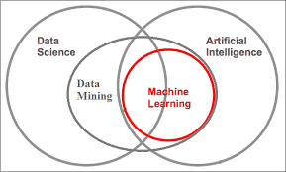
Lecture
Machine Learning and Data Mining
01
Similar Goals, Different Emphases
Machine Learning focuses on:
  Generalization from data
  Algorithm performance
Data Mining focuses on:
  Business context
  Interpretability and deployment
ML powers the engine; data mining steers the car
1 – 38

Slide 39
Lecture
Managing Data Science Teams
01
Cross-Functional Collaboration Matters
Data science requires integration of:
  Business domain expertise
  Data engineering
  Modeling and analytics skills
Success depends on:
  Open communication
  Shared understanding of objectives
  Access to relevant data
Encourage teams to work iteratively, not in silos
1 – 39

Slide 40
Who Should be Involved (Skills & Roles)?
Lecture
01
Business Stakeholder
defines the decision need
Data scientist/ analyst
leads modeling and evaluation
Data engineer
manages access and transformation
Deployment/ IT
implements model in production
1 – 40

Slide 41
Success Factors for Data Science Projects
Lecture
01
A successful project depends on:
Supported by tools like:
  Statistics, querying, regression, machine learning
Technology alone isn’t enough — process and people matter just as much
Clear business understanding
Proper task framing
Clean and relevant data
Iterative modeling and evaluation
Deployment that enables action
1 – 41

Slide 42
Lecture
Key Points
01
Effective data science = Alignment of data, technique, and decision-making
Business problems must be reframed as data mining tasks
Understand the distinction between:
CRISP-DM provides a proven, structured approach to projects
Supervised vs. unsupervised methods
Modeling vs. deployment
1 – 42

Slide 43

For Discussion Panel and Next Lecture:
Use the open-source Telco Customer Churn dataset available on Kaggle.
Import the Dataset into Excel
Familiarize yourself with the columns
Lecture
1
For Discussion Panel and Next Lecture
1 – 43

Slide 44



Thank You

