Slide 1


Ch.10- Performance
Management
Prepared by Dr. Sahar Ahmed
Week Eight
Lecture 7

Slide 2

Learning Outcome
1
Understand the process of performance management and the role performance feedback plays in performance management
Examine the strategic choices an organization faces in establishing a performance management system
Evaluate the associated pros and cons of decisions related to the use of the performance management system
4
Gain an awareness of why performance management systems may fail and the strategies to improve
www.midocean.ae

Slide 3
Introduction
Importance of Performance Management
An organization's success relies on managing employee performance and aligning it with organizational goals.
As organizations become streamlined and employees take on broader roles, performance feedback becomes more critical.
It ensures employees perform well and their behaviors align with organizational goals.
www.midocean.ae

Slide 4
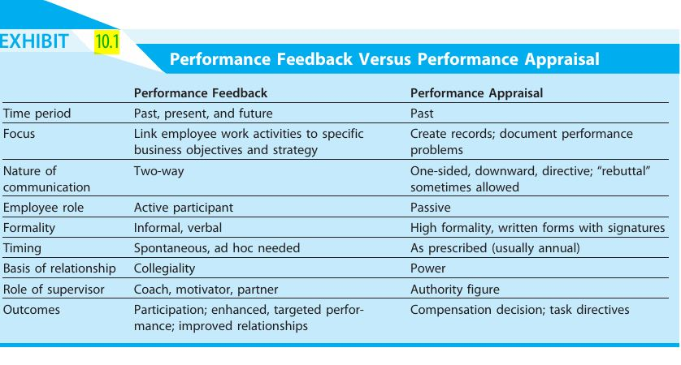
www.midocean.ae

Slide 5
Introduction
comp
Effective Performance Management System
Requires collaboration between employees and supervisors: setting goals, reviewing results, assessing needs, and future planning.
Differs from performance appraisals, which are one-sided evaluations by supervisors focused on the past with minimal employee input.
Utilizes performance feedback, a two-way conversation for employee improvement.
Utilizes past performance data to set goals for the present and future.
www.midocean.ae

Slide 6
Important Consideration
Flexibility in Performance Management Systems
Formal or informal systems can be effective, but alignment with organizational goals and culture is key.
Example: SAS company uses continuous performance conversations instead of formal reviews.
www.midocean.ae

Slide 7
Designing an Effective Performance Management System
Purpose and Use: What's the main goal of the system? Is it for employee development, informing rewards and compensation, boosting motivation, ensuring legal compliance, or HR planning (or a combination)? It's crucial to define the purpose upfront to avoid conflicting goals and ensure data collection supports them all.
Employee Development: The system should identify skill and performance gaps to guide training and development programs. Performance feedback should provide information to fuel these programs, and desired outcomes from training should be incorporated back into the performance management system. This creates a two-way loop for improvement.
www.midocean.ae

Slide 8
Designing an Effective Performance Management System
Rewards and Compensation: Decisions like salary, promotions, and bonuses often rely on performance data. Employees must trust the performance feedback system for these decisions to be seen as fair. An unfair system can lead to a perceived unfairness in compensation as well.
Motivation: A formal process for acknowledging and praising employees can reinforce positive behaviors and outcomes. The system should clearly communicate expectations and allow employees to express their desired job assignments and responsibilities.
Legal Compliance: Documentation of performance deficiencies is crucial for defending against claims of unfair dismissal or discrimination. Data showing consistent, unacceptable performance strengthens the organization's defense against such charges.
www.midocean.ae

Slide 9
limitations to the traditional method of Performance Evaluation
Limited Knowledge: Supervisors may not be familiar with the technical aspects of the employee's work, hindering accurate assessment.
Subjectivity: Supervisor bias (halo effect, stereotypes) and personal agendas can influence ratings.
Focus on Recent Events: Evaluations might focus heavily on recent events, neglecting earlier performance.
Central Tendency: A tendency to avoid extremes in ratings, placing most employees in the middle.
Inflated or Deflated Ratings: Empathy, competition, or personal issues can skew supervisor ratings.
Disagreements on Causes: Supervisors and employees may have different views on the reasons behind performance levels.
www.midocean.ae

Slide 10
New approach to Performance Evaluation- 360 degree
New approach incorporates feedback from various sources:
Subordinates: They offer insights into a manager's leadership style and interpersonal skills, helping the organization identify high-potential employees and address leadership development needs. However, this feedback can be influenced by internal politics or personal conflicts.
Customers: Their unbiased perspective is crucial, especially in service-oriented companies. Their feedback directly impacts the organization's bottom line and identifies areas for employee development and reward.
www.midocean.ae

Slide 11
New approach to Performance Evaluation-360 degree
New approach incorporates feedback from various sources:
Self-Evaluation: allows employees to participate in their development process and provide a more holistic view of their performance. They can offer specific examples and insights that supervisors might miss.
Peer appraisals: Involving coworkers in the evaluation process can provide valuable insights into an employee's interpersonal skills, teamwork, and overall contribution to the team.
Rating committees: A panel of supervisors can offer a more comprehensive view of an employee's performance, reducing the impact of individual biases.
www.midocean.ae

Slide 12
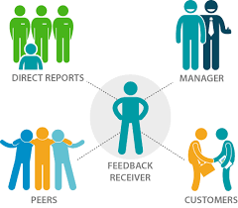
360 Evaluation
www.midocean.ae

Slide 13
360-degree feedback systems
Benefits:
Multiple Perspectives: Provides a well-rounded view of an employee's performance.
Reduced Bias: Balances individual viewpoints and reduces supervisor bias.
Employee Development: Helps identify areas for improvement and growth
Challenges:
Time and Cost: Collecting and analyzing data from multiple sources can be time-consuming and expensive.
Diminishing Returns: Collecting excessive data can be overwhelming and provide little additional value.
Careful Implementation: Requires clear planning and alignment with the organization's strategy to avoid confusion and conflict.
www.midocean.ae

Slide 14
360-degree feedback systems
Effective peer feedback systems require:
Low Stakes: When evaluations don't directly impact colleagues' careers or rewards, they're more likely to be honest and objective.
Trust in the System: Employees need to believe the performance management system is fair and accurate for peer feedback to be truly valuable.
The key is to choose evaluators who can provide objective and insightful feedback while minimizing the potential for bias and political maneuvering.
www.midocean.ae

Slide 15
Evaluating Employees
There are three main approaches to evaluating employee performance:
Traits: This focuses on characteristics like loyalty, work ethic, and sociability. While it can assess cultural fit, it doesn't directly measure job performance and can be subjective.
Behaviors: This examines specific actions, such as teamwork, punctuality, initiative, and meeting deadlines. This provides valuable feedback as it pinpoints areas for improvement and highlights strengths. However, employees might exhibit good behaviors but not achieving results.
www.midocean.ae

Slide 16
Evaluating Employees
Outcomes/Results: This focuses on concrete accomplishments, like sales figures, profitability, cost reduction, or quality. These are objective measures and directly linked to organizational goals. However, results can be influenced by factors beyond the employee's control (budget cuts, resource limitations) and might not reflect how the results were achieved (e.g., high costs, damaged relationships).
The Ideal Approach:
The best approach combines elements from all three. Organizations should choose measures that align with their strategic objectives.
www.midocean.ae

Slide 17
Performance Evaluation Measures
Absolute: Evaluates employees against job standards, regardless of others. (e.g., Did the salesperson meet their sales quota?)
Relative: Compares employees to each other, often ranking them. (e.g., Who was the top salesperson?)
Relative Measures: Pros and Cons
Pros:
  Identify top performers for rewards and promotions.
  Can motivate competition and improvement.
Cons:
  Skewed results if all employees perform similarly (everyone ranked low/high).
  Ignores individual improvement if compared to a static group.
www.midocean.ae

Slide 18
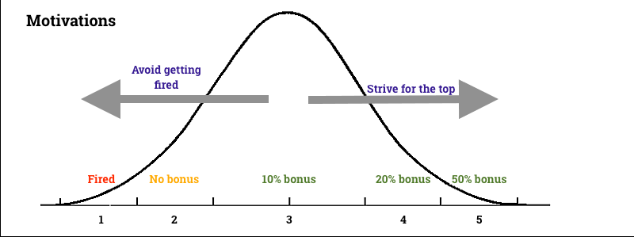
Forced Ranking Example
www.midocean.ae

Slide 19
Forced Ranking: A Specific Relative Measure
Involves placing employees into performance level categories (e.g., top 20%, middle 70%, bottom 10%).
Pros:
  Clearly differentiates performance levels.
  Provides data for compensation decisions.
  Discourages inflated reviews or leniency.
Cons:
  Can be arbitrary and unfair.
  May lead to low morale and lawsuits.
  Not suitable for all cultures (better for results-driven environments).
www.midocean.ae

Slide 20
Performance Evaluation Methods
Graphic Rating Scales: A popular tool, these scales involve rating employees on various aspects like traits, behaviors, or results. Imagine a scale from 1 (low) to 5 (high) for punctuality.
www.midocean.ae

Slide 21
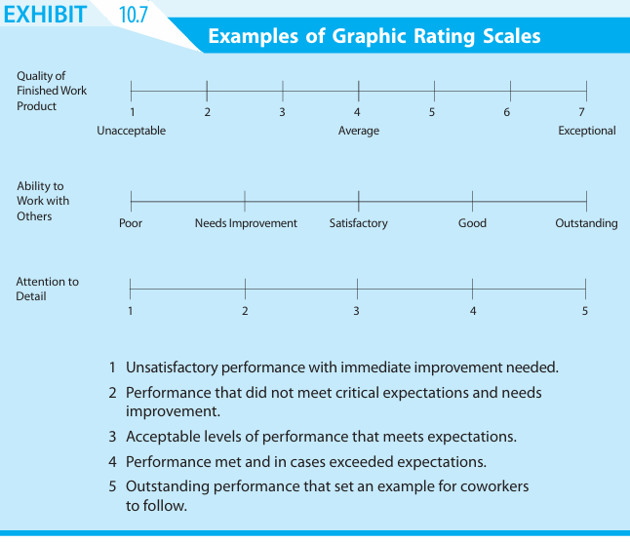
Graphic Rating Scales example
www.midocean.ae

Slide 22
Performance Evaluation Methods
Weighted Checklists: These provide specific criteria to assess performance, with varying importance assigned to each. Think of a checklist for a customer service rep, with factors like call resolution time weighted more heavily.
www.midocean.ae

Slide 23
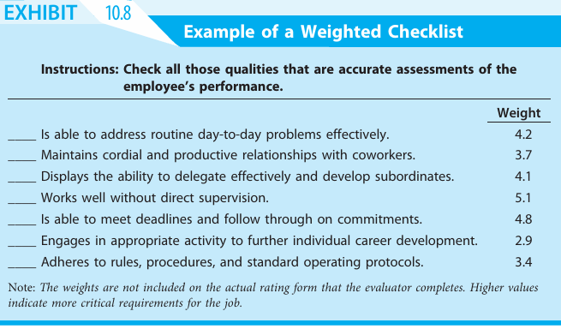
Weighted Checklists example
www.midocean.ae

Slide 24
Performance Evaluation Methods
Behaviorally Anchored Rating Scales (BARS): These go beyond simple scales by providing specific descriptions of behavior at different levels. Imagine examples of "always greets customers with a smile" (high) vs. "rarely interacts with customers" (low) for a retail employee.
www.midocean.ae

Slide 25
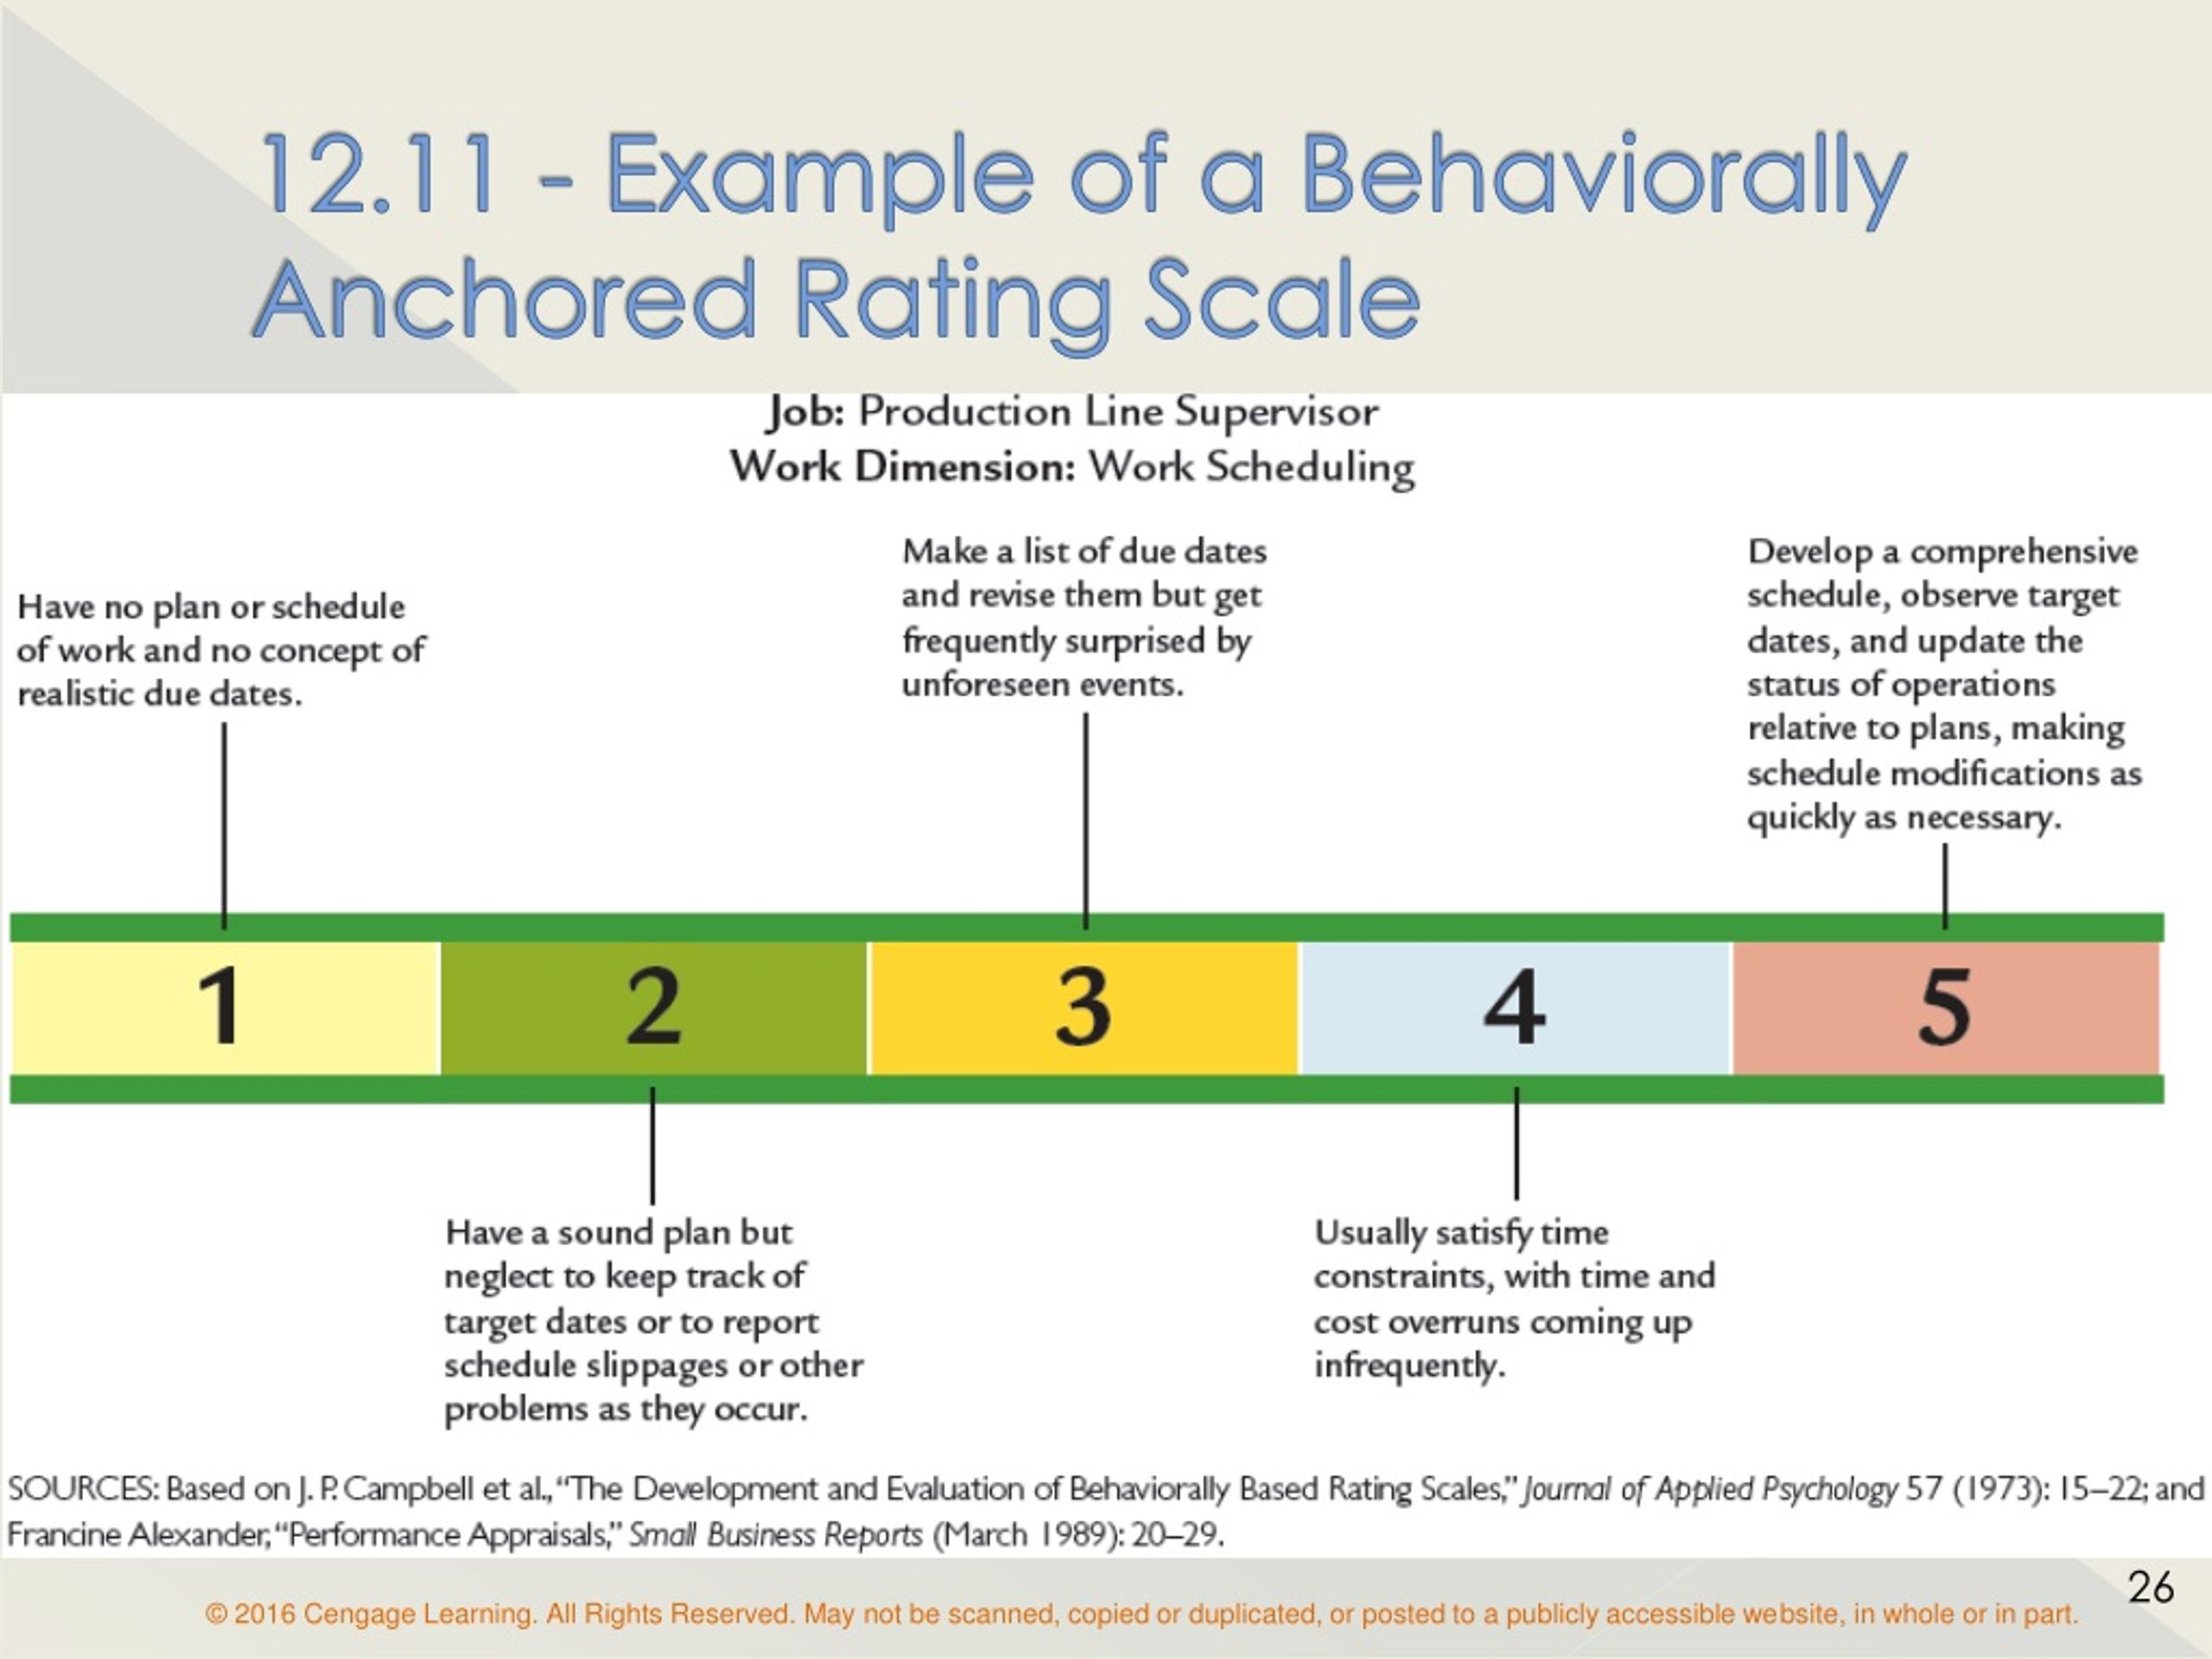
BARS Example
www.midocean.ae

Slide 26
Performance Evaluation Methods
Behavioral Observation Scales (BOS): Addressing inconsistent employee behavior, BOS measures the frequency of specific actions. This could track how often a salesperson uses active listening skills in customer interactions.
www.midocean.ae

Slide 27
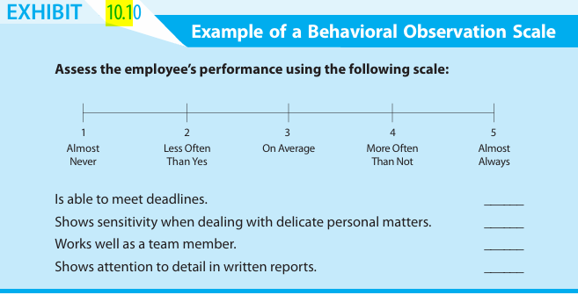
BOS Example
www.midocean.ae

Slide 28
Performance Evaluation Methods
Objectives-Based Measures: This approach ties performance feedback to predetermined, negotiated work objectives. Imagine a manager and employee jointly setting goals for increasing sales within a specific timeframe.
Critical Incident Measures: This method focuses on specific examples of outstanding or problematic employee behavior during the evaluation period. Imagine a manager noting a salesperson's exceptional handling of a difficult customer complaint.
www.midocean.ae

Slide 29
Choosing the Right Tool
Performance evaluation methods are not mutually exclusive. Organizations can combine them, but it's important to avoid a cumbersome or overly complex system.
The chosen methods should align with the overall goals of the performance management system and the organization's strategic objectives.
www.midocean.ae

Slide 30
Benefits of Effective Measurement
Targeted Feedback: Specific examples from BOS or critical incidents can provide more meaningful feedback for employees compared to general impressions.
Enhanced Motivation: Objectives-based systems can boost motivation by allowing employees to participate in setting goals and understanding their contribution to organizational objectives.
Increased Commitment: When employees have a say in their goals, they're more likely to be committed to achieving them.
www.midocean.ae

Slide 31
Potential Pitfalls
Vague Objectives: Objectives should be clear and measurable to avoid confusion and ensure fair evaluation.
Unrealistic Objectives: Setting goals that are too difficult can demotivate employees. Striking a balance between challenge and achievability is key.
Improper Measurement: Objectives should be valid measures of performance, not just easily quantified but irrelevant factors. For example, focusing solely on sales volume might neglect customer service.
www.midocean.ae

Slide 32
Why performance management systems fall short of expectations?
Managerial Disengagement: Many managers find the process time-consuming, complex, and uncomfortable.
Reasons for Resistance:
  Complexity: Data collection, analysis, and reconciling conflicting feedback can be cumbersome.
  Lack of Future Focus: If performance data doesn't translate into future goal setting
  Discrimination Concerns: Subjective data raises concerns about potential bias in reward decisions.
  Limited Control: Managers may feel they lack control over the process, especially when standards are set by senior management.
  Disconnected Rewards: Lack of clear consequences for performance diminishes the system's importance.
www.midocean.ae

Slide 33
How to Improve Performance Management Systems
Building Buy-In:
User Involvement: Involve managers in the design process. Their input as the system's "consumers" is crucial for creating a system that works for everyone.
Accountability: Hold managers accountable for both their subordinates' performance and their development. Linking managers' success to effective use of the system increases their commitment.
www.midocean.ae

Slide 34
How to Improve Performance Management Systems
Enhancing the System:
Clear Expectations: Set clear performance expectations at all levels. This facilitates timely reviews and allows for more specific feedback.
Purpose and Goals: Define the system's purpose and goals clearly. Linking it to the organization's strategy makes it more relevant and legitimizes the process.
Rewards Integration: Clearly link performance measures to rewards, solidifying the system's value.
www.midocean.ae

Slide 35
How to Improve Performance Management Systems
Leadership Commitment:
Gain absolute commitment from top management. A recent survey found 42% of executives don't even review the system!
When senior leaders publicly support and use the system, it sends a strong message about its importance.
By addressing these points, organizations can create a performance management system that managers are invested in, leading to a more performance-driven culture with engaged employees.
www.midocean.ae

Slide 36
Conclusion
Performance management is an ongoing cycle that encompasses setting clear performance expectations, providing continuous feedback and coaching, conducting regular performance evaluations, and using these insights to guide development plans.
Performance feedback plays a central role in this process. By offering specific, constructive feedback, managers can help employees understand their strengths and weaknesses, identify areas for improvement, and adjust their behaviors to achieve better results.
2. Strategic Choices in Performance Management Systems:
Complexity vs. Simplicity: Organizations can choose between a detailed system with many metrics or a simpler, streamlined approach depending on factors like size and industry.
Focus and Frequency: The system can focus on outcomes (results) or behaviors while achieving them. The frequency of formal reviews can also be tailored (annual vs. more frequent check-ins).
www.midocean.ae

Slide 37
Conclusion
Understanding the Pros and Cons:
Pros:
Improved Performance & Engagement: Effective systems can lead to significant gains in performance and employee engagement.
Talent Development & Data-Driven Decisions: Performance data helps identify high-potential employees and informs strategic talent management decisions.
Cons:
Administrative Burden & Subjectivity: Complex systems can be time-consuming and bureaucratic. Performance evaluations can be subjective, leading to potential biases.
Short-Term Focus & Employee Dissatisfaction: Overemphasis on short-term results can discourage long-term development, and poorly designed systems can demotivate employees.
www.midocean.ae

Slide 38
Conclusion
Reasons for System Failure and Improvement Strategies:
Lack of Strategic Alignment
Inconsistent Communication
Limited Manager Training
Focus on Punishment & Lack of Employee Involvement
Strategies for Effective Systems:
Simplify the Process: Focus on Meaningful Feedback
Develop Manager Capabilities
Link Performance to Rewards
Embrace Technology
www.midocean.ae

Slide 39
Conclusion
A Roadmap for Success:
The chapter goes beyond identifying challenges and offers a roadmap for organizations to create effective performance management systems:
Collaborative Design & Strategic Alignment: Involve managers in the design process and ensure the system is tightly linked to the organization's strategy.
Fair and Objective Evaluations: Establish clear performance standards using a combination of absolute (rating) and relative (ranking) measures when appropriate.
  The chapter also discussed various evaluation methods beyond setting standards, such as:
    Management by Objectives (MBO)
    360-Degree Feedback
www.midocean.ae

Slide 40
Conclusion
Fostering Open Communication: Promote open and frequent communication regarding expectations, performance, and development goals.
Establishing Clear Consequences: Implement clear and consistent consequences for performance, both positive (rewards) and negative (performance improvement plans).
Securing Top-Management Commitment: Gain unwavering commitment from top management to create a performance-driven culture.
Continuous Improvement: Recognize that the system is a dynamic tool and regularly review and refine it to address changing needs and maintain its effectiveness.
www.midocean.ae

Slide 41
Week
01
References
Main Reference
Mello A .Jeffrey (2011). Strategic Management of Human Resources (3rd ed.) South-Western Cengage Learning.
Additional Resources for extra reading.
Boselie, Paul (2014). Strategic Human Resource Management: A Balanced Approach .McGraw Hill Companies.
Millmor, Mike, Philip Lewis, and others (2007), Strategic Human Resource Management Contemporary issues. Ft Prentice Hall.
www.midocean.ae

Slide 42



Thank You

