Slide 1



Principles of Management Information Systems
MGM331
Lecture 0
Overview
Prepared by
Dr. Eng. Youssef Ntefeh
www.midocean.ae

Slide 2

What is Information Systems

Slide 3
Preface
As organizations continue to operate in an increasingly competitive and global marketplace, workers in all business areas including accounting, customer service, distribution, finance, human resources, information systems, logistics, marketing, manufacturing, research and development, and sales must be well prepared to make the significant contributions required for success.

Slide 4
Preface
Regardless of your future role, you need to understand what information systems can and cannot do and be able to use them to help you achieve personal and organizational goals.
You will be expected to discover opportunities to use information systems and to participate in the design and implementation of solutions to business problems employing information systems.

Slide 5
Preface
To be successful, you must be able to view information systems from the perspective of business and organizational needs.
For your solutions to be accepted, you must recognize and address their impact on coworkers, customers, suppliers, and other key business partners.
For these reasons, a course in information systems is essential for students in today’s high-tech world.

Slide 6
Preface
This course offers the traditional coverage of computer concepts, but places the material within the context of meeting business and organizational needs.
The course is not overly technical, but rather deals with the role that information systems play in an organization and the key principles a manager or technology specialist needs to grasp to be successful.

Slide 7
Preface
The principles of IS are brought together and presented in a way that is understandable, relevant, and interesting.
In addition, the course offers an overview of the entire IS discipline, while giving students a solid foundation for further study in more advanced IS courses such as programming, systems analysis and design, project management, database management, data communications, Web site design and development, information system security, big data and analytics, electronic and mobile commerce, and informatics. As such, it serves the needs of both general business managers and those who aspire to become IS professionals.

Slide 8
IS Principles First, Where They Belong
Exposing students to basic IS principles is an advantage even for those students who take no IS courses beyond the introductory IS course.
Since most functional areas of the business rely on information systems, an understanding of IS principles helps students in their other course work. In addition, introducing students to the principles of information systems helps future business managers employ information systems successfully and avoid mishaps that often result in unfortunate consequences.
Furthermore, presenting IS concepts at the introductory level creates interest among students who may later choose information systems as their field of concentration.

Slide 9
Goals of This Course
To provide a set of core IS principles that prepare students to function more efficiently and effectively as workers, managers, decision makers, and organizational leaders
To provide insights into the challenging and changing role of the IS professional so that students can better appreciate the role of this key individual
To show the value of the IS discipline as an attractive field of specialization so that students can evaluate this as a potential career path

Slide 10
IS Principles
IS course although comprehensive, cannot cover every aspect of the rapidly changing IS discipline.
This course provide students with an essential core of guiding IS principles to use as they strive to use IS systems in their academic and work environment.
Think of principles as basic truths or rules that remain constant regardless of the situation. As such, they provide strong guidance for tough decision making.

Slide 11
IS Principles
A set of IS principles is highlighted at the beginning of each chapter. The use of these principles to solve real-world problems is driven home from the opening examples of cutting edge applications to the dozens of real-world examples of organizations applying these principles.
The ultimate goal of Principles of Information Systems course, is to develop effective, thinking, action-oriented students by instilling them with principles to help guide their decision making and actions.

Slide 12
Changing Role of the IS Professional
As business and the IS discipline have changed, so too has the role of the IS professional.
Once considered a technical specialist, today the IS professional operates as an internal consultant to all functional areas of the organization, being knowledgeable about their needs and competent in bringing the power of information systems to bear throughout the entire organization.
The IS professional must view issues through a global perspective that encompasses the entire enterprise and the broader industry and business environment in which it operates.

Slide 13
Changing Role of the IS Professional
The scope of responsibilities of an IS professional today is not confined to just his or her organization but encompasses the entire ecosystem of employees, contractors, suppliers, customers, competitors, regulatory agencies, and other entities, no matter where they are located.
This broad scope of responsibilities creates a new challenge: how to help an organization survive in our highly interconnected, highly competitive global environment. In accepting that challenge, the IS professional plays a pivotal role in shaping the business itself and ensuring its success.

Slide 14
Changing Role of the IS Professional
To survive, businesses must strive for the highest level of customer satisfaction and loyalty through innovative products and services, competitive prices, and ever-improving product and service quality.
The IS professional assumes a critical role in determining the organization’s approach to both overall cost and quality performance.

Slide 15
IS as a Field of Study
Developer as three of the top 20 best jobs for 2016 based on hiring demand, median salary, employment rate, future job prospects, stress level, and work– life balance.
The U.S. Bureau of Labor Statistics identified software developers, computer systems analysts, and computer support specialists as among the fastest growing occupations for the period 2012 and 2022. Clearly, the long-term job prospects for skilled and business-savvy information systems professionals is good. Employment of such workers is expected to grow faster than the average for all occupations through the year 2022. Upon graduation, IS graduates at many schools are among the highest paid of all business graduates.

Slide 16
Brief Contents
PART 1 Information Systems in Perspective
Chapter 1 An Introduction to Information Systems
Chapter 2 Information Systems in Organizations
PART 2 Information Technology Concepts
Chapter 3 Hardware and Mobile Devices
Chapter 4 Software and Mobile Applications
Chapter 5 Database Systems and Big Data
Chapter 6 Networks and Cloud Computing 238

Slide 17
Brief Contents
PART 3 Business Information Systems
Chapter 7 Electronic and Mobile Commerce
Chapter 8 Enterprise Systems
Chapter 9 Business Intelligence and Analytics
Chapter 10 Knowledge Management and Specialized Information System

Slide 18

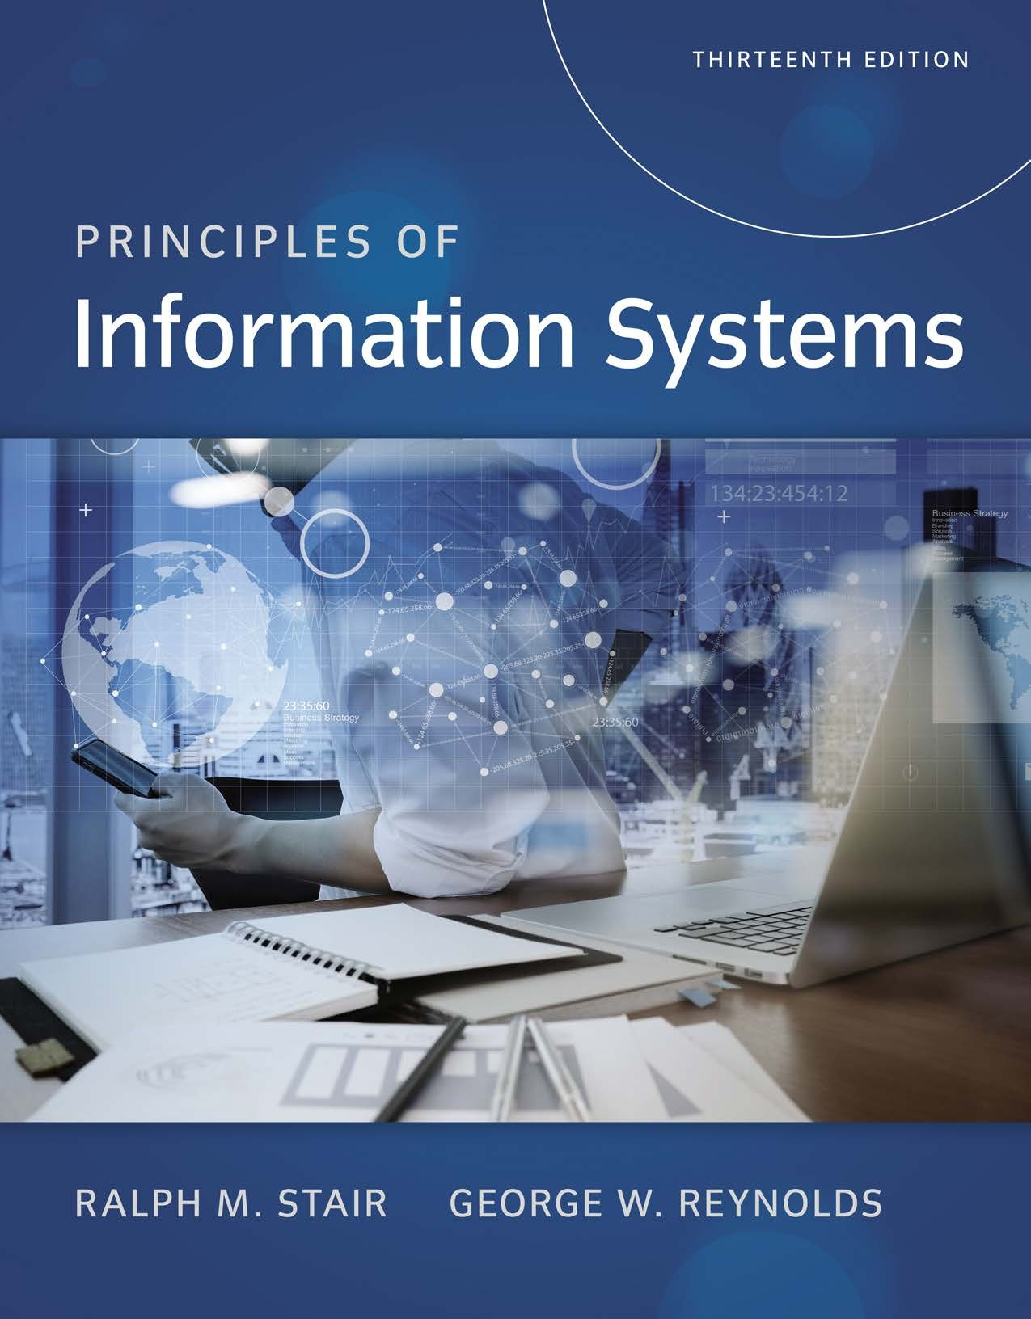
Reference

