Slide 1






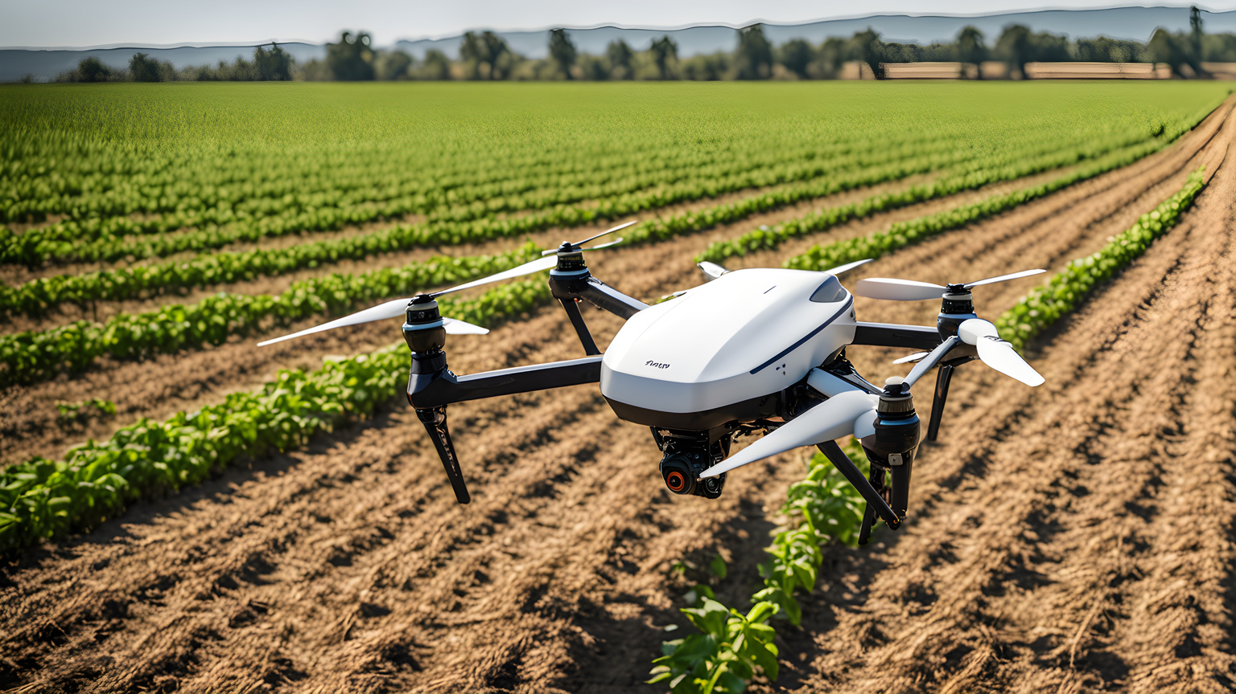
Leveraging AI to study the impact of climate change on the spread and severity of plant diseases
Fatima Alkaff
Master’s Student, Department of Artificial Intelligence
Midocean University
Lecturer: Dr. Hajer Saleh

Slide 2




Presentation Roadmap
  Introduction
  Problem Statement
  Objective
  Related Works
  Methodology

Slide 3





AI and the impact of climate change on plant diseases
Intro
Statement
Objective
Related Works
Methodology
The worst problem confronting agriculture at present is global climate change, including changes in temperature, humidity, and altered precipitation, which is inducing increasing plant disease and insect transmission.
This proposal aims to develop an artificial intelligence system for predicting the intensity of climate change-induced plant diseases. Other than using historical climate data and crop infection disease, research shows that developing an early warning crop plan forecast program would reduce crop loss, help farmers decide, and be part of a larger world climate change-induced sustainable agriculture.
Introduction

Slide 4
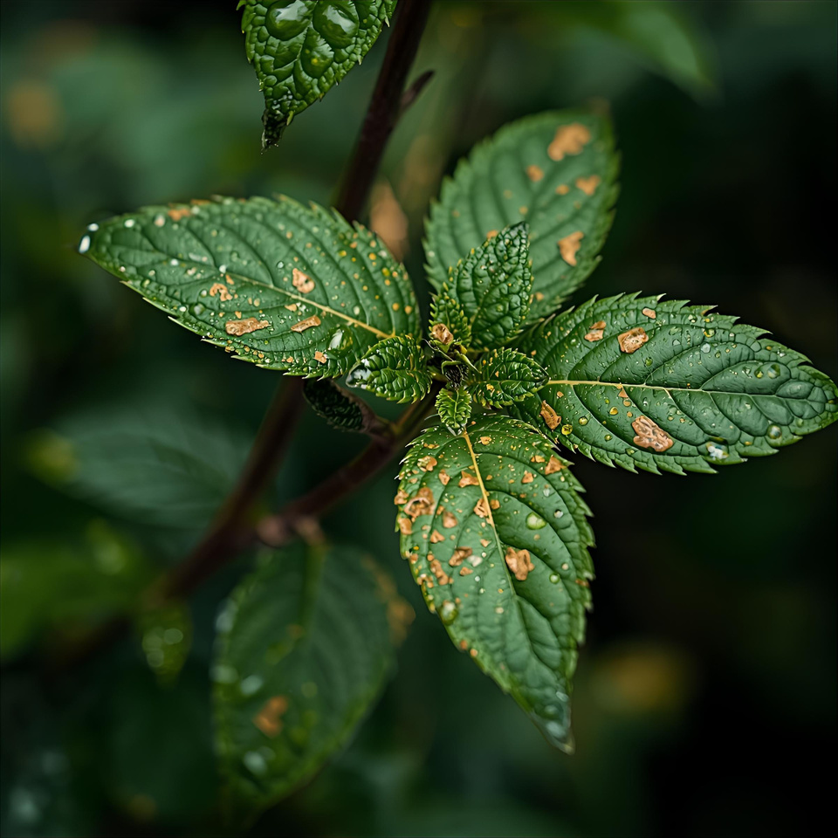
AI and the impact of climate change on plant diseases
Intro
Statement
Objective
Related Works
Methodology
Problem Statement
Although more awareness of the role played by climate change in plant disease is present, current forecasting methods fall short. There is an evident requirement for intelligent and adaptive models that will convert multi-source climatic and biological data into a format in which they will be capable of predicting outbreaks of disease in a constantly changing climate.
The project realizes the requirement by offering a solution to the issue of bringing deep learning algorithms to the model development for predicting the timing, location, and magnitude of plant disease outbreaks in terms of climatic trends.

Slide 5
AI and the impact of climate change on plant diseases
Intro
Statement
Objective
Related Works
Methodology
OBJECTIVES
Employ multi-source data fusion ( plant disease epidemic history, climatic condition history, and real-time environmental monitoring).
Consolidate sustainable agriculture through removing pesticide misuse and enhancing environment and climate-resilient agriculture.
Employ an early warning system with a pre-warning of a likely disease outbreak if the climate is changing.
Pilot and scale up the forecasting system to different zones to enhance scalability, accuracy, and simplicity.
Employ deep learning models to detect plant disease epidemics.

Slide 6


AI and the impact of climate change on plant diseases
Intro
Statement
Objective
Related Works
Methodology
Related Works

Slide 7

AI and the impact of climate change on plant diseases
Intro
Statement
Objective
Related Works
Methodology
1.Plant Disease Detection Using Deep Learning Techniques
1
Applied Convolutional Neural Network (CNN) models: ResNet152, VGG19, DenseNet169, and MobileNetv3 to detect plant diseases using the highly regarded PlantVillage dataset. In addition, image augmentation Keras' Image Data Generator was used to extend the training set. The results showed that MobileNetv3 had the best testing accuracy of 99.75%, ResNet152 accuracy of 98.86%, VGG19 accuracy of 99.07% and DenseNet169 accuracy of 99.22%.
5
4
2
3

Slide 8
AI and the impact of climate change on plant diseases
Intro
Statement
Objective
Related Works
Methodology
2. Tomato Leaf Disease Detection using Convolution Neural Network
1
Applied CNN: VGG16, InceptionV3, and MobileNet for disease detection and classification. Images of Tomato disease have been taken from the PlantVillage dataset, which includes over 50,000 images of 14 crops. Experimentally, they observed testing accuracy ranging from 76% to 100% for the classification. And the average testing accuracy of the model is 91.2% for the 9 diseases and 1 healthy class. Where the Custom CNN is the best accuracy up to 91.2%, VGG‑16 up to 77.2%, Inception V3 up to 63.4% and MobileNet up to 63.7%.
5
4
2
3

Slide 9
AI and the impact of climate change on plant diseases
Intro
Statement
Objective
Related Works
Methodology
3. Automatic Image-Based Plant Disease Severity Estimation Using Deep Learning
1
5
used apple black rot images in the PlantVillage dataset, a series of CNN: VGG16, VGG19, Inception‑v3, and ResNet50 were trained to diagnose the severity of the disease. Results show that the best model is the deep VGG16 model trained with transfer learning, which yields an overall accuracy of 90.4%.
4
2
3

Slide 10
AI and the impact of climate change on plant diseases
Intro
Statement
Objective
Related Works
Methodology
4. Plant leaf disease classification using EfficientNet deep learning model
1
5
proposed EfficientNet B5 and B4 models of DL architecture in plant leaf disease classification. All models were trained with the original and augmented PlantVillage datasets, having 55,448 and 61,486 images. They compared performance with other state-of-the-art DL models. The results showed that B5 and B4 models of EfficientNet architecture achieved the highest values compared to other DL models, with 99.91% and 99.97% respectively for accuracy.
4
2
3

Slide 11
AI and the impact of climate change on plant diseases
Intro
Statement
Objective
Related Works
Methodology
5. A Deep Learning-based Approach for Banana Leaf Diseases Classification
1
5
used the LeNet architecture as a CNN to classify and detect two famous banana diseases, which are banana sigatoka and banana speckle, using a real dataset of banana diseases obtained from the PlantVillage. The results demonstrated with 20% training and 80% testing, they achieved 98.61% accuracy.
4
2
3

Slide 12
AI and the impact of climate change on plant diseases
Intro
Statement
Objective
Related Works
Methodology
Methodology - Dataset
Plant Disease Datasets
  PlantVillage Dataset: Content: 50,000+ labeled images of healthy and diseased plant leaves (38 classes).
Climate & Environmental Data
  NASA POWER Climate Data: Daily weather & solar radiation.
  ERA5 (ECMWF Reanalysis Dataset): Hourly global climate variables (temperature, humidity, rainfall).

Slide 13

AI and the impact of climate change on plant diseases
Intro
Statement
Objective
Related Works
Methodology
Methodology - Data pre-processing
Resize Images
Handle Class Imbalance
Data Cleaning
Split Data

Slide 14

AI and the impact of climate change on plant diseases
Intro
Statement
Objective
Related Works
Methodology
Methodology
Deep Learning Models
Evaluation model
MobileNet
EfficientNet
ResNet
LSTM
GRU
Accuracy
F1-Score

Slide 15
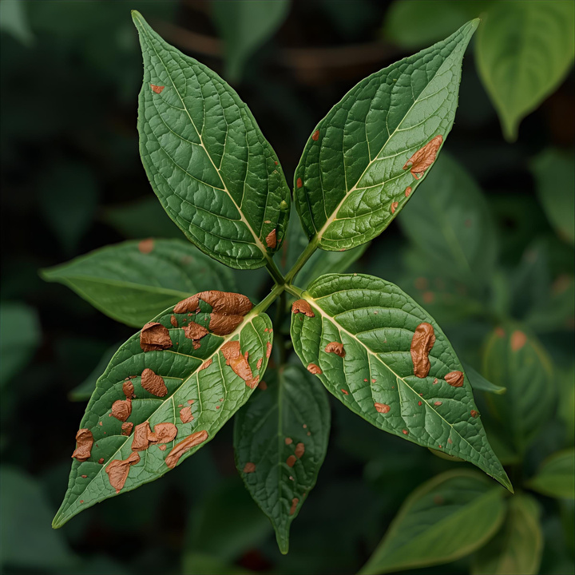
THANK YOU!
Fatima Alkaff
Master’s Student,
Department of Artificial Intelligence
Midocean University
Lecturer: Dr. Hajer Saleh

