Slide 1


Finance Concepts
Prepared by Dr. Omar Al-kasasbeh
FNT 615
Finance Concepts
Orientation-lecture

Slide 2



Finance Concepts
FNT 615
Finance Concepts
Orientation-lecture
Prepared by
Dr. Omar Al-kasasbeh
https://midocean.edu.km

Slide 3

Chapter
Introduction to Finance
01
Understand the importance of Finance in an Organization.
2. Gain insights into the various Concepts of Time and Value.
https://midocean.edu.km

Slide 4
Chapter
01
https://midocean.edu.km

Slide 5
Chapter
Economic Foundations: Money and Rates
02
Understand the principles of Microeconomics and Macroeconomics.
Explain mechanisms of Business Cycles and Economic Activity.
Study foreign exchange rate systems.
Identify reliable and official sources and characteristics of economic data.
https://midocean.edu.km

Slide 6
Chapter
Graph of Demand and Supply
02
https://midocean.edu.km

Slide 7
Chapter
Financial Markets
03
Explain the structure and main functions of financial markets.
Differentiate between the major types of financial markets and instruments.
Analyze the role of financial markets in facilitating capital formation and economic growth.
https://midocean.edu.km

Slide 8
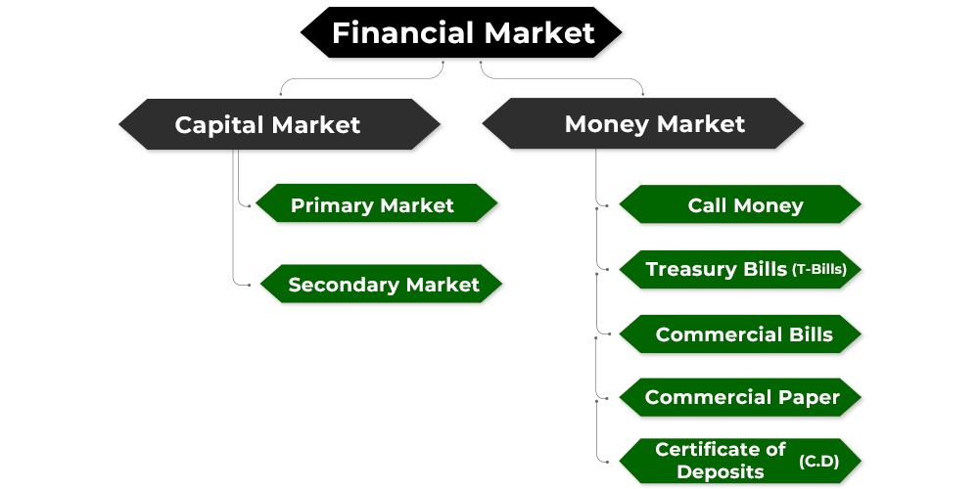
Chapter
03
https://midocean.edu.km

Slide 9
Chapter
Financial Statements
04
Understand the structure and purpose of the Income Statement.
Explain the components and significance of the Balance Sheet.
Analyze the Statement of Cash Flows and its importance in assessing liquidity.
https://midocean.edu.km

Slide 10
Chapter
04
https://midocean.edu.km

Slide 11
Chapter
Time Value of Money
05
1. Understand the basic principles of the Time Value of Money (TVM).
2. Apply methods to solve Time Value of Money problems.
3. Explain applications of Time Value of Money in finance.
https://midocean.edu.km

Slide 12
Chapter
05
https://midocean.edu.km

Slide 13
Chapter
The Meaning and Measurement of Risk and Return
06
Compare the historical relationship between risk and rates of return in capital markets.
Explain the relationship between an investor’s required rate of return and the riskiness of an investment.
https://midocean.edu.km

Slide 14

Chapter
06
https://midocean.edu.km

Slide 15
Chapter
Bonds and Stocks
07
Understand characteristics of bonds and the principles of bond valuation.
Use the yield curve to analyze interest rates and investment decisions.
Apply multiple approaches to stock valuation.
https://midocean.edu.km

Slide 16
Chapter
07
Steps in Pricing a Bond
https://midocean.edu.km

Slide 17
Chapter
The cost of capital
08
Understand the concepts underlying the
firm’s cost of capital.
2. Evaluate the costs of the individual
sources of capital.
https://midocean.edu.km

Slide 18
Chapter
08
https://midocean.edu.km

Slide 19



Thank You

