Slide 1




Organizational Behavior and Projects
PMG421
Prepared by Mrs. Deena Ibrahim
Lecture 7
Tools for Understanding Processes

Slide 2


Tools for Understanding Processes .
1.2 Flow Charts. 1.3 Run Charts 1.4 Control Charts
2. Summary

Slide 3

1- Understanding Project Processes
Understanding data is important, but it is only an early step in managing project quality. Data are the voices of processes. When performed, processes produce some kind of result. Data are the expressions of those results. The next step in managing project quality is to understand processes.

Slide 4
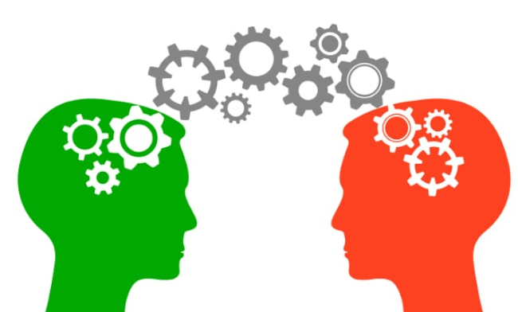
Tools for Understanding Processes,
Three quality tools for understanding processes are useful for project managers. One of them is probably familiar to most project managers. The other two may be less familiar because of their traditional application to manufacturing processes.

Slide 5
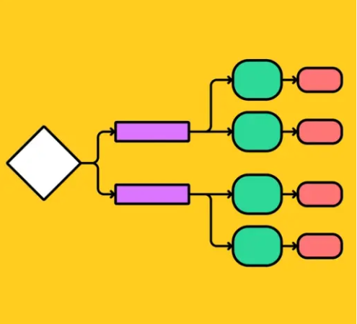
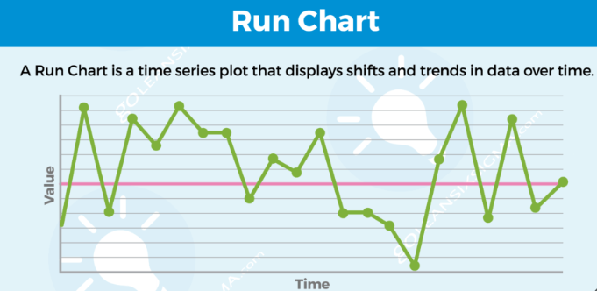
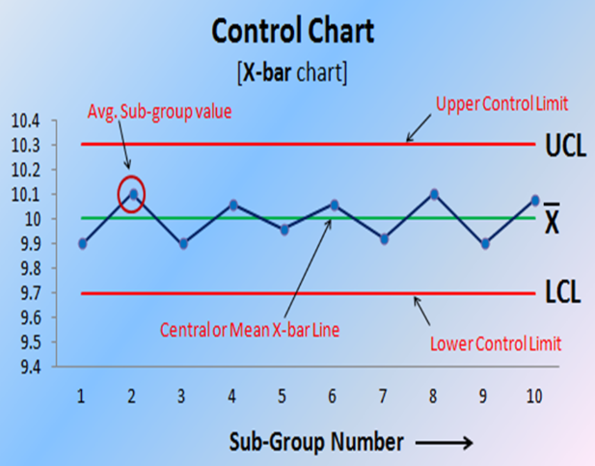
Flow Charts
Run Charts
Control Charts

Slide 6
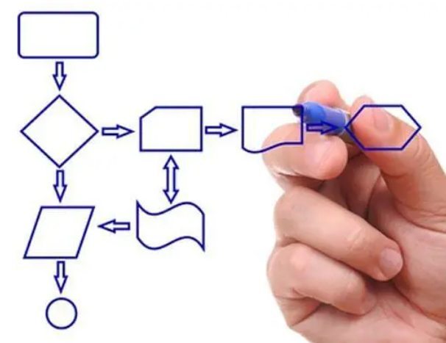
1.2 Flow Charts,
Flow charts are probably familiar to most project managers. They are common tools of basic management. A flow chart identifies the sequence of events in a process. Beyond that, it allows identification of the sometimes-obscure elements in a process.

Slide 7
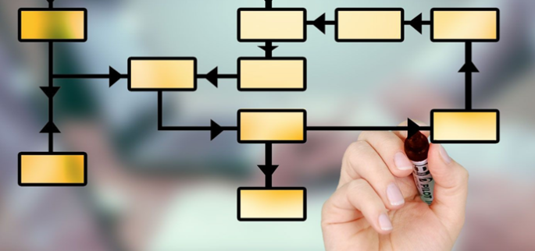
Using flow charts requires six deliberate actions:
1. Set boundaries. The individual or team should decide what they will consider in the flow-charting effort and what they will exclude. A good result often depends on properly framing the effort at the start. The team should also agree on the level of detail to be obtained.
2. Determine the steps in the process.
Before attempting to draw the chart, identify the basic framework of inputs, outputs, activities, and decisions.

Slide 8
3. Establish the sequence of process steps.
This can be done effectively with a lot of “sticky notes” and wall space. Involve the team so that different views may be considered. It is important to describe the sequence as it is, not as it should be. Performance results arise from what is occurring, not what is expected to occur.

Slide 9
4- Draw the flow chart. Automated tools are available to do this. Keep things simple. Add the level of detail necessary to understand the process. Trying to include the lowest possible level of detail may only result in a morass of symbols and lines that is unintelligible and of little value. Use simple words to describe activities and be consistent in both construction and language.
5. Test the flow chart for completeness and accuracy. First, ensure that the chart is constructed correctly and that all symbols are properly used. Review the process flow to ensure that all activities are included and fully addressed.

Slide 10
Beware of “magic happens” activities, those that suggest some kind of activity or result but do not include all the essential elements. It may be helpful to obtain a review by someone not directly involved in the effort, but who is knowledgeable about the process.
6. Finalize the chart. Put the chart in final form using consistent fonts and graphic alignment. A well-organized chart, even a “pretty” chart, is easier to read and understand.

Slide 11
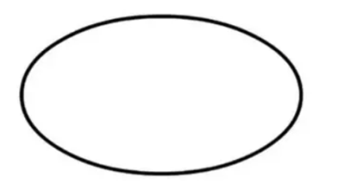
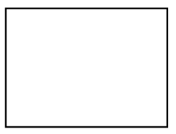



1- An oval indicates start points and end points, or inputs and outputs.
2- A rectangle represents an activity.
3- A diamond represents a decision point.
4- A circle indicates a connection to another chart.
5- An arrow represents the direction of process flow.

Slide 12
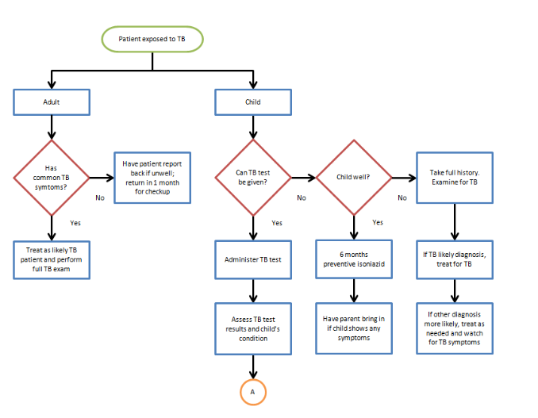
Flow chart template:

Slide 13
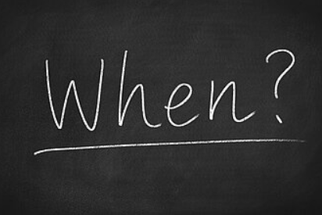
WHEN TO USE A FLOWCHART
To develop understanding of how a process is done.
To study a process for improvement.
To communicate to others how a process is done.
When better communication is needed between people involved with the same process.
To document a process.
When planning a project.

Slide 14

Advantages of using a flowchart :
Builds clarity.
Helps identify specific steps.
Outlines a complex process.
Communicates ideas quickly.
Coordinates team effort.
Increases efficiency and exposes inefficient areas.
Creates clear documentation.
Helps solve problems.

Slide 15
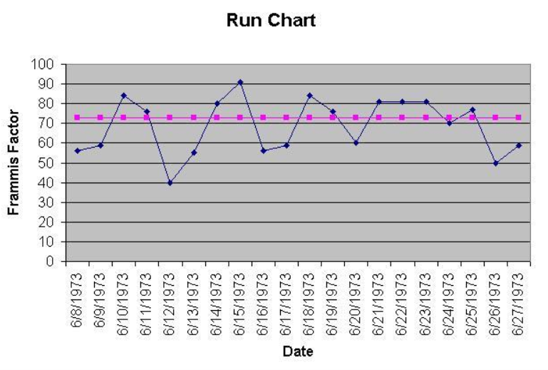
1.3 Run Chart
A run chart is used to observe process performance over time. It is a line graph with data that vary around a centerline, usually the mean. It is used for repeatable processes where performance is expected to be stable. A run chart will show defect trends, shifts, or cycles.

Slide 16
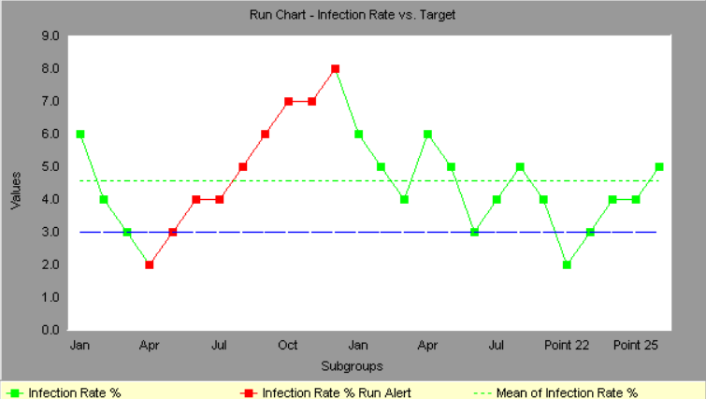
To create a run chart:
Identify the process to be observed. Make sure the process involves some kind of repeatable activity in which results are expected to be consistent over time.
Collect data. Usually twenty to twenty-five data points are required for a meaningful chart.

Slide 17
3- Create the graph. Plot the data on an x-y axis graph, then calculate and plot the mean. Initial data collection establishes the process mean. Subsequent data must be evaluated against that mean unless the process has been changed since initial data collection.
4- Interpret the data. Look for trends, shifts in data groupings, or cycles. All may suggest further analysis to determine the reason.
Notes:
https://www.ccohs.ca/oshanswers/prevention/effectiv.html

Slide 18

Benefits of using Run charts,
To display collected data to make it easy to visualize.
If you make any changes or install any improvements, a run chart can show the results of these improvements.
Run charts give guidance as you continue with improvement projects.
Run charts help to determine when changes are actually improvements.
Within the Control phase of DMAIC, run charts determine if you are holding gains made by improvement projects

Slide 19
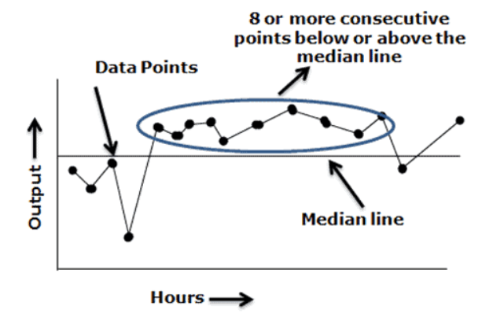
When to use run charts
To visually depict how the process is performing.
Effectively track and communicate improvements (and determine success).
To identify process variation and avoid unbiased actions.
Display outputs to look for stability or instability.

Slide 20

4.1 Control Charts
Control charts are very powerful tools for monitoring, controlling, and improving processes over time. They are one of the most complex quality tools and probably the most little used outside of manufacturing domains. Control charts are applicable to administrative processes. Data speak, sometimes loudly and sometimes more subtly. Control charts, as “the voice of the process,” can speak volumes of useful information.

Slide 21
Control charts use two types of data:
Attribute and variable.
Attribute data are binary. Something is go or no-go. A report is either late or not late; the degree of lateness is irrelevant.
Variable data are some kind of measurement. An environmental project may be concerned not about the presence or absence of contaminants in groundwater but about the level of contamination as measured on a continuous scale of parts per million.

Slide 22
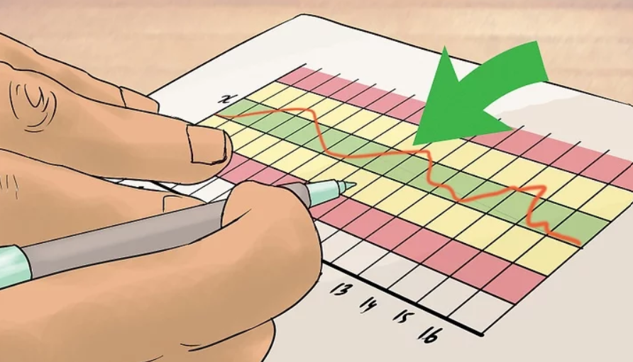
Using control charts includes four steps: 1. Collect initial data. This will be the baseline data for the process.
2. Create the control chart. Plot the data. Calculate and plot the mean and the upper and lower control limits.
3. Enter new data. This is the key. A control chart is not just a snapshot of collected data. It is a tool for use over time to ensure that the process remains in statistical control. Using the mean and control limits established by the baseline data, enter new data points and determine if they lie within or outside the control limits.

Slide 23
4. Do not change the control limits based on new data unless the process changes. The control chart is the voice of the process. Do not try to change the voice unless you change the process. Completion of a process improvement effort to reduce random cause variation would be a reason to collect new data and establish a new mean and new control limits.

Slide 24


Important to know,
Two types of variation affect process performance:
Random cause and special cause.
Random cause variation, sometimes called common cause variation, is inherent in the system. It is always present. It cannot be specifically identified. An example might be a low level of illumination in the work area.
Control limits are established by data, not by management direction.

Slide 25
Control charts define process performance; they are the voice of the process, but managers or customers may not be satisfied with process performance. Either may decide that they want to see fewer defects than indicated by the control charts. In so doing, they are establishing a specification that process performance is expected to meet. Specifications define customer requirements; they have been called the “voice of the customer.”

Slide 26
When a control chart indicates values outside the control limits, the process is considered to be out of statistical control.. A process out of control will not produce predictable results and managers will have no idea about what to expect.
Interpreting a control chart is rather simple. Data points that lie outside the control limits suggest special cause variation and require investigation. Data points that lie within the control limits suggest random cause variation and require no investigation, except for some unusual exceptions

Slide 27
Control Chart V. Run chart
Run chart | Control chart
- Run charts have an X and a Y axis. Time is always shown on the horizontal axis, and the measure of improvement is shown on the vertical, Y axis. - Run charts have a median – used as a centerline. - Run charts are less sensitive . - Run charts can identify Common Cause and some types of Special Cause Variation - Run charts can help when you start improvement initiatives, as you can start with a small amount of data. | - Control charts are more sensitive than run charts and so able to give more detail. - Control charts have a ‘mean’ or average which is plotted on the central line (CL). - Control charts have control limits - Control charts can define ‘process capability’. - Control charts are able to detect special causes and help the user more accurately predict what will happen. - You need more data for a control chart.

Slide 28
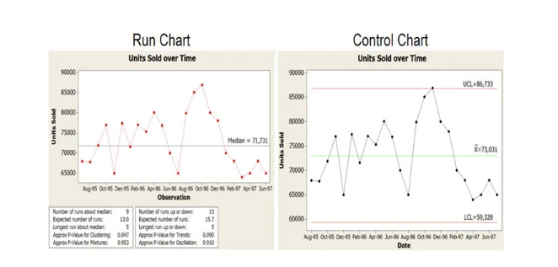

Slide 29
Benefits of using a Control Chart
• To monitor and control the ongoing process by recognizing the issues that arise.
• To predict the expected ranges of outcomes from the process.
• To determine the stability of a process.
• To analyze the patterns of the process variation from the special causes (non-routine events) or common causes (built into the process).
• To determine the areas where the quality needs to be improved in the project in order to increase the productivity.

Slide 30

◆ Flow charts identify the sequence of events in a process. They allow analysis of where errors might occur. A small set of commonly used symbols provides significant capability.
◆ Run charts show process performance over time. They are applied to repeatable processes in which results are expected to be consistent. Run charts show how data vary around a centerline, usually a mean.
◆ Control charts also show performance over time. They are run charts with added upper and lower control limits that allow monitoring, controlling, and improving processes over time.
◆ Control charts use sample data, and has different types. The type of chart is determined by the type of data and sample size.

Slide 31
◆ Control limits may be established through rigorous mathematical calculations or by setting them equal to 3σ above and below the mean.
◆ Data that lie within control limits result from random cause variation. This kind of variation is inherent in the system and can be reduced only by improving the whole process. When all data lie within control limits, the process is in statistical control and results are predictable.
◆ Data that lie outside control limits result from special cause variation. This kind of variation can and must be identified and removed to bring the process back into statistical control.
◆ Managers or customers may establish specification limits for process performance. If the specification limit is inside the control limit, the process is guaranteed to produce defective results. Processes must be improved so that control limits are inside specification limits, guaranteeing acceptable process performance.

Slide 32


Slide 33


