Slide 1


Slide 2
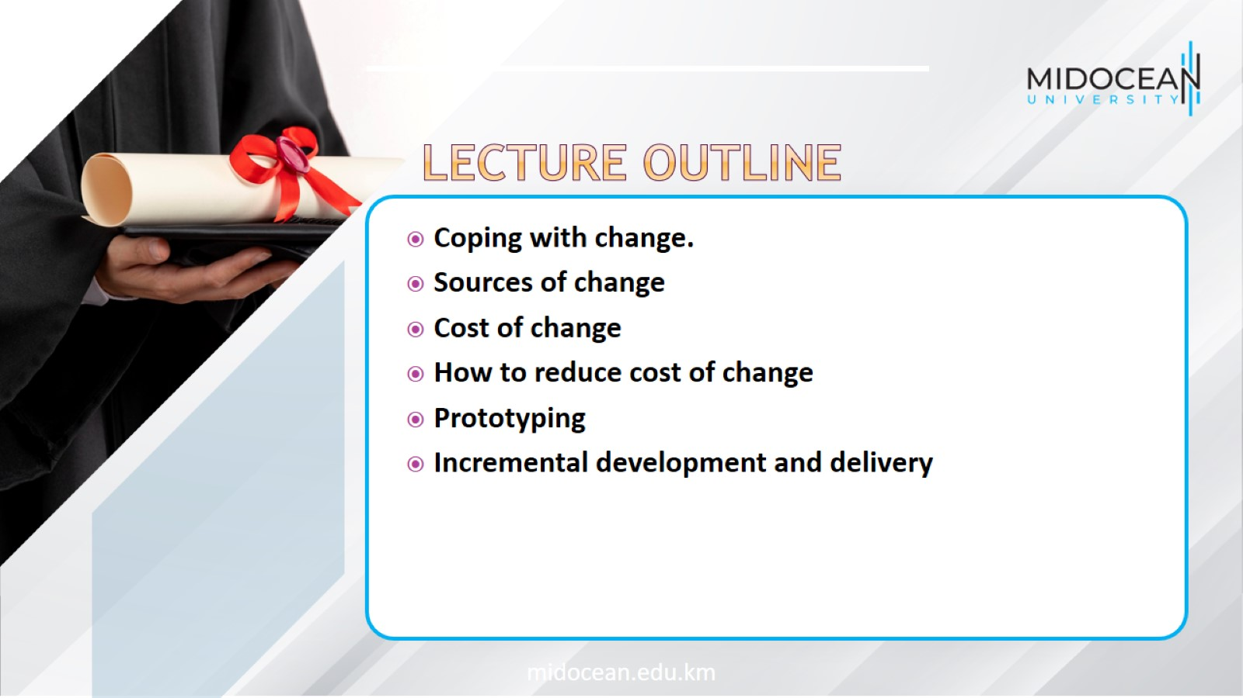

Slide 3
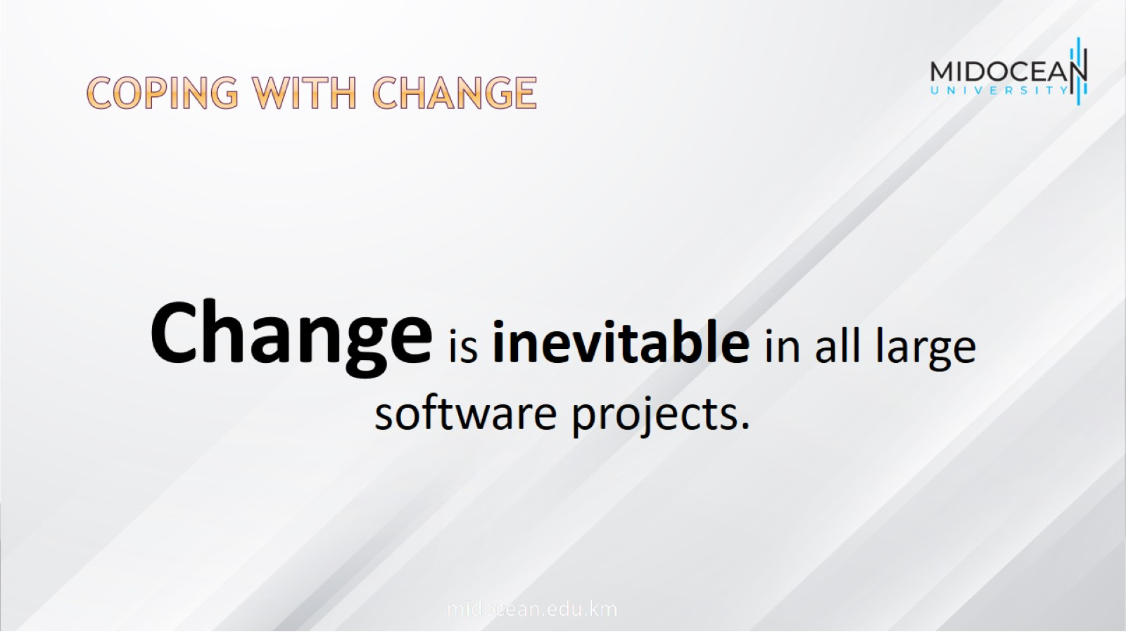
Coping with change

Slide 4
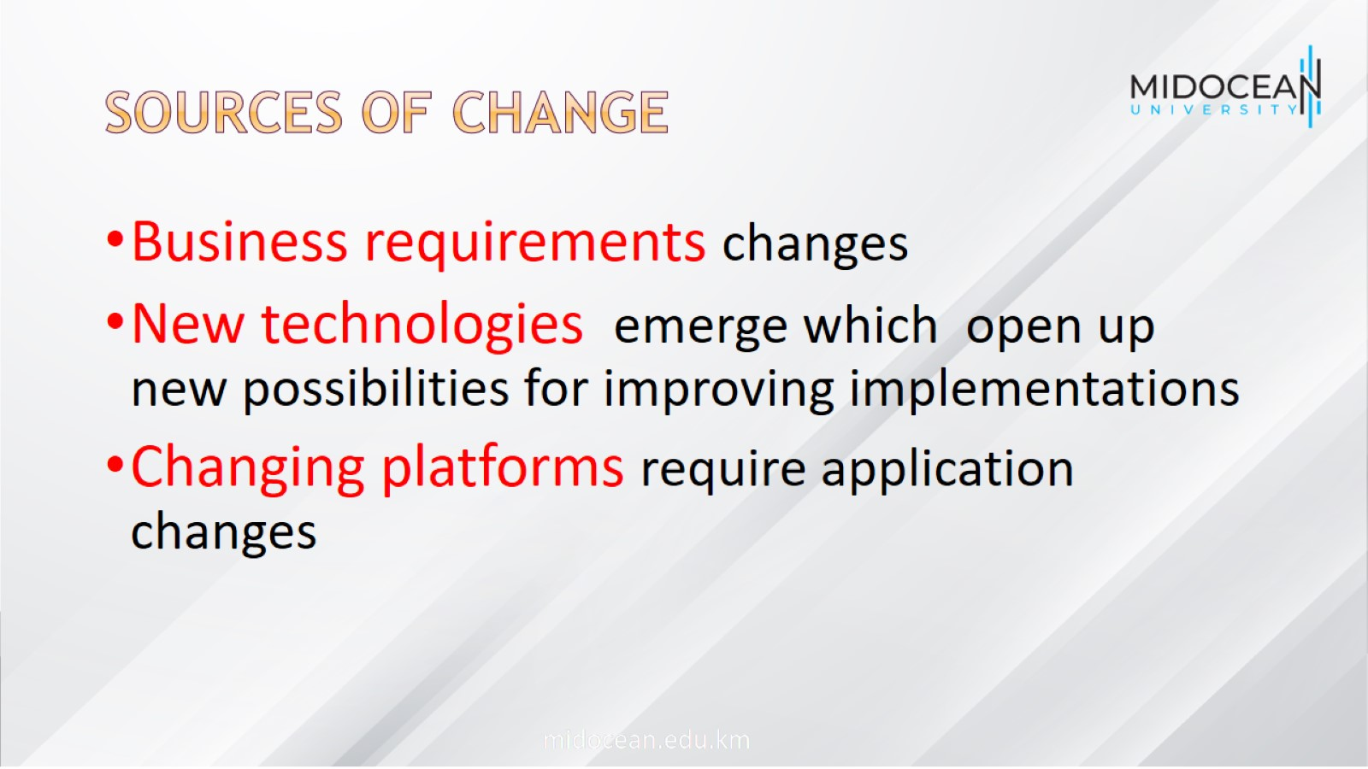
Sources of change

Slide 5
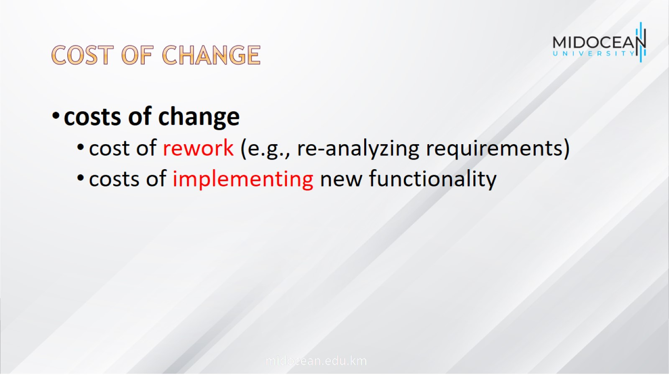
Cost of change

Slide 6
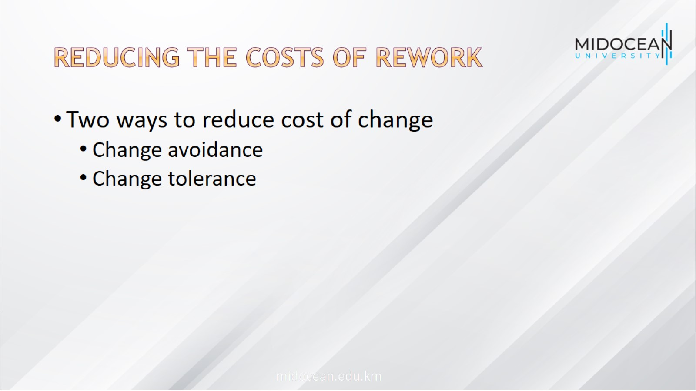
Reducing the costs of rework

Slide 7
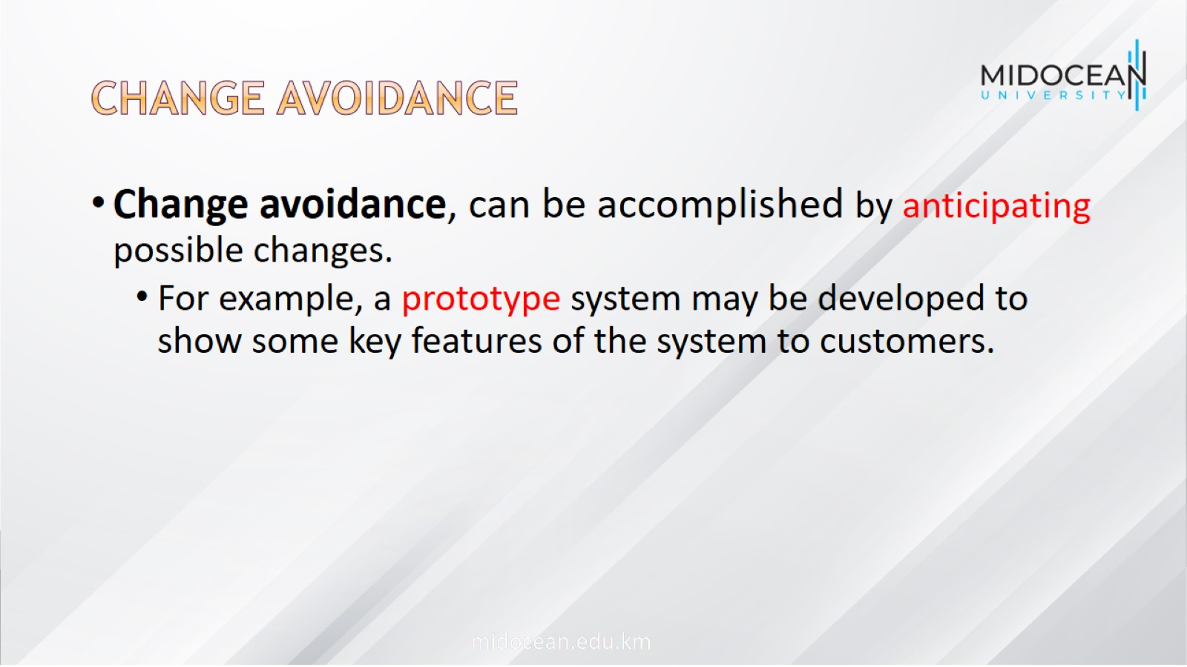
Change avoidance

Slide 8
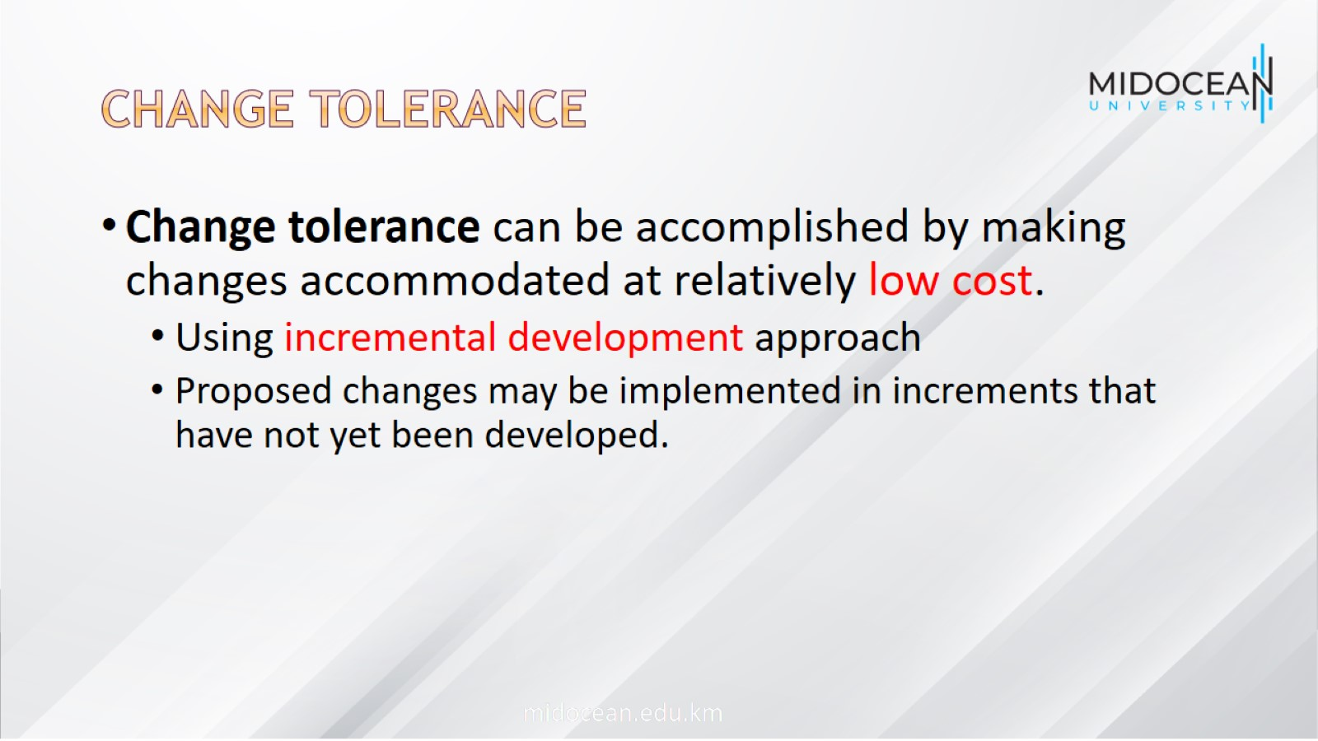
Change tolerance

Slide 9
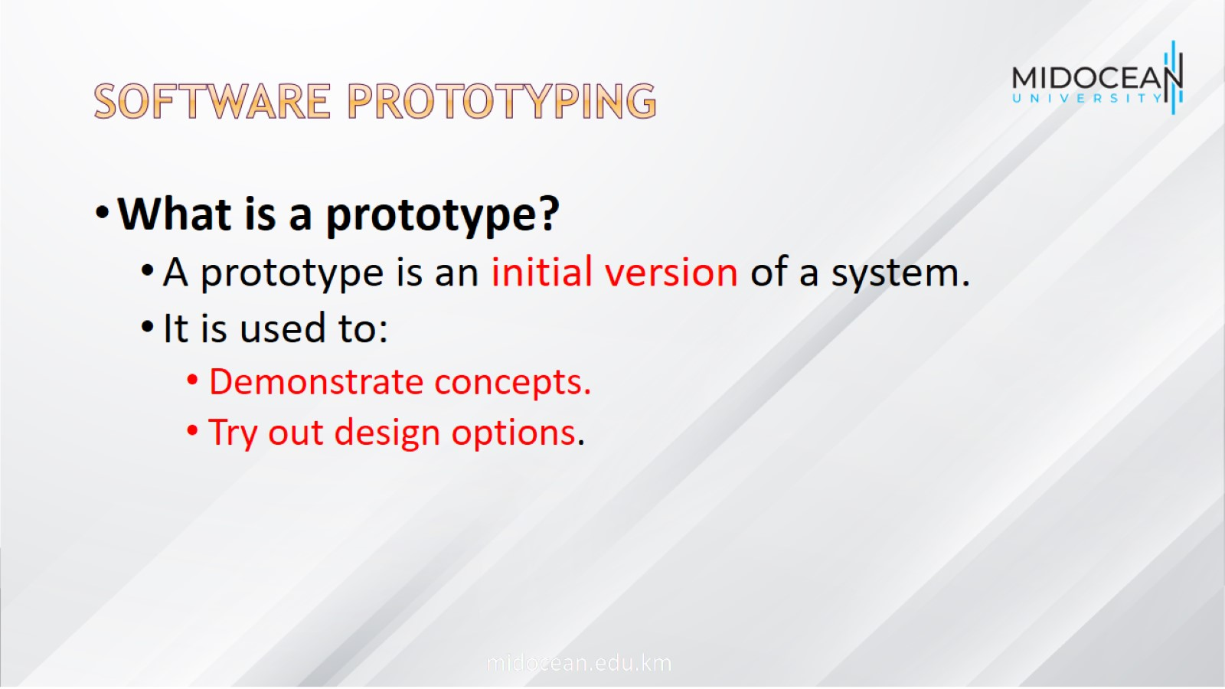
Software prototyping

Slide 10
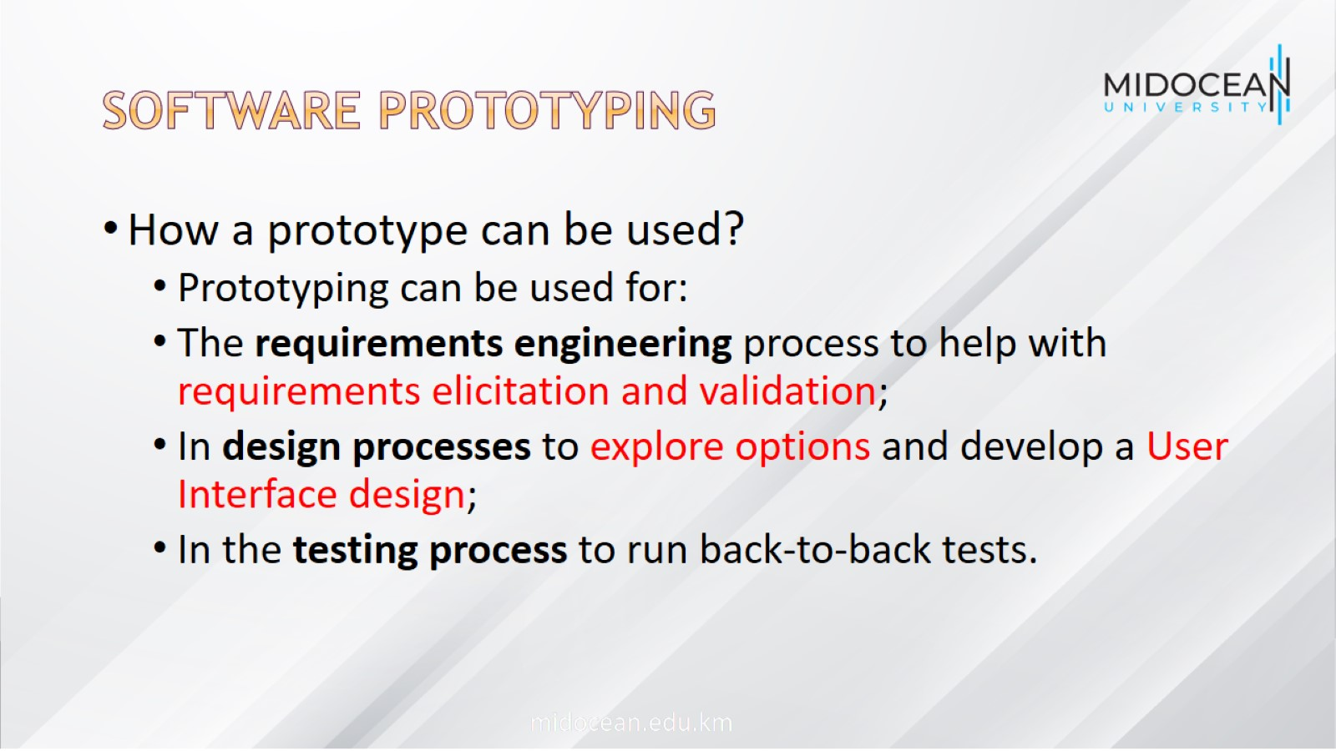
Software prototyping

Slide 11
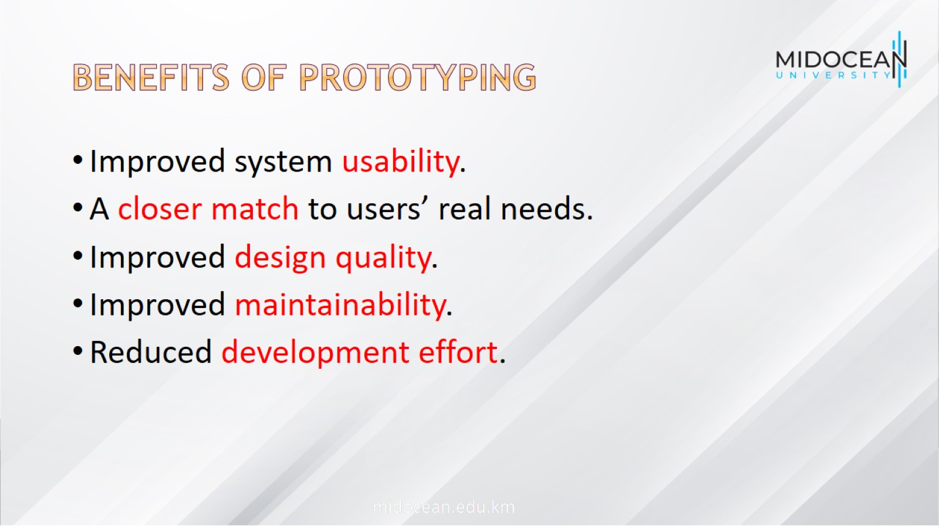
Benefits of prototyping

Slide 12
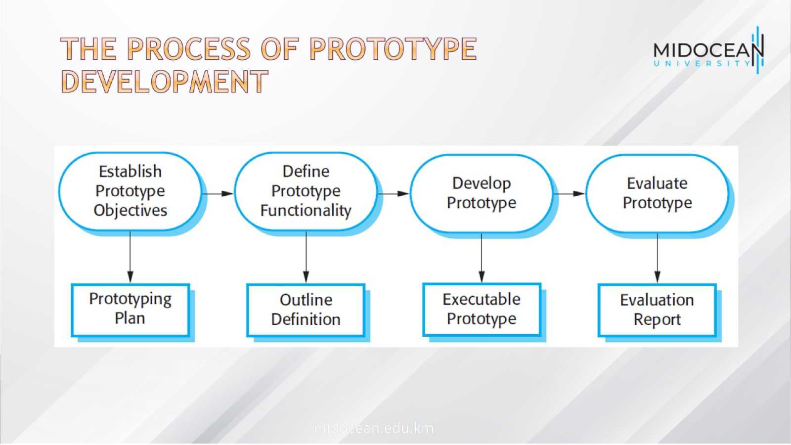
The process of prototype development

Slide 13

Prototype development features

Slide 14
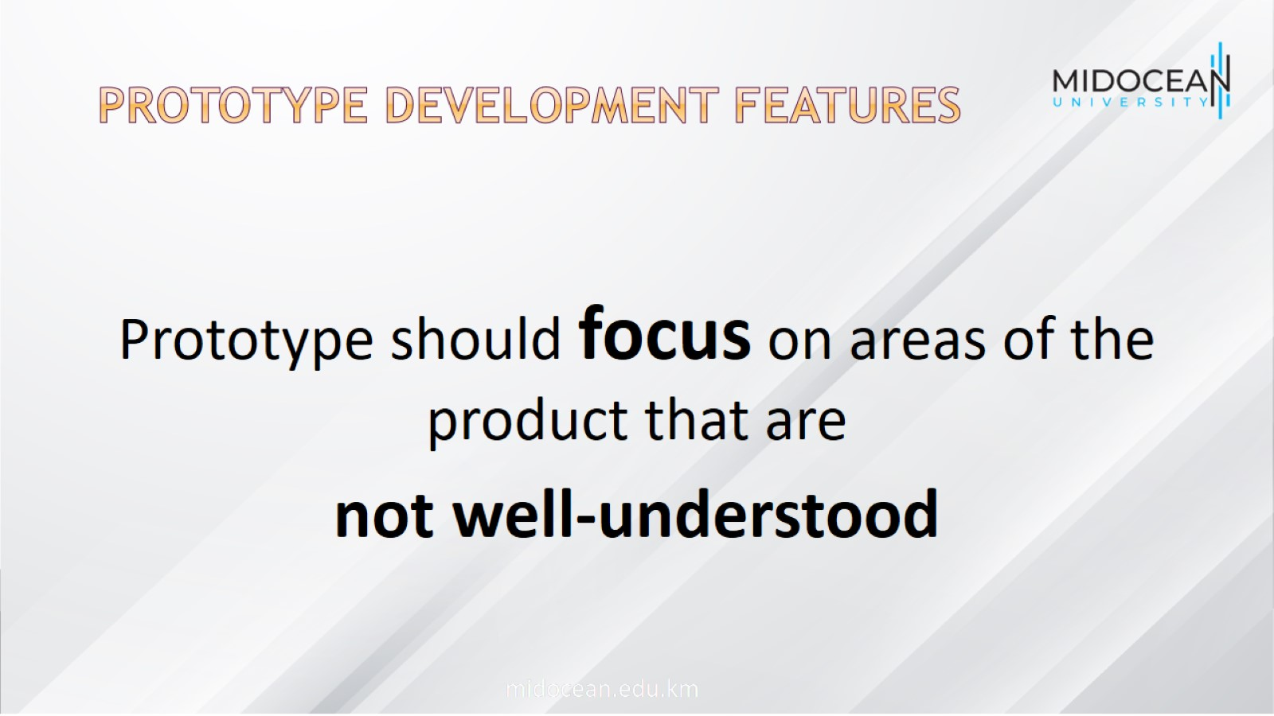
Prototype development features

Slide 15
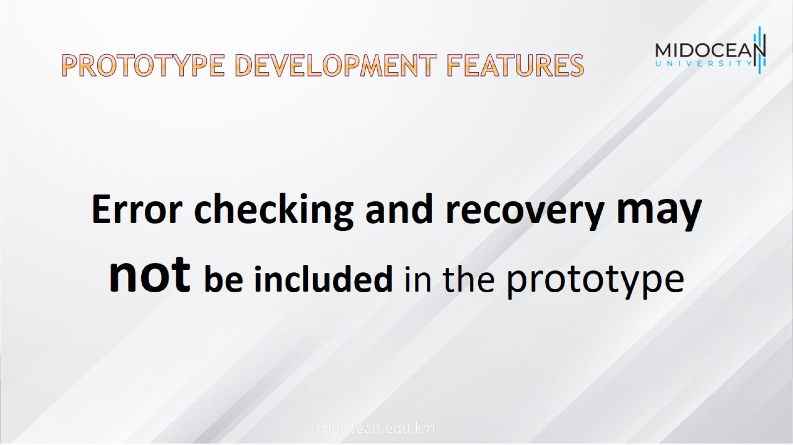
Prototype development features

Slide 16
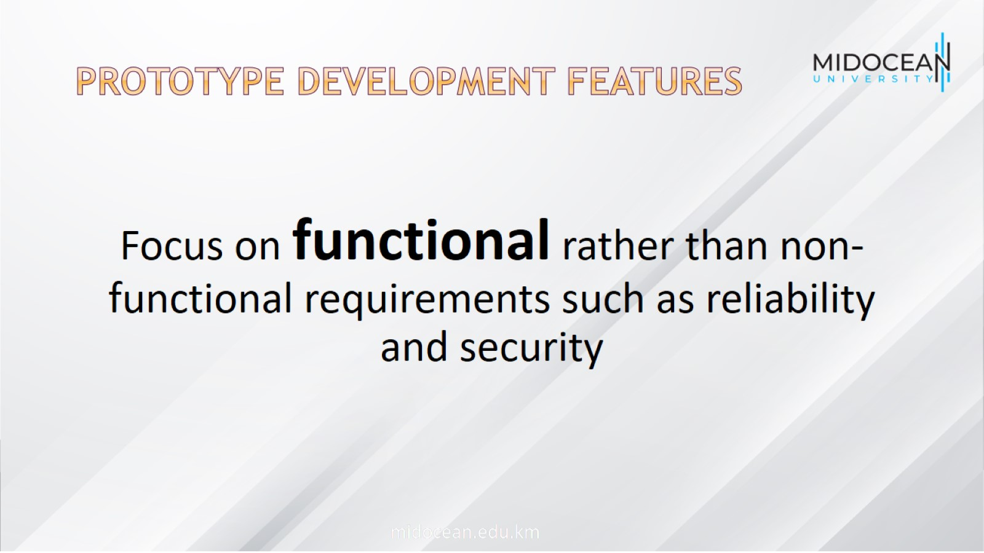
Prototype development features

Slide 17
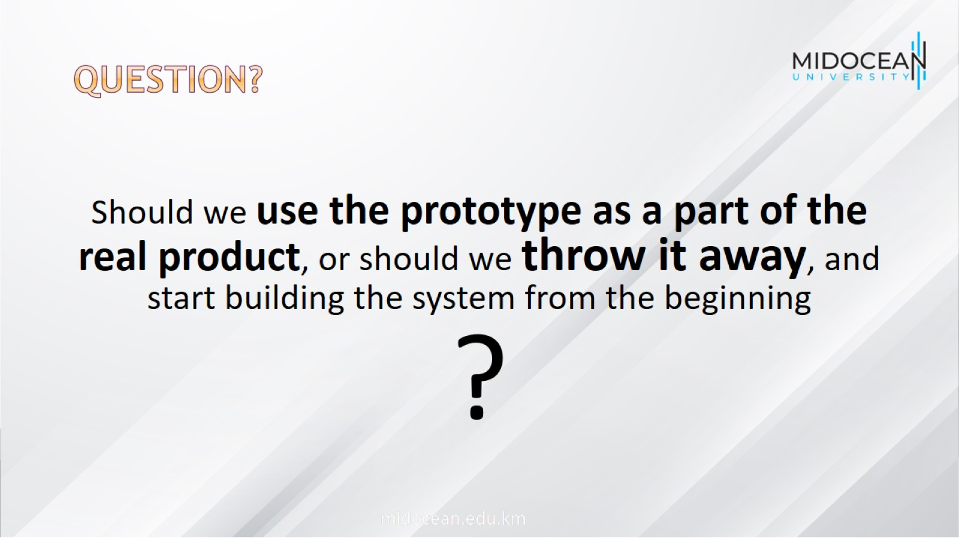
Question?

Slide 18
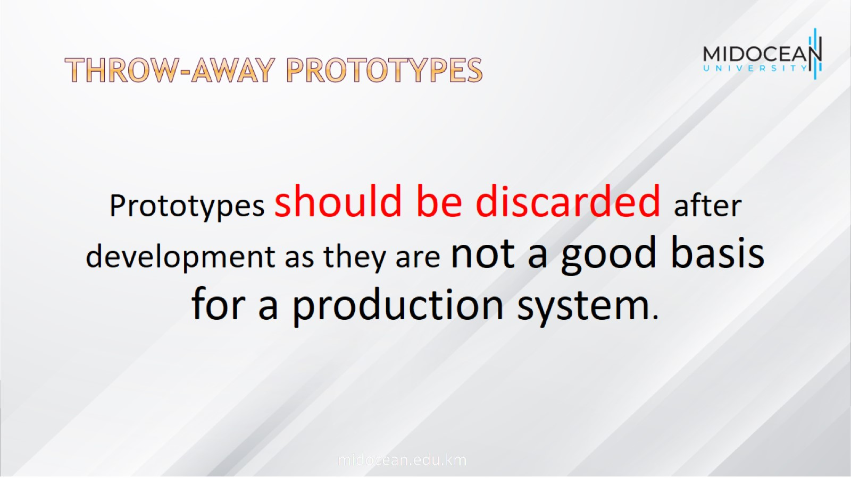
Throw-away prototypes

Slide 19
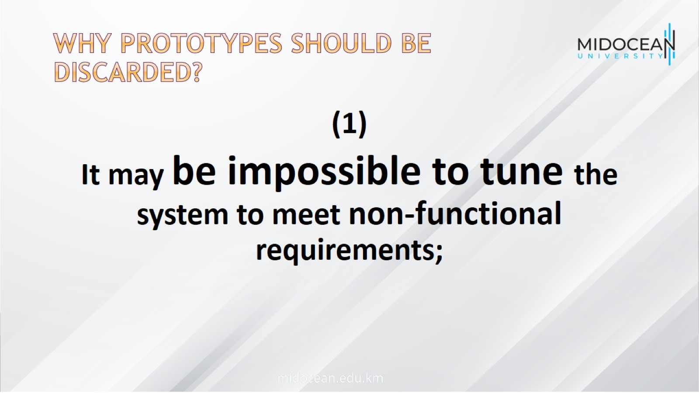
Why Prototypes should be discarded?

Slide 20
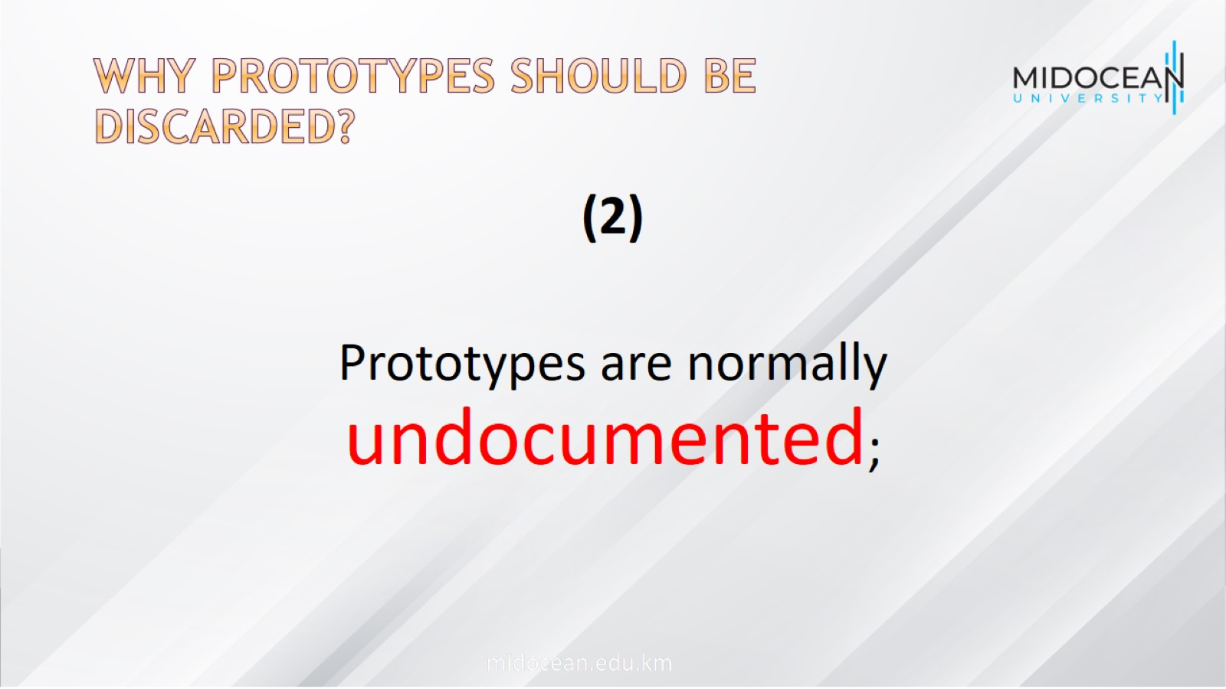
Why Prototypes should be discarded?

Slide 21
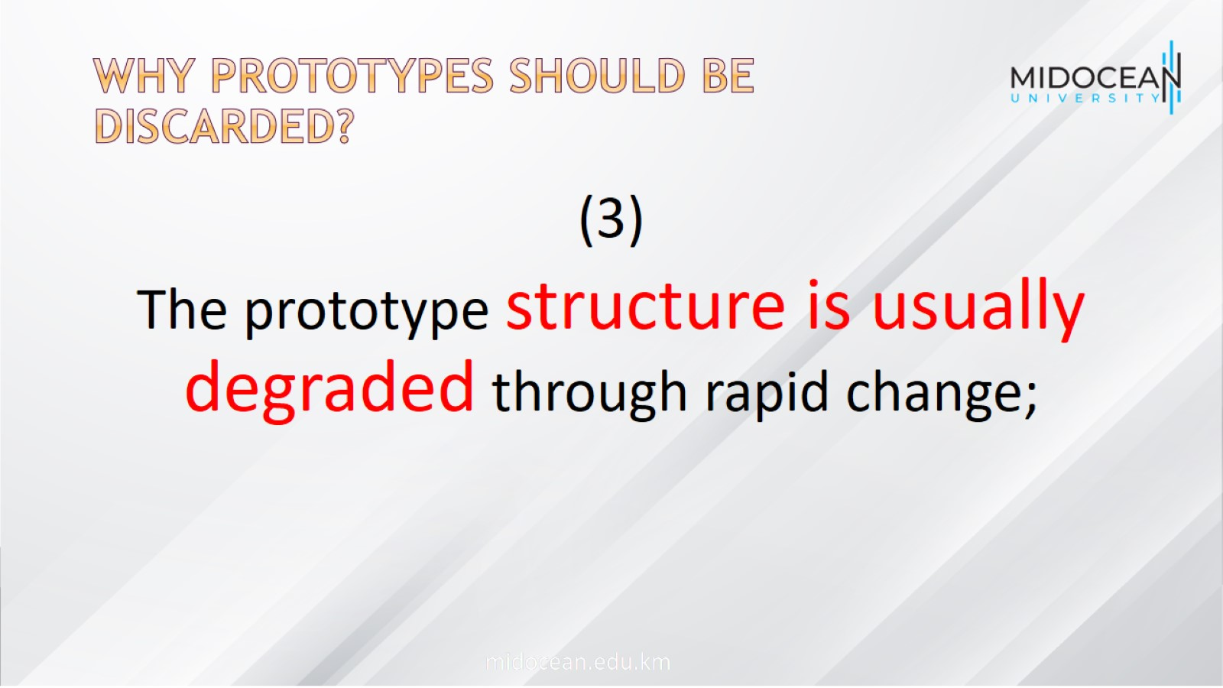
Why Prototypes should be discarded?

Slide 22
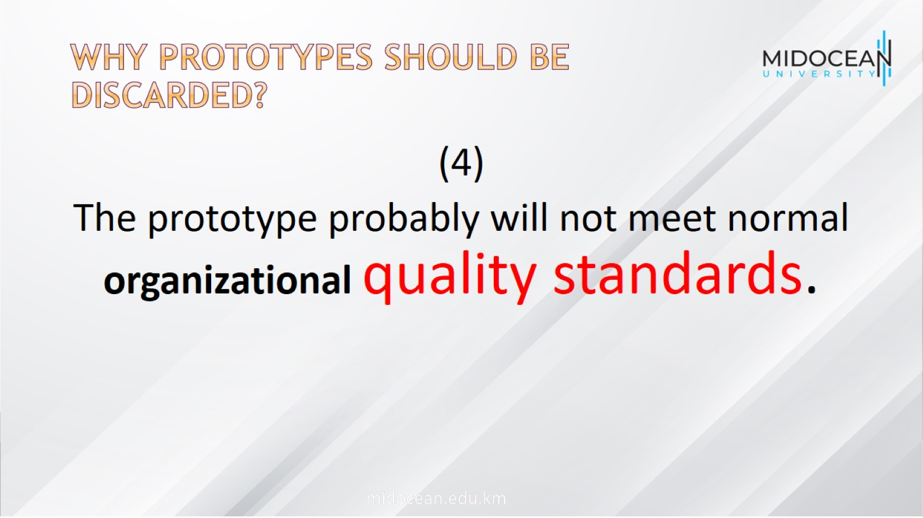
Why Prototypes should be discarded?

Slide 23
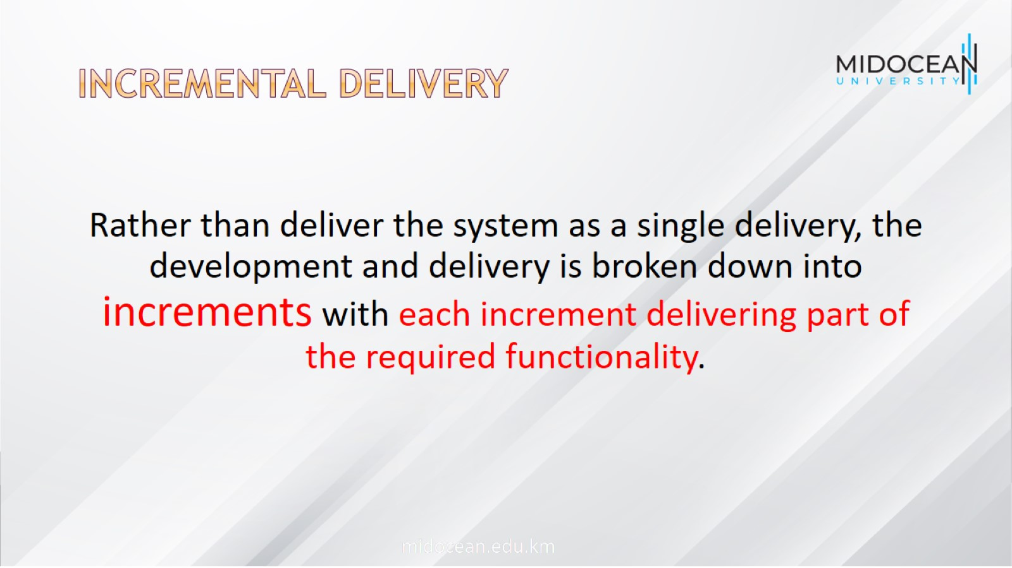
Incremental delivery

Slide 24
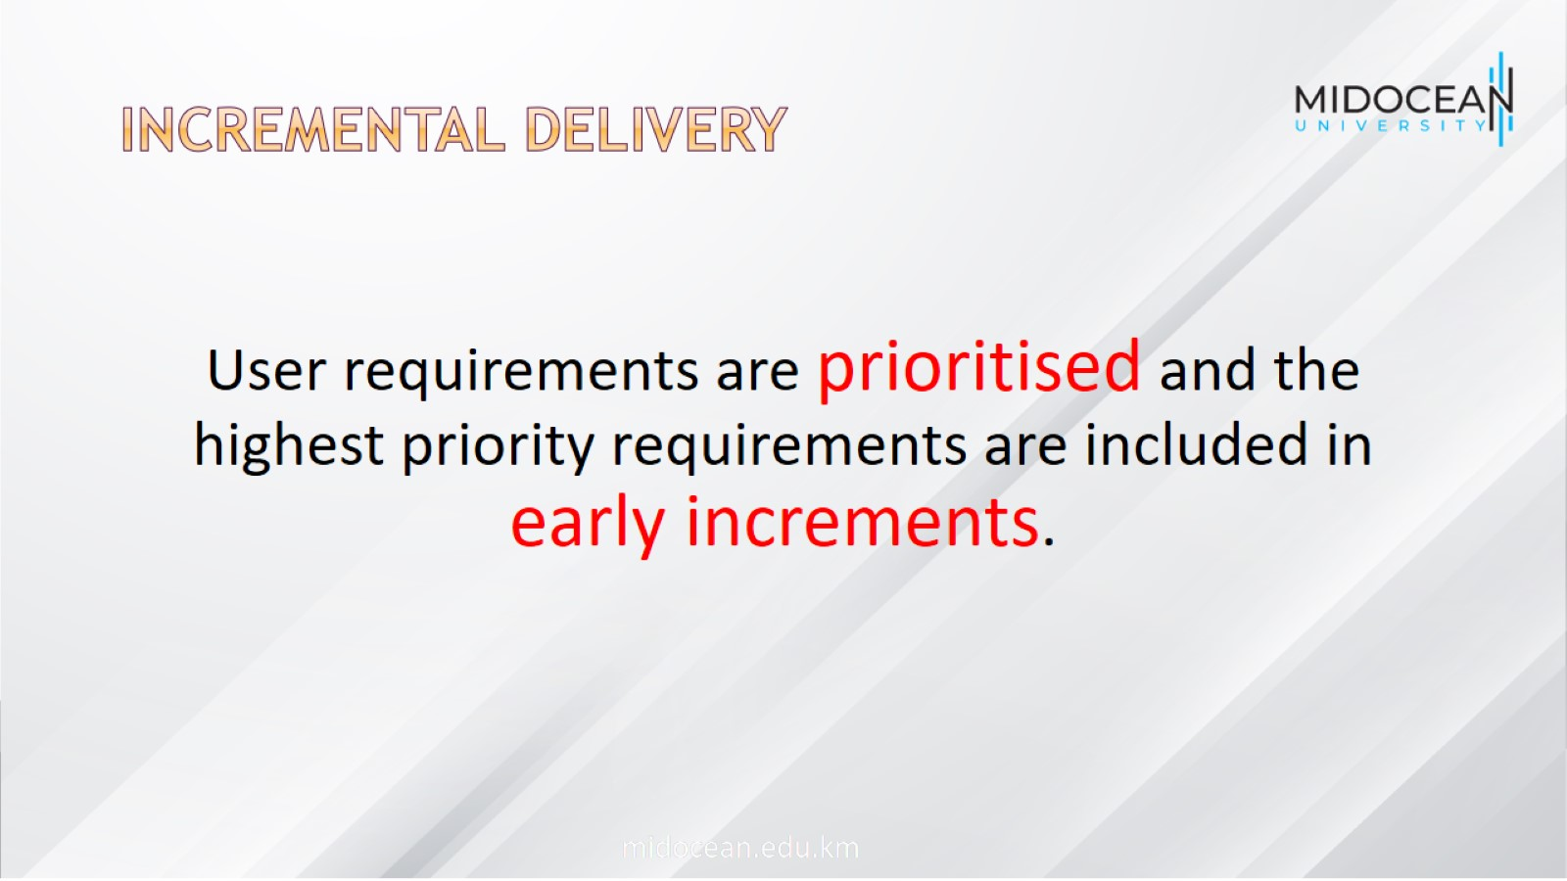
Incremental delivery

Slide 25
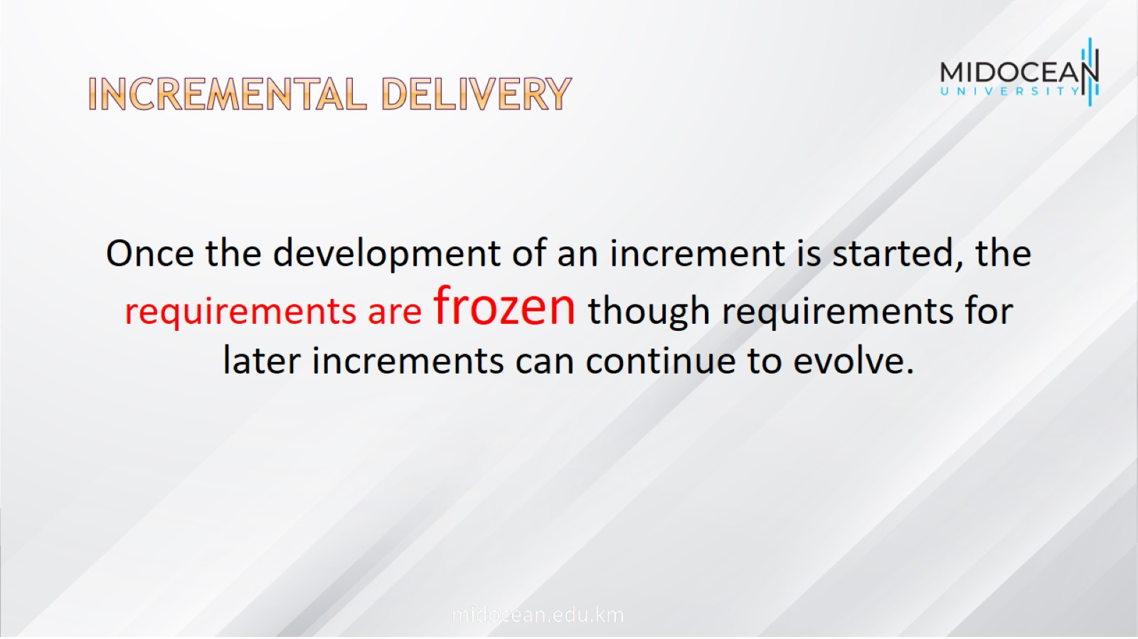
Incremental delivery

Slide 26
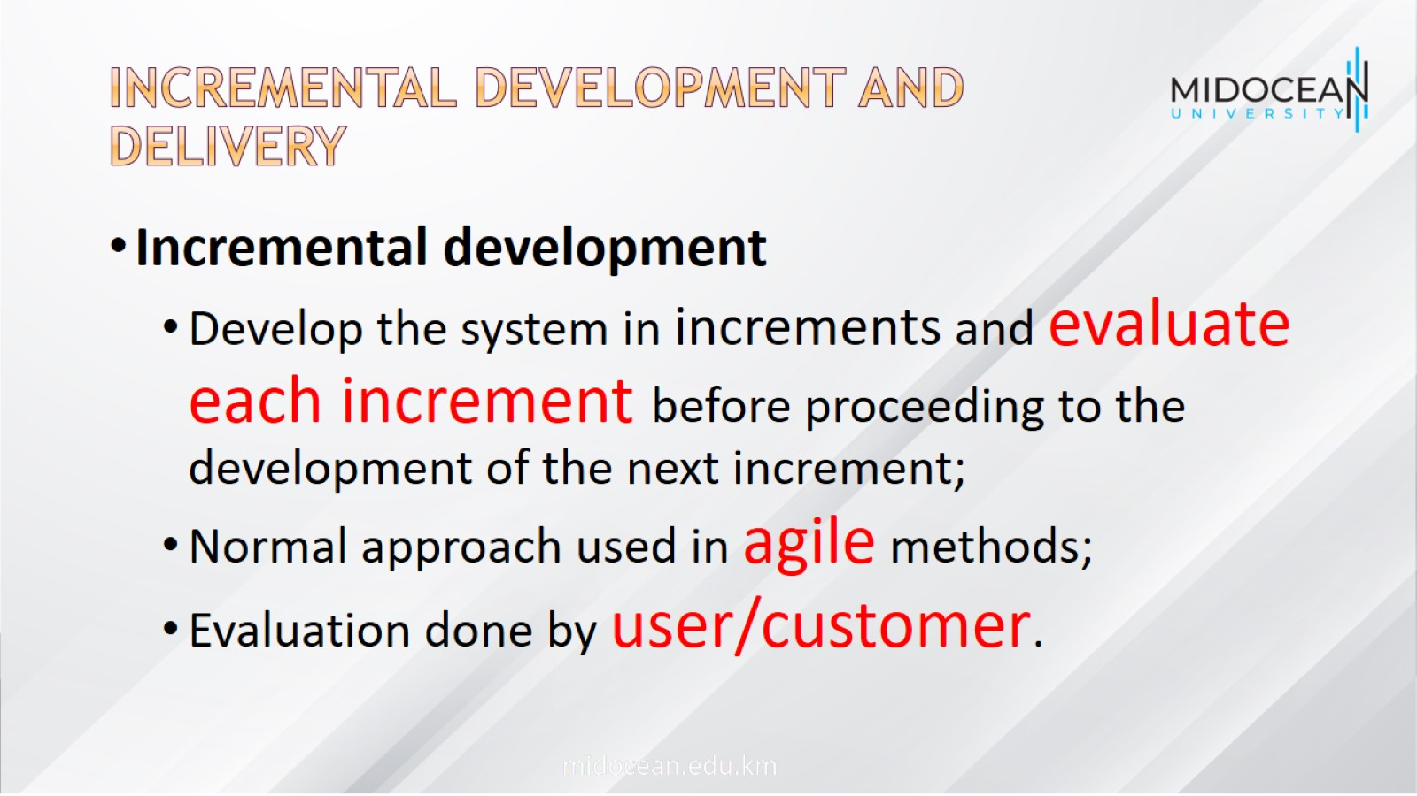
Incremental development and delivery

Slide 27
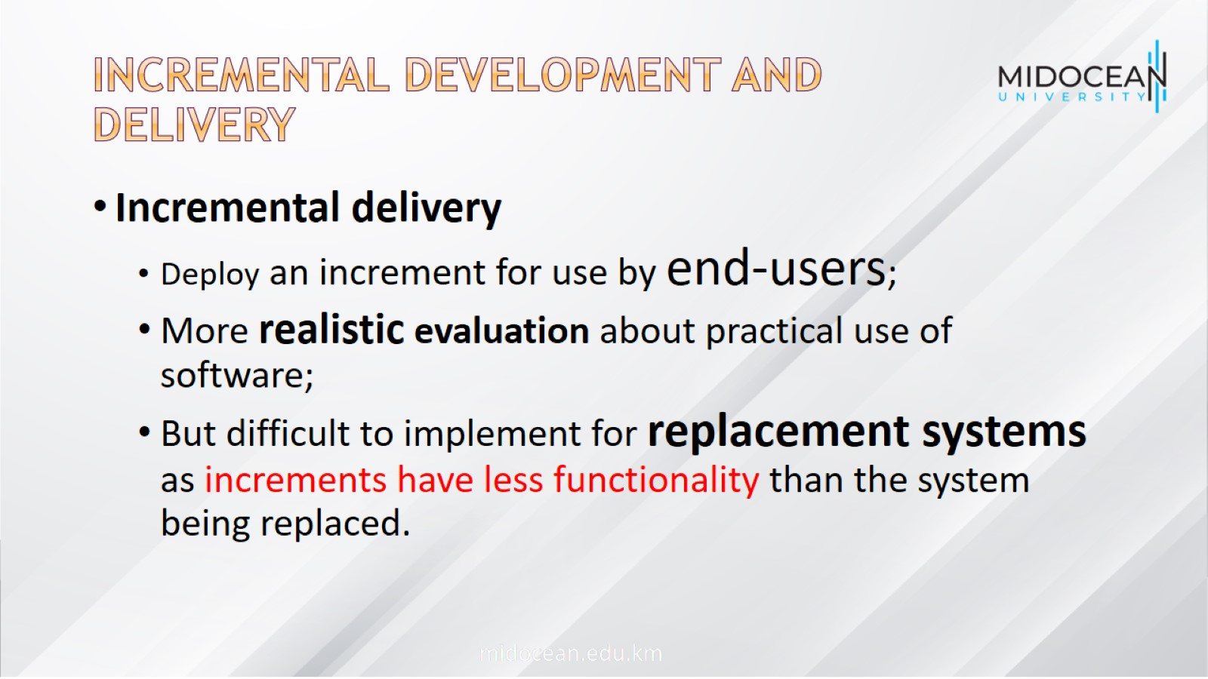
Incremental development and delivery

Slide 28
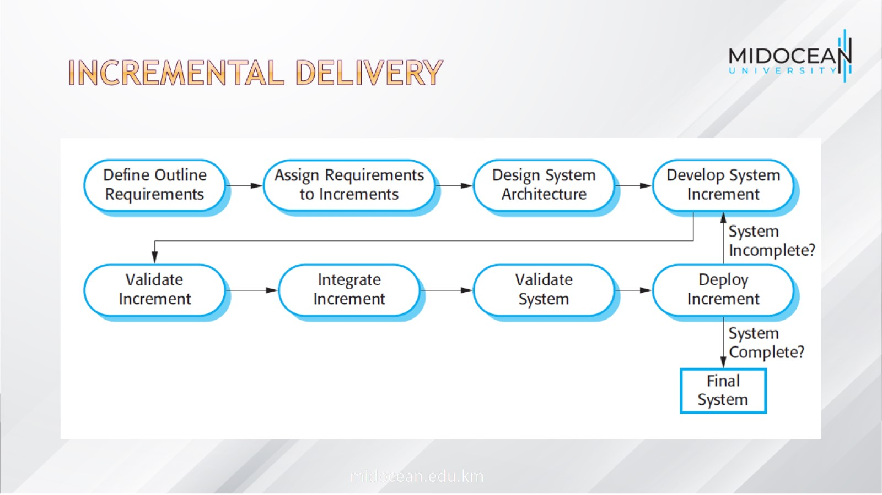
Incremental delivery

Slide 29
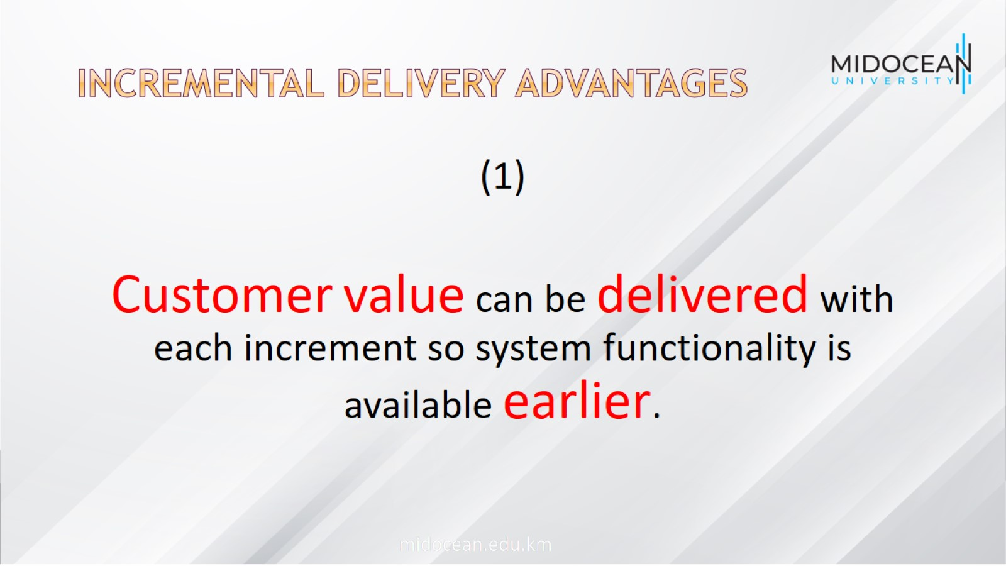
Incremental delivery advantages

Slide 30
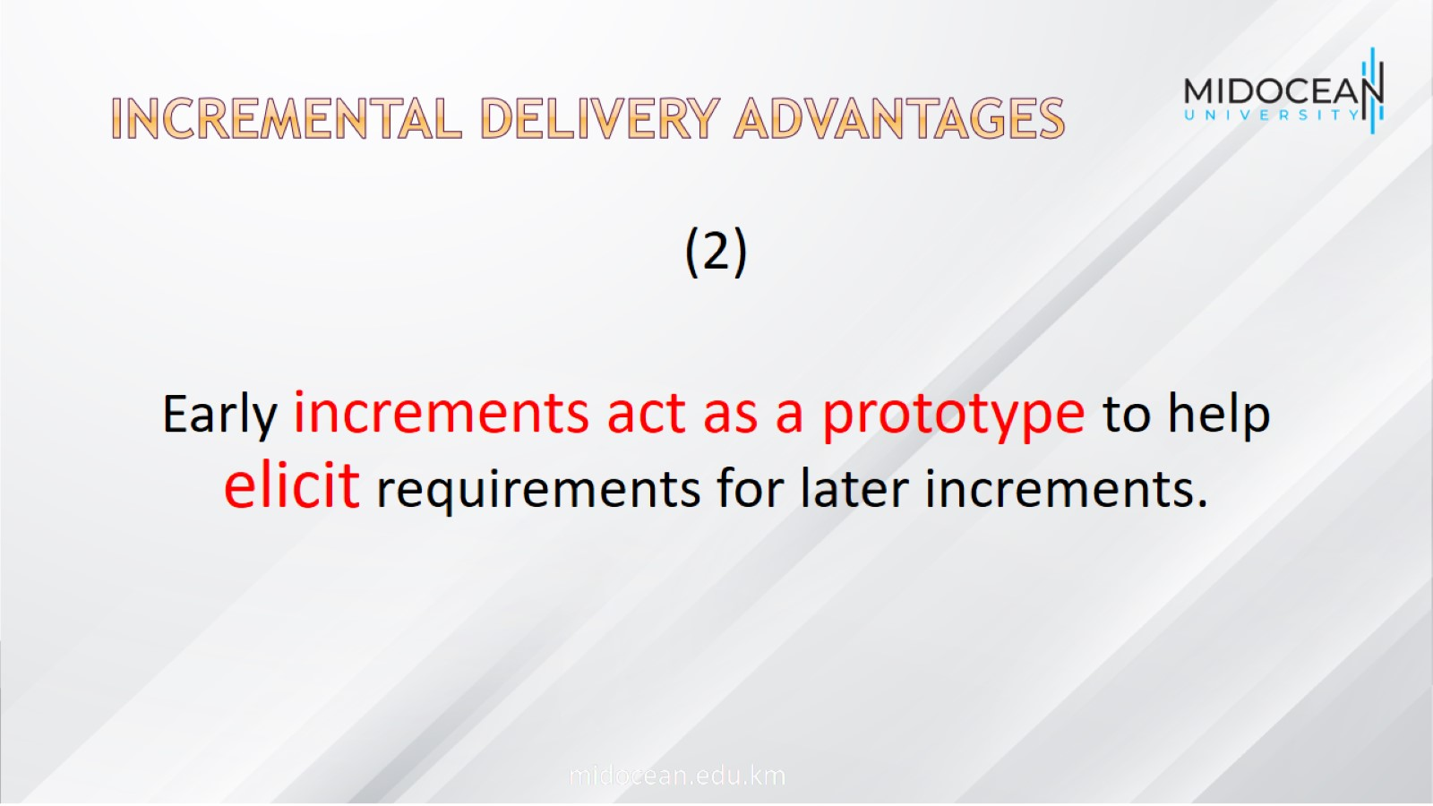
Incremental delivery advantages

Slide 31
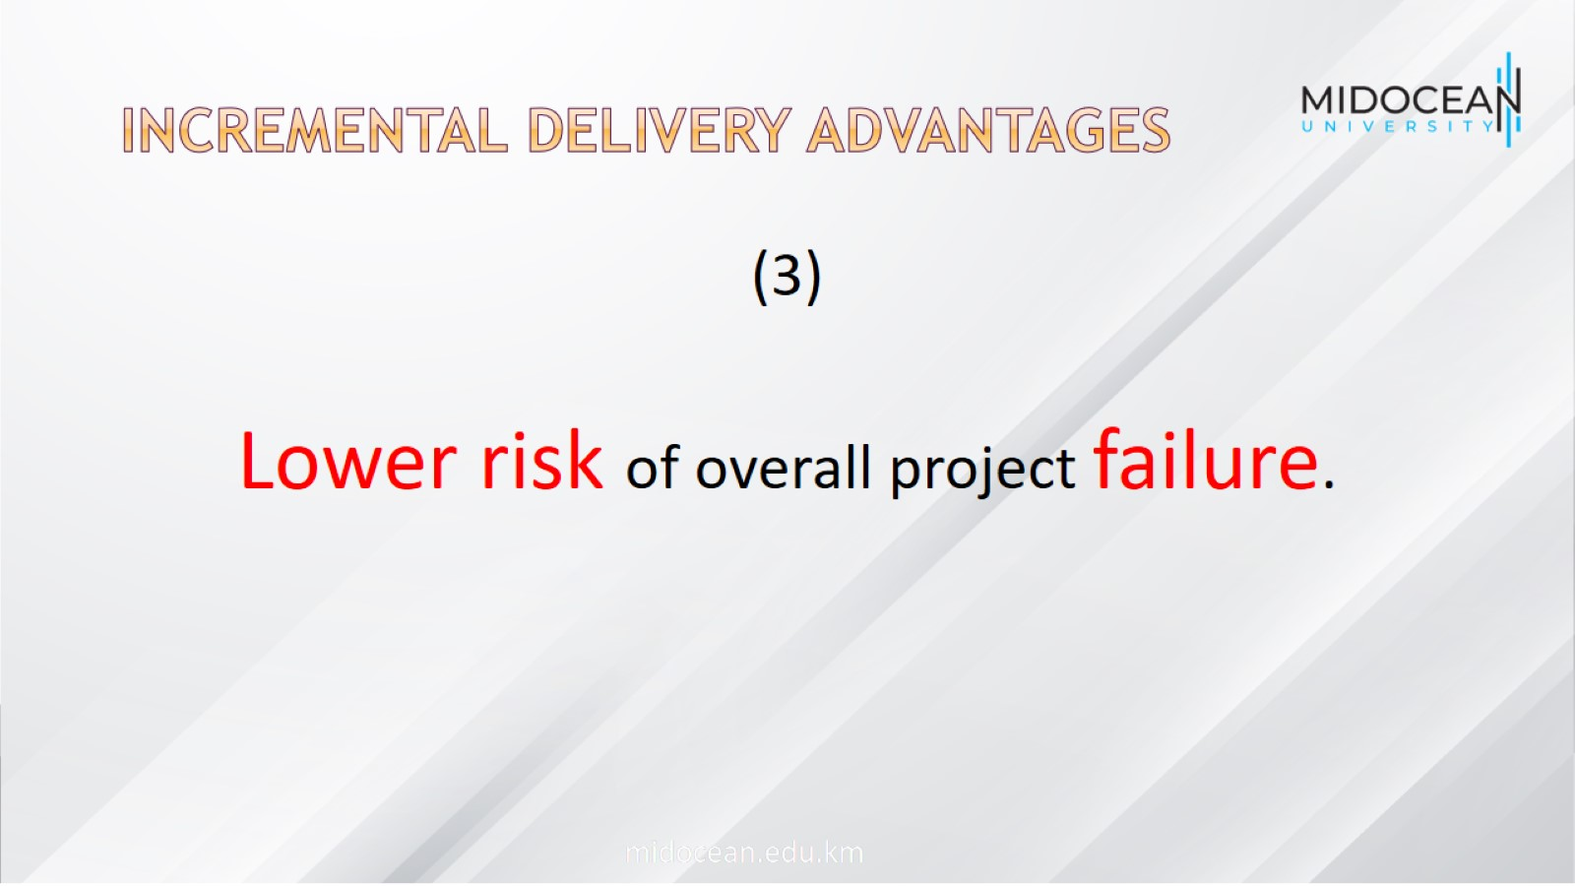
Incremental delivery advantages

Slide 32
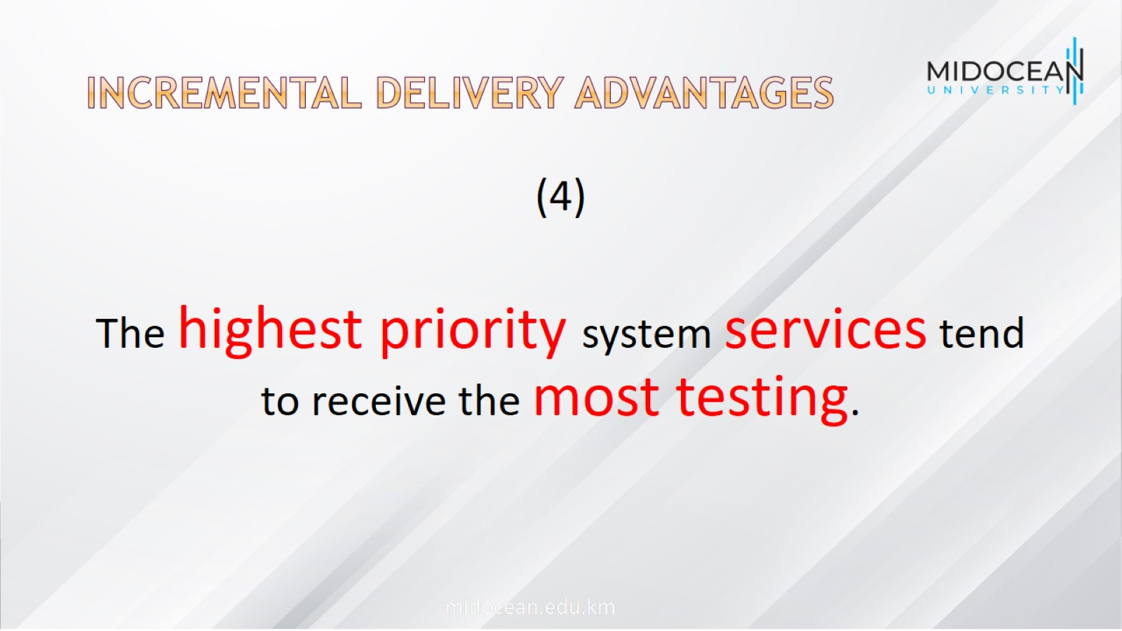
Incremental delivery advantages

Slide 33
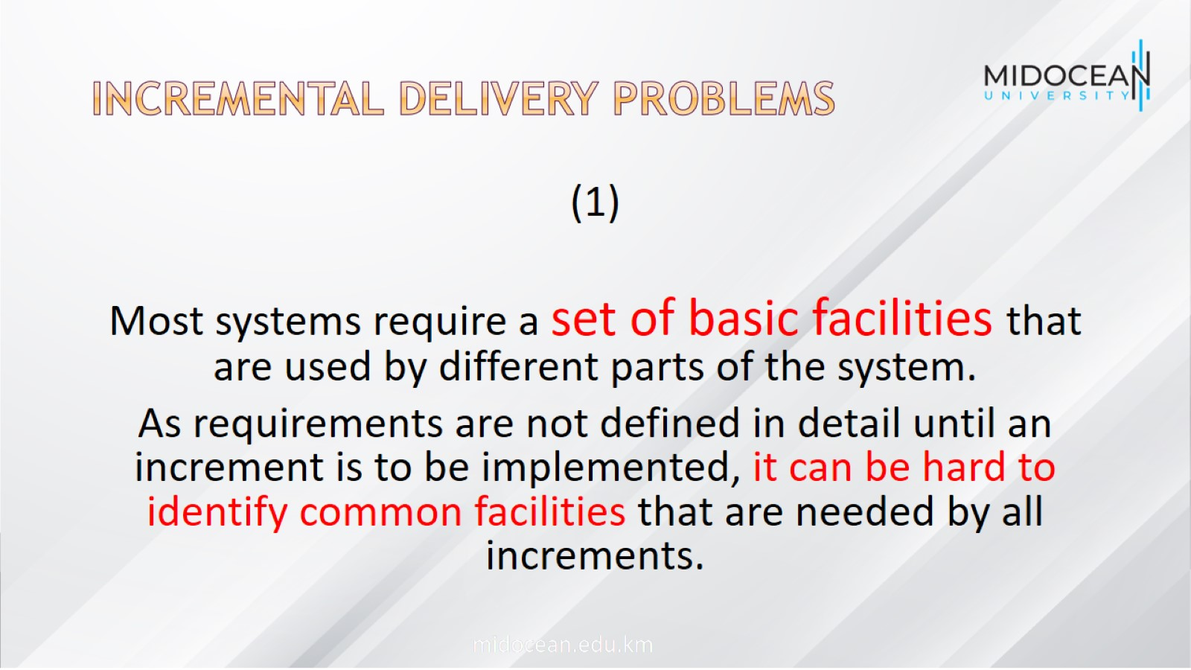
Incremental delivery problems

Slide 34
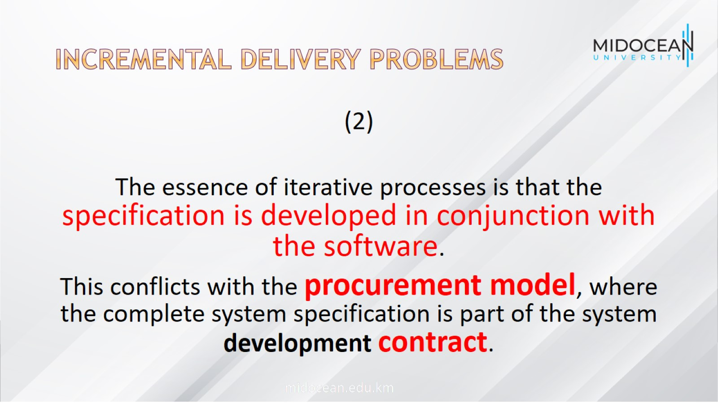
Incremental delivery problems

Slide 35
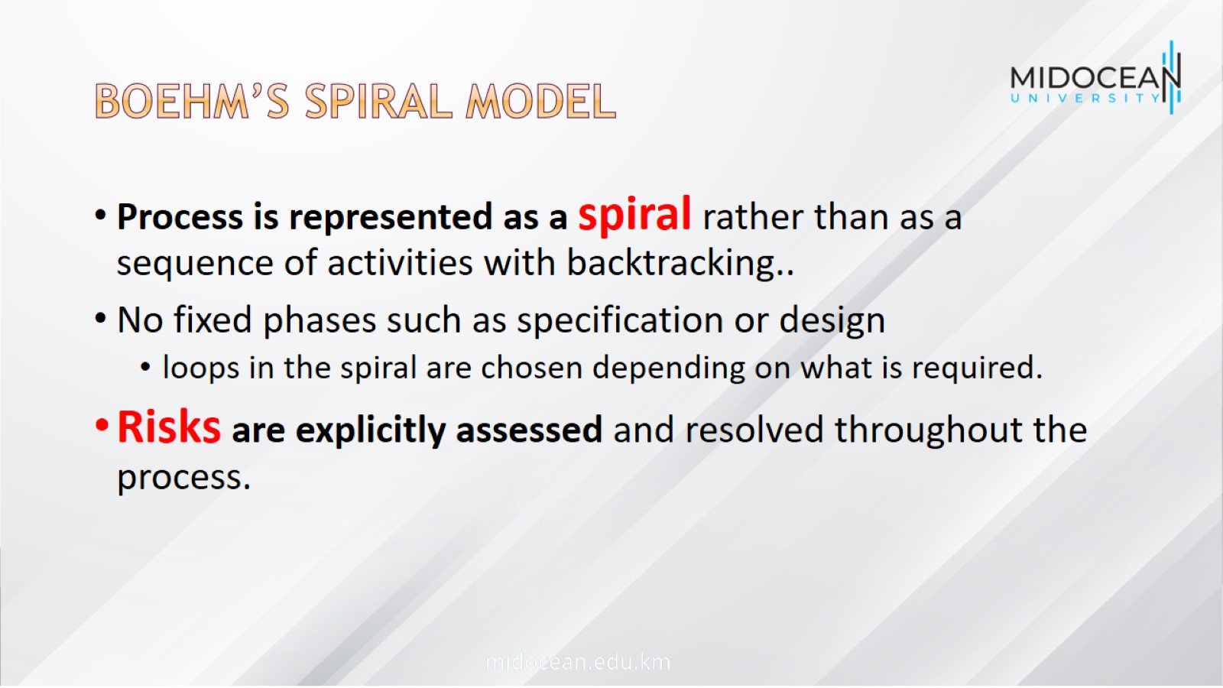
Boehm’s spiral model

Slide 36
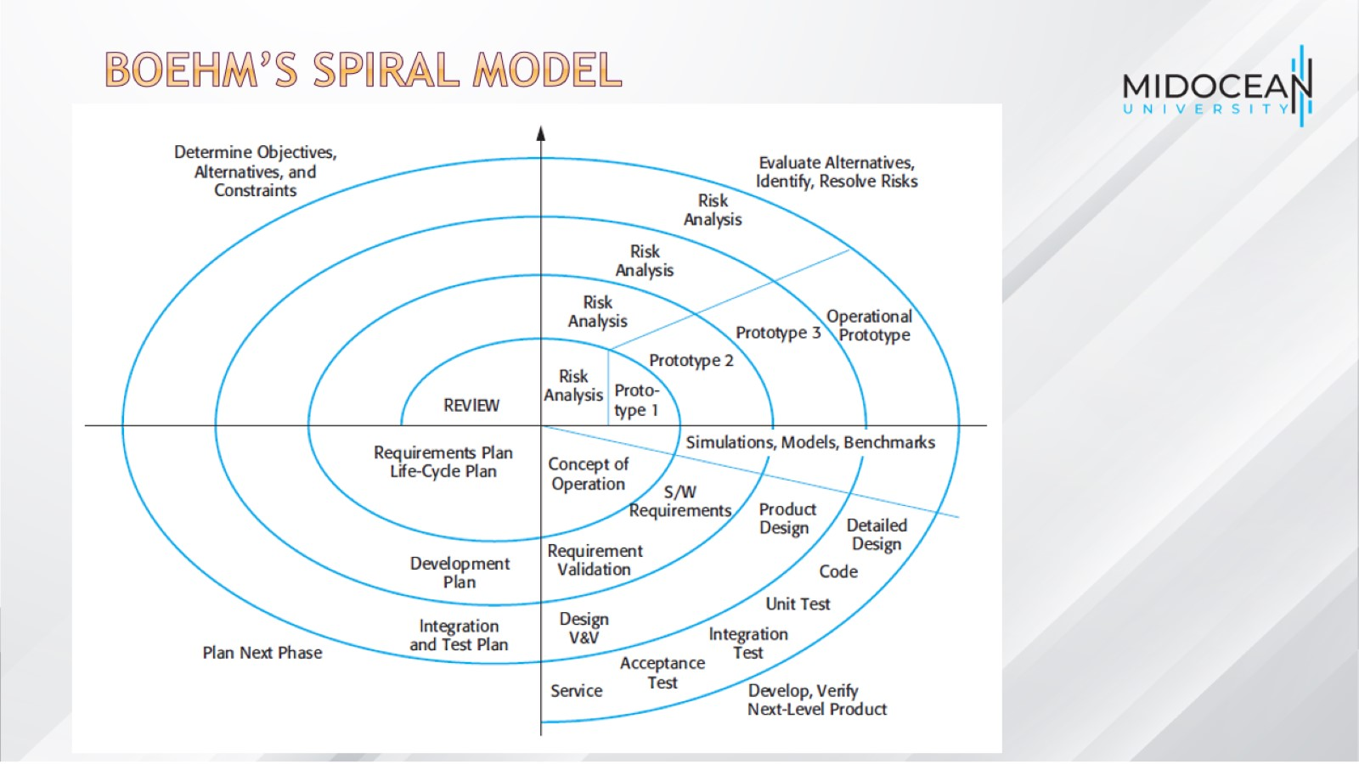
Boehm’s spiral model

Slide 37
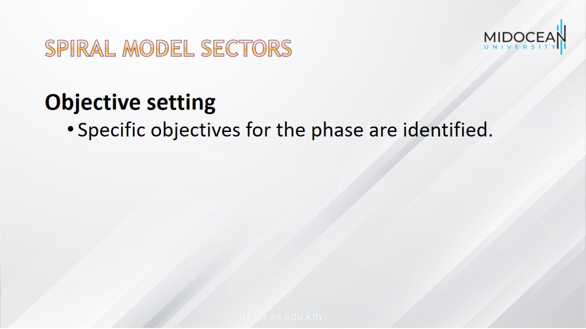
Spiral model sectors

Slide 38
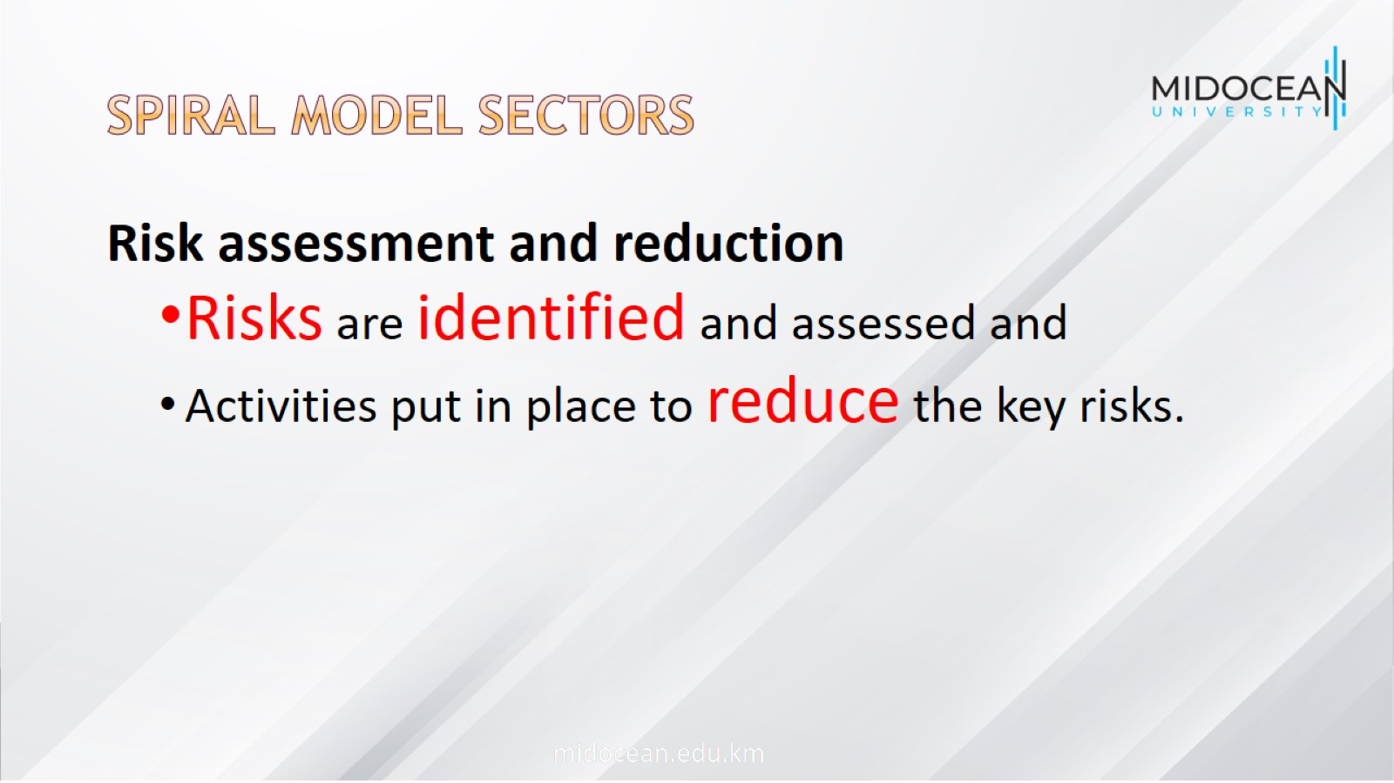
Spiral model sectors

Slide 39
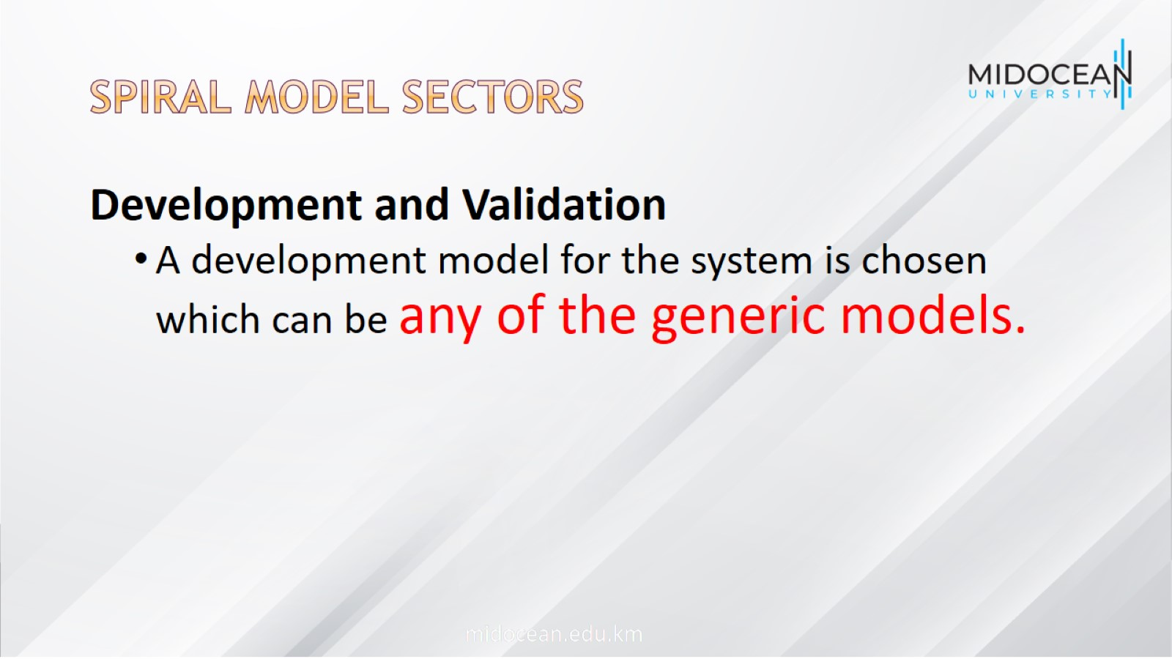
Spiral model sectors

Slide 40
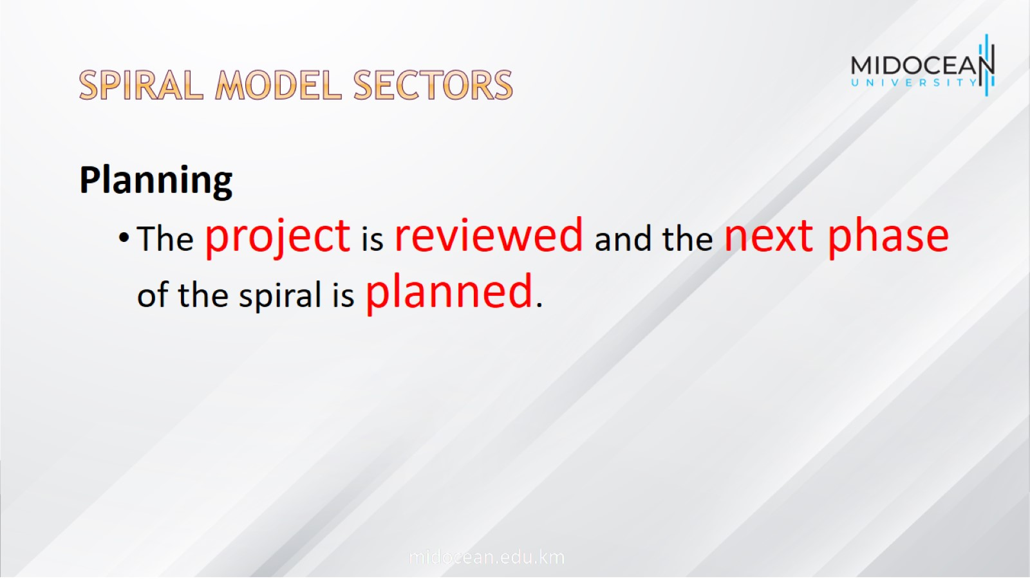
Spiral model sectors

Slide 41
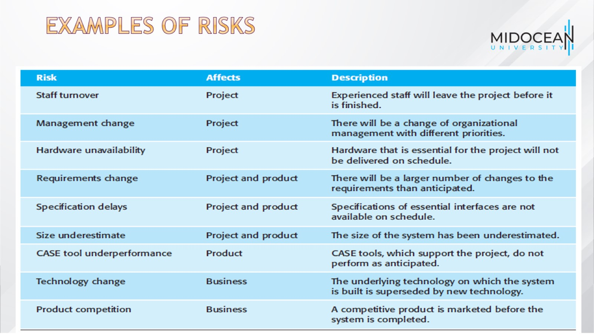
Examples of risks

Slide 42
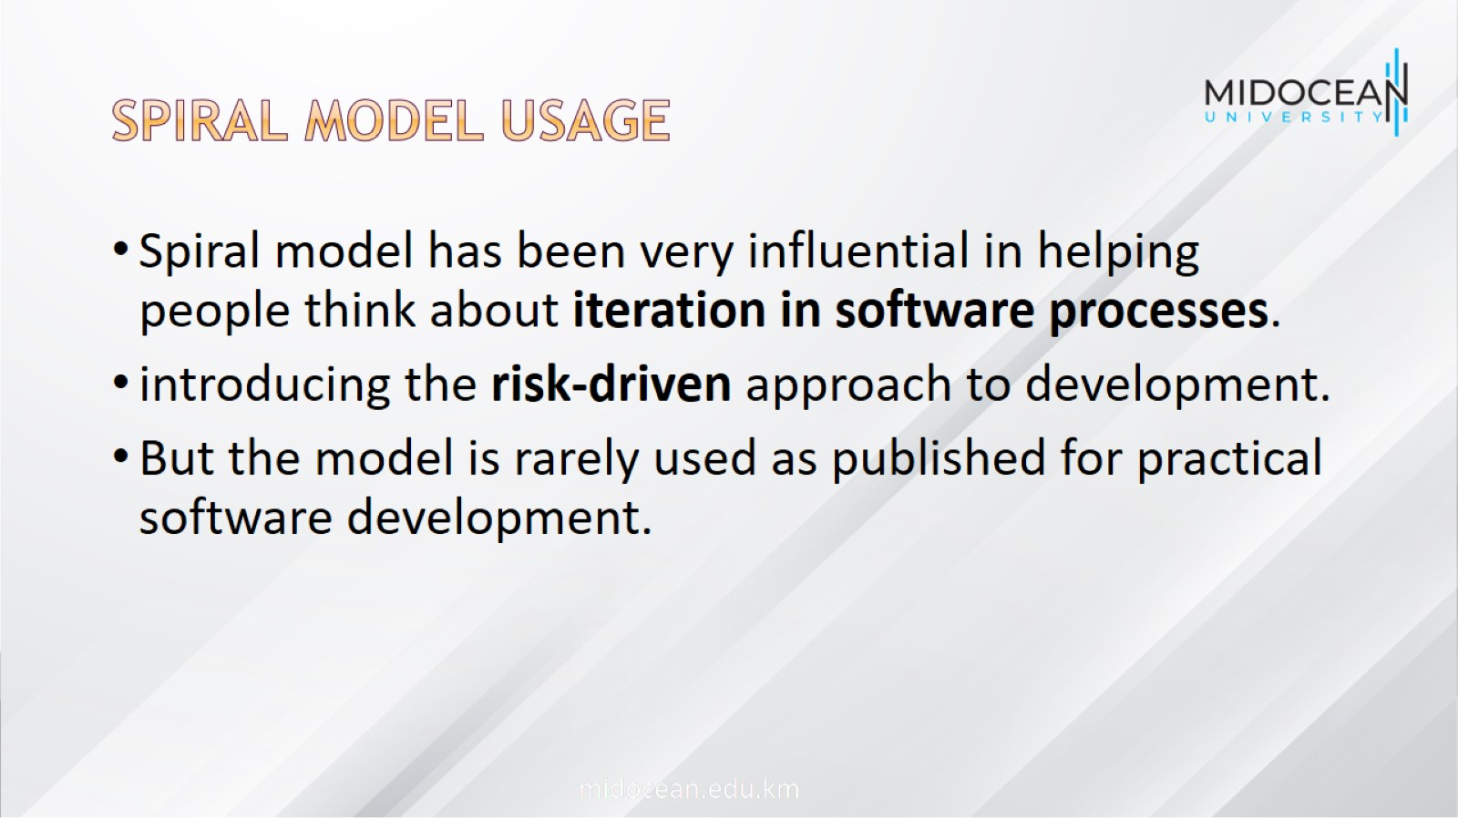
Spiral model usage

Slide 43
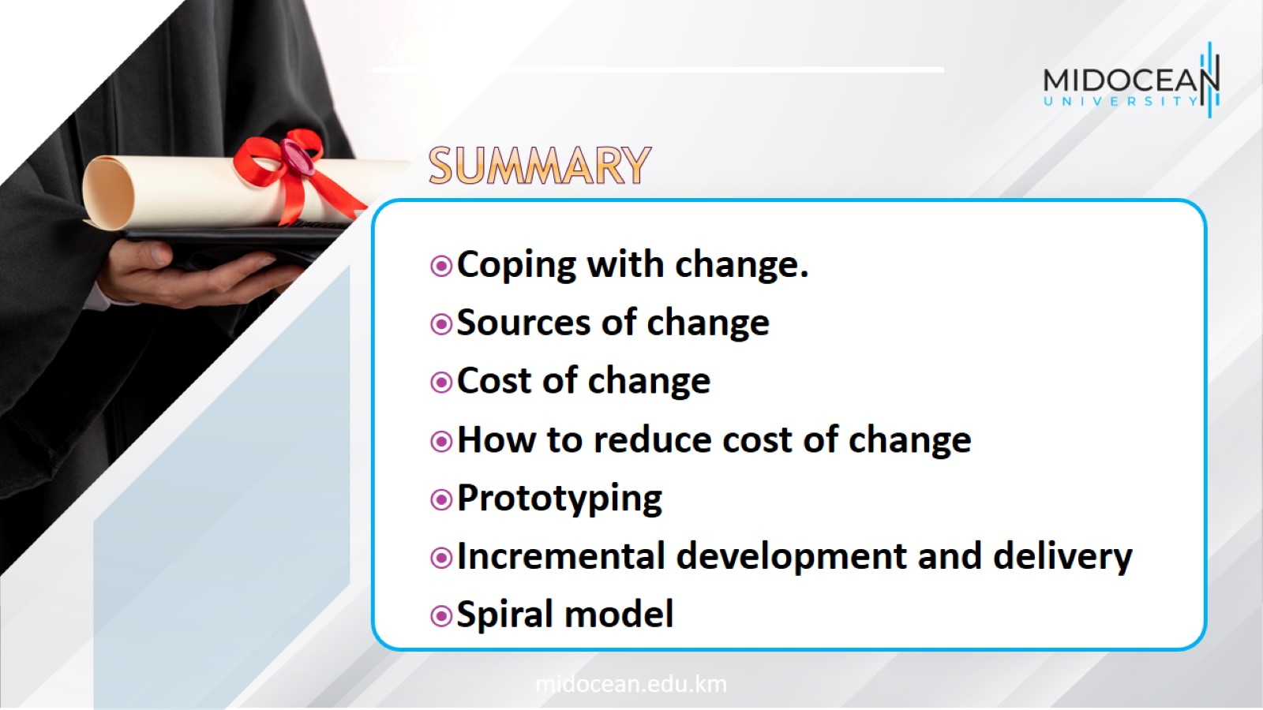

Slide 44


