Slide 1




Research Methodology in Computer Science (AI800)
Lecture 10
Research Tools and Software: LaTeX
Prepared by
Dr. Mohammed Anbar
www.midocean.ae

Slide 2

Outlines
Learning Outcomes
Overview
What is LaTeX?
Why Use LaTeX?
Installing LaTeX
LaTeX document structure
Learning Outcomes
Overview
What is LaTeX?
Why Use LaTeX?
Installing LaTeX
LaTeX document structure
www.midocean.ae

Slide 3
Learning Outcomes
To introduce participants to the basics of LaTeX and its benefits.
To provide hands-on experience in creating professional-looking documents.
To learn how to format text, create tables and figures, manage references and citations, and customize document layouts.
www.midocean.ae

Slide 4

What is LaTeX?
LaTeX is a method for preparing documents for typesetting of superior quality.
LaTeX may be used for nearly any type of publishing, while it is most used to create technical or scientific texts.
www.midocean.ae

Slide 5
Why Use LaTeX?
Expertly designed preset layouts give a paper the authentic "printed" look.
Equations and mathematical symbols may be combined with ease.
Simple to create even intricate structures like table of contents, footnotes, and references.
Makes the author concentrate on the document's logical structure rather than its visual appeal.
Produces more good-looking papers. It's affordable (or free), lightweight, compatible, adaptable, and versatile.
www.midocean.ae

Slide 6
Installing LaTeX
Texmaker
TeXstudio
Overleaf
TeXworks
TeXnicCenter
LyX
www.midocean.ae

Slide 7
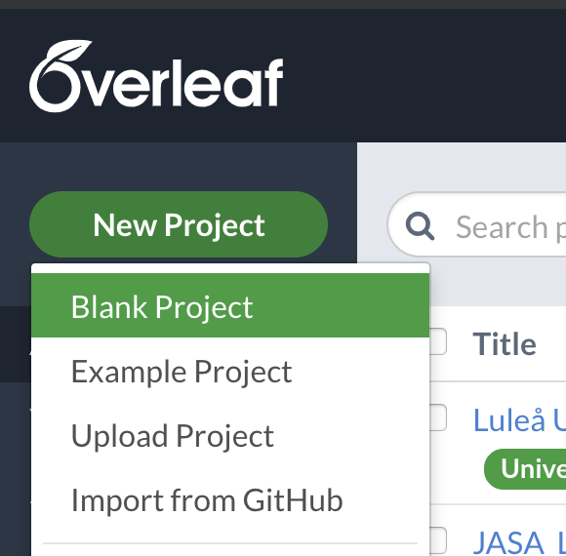
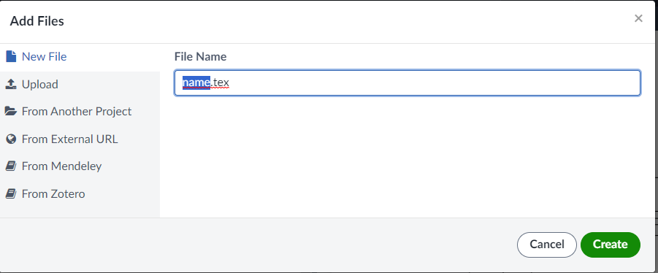
Start using Overleaf
Go to : www.overleaf.com.
  Register
  Login
  Starting a new project
www.midocean.ae

Slide 8
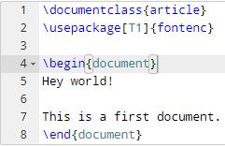
LaTeX document structure
You specify your document class.
Document classes: letter, article, report, book, slides(beamer, prosper)
  \documentclass{article}
  Backslash – at the beginning of text markup command.
Packages: numerous packages are available
  \usepackage[margin=1in]{geometry}
  \usepackage{setspace}
  \usepackage{harvard}
www.midocean.ae

Slide 9
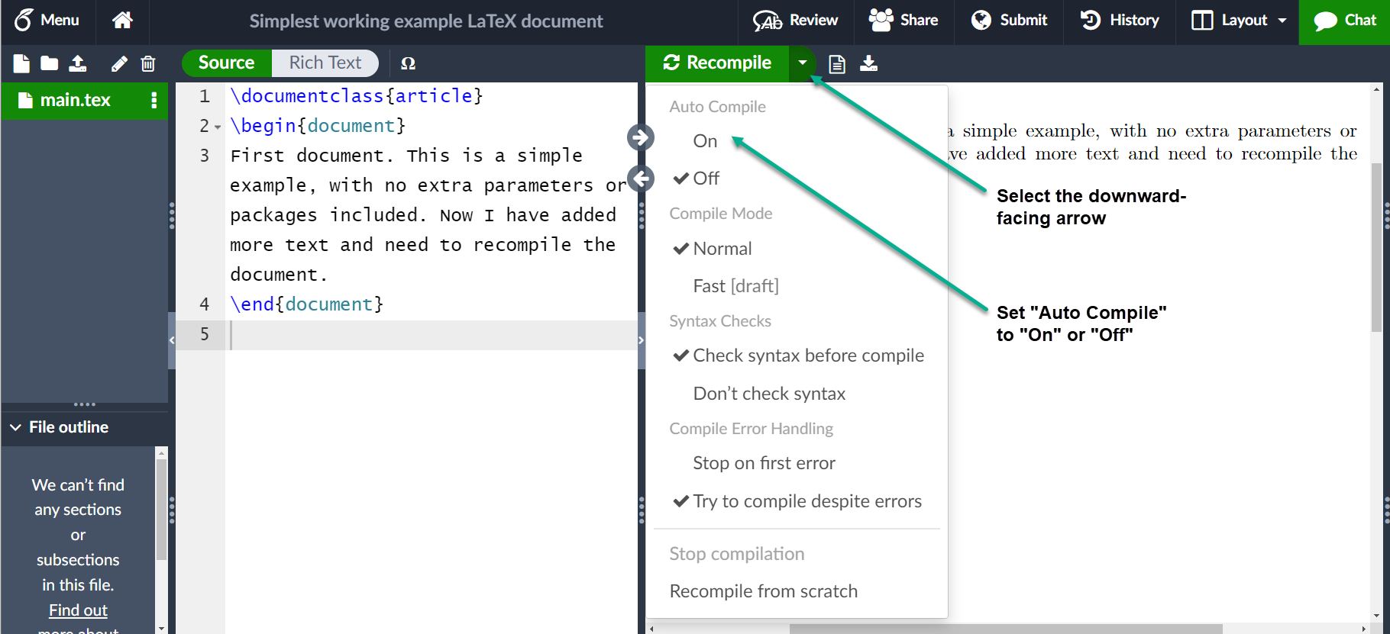
Writing your first piece of LATEX
www.midocean.ae

Slide 10
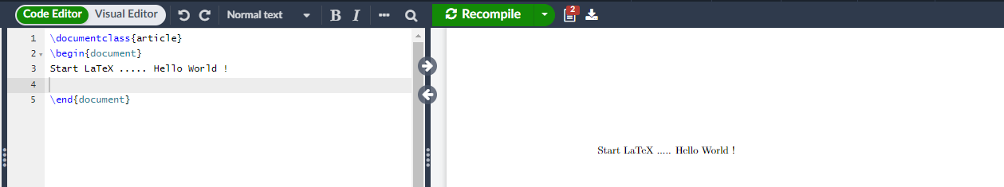
Writing your first piece of LATEX
  \documentclass{article}
  \begin{document}
  Start LaTeX ..... Hello World !
  Hello World !
  \end{document}
Output
www.midocean.ae

Slide 11
Examples of LaTeX Coding
Changing Your Margins
The default margins for a LaTeX article are rather large. You can alter them to whatever you want in the following way. Add the command:
\usepackage{geometry}
\geometry{left=1in,right=1in,top=1in,bottom=1in}
Create a document using A4-sized paper with a text area which shouldn't exceed 6 inches wide and 8 inches high.
\usepackage[a4paper, total={6in, 8in}]{geometry}
www.midocean.ae

Slide 12

Examples of LaTeX Coding (cont. )
  \documentclass{article}
  \usepackage{blindtext}
  \usepackage[a4paper, total={6in, 8in}]{geometry}
  \begin{document}
  \section{Introduction}
  This is a test document which uses A4-sized paper and the user-defined text area. \end{document}
Output
www.midocean.ae

Slide 13
Including title, author and date information
\documentclass[12pt, letterpaper]{article}
\title{My first LaTeX document}\author
{Dr.Mohammed Anbar
\thanks{Funded by the Overleaf team.}}
\date{November 2023}\begin{document}
\maketitle
We have now added a title, author and date to our first
\LaTeX{} document!
\end{document}
www.midocean.ae

Slide 14
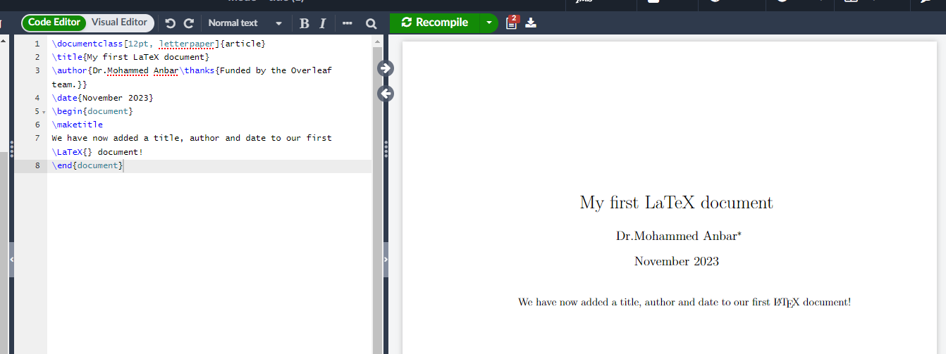
Output
www.midocean.ae

Slide 15
In the Body (section and subsection)
To begin a new section
\section{}
  Similarly, \subsection{}, \subsubsection{}, \subsubsubsection{}
  LaTeX does automatic numbering. If you don’t like it, use section*{}
www.midocean.ae

Slide 16
Bold, italics and underlining
Bold: bold text in LaTeX is typeset using :
\textbf{...} command.
Italics: italicised text is produced using :
\textit{...} command.
Underline: to underline text use :
\underline{...} command.
www.midocean.ae

Slide 17
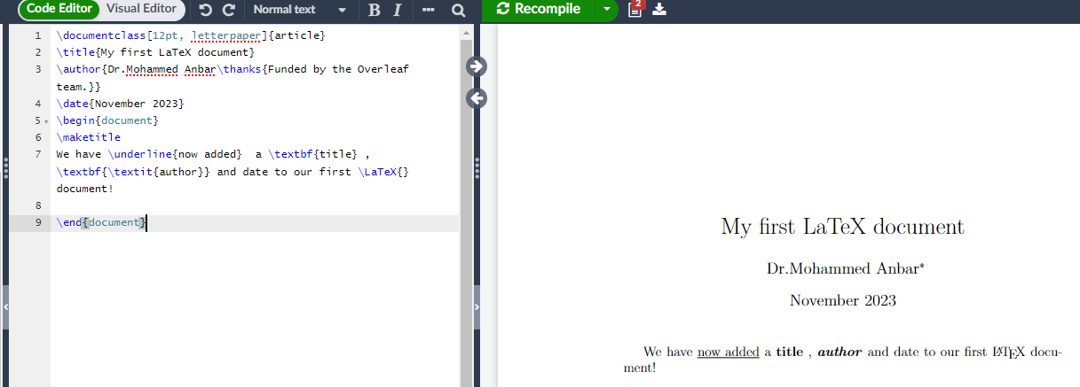
Bold, italics and underlining (cont.)
www.midocean.ae

Slide 18
Enumeration in LaTeX
\begin{enumerate}
\item One
\item Two
\item Three
\end{enumerate}
\begin{itemize}
\item One
\item Two
\item Three
\end{itemize}
\begin{enumerate}
\item One
\item Two
\item Three
\end{enumerate}
www.midocean.ae

Slide 19
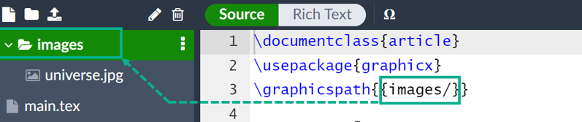
Images
Upload images to your Overleaf project.
Add the command:
\usepackage{graphicx} %LaTeX package to import graphics
\graphicspath{{images/}} %configuring the graphicx package
www.midocean.ae

Slide 20
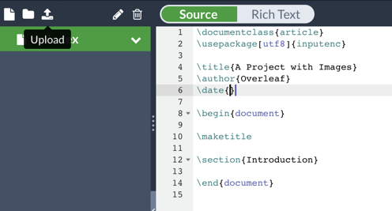
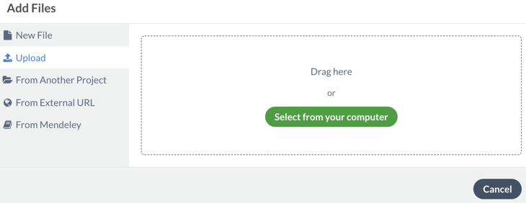
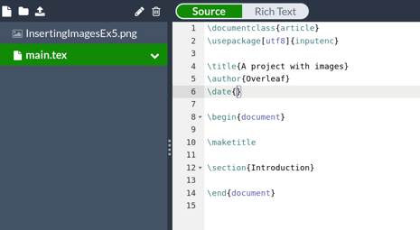
Upload images
www.midocean.ae

Slide 21
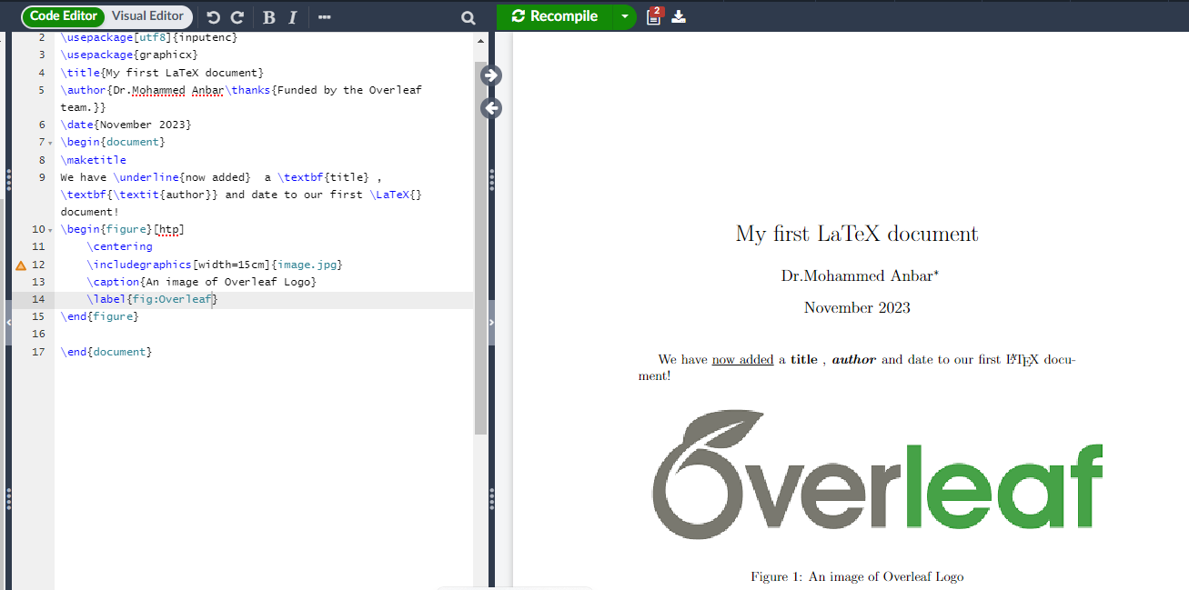
Use images within LATEX file
\begin{figure}[htp] \centering \includegraphics[width=15cm]{image.jpg} \caption{An image of Overleaf Logo} \label{fig:Overleaf}\end{figure}
www.midocean.ae

Slide 22
Creating a Table
Add numbered table
  \begin{table} \caption{}
Creating a table
Simple tables can be produced by
  \begin{tabular}[pos]{tablespec}
  Within the {tablespec} section, one details the number of columns, the alignment, and the number of vertical lines of the table.
    {lrc}, {|l|r|c}
  Then type in from left to right, the values for each cell with & in between.
  Put “\\” at the end of each row, then input another row of values if needed.
www.midocean.ae

Slide 23

Creating a 3*4 Table
\begin{table}[h]
\caption{Creating a simple table in \LaTeX{} }
\begin{tabular}{llll}
\hline
\hline
& Col1 & Col2 & Col3 \\
\hlineRow1 cell1 & Row1 cell2 & Row1 cell3 & Row1 cell4\\
Row2 cell1 & Row2 cell2 & Row2 cell3 & Row2 cell4\\
\hline
\end{tabular}
\end{table}
Output
www.midocean.ae

Slide 24
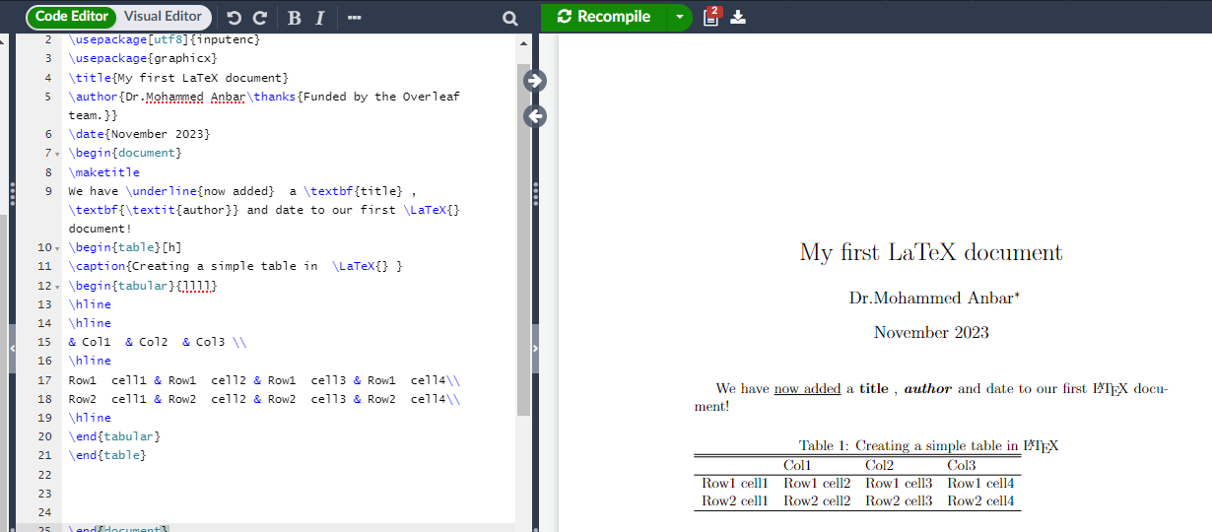
Creating a 3*4 Table
www.midocean.ae

Slide 25
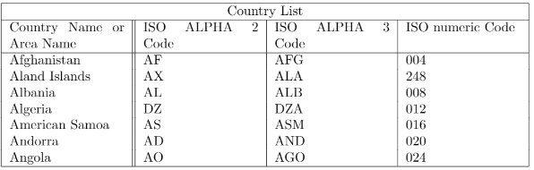
Combining rows and columns
\begin{tabular}{ |p{3cm}||p{3cm}|p{3cm}|p{3cm}| }
\hline
\multicolumn{4}{|c|}{Country List} \\
\hline
Country Name or Area Name& ISO ALPHA 2 Code &ISO ALPHA 3 Code&ISO numeric Code\\
\hline
Afghanistan & AF &AFG& 004\\
Aland Islands& AX & ALA &248\\
Albania &AL & ALB& 008\\
Algeria &DZ & DZA& 012\\
American Samoa& AS & ASM&016\\
Andorra& AD & AND &020\\
Angola& AO & AGO&024\\
\hline
\end{tabular}
Output
www.midocean.ae

Slide 26
Online Tools to Generate a latex table
Several online tools available that can help you generate a LaTeX table easily and efficiently.
  provide user-friendly interfaces where you can input your data and customize the table's appearance.
  offer features like automatic column alignment, merging cells, and adding borders to make your table look professional.
  allow you to export the generated LaTeX code directly, saving you time and effort in manually writing the code yourself.
Online a LaTeX table Generator such as:
  Tables Generator: https://www.tablesgenerator.com/
  LaTeX Tables Editor: https://www.latex-tables.com/
  LaTeX Table Editor and Generator: https://tableconvert.com/latex-generator
www.midocean.ae

Slide 27
Mathematics and Matrices in LaTeX
LaTeX is a powerful typesetting system that is widely used in academia for writing mathematical documents.
LaTeX provides a comprehensive set of tools and commands for creating complex mathematical equations and symbols, making it particularly suitable for typesetting mathematics and matrices.
LaTeX create matrices of any size, specify their elements, and format them according to your needs.
LaTeX offers an efficient and flexible solution to write a research paper, a thesis, or simply need to display mathematical equations in the document,
www.midocean.ae

Slide 28
Mathematics in LaTeX
Inline Math
$6+2= 8$
superscript: $x^{5}$
subscript : $x_{5} $
Geek letters :
$ \alpha $
$ \beta $
$ \gamma $
$ \de1ta $
www.midocean.ae

Slide 29
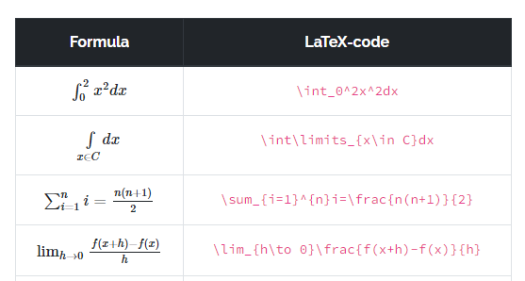
Mathematics in LaTeX (cont. )
Basic math functions
www.midocean.ae

Slide 30
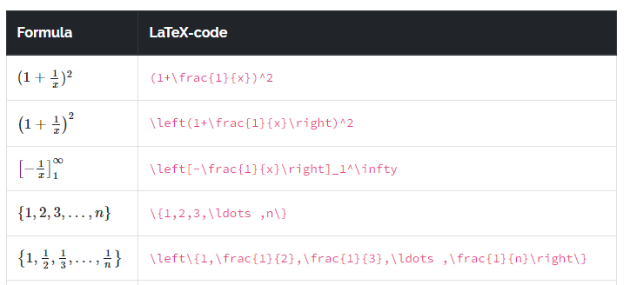
Mathematics in LaTeX (cont. )
Basic math functions
www.midocean.ae

Slide 31
Mathematics in LaTeX (cont. )
Equation on new line
\begin{equation}
3\cdot5=15
\end{equation}
\begin{equation}
x=\frac{2}{3}
\end{equation}
www.midocean.ae

Slide 32
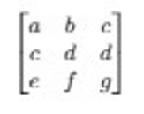
Matrices in LaTeX
A rectangular array of numbers, symbols, or phrases organized in rows and columns is called a matrix.
A math environment for typesetting matrices can be used to construct a matrix in LaTeX.
For generating matrix in LaTeX we have to use the package amsmath by giving the command \usepackage{amsmath}.
\begin{document}
$$
\begin{bmatrix}
a & b & c \\
c & d & d\\
e & f & g \\
\end{bmatrix}
\quad
$$
Output
www.midocean.ae

Slide 33
Matrices in LaTeX (cont. )
There can be various types of brackets to use in a matrix. Some of them are discussed below:
\begin{matrix}: This command creates a matrix without brackets or boundaries.
\begin{pmatrix}: This command creates a matrix with brackets or parenthesis.
\begin{bmatrix}: This command creates a matrix with square brackets or boundaries.
\begin{Bmatrix}: This command creates a matrix with curly brackets or boundaries.
\begin{vmatrix}: This command creates a matrix with a rectangular line boundary.
\begin{Vmatrix}: This command creates a matrix with double vertical bar brackets or boundaries.
www.midocean.ae

Slide 34
Online Tools to Generate Mathematics and Matrices
Online tools to generate mathematics and matrices are widely available and can be incredibly useful for both students and professionals.
  Allow users to quickly and easily generate complex mathematical equations, solve equations, perform matrix operations, and visualize data in matrix form.
  Provide a convenient way to save time and effort by automating calculations that would otherwise be time-consuming or prone to human error.
  Offer advanced features such as graphing functions, creating 3D plots, and generating random matrices.
Online a LaTeX Mathematics and Matrices Generator such as:
  Latex Matrix Generator: https://jasonwarta.github.io/latex-matrix/
  Equation Editor for online mathematics: https://editor.codecogs.com/
  LaTeX Matrix Generator : https://latex-matrix.netlify.app/
www.midocean.ae

Slide 35
Adding comments
To make a comment in LATEX, simply write a % symbol at the beginning of the line:
\documentclass[12pt, letterpaper]{article}
\title{My first LaTeX document}
\author{Hubert Farnsworth\thanks{Funded by the Overleaf team.}}
\date{August 2022}
\begin{document}
\maketitle
We have now added a title, author and date to our first \LaTeX{} document!
% This line here is a comment. It will not be typeset in the document.
\end{document}
www.midocean.ae

Slide 36

Citations and reference using Biblatex approach
Biblatex is a powerful tool for managing citations and references in academic writing, offering a flexible and customizable approach.
With its extensive range of citation styles and support for various bibliographic databases, biblatex simplifies the process of generating accurate and consistent citations.
Biblatex seamlessly integrates with LaTeX, facilitating precise document formatting and contributing to a polished and standardized presentation of citations and references in academic writing.
www.midocean.ae

Slide 37
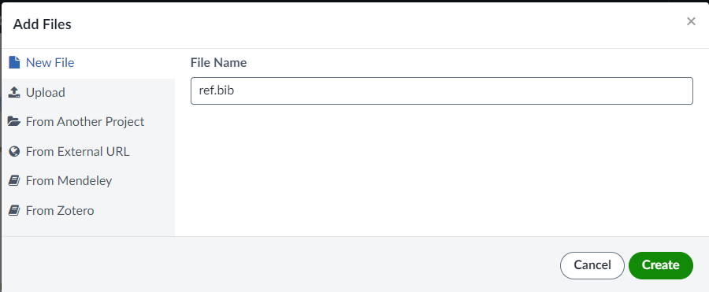
Citations and reference using Biblatex approach (cont.)
1. Create .bib file
2. Use natbib package
\usepackage[square]{natbib}
\bibliographystyle{ieeetr}
\bibliography{ref}
www.midocean.ae

Slide 38
Using journal LaTex template
Demo
www.midocean.ae

Slide 39
References
Leslie Lampert. 1994. LaTeX: A Document Preparation System.
Helmut Kopta and Patrick W. Daly. 2004.Guide to LaTex
Frank Mittelbach et al. 2004. The LaTeX Companion
Online Guides
  https://www.overleaf.com/
  http://en.wikibooks.org/wiki/LaTeX
  http://tobi.oetiker.ch/lshort/lshort.pdf
www.midocean.ae

Slide 40



Thank You

