Slide 1



DIGITAL MARKETING
APPLICATIONS
Prepared by Dr. HEBA ZIAD
COURSE CODE - MKT720
lecture 6

Slide 2
Relationship marketing using digital platforms
Chapter at a glance
Main topics
customer lifecycle management strategy
Permission Marketing
PERSONALIZATION AND MASS CUSTOMISATION
Customer Identity and Access Management
Voice of Customer Methodologies
Lecture 6
COURSE CODE - MKT720

Slide 3

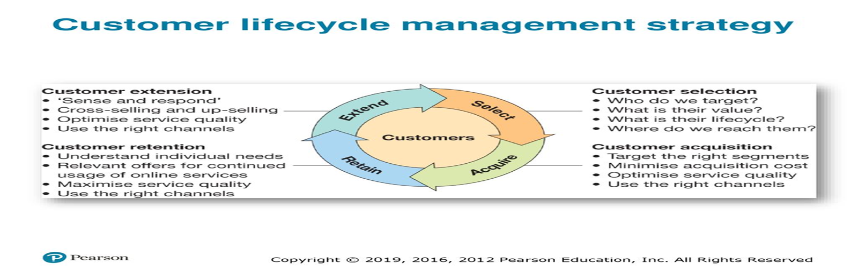
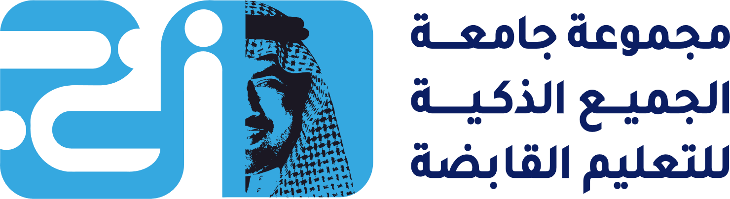
CUSTOMER LIFE CYCLE MANAGEMENT STRATEGY
classic methods of orchestrating communications based on the position of customers in the lifecycle and the use of sense and respond' communications to build customer loyalty at each stage of the customer lifecycle. These can be used by businesses of any size, whereas some of the more advanced Big Data and Artificial Intelligence approaches tend to be used by larger businesses currently .To plan these communications requires consideration of the business goals of engagement using a high-level view of the classic customer lifecycle of select, acquire, retain, extend as shown in Figure
Customer lifecycle The stages each customer will pass through in a long-term relationship through acquisition, retention and extension.

Slide 4
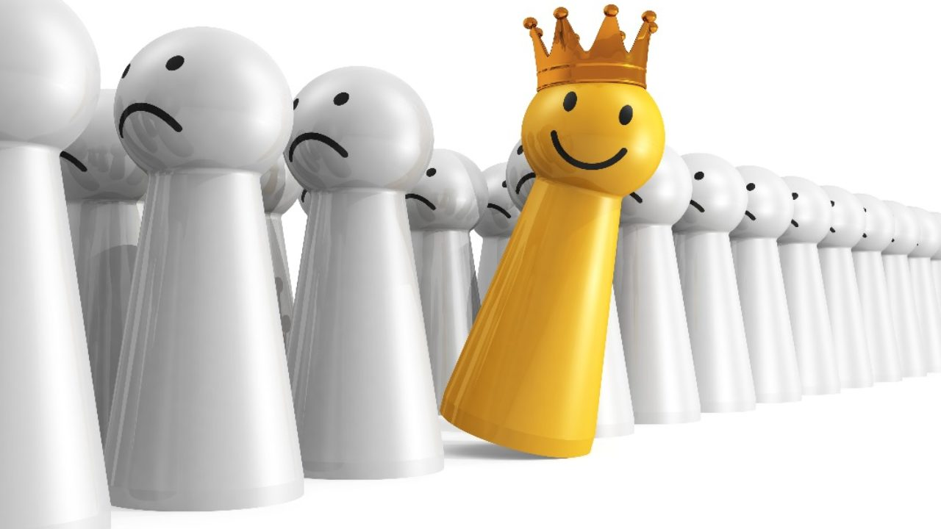
Customer selection means defining the types of customers that a company will market to. It means identifying different groups of customers for which to develop offerings and to target during acquisition, retention and extension. Different ways of segmenting customers by value and by their detailed lifecycle with the company are reviewed.
Customer acquisition refers to marketing activities to form relationships with new customers while minimizing acquisition costs and targeting high-value customers. Service quality and selecting the right channels for different customers are important at this stage and throughout the lifecycle.
For an online business, acquisition may involve a single-step conversion - for example, if a new visitor arrives on a site and purchases on the first visit. Typically, a longer, multi-step process is needed for conversion to sale where a visitor returns to the site. To facilitate conversion, customer lifecycle marketing should seek to form an initial relationship through asking for contact details for communication, such as email address, mobile number or a social media contact. This is the permission marketing approach,
Customer selection Identifying key customer segments and targeting them for relationship building.
Customer acquisition Strategies and techniques used to gain new customers.

Slide 5

3- Customer retention refers to the marketing activities taken by an organization to keep its existing customers, i.e. to encourage them to buy again or continue a contract char renews for a service. Identifying relevant offerings based on their individual needs and detailed position in the customer lifecycle (e.g. number and value of purchases) is key
4- Customer extension refers to increasing the depth or range of products that a customer purchases from a company. This is often referred to as 'customer development'.
Activation A prospect or customer takes the first step in actively using an online service after initial registration or purchase
Customer extension Techniques to encourage customers to increase their involvement with an organization
Interruption marketing :- Marketing communications that disrupt customers' activities,

Slide 6

There is a range of customer extension techniques that are particularly important to online retailers:
• Re-sell. Selling similar products to existing customers - particularly important in some BOB contexts as rebuys or modified rebuys.
• Cross-sell. Selling additional products that may be closely related to the original purchase, but not necessarily so.
• Up-sell. A subset of cross-selling, but in this case selling more expensive products.
• Reactivation. Customers who have not purchased for some time, or have lapsed, can be encouraged to purchase again.
• Referrals. Generating sales from recommendations from existing customers - for-example, member-get-member deals.
You can see that this framework distinguishes between customer retention and customer extension. Retention involves keeping the most valuable customers by selecting relevant customers for retention, understanding their loyalty factors that keep them buying and then developing strategies that encourage loyalty and cement the relationship. Customer extension is about developing customers to try a broader range of products to convert the most grow able customers into the most valuable customers.

Slide 7

stages to achieve goals which popularized as the 5Is:
• Identification. Learn the characteristics of customers in as much detail as possible to be able to conduct the dialogue.
• Individualization. Individualizing is using mass customization and personalization to define the company's approach to each customer, offering a benefit to the customer based on the identification of customer needs. The effort expended on each customer should be consistent with the value of that customer to the organization.
• Interaction. Continued dialogue to understand both the customer's needs and the customer's strategic value.
• Integration. Integration of the relationship and knowledge of the customer must extend throughout all parts of the company, harnessing data integrated from different systems.
• Integrity. Since all relationships are built on trust, it is essential not to lose the trust of the customer. Efforts to learn from the customer should not be seen as intrusive, and privacy should be maintained.

Slide 8
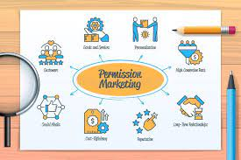
What is Permission Marketing?
If you are in marketing or doing any business and you provide the value to your customers with the help of your products or services.
So Similarly In Permission Marketing, Before you provide the value or before providing the proposition of your product, You ask the customer “Do you want our Product ?”
Or
You ask “Do you have a requirement of this Product”
So You take permission from your customers for advertising.
Permission marketing is anticipated, relevant and personal[and timely]
Permission Marketing
Permission Marketing is a marketing activity where you receive the privilege of permission to deliver anticipated, personalized or any relevant messages to the customers that means the real permission not just presumed permission.
Permission marketing Customers agree (opt-in) to be involved in an organization's marketing activities, usually as a result of an incentive.

Slide 9

Benefits of Permission Marketing
Some of the benefits and advantages of the permission marketing strategy are as follows;
Cost-Effective Strategy
Sending emails and messages is much cheaper than any other kind of marketing technique. All you have to do is to research and send precise and relevant information to the customers. If the information and relevant, then they won’t ignore your message. Hopefully, you’ll convert them into actual customers at a very low cost.
Higher Conversion Rate
The conversion rate is also higher in permission marketing than the traditional type of marketing. It’s because you follow the personalized approach with your target audience and develop a relationship with. When you provide the relevant information, then it makes the bond much stronger and increases the conversion rate.
Personalized
One of the most interesting features of permission marketing is the personalized approach. It means that you invoke the previous history, and start things where you have left them. It would make customers feel that you haven’t forgotten about them. Mentioning the previous records would make you connect with them immediately.
OPT-IN
A CUSTOMER PROACTIVELY AGREES TO RECEIVE FURTHER INFORMATION
OPT-OUT
A CUSTOMER DECLINE THE OFFER TO RECEIVE FURTHER INFORMATION

Slide 10
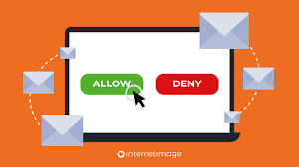
Long Term Customer Relations
When you provide relevant information, follow the personal approach, and make them feel comfortable and a valued person, then such a relationship usually lasts longer because they have a shared common history with each other.
Maintain Reputation
When you follow the personal approach and ask their permission, then it would make them feel under control. Then they won’t ignore your messages. When people don’t avoid your messages, it means that you have maintained a good reputation in the community.
Cons of Permission Marketing
1. Slow Results:- Yes it takes a lot of times to identify your real targeted audience and talk to them.
Interruption Marketing has been around for many years But Slowly and gradually permission marketing is taking over the scene.

Slide 11
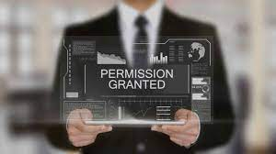
Levels of Permission in Permission Marketing
There are different levels of permission in the permission marketing strategy, and here it follows;
Intravenous Permission It's the first and highest level of permission
Intravenous permission means that you permit the doctor to insert medicine into your veins, whereas Intravenous means within the veins. It’s the first and highest level of permission, the doctor is getting permission for the injection or the operation is a very good example. It carries a huge risk, but the reward is higher.
Buying the subscription of Netflix or Hulu is a very good example of intravenous permission. Where you buy the monthly package, whether you watch it or not, the channel would charge would money for the whole month because it has the right.
Points Level Permission At this level, you can reward different points to the customers for being more attentive.
Point- level-permission is a type of game, where you reward customers with different points if they remain attentive. In the end, customers can cash out those points. If you remain more attentive, then you would earn more points, and more points mean more money.

Slide 12
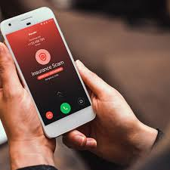
Personal Relationships
refer to close connections between people, formed by emotional bonds and interactions. These bonds often grow from and are strengthened by mutual experiences.
Personal relationship level is usually used in business relations, where you leverage the personal relation and ask something in return. It’s like word of mouth marketing.
When an American company sold 11 million dollars worth of computers to the government, then it usually requires a lot of documentation and quotas. But the company uses a personal relationship as leverage to close the deal.
Brand Trust
Brand trust is a bit lower level of permission, where you pay a heavy price to certain brands because you expect the company would provide you the high-quality product. Starbuck coffee and Campbell’s soup are a very good example of brand trust.
Situational Permission
Situational permission is the lowest level of permission where you ask for a certain thing depending on the situation. KFC Burgers and McDonald’s made millions of dollars by asking questions like ‘would you like finger fries?’
Spam (No Permission)
Spam is the level where you don’t have permission. Newbie usually starts from here.

Slide 13
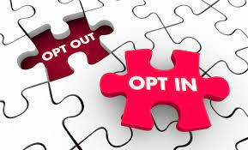
Permission Marketing Examples
Some of the examples of permission marketing are as follows;
Opt-in Emails
Opt-in-email is a very good example of permission marketing. It means that the customer has chosen to receive the promotion of certain products. The company only sends emails to those clients who have chosen the opt-in email.
RSS Feeds
An RSS feed is when a company sends a notification to all of its subscribers about the latest promotion.
Loyalty Cards
Loyalty cards are when companies encourage their customers to keep shopping for their products, and the brand provides gifts to their most loyal customers.
YouTube
YouTube is a product of Google and its where content creators share videos. When a channel uploads something new, then all the channel’s subscribers would receive the notification.
Facebook
Facebook is a social media platform where people share and post written, pictorial, and visual content. However, marketers would like to connect with those people who are influential and many people follow them. When they endorse your product, hundreds of people would try your product.

Slide 14
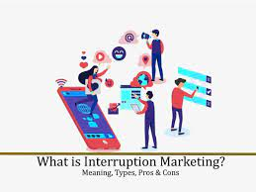
Interruption Marketing VS Permission Marketing
Companies spend a high amount of money on marketing so that they can grow their brands and increase sales.
Thus It is very necessary for them so that they can find a better mixture of marketing strategies or Techniques that are beneficial for them
These Techniques tend to fall into two camps
1. Interruption Marketing
2. Permission Marketing
Interruption Marketing
This is a marketing activity which disturbs the viewer’s attention or focus. The main goal of this interruption marketing is only to capture the focus or to capture the people’s attention to produce the interest of your product which you are advertising.

Slide 15

Media Used of Interruption Marketing (examples).
Telemarketing
Telemarketing falls under the category of direct/traditional interruption marketing, where the marketers randomly call all the people and ask them whether they would be interested in buying the company’s product/service or not.B. Yellow Pages Ads.
Cold Calling
Cold calling falls under the umbrella of telemarketing, where you make telephonic calls to all the people randomly to market your company’s product/service. Those cold callers usually follow the pre-decided script of the marketing department, so that they shouldn’t miss anything.
E-mail Spam
Spam email is the type when you don’t have the permission to send emails to the receiver, such an email goes to the spam and it’s also the type of interruption marketing.
Pre-roll Ads
Pre-roll advertisements are the type that you see on YouTube and it starts playing automatically and watcher has the option to skip it after 5 seconds.
Popup Ads
Whiling browsing some websites, advertisements start popping up in the form of new windows. Some popup ads start playing automatically the company’s message and others ask for certain actions from the customer.

Slide 16
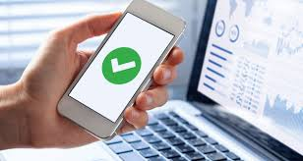
Media Used of Interruption Marketing
Types of Interruption Marketing
Interruption Marketing Pros
Some of the advantages and benefits of interrupt marketing are as follows;
Quick Results
One of the most important advantages of interruption marketing is that it gives you fast and quick results. But the business has to pay a lot of money on the channels to play their ads.
Reach to the Masses
This type of marketing strategy only works when the media is widely spread. People find interruption ads disturbing, but they’ll watch it uninterestingly and wait for their show to become online again. The target audience is general and you don’t have the luxury to target the specific demographic in the population.
High-Profit Margin
The point of spending so much capital on the TV ads is because you’ll have the opportunity to reach a mass audience and target new customers every time the ad plays. More audience and new people mean that the company would be able to earn more profit from interruption marketing if the ad works.

Slide 17
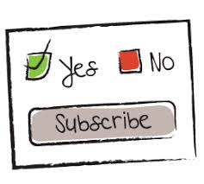
Interrupt Marketing Cons
Some of the disadvantages and drawbacks of the interruption marketing are as follows;
Lack of Target Audience
Promotional ads are general that you don’t have the opportunity to personalize the advertisements and target the specific audience.
Time-Bound Advertisement
The interruption advertisements run on different media channels as long as the company keeps paying and sponsoring. Once the brand stops sponsoring the advertisements, they won’t be played. The life of interruption marketing ads is limited.
Rejection from Potential Customers
If people have a bad experience with certain products, then they would be annoyed with the interrupting advertisements because they don’t like it.
Low ROI
When certain advertisement annoys the audience and they’ll change the channel. It means that the advertisement of the company isn’t working. Therefore, their return on investment would be lower because people aren’t watching the advertisement, and possibly they won’t buy the company’s product.

Slide 18

The Future of Interruption Marketing
Whether it’s electronic billboards, YouTube ads, or ads on the TV, our lives are almost overrun by the interruption advertisement. The marketers are getting very smart and they’re making the interrupting ads so interesting and smooth that the watcher won’t even be disturbed by it.

Slide 19
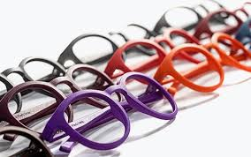
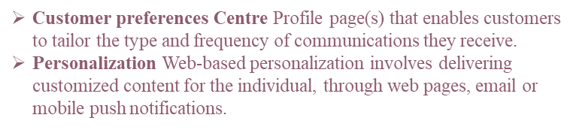
PERSONALIZATION AND MASS CUSTOMISATION
Increasingly, companies gather much personal data through the application of digital technology and then use it to develop personalized communication messages,
with the aim of making the content appear more aligned to an individual's interests. The different targeting variables shown in Figure can be used to deliver more relevant, contextual personalized email or web messages. However, not all individuals respond favorably; indeed some react negatively towards brands that adopt this approach due to fears over security of personal data and the feeling they are being manipulated). This leaves online marketers with a dilemma: should they strengthen privacy controls but in doing so reduce the opportunity to personalize their advertising messages and thereby reduce the potency of personalized communications?
the question of How strengthening privacy controls affects advertising performance' using Facebook advertising campaigns.
when individuals were given more control over privacy settings they were more likely to respond positively to personalized communications. So, to derive maximum benefits from the use of personal information, advertisers should consider giving individuals more control over how their information is used - for example, through tailoring content they receive via email through a customer preferences centre.

Slide 20
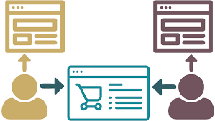
Recommendations based on profile information, behavior or predictive analytics are usually known as personalization or sometimes mass customization. A well-known example of personalization is when Amazon recommends similar products according to what others in a segment have offered, or if it sent a similar email to customers who had an interest in a particular topic.
Collaborative filtering is a method of implementing personalization where site visitors are recommended content or offers by comparing them with customers in its database. The more information a database contains about an individual customer, the more useful its recommendations can be. The best-known example of this technology in action can be
Mass customization The creation of tailored marketing messages or products for individual customers or groups of customers typically using technology to retain the economies of scale and the capacity of mass marketing or production.
Collaborative filtering Recommended content or promotions are automatically created based on reviewing similarities in how customers behave.

Slide 21
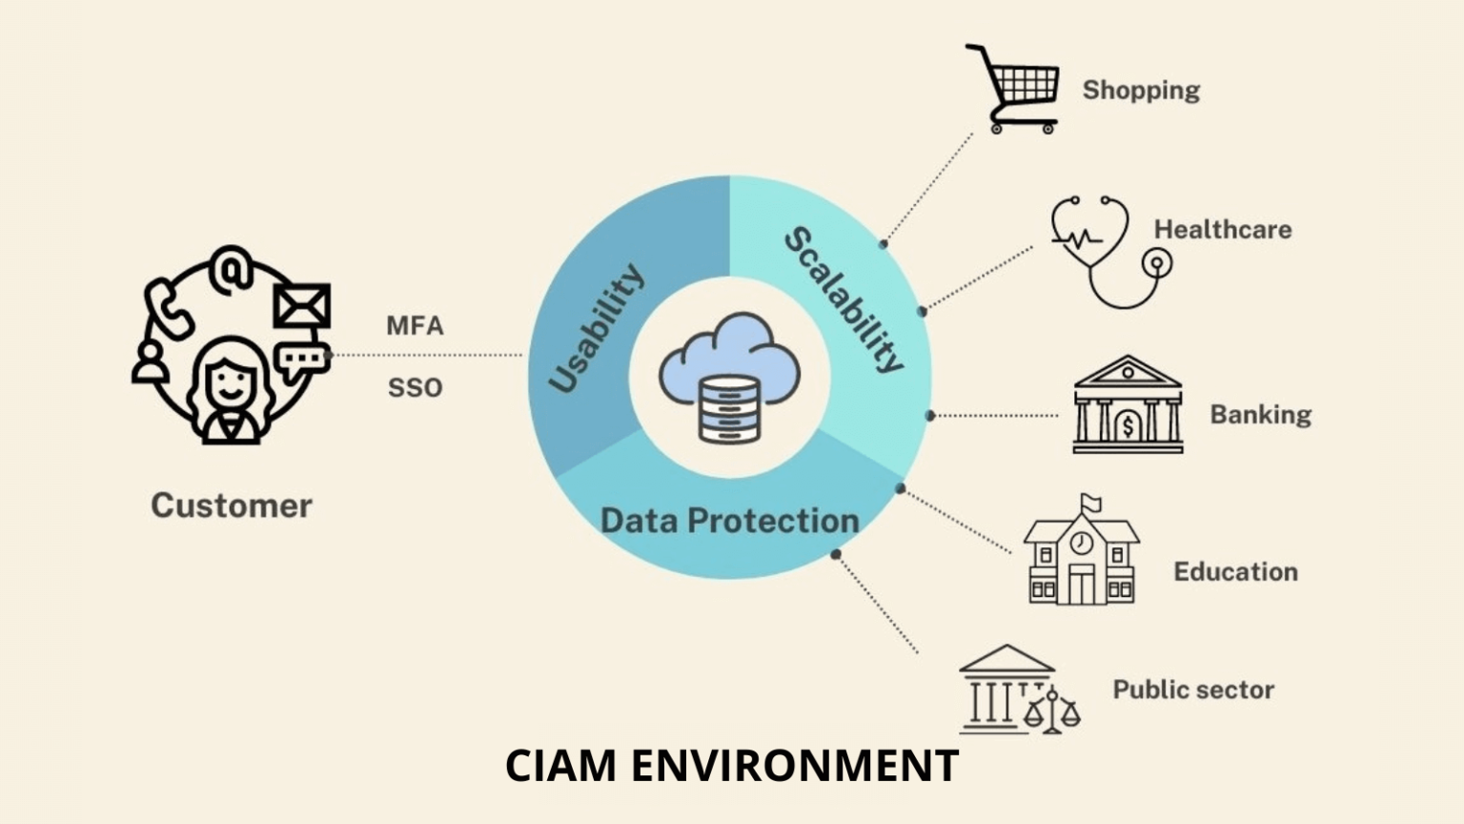
What is Customer Identity and Access Management (CIAM)?
CIAM (Customer identity and access management) is part of the identity and access management (IAM) system integrated into applications for external users such as customers/consumers. The primary goal of CIAM is to manage and control end users’ access to digital services. However, it also includes collecting, analyzing, managing, and storing customer data. And when it comes to all these processes, security is the top priority. In this context, CIAM is designed with a high perspective.
CIAM must provide a secure, simple, and seamless path for external use cases while protecting sensitive data against malicious intrusions and preventing data breaches. Realizing those attributes requires identity management, privacy and access management, and fraud detection and prevention capabilities.

Slide 22

What Should be Considered When Establishing a Robust CIAM System?
Scalability
To respond to fluctuating customer demands for several reasons and exponentially increasing data from a single customer, the CIAM system must be scalable. So, the system can handle many users, roles, and connections.
Scalability, Security & Privacy, Usability, Extensibility, and APIs & Integration are the five pillars of CIAM.

Slide 23
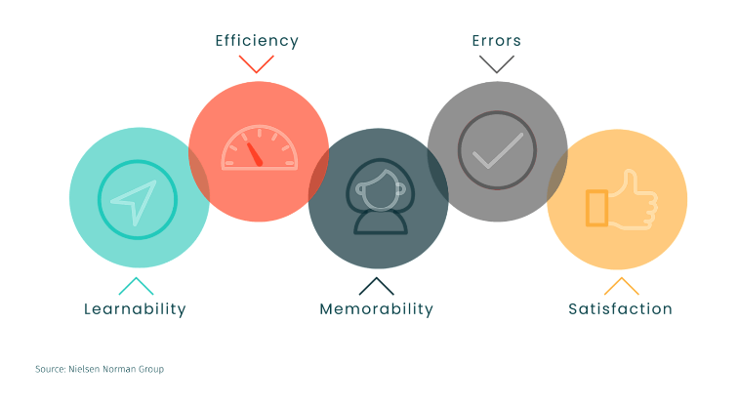
2. Usability
External users of the CIAM system do not receive formal employee training and have no motivation to follow instructions. They prefer not to read manuals or go through learning to use a system if everything is easy to use . As a result, a CIAM system should be designed to be highly user-friendly.
The following CIAM applications will make it easier to use:
Self-Service Account Management: Self-service account management empowers users by giving them control and visibility over their data and how it is used. Customers can thus efficiently perform various tasks such as profile data and preference management, password reset, and help requests.
Personalization: CIAM provides customers consistent access to their data across all channels by providing a central profile synchronizing across all digital channels.
Single Sign On (SSO): This feature allows users to automatically sign in to several other apps when they sign in to one. The most common type of SSO is social login, enabling users to log in using credentials from a third-party provider such as Facebook, Google, or Apple.

Slide 24

What Should be Considered When Establishing a Robust CIAM System?
1. Scalability
To respond to fluctuating customer demands for several reasons and exponentially increasing data from a single customer, the CIAM system must be scalable. So, the system can handle many users, roles, and connections.
2. Usability
External users of the CIAM system do not receive formal employee training and have no motivation to follow instructions. They prefer not to read manuals or go through learning to use a system if everything is easy to use. As a result, a CIAM system should be designed to be highly user-friendly. The following CIAM applications will make it easier to use:
Self-Service Account Management: Self-service account management empowers users by giving them control and visibility over their data and how it is used. Customers can thus efficiently perform various tasks such as profile data and preference management, password reset, and help requests.
Personalization: CIAM provides customers consistent access to their data across all channels by providing a central profile synchronizing across all digital channels.
Single Sign On (SSO): This feature allows users to automatically sign in to several other apps when they sign in to one. The most common type of SSO is social login, enabling users to log in using credentials from a third-party provider such as Facebook, Google, or Apple.
3. Data Protection
CIAM solutions collect personally identifiable information due to the nature of CIAM, which involves the user logging in, managing his profile, and accessing services. The amount of data processed at CIAM has expanded as customers increasingly share information with organizations and partners. Security issues with these data types can result in financial losses and loss of the organization’s reputation and trust. As a result, CIAM must offer security solutions that protect both organizations and customers.
Passwords, usernames, phone numbers, credit card numbers, and other pieces of personal information are frequently compromised through data breaches by threat actors. Data leaks can sometimes occur by insiders or because of an error.
CIAM systems track who has access to customer data and notify administrators of any suspicious activity. This tracking ensures that neither an employee nor a bad actor accesses sensitive data.
CIAM also protects customers’ data while it is in storage or transit by encrypting it. Even if the information is captured, it will be useless.

Slide 25


What Should be Considered When Establishing a Robust CIAM System?
1. Scalability
To respond to fluctuating customer demands for several reasons and exponentially increasing data from a single customer, the CIAM system must be scalable. So, the system can handle many users, roles, and connections.
2. Usability
External users of the CIAM system do not receive formal employee training and have no motivation to follow instructions. They prefer not to read manuals or go through learning to use a system if everything is easy to use. As a result, a CIAM system should be designed to be highly user-friendly. The following CIAM applications will make it easier to use:
Self-Service Account Management: Self-service account management empowers users by giving them control and visibility over their data and how it is used. Customers can thus efficiently perform various tasks such as profile data and preference management, password reset, and help requests.
Personalization: CIAM provides customers consistent access to their data across all channels by providing a central profile synchronizing across all digital channels.
Single Sign On (SSO): This feature allows users to automatically sign in to several other apps when they sign in to one. The most common type of SSO is social login, enabling users to log in using credentials from a third-party provider such as Facebook, Google, or Apple.
3. Data Protection
Fraud is another security issue that customers may face. Multi-factor authentication (MFA) is helpful against fraud attempts. MFA requires a different form of authentication besides username and password. This verification can be in the form of a one-time PIN, an email, or a biometric credential like facial recognition or fingerprint sent to the user instantly.
CIAM is a system that allows customers to access digital assets, establish and keep customer data, authenticate legitimate users, and deny access to threat actors. The goal is to make digital application access more straightforward and more secure.
CIAM solutions are distinguished from traditional IAM solutions, designed for accessing internal IT systems, by focusing on authentication and authorization processes of the public face of corporate applications and services.
Fraud detection software is designed to monitor, investigate and block fraudulent activity on your website. It's frequently used to prevent fraudulent transactions made with stolen cards or identities.

Slide 26
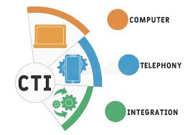
Strong Together: CIAM & CTI
Because of the digital transformation in many areas, identity now includes a diverse range of data such as financial, medical, educational, purchases, preferences and behavioral patterns, and more. Managing and securing identity requires managing and securing all of this data. Additionally, access-related breaches are one of the most well-known security breaches. Cyber Threat Intelligence (CTI) is an option to establish identity and access security in this framework.
CTI allows security professionals to take proactive measures about possible threats. When the CIAM solution is associated with CTI, it can detect suspicious activity discovered by CTI analysis and prevent the threat from escalating into an incident. In a system where CTI and CIAM inform each other, based on intelligence from CTI, customized authentication processes can be performed for specific users, activities, or risk levels. In this context, using the CTI product to support the CIAM system creates a more robust security posture.
Customer identity and access management (CIAM) is a type of identity technology that allows organizations to manage customer identities, providing security and an enhanced experience. The primary purpose of CIAM is to help organizations deliver a great experience to customers and to protect their user data.
Customer identity and access management(CIAM)A category of application for managing user access and consent to online information and services typically known as social log-in or sign-on.

Slide 27

Customer identity management
Permission-based marketing and the automation of marketing information can create issues in respect of consumer privacy law (Careful management is required to ensure protection of customer data and this should lead to better quality targeting. The concept of customer identity and access management (CIAM) is one element of this requirement.
The benefits of CIAM services, which are available from CRM-independent CIAM providers.
•Streamline new customer acquisition and registration processes through social log-in. Allowing customers to use bring-your-own-identity (BYOI) from a recognized social identity provider such as Facebook, Google, LinkedIn or PayPal, and pre register on a site is a large component of many CIAM implementations.
• Manage user consent to meet compliance with global privacy requirements. Multinational brands with millions of customers must address demands globally where different regions and countries have different privacy requirements.
•Provide user-centric capabilities for preference management. Updating communications preferences or opting-out in a preference Centre.
• Integrate with other systems and report on performance. CIAMs can integrate with CRM systems, but do not replace their messaging functionality.

Slide 28

Using digital media to increase customer loyalty and value
The ultimate commercial aim of relationship marketing approaches such as CRM is to increase engagement with customers, leading to increased customer loyalty and so directing sales from these customers and indirect sales through advocacy. Understanding the different levers that contribute to increased engagement and loyalty among different customer groups should be the starting point in developing a customer retention and growth strategy.

Slide 29
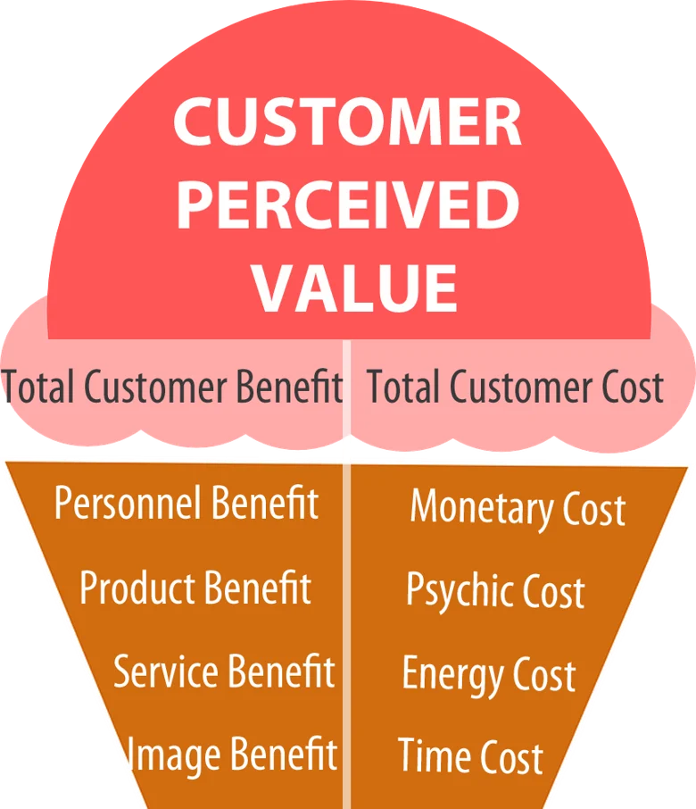
What is customer value?
Customer value is best defined as how much a product or service is worth to a customer. It’s a measure of all the costs and benefits associated with a product or service. Examples include price, quality, and what the product or service can do for that particular person. There are also monetary, time, energy, and emotional costs that consumers consider when evaluating the value of a purchase.
How is customer value created?
Customer value isn’t only about money. It’s typically created through the solution that a product or service provides, not only to the buyer but to their organization as well. Keep in mind that customer value is subjective. Price is universal—it will cost every customer the same amount to purchase your product or service. But the value will be different for every buyer because it involves so many variables, including customer experience.
Why is customer value important?
Delivering customer value is key to maintaining long-term relationships with existing customers and earning repeat business. It’s an important part of meeting customers’ needs and expectations and learning how they change over time. Knowing how customers feel about your product and the service experience you offer is key to building customer loyalty and increasing customer lifetime value.
Customer value formula
Use the formula below to measure customer value.
Total Customer Benefits — Total Customer Costs = Customer Value
Customer value measures a product or service's worth and compares it to its possible alternatives. This determines whether the customer feels like they received enough value for the price they paid for the product/service.

Slide 30
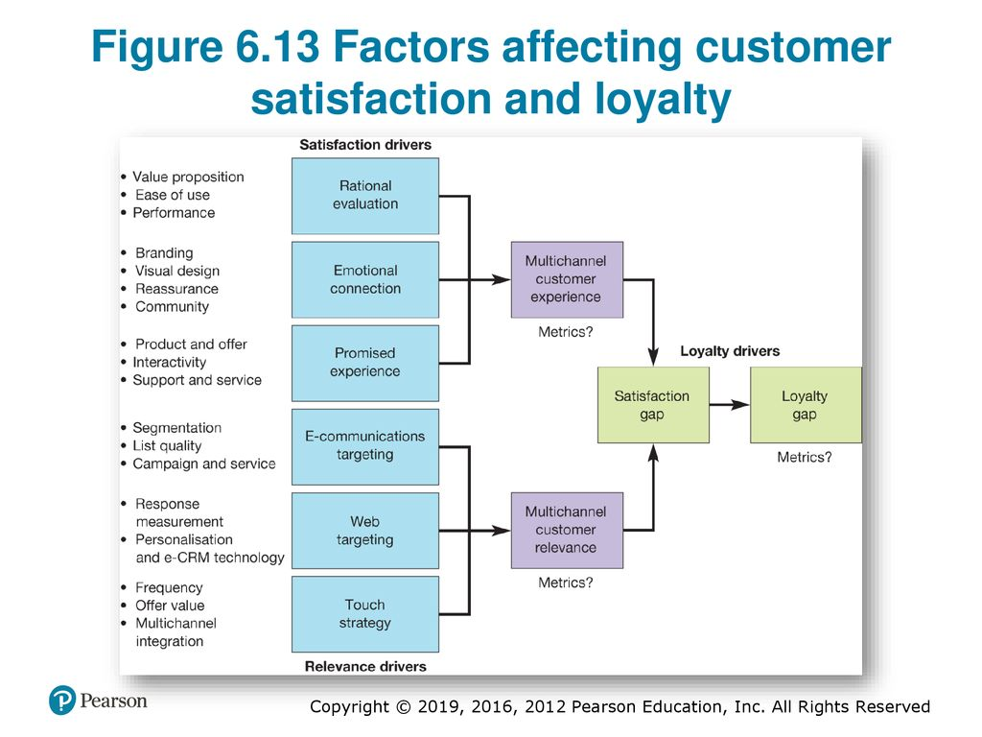

Slide 31
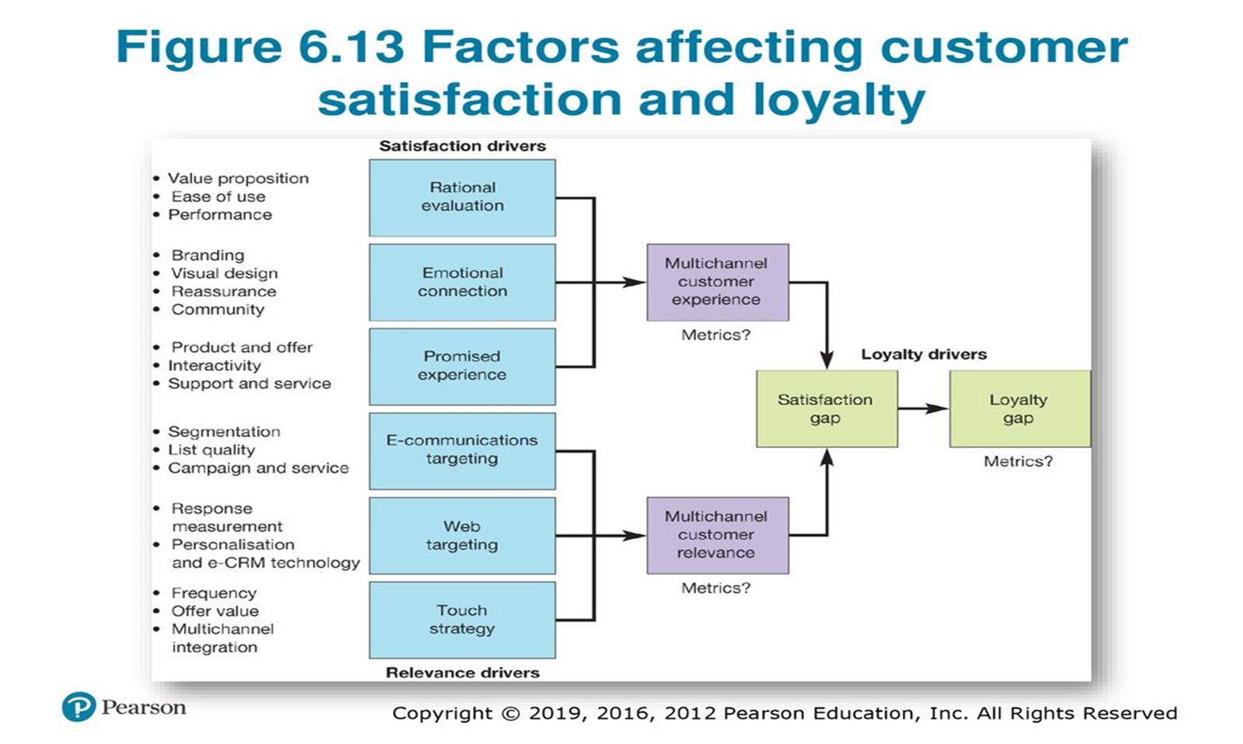
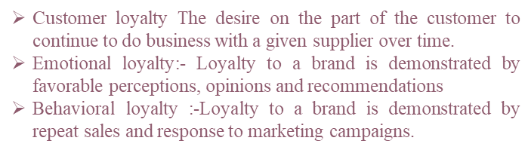
DETERMINING WHAT CUSTOMER VALUE
Consider the different forms of online interaction a consumer can have with a brand that can determine their perceptions of satisfaction and influence loyalty. Figure shows how, when using digital media for online retention marketing, our ultimate goal on the right of the diagram is customer loyalty. The factors on the left help to deliver two main drivers of loyalty. First, emotional loyalty, where loyalty to a brand is demonstrated by favorable perceptions, opinions and recommendations, including social sharing.
The success factors at the top of the diagram are all related to the customer experience of online services. These tend to influence emotional loyalty the most, and these are important in determining customer satisfaction.
The second type of loyalty is behavioral loyalty, where loyalty relates to repeat sales, repeated site visits, social interactions and response to marketing campaigns. To achieve these repeat sales, companies work hard to deliver relevant marketing communications, either through email and social media communications, web-based personalization or through traditional media.
Figure shows typical loyalty drivers to review, but customer research is essential to understand how specific factors affect loyalty and how satisfaction influences loyalty.

Slide 32

THE RELATIONSHIP BETWEEN SATISFACTION AND LOYALTY
The terms 'satisfaction' and *loyalty' are sometimes used interchangeably, we have been that they do not necessarily correspond. Customer satisfaction refers to how happy a customer is about the quality of products and services. As a customer's satisfaction with products and/or services increases, so should their behavioral and emotional loyalty, together with advocacy
however, there may be customers with a high degree of satisfaction who don't exhibit behavioral loyalty and, conversely, customers who are loyal according o their behavior that may be at risk of defection since they are not satisfied. The implications are that it is important not only to measure satisfaction with online services, but loyalty also. In this way, we are able to identify customers at risk of defection who are likely TO choose an alternative and those in the zone of indifference. This is an important category of customer who, although they may have a high degree of satisfaction, is not necessarily loyal
Consumer identity is the consumption pattern through which a consumer describes themselves.
Online sentiment is the emotion people experience when engaging with your brand, product or service

Slide 33
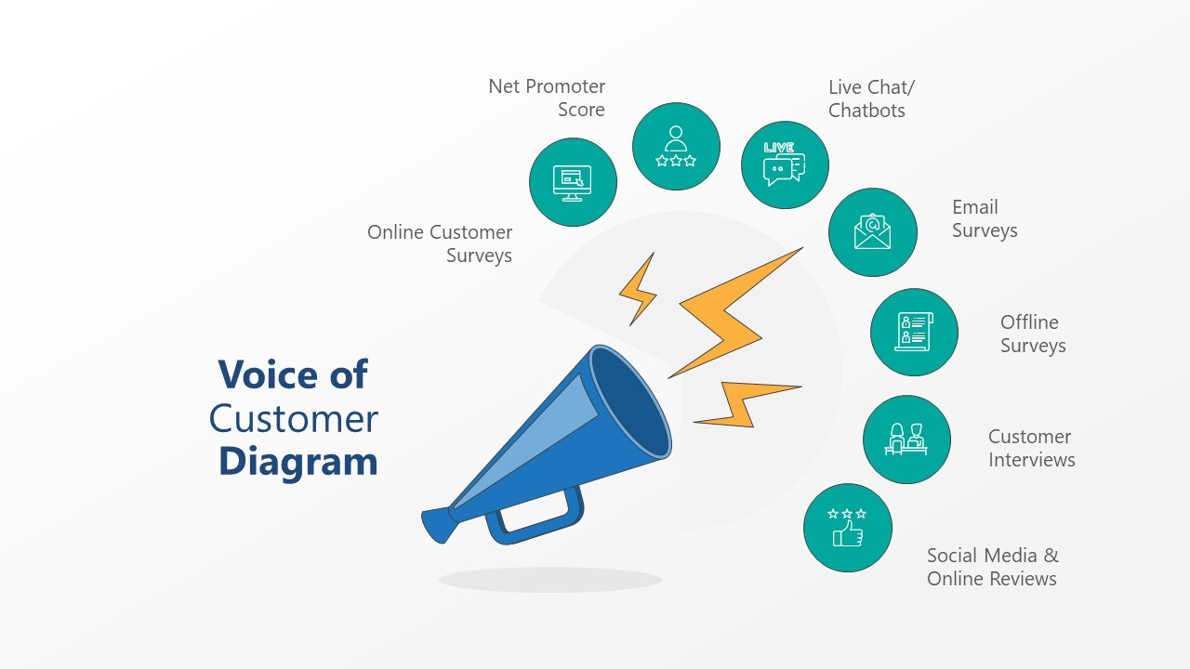
Voice of customer program helps a business to closely monitor the pulse of customers to understand their views and perspectives clearer. This aids to bridge the gap between what a brand provides and what customers expect from them. When customers are happy, they turn into loyal brand advocates. This paves the way for steady revenue, more customers, brand image enhancement to name a few. Voice of customer programs are now adopted by companies across any sphere and has become the go-to tool to uncover and react to customer concerns, choice, and grievances. Thus having a voice of customer tool helps to set up and effectively implement a voice of customer program in place to improve customer satisfaction and engagement. Voice of customer or VoC, aims to improve the overall experience journey a consumer has with the brand.
Online voice of customer (VoC) measures are useful for reviewing customer sentiment online. The satisfaction ratings we have reviewed are one example of VoC measures
the reasons for why a customer is visiting a site are compared against their success in completing tasks and their satisfaction ratings. This is a key technique for improving online now customer journeys.

Slide 34
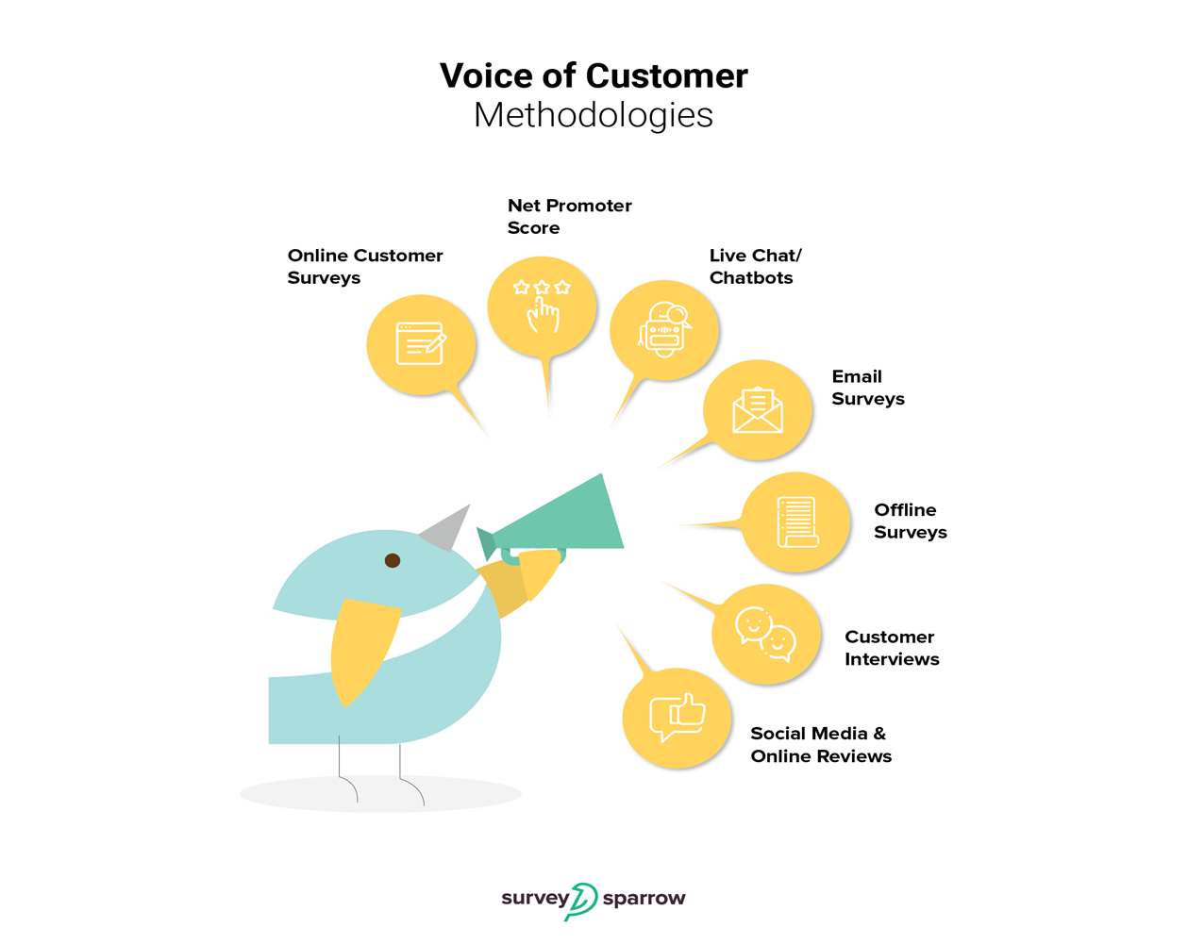
Voice of Customer Methodologies
The Internet has made lives simpler and task execution efficient. Listening to the voice of customers is not a Herculean task, thanks to the plethora of ways in which a business can reach out to a customer. Let's have a quick look at the most popular VoC methodologies in vogue.
Online Customer Surveys
When you want answers to your questions, what better way to go about it than online surveys! An online survey software helps you quickly draft up surveys that help you get crucial data from customers and gather valuable conclusions from it. This will help you to discover facets that require immediate attention. A voice of customer tool that allows to build & send engaging surveys must be your top pick any day!

Slide 35
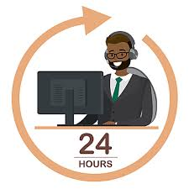
Voice of Customer Methodologies
Net Promoter Score (NPS) is a key VoC measure of advocacy the 'Ultimate Question' is essentially 'would you recommend us?. The aim is to work out techniques to maximize this NPS. the main process for NPS as follows:
1 Systematically categorize customers into promoters, passives or detractors. If you prefer, you can call them loyal advocates, fair-weather friends and adversaries.
2 Create closed-loop processes so that the right employees will directly investigate the root causes that drive customers into these categories.
3 Make the creation of more promoters and fewer detractors a top priority so employees up and down the organization take actions based on their findings from these root-cause investigations.
In practice, consumers are asked Would you recommend brand/company X] to a friend or colleague?', answered on a scale between 0 (not at all likely) and 10 (extremely likely).
Net Promoter Score®
Net Promoter Score has changed the very face of customer experience and engagement. This simple, yet powerful metric helps to evaluate customer loyalty and brand affinity with just a question or two. Setting and implementing NPS system for your business gives you tremendous advantage any day. All that you must to do is, whip up a quick and crisp NPS survey with your voice of customer tool and rest assured- you can collect invaluable data from it.
Net Promoter Score(NPS)A measure of the number of advocates a company (or website) has who would recommend it compared to the number of detractors.

Slide 36

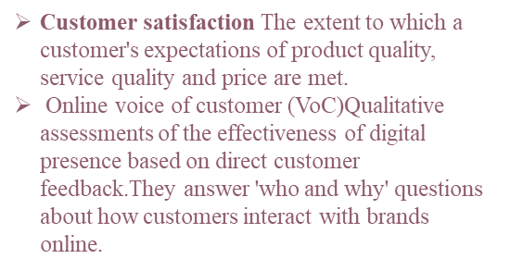
Voice of Customer Methodologies
Social Media
Social Media is a powerful time in this tech age. A single tweet or post is all that it takes to make a brand an instant hit or send it tumbling down. Most of the consumers take to social media to be vocal about their opinions. Thus one can safely say social media is a goldmine of the voice of customer data where you can quickly understand customer trends, resolve their queries and address their opinions.
Online Reviews
Online reviews are instrumental in shaping the image of a business There is a whole bunch of things you can learn from online reviews. Customers are very candid and brutally honest while they post feedback reviews online. There’s a huge repository of the voice of customer data that you can mine from online reviews.
Live Chat/ Chat bots
Interacting with customers has taken a novel and smart approach with the entry of live chat and chat bots. A chat bot for website gently pops up when a user visitor enters a site and collects quick feedback from them. Thus having website live chat helps you to obtain customer feedback, resolve complaints, and address queries.

Slide 37

Emails
Emails are powerful medium to engage with your customers. Be it collecting feedback or following-up to improve the engagement, and email surveys are one of the proven methods to listen to the voice of customers.
Offline Surveys
It’s not necessary to go online always. When you are collecting reviews from customers in-person, keeping your customers waiting while the internet takes its own sweet time is a big no-no. Thus, having offline surveys to do the job for you is the best option in such cases. In this manner, you needn’t worry about faltering internet connection; the offline survey app collects data and backs it up whenever a connection is established.
Customer Interviews
In-person interviews help you collect detailed voice of customer data even though it’s a time-consuming process. Direct interaction with customers helps companies get an in-depth understanding of what needs to be improved and what’s already faring well.

Slide 38

Voice of Customer Tools: Why You Need One
Meet Customer Expectation
A voice of customer tool helps you to collect valuable feedback from your customers. This helps to gain light on what’s amiss from your side that the customers wish to be rectified. Knowing and acting according to the expectation of your customers easily help to place your product at the top.
Improve Customer Experience
Customers take the experience they had with a brand very seriously. They are fiercely honest when it comes to giving a review online about a product they encountered and used. A small string of negative reviews is enough to kick out your brand from the competition. Thus closely monitor their experience and feedback and take the efforts to go that extra mile to ensure they are happy and satisfied. A voice of customer tool helps to tap out crucial data so as to help a business improve and provide the best experience at every touch-point.
Reduce Customer Churn
When you know how to handle customers, what they expect from you, how to improve the interaction at every touch-point, it is effortless to win their hearts. When a customer is happy, they remain loyal to remain. Soon enough, this translates into bigger and better numbers- regarding revenue and new customers and low numbers for customer churn.
Make Your Brand Stand-out
When you have the clear-cut idea about what your customers want, their changing interests it is easy to draw-up trends and patterns that’ll help you to bring about product enhancements and tweaks to tailor-fit their ideas. A voice of customer tool can thus be your wingman in making your brand a class apart from all the competitors.

Slide 39

DIFFERENTIATING CUSTOMERS BY VALUE AND ENGAGEMENT
A core approach to relationship marketing is to focus our limited resources and marketing activities on the most valuable customers. Within the online customer base of an organization, there will be customers who have different levels of activity or engagement with online services and purchasing.
key part of CRM strategy is to define measures that indicate activity levels and then develop tactics to increase activity levels through more frequent use.

Slide 40

You can see that corresponding strategies can be developed for each of these objectives.
Objectives and corresponding tactics can be set for:
• Increasing the number of new users per month and annually through promoting online services to drive visitors to the website.
• Increasing the percentage of active users Using direct communications, such as email, personalized website messages, direct mail and phone communications, to new, dormant and inactive users increases the percentage of active users.
• Decreasing the percentage of dormant users (once new or active - could be sub-categories) who have not used the service or responded to communications within a defined time period, such as three months.
• Decreasing the percentage of inactive users (or non-activated) users. These are those who signed up for a service but have not used the service.

Slide 41

Another key metric, in fact the key retention metric for e-commerce sites, refers to repeat business. The importance of retention rate metrics
The main retention metrics they mention that influence profitability are:
• Repeat-customer base: the proportion of the customer base that has made repeat purchases
• Number of transactions per repeat customer: this indicates the stage of development of the customer in the relationship (another similar measure is number of product categories purchased).
• Revenue per transaction of repeat customer: this is a proxy for lifetime value since it gives average order value.

Slide 42

SUMMERY
CHAPTER AT A GLANCE
CUSTOMER LIFE CYCLE MANAGEMENT STRATEGY
INTERRUPTION MARKETING VS PERMISSION MARKETING
PERSONALIZATION AND MASS CUSTOMISATION
CUSTOMER IDENTITY AND ACCESS MANAGEMENT
CUSTOMER VALUE
THE RELATIONSHIP BETWEEN SATISFACTION AND LOYALTY
VOICE OF CUSTOMER PROGRAM

Slide 43



Thank You

