Slide 1


College of Management
Project Communications
Lecturer: Dr. Raef Baraka
PMG 112
Introduction Lecture

Slide 2


Lecture
Course Overview
01

Slide 3

Projects Communication
Course Description
This course presents a new way to look at communication within projects. It combines real-world examples and practical tips with theory, research, and professional standards you can apply to any size and type of project.
It gives actionable insights into identifying your audience, choosing the right tools, managing change, handling conflict, expanding your professional toolkit with templates, activities, and resources, and developing your project communications expertise with reflective questions and recommendations.

Slide 4
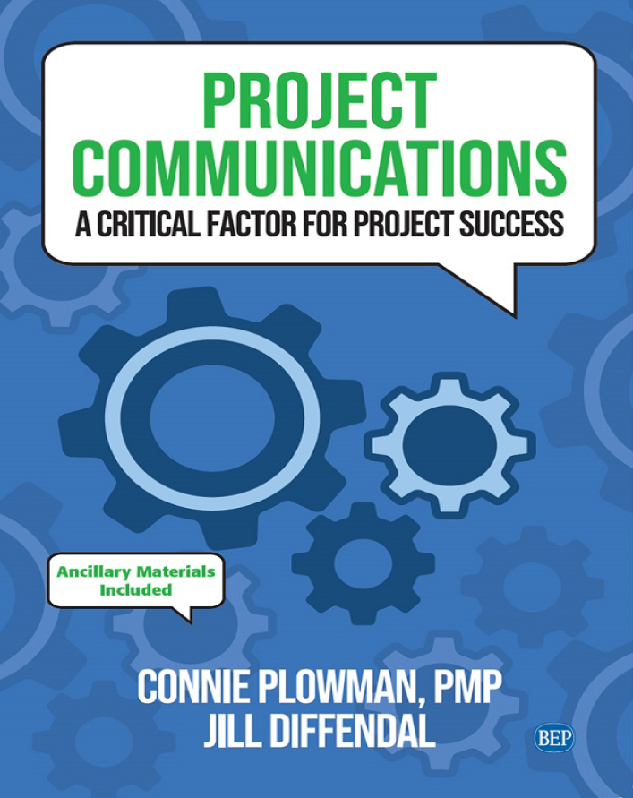
Reference Book:
Ch1: Introduction.
Ch2: Exploring Communication Theories.
Ch3: Knowing Your Audience.
Ch4: Starting with the Basics.
Ch5: Planning Project Communications.
Ch6: Managing and Monitoring Project Communications.
Ch7: Using Project Communication Tools.
Ch8: Communicating Change.
Ch9: Managing Conflict through Communication.
Ch10: Closing.

Slide 5
Lecture
Course Chapters
01

Slide 6

Chapter 1: Introduction to project communication
The purpose of this chapter is to help you:
Understand why project communication is so important.
Know what to expect from this course: what it will cover, who the audience is, how the course is structured, and key definitions.
Trace the evolution of project communications

Slide 7
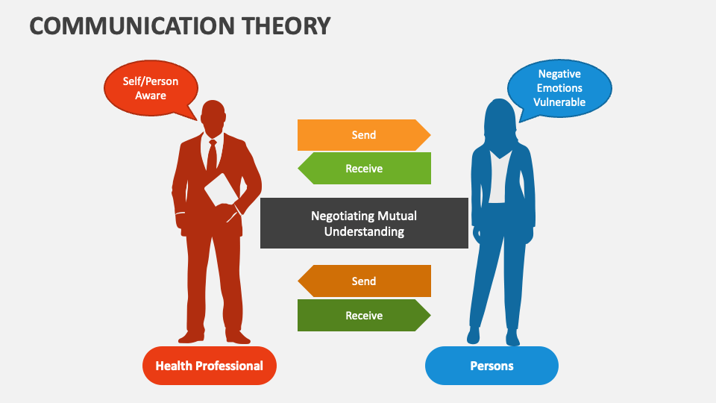
Chapter 2: Exploring Communication Theories
The purpose of this chapter is to help you:
Understand why people communicate by looking at two different communication theories that focus on communication as a way people handle uncertainty
Evaluate the impact of the quality as well as the quantity of communication in a project.
See the connection between effective communication and stakeholder trust.

Slide 8

Chapter 3: Knowing Your Audience
The purpose of this chapter is to help you:
Explore various recommendations for identifying the audience in your project, including their role, their level of power and influence over the project, and their level of support for the project•
See the value of understanding what is important to the members of your audience—the WIIFM (what’s in it for me).

Slide 9
Chapter 3: Knowing Your Audience
The purpose of this chapter is to help you:
Become familiar with stakeholder personas as a communication approach.
Put it into practice: Know your audience in traditional, agile, and virtual project teams.

Slide 10

Chapter 4: Starting with the Basics
The purpose of this chapter is to help you:
Look at how high-performing organizations and project teams communicate.
Identify things to consider when communicating on projects, including the need for inclusive language.
Distinguish between formal and informal communications.

Slide 11
Chapter 4: Starting with the Basics
The purpose of this chapter is to help you:
Examine the scalability of project communications
Put it into practice: Project communication basics in traditional, agile, and virtual project teams.

Slide 12
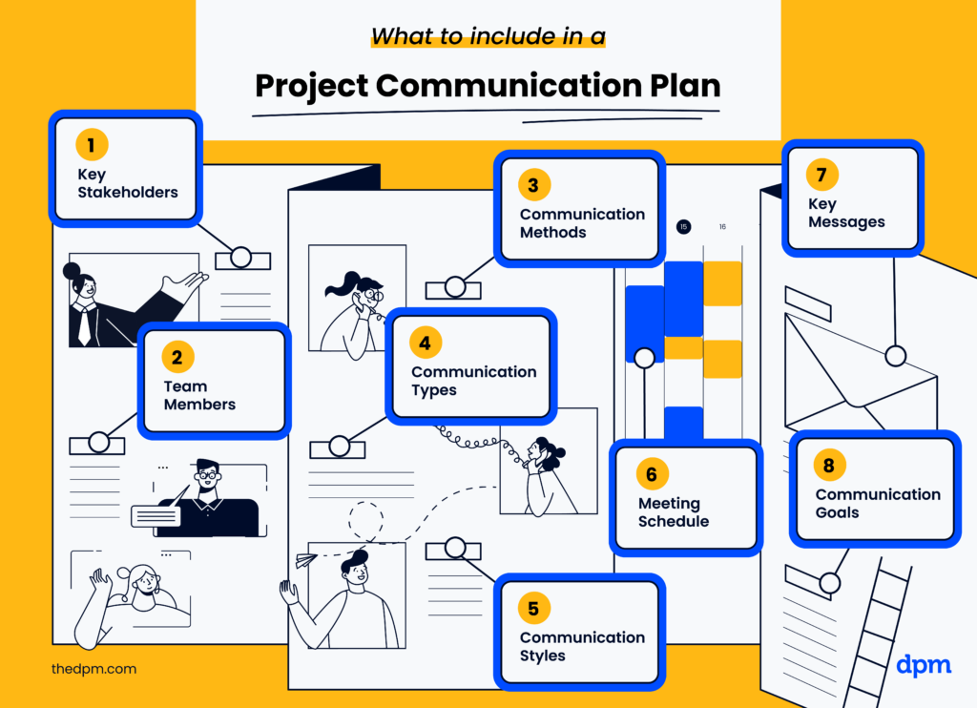
Chapter 5: Planning Project Communications
The purpose of this chapter is to help you:
Understand the purpose, content, and development of a project communications management plan.
Demonstrate how to effectively use a project communications management plan.

Slide 13
Chapter 5: Planning Project Communications
The purpose of this chapter is to help you:
Examine a communications matrix.
Put it into practice: Planning communications in traditional, agile, and virtual project teams.

Slide 14

Chapter 6: Managing and Monitoring Project Communications
The purpose of this chapter is to help you:
Build key skills needed to address stakeholders’ practical needs and personal needs when communicating on projects—including a five-step approach.
Measure the effectiveness of your project communications.

Slide 15
Chapter 6: Managing and Monitoring Project Communications
The purpose of this chapter is to help you:
Understand the importance of incorporating feedback loops.
Examine lessons learned and retrospectives.
Put it into practice: Managing and monitoring communications in traditional, agile, and virtual project teams.

Slide 16

Chapter 7: Using Project Communication Tools
The purpose of this chapter is to help you:
Consider what goes into choosing the right communication tools for your project
Examine the purpose and benefits of different project communication tools
Understand the importance of being knowledgeable about whatever communication tools you use for your project.

Slide 17
Chapter 7: Using Project Communication Tools
The purpose of this chapter is to help you:
Put it into practice: Using communication tools in traditional, agile, and virtual project teams.

Slide 18

Chapter 8: Communicating Change
The purpose of this chapter is to help you:
Understand change management, including three common models of managing change.
Describe how change management and project management work together.
Integrate change management into a project through communications.

Slide 19
Chapter 8: Communicating Change
The purpose of this chapter is to help you:
Put it into practice: Communicating change in traditional, agile, and virtual project teams.

Slide 20
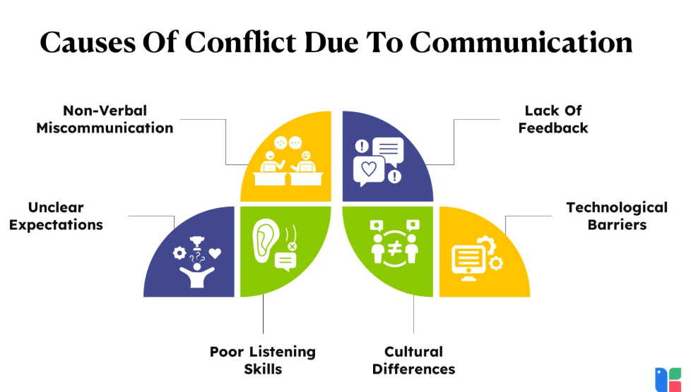
Chapter 9: Managing Conflict through Communication
The purpose of this chapter is to help you:
Examine two different types of conflict and how they can affect the project and the team•
Explore strategies for understanding and resolving conflict within the project team.

Slide 21
Chapter 9: Managing Conflict through Communication
The purpose of this chapter is to help you:
Consider ways to communicate with stakeholders when they do not support the project, when their expectations conflict with one another, or when the project deviates from the plan
Put it into practice: Managing conflict through communication in traditional, agile, and virtual project teams.

Slide 22

Chapter 10: Closing
The purpose of this chapter is to help you:
See where we have been and where we are going from here.
Know how to put this information into a personalized action plan.
Explore different ways to communicate the value of project management.

Slide 23



Thank You

