Slide 1





Project Monitoring Course
Prepared & presented by:
Dr. Dhouha Melliti
2022-2023
Lecture 01:
Introduction to Monitoring

Slide 2





Lecture 1
General Introduction
«The future is something that is built. We don't suffer the future, we make it» Georges Bernanos

Slide 3
Lecture 1
General Introduction
The Project Monitoring course is the last module of the Project Cycle Management which is intended to assist students, leaders and managers to understand the processes, methods, approaches and tools for effective monitoring and evaluation of a project or program being implemented by their organizations/institutions.

Slide 4

Lecture 1
Course objectives
By the end of this training course, the participants will be able to:
Understand key elements of project monitoring and evaluation and its cycle within the project or program;
Identify key functions of in project or program, system and framework as well as evaluation criteria;
Distinguish between Monitoring and Evaluation;
Identify the Key steps in setting Monitoring and Evaluation process;
Adopt some methods and tools for effective project Monitoring & Evaluation.

Slide 5


Lecture 1
Contents of the Monitoring module
Introduction to monitoring
Norms, standards and management for monitoring and evaluation
Monitoring..?
Mehodologies and analysis for monitoring and evaluation
Evaluation

Slide 6


Lecture 1
pre-requisites
Project Planning
&
Project Management

Slide 7


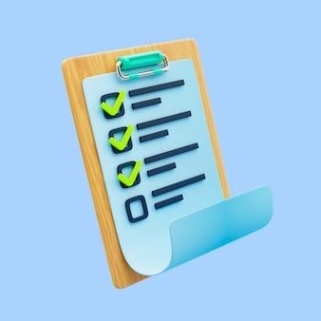
Lecture 1
Session outline
Lecture 1
Session outline
  Séance 1: Introduction générale du module
General Introduction
1
  Séance 2: Organisation d’un projet
Overview of Project Monitoring
2
The place of Project Monitoring & Evaluation in the Project Cycle Management?
  Séance 3: Planification d’un projet (Mise en situation)
3
  Séance 4: Planification d’un projet (Méthode PERT, Exercices PERT, Diagramme de GANTT )
Monitoring & Evaluation System and Framework
4
  Séance 5: Exercices PERT et Simulation via MS PROJECT
5
  Séance 6: gestion des ressources et management des risques
6
  Séance 7: Soutenance projets
7

Slide 8

Lecture 1
Session 1: General introducton
Project-definition
Many people and organizations have defined what a project is,
‘A unique process, consisting of a set of co-ordinated and controlled activities with start and finish dates, undertaken to achieve an objectives conforming to specific requirements, includ- ing constraints of time, cost and resources.’

Slide 9
Lecture 1
Project Management & Planning
As stated in the definition, a project has a definite starting and finishing point and must meet certain specified objectives.
These objectives, must meet three fundamental criteria:
1. The project must be completed on time;
2. The project must be accomplished within the budgeted cost; and
3. The project must meet the prescribed quality requirements.

Slide 10
Lecture 1
Project Management & Planning
Why does one need project management?
What is the difference between project management and management of any other business or enterprise?
Why has project management taken off so dramatically in the last 20 years?

Slide 11
Lecture 1
Project Management & Planning
Project Management
The planning, monitoring, and control of all aspects of a project and the motivation of all those involved in it, in order to achieve the project objectives within agreed criteria of time, cost, and performance.

Slide 12

Lecture 1
Project Management & Planning
Project management is essentially management of change, it is not applicable to running a factory making sausage pies, but it will be the right system when there is a requirement to relocate the factory, build an extension, or produce a different product requiring new machinery.

Slide 13

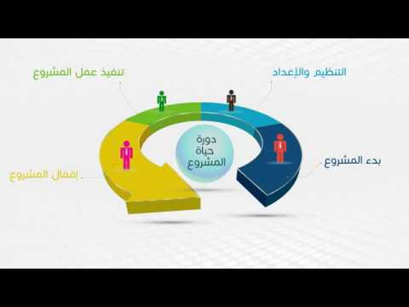
Lecture 1
Project Management & Planning
Project life cycle (PMI)
Initiating
Planning
Executing
Closing
Monitoring

Slide 14
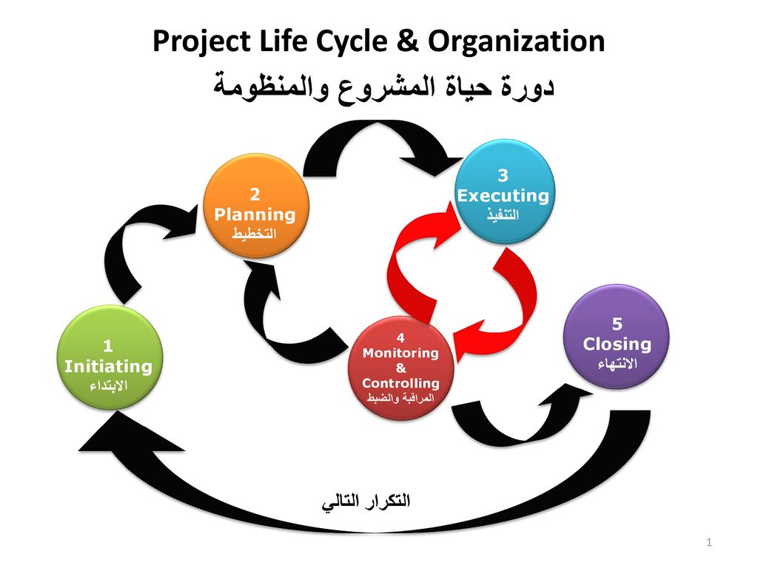
Lecture 1
Project Management & Planning

Slide 15
Lecture 1
Project Management & Planning
Most, if not all, projects go through a life cycle that varies with the size and complexity of the project. On medium to large projects the life cycle will generally follow the following pattern:
Concept: Basic ideas, business case, statement of requirements, scope;
Feasibility: Tests for technical, commercial, and financial sviability, technical studies, investment appraisal, DCF, etc.;
Evaluation: Application for funds, stating risks, options, TCQ criteria;
Authorization: Approvals, permits, conditions, project strategy;
Implementation: Development design, procurement, fabrication, installation, commissioning;
Completion: Performance tests, handover to client, post-project appraisal;
Operation: Revenue earning period, production, maintenance;
8. Termination: Close-down, decommissioning, disposal.

Slide 16


Lecture 1
Project Management & Planning
small reminder...
The role of a project manager
Moves on to execute and oversee all activities to create deliverables as outlined in the work plan.
Monitor the progress of the project and ensure that milestones and deliverables are on schedule.
Needs to take a step back and let your team execute the project plan.

Slide 17
Lecture 1
Project Management & Planning
small reminder...
The project monitoring phase
is the fourth and most demanding phase of the project life cycle and the most demanding.
The team performs all planned activities, builds the deliverables
and presents them to the project stakeholders.

Slide 18

Lecture 1
Overview of Project Monitoring
2.1. What is monitoring ?
Each development organization typically has its own definition for monitoring, evaluation and other development terms and concepts.
It is a process that helps improve performance and achieve results of the project. Its goal is to improve current and future management of outputs, outcomes and impact.

Slide 19
Lecture 1
Overview of Project Monitoring
“Monitoring” definitions
•A management activity that allows a continuous adaptation of the intervention if problems arise or if changes in the context have an influence on the performance of the operation.
•The systematic collection of information on all aspects of the project while it is being implemented.
•A continuing function that aims primarily to provide the management and main stakeholders of an ongoing intervention with early indications of progress, or lack thereof, in the achievement of results.

Slide 20





Lecture 1
Overview of Project Monitoring
Monitoring activities
Monitoring results
Monitoring budget and expenditures
Monitoring risks
Figure 1. Four key monitoring areas

Slide 21
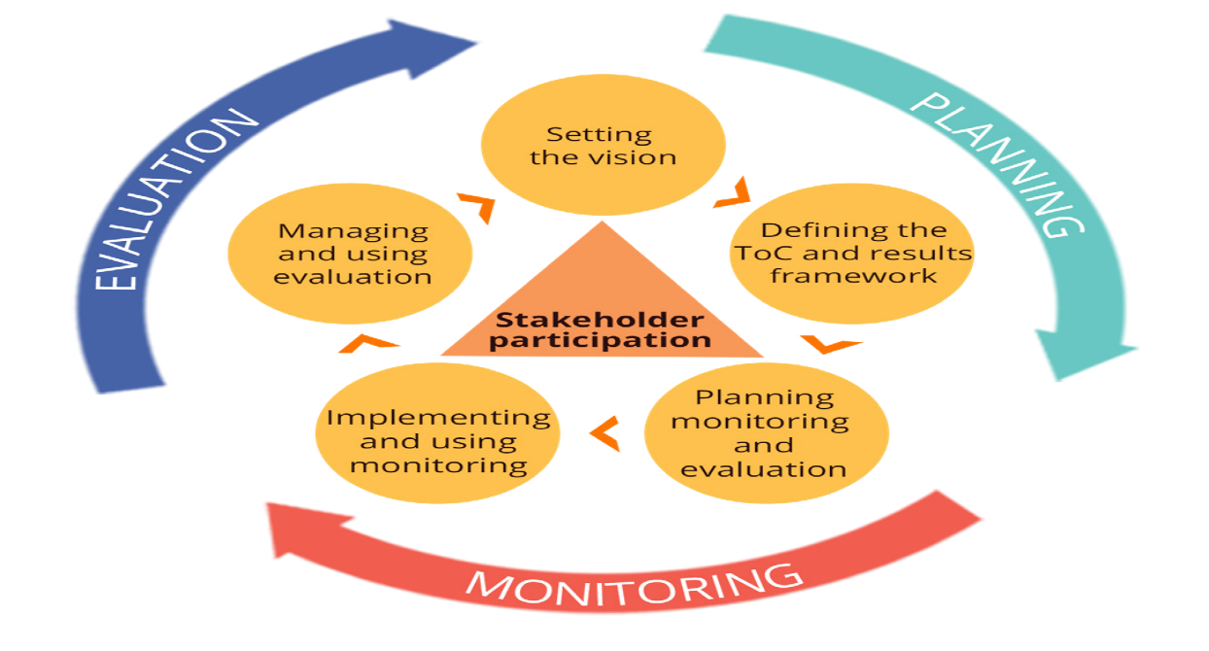
Lecture 1
Overview of Project Monitoring
2.2.When to monitor?
Monitoring is undertaken on an ongoing basis during the implementation of an intervention. Where possible, it is essential to ask relevant “monitoring questions” regularly.
Figure 2.1. Results-based management life cycle

Slide 22

Lecture 1
Overview of Project Monitoring
2.3.Why monitoring?
Monitoring aims to answer the following questions:
While implementing activities:
When measuring results:
Are results being achieved? What activities are being implemented?
Is progress shown against indicators? Are they being implemented as planned?
Are targets being met? What is the current budget burn rate?
Are target groups satisfied with the services?
Have any new risks been identified?
Are intended target groups being reached?

Slide 23
Keydifferencesbetweenmonitoringandevaluation
Monitoring | Evaluation
Monitoring is the continuous, systematic collection ofdata/information throughout the implementation ofaninterventionaspartofinterventionmanagement.It focuses on the implementation of an intervention,comparingwhatisdeliveredtowhatwasplanned. | Evaluation is a scheduled, periodic and in-depthassessment at specific points in time (before, during,at the end of or after an intervention). It is a specificprocess that assess this success of an interventionagainstanestablishedsetofevaluationcriteria.
Itisusuallyconductedbypeopledirectlyinvolvedinimplementingtheintervention. | Itisusuallyconductedbypeoplenothavingdirectlyparticipatedintheintervention.
Itroutinelycollectsdataagainstindicatorsandcomparesachievedresultswithtargets. | Itassessescausalcontributionsofinterventionstoresultsandexploresunintendedresults.
Itfocusesontrackingtheprogressofregularorday-to-dayactivitiesduringimplementation. | It assesses whether, why and how well change hasoccurred and whether the change can be attributedtotheintervention.
Itlooksatproductionofresultsattheoutputandoutcomelevel. | Itlooksatperformanceandachievementofresultsattheoutput,outcome,aswellastheobjectivelevel.
Itconcentratesonplannedinterventionelements. | Itassessesplannedelementsandlooksforunplanned change, searches for causes, challenges,risks,assumptionsandsustainability.
Lecture 1
The place of Project Monitoring & Evaluation in the Project Cycle Management?
3.1.Monitoring versus evaluation
 | Monitoring | Evaluation
Why? | Checkprogress,Inform decisions and remedialaction,Updateproject plans,Supportaccountability | Assessprogressand worth,Identify lessons and recommendations forlonger-termplanning andOrganizationallearning;Provideaccountability
When? | Ongoingduringproject/program | Periodicandafterproject/ program
Who? | Internal, involving project/programimplementers | Canbeinternalorexternaltoorganization
Link to logicalhierarchy | Focus on inputs, activities,outputs and shorter-termoutcomes | Focuson outcomesandoverall goal
•Monitoring is ongoing and tends to focus on what is happening. Monitoring data is typically used by managers for ongoing project implementation, tracking outputs, budgets, compliance with procedures, etc.
•Evaluation is a process of assessing whether the project has achieved its intended objectives.

Slide 24
Keydifferencesbetweenmonitoringandevaluation
Monitoring | Evaluation
Monitoring is the continuous, systematic collection ofdata/information throughout the implementation ofaninterventionaspartofinterventionmanagement.It focuses on the implementation of an intervention,comparingwhatisdeliveredtowhatwasplanned. | Evaluation is a scheduled, periodic and in-depthassessment at specific points in time (before, during,at the end of or after an intervention). It is a specificprocess that assess this success of an interventionagainstanestablishedsetofevaluationcriteria.
Itisusuallyconductedbypeopledirectlyinvolvedinimplementingtheintervention. | Itisusuallyconductedbypeoplenothavingdirectlyparticipatedintheintervention.
Itroutinelycollectsdataagainstindicatorsandcomparesachievedresultswithtargets. | Itassessescausalcontributionsofinterventionstoresultsandexploresunintendedresults.
Itfocusesontrackingtheprogressofregularorday-to-dayactivitiesduringimplementation. | It assesses whether, why and how well change hasoccurred and whether the change can be attributedtotheintervention.
Itlooksatproductionofresultsattheoutputandoutcomelevel. | Itlooksatperformanceandachievementofresultsattheoutput,outcome,aswellastheobjectivelevel.
Itconcentratesonplannedinterventionelements. | Itassessesplannedelementsandlooksforunplanned change, searches for causes, challenges,risks,assumptionsandsustainability.
Lecture 1
The place of Project Monitoring & Evaluation in the Project Cycle Management?
3.1.Monitoring versus evaluation
 | Monitoring | Evaluation
Why? | Checkprogress,Inform decisions and remedialaction,Updateproject plans,Supportaccountability | Assessprogressand worth,Identify lessons and recommendations forlonger-termplanning andOrganizationallearning;Provideaccountability
When? | Ongoingduringproject/program | Periodicandafterproject/ program
Who? | Internal, involving project/programimplementers | Canbeinternalorexternaltoorganization
Link to logicalhierarchy | Focus on inputs, activities,outputs and shorter-termoutcomes | Focuson outcomesandoverall goal
By drawing conclusions, evaluation intends to provide recommendations for the improvement on the future course of the project as well as lessons learned for other projects. Some big organizations use specific criteria when they do evaluation. Often, the main criteria assessed are efficiency, effectiveness and impact. Also, relevance and sustainability are usually included.

Slide 25
Lecture 1
The place of Project Monitoring & Evaluation in the Project Cycle Management?
 | Monitoring | Evaluation
Why? | - Check progress -Inform decisions and remedial action, -Update project plans, -Support accountability | -Assess progress and worth, -Identify lessons and recommendations for longer-term planning and organizational learning; -Provides accountability
When? | Ongoing during project/program | Periodic and after project/ program
Who? | Internal, involving project/program implementers | Can be internal or external to organization
Link to logical hierarchy | Focus on inputs, activities, outputs and shorter-term outcomes | Focus on outcomes and overall goal

Slide 26
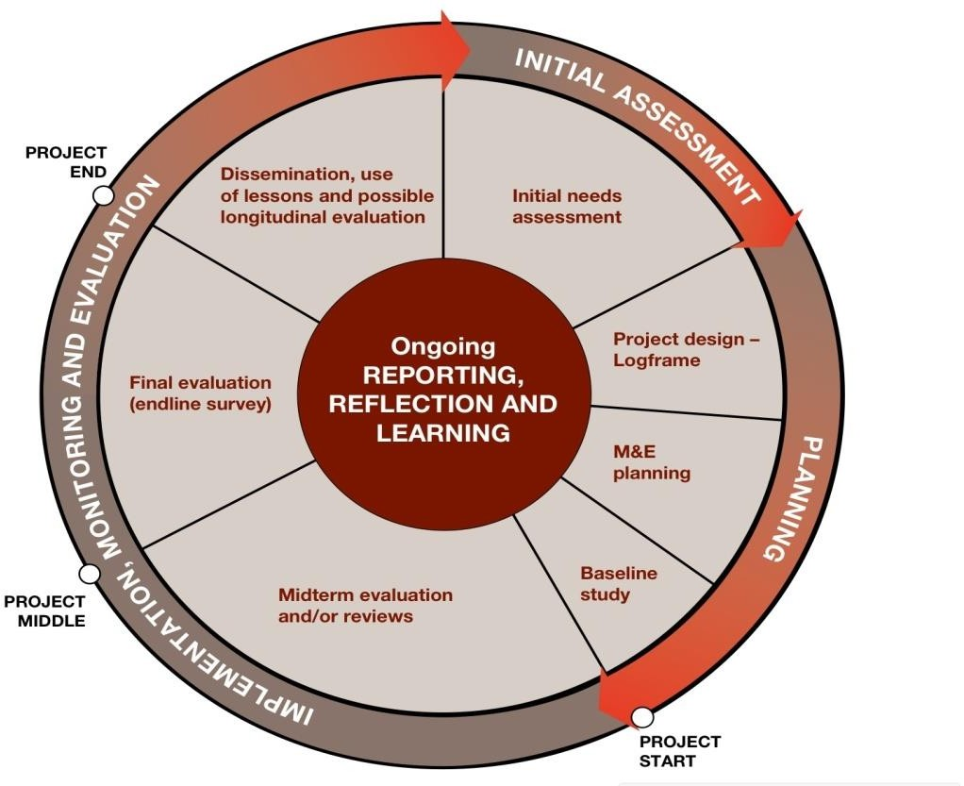
Lecture 1
The place of Project Monitoring & Evaluation in the Project Cycle Management?
3.2.M&E in Project Cycle Management

Slide 27

Lecture 1
The place of Project Monitoring & Evaluation in the Project Cycle Management?
3.3 The importance of M&E in the project management
A well-functioning M&E system is a critical part of good project/program management and accountability.
While you implementing activities as indicated in your workplan, it is important to have regular monitoring and evaluation in order to provide timely and reliable M&E information to:

Slide 28

Lecture 1
The place of Project Monitoring & Evaluation in the Project Cycle Management?
Support project/program implementation with accurate
Promote and celebrate our work
Contribute to organizational learning and knowledge
Provide opportunities for stakeholder feedback
Uphold accountability and compliance

Slide 29
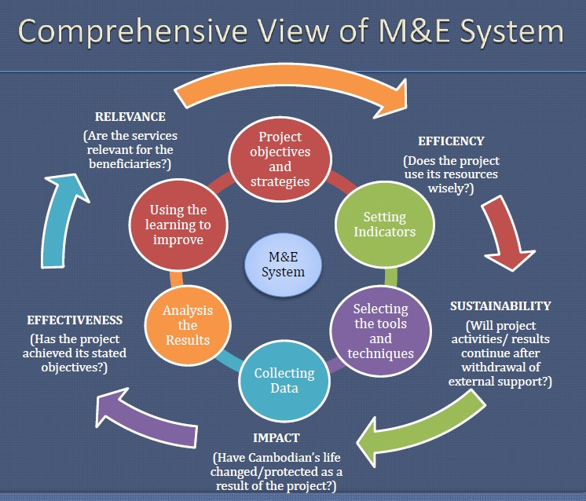
Lecture 1
M&E System and Framework?

Slide 30
Lecture 1
M&E System and Framework?
Inner cycle is about Monitoring involves
6 steps
Identify Project Objectives and Strategies
Setting Indicators
Selecting the Tools and Techniques:
Collecting Data
Analyze the Results
Use the Learning to Improve

Slide 31
Lecture 1
M&E System and Framework?
Outer cycle is about Evaluation involves
5 key criteria
Relevance
Effectiveness
Efficiency
Sustainability
Impact

Slide 32

Lecture 1
M&E System and Framework?
Outer cycle is about Evaluation involves
To assess or evaluate the project or program, the evaluator/ evaluation team will use different tools and techniques for data collection, interview and focus group discussion and self- assessment forms. Some support documents such as financial reports could be also helpful to verify the use of funds (expenses) for the project implementation/activities.

Slide 33
Lecture 1
M&E System and Framework?
4.1.Elements of a good M&E system
5 elements of good system
A capable Monitoring and Evaluation staff unit
Clear goals and objectives of the project
A core set of indicators and targets
A plan for data collection and analysis
A plan for data dissemination

Slide 34
Lecture 1
M&E System and Framework?
4.2. Tasks in Monitoring and Evaluation
Tasks in M&E: 6 tasks
Task 1: Early Design Phase (Formulation & Approval)
1) Setting scope & purpose
2) Setting key performance questions, indicators and mechanisms
3) Identify organizational arrangement for M&E
4) Indicative M&E budget
5) Document the above as M&E framework

Slide 35
Lecture 1
M&E System and Framework?
•
Task 2: Start-up prior to project funding (with special operating fund)
6) Review the key performance questions, indicators, monitoring mechanisms, and project strategy
7) Initiate baseline study
8) Train few potential staff on M&E
9) Prepare Project Implementation Plan (PIP) with few key staff
•

Slide 36
Lecture 1
M&E System and Framework?
•
Task 3: Start up after project funding
10) Review project design in relation to M&E with the key stakeholders
11) Prepare detailed M&E Plan according to the partnership arrangements
12) Put in place required manpower, capacity and conditions for M&E implementation
•

Slide 37
Lecture 1
M&E System and Framework?
Task 4: During project implementation
13) Ensure management has required information
14) Facilitate regular review meetings/communication with implementers
15) Prepare annual reviews and support supervision missions
16) Conduct focus studies or emergency issue
17) Communicate results to the stakeholders
•

Slide 38
Lecture 1
M&E System and Framework?
Task 5: Midterm Review (MTR) or Evaluation
18) Facilitate MTR or evaluation internal or external process
19) Assist in response to the MTR or evaluation feedback
20) Assist in project plan/ design review as per MTR or evaluation recommendations
21) Adjust the M&E system if needed
•

Slide 39
Lecture 1
M&E System and Framework?
Task 6: Project phase-out or completion
22) Conduct end-of-project evaluation and/or impact study
23) Find out how the impacts will be sustained
24) Hold workshop and do field studies
25) Articulate lessons learned for the next phase or other projects

Slide 40

Lecture 1
M&E System and Framework?
4.3 Key steps in setting Monitoring and Evaluation system
Identify/ establish purpose and scope
Specify information needed and indicators
Planning information gathering and organization
Planning critical reflection process and events
Planning for quality communication and reporting
Planning for conditions and capacities

Slide 41
Lecture 1
M&E System and Framework?
4.4 Key Criterion for Monitoring and Evaluation
• Each development organization typically uses its own definition for the criteria. 5 key evaluation criteria are identified:
1) Relevance
2) Effectiveness
3) Efficiency
4) Impact
5) Sustainability
•

Slide 42
Lecture 1
M&E System and Framework?
4.5. Planning and Steps for Project Monitoring and Evaluation system
A.Steps in Project Monitoring (6 main steps)
Step 1: Identify Project Objectives and Strategies:
Specify the Intervention (Goals, Objectives, Activities/Process, Inputs, Outcomes, and Impacts)
Step 2: Setting Indicators:
Needs of Information, Performance Monitoring and SMART4 Indicators

Slide 43
Lecture 1
M&E System and Framework?
Step 3: Selecting the Tools and Techniques:
Select strategy for M&E Data collection in different methods from existing and new sources.
Step 4: Collecting Data:
Set baseline and realistic Targets for Objectively Verifiable Indicators (OVI) of performance
Step 5: Analyse the Results:
Design and Implement Monitoring tools/system (manual and computerized)
Step 6: Use the Learning to Improve:
Use of monitoring data in project Evaluation, Planning, Management and Reporting.

Slide 44
Lecture 1
M&E System and Framework?
B. Steps in Project Evaluation (5 main steps)
Step1: Implementing M&E Plan:
Knowing when should midterm and final term evaluation be started for your program/project
Step 2: Develop clear Terms of References (TORs) and budget for evaluation:
This is an important job. Without clear TORs and enough budget allocation to evaluation, the organization will not know the progress, developmentand impacts of the project and cannot closing the project

Slide 45
Lecture 1
M&E System and Framework?
Step3: Recruit qualified external consultant or team of consultant:
Carry out evaluation task based on agreed TORs, termes and conditions
Step 4: Coordinate/ facilitate consultant or team of consultant: The M&E Unit/Department staff will facilitate consultant team to perform the task including assisting in logistic arrangement (contact key informants, beneficiaries groups, stakeholders etc.,)
·

Slide 46
Lecture 1
M&E System and Framework?
Step 5: Take actions / recommendations for next implementation phase:
After report is concluded and finalized, your organization and management team will need to consider and take appropriate actions from the report’s recommendations and for development of next phase/ cycle of the project.

Slide 47
Lecture 1
Starting
Finalize a plan for collecting and analyzing monitoring data. And start to think about it while selecting the indicator and designing the project.
Planning
Review lessons learned from previous initiatives, Clearly define the overall goal and results, develop relevant indicators. And start developing a plan for data collection and analysis.
Execution
Collect data from different sources using different methods, analyze, interpret and exchange conclusions. The data collected should be used to guide good practice and performance-based programming.
the final stage and review
Collect data from different sources using different methods, analyze, interpret and exchange conclusions.

Slide 48

Lecture 1

