Slide 1


Procurement and Supply Chain Management
Prepared by Dr. Tarek Mohamed
MGM 431
Lecture 01

Slide 2



Procurement and Supply Chain Management
Lecture 01
MGM 431
Prepared by
Dr. Tarek Mohamed
www.midocean.ae

Slide 3

Course Agenda
Chapter
01
1-Discuss the goal of a supply chain and explain the
impact of supply chain decisions on the success of a firm.
2-Identify the three key supply chain decision phases and
explain the significance of each one.
3-Describe the cycle and push/pull views of a supply chain.
4-Classify the supply chain macro processes in a firm.
www.midocean.ae

Slide 4


Slide 5
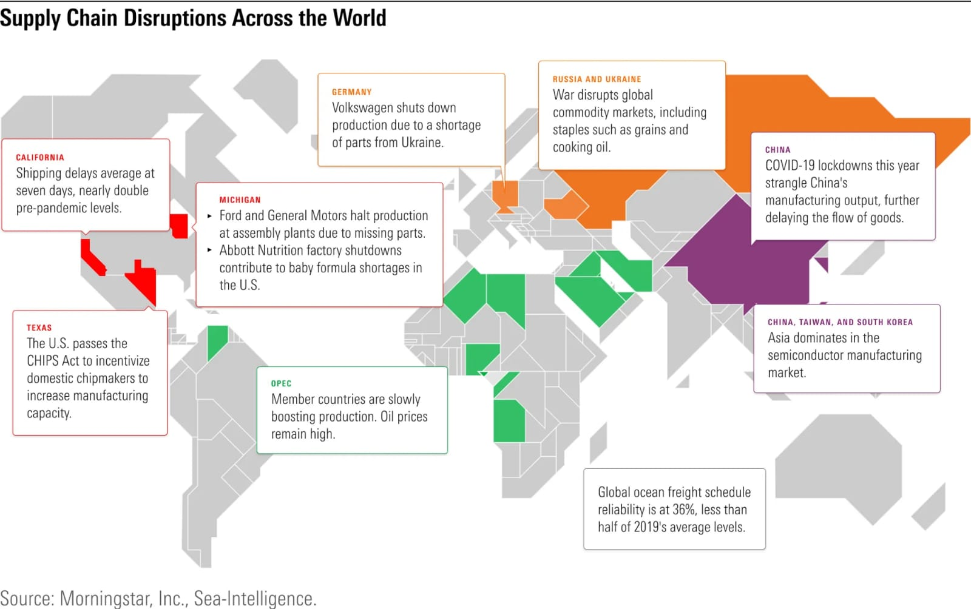

Slide 6
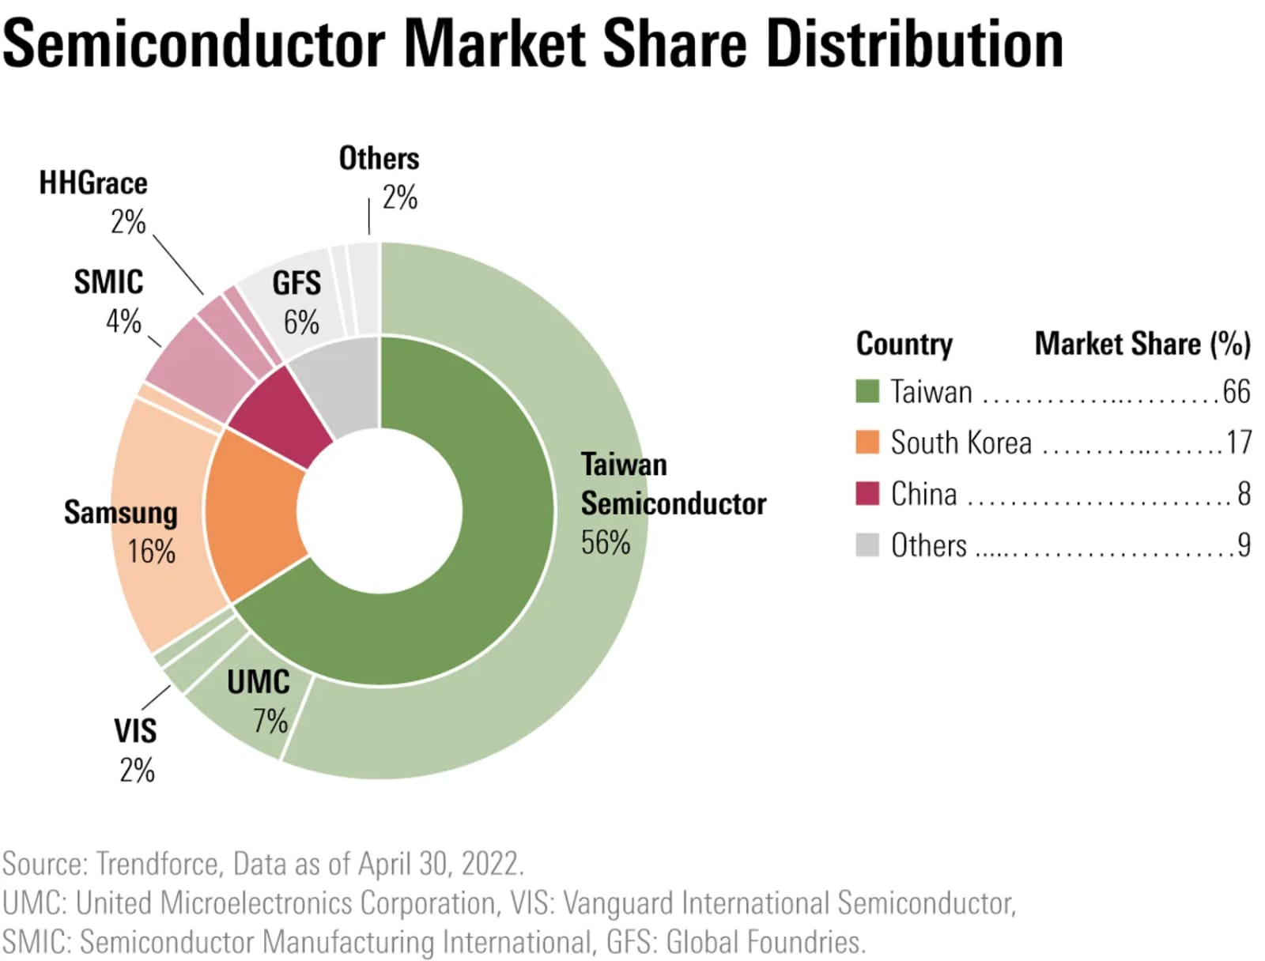

Slide 7
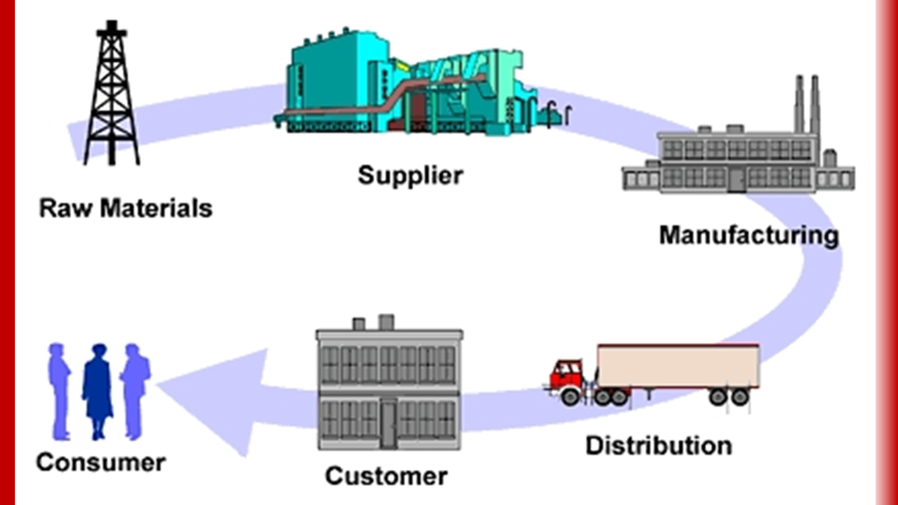

Slide 8
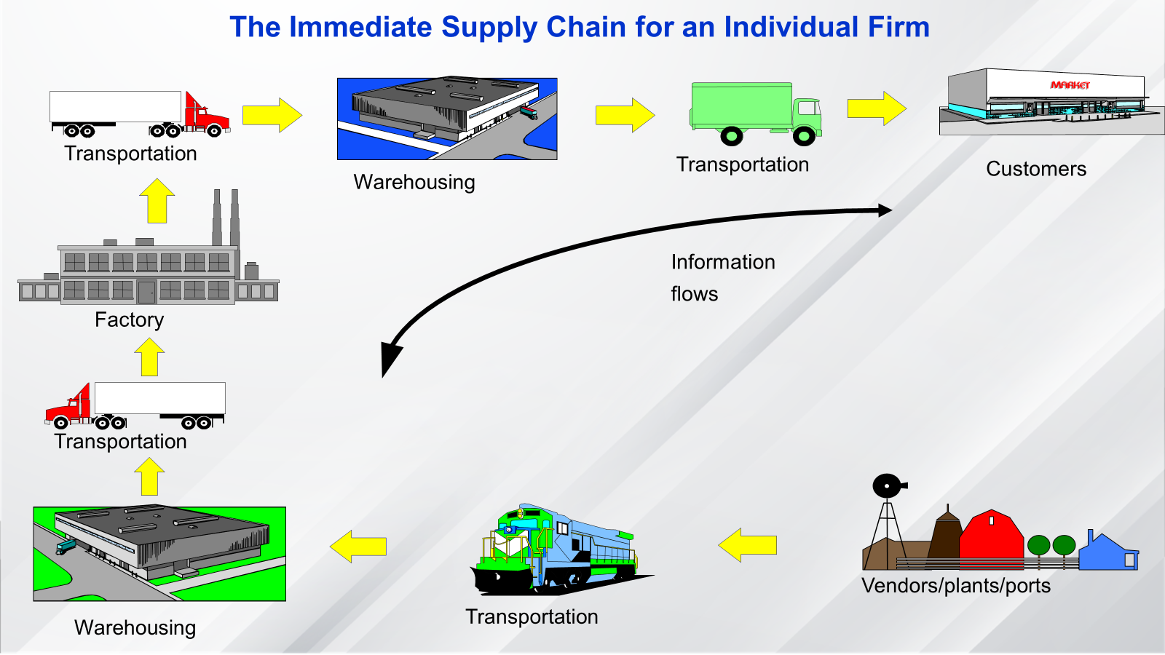

Slide 9

What is Supply Chain Management
All stages involved, directly or indirectly, in fulfilling a customer request.
Within each company, the supply chain includes all functions involved in fulfilling a customer request (product development, marketing, operations, distribution, finance, customer service).
All facilities, functions, and activities, associated with the flow and transformation of goods and services from raw materials to customer, as well as the associated information flows.
An integrated group of processes to “Plan,” “Source,” “Make,” and “deliver” products to customers.
www.midocean.ae

Slide 10
What is Supply Chain Management
Customer is an integral part of the supply chain.
Includes movement of products from suppliers to manufacturers to distributors and information, funds, and products in both directions.
May be more accurate to use the term “supply network” or “supply web”.
Typical supply chain stages: customers, retailers, wholesalers/distributors, manufacturers, component/raw material suppliers.
All stages may not be present in all supply chains (e.g., no retailer or distributor for Dell).
www.midocean.ae

Slide 11

Supply Chain Structure
www.midocean.ae

Slide 12
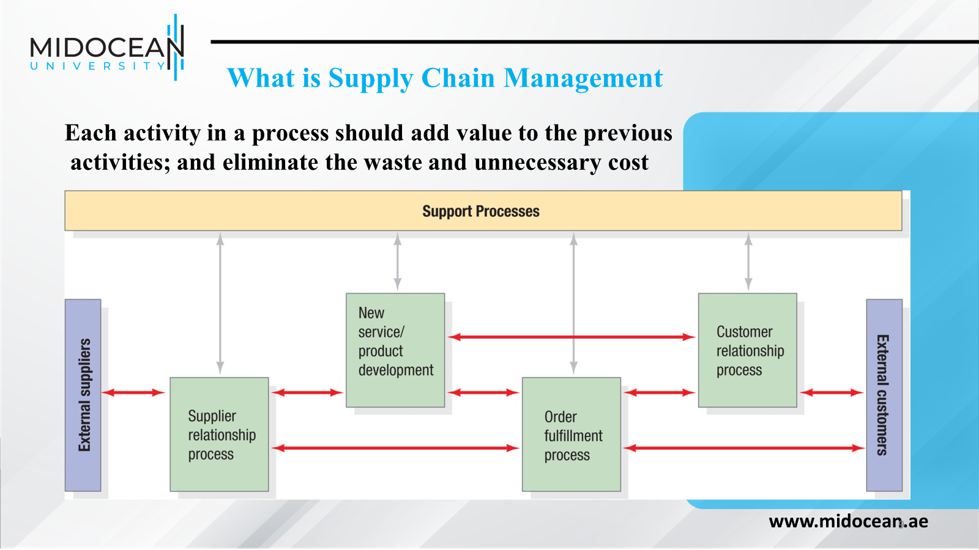

Slide 13
What is Supply Chain Management
P&G manufacturing plant receives raw materials from a variety of suppliers.
For example, the packaging material may come from Tenneco packaging, while Tenneco receives raw materials to manufacture the packaging from other suppliers.
www.midocean.ae

Slide 14
Importance of Supply Chain Decisions
Maximize overall value generated.
Supply Chain Surplus = Customer Value – Supply Chain Cost.
Example: a customer purchases a router from Amazon for $100 (revenue).
Supply chain costs include (information, storage, transportation, produce components, assembly, etc.)
The difference between $100 and the sum of all of these costs is the supply chain profit.
Supply chain profitability is the total profit to be shared across all stages of the supply chain.
www.midocean.ae

Slide 15
Importance of Supply Chain Decisions
Dell, $56 billion in 2006, by adopting new supply chain strategies to $102.301 billion in 2023.
Wal-Mart, $1 billion sales in 1980 jumped to $611.289 billion in 2023.
Boeing’s annual revenue, $101 billion in 2018 to $77.8 billion in 2023.
Apple, $65 billion in 2010 to $383.29 billion in 2023.
Amazon's annual revenue, $ 34 billion in 2010 to $574.785 billion in 2023.
www.midocean.ae

Slide 16
Importance of Supply Chain Decisions
There is a close connection between the design and management of supply chain flows (product, information, and funds) and the success of a supply chain.
Wal-Mart, Dell Computer, and Seven-Eleven Japan are examples of companies that have built their success on superior design, planning, and operation of their supply chain.
www.midocean.ae

Slide 17
Importance of Supply Chain Decisions
Wal-Mart has been a leader in using supply chain design, planning, and operation to achieve success.
From its beginning, the company invested heavily in transportation and information infrastructure to facilitate the effective flow of goods and information.
Wal-Mart designed its supply chain with clusters of stores around distribution centers to facilitate frequent replenishment at its retail stores in a cost-effective manner. Frequent replenishment allows stores to match supply and demand more effectively than the competition.
www.midocean.ae

Slide 18
Decision Phases in a Supply Chain
Successful supply chain management requires many decisions relating to the flow of information, products, and funds.
Each decision should be made to raise the supply chain surplus.
These decisions fall into three categories or phases, depending on the frequency of each decision and the time frame during which a decision phase has an impact.
As a result, each category of decisions must consider uncertainty over the decision horizon.
www.midocean.ae

Slide 19
Decision Phases in a Supply Chain
Supply chain strategy or design
How to structure the supply chain over the next several years
Supply chain planning
Decisions over the next quarter or year
Supply chain operation
Daily or weekly operational decisions
www.midocean.ae

Slide 20
Supply Chain Strategy or Design
Decisions about the configuration of the supply chain, allocation of resources, and what processes each stage will perform.
Strategic supply chain decisions
Outsource supply chain functions
Locations and capacities of facilities
Products to be made or stored at various locations
Modes of transportation
Information systems
Supply chain design must support strategic objectives
Supply chain design decisions are long-term and expensive to reverse – must take into account market uncertainty
www.midocean.ae

Slide 21
Supply Chain Planning
For decisions made during this phase,
The time frame considered is a quarter to a year. Therefore,
The supply chain's configuration determined in the strategic phase is fixed.
The goal of planning is to maximize the supply chain surplus that can be generated over the planning horizon
www.midocean.ae

Slide 22
Supply Chain Planning
Definition of a set of policies that govern short-term operations.
Fixed by the supply configuration from the strategic phase.
The goal is to maximize supply chain surplus given established constraints.
Starts with a forecast of demand in the coming year.
www.midocean.ae

Slide 23
Supply Chain Planning
Planning decisions:
Which markets will be supplied from which locations
Planned buildup of inventories
Subcontracting
Inventory policies
Timing and size of market promotions
Must consider demand uncertainty, exchange rates, and competition over the time horizon in planning decisions
www.midocean.ae

Slide 24
Supply Chain Operation
The time horizon is weekly or daily
Decisions regarding individual customer orders
Supply chain configuration is fixed and planning policies are defined
The goal is to handle incoming customer orders as effectively as possible
Allocate orders to inventory or production, set order due dates, generate pick lists at a warehouse, allocate an order to a particular shipment, set delivery schedules, place replenishment orders
Much less uncertainty (short time horizon)
www.midocean.ae

Slide 25
Process Views of a Supply Chain
A supply chain is a sequence of processes and flows that take place within and between different stages and combine to fill a customer's need for a product.
There are two different ways to view the processes performed in a supply chain.
Cycle View:
The processes in a supply chain are divided into a series of cycles, each performed at the interface between two successive stages of the supply chain.
www.midocean.ae

Slide 26
Cycle View of Supply Chain Processes
Given the five stages of a supply chain, all supply chain processes can be broken down into the following four process cycles,
Customer order cycle
Replenishment cycle
Manufacturing cycle
Procurement cycle
www.midocean.ae

Slide 27
Cycle View of Supply Chain Processes
Customer order cycle
All the processes directly involved in receiving and filling a customer order
Replenishment cycle
All the processes involved in replenishing retailer inventory
Manufacturing cycle
All processes involved in generating the product that will fill the customer,
retailer and distributor orders. It is driven by the actual orders placed with the
manufacturer, forecasts for expected future demand, and the current product
availability in the manufacturer’s finished-product warehouse.
Procurement cycle
All the processes necessary to ensure that materials are available for
manufacturing to occur according to schedule.
www.midocean.ae

Slide 28
Cycle View of Supply Chain Processes
Each cycle occurs at the interface between two successive stages of the supply chain.
Not every supply chain will have all four cycles clearly separated. For example, a grocery supply chain in which a retailer stocks finished goods inventories and places replenishment orders with a distributor is likely to have all four cycles separated.
Dell, in contrast, bypasses the retailer and distributor when it sells servers directly to customers ( Direct Channel).
www.midocean.ae

Slide 29

Cycle View of Supply Chain Processes
Customer Order Cycle
Customer
Retailer
Replenishment Cycle
Distributor
Manufacturing Cycle
Manufacturer
Procurement Cycle
Supplier
www.midocean.ae

Slide 30
Cycle View of
Supply Chain Processes
Each cycle consists of six sub processes as shown:
Each cycle starts with the supplier marketing the product to customers.
A buyer then places an order that is received by the supplier.
The supplier supplies the order, which is received by the buyer.
The buyer may return some of the product or other recycled material to the supplier or a third party. The cycle of activities then begins all over again.
www.midocean.ae

Slide 31
Process Views of a Supply Chain
Push/Pull View:
The processes in a supply chain are divided into two categories, depending on whether they are executed in response to a customer order or in anticipation of customer orders. Pull processes are initiated by a customer order, whereas push processes are initiated and performed in anticipation of customer orders.
www.midocean.ae

Slide 32
Push/Pull View of Supply Chain Processes
Supply chain processes fall into one of two categories depending on the timing of their execution relative to customer demand.
Pull: execution is initiated in response to a customer order (reactive).
Push: execution is initiated in anticipation of customer orders (speculative).
The Push/pull boundary separates push processes from pull processes.
www.midocean.ae

Slide 33
Push/Pull View of Supply Chain Processes
Pull: execution is initiated in response to a customer order (reactive).
Dell assembles its computers to order and therefore, all processes except for those involved in the procurement cycle are “pull ”
www.midocean.ae

Slide 34
Push/Pull View of Supply Chain Processes
Push: execution is initiated in anticipation of customer orders (speculative).
Compaq: All processes except for those involved in the customer order cycle are of “push” type.
www.midocean.ae

Slide 35
Supply Chain Macro Processes
Supply chain processes discussed in the two views can be classified into
  Customer Relationship Management (CRM):
  All processes at the interface between the firm and its customers.
  Internal Supply Chain Management (ISCM):
  All processes that are internal to the firm.
  Supplier Relationship Management (SRM):
All processes at the interface between the firm and its suppliers.
www.midocean.ae

Slide 36
Push/Pull View of Supply Chain Processes
The three macro processes manage the flow of information, products, and funds required to generate, receive, and fulfill a customer request.
The CRM macro process aims to generate customer demand and facilitate the placement and tracking of orders.
The ISCM macro process aims to fulfill the demand generated by the CRM process in a timely manner and at the lowest possible cost.
The SRM macro process aims to arrange for and manage supply sources for various goods and services.
www.midocean.ae

Slide 37
Supply Chain Macro Processes
www.midocean.ae

Slide 38
Essential Reference
Chopra, S., & Meindl, P. (2016). Global Edition. Pearson Education Limited
Chapter One.
Lysons, K., & Farrington, B. (2020). Procurement and supply chain management. Pearson UK.
Morris, P. W., & Pinto, J. K. (Eds.). (2007). The Wiley guide to project technology, supply chain, and procurement management (Vol. 4). John Wiley & Sons.
Schwalbe, K. (2015). Information technology project management. Cengage Learning.
Supply Chain Council
www.midocean.ae

Slide 39

Summary of Learning Objectives
Chapter
01
1-Discuss the goal of a supply chain and explain the
impact of supply chain decisions on the success of a firm.
2-Identify the three key supply chain decision phases and
explain the significance of each one.
3-Describe the cycle and push/pull views of a supply chain.
4-Classify the supply chain macro processes in a firm.
www.midocean.ae

Slide 40



Thank You

