Slide 1


Strategic Planning for Successful Healthcare Systems
Prepared by Dr. Abdulaziz Alsaedi
MHA611
Healthcare Systems
Lecture 07

Slide 2

Outlines:
Introduction to strategic planning.
Why do Healthcare Systems need a strategy?
Strategic planning in the healthcare field.
Why do strategies fail?
Levels of strategic planning.
Strategic planning process.

Slide 3

Chapter
Learning Objectives
07
Understanding the importance of strategic planning for healthcare systems.
Understanding the challenges in healthcare planning.
Understanding why strategic plans fail.
Understanding the different levels of strategic planning.
Understanding the steps of strategic planning.

Slide 4
Chapter
Introduction
07
Healthcare systems across the board need a comprehensive strategy to navigate the complex and ever-changing landscape of healthcare delivery.
The healthcare environment is constantly evolving due to new technologies, changing regulations, and shifting patient expectations. Strategic planning helps organizations stay ahead of these changes and be better prepared for the future.
Healthcare organizations often face limited resources. Strategic planning enables them to prioritize and make the best use of their funding, staff, and physical space.
All healthcare systems need a well-crafted strategy to thrive in today's complex healthcare environment and better serve their patients, staff, and communities.

Slide 5
Chapter
Strategic Planning in the Healthcare Field
07
While the basic principles of strategic planning apply to all fields, there are some unique features of strategic planning in healthcare that set it apart from other industries.
One of the primary differences is the complexity of the healthcare environment.
Healthcare is a highly regulated industry with multiple stakeholders, including patients, providers, insurers, and policymakers.
The interactions between these stakeholders can be complicated and require careful consideration when developing a strategic plan.

Slide 6
Chapter
07
Why do Healthcare Systems need a strategy?

Slide 7
Chapter
Why do Healthcare Systems need a strategy
07
1. Adapting to a Changing Environment:
The healthcare landscape is constantly evolving due to:
New technologies and medical advancements.
Changing regulations and policies.
Shifting patient expectations and demographics.
Emerging public health challenges.
A well-developed strategy allows healthcare organizations to anticipate and respond effectively to these changes, ensuring they remain relevant and competitive.

Slide 8
Chapter
Why do Healthcare Systems need a strategy
07
2. Optimizing Resource Allocation:
Healthcare systems often face resource constraints, including:
Limited funding.
Staffing shortages.
Physical space limitations.
Strategic planning enables organizations to prioritize their most critical needs and allocate resources efficiently to achieve the greatest impact.

Slide 9
Chapter
Why do Healthcare Systems need a strategy
07
3. Improving Patient Outcomes:
A clear strategy helps healthcare systems focus on:
Enhancing quality of care.
Implementing new care delivery models.
Investing in technologies that improve patient safety.
Developing programs to address specific health needs in their communities.
By aligning resources and efforts with strategic goals, organizations can drive meaningful improvements in patient outcomes and experiences.

Slide 10
Chapter
Why do Healthcare Systems need a strategy
07
4. Enhancing Operational Efficiency:
Strategic management in healthcare promotes:
Streamlined processes.
Better coordination between departments.
Improved communication among staff.
Data-driven decision making.
These factors contribute to increased operational efficiency and cost-effectiveness.

Slide 11
Chapter
Why do Healthcare Systems need a strategy
07
5. Fostering Innovation:
A well-crafted strategy encourages innovation by:
Setting ambitious goals that challenge the status quo.
Allocating resources for research and development.
Creating a culture that values creative problem-solving.
Identifying opportunities to pilot new care delivery models or technologies.

Slide 12
Chapter
Why do Healthcare Systems need a strategy
07
6. Ensuring Long-term Sustainability:
In an increasingly competitive healthcare market, a robust strategy helps organizations:
Differentiate themselves from competitors.
Build strong relationships with patients and communities.
Adapt to financial pressures and changing reimbursement models.
Attract and retain top talent.
By focusing on long-term sustainability, healthcare systems can continue to fulfill their mission of providing high-quality care for years to come.

Slide 13
Chapter
07
Strategic Challenges in Healthcare

Slide 14
Chapter
Top 5 Strategic Challenges in Healthcare
07
1. New Technologies:
In the medical field, new technologies seem to appear every day. From remote patient monitoring to robust patient portals, healthcare facilities must consider the evolution of the tools used during day-to-day care. These resources may impact workflows, budgets and the patient experience.
Many new technologies offer benefits like improved efficiency and positive experiences, but they can also create healthcare challenges in the form of new requirements for your IT team and staff training. Remaining flexible can help you accommodate these possibilities, stay ahead of the competition and improve care with modern capabilities.

Slide 15
Chapter
Top 5 Strategic Challenges in Healthcare
07
2. Mass Adoption of Virtual Care:
From a cost perspective, one shining light for healthcare systems is the rise of virtual care, commonly referred to as telemedicine. Using internet-enabled services, healthcare providers are able to consult with patients virtually and provide diagnoses, thereby saving time and resources associated with an in-person hospital consult.
As this technology continues to proliferate, and patients become more comfortable with interacting with their doctors over virtual systems, healthcare systems will be able to trim significant expenses across departments, helping to control costs.

Slide 16
Chapter
Top 5 Strategic Challenges in Healthcare
07
3. Continued Management of Cybersecurity Risks
Data security has become a significant challenge across industries, but none more so than the healthcare industry. Due to the extensive nature of personal information inherent in healthcare records, insurance companies and healthcare systems should be cautious regarding the security of their patient records.
As regular security breaches always remind us, healthcare entities should pay special attention to the security of their systems to ensure the privacy of subscribers. Healthcare leadership will need to collaborate extensively with IT, in a strategic sense, to ensure the department has the resources and technology necessary to guarantee data security and HIPAA compliance.

Slide 17
Chapter
Top 5 Strategic Challenges in Healthcare
07
4. Evolving Coding Requirements:
The next version of the International Classification of Diseases (ICD) is currently under review in the U.S. If you’ve been in the industry for a while, you might remember the transition to ICD-10 back in 2015. Although we may not see ICD-11 for a while, healthcare strategy must consider this eventual implementation and other potential changes to reporting and documentation requirements. To ensure full reimbursement, organizations may need to upgrade existing systems and train employees accordingly.

Slide 18
Chapter
Top 5 Strategic Challenges in Healthcare
07
5. Population Health Management:
Healthcare systems across the country are being confronted with a new paradigm of healthcare delivery: Ensuring the overall health of demographic cohorts within their communities.
Shifts toward value-based care only increase the focus on population health, requiring healthcare leaders to design strategic plans and allocate resources to educate the populations they serve on preventative care.
This will require the participation of stakeholders across departments and often will necessitate new programs to be established to help further population health interests.

Slide 19

Chapter
07
Why do Strategies Fail?

Slide 20
Chapter
07
Based on the search results, there are several key reasons why strategies, particularly in healthcare systems, tend to fail:
1. Ineffective implementation:
Many organizations focus too much on creating an attractive strategic document while neglecting the crucial implementation phase.
The time required for implementation is often much longer than the time spent preparing the plan, leading to loss of momentum.

Slide 21
Chapter
07
2. Lack of clear objectives and communication:
Vague or unrealistic goals can lead to confusion and lack of focus.
Poor communication of the plan to all stakeholders results in a lack of alignment and commitment.
3. Insufficient resources:
Inadequate resources, including time, budget, and personnel, can hinder implementation.
Limited financial allocations or external policies may affect the ability to achieve strategic goals.

Slide 22
Chapter
07
4. Inflexibility:
Inability to adapt the plan to changing circumstances can make it obsolete.
External factors that cannot be controlled, such as economic or natural factors, may derail plans.
5. Lack of staff capabilities and training:
Insufficient training for staff, especially at the first level, can impede execution.
Staff members may have inadequate capabilities to fulfill their roles in implementing new strategies.
6. Poor information systems:
Lack of modern systems to manage and monitor strategic activities can hinder progress.
Absence of robust, consistent, and integrated digital information systems makes it difficult to measure and manage resources, activities, quality, and efficiency.

Slide 23
Chapter
07
7. Lack of organizational support:
Insufficient buy-in from leadership and staff can undermine strategy execution.
Resistance to change from authorities can impede progress.
8. Overambitious planning:
Attempting to be everything to everyone can result in not excelling in anything.
Having too many goals and metrics makes prioritization and communication difficult.
9. Insufficient comprehensiveness:
Failure to address all necessary aspects of the healthcare system in the reform strategy.
10. Political and leadership issues:
Deficiencies in political leadership and long-term commitment to the reform program can lead to failure.
Hasty initiation and unscientific reform planning can result in poor outcomes.

Slide 24

Chapter
Levels of Strategic Planning
07
Corporate strategy
Business unit strategy
Functional area level
Team level
Employee level
Regional strategy

Slide 25
Chapter
07
Strategic Planning Process

Slide 26
Chapter
07
Step 1: Assessment
It is critical that before an organization maps out its future, there is some consensus around where things currently stand. During the Assessment step, an analysis of the current internal and external environments is completed. As part of this step, the organization develops or re-validates high-level strategic elements (e.g., mission, vision, values, market assessments, enablers & challenges, primary and secondary customer/stakeholder needs analysis and others) needed for context in strategy formulation.

Slide 27
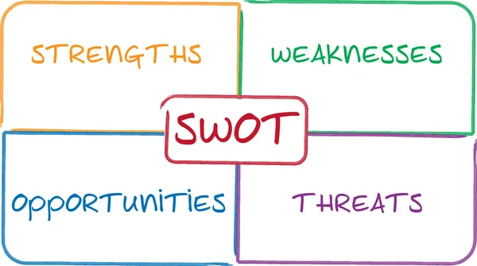
Chapter
07
SWOT Analysis:
A SWOT analysis is a strategic planning tool that helps a business identify the internal strengths, weaknesses, and external opportunities and threats that can impact the organization's growth initiatives and pursuit of its goals.
SWOT analyses work best when you set up a group brainstorming, where everyone makes suggestions for each category. When you engage employees and strategize everyone’s roles from the very beginning, they will become more invested in the outcome.

Slide 28
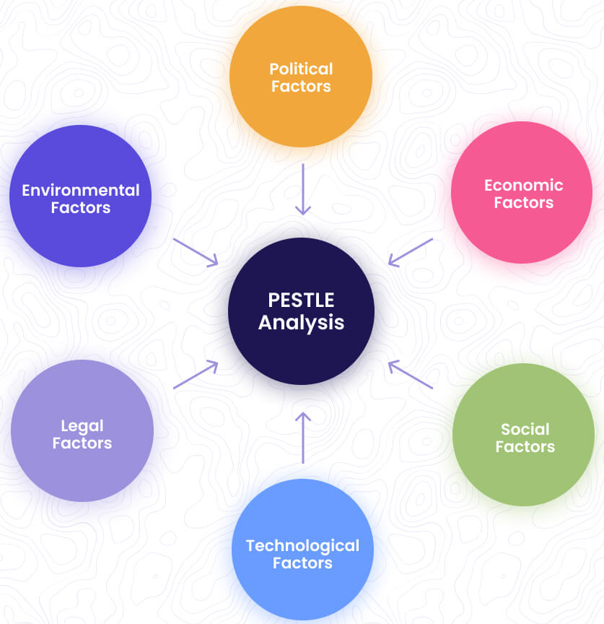
Chapter
07
PESTEL Analysis:
A PESTEL analysis is a tried-and-true approach for identifying macro-environmental factors that might impact an organization.
It helps teams with strategic decision-making, business analysis, and navigating periods of change. The term PESTEL stands for:
Political
Economic
Social
Technological
Environmental
Legal

Slide 29
Chapter
07
Step 2: Strategy
Building on the assessment, organizations formulate/clarify strategy in the Strategy step. The development of the strategy includes developing or clarifying your customer value proposition, visualizing the strategy using a Strategy Profile and decomposing the high-level strategic direction into three to four Strategic Themes (or goals). Strategic Themes are those focus areas in which the organization must excel in order to fulfill its mission and achieve its vision, given the enablers it can leverage, the challenges it must overcome, and the customer value proposition it must deliver upon.

Slide 30
Chapter
07
Step 3: Strategic Objectives
In the Strategic Objectives step, the building blocks of strategy are developed. Strategic Objectives are the linchpins of a successful strategic planning and management system and are the key to implementing strategy. Objectives are qualitative, continuous improvement actions (outcomes) critical to strategy success. Objectives are developed on the strategic theme level first and then merged together to form organization-level objectives.

Slide 31
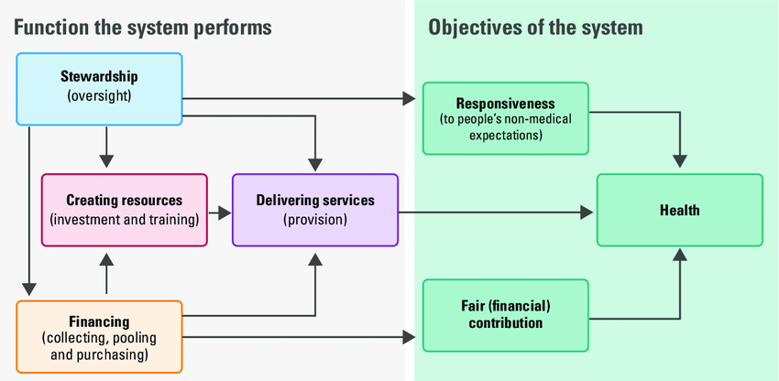
Chapter
07
Main objectives of Healthcare Systems:

Slide 32
Chapter
07
Step 4: Strategy Mapping
In the Strategy Mapping step, cause-and-effect links are developed between the Strategic Objectives, creating a “value chain” of how customers and stakeholders are satisfied by the organization’s products and services.
Strategy Maps are developed for each theme to ensure a complete strategy to achieve each strategic result and then those are merged into a final organizational Strategy Map. A Strategy Map is a graphic that shows the cause-and-effect relationships of objectives across the four perspectives, telling the story of how the organization will achieve the results desired.

Slide 33
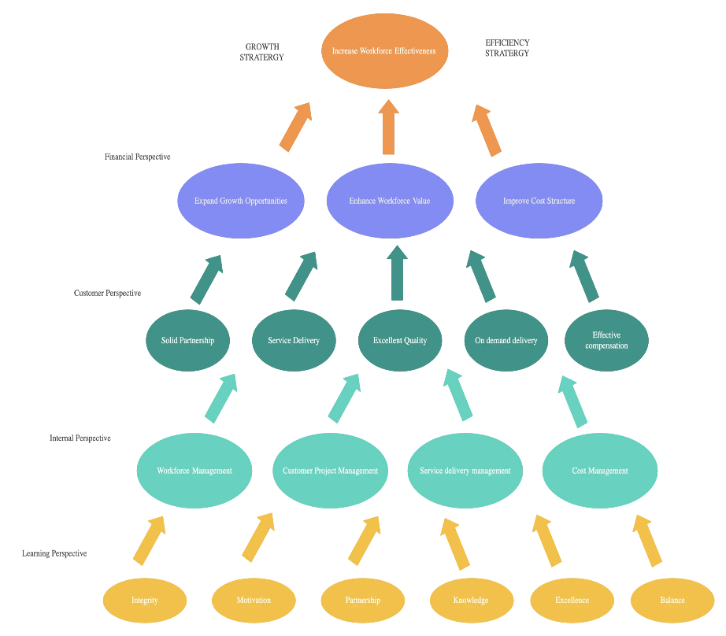
Chapter
07
Step 4: Strategy Mapping
Objectives should be linked to each other.
Objectives should have contributions.
An objective might be linked to more than one objective.
Unlinked objectives should be removed.
Objectives draw the success story of the healthcare systems.

Slide 34
Chapter
07
Step 5: Performance Measures
Performance Measures (KPIs) are critical to tracking the progress of an organization’s strategy. The image below shows the interconnectivity relationships among different types of performance measures. Operational measures focus on the use of resources, processes and production (output).
These measures “drive” the outcomes a business desires, with some outcomes being more intermediate than other, more final, outcomes. Our process gets at these relationships, so you can identify the most meaningful outcome measures to determine if your actions are leading to the strategic results you desire.

Slide 35
Chapter
07
Step 6: Strategic Initiatives
In the Strategic Initiatives step, the projects that are critical to the success of the strategy, are developed, prioritized, and implemented. Initiatives help close performance gaps in performance to hit targets.
It is important to focus the organization on the execution of the most prioritized strategic projects versus creating a long list of potential actions and projects. Without this disciplined focus, organizations struggle to execute their strategy.

Slide 36
Chapter
07
Step 7: Performance Analysis
In the Performance Analysis step, data is transformed into evidence-based knowledge and understanding.
Effective analysis helps people make better decisions that will drive improved strategic outcomes. This step focuses on measuring and evaluating performance to identify what works well and what doesn’t, taking corrective action and becoming a high-performance organization.

Slide 37
Chapter
07
Step 8: Alignment
In the Alignment step, strategy is transformed from something only executives worry about to something everyone supports by cascading high-level enterprise strategy to first business and support units and then to individual employees.
The Alignment step produces scorecards for business and support units, and individual scorecards for each employee or team.

Slide 38
Chapter
07
Step 9: Evaluation
Evaluation is an opportunity to review and refresh. During this step, leaders and managers evaluate how well the organization has accomplished desired results and how well the strategic management system improves communications, alignment and performance.
It ensures that the strategic planning and management system is dynamic and incorporates continuous improvement into day-to-day operations and management.

Slide 39
Chapter
Summary
07
Strategy planning is essential to navigate the complex and ever-changing landscape of healthcare delivery.
The healthcare landscape is constantly evolving.
The advancement in technologies is one of the main challenges in healthcare.
Good strategic plans might fail because of ineffective implementation.
Strategic Planning has six (6) levels.
Strategic Planning has nine (9) steps.

Slide 40



Thank You

Slide 41
Chapter
References:
07
Wang, H. (2016). Comparative Health Systems: A Global Perspective. In International Encyclopedia of Public Health. Jones & Bartlett Learning. https://doi.org/10.1016/B978-0-12-803678-5.00085-0
Rivki, M., Bachtiar, A. M., Informatika, T., Teknik, F., & Indonesia, U. K. (2013). healthcare Systems Around The World (Issue 112).
Will, K. K., Mutyala, J., & Essary, A. C. (2023). Health Systems Science. Jaapa, 36(6), 45–46. https://doi.org/10.1097/01.jaa.0000931464.13332.f1
https://www.mdclarity.com/glossary/social-insurance-bismarck-model
https://www.ahaap.org/out-of-pocket-model

