Slide 1


Healthcare Systems
around the world
Prepared by Dr. Abdulaziz Alsaedi
MHA611
Healthcare Systems
Lecture 04

Slide 2

Outlines:
Overview of the healthcare system.
Key component of the healthcare system.
Key functions of the healthcare system.
Types of healthcare systems.
Country ranking regarding healthcare systems.

Slide 3

Chapter
Learning Objectives
04
Understanding the healthcare systems and its key components.
Understanding the key functions of healthcare systems.
Understanding the Bismarck model of the healthcare system.
Understanding the Beveridge model of the healthcare system.
Understanding the National Health Insurance model of the healthcare system.
Understanding the out-of-pocket model of the healthcare system.
Understanding the best-ranked healthcare systems all over the world.
Book: healthcare System around the world

Slide 4
Part One:
Overview of the Healthcare Systems

Slide 5
Chapter
Overview
04
A healthcare system, often referred to as a health system, is a complex organization of people, institutions, and resources designed to deliver healthcare services to meet the health needs of populations.
A health system is the combination of resources, organization, financing and management that culminate in the delivery of health services to the population.
The World Health Organization (WHO) defines a health system as comprising all organizations, people, and actions whose primary intent is to promote, restore, or maintain health.
Book: healthcare System around the world

Slide 6
Chapter
Key Components of Healthcare Systems
04
Organizations: This includes hospitals, clinics, and other health facilities that provide care.
Personnel: healthcare professionals such as doctors, nurses, and allied health workers who deliver medical services.
Resources: Financial resources, medical supplies, and technology necessary for providing care.
Policies and Governance: Frameworks that guide the operation of the health system, ensuring it meets the needs of the population effectively.
Book: healthcare System around the world

Slide 7
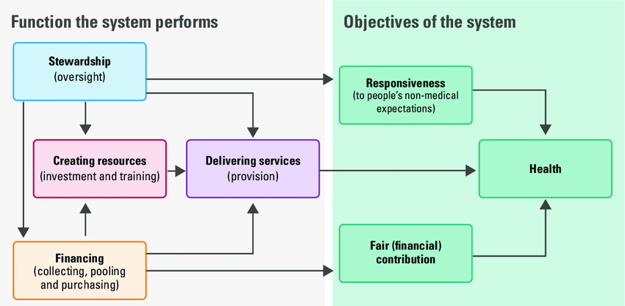
Chapter
Functions of Healthcare Systems
04
Book: healthcare System around the world

Slide 8
Chapter
Functions of Healthcare Systems
04
Healthcare systems serve several key functions:
Service Delivery: Providing medical services to individuals, including preventive, curative, and rehabilitative care.
Health Financing: Mechanisms for funding health services, which include public funding through taxes or private insurance.
Health Workforce Development: Training and maintaining a workforce capable of delivering high-quality care.
Health Information Systems: Collecting and analyzing data to inform decision-making and improve service delivery.
Book: healthcare System around the world

Slide 9
Part Two:
Types of Healthcare Systems

Slide 10
Chapter
Types of Healthcare Systems
04
Healthcare systems worldwide are diverse, reflecting the unique historical, cultural, and economic contexts of each nation.
These systems can be categorized into several primary models, each with distinct characteristics, strengths, and weaknesses.
The diversity of healthcare systems around the world arises from a combination of historical, cultural, economic, and political factors.
Each country's approach to healthcare reflects its unique context and priorities.
The differences in global healthcare systems stem from a complex interplay of historical legacies, economic conditions, political frameworks, cultural values, and international influences.
Book: healthcare System around the world

Slide 11
Chapter
Types of Healthcare Systems
04
The design and structure of healthcare systems vary widely across countries due to several factors:
Economic Conditions: Wealthier nations often have more resources to invest in comprehensive health systems compared to low-income countries.
Cultural Values: Societal beliefs about health and wellness influence how healthcare is organized and delivered.
Political Frameworks: The governance structure can determine how services are funded and managed—whether through centralized government control or decentralized market-driven approaches.
Book: healthcare System around the world

Slide 12
Chapter
Types of Healthcare Systems
04
The design and structure of healthcare systems vary widely across countries due to several factors:
Historical Context:
Colonial History: Many countries' health systems were shaped by their colonial past. For instance, former colonies may have inherited fragmented healthcare structures that reflect the interests of colonial powers rather than the needs of the local population.
Post-War Developments: After World War II, many countries established universal healthcare systems as part of rebuilding efforts. The Beveridge model in the UK is a prime example, aiming to provide comprehensive care funded through taxation.
Book: healthcare System around the world

Slide 13
Chapter
Types of Healthcare Systems
04
Economic Factors:
Level of Economic Development: Wealthier nations often have more resources to invest in healthcare infrastructure, leading to more comprehensive systems. In contrast, low-income countries may rely on out-of-pocket payments or limited public services due to budget constraints.
Healthcare Funding Models: Different funding mechanisms—such as taxation (Beveridge model), employer contributions (Bismarck model), or private insurance—impact how services are delivered and accessed.
Book: healthcare System around the world

Slide 14
Chapter
Types of Healthcare Systems
04
Political Systems
Government Structure: Countries with centralized governments may implement national healthcare systems more easily than those with decentralized or fragmented political structures. For example, Canada’s single-payer system contrasts with the multiple insurance options available in the United States.
Policy Priorities: Political ideologies influence healthcare policies. Countries that prioritize social welfare tend to adopt models that ensure universal access, while those favoring market-driven approaches may focus on private sector solutions.
Book: healthcare System around the world

Slide 15
Chapter
Types of Healthcare Systems
04
Cultural Influences
Cultural Attitudes Toward healthcare: Societal beliefs about health and wellness can shape how healthcare is organized. For instance, cultures that emphasize community and collective well-being may favor universal systems, while those valuing individualism might lean towards privatization.
Diversity of Patient Populations: Countries with diverse populations often require healthcare systems that can accommodate various cultural practices and languages, leading to tailored approaches in service delivery.
Book: healthcare System around the world

Slide 16
Chapter
Types of Healthcare Systems
04
Global Health Trends
International Organizations: The influence of organizations like the World Health Organization (WHO) encourages countries to adopt certain practices or frameworks for healthcare delivery, promoting concepts like Universal Health Coverage (UHC).
Globalization: Increased interconnectedness can lead to shared best practices but also expose countries to global market pressures that may influence their healthcare models.
Book: healthcare System around the world

Slide 17
Chapter
Types of Healthcare Systems
04
How many models/ types of healthcare systems are there?
Book: healthcare System around the world

Slide 18
Chapter
Types of Healthcare Systems
04
There are four main types of healthcare systems around the world. These are:
The Bismarck model
The Beveridge model
National health insurance (single-payer model)
Fee-for-service (out-of-pocket model)
Let’s explore each of these models in more detail.
Book: healthcare System around the world

Slide 19
Chapter
Types of Healthcare Systems
04
The Bismarck model:
The Social Insurance (Bismarck) model is a healthcare financing system that is based on the principles of social insurance.
It is named after Otto von Bismarck, the German statesman who introduced this model in the late 19th century.
The Bismarck model is characterized by the mandatory participation of individuals in a social insurance program, which is funded through contributions from both employers and employees.
These contributions are used to provide healthcare coverage to the entire population, ensuring that everyone has access to essential medical services.
Book: healthcare System around the world

Slide 20
Chapter
Types of Healthcare Systems
04
The Bismarck model (cont’d):
The government often mandates participation in these programs to ensure that the risk pool is large enough to cover the healthcare needs of the entire population.
The insurance funds are usually administered by nonprofit organizations or government agencies, which are responsible for collecting contributions, managing the funds, and reimbursing healthcare providers.
In the Bismarck model, healthcare providers are typically private entities, including hospitals, clinics, and physicians.
These providers deliver healthcare services to insured individuals and submit claims to the insurance funds for reimbursement.
Book: healthcare System around the world

Slide 21

Chapter
Types of Healthcare Systems
04
The Bismarck model (Example):
Germany:
Germany is often considered the birthplace of the Bismarck model.
The country has a multi-payer system, with multiple insurance funds covering different occupational groups.
The government regulates these funds and ensures that they provide comprehensive healthcare coverage to all insured individuals.
Book: healthcare System around the world

Slide 22



Chapter
Types of Healthcare Systems
04
The Bismarck model (Example):
France
Japan
Netherland
Book: healthcare System around the world

Slide 23
Chapter
Types of Healthcare Systems
04
2. The Beveridge model
It is a healthcare system that is based on the principles outlined by Sir William Beveridge in his 1942 report titled "Social Insurance and Allied Services. It is also known as the National Health Services (NHS).
The NHS model is a publicly funded healthcare system that provides comprehensive medical services to all residents of a country, regardless of their ability to pay.
The main objective of the NHS model is to ensure that healthcare services are accessible to all citizens, regardless of their socioeconomic status.
It is based on the principle of social solidarity, where the entire population contributes to the funding of healthcare through taxes or other forms of mandatory contributions.
Book: healthcare System around the world

Slide 24
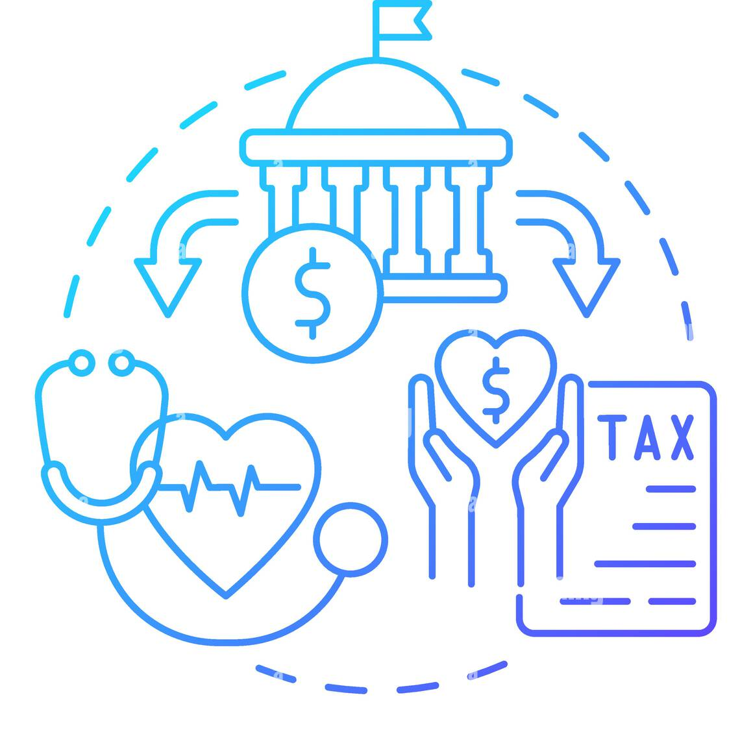
Chapter
Types of Healthcare Systems
04
2. The Beveridge model (cont’d):
Key features:
  Universal Coverage
  Publicly Funded
  Comprehensive Services
  Free at the Point of Service
  Government Control
Book: healthcare System around the world

Slide 25

Chapter
Types of Healthcare Systems
04
2. The Beveridge model (Example):
Britain:
The United Kingdom is the birthplace of the NHS model.
The National Health Service was established in 1948 and provides comprehensive healthcare services to all residents of England, Scotland, Wales, and Northern Ireland.
While the Bismarck model and Beveridge model share the goal of providing universal healthcare coverage, they differ in terms of funding, administration, and the role of the government.
Book: healthcare System around the world

Slide 26



Chapter
Types of Healthcare Systems
04
2. The Beveridge model (Example):
Spain
Australia
New Zealand
Book: healthcare System around the world

Slide 27
Chapter
Types of Healthcare Systems
04
3. National health insurance (single-payer model)
This system has elements of both Beveridge and Bismarck.
It uses private-sector providers, but payment comes from a government-run insurance program that every citizen pays into.
Since there’s no need for marketing, no financial motive to deny claims, and no profit, these universal insurance programs tend to be cheaper and much simpler administratively than American-style for-profit insurance.
The single-payer tends to have considerable market power to negotiate for lower prices.
Book: healthcare System around the world

Slide 28
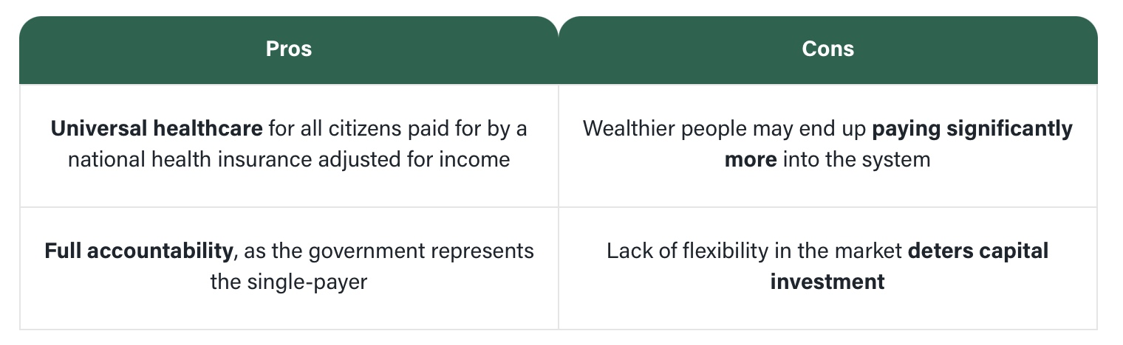
Chapter
Types of Healthcare Systems
04
3. National health insurance (single-payer model)
Book: healthcare System around the world

Slide 29



Chapter
Types of Healthcare Systems
04
3. National health insurance (Example):
Canada
Taiwan
South Korea
Book: healthcare System around the world

Slide 30
Chapter
Types of Healthcare Systems
04
4. Fee-for-service (out-of-pocket model):
The out-of-pocket healthcare system, sometimes known as the fee-for-service model, is entirely decentralized, with zero or next-to-zero government intervention both in terms of funding and delivery.
In countries that use the out-of-pocket model, citizens are expected to pay for their own healthcare costs ‘out of pocket’ at the point-of-care, i.e. with their own money.
The chief advantage of the out-of-pocket model is that it facilitates rapid developments in the healthcare sector. Since medical and pharmaceutical providers compete with each other to provide faster, more effective and cheaper products and services, their patients benefit from more flexibility and access to the latest-and-greatest healthcare.

Slide 31
Chapter
Types of Healthcare Systems
04
4. Fee-for-service (out-of-pocket model):
Benefits | Faults
People don’t need to pay for others’ healthcare, besides their own and their dependents. Doesn’t require public management. Businesses and practitioners have the freedom to charge any amount. Service is often immediate if you can pay. | Decreased longevity of life compared to mass medical care systems. Higher healthcare costs for all. Varying prices across the board. Unequal healthcare access and coverage. Resources, facilities, and doctors are of limited supply and often unclean or less educated than in mass systems.

Slide 32



Chapter
Types of Healthcare Systems
04
4. Fee-for-service (Example):
USA
Pakistan
India

Slide 33
Part Four:
Which is the best Healthcare System?

Slide 34
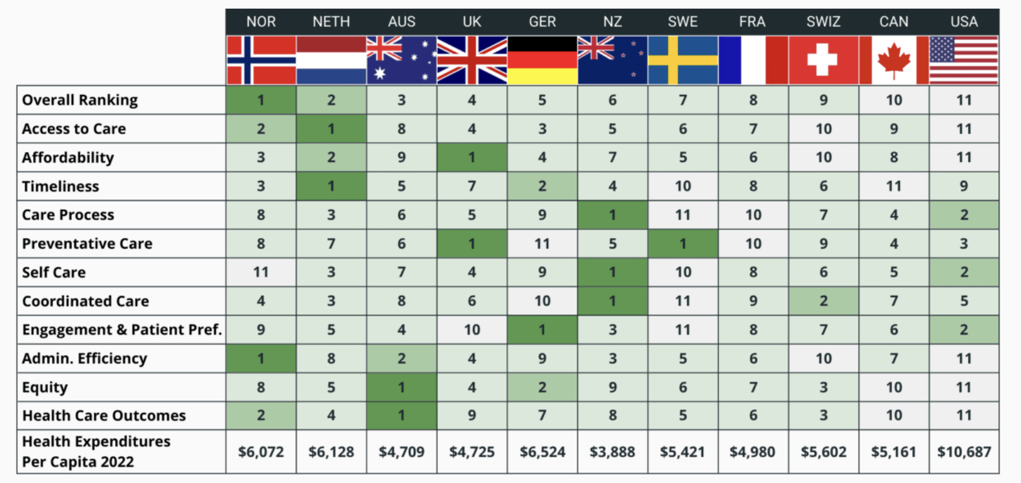
Chapter
Best Healthcare in the World
04
Book: healthcare System around the world

Slide 35
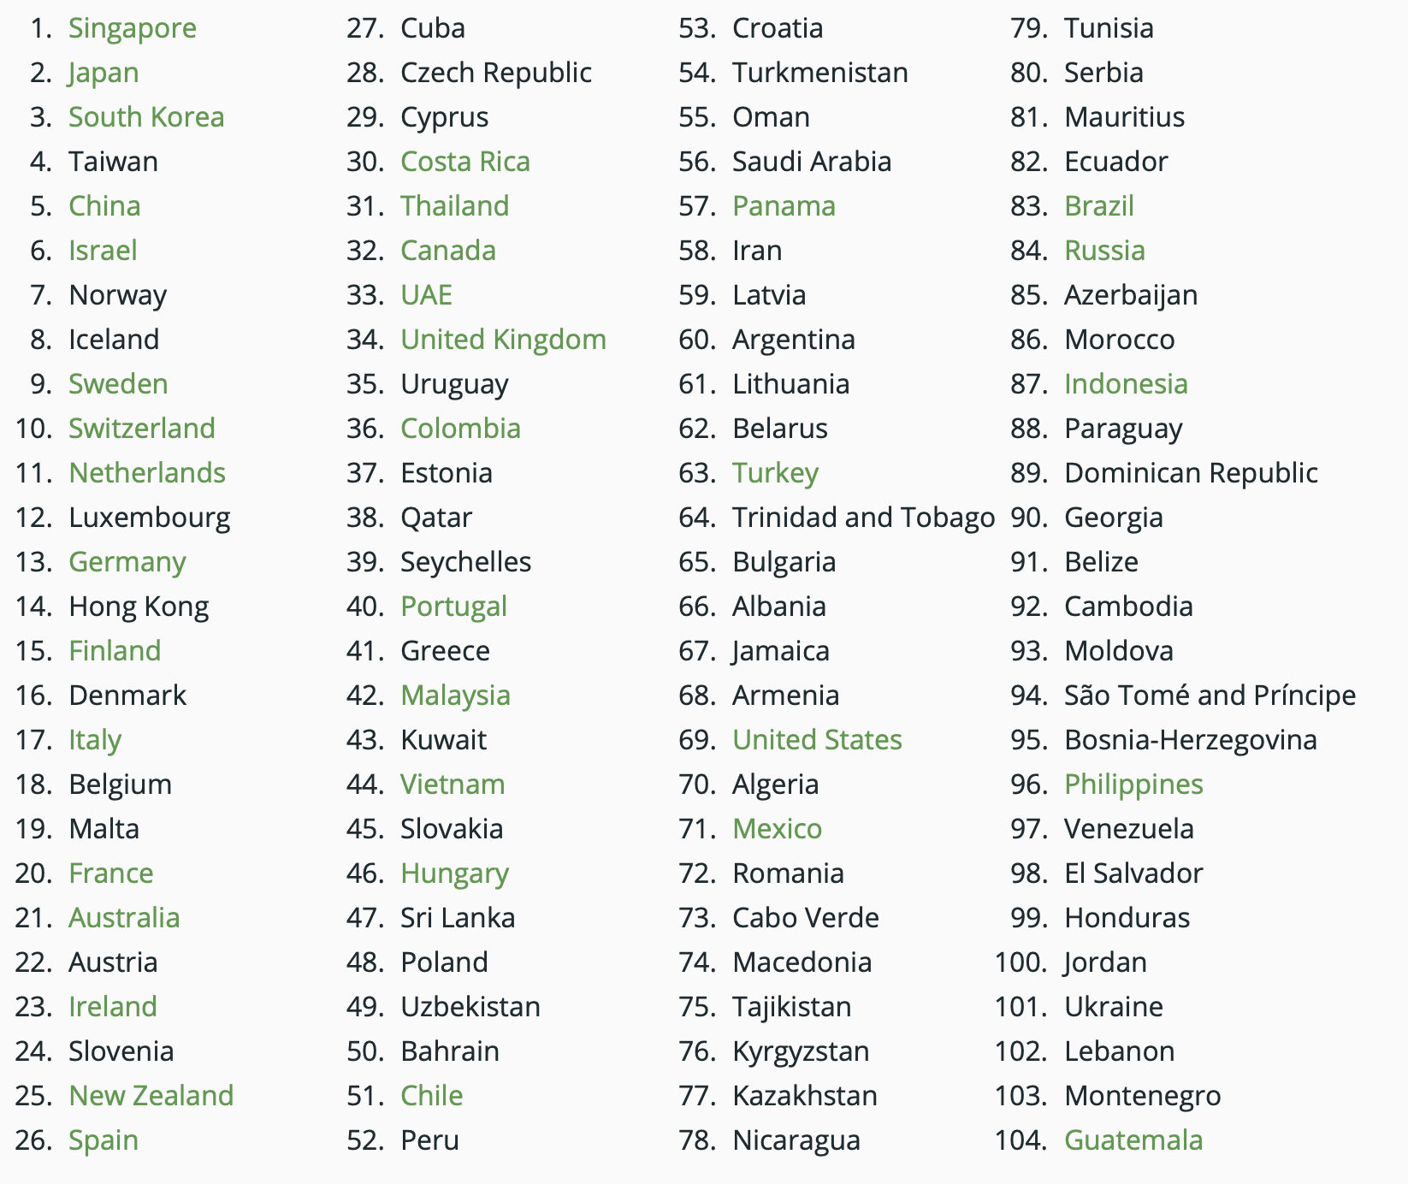
Chapter
Best Healthcare in the World
04
First : Singapore
Last: Guatemala
Source: Legatum Institute and Prosperity.com

Slide 36
Chapter
Best Healthcare in the World
04
The Best Healthcare Systems in the World in 2024
The Legatum Institute, a London-based think tank, has also evaluated where to find the best healthcare in the world. Its 2023 report includes a "Health pillar" based on how healthy a society is and whether people can access tools to maintain their health, including healthcare services. Of course, in most countries, you'll need a travel insurance plan for short visits for up to one year or an international medical insurance plan if you want long-term medical coverage for a year or more to access these services.
According to this assessment, what country has the best healthcare? Singapore comes in at No. 1! Japan and South Korea came in 2nd and 3rd.
In this assessment, The USA came in 69th!
Source: Legatum Institute and Prosperity.com

Slide 37
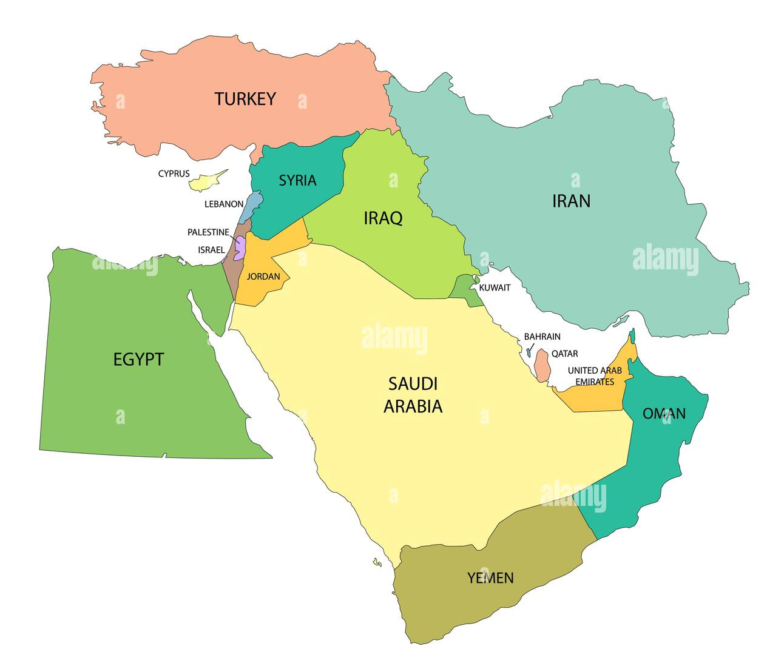
Chapter
Best Healthcare in the World
04
Middle East countries
United Arab Emirates (33)
Qatar (38)
Kuwait (43)
Bahrain (50)
Oman (55)
Saudi Arabia (56)
Iran (58)
Turkey (63)
Jordan (100)
Lebanon (102)
Source: Legatum Institute and Prosperity.com

Slide 38
Chapter
Summary
04
Healthcare systems are considered as an integration of multiple resources to provide and ensure health.
Healthcare systems have four key components.
Healthcare systems have four key functions.
Healthcare systems are categorized into four main models.
Singapore is the 1st ranked healthcare in the world.
Book: healthcare Science

Slide 39



Thank You

Slide 40
Chapter
References:
02
Wang, H. (2016). Comparative Health Systems: A Global Perspective. In International Encyclopedia of Public Health. Jones & Bartlett Learning. https://doi.org/10.1016/B978-0-12-803678-5.00085-0
Rivki, M., Bachtiar, A. M., Informatika, T., Teknik, F., & Indonesia, U. K. (2013). healthcare Systems Around The World (Issue 112).
Will, K. K., Mutyala, J., & Essary, A. C. (2023). Health Systems Science. Jaapa, 36(6), 45–46. https://doi.org/10.1097/01.jaa.0000931464.13332.f1
https://www.mdclarity.com/glossary/social-insurance-bismarck-model
https://www.ahaap.org/out-of-pocket-model

