Slide 1



IPv6 Addressing
Lecture 6
CCNA – Introduction to Networks V7.0 (ITN)
Prepared by
Dr. Abdelrhman Ahmed

Slide 2
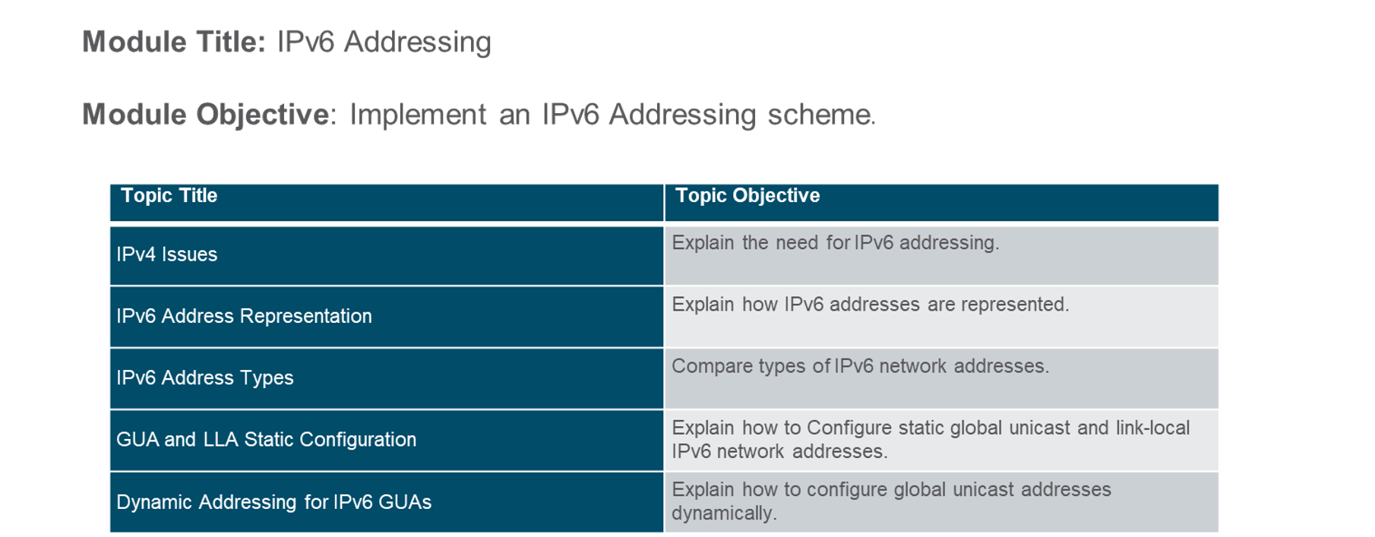
Chapter
Module Objectives
06

Slide 3
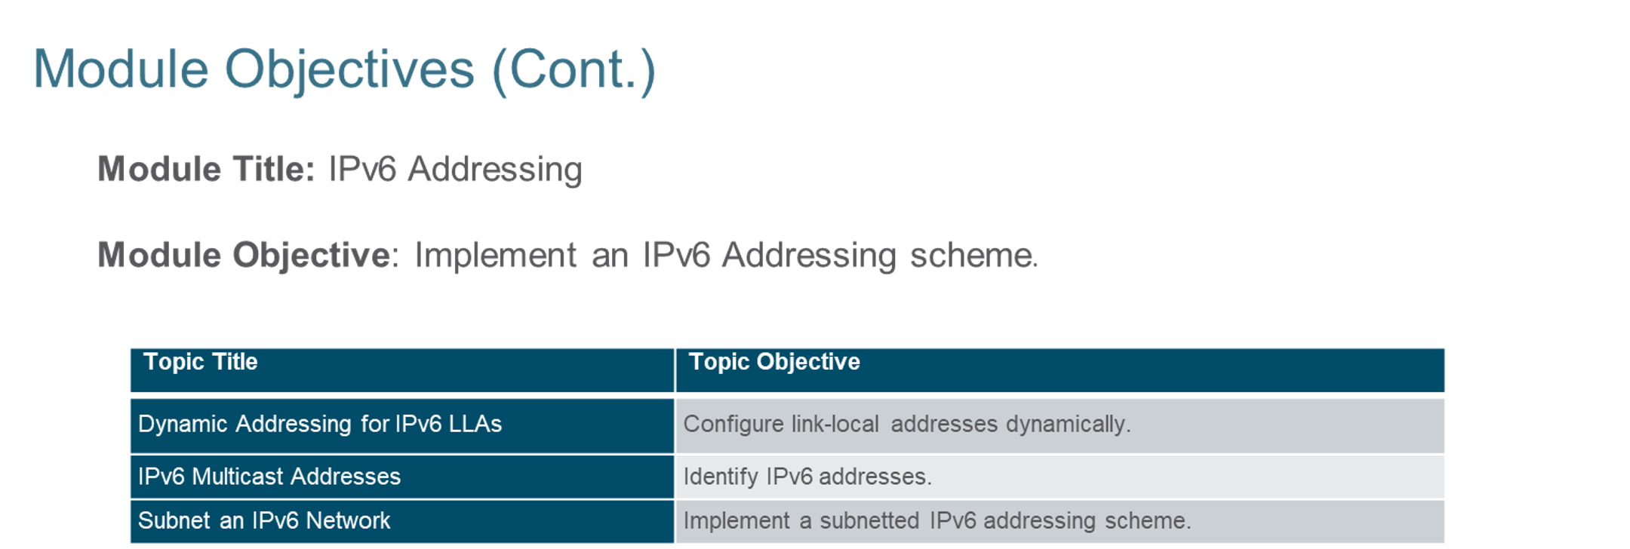
Chapter
Module Objectives
06

Slide 4
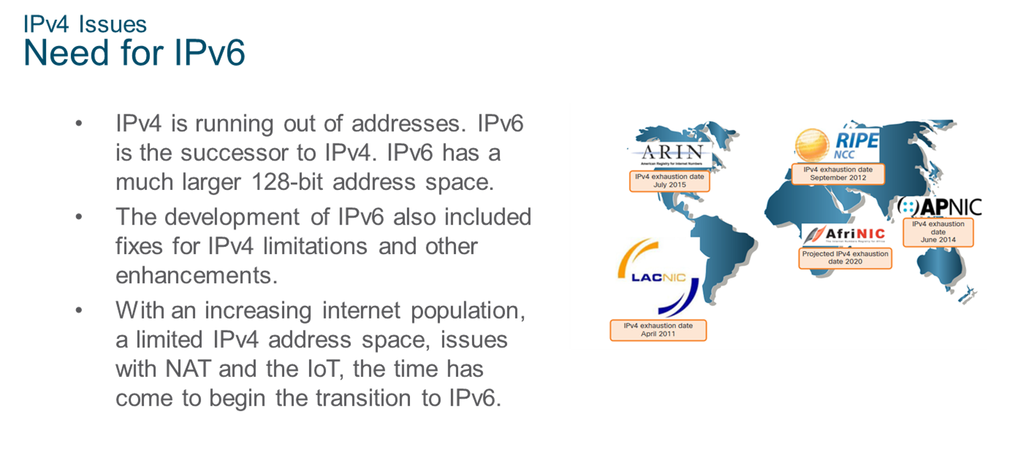
Chapter
IPv4 Issues
06

Slide 5
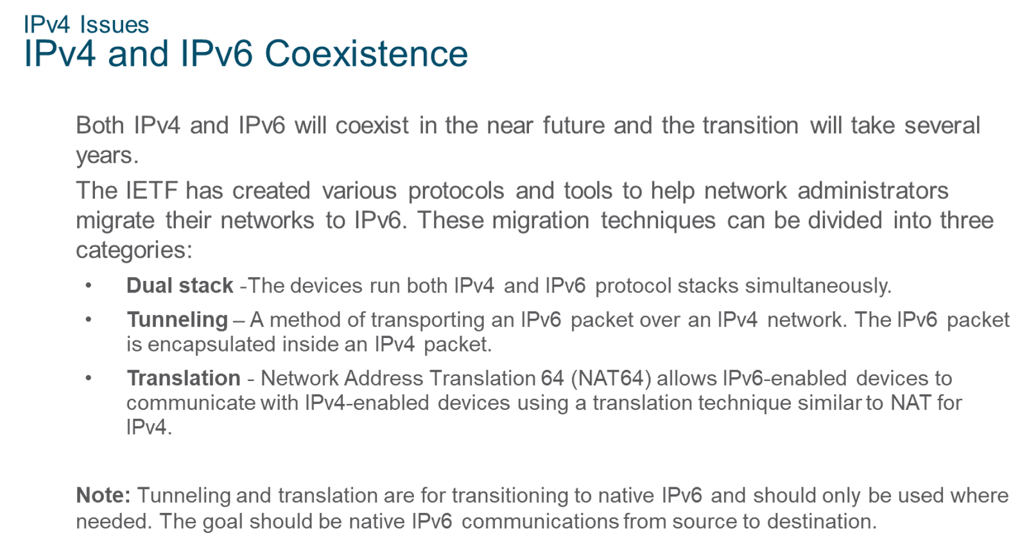
Chapter
IPv4 Issues
06

Slide 6
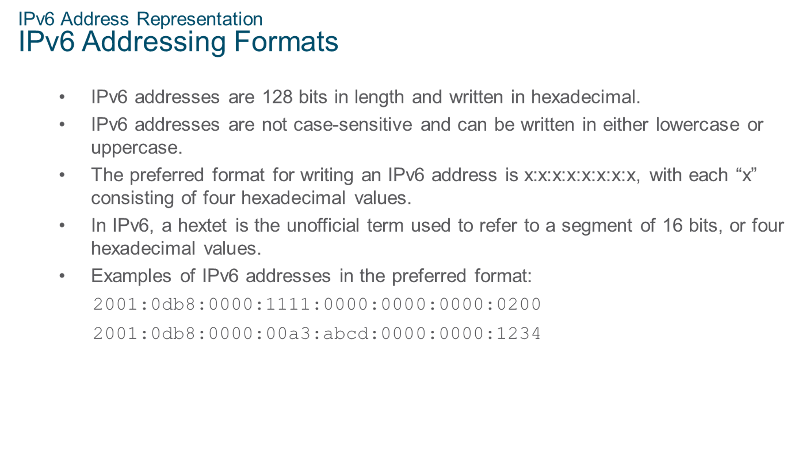
Chapter
IPv6 Address Representation
06

Slide 7
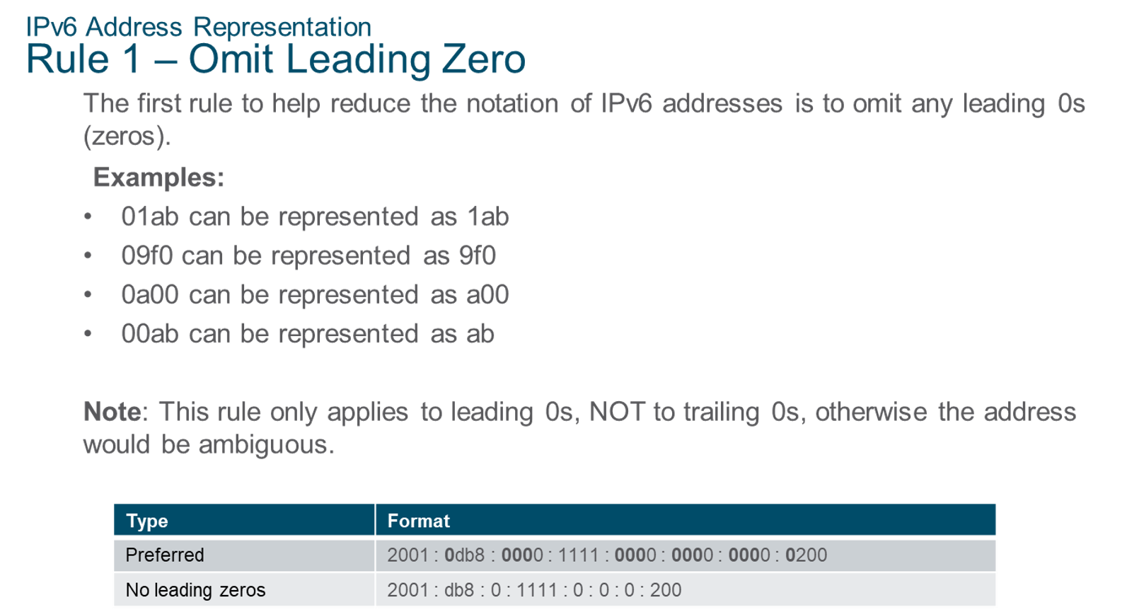
Chapter
IPv6 Address Representation
06

Slide 8
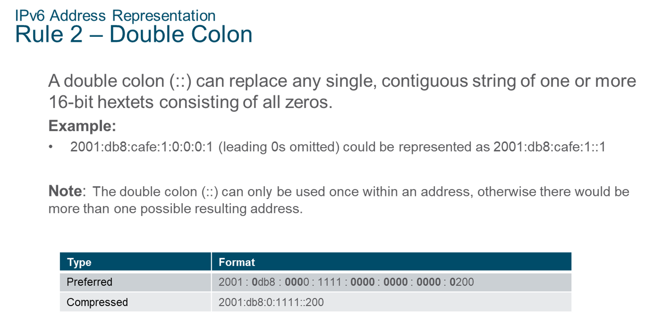
Chapter
IPv6 Address Representation
06

Slide 9
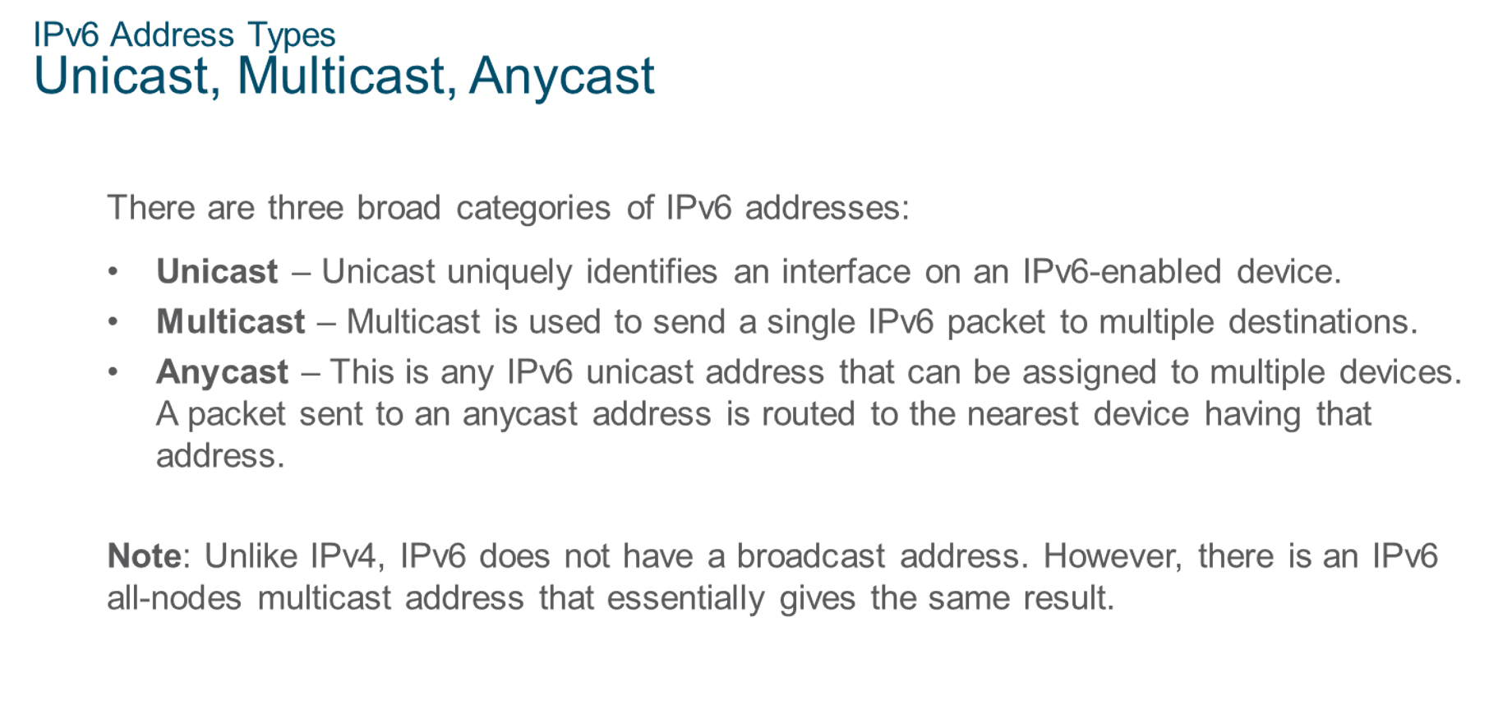
Chapter
IPv6 Address Types
06

Slide 10
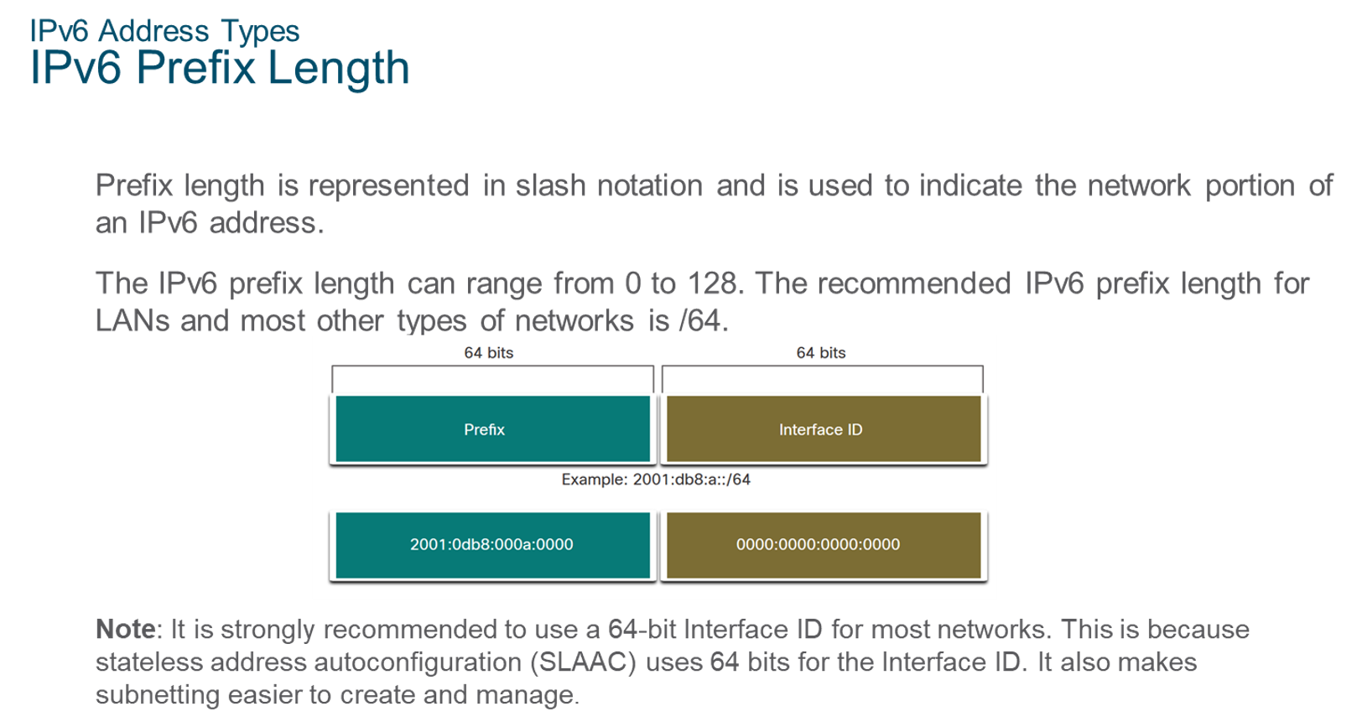
Chapter
IPv6 Address Types
06

Slide 11
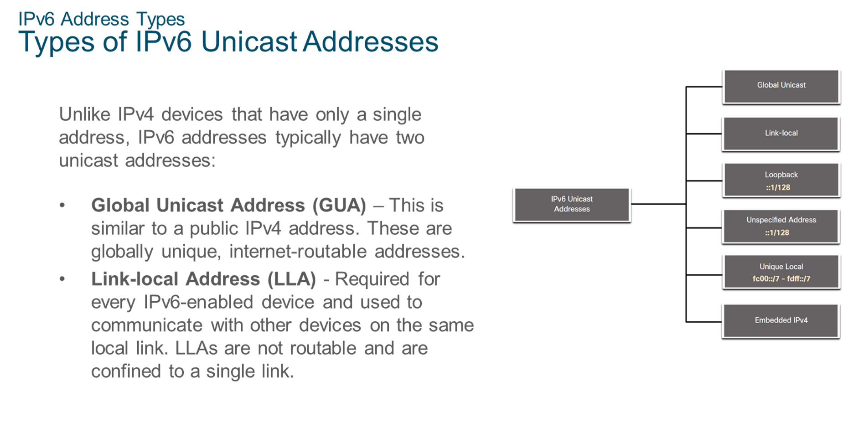
Chapter
06
IPv6 Address Types

Slide 12
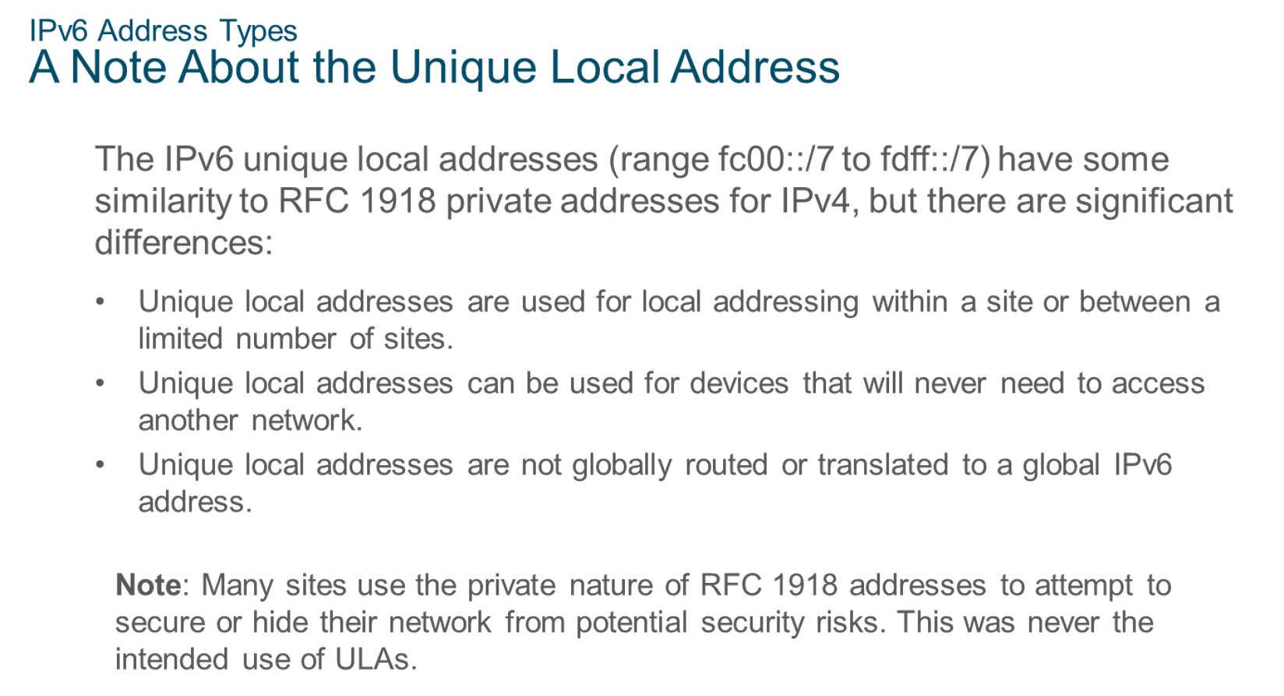
Chapter
IPv6 Address Types
06

Slide 13
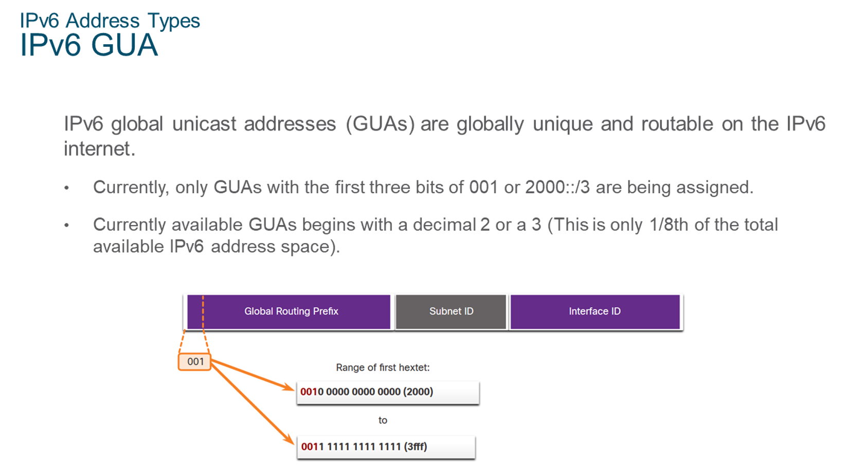
Chapter
IPv6 Address Types
06

Slide 14
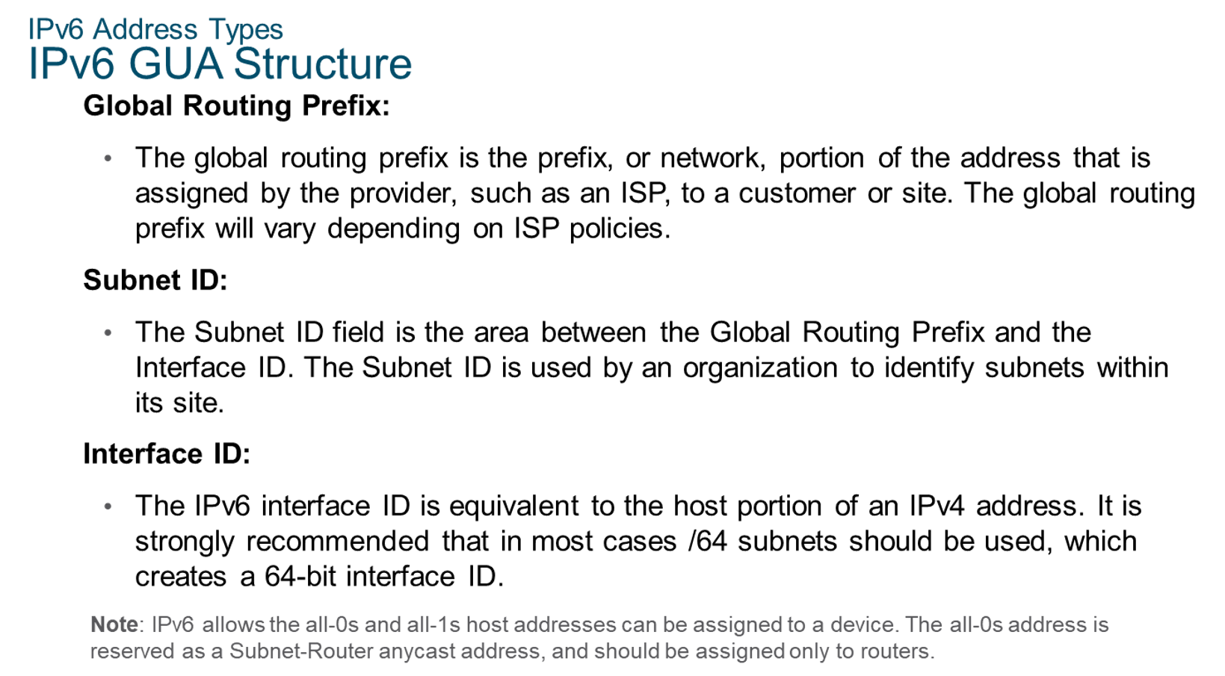
Chapter
IPv6 Address Types
06

Slide 15
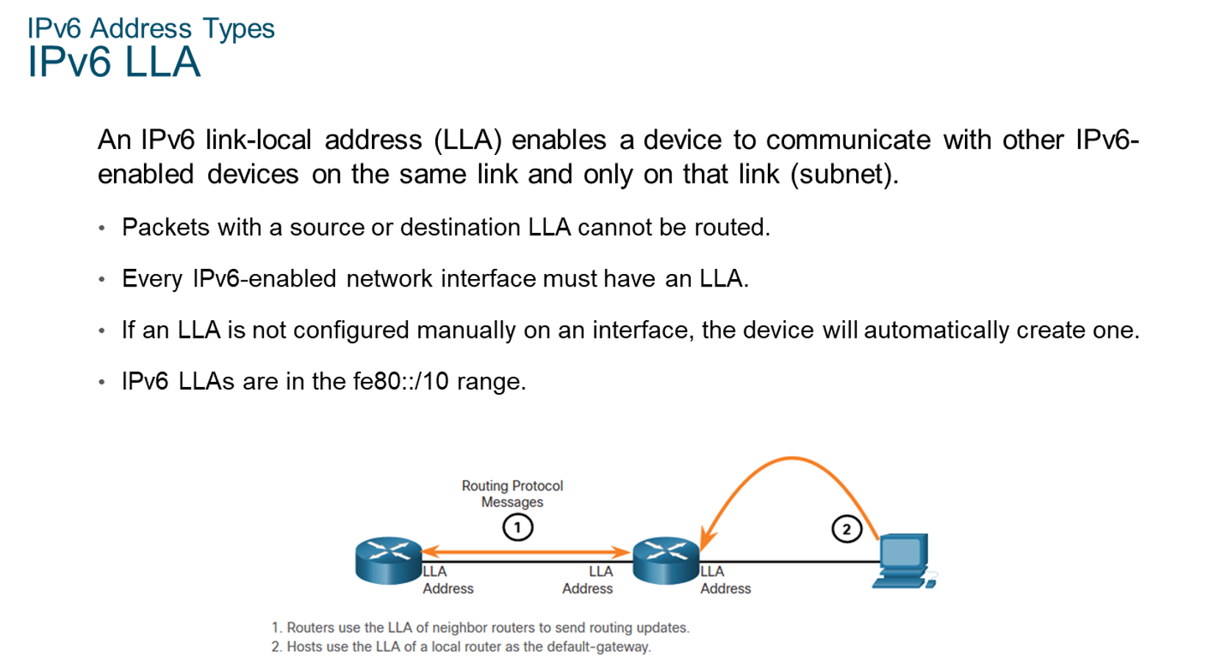
Chapter
IPv6 Address Types
06

Slide 16
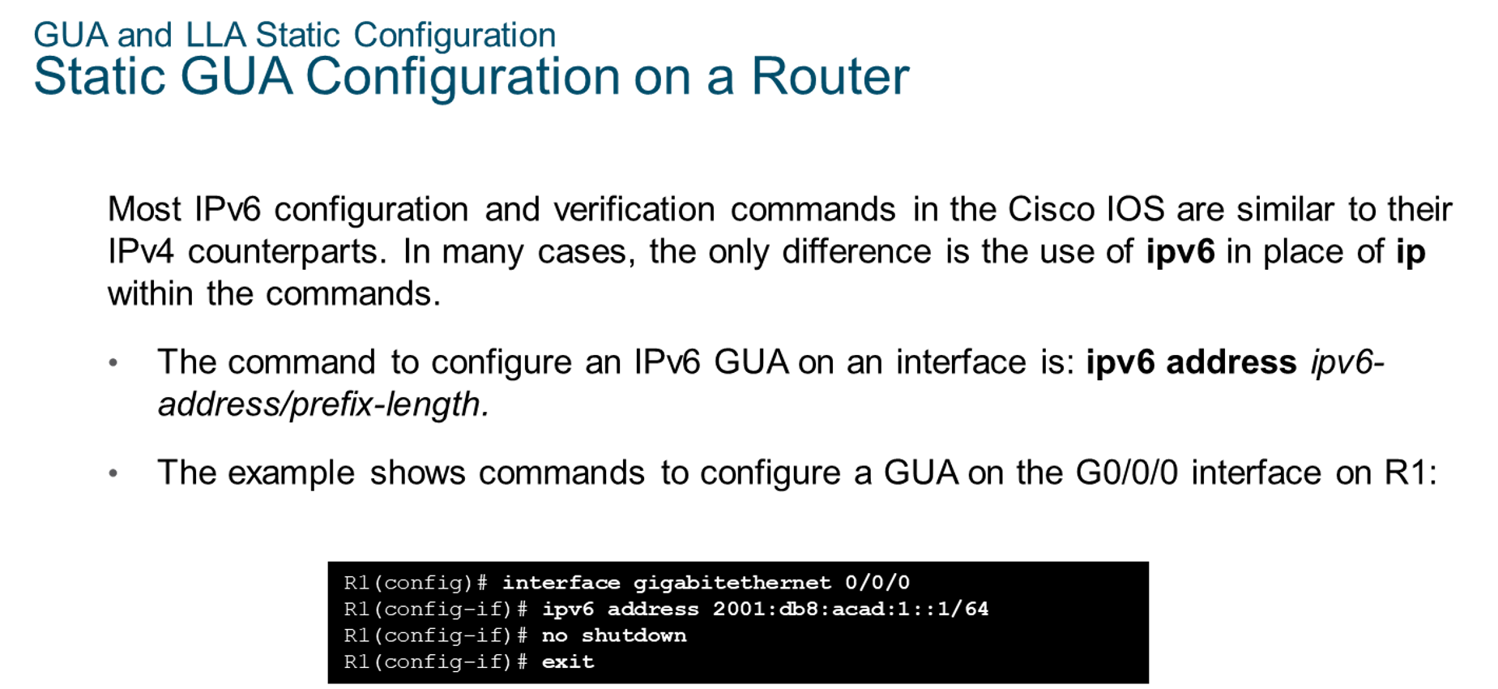
Chapter
GUA and LLA Static Configuration
06

Slide 17
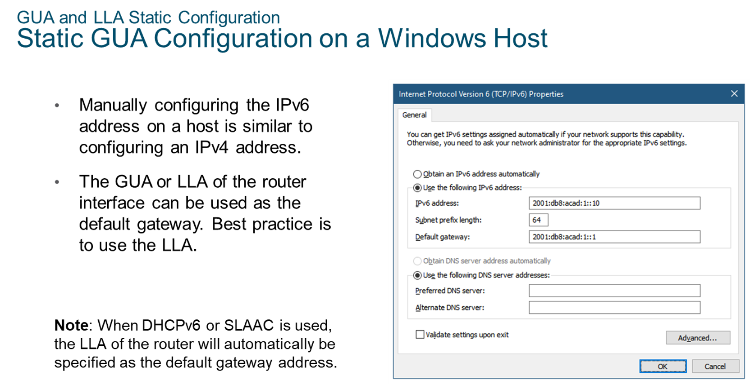
Chapter
GUA and LLA Static Configuration
06

Slide 18
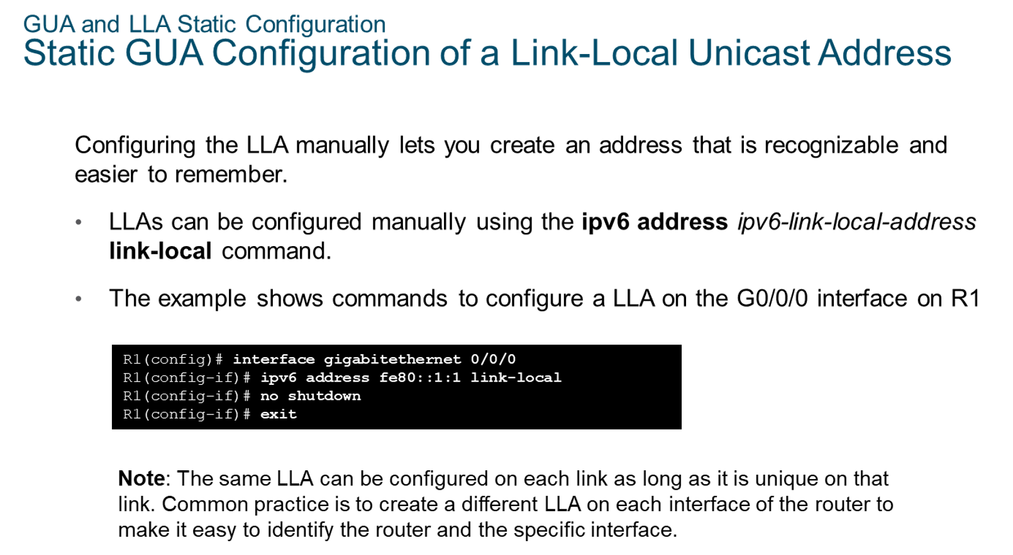
Chapter
GUA and LLA static Configuration
06

Slide 19
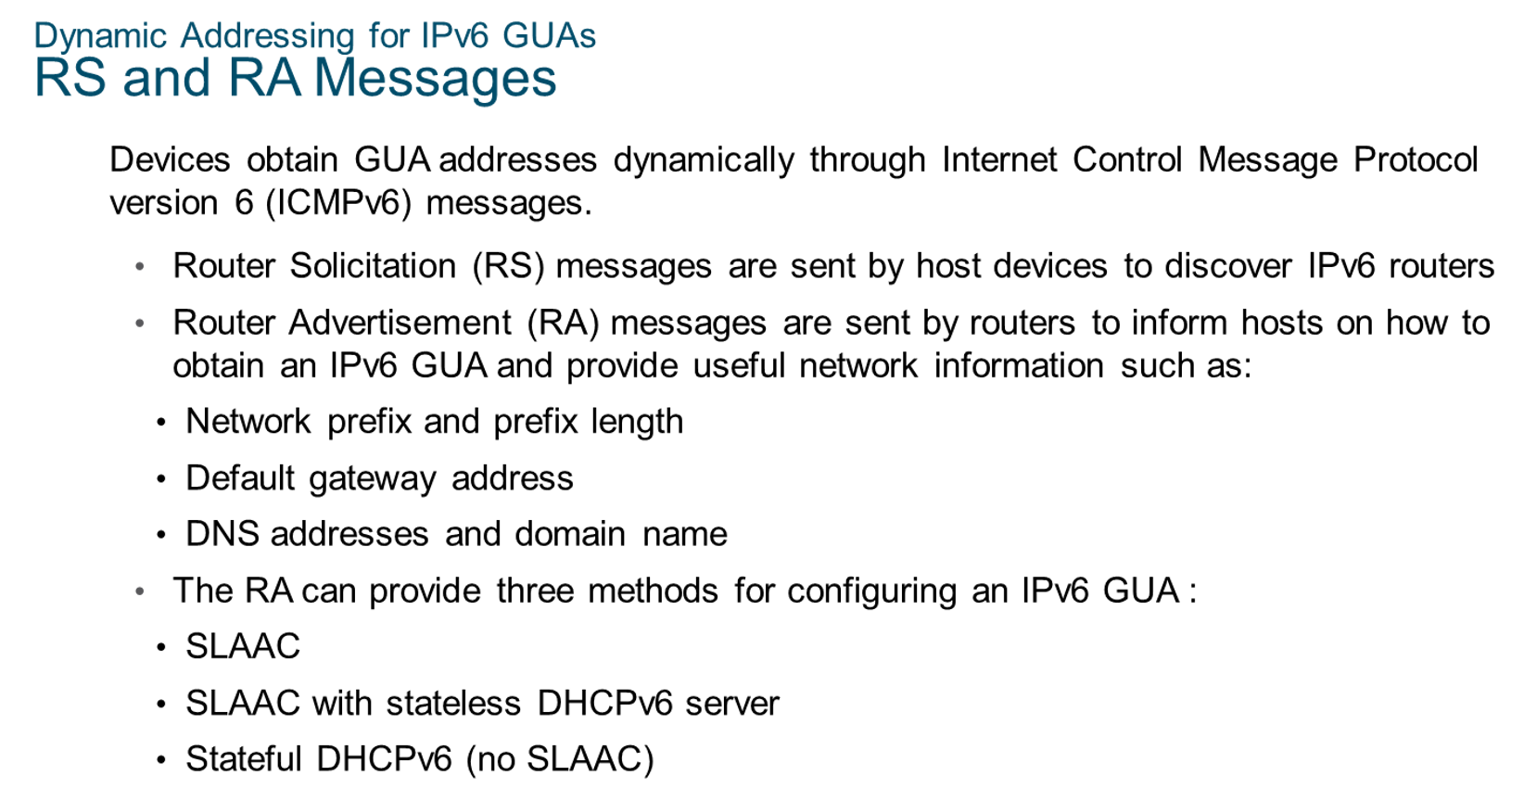
Chapter
Dynamic Addressing for IPv6 GUAs
06

Slide 20
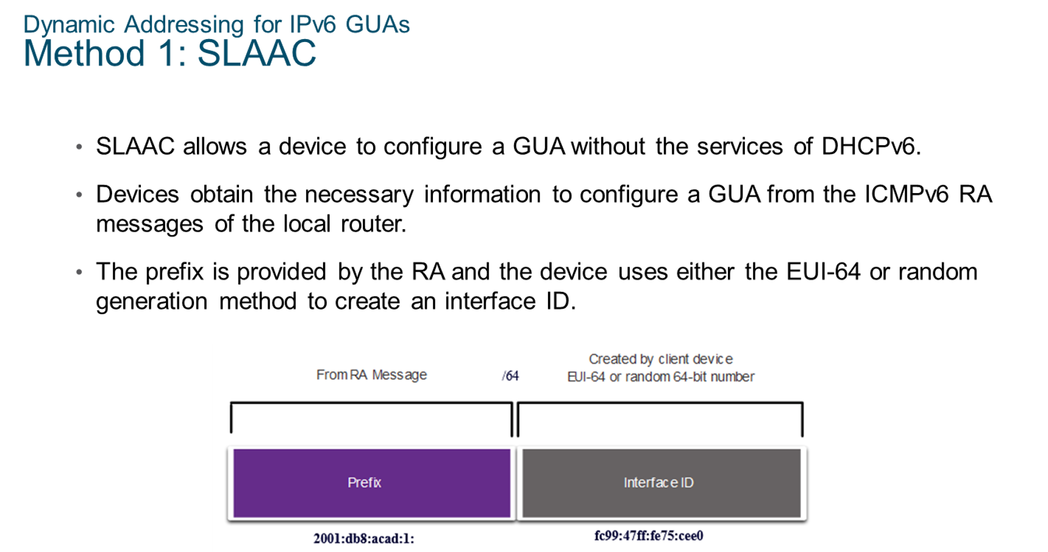
Chapter
Dynamic Addressing for IPv6 GUAs
06

Slide 21
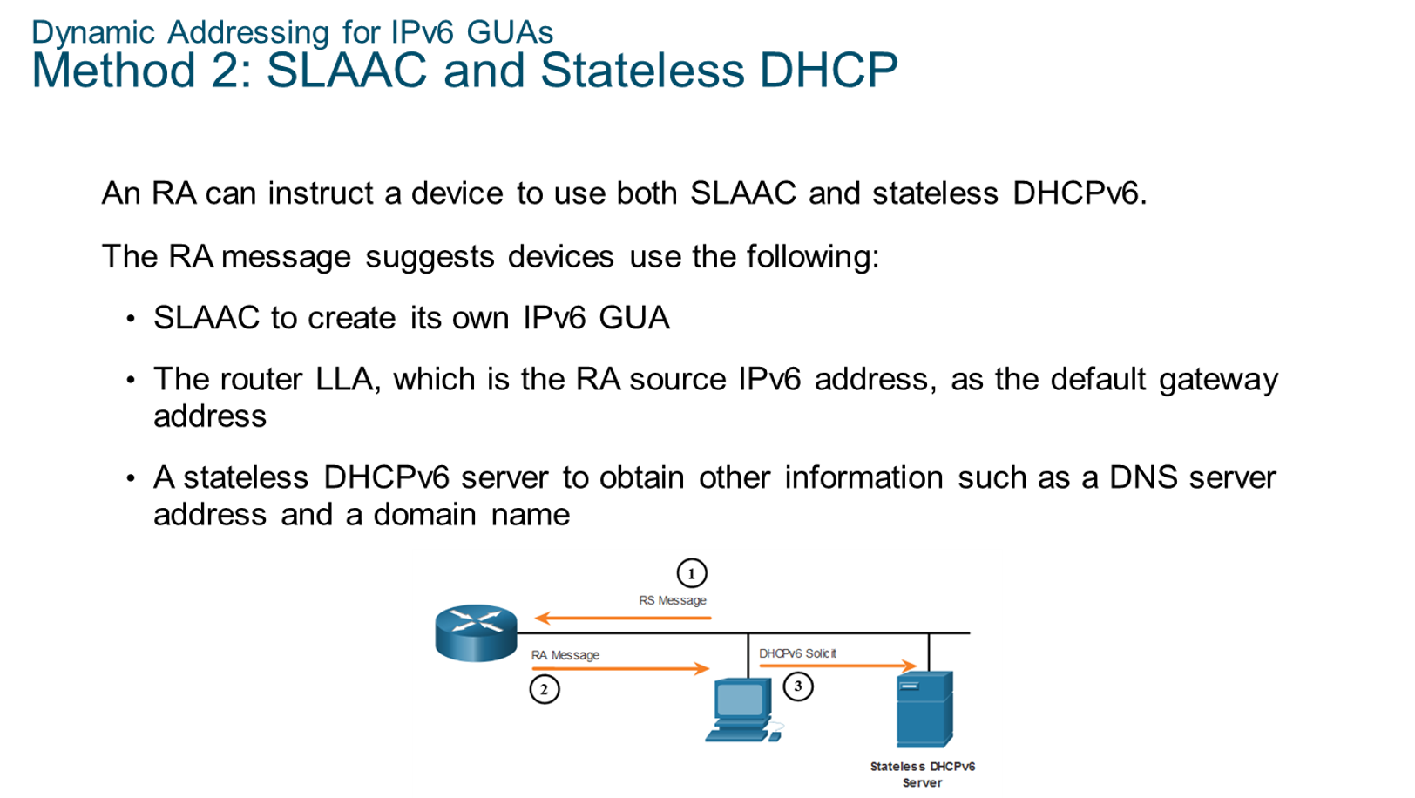
Chapter
Dynamic Addressing for IPv6 GUAs
06

Slide 22
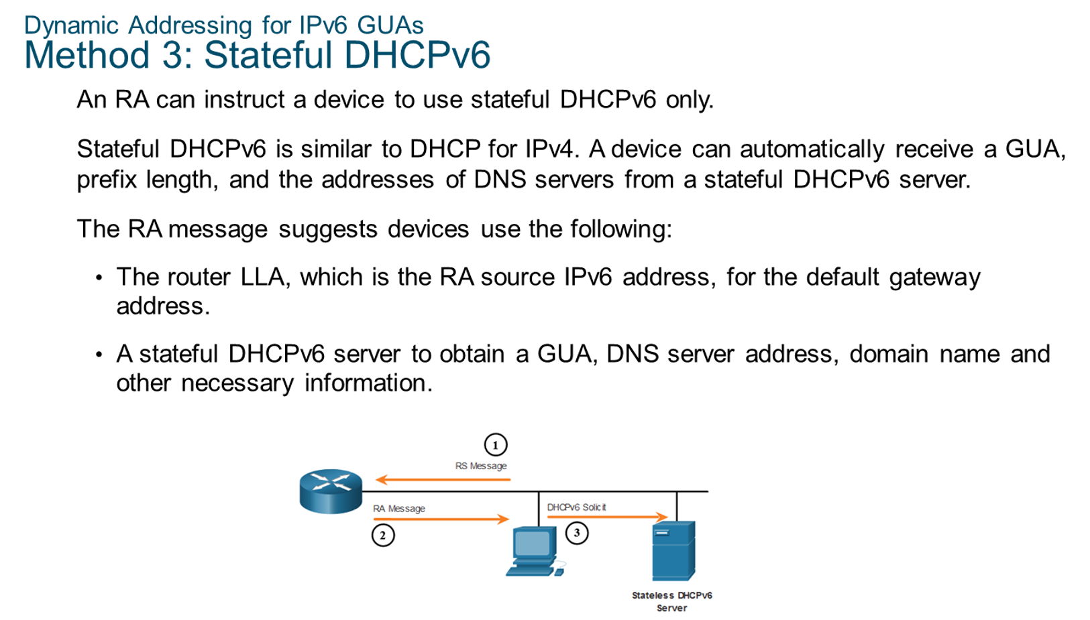
Chapter
Dynamic Addressing for IPv6 GUAs
06

Slide 23
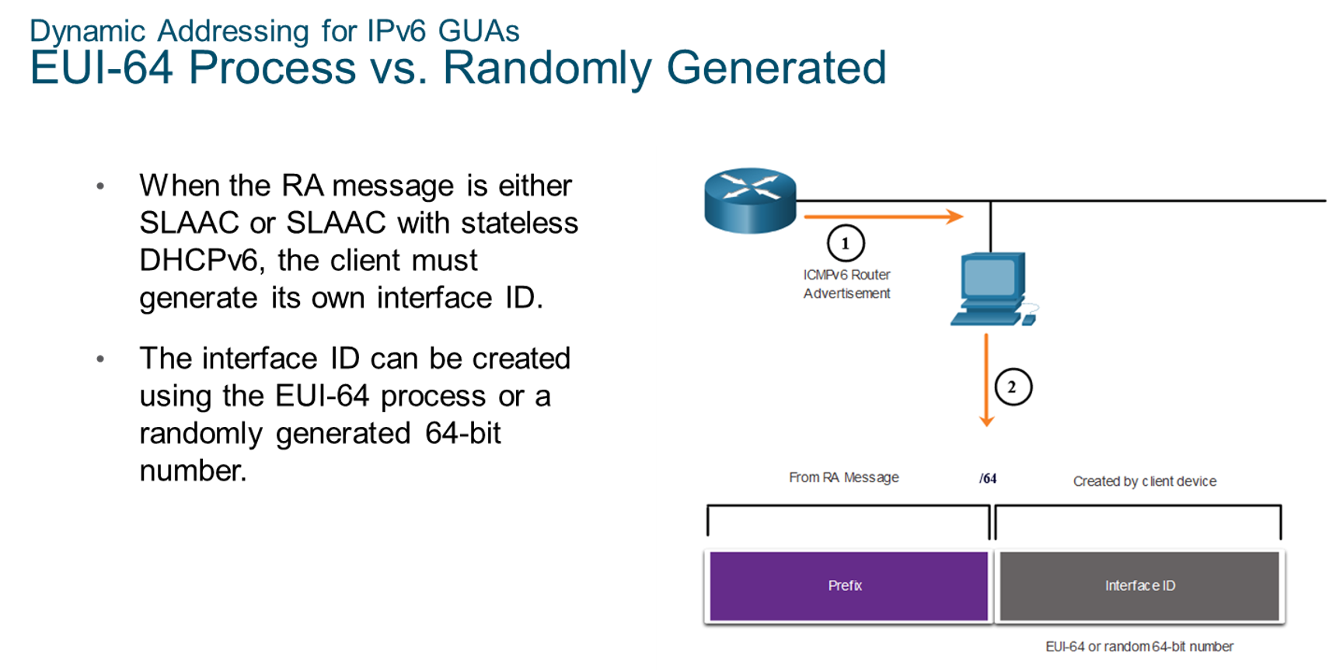
Chapter
Dynamic Addressing for IPv6 GUAs
06

Slide 24
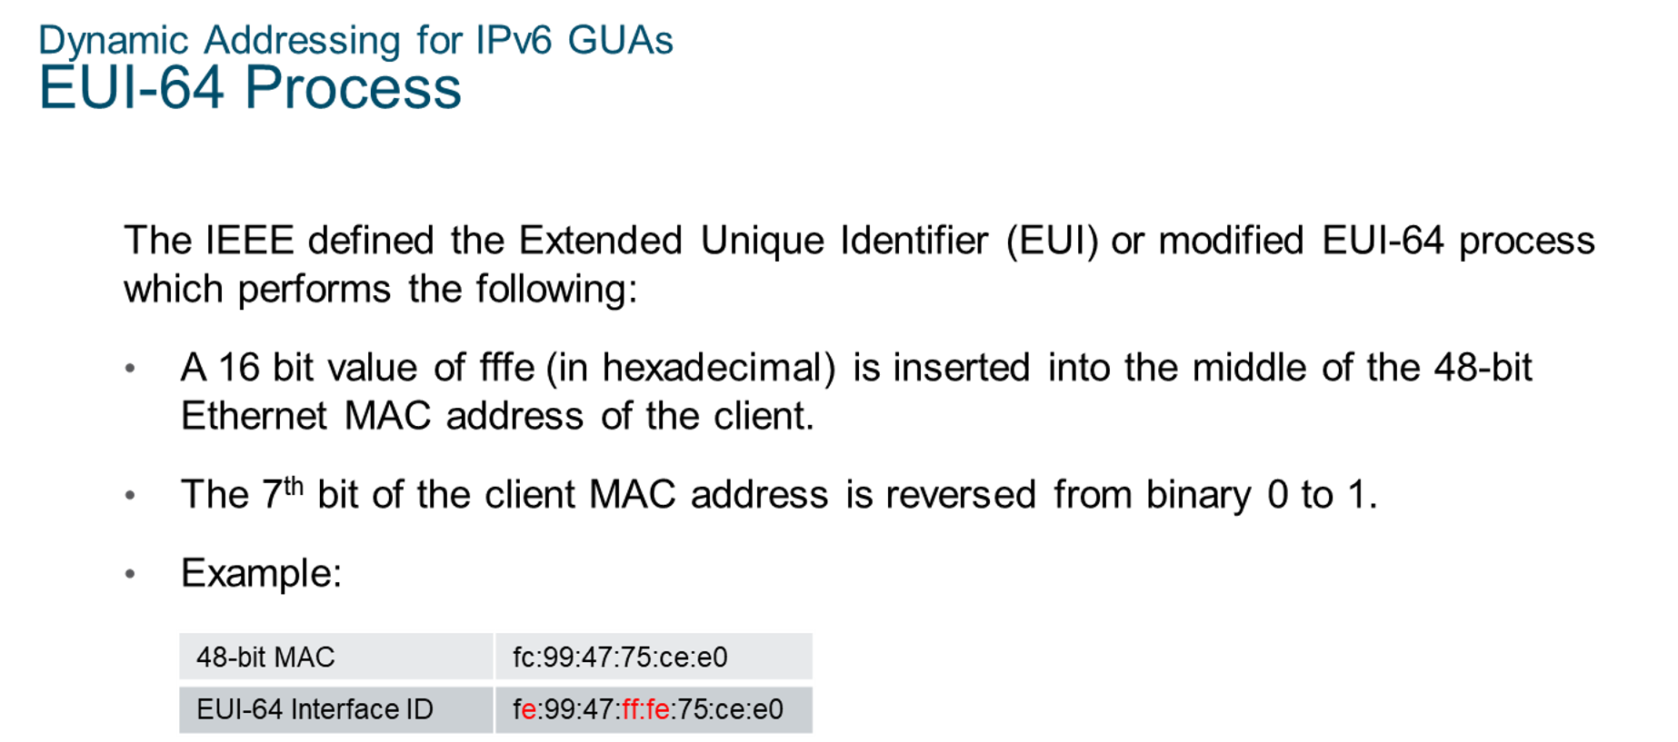
Chapter
Dynamic Addressing for IPv6 GUAs
06

Slide 25
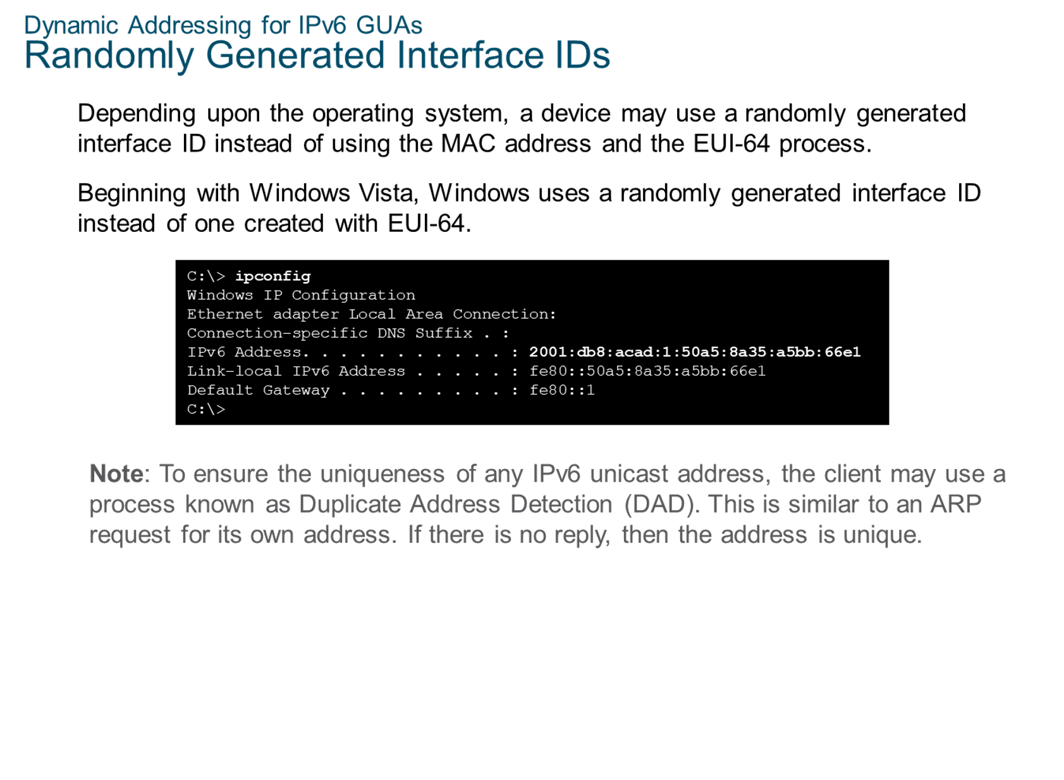
Chapter
Dynamic Addressing for IPv6 GUAs
06

Slide 26
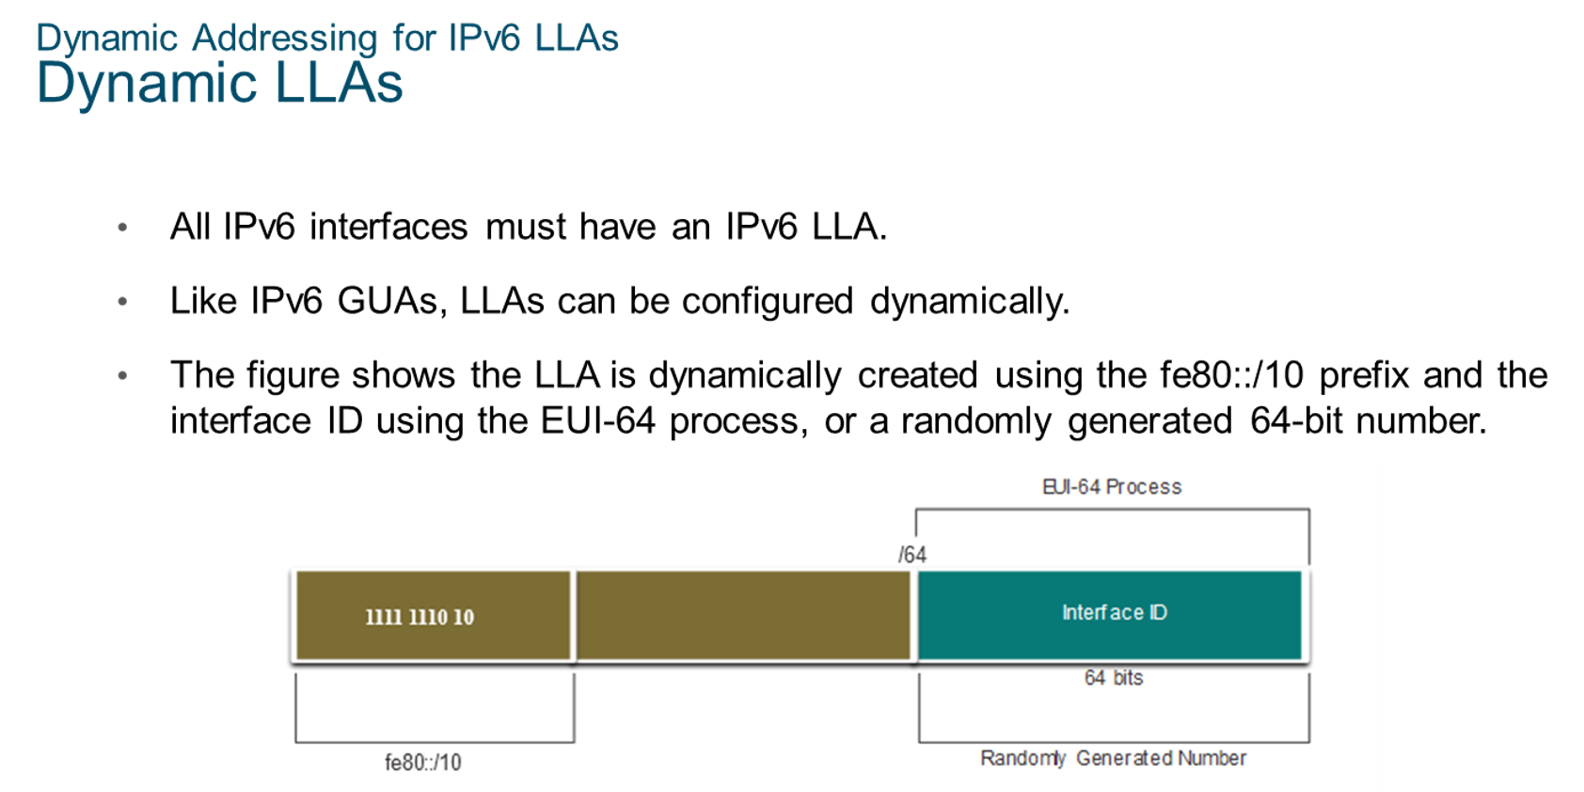
Chapter
Dynamic Addressing for IPv6 LLAs
06

Slide 27
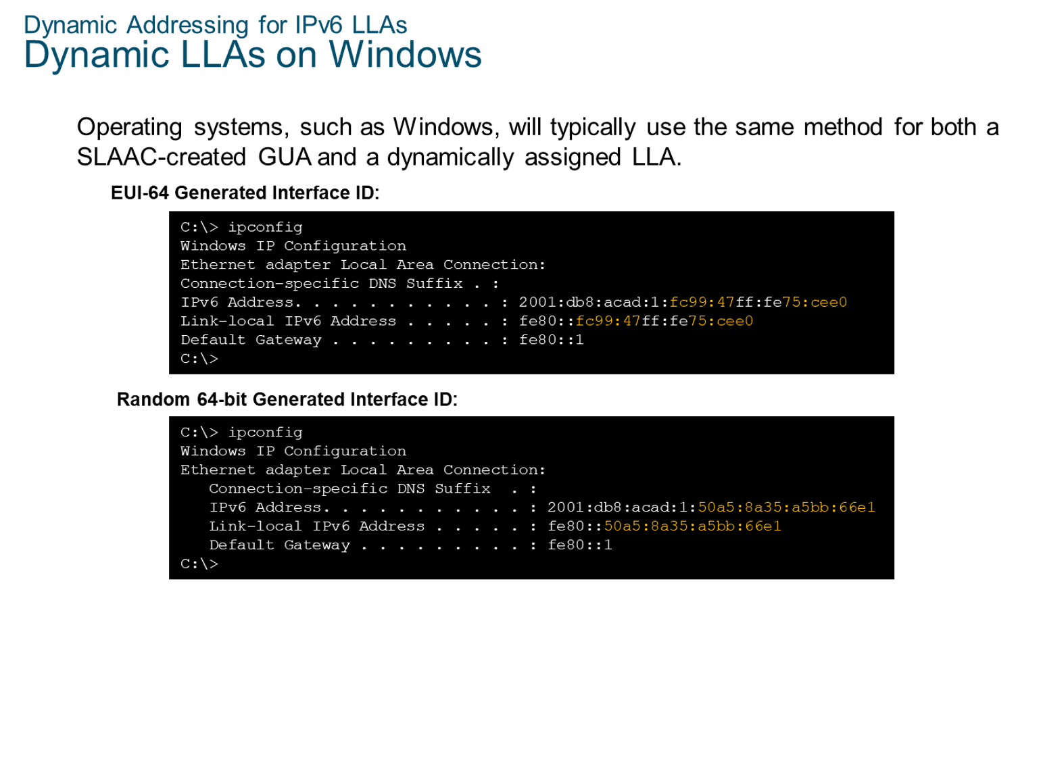
Chapter
Dynamic Addressing for IPv6 LLAs
06

Slide 28
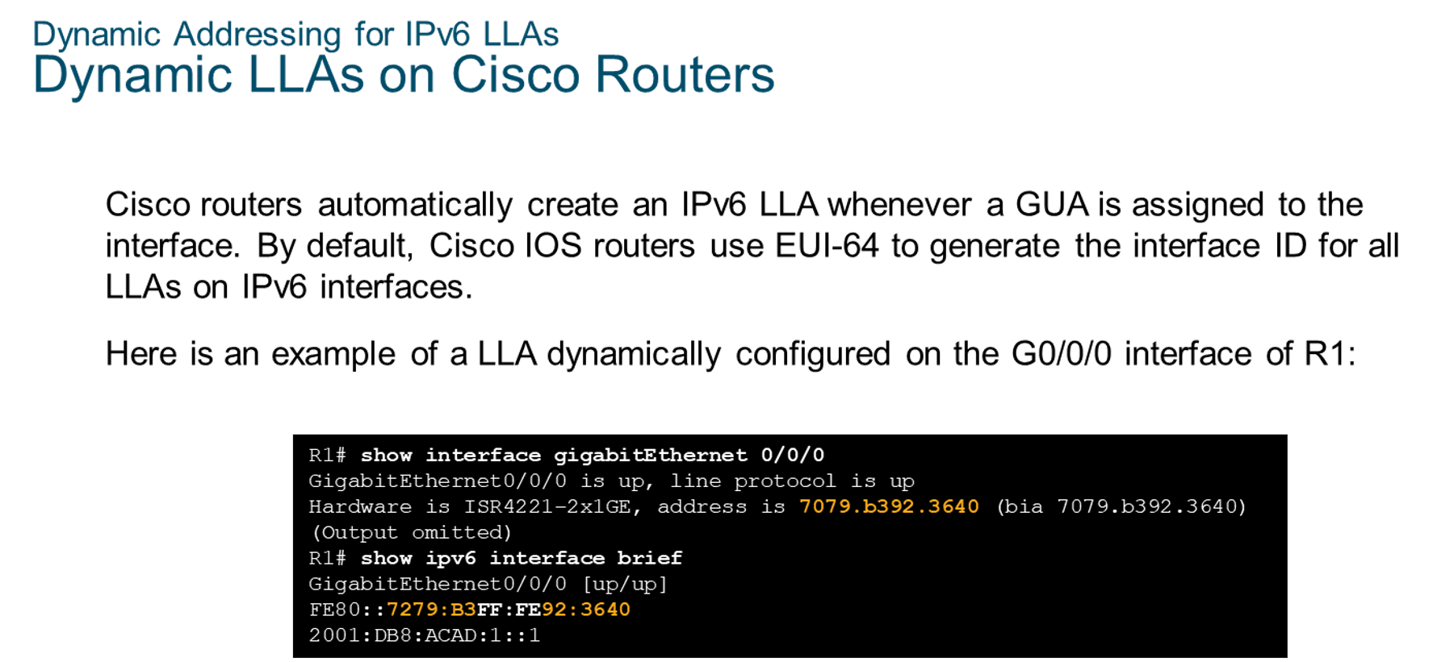
Chapter
Dynamic Addressing for IPv6 LLAs
06

Slide 29
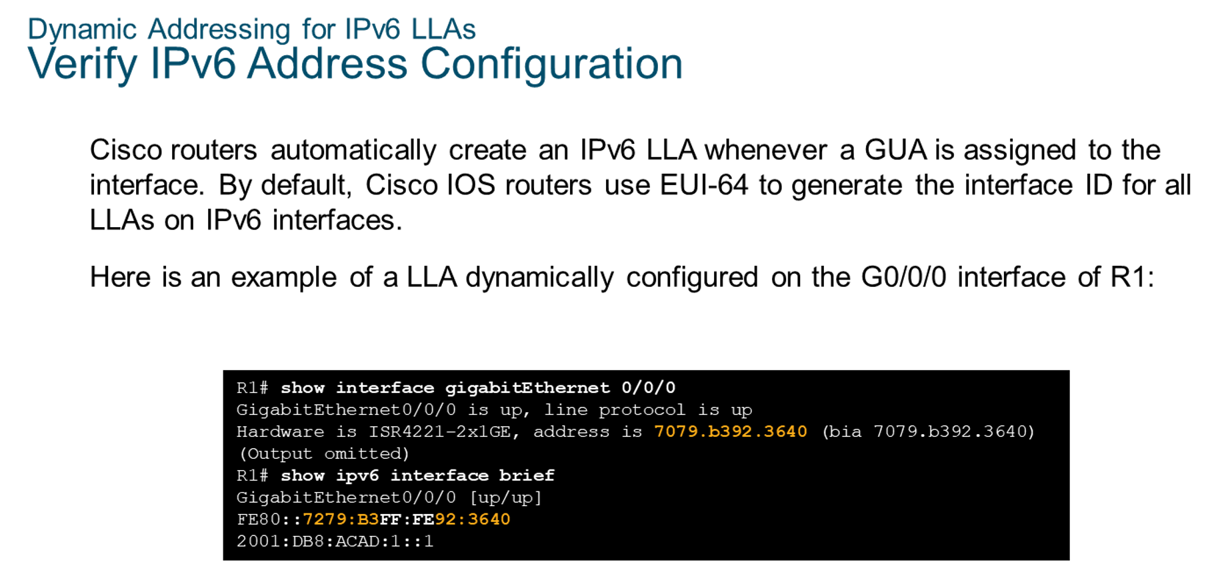
Chapter
Dynamic Addressing for IPv6 LLAs
06

Slide 30
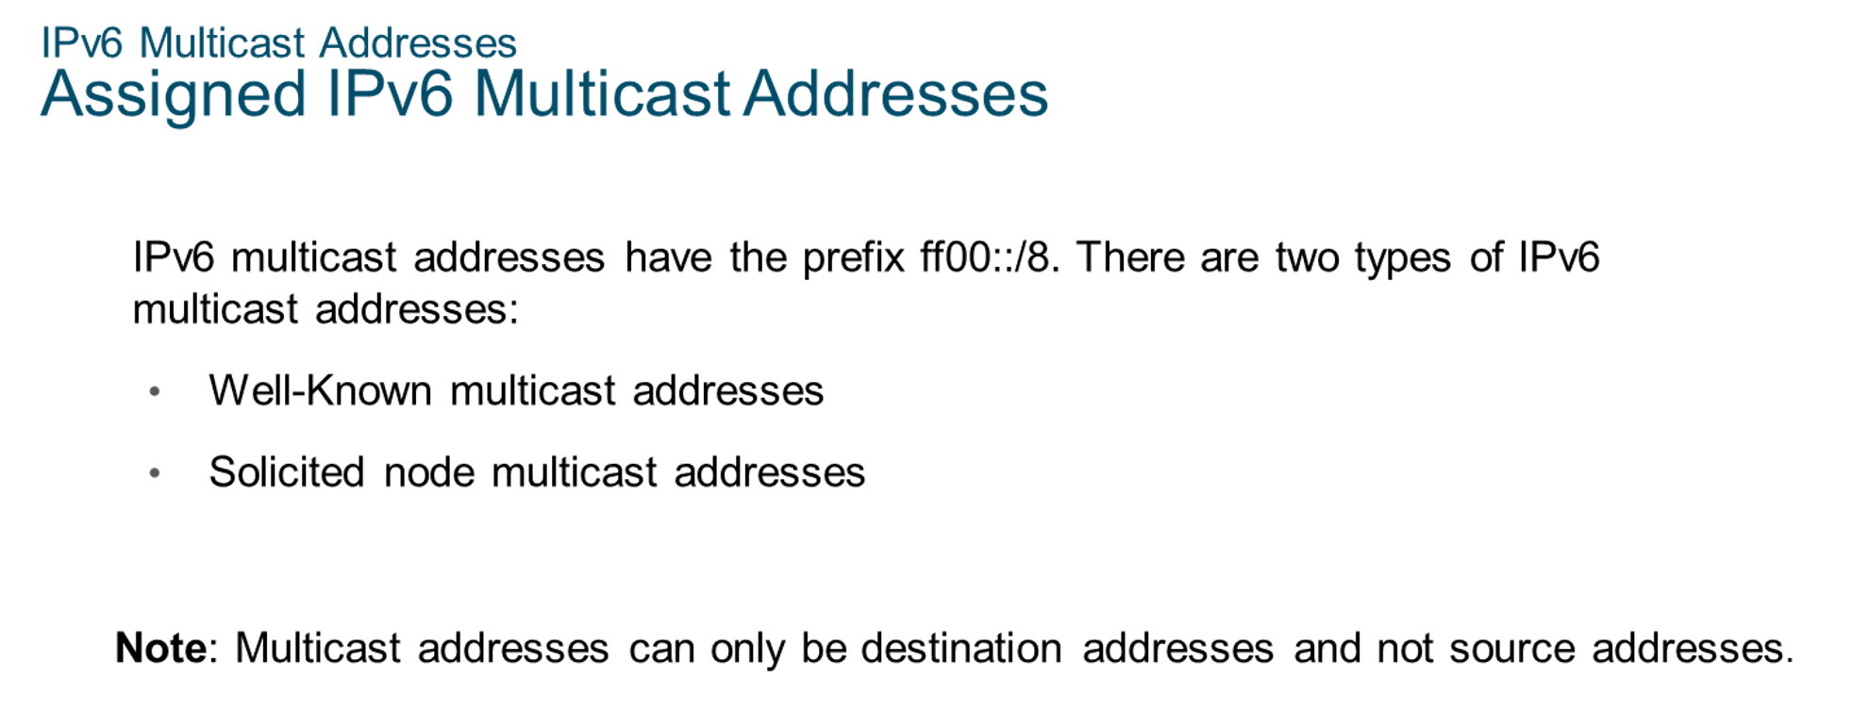
Chapter
IPv6 Multicast Addresses
06

Slide 31
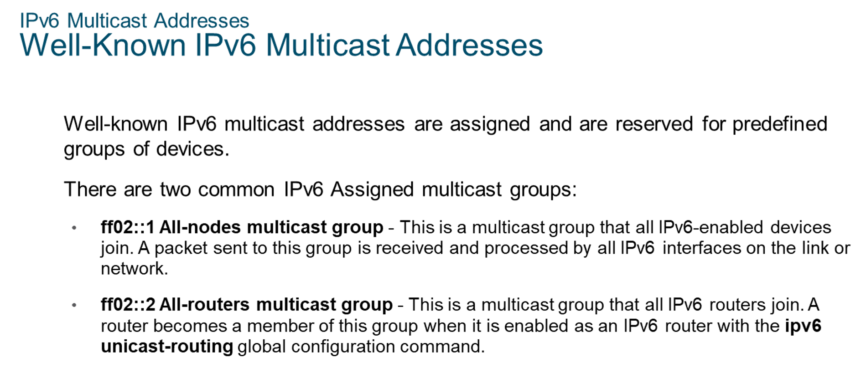
Chapter
IPv6 Multicast Addresses
06

Slide 32
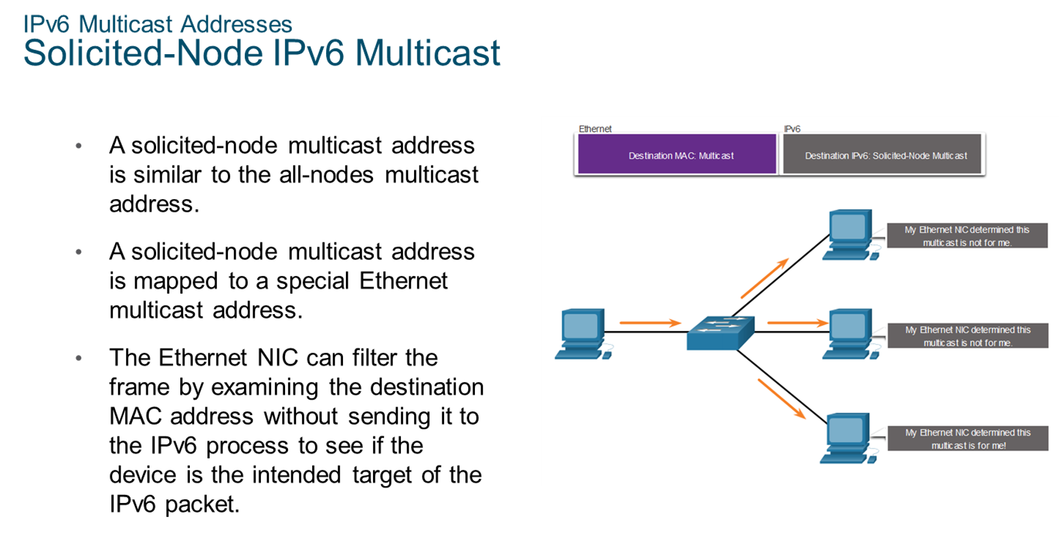
Chapter
IPv6 Multicast Addresses
06

Slide 33
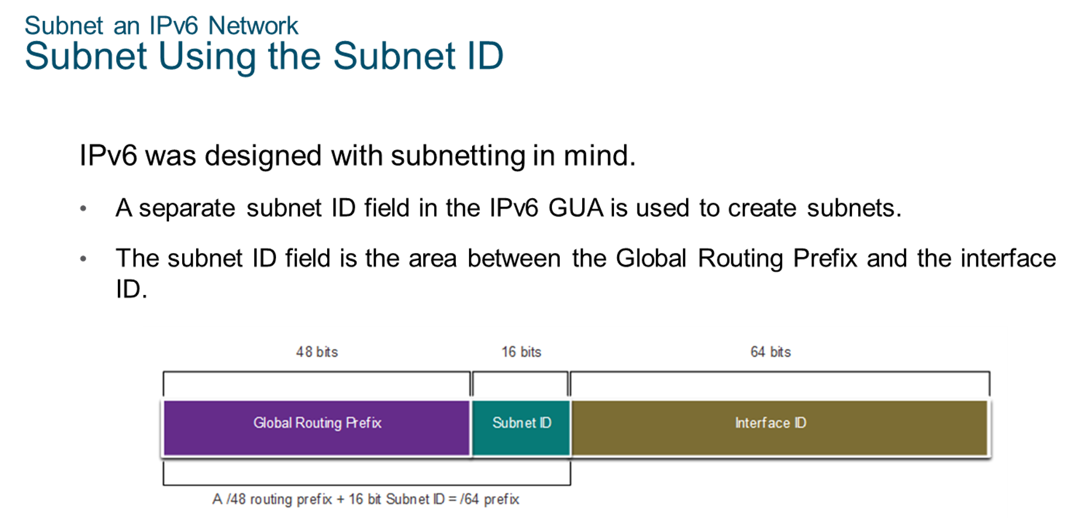
Chapter
Subnet an IPv6 Network
06

Slide 34
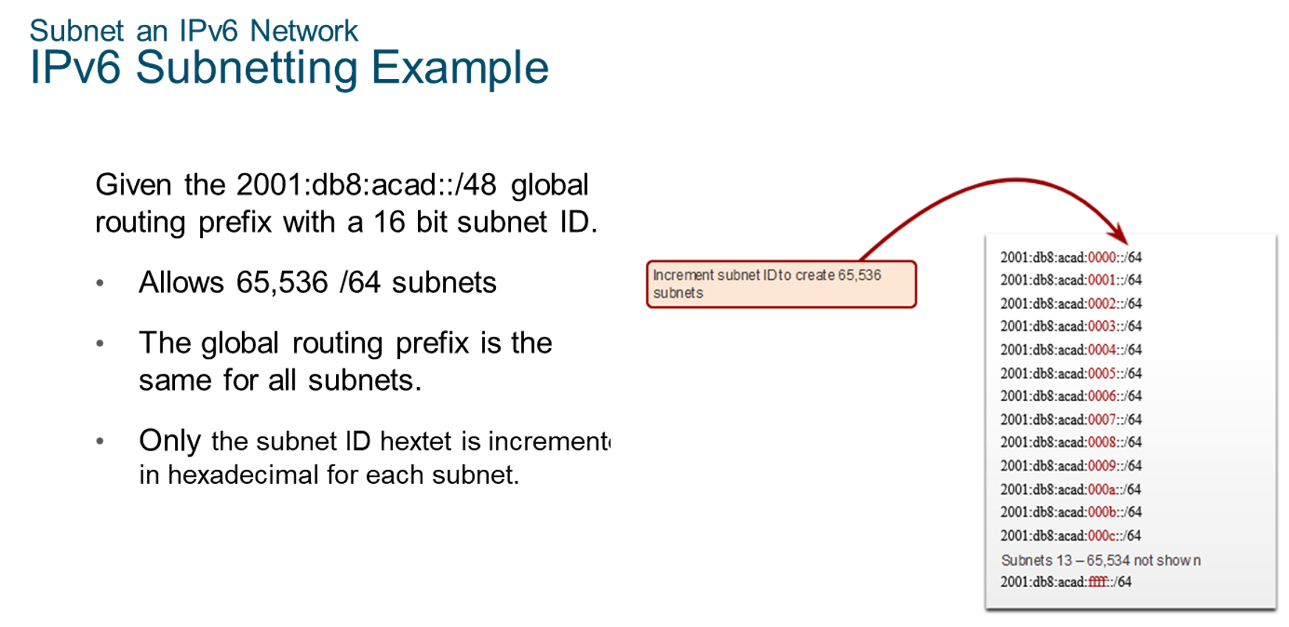
Chapter
Subnet an IPv6 Network
06

Slide 35
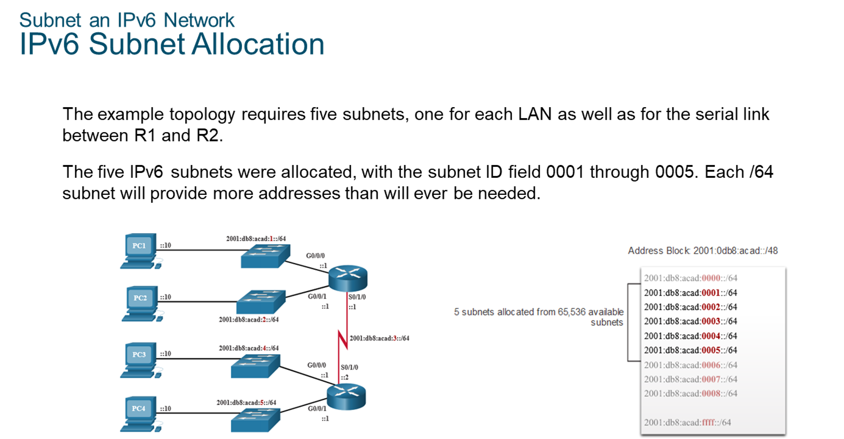
Chapter
Subnet an IPv6 Network
06

Slide 36
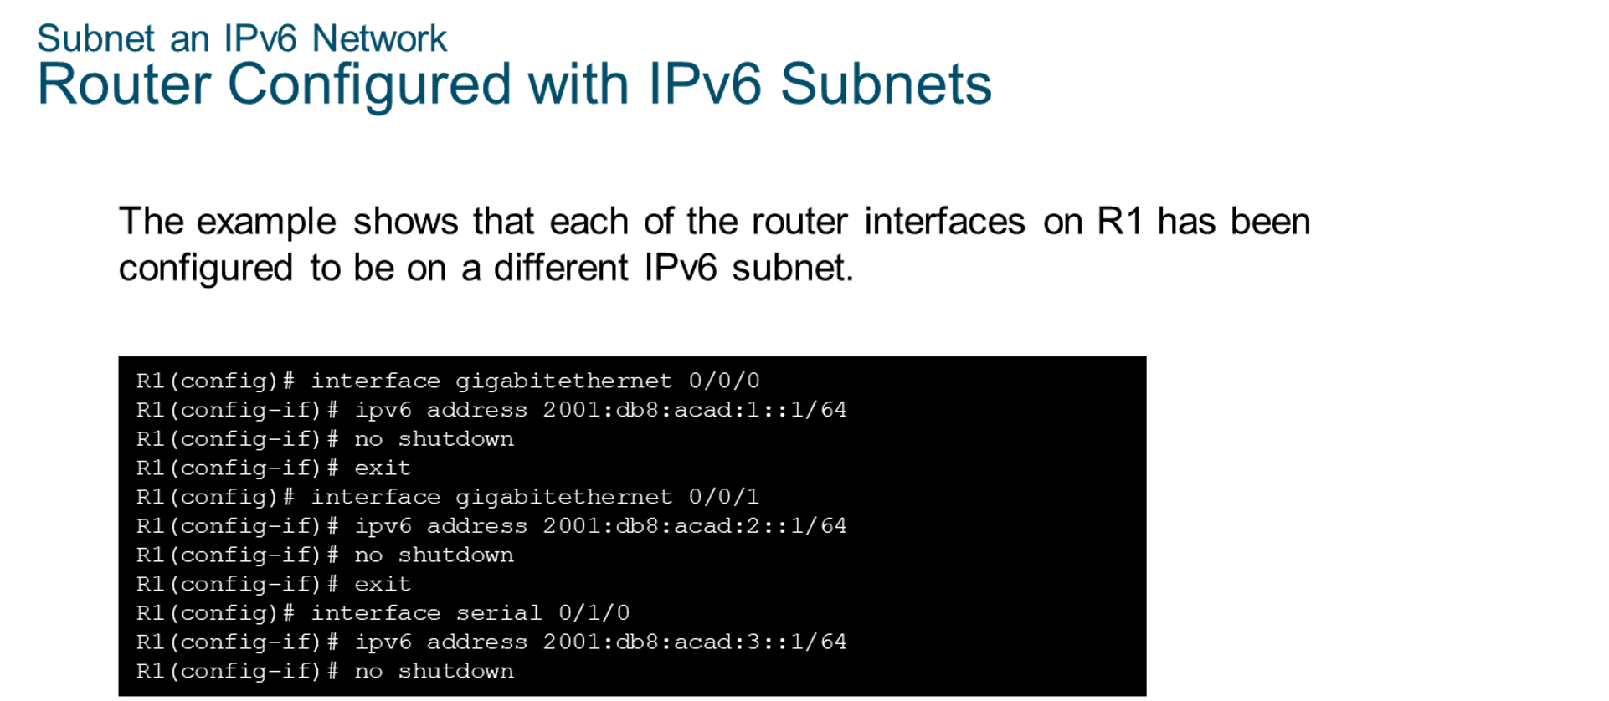
Chapter
Subnet an IPv6 Network
06

Slide 37



Thank You

