Slide 1


Slide 2


Slide 3
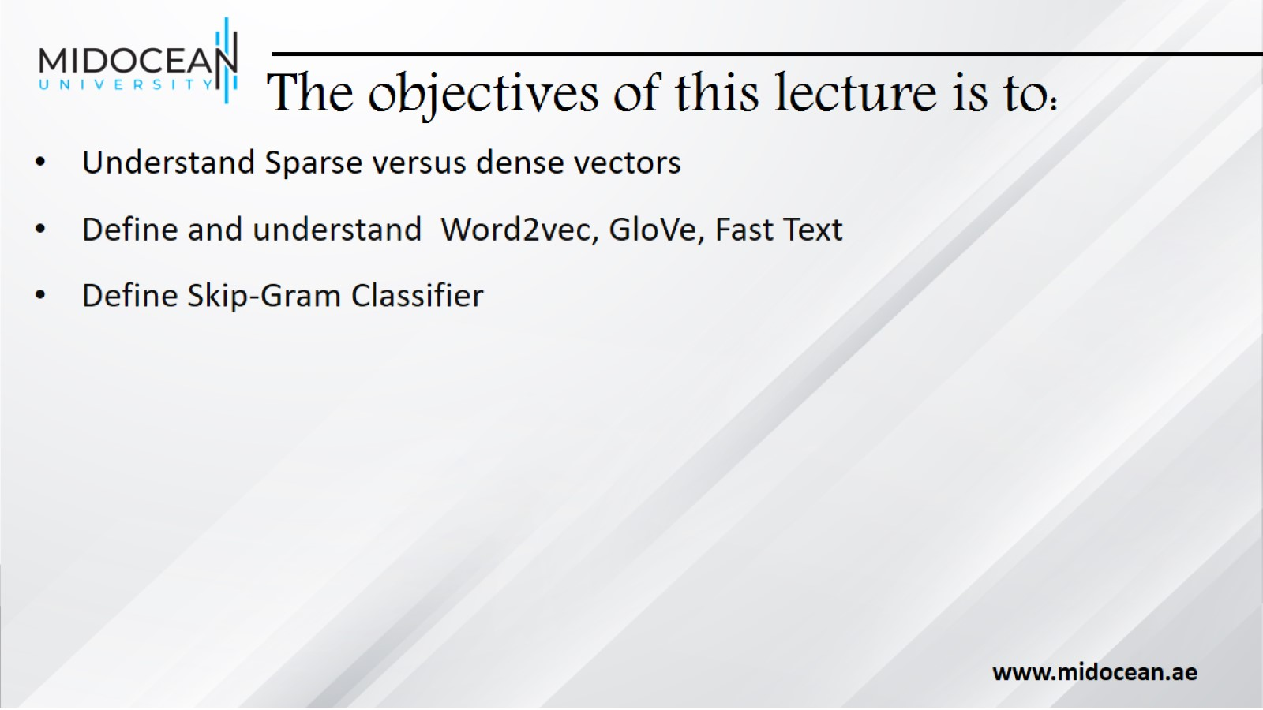
The objectives of this lecture is to:

Slide 4
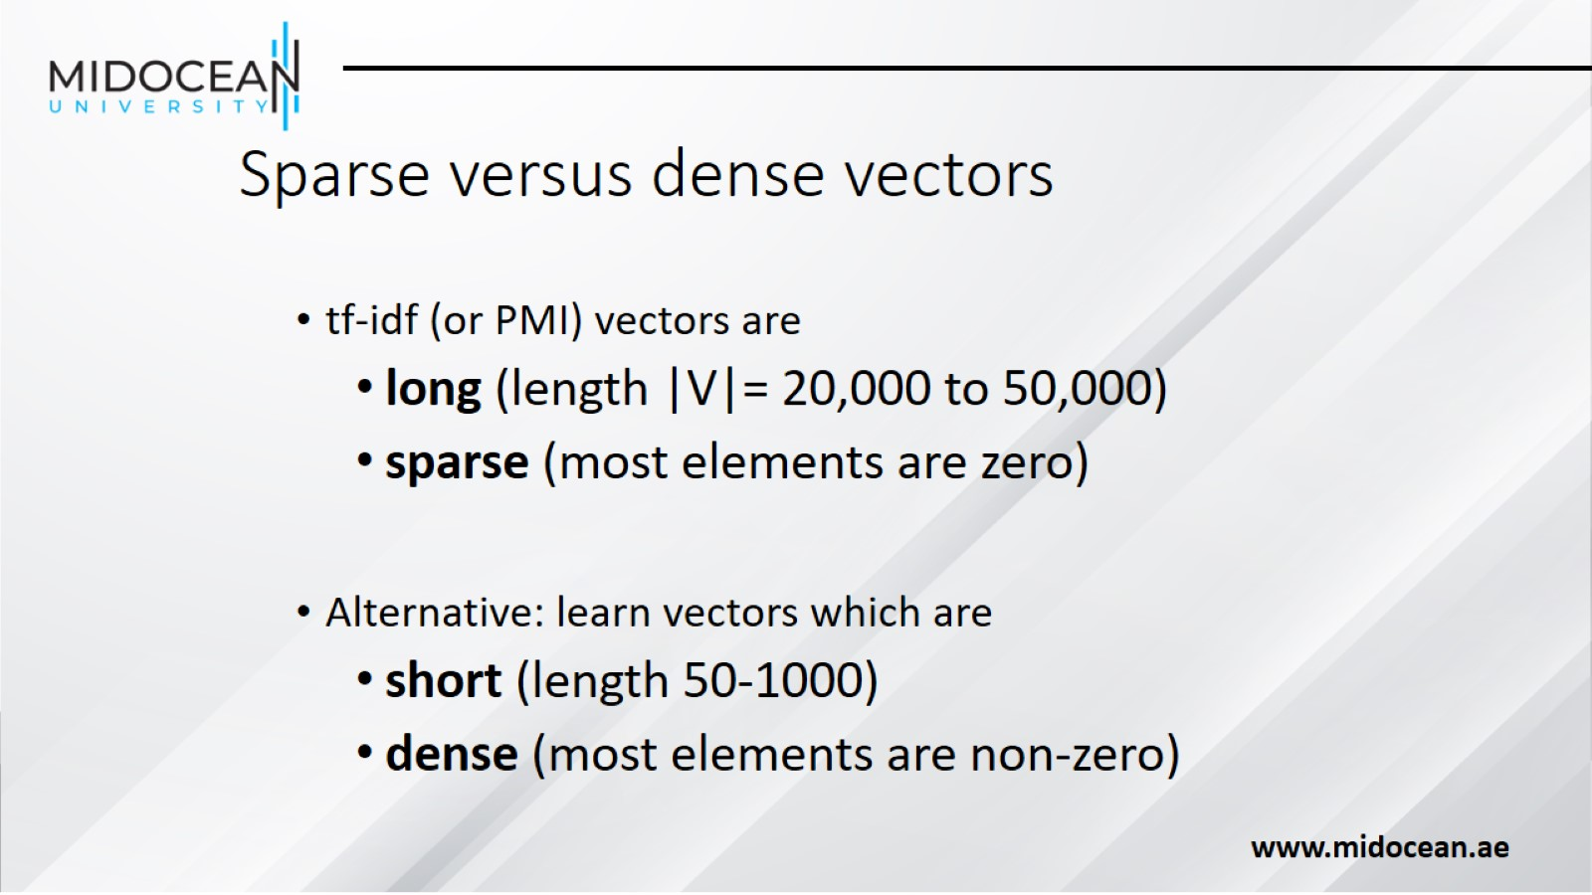
Sparse versus dense vectors

Slide 5
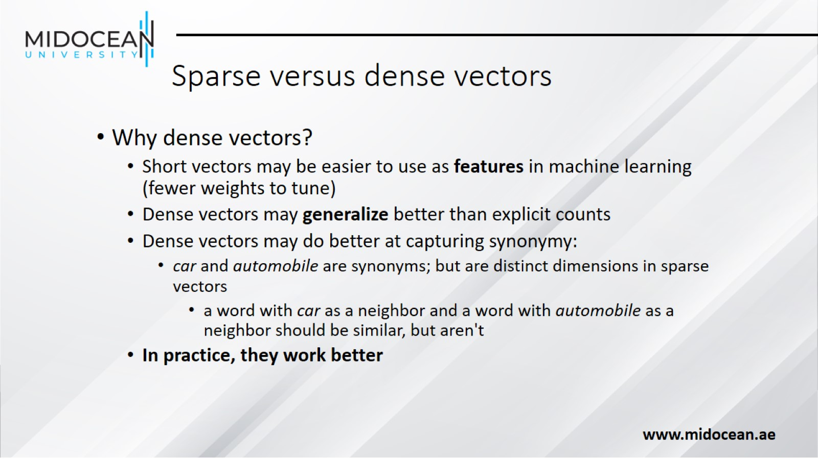
Sparse versus dense vectors

Slide 6
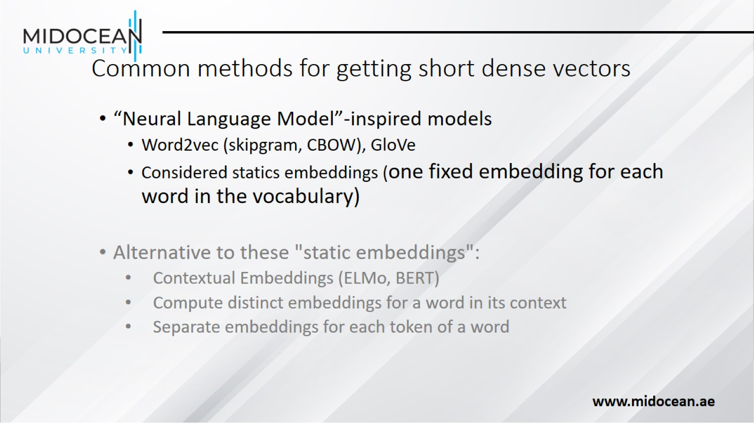
Common methods for getting short dense vectors

Slide 7
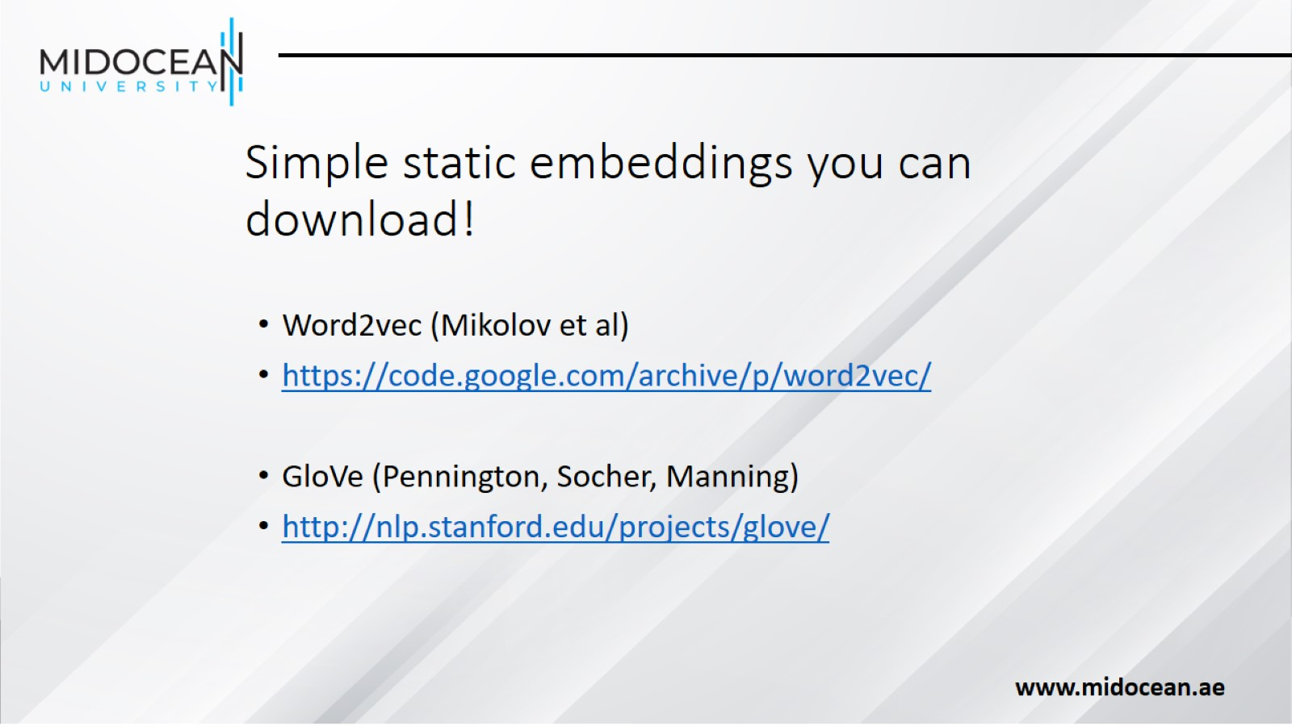
Simple static embeddings you can download!

Slide 8
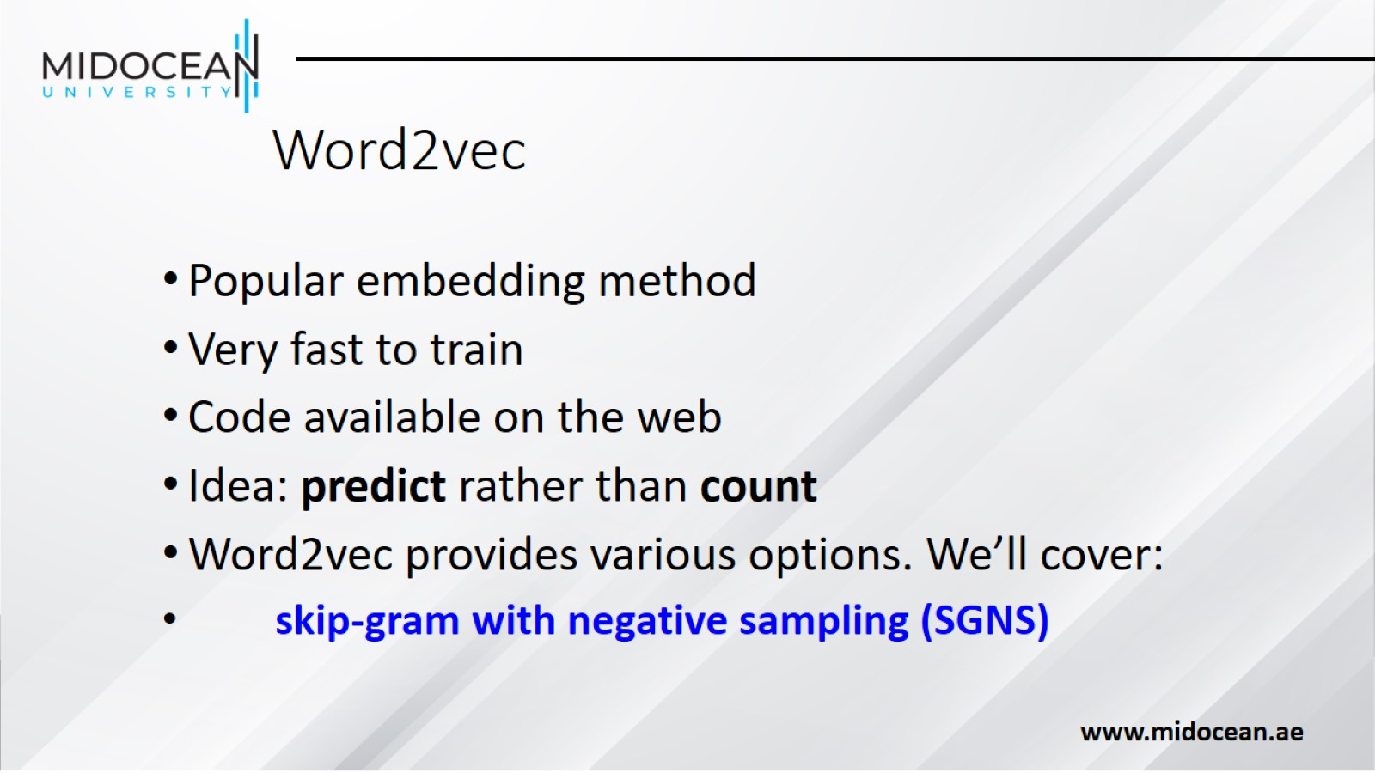
Word2vec

Slide 9
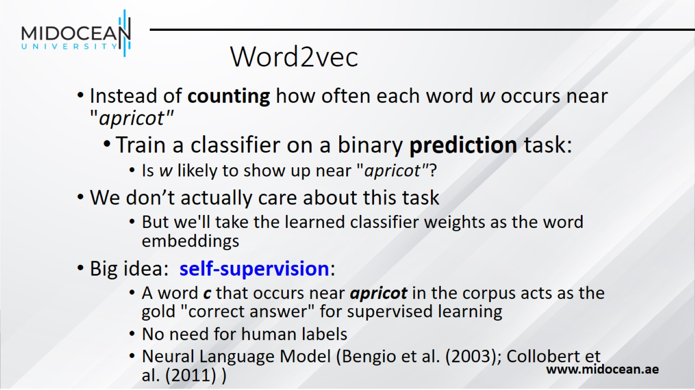
Word2vec

Slide 10
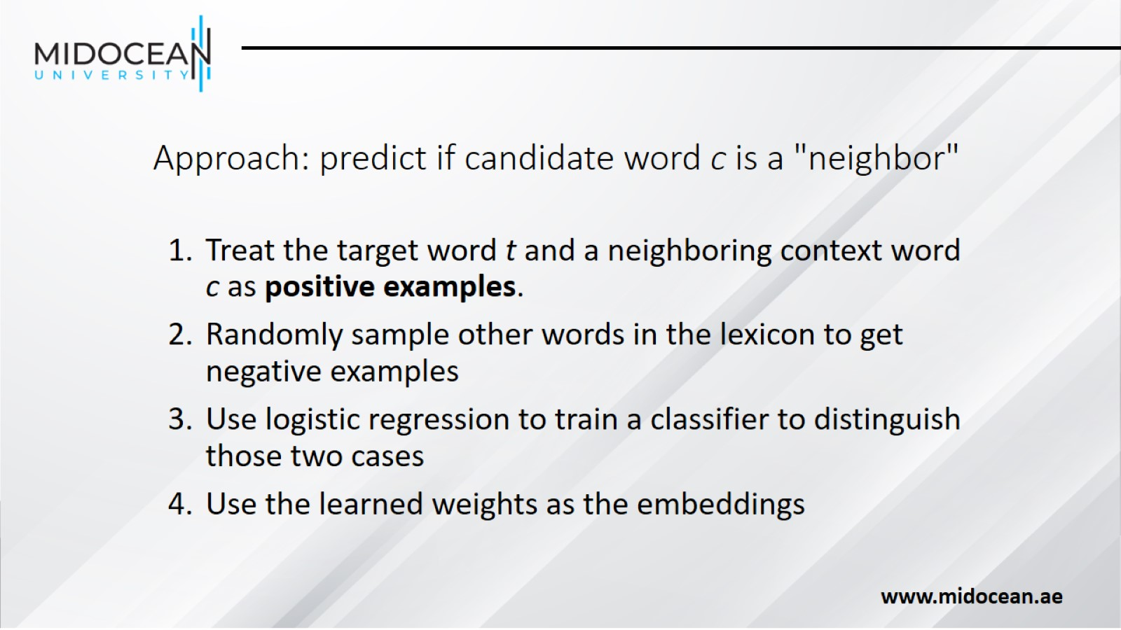
Approach: predict if candidate word c is a "neighbor"

Slide 11
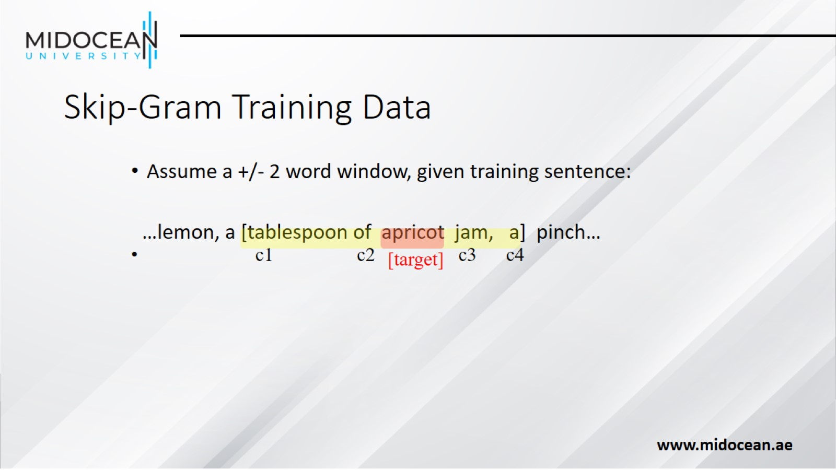
Skip-Gram Training Data

Slide 12
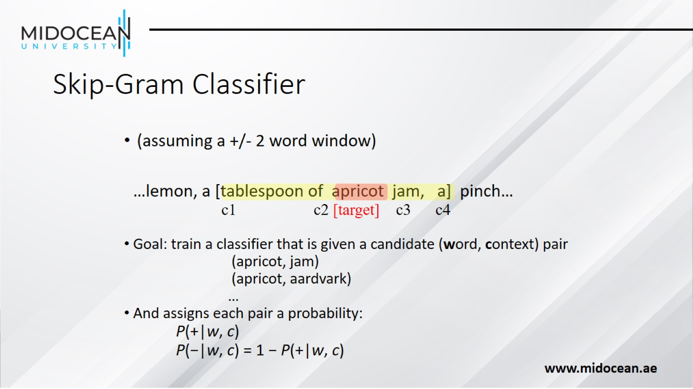
Skip-Gram Classifier

Slide 13
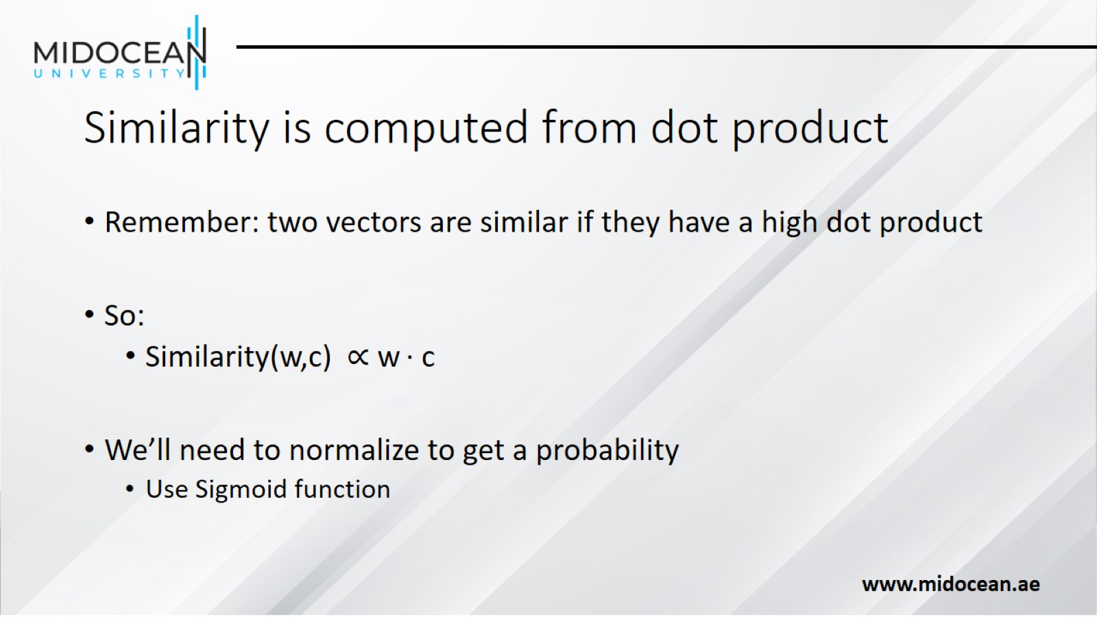
Similarity is computed from dot product

Slide 14
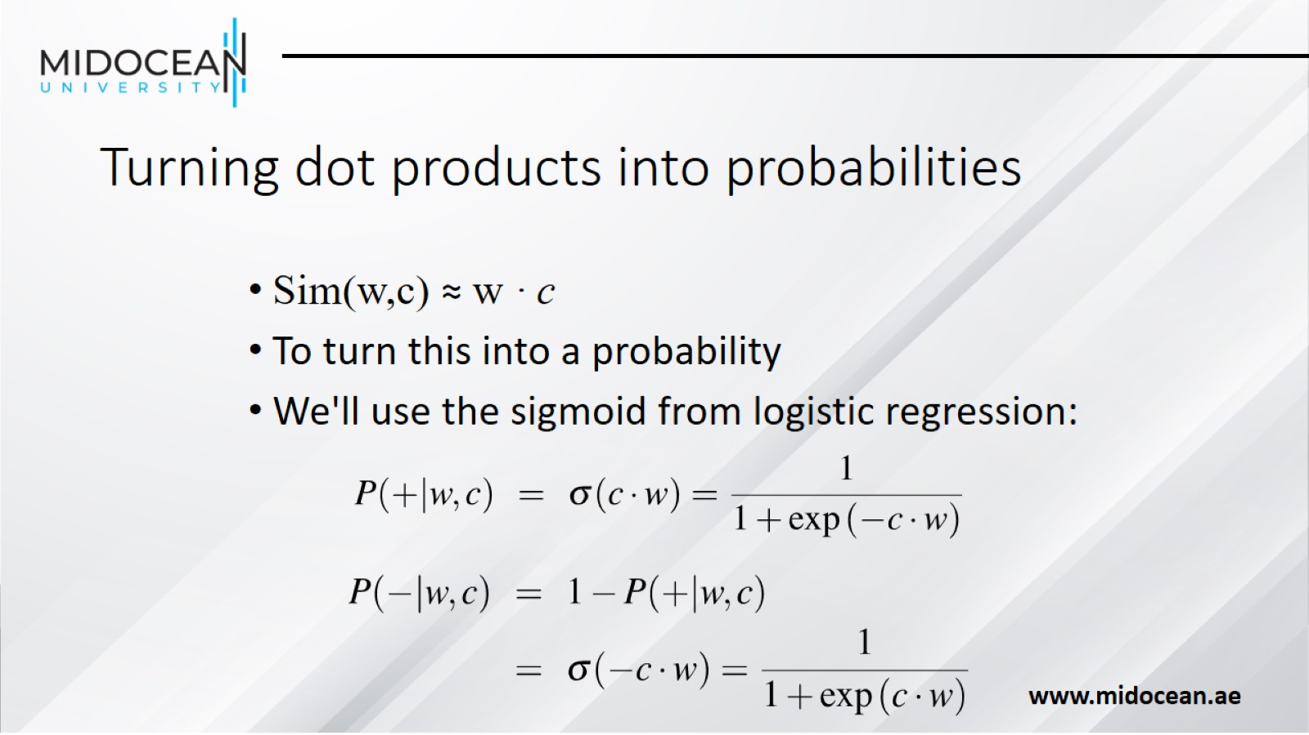
Turning dot products into probabilities

Slide 15
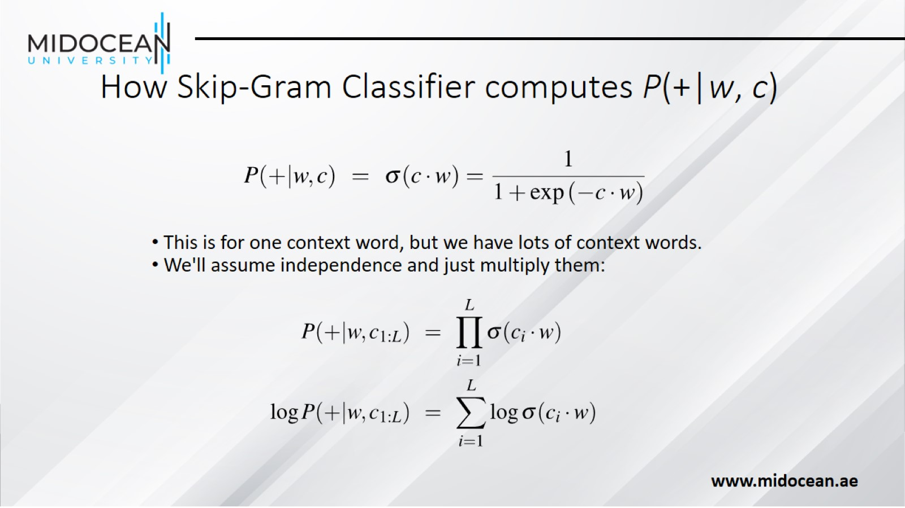
How Skip-Gram Classifier computes P(+|w, c)

Slide 16
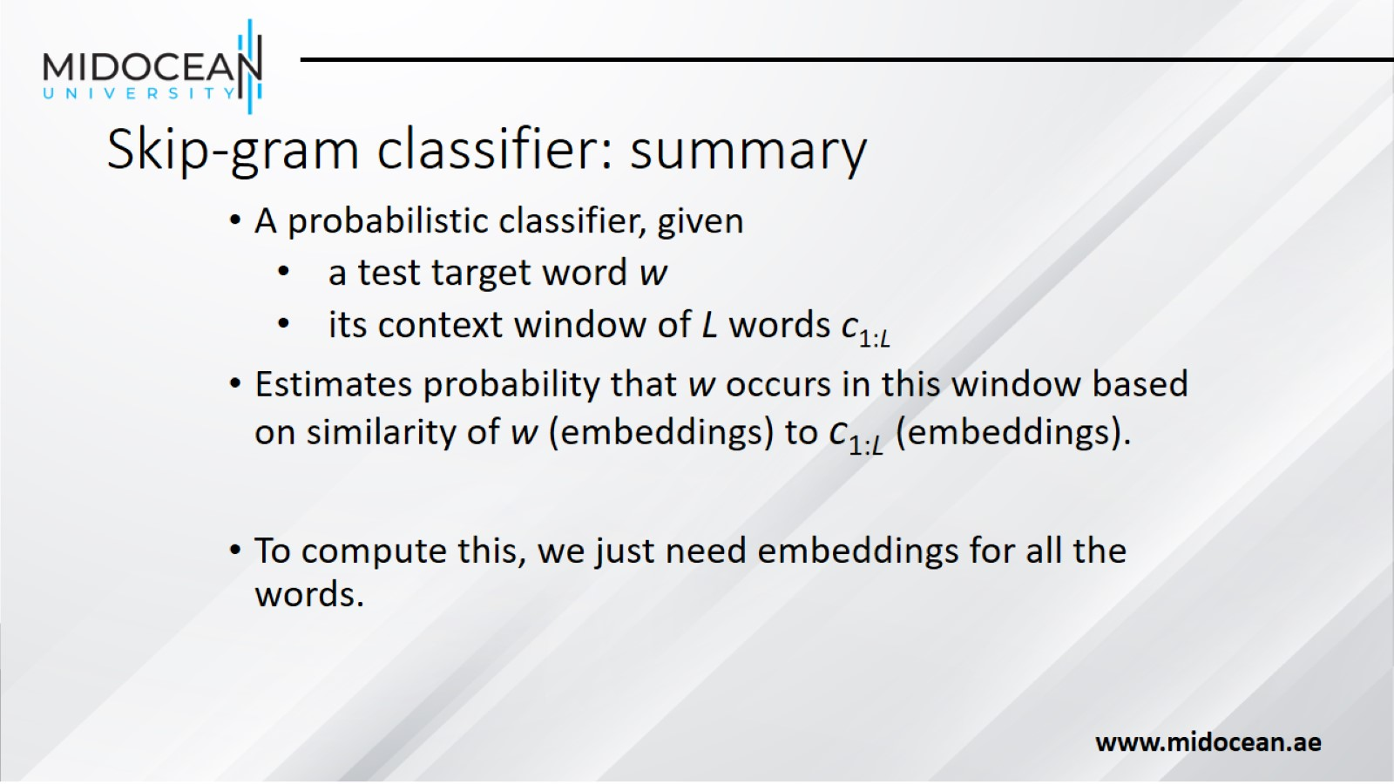
Skip-gram classifier: summary

Slide 17
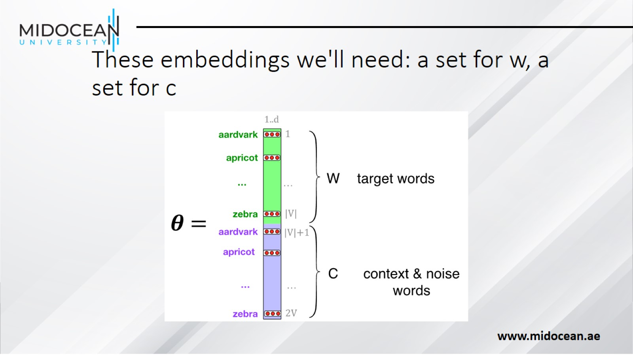
These embeddings we'll need: a set for w, a set for c

Slide 18
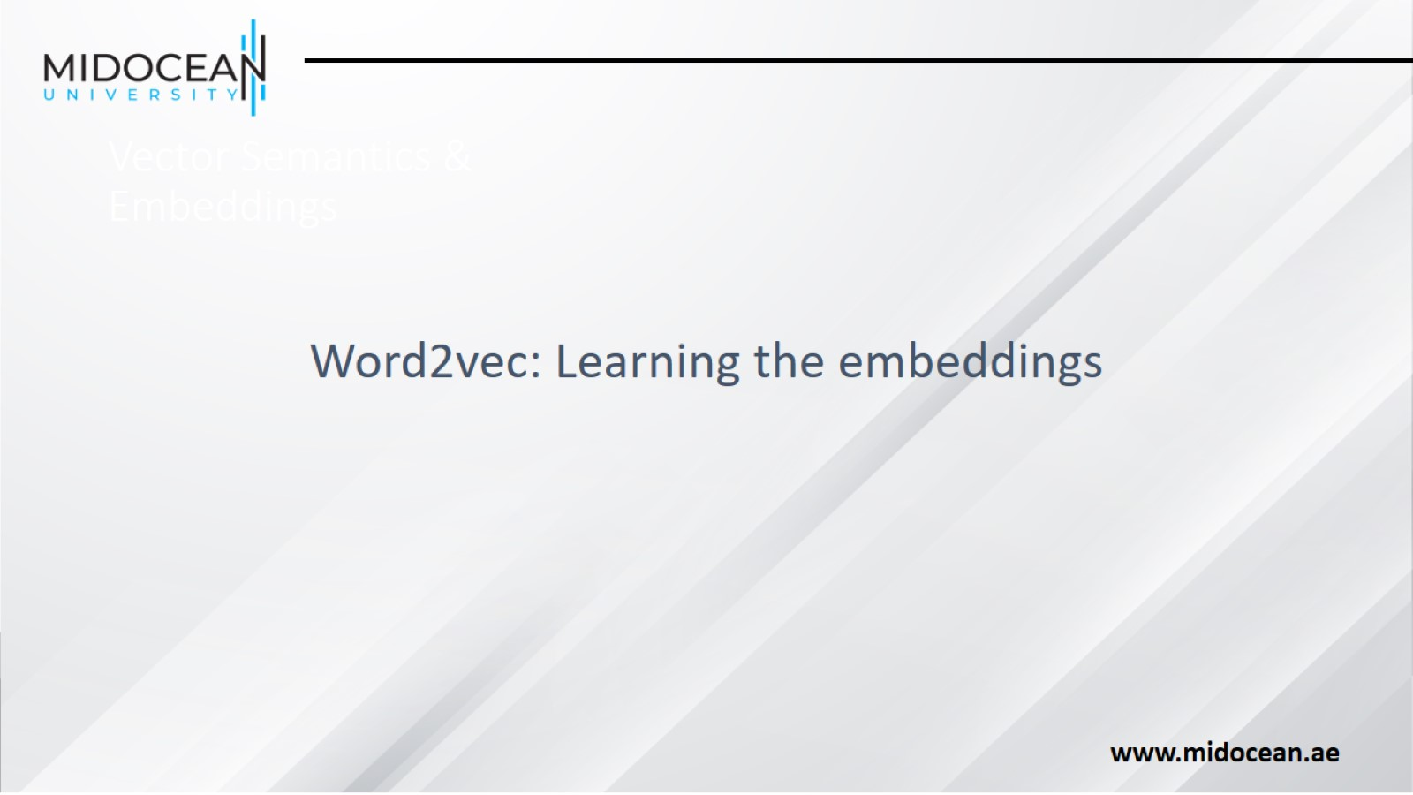
Vector Semantics & Embeddings

Slide 19
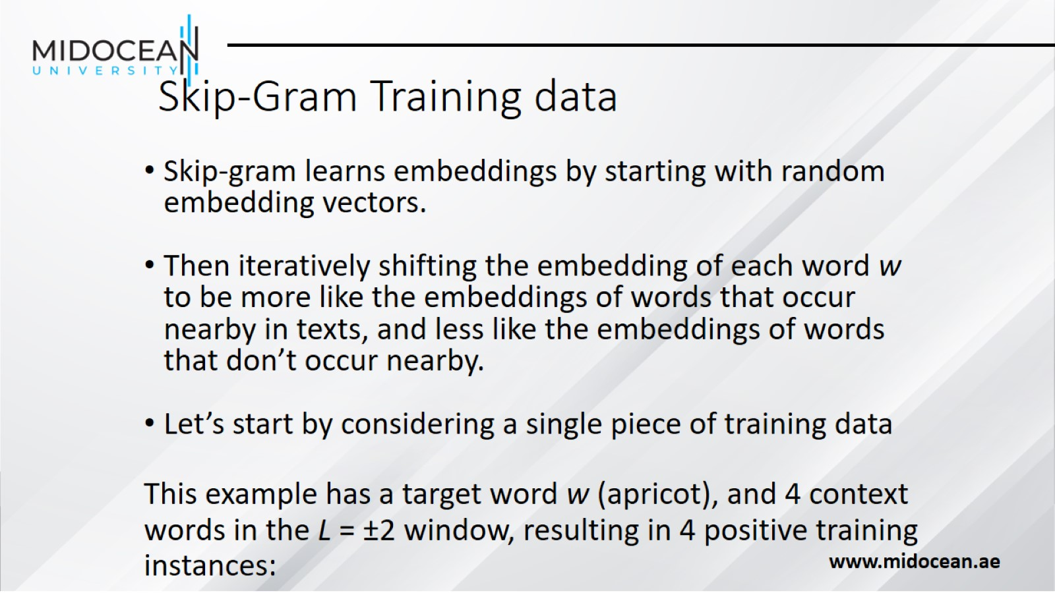
Skip-Gram Training data

Slide 20
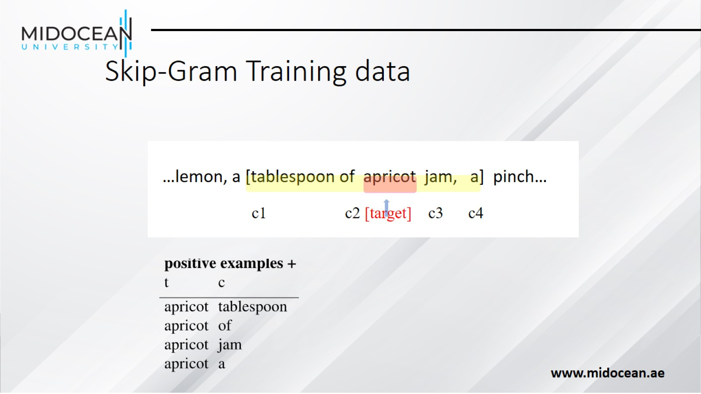
Skip-Gram Training data

Slide 21
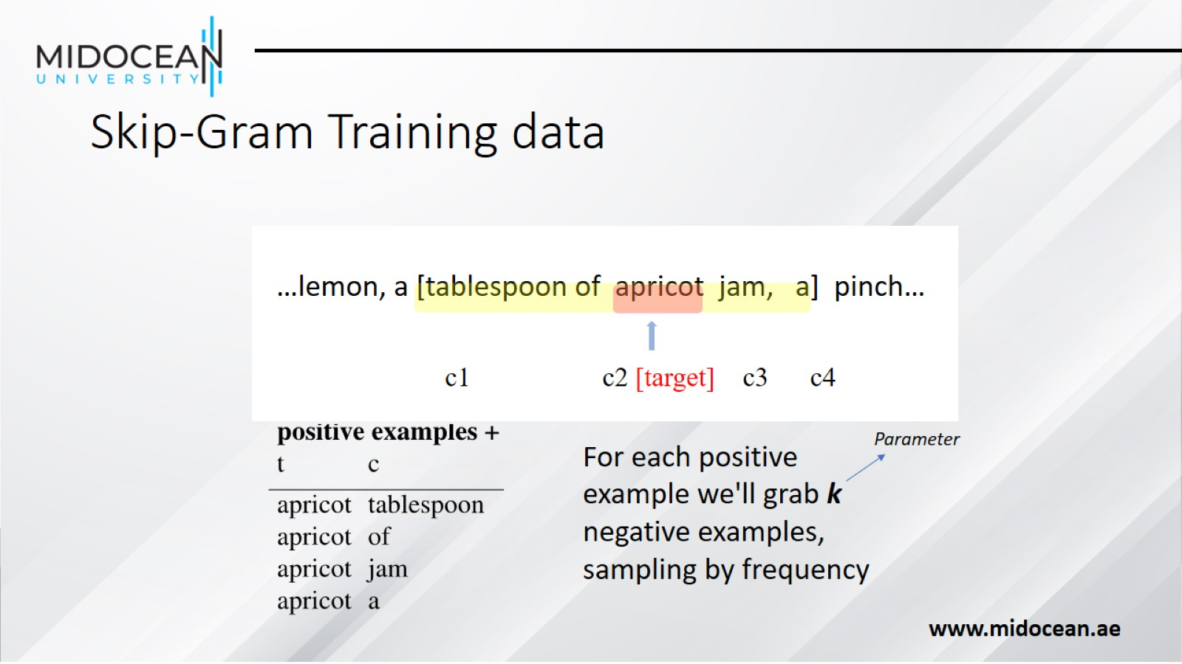
Skip-Gram Training data

Slide 22
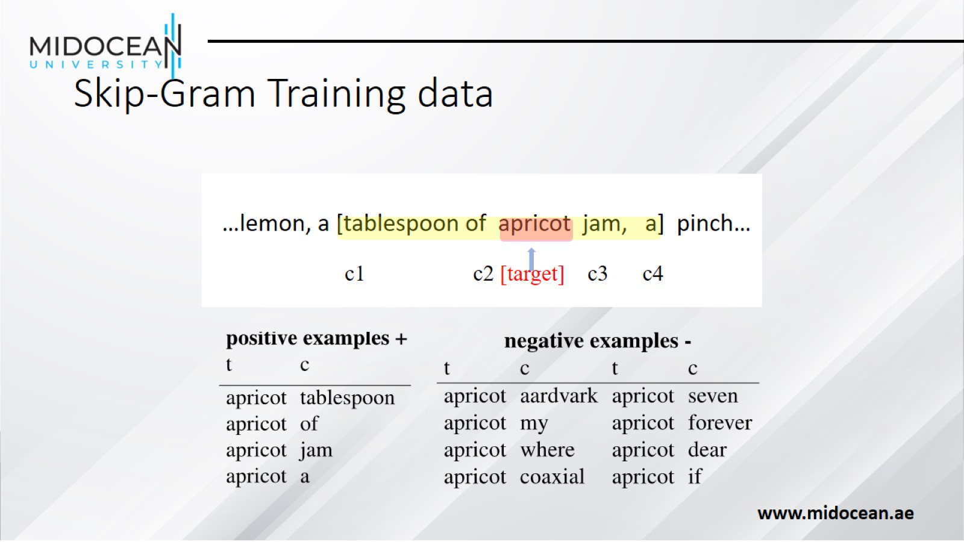
Skip-Gram Training data

Slide 23
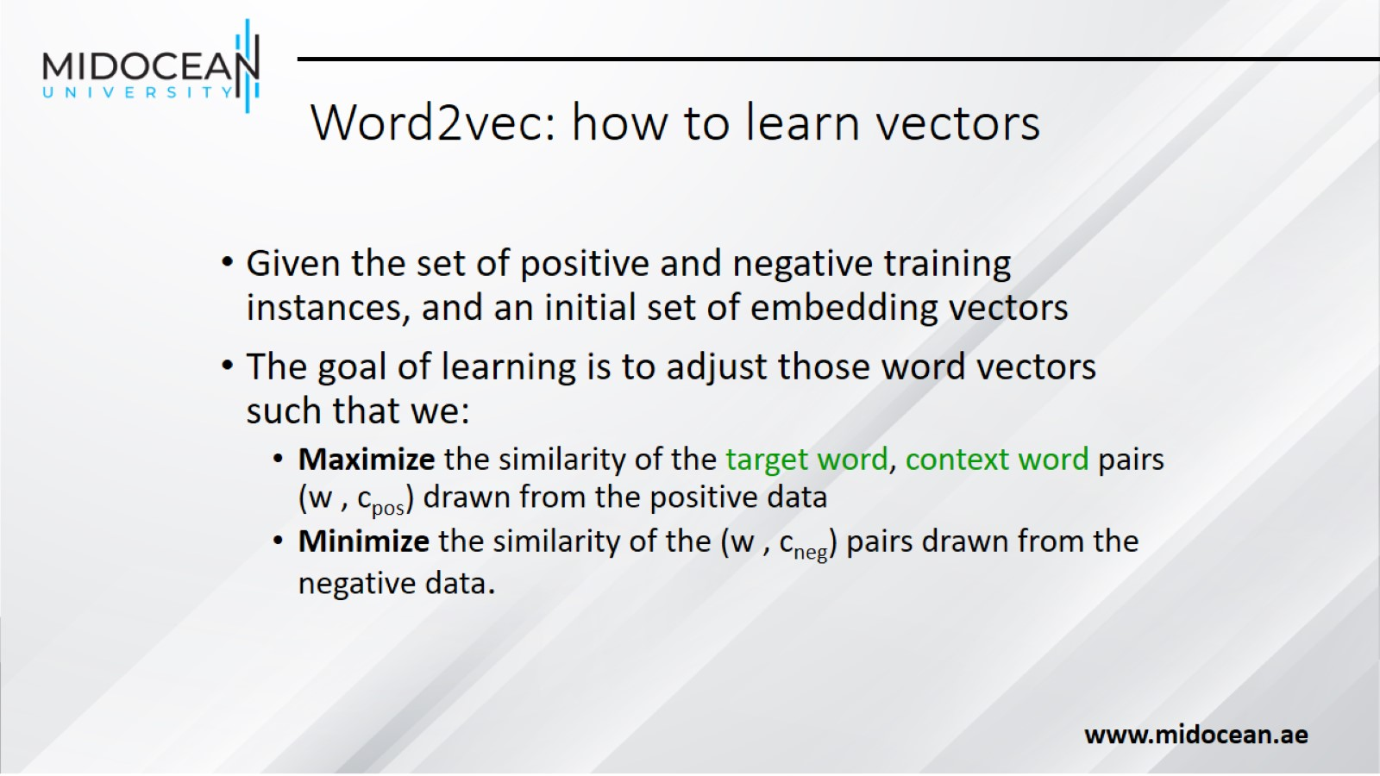
Word2vec: how to learn vectors

Slide 24
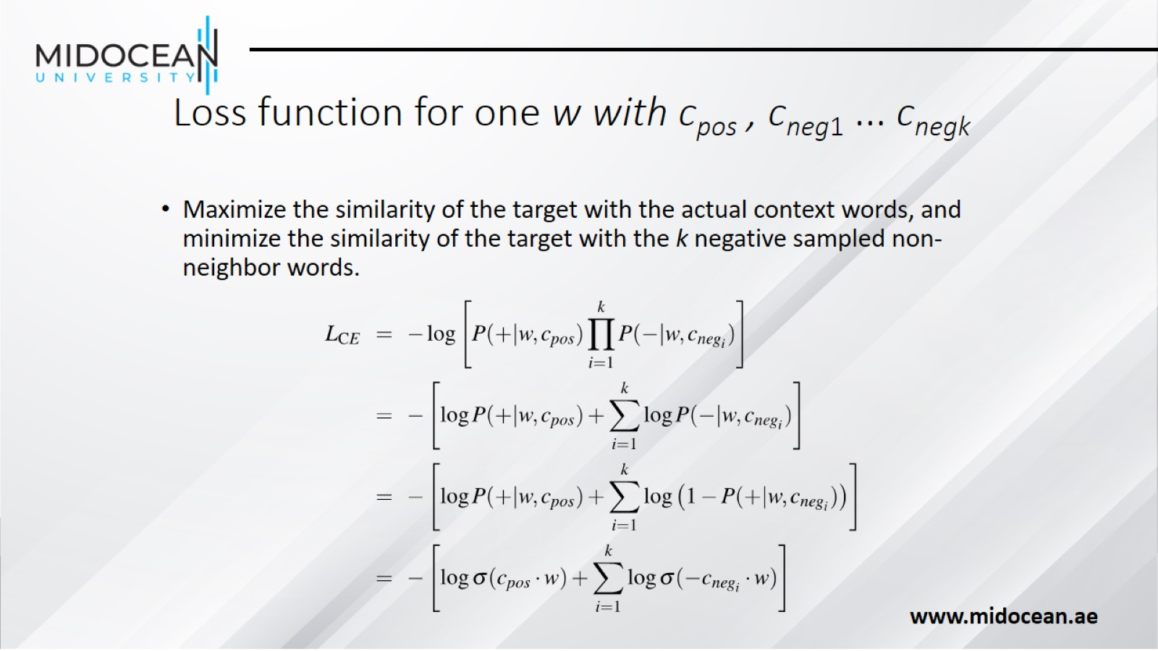
Loss function for one w with c_{pos} , c_{neg1} ... c_{negk}

Slide 25
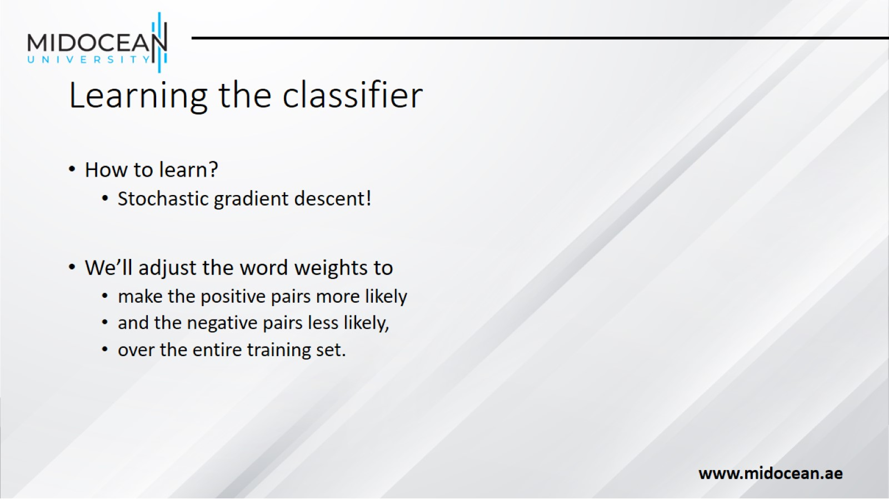
Learning the classifier

Slide 26
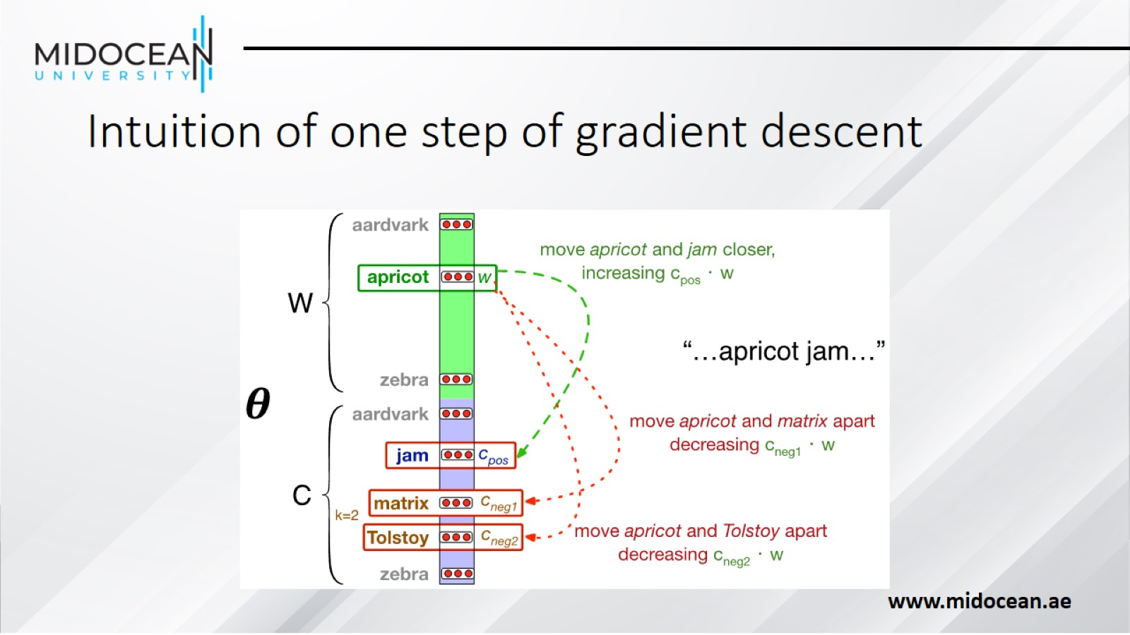
Intuition of one step of gradient descent

Slide 27
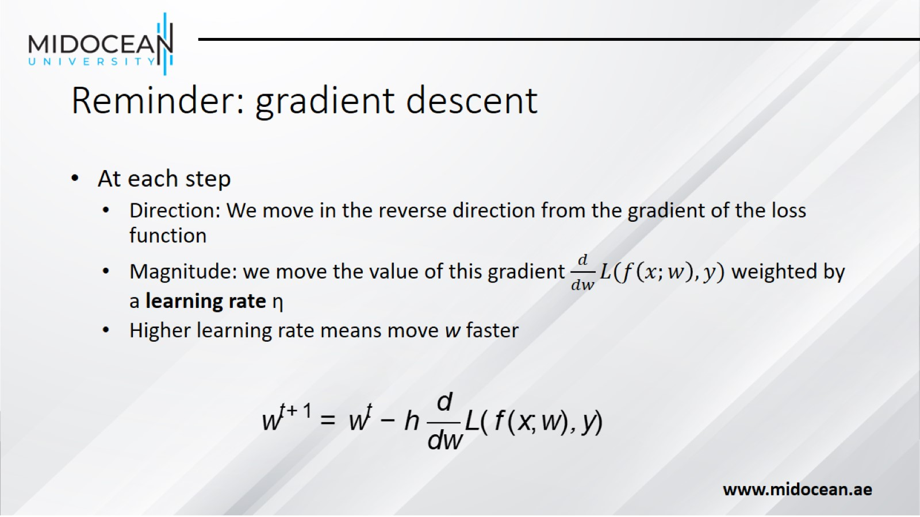
Reminder: gradient descent

Slide 28
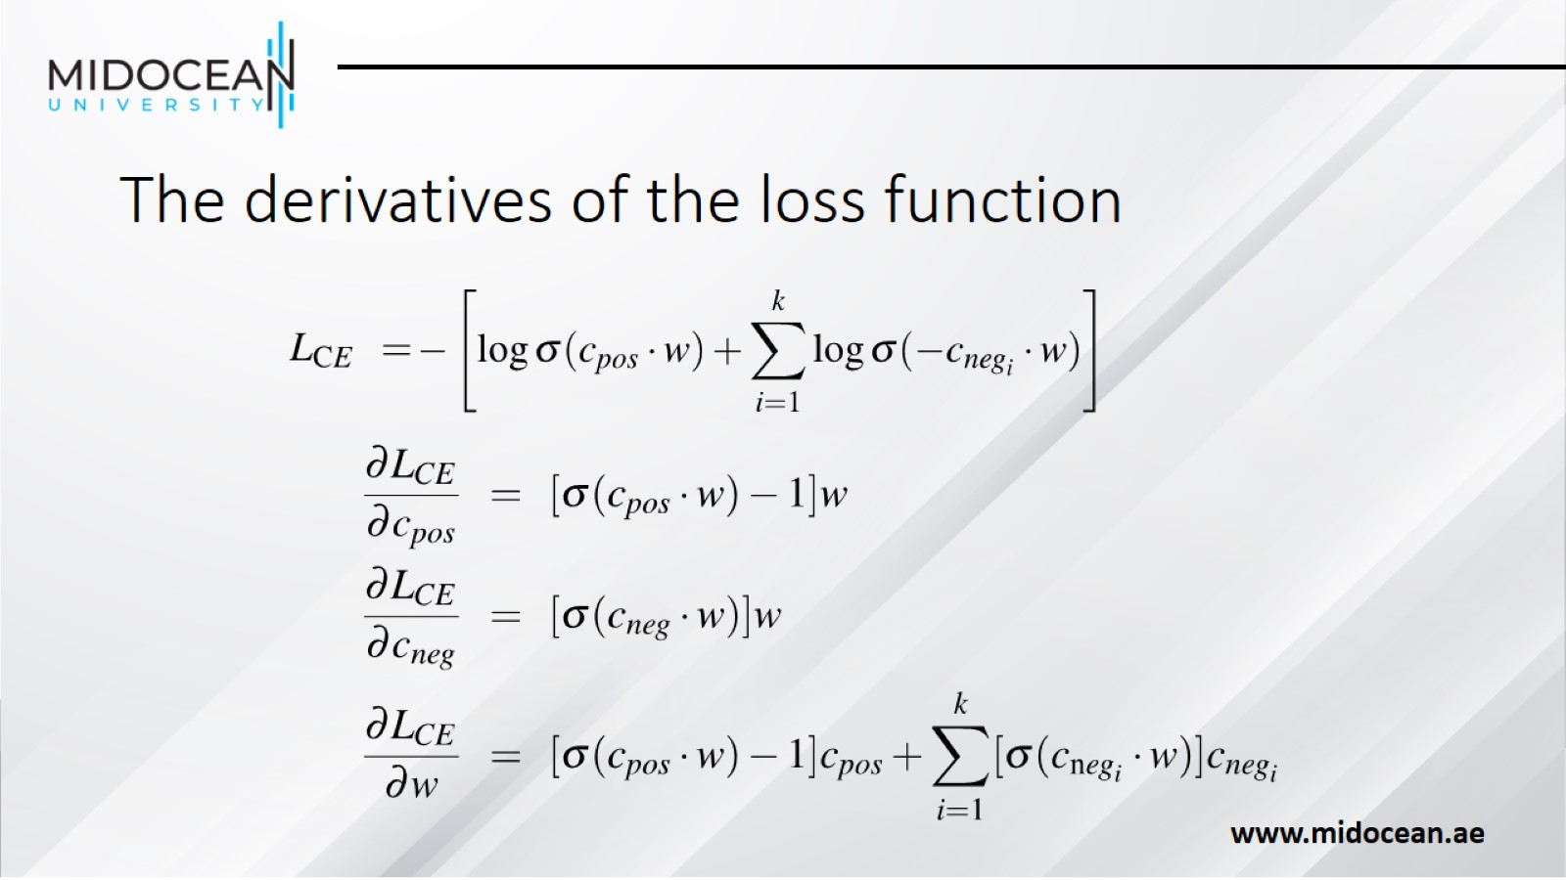
The derivatives of the loss function

Slide 29
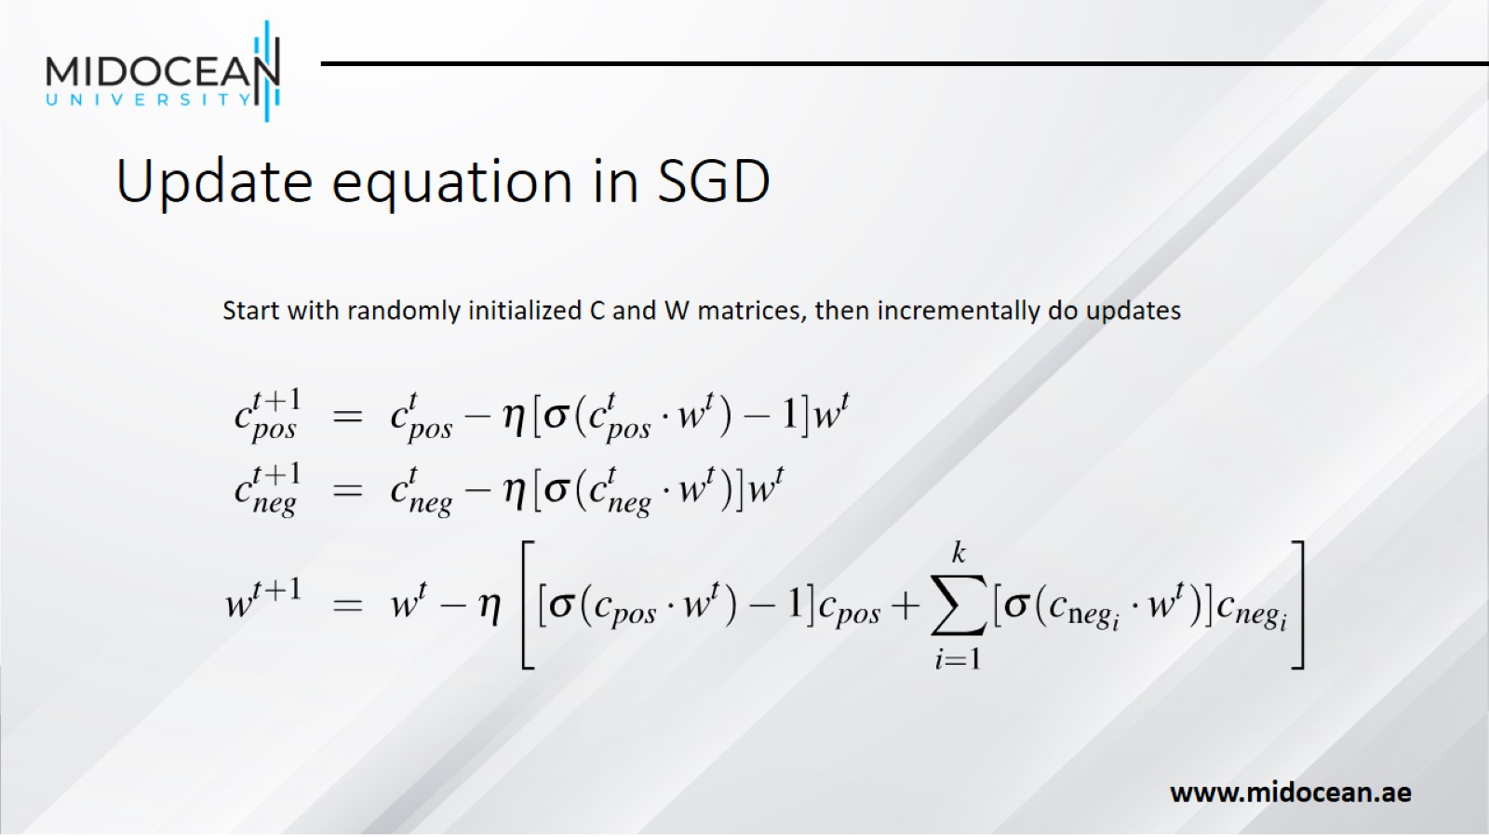
Update equation in SGD

Slide 30
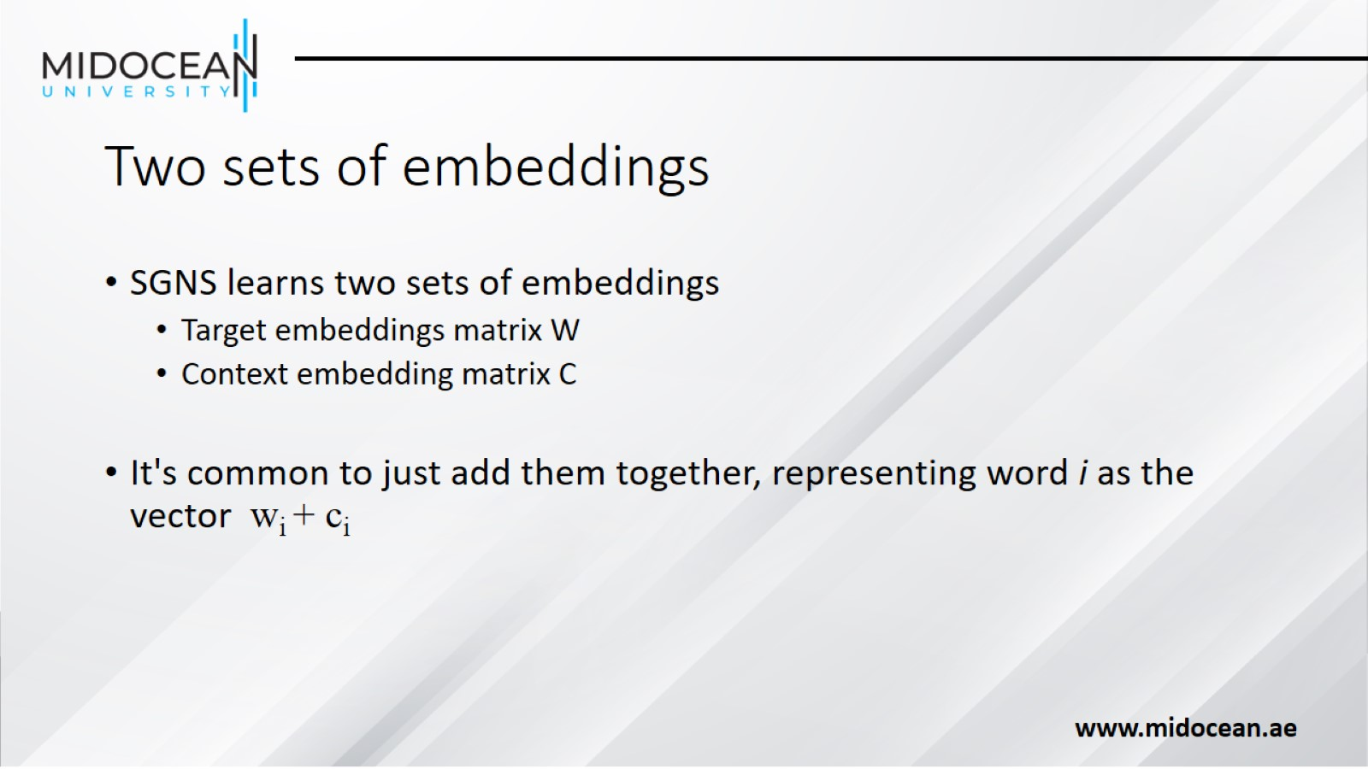
Two sets of embeddings

Slide 31
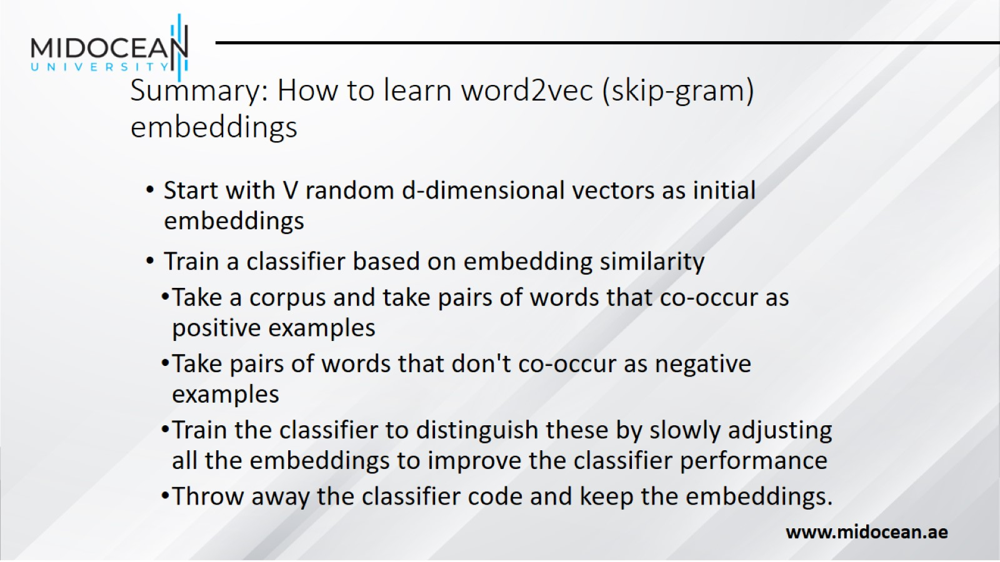
Summary: How to learn word2vec (skip-gram) embeddings

Slide 32
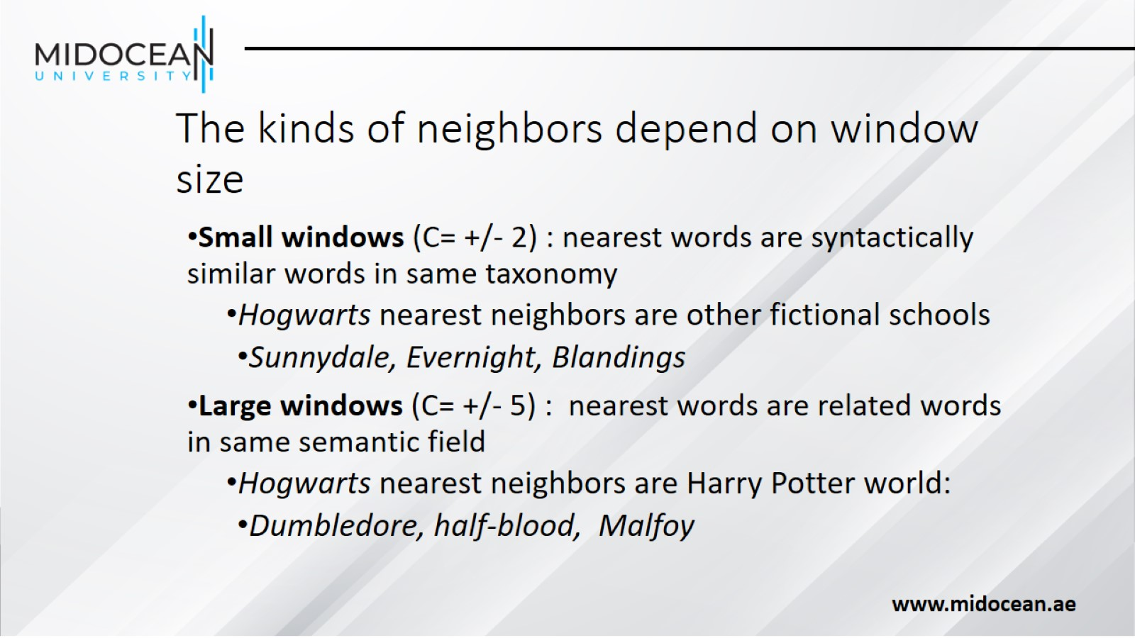
The kinds of neighbors depend on window size

Slide 33
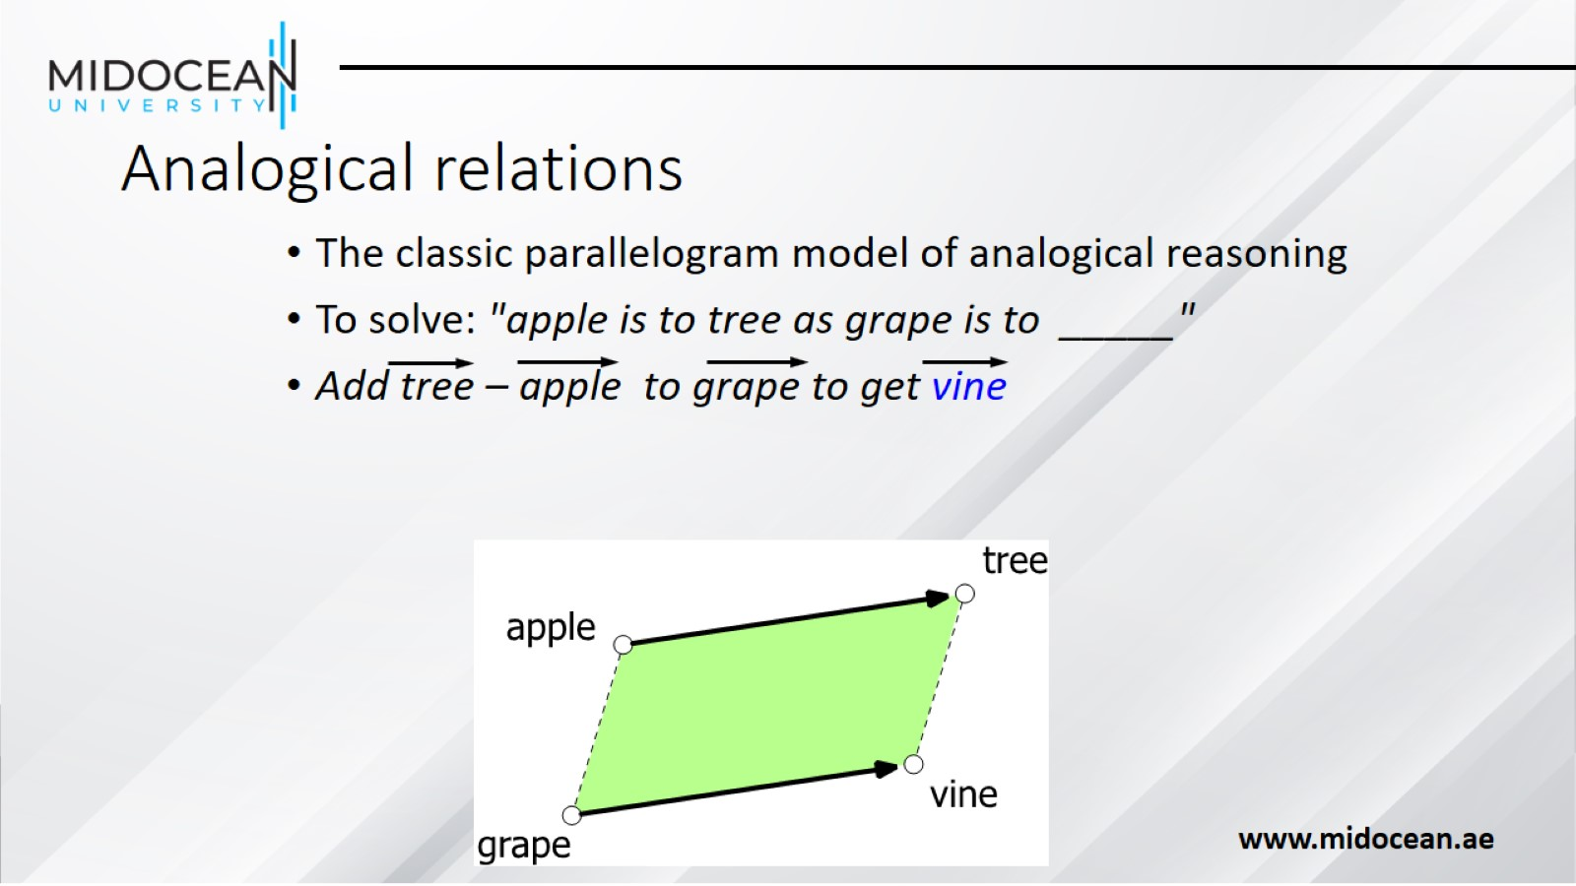
Analogical relations

Slide 34
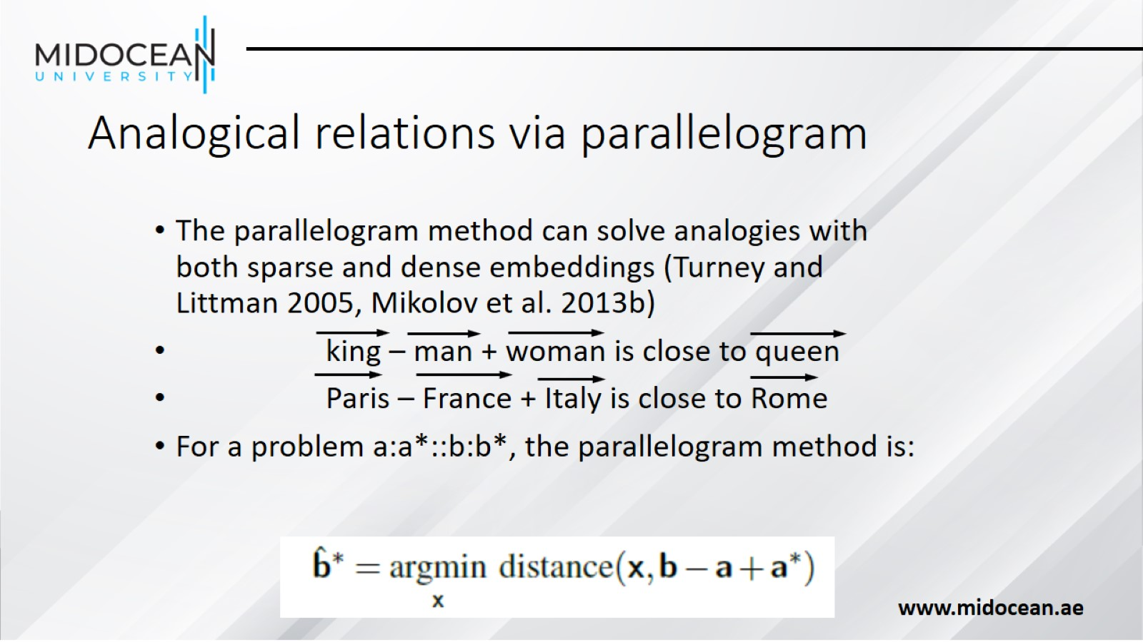
Analogical relations via parallelogram

Slide 35
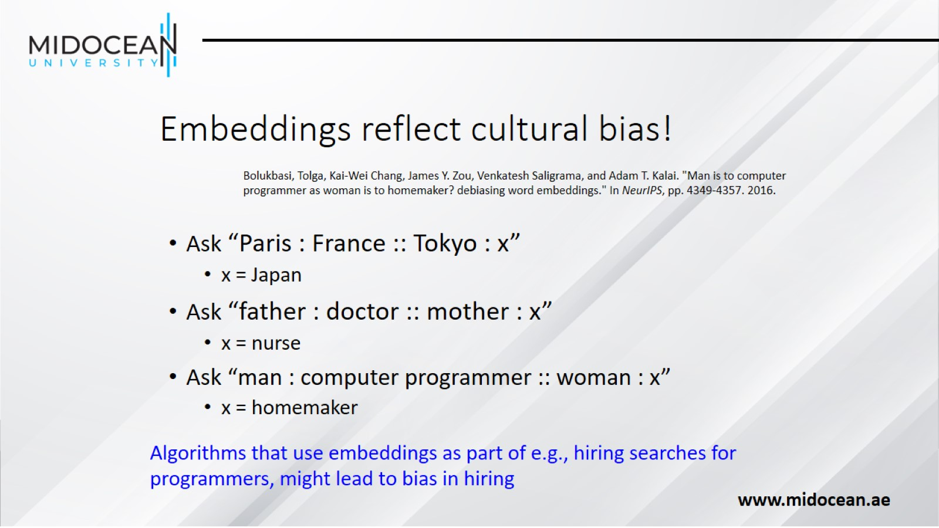
Embeddings reflect cultural bias!

Slide 36
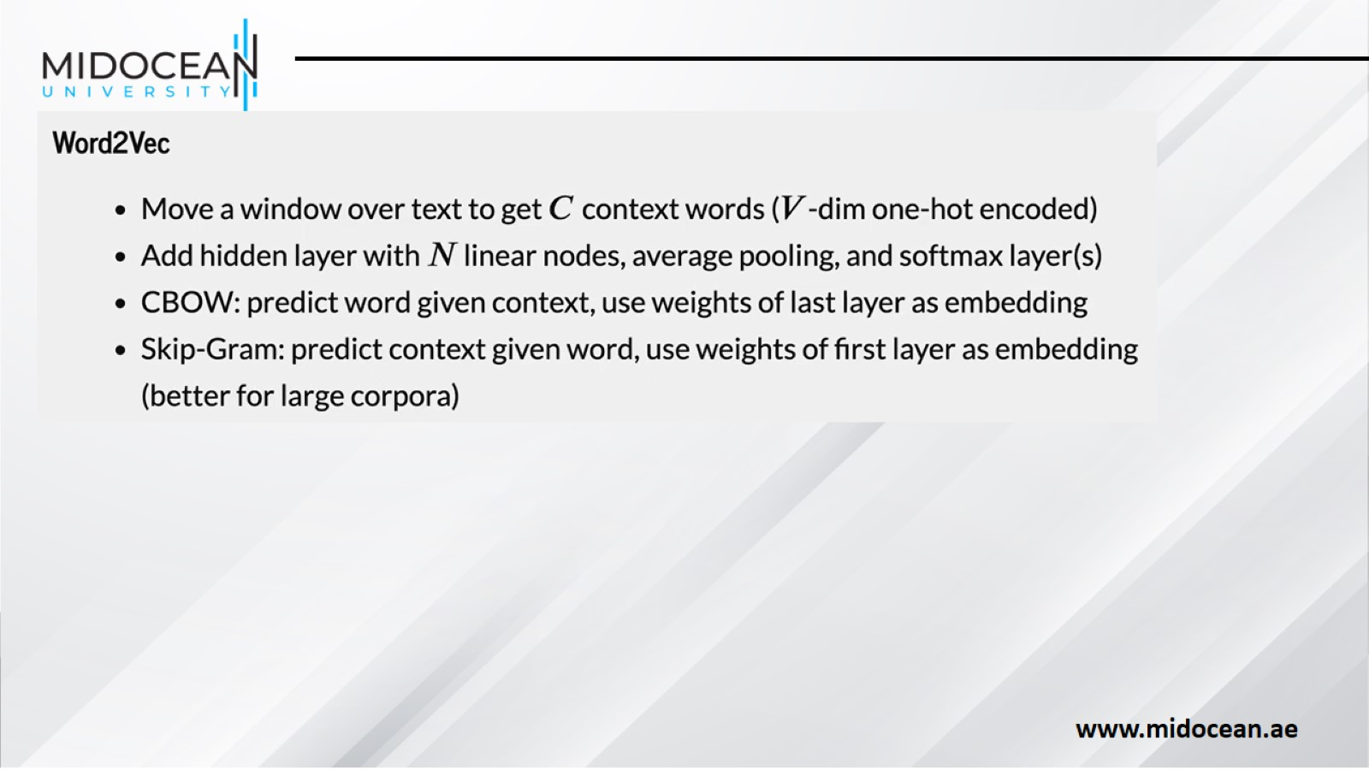

Slide 37
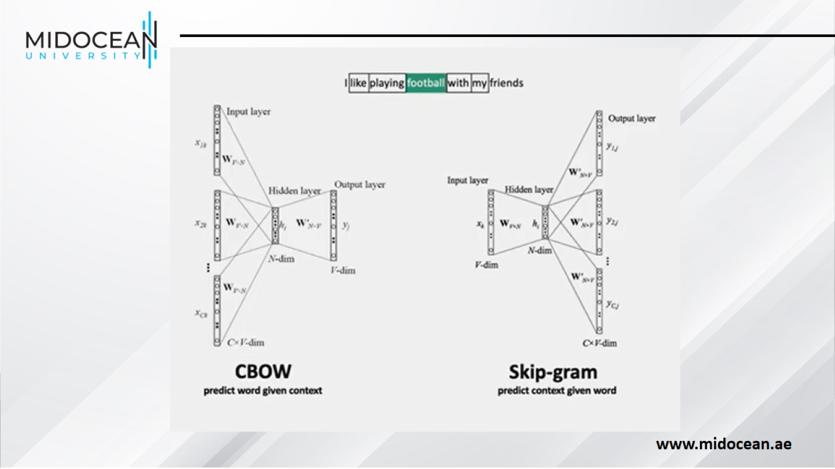

Slide 38
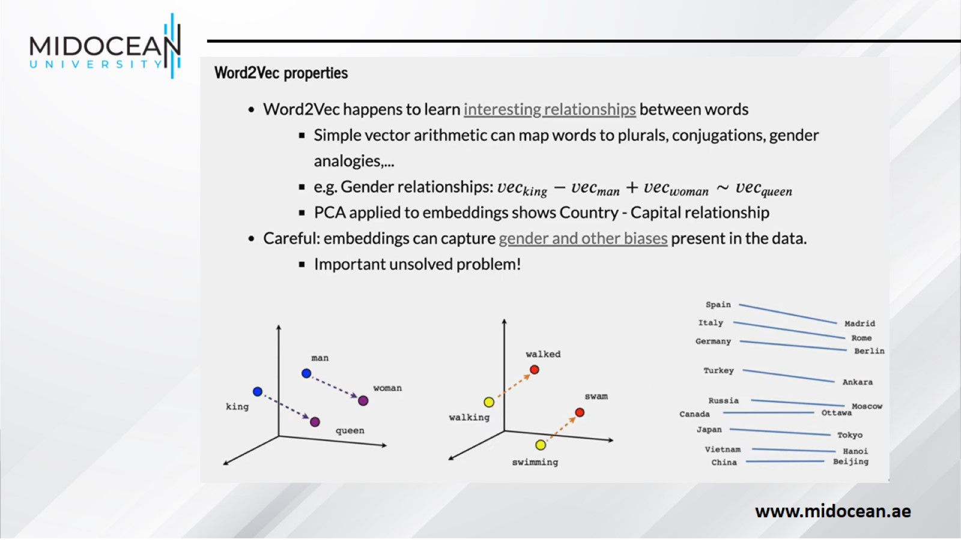

Slide 39
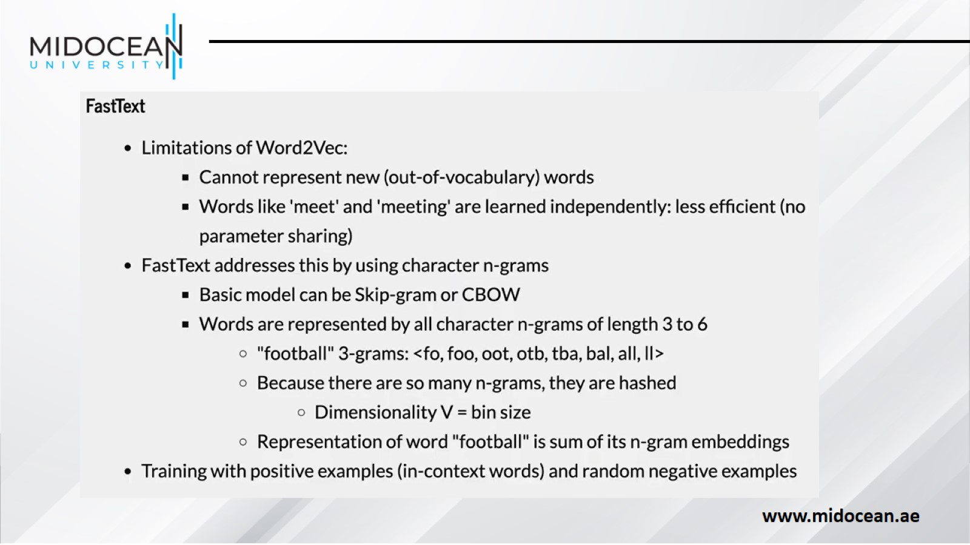

Slide 40
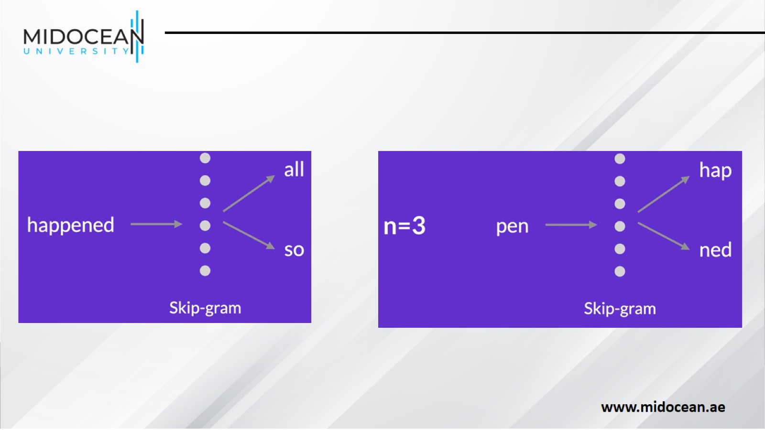

Slide 41
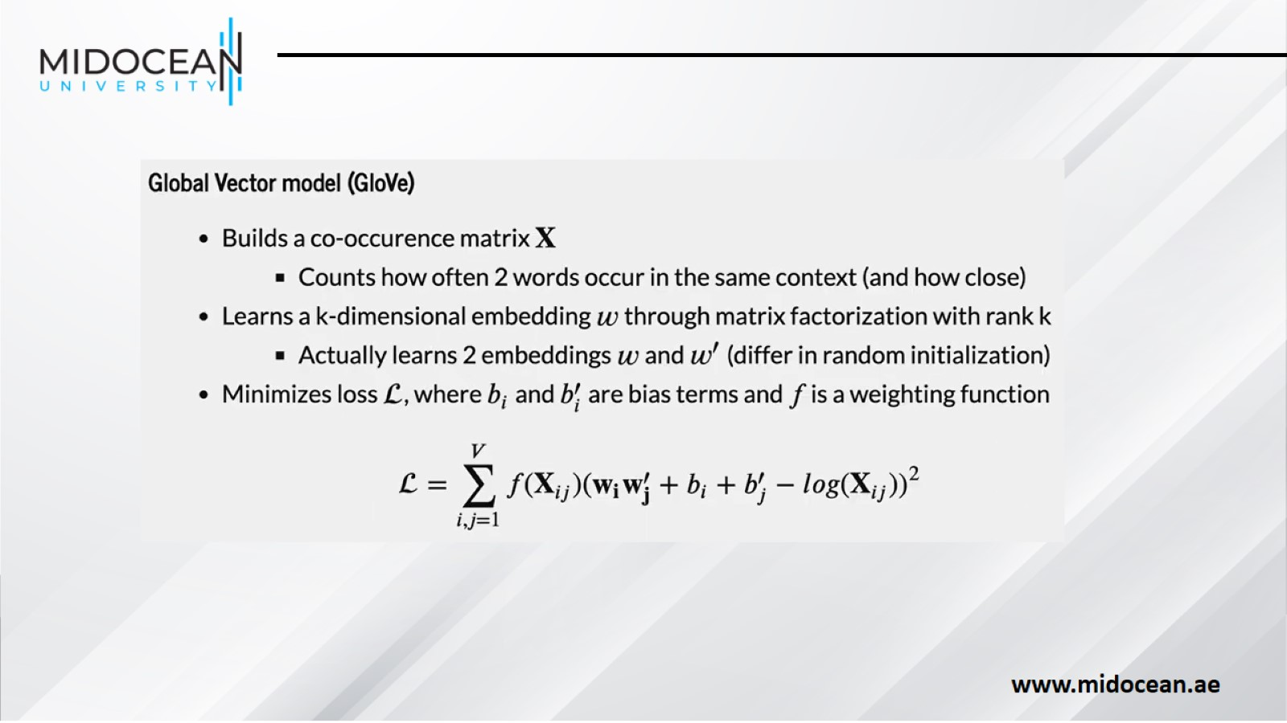

Slide 42
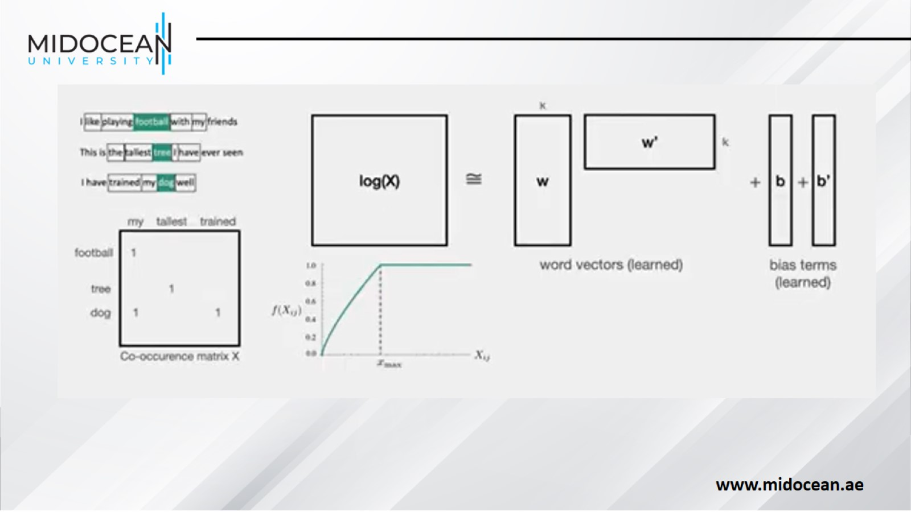

Slide 43
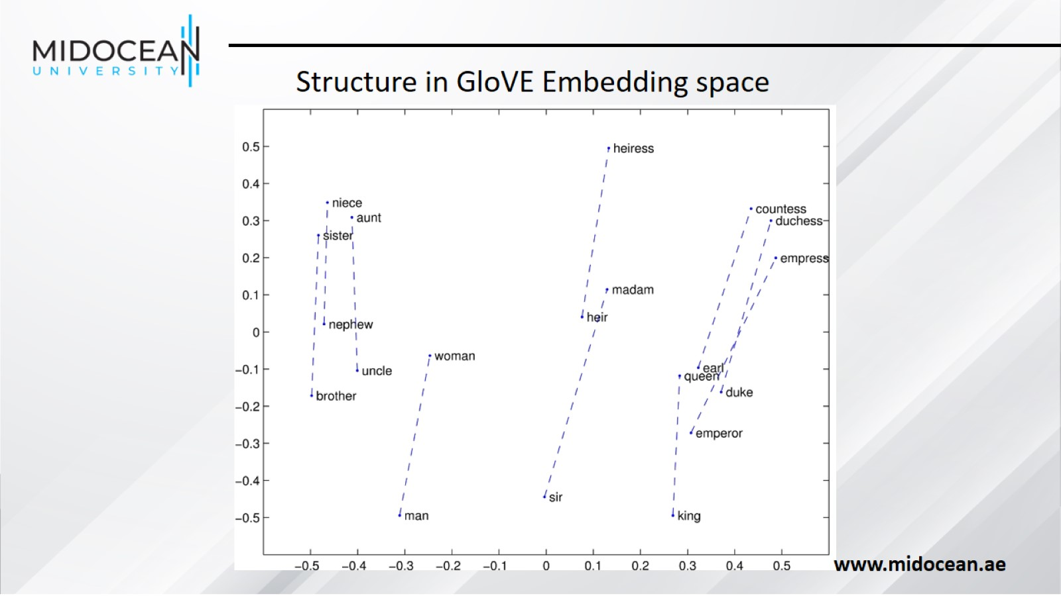

Slide 44
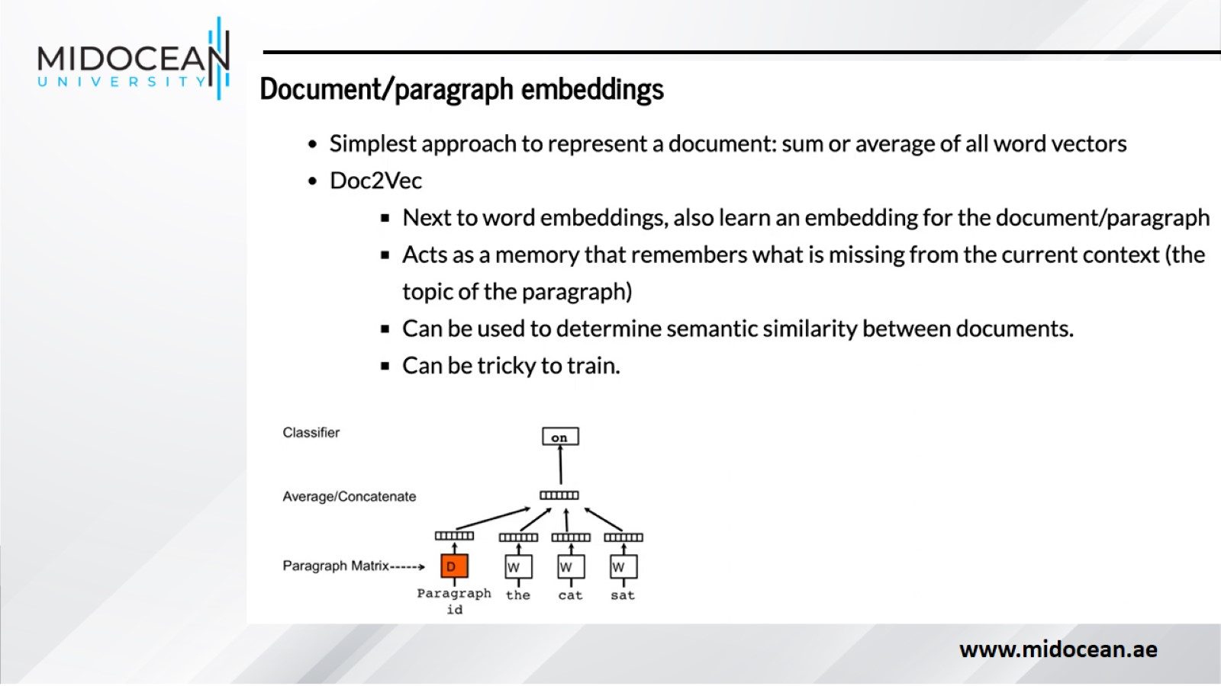

Slide 45
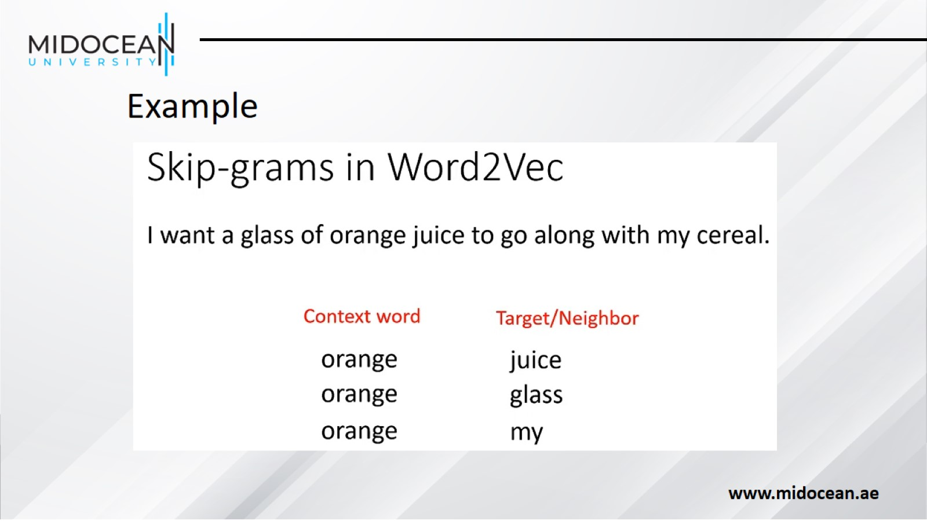

Slide 46
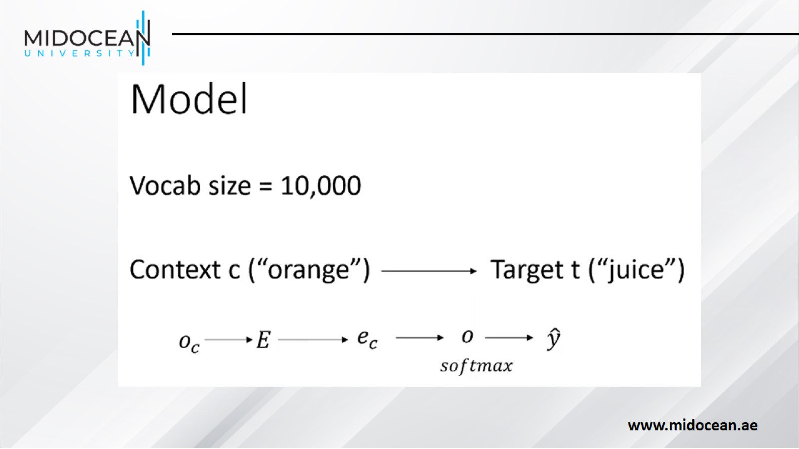

Slide 47
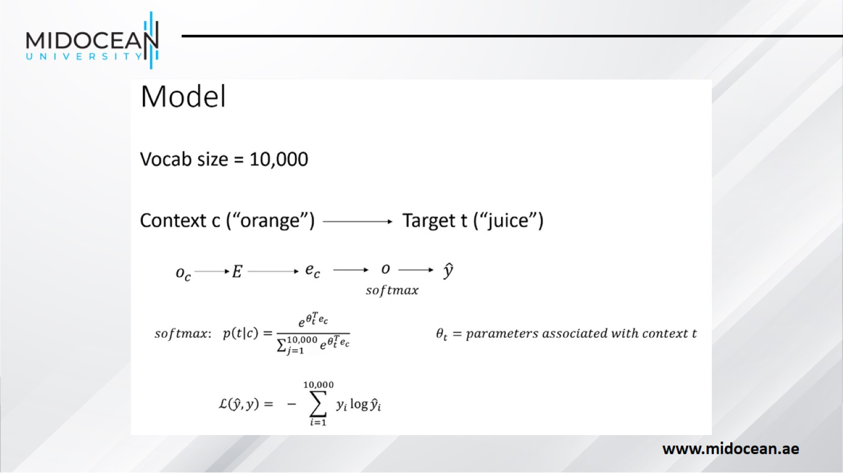

Slide 48
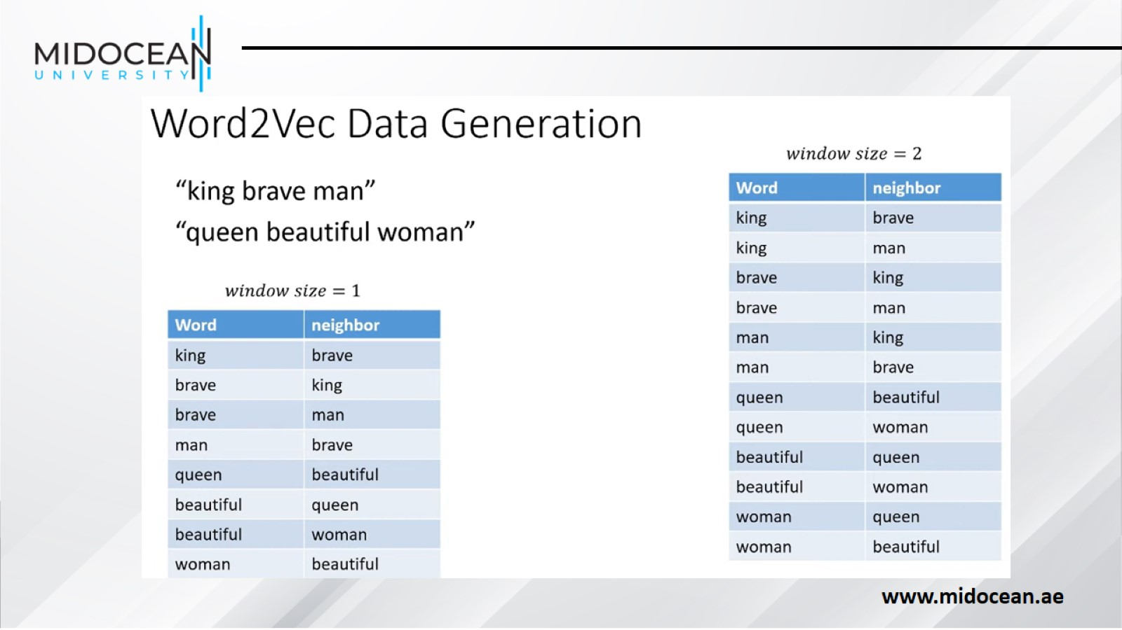

Slide 49
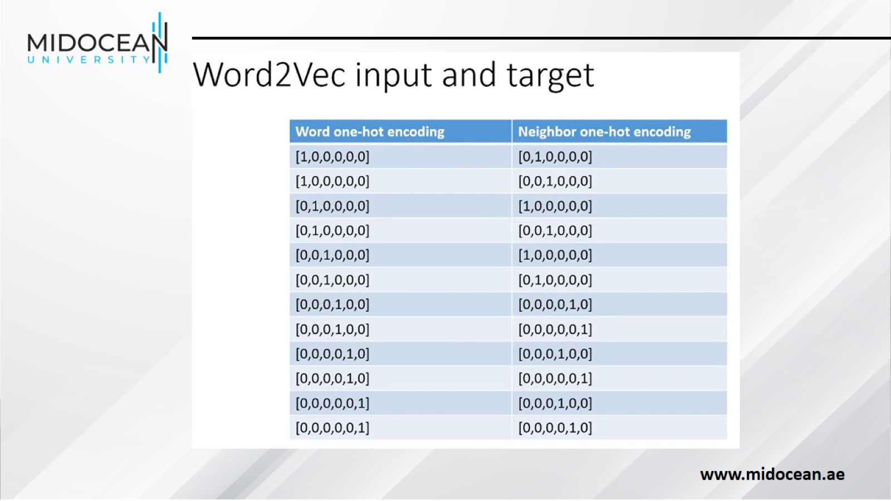

Slide 50
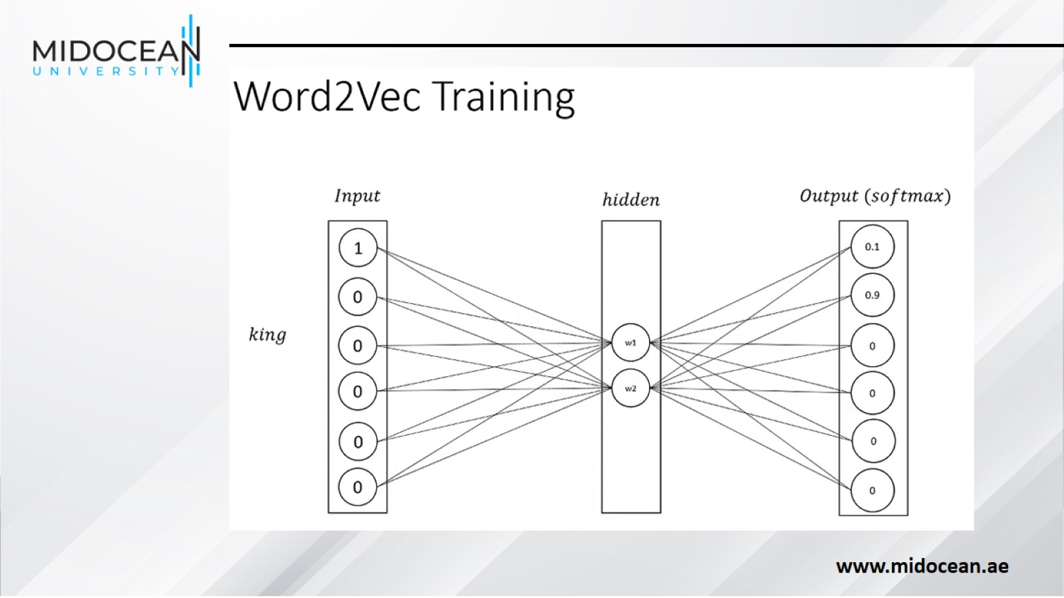

Slide 51
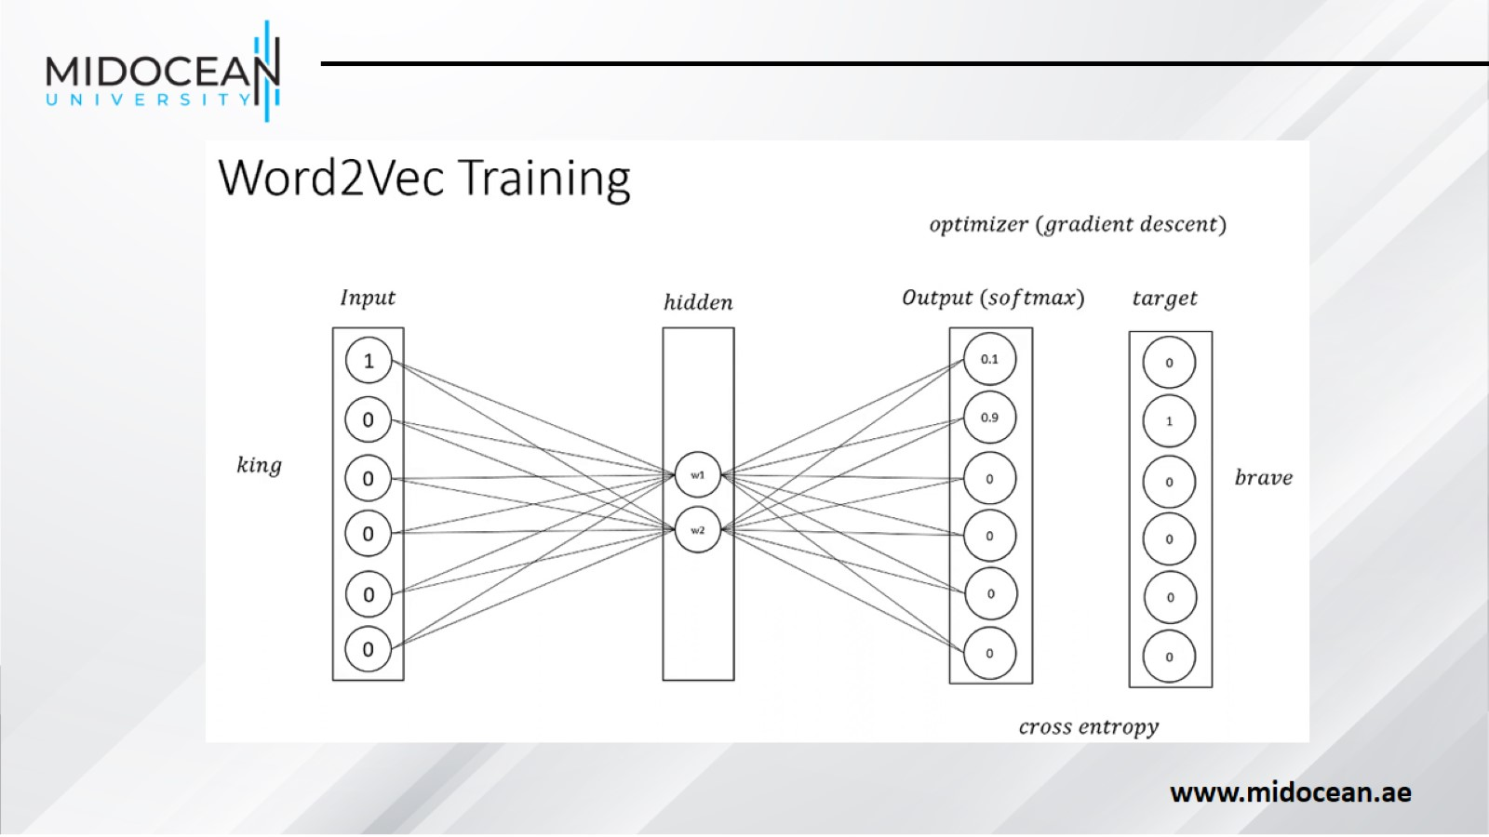

Slide 52
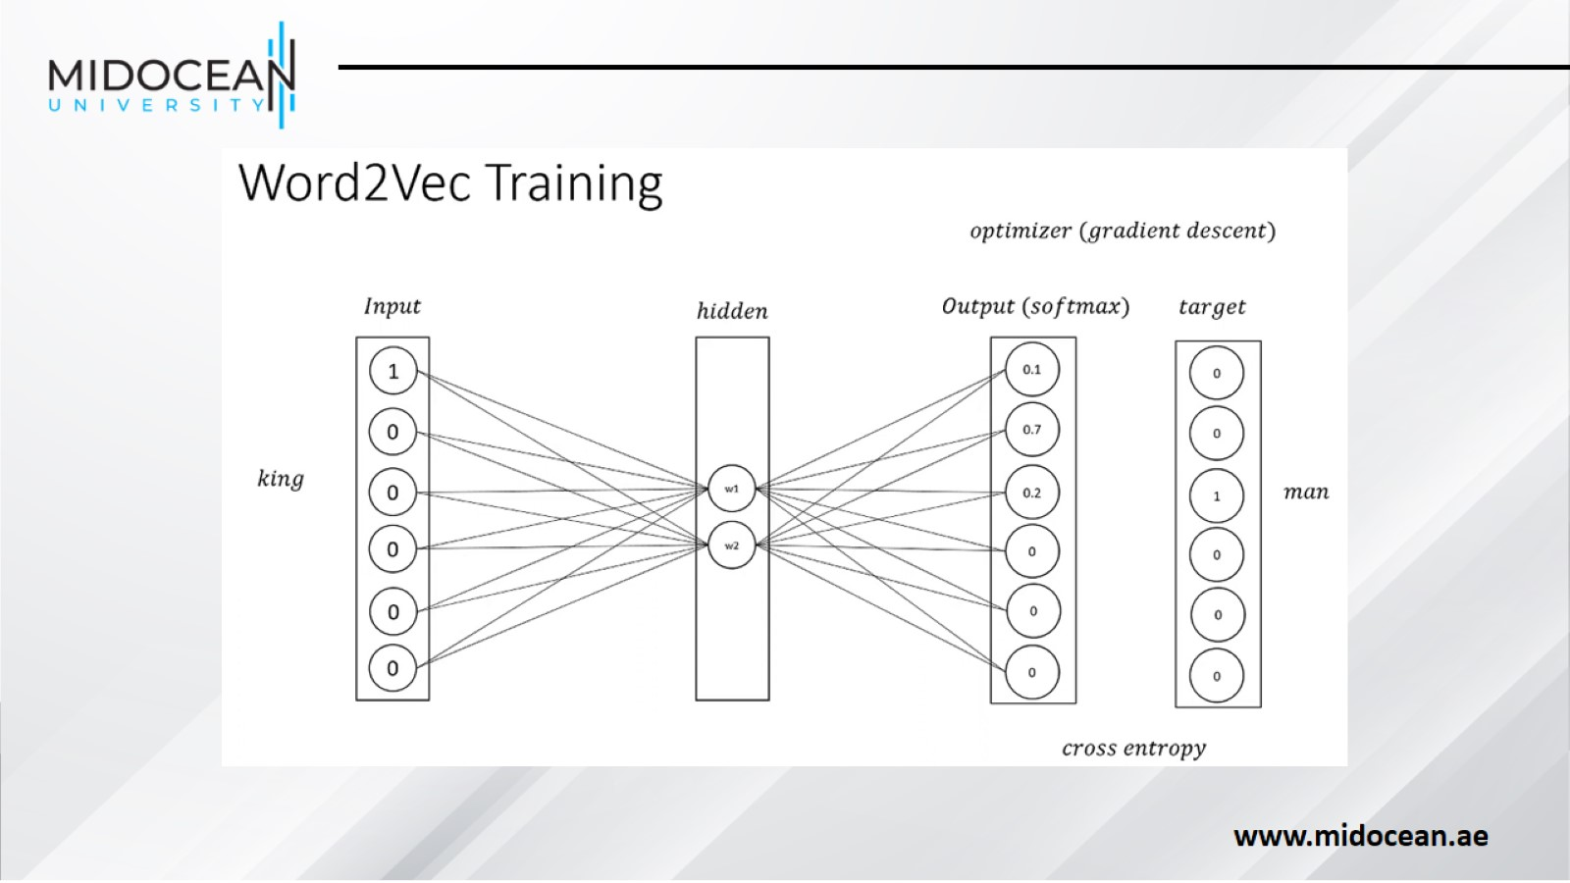

Slide 53


Slide 54


Slide 55


Slide 56


Slide 57


Slide 58


Slide 59


Slide 60


Slide 61


Slide 62

Summary

Slide 63


