Slide 1

RHSA (Admin 1) Red Hat Enterprise Linux 8 Essentials
Prepared by Eng. Taghreed Elsayed
Lecture 5
Controlling Access to Files with Linux File System Permissions

Slide 2

Chapter
06
Controlling Access to Files with Linux File System Permissions
LINUX FILE SYSTEM PERMISSIONS
Access to files by users are controlled by file permissions. The Linux file permissions system is simple but flexible, which makes it easy to understand and apply, yet able to handle most normal permission cases easily.
Files have just three categories of user to which permissions apply. The file is owned by a user, normally the one who created the file.
The file is also owned by a single group, usually the primary group of the user who created the file, but this can be changed. Different permissions can be set for the owning user, the owning group, and for all other users on the system that are not the user or a member of the owning group.
The most specific permissions apply. So, user permissions override group permissions, which override other permissions.

Slide 3
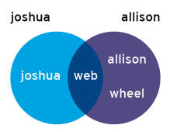
Chapter
06
Controlling Access to Files with Linux File System Permissions
In the graphic that follows, joshua is a member of the groups joshua and web, while allison is a member of allison, wheel, and web.
When joshua and allison have the need to collaborate, the files should be associated with the group web and the group permissions should allow the desired access.
There are also just three categories of permissions which apply: read, write, and execute. These permissions affect access to files and directories as follows:

Slide 4
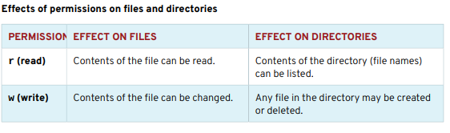
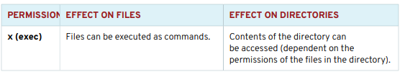
Chapter
06
Controlling Access to Files with Linux File System Permissions

Slide 5
Chapter
06
Controlling Access to Files with Linux File System Permissions
Read and exec on read-only directories, so that they can list the directory and access its contents.
If a user only has read access on a directory, the names of the files in it can be listed, but no other information, including permissions or time stamps, are available, nor can they be accessed.
If a user only has exec access on a directory, they cannot list the names of the files in the directory, but if they already know the name of a file which they have permission to read, then they can access the contents of that file by explicitly specifying the file name.
A file may be removed by anyone who has write permission to the directory in which the file resides, regardless of the ownership or permissions on the file itself. (This can be overridden with a special permission, the sticky bit, which will be discussed at the end of the unit.)

Slide 6

Chapter
06
Controlling Access to Files with Linux File System Permissions
VIEWING FILE/DIRECTORY PERMISSIONS AND OWNERSHIP
The -l option of the ls command will expand the file listing to include both the permissions of a file and the ownership:
The command ls -l directory name will show the expanded listing of all of the files that reside inside the directory.
To prevent the descent into the directory and see the expanded listing of the directory itself, add the -d option to ls:

Slide 7

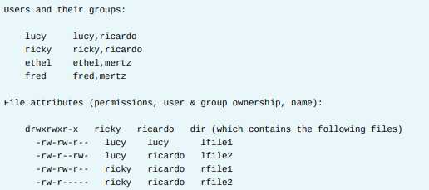
Chapter
06
Controlling Access to Files with Linux File System Permissions
EXAMPLES: LINUX USER, GROUP, OTHER CONCEPTS

Slide 8
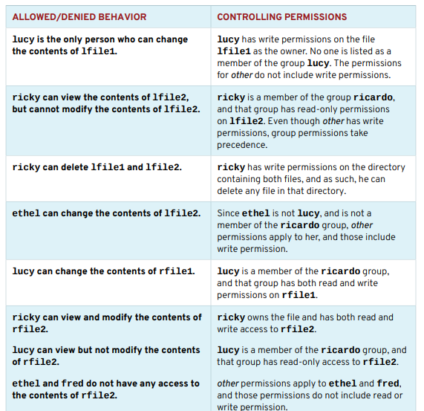
Chapter
06
Controlling Access to Files with Linux File System Permissions

Slide 9

Chapter
06
Controlling Access to Files with Linux File System Permissions
MANAGING FILE SYSTEM PERMISSIONS FROM THE COMMAND LINE
CHANGING FILE/DIRECTORY PERMISSIONS The command used to change permissions from the command line is chmod, short for "change mode" (permissions are also called the mode of a file).
The chmod command takes a permission instruction followed by a list of files or directories to change. The permission instruction can be issued either symbolically (the symbolic method) or numerically (the numeric method).
Symbolic method keywords:

Slide 10
Chapter
06
Controlling Access to Files with Linux File System Permissions
• Who is u, g, o, a (for user, group, other, all)
• What is +, -, = (for add, remove, set exactly)
• Which is r, w, x (for read, write, execute)
The symbolic method of changing file permissions uses letters to represent the different groups of permissions: u for user, g for group, o for other, and a for all.
With the symbolic method, it is not necessary to set a complete new group of permissions.
Instead, it is possible to change one or more of the existing permissions. In order to accomplish this, use three symbols:
+ to add permissions to a set
- to remove permissions from a set
= to replace the entire set for a group of permissions.

Slide 11

Chapter
06
Controlling Access to Files with Linux File System Permissions
The permissions themselves are represented by a single letter: r for read, w for write, and x for execute
When using chmod to change permissions with the symbolic method, using a capital X as the permission flag will add execute permission only if the file is a directory or already has execute set for user, group, or other.
Numeric method:

Slide 12
Chapter
06
Controlling Access to Files with Linux File System Permissions
• Each digit represents an access level:
user, group, other. • # is sum of r=4, w=2, and x=1. Using the numeric method, permissions are represented by a three-digit (or four, when setting advanced permissions) octal number. A single octal digit can represent the numbers 0-7, exactly the number of possibilities for a three-bit number.
To convert between symbolic and numeric representation of permissions, we need to know how the mapping is done.
In the three-digit octal (numeric) representation, each digit stands for one group of permissions, from left to right: user, group, and other. In each of these groups, start with 0. If the read permission is present, add 4. Add 2 if write is present, and 1 for execute.

Slide 13
Chapter
06
Controlling Access to Files with Linux File System Permissions
Numeric permissions are often used by advanced administrators since they are shorter to type and pronounce, while still giving full control over all permissions.
Examine the permissions -rwxr-x---. For the user, rwx is calculated as 4+2+1=7. For the group, r-x is calculated as 4+0+1=5, and for other users, --- is represented with 0.
Putting these three together, the numeric representation of those permissions is 750.
This calculation can also be performed in the opposite direction. Look at the permissions 640.
For the user permissions, 6 represents read (4) and write (2), which displays as rw-. For the group part, 4 only includes read (4) and displays as r--. The 0 for other provides no permissions (---) and the final set of symbolic permissions for this file is -rw-r-----.

Slide 14


Chapter
06
Controlling Access to Files with Linux File System Permissions
Examples :
• Remove read and write permission for group and other on file1:
Add execute permission for everyone on file2:

Slide 15

Chapter
06
Controlling Access to Files with Linux File System Permissions
Set read, write, and execute permission for user, read, and execute for group, and no permission for other on sampledir:
The chmod command supports the -R option to recursively set permissions on the files in an entire directory tree.
When using the -R option, it can be useful to set permissions symbolically using the X flag.

Slide 16

Chapter
06
Controlling Access to Files with Linux File System Permissions
This will allow the execute (search) permission to be set on directories so that their contents can be accessed, without changing permissions on most files.
But be cautious. If a file has any execute permission set, X will set the specified execute permission on that file as well.
For example, the following command will recursively set read and write access on demodir and all its children for their group owner, but will only apply group execute permissions to directories and files which already have execute set for user, group, and/or other.

Slide 17

Chapter
06
Controlling Access to Files with Linux File System Permissions
CHANGING FILE/DIRECTORY USER OR GROUP OWNERSHIP
File ownership can be changed with the chown command (change owner). For example, to grant ownership of the file foofile to student, the following command could be used:
chown can be used with the -R option to recursively change the ownership of an entire directory tree. The following command would grant ownership of foodir and all files and subdirectories within it to student:

Slide 18

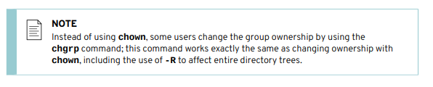
Chapter
06
Controlling Access to Files with Linux File System Permissions

Slide 19
Chapter
06
Controlling Access to Files with Linux File System Permissions
MANAGING DEFAULT PERMISSIONS AND FILE ACCESS
SPECIAL PERMISSIONS The setuid (or setgid) permission on an executable file means that the command will run as the user (or group) of the file, not as the user that ran the command.
One example is the passwd command:
In a long listing, you can spot the setuid permissions by a lowercase s where you would normally expect the x (owner execute permissions) to be.
If the owner does not have execute permissions, this will be replaced by an uppercase S.

Slide 20

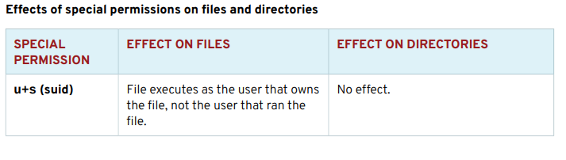
Chapter
06
Controlling Access to Files with Linux File System Permissions
The sticky bit for a directory sets a special restriction on deletion of files: Only the owner of the file (and root) can delete files within the directory. An example is /tmp:

Slide 21
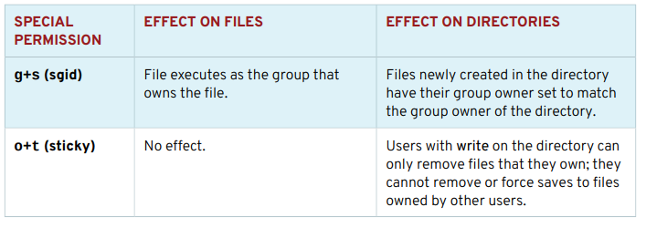
Chapter
06
Controlling Access to Files with Linux File System Permissions
Setting special permissions
• Symbolically: setuid = u+s; setgid = g+s; sticky = o+t
• Numerically (fourth preceding digit): setuid = 4; setgid = 2; sticky = 1

Slide 22
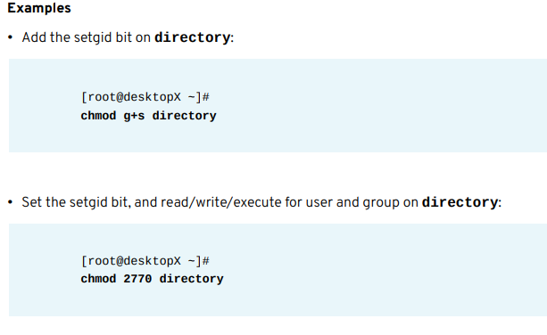
Chapter
06
Controlling Access to Files with Linux File System Permissions

Slide 23
Chapter
06
Controlling Access to Files with Linux File System Permissions
→ DEFAULT FILE PERMISSIONS
The default permissions for files are set by the processes that create them.
For example, text editors create files so they are readable and writeable, but not executable, by everyone. The same goes for shell redirection.
Additionally, binary executables are created executable by the compilers that create them.
The mkdir command creates new directories with all permissions set—read, write, and execute.
These permissions are not typically set when new files and directories are created. This is because some of the permissions are cleared by the umask of the shell process.
The umask command without arguments will display the current value of the shell's umask:

Slide 24

Chapter
06
Controlling Access to Files with Linux File System Permissions
The leading zeros indicate the special, user, and group permissions are not cleared. A umask of 077 clears all the group and other permissions of newly created files.
unmask → Octal bitmask that is used to clear the perms of new files and directories created by that process.
Use the umask command with a single numeric argument to change the umask of the current shell.
The numeric argument should be an octal value corresponding to the new umask value. If it is less than 3 digits, leading zeros are assumed.
In this example, please follow along with the next steps while your instructor demonstrates the effects of umask on new files and directories.

Slide 25
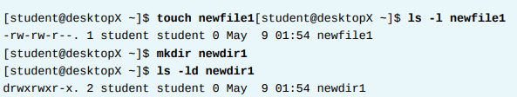
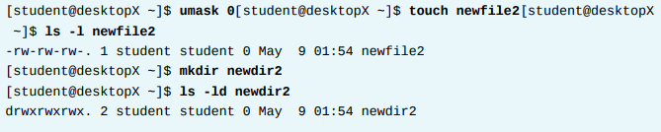
Chapter
06
Controlling Access to Files with Linux File System Permissions
1. Create a new file and directory to see how the default umask affects permissions.
2. Set the umask value to 0. This setting will not mask any of the permissions of new files. Create a new file and directory to see how this new umask affects permissions.

Slide 26
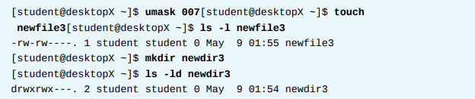
Chapter
06
Controlling Access to Files with Linux File System Permissions
3. Set the umask value to 007. This setting will mask all of the “other” permissions of new files.
4. Set the umask value to 027. This setting will mask write access for group members and all of the “other” permissions of new files.

Slide 27
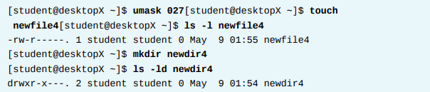
Chapter
06
Controlling Access to Files with Linux File System Permissions
5. Log in as root to change the default umask for unprivileged users to prohibit all access for users not in their group.
Modify /etc/bashrc and /etc/profile to change the default umask for Bash shell users. Since the default umask for unprivileged users is 0002, look for the umask command in these files that sets the umask to that value. Change them to set the umask to 007.

Slide 28
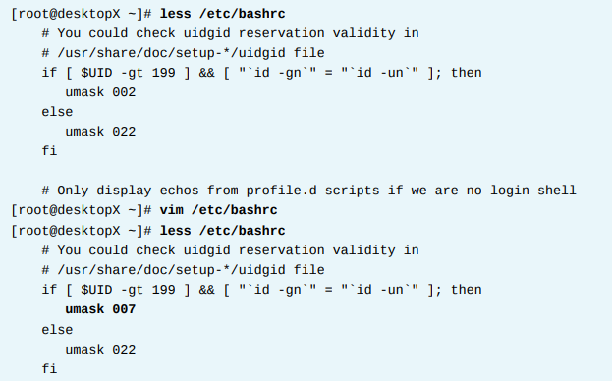
Chapter
06
Controlling Access to Files with Linux File System Permissions

Slide 29
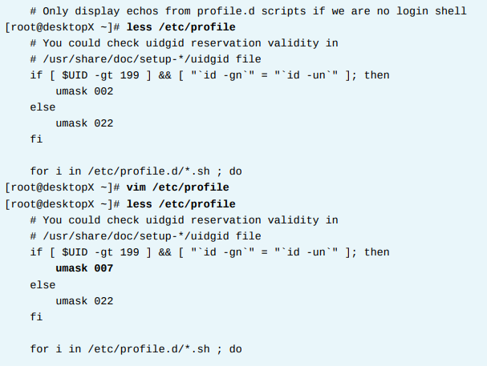
Chapter
06
Controlling Access to Files with Linux File System Permissions

Slide 30
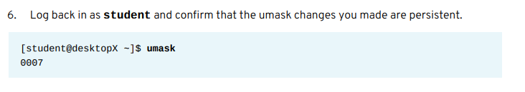
Chapter
06
Controlling Access to Files with Linux File System Permissions

Slide 31

EXAMPLE
Chapter
06
Controlling Access to Files with Linux File System Permissions
Your serverX machine has three accounts, curly, larry, and moe, who are members of a group called stooges. The password for each account is password.
1. Open a terminal window and become root on serverX.

Slide 32
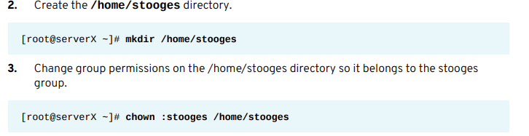
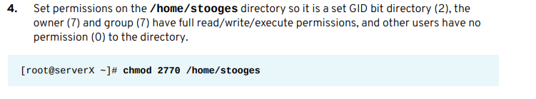
Chapter
06
Controlling Access to Files with Linux File System Permissions

Slide 33
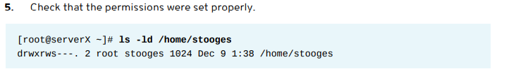
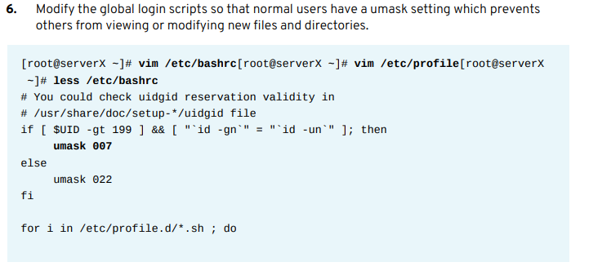
Chapter
06
Controlling Access to Files with Linux File System Permissions

Slide 34
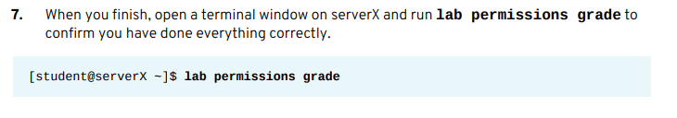
Chapter
06
Controlling Access to Files with Linux File System Permissions

Slide 35

Chapter
06
Controlling Access to Files with Linux File System Permissions

Slide 36
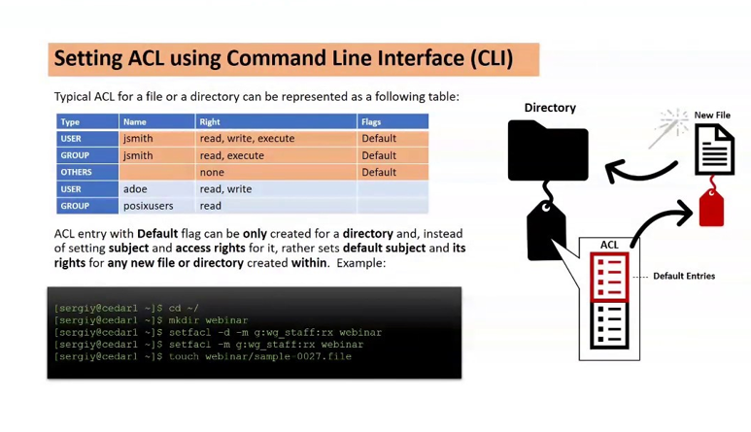
Chapter
06
Controlling Access to Files with Linux File System Permissions

Slide 37
Chapter
06
Controlling Access to Files with Linux File System Permissions
Chmod symbolic mode
Chmod: user→u+ or – or =
Group→g+ or – or =
Others →O+ or – or =
all →a+ or – or =
Chmod Octal mode
R w x → 2*2*2=8 →0 /1 →binary

Slide 38
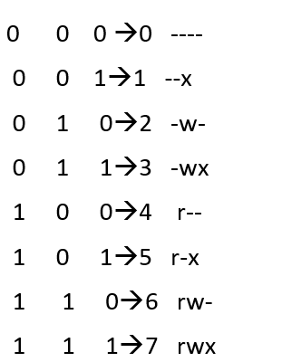
Chapter
06
Controlling Access to Files with Linux File System Permissions

Slide 39
Chapter
06
Controlling Access to Files with Linux File System Permissions
7 → 0 0 7
User group others
7 0 0
User group others
Chmod 7 5 4 file40
Owner user owner group others
Rwx r-x r--

