Slide 1


Managing People and Organizations
Prepared by Dr. Usama Al-Fendi
MGM603
Managing People and Organizations
Lecture 8

Slide 2

Lecture
Motivating Behavior with Work and Rewards
8
Sequence of Chapter 6:
Chapter 5 described a variety of perspectives on motivation, a manager might still need to translate that theory into operational terms.
managers may need to take certain steps to translate the potential for motivation directed at enhanced performance into real motivation and enhanced performance.
Chapter 6 presents the more common methods used to enhance performance.
The chapter covers six methods: job design, employee participation and empowerment, flexible work arrangements, goal setting, performance management, and organizational rewards.
www.midocean.ae

Slide 3
Lecture
Motivating Behavior with Work and Rewards
8
Summary of Lecture 7
Employee involvement using participative management and empowerment can help improve employee motivation in many business settings.
New management practices such as the use of various kinds of work teams and of flatter, more decentralized methods of organizing are intended to empower employees throughout the organization.
Organizations that want to empower their employees need to understand a variety of issues as they go about promotion participation.
Flexible work arrangements are commonly used today to enhance motivated job performance.
Among the more popular alternative arrangements are compressed workweeks, flexible work schedules, extended work schedules, job sharing, and telecommuting.
www.midocean.ae

Slide 4
Lecture
Motivating Behavior with Work and Rewards
8
Goal Setting and Motivation
Goals | From a motivational perspective, a goal is a meaningful objective. Goals are used for two purposes in most organizations: 1- First, they provide a useful framework for managing motivation. Managers and employees can set goals for themselves and then work toward them 2- Second, goals are an effective control device (control meaning the monitoring by management of how well the organization is performing).
www.midocean.ae

Slide 5
Lecture
Motivating Behavior with Work and Rewards
8
Goal Setting and Motivation
Goals | Social learning theory perhaps best describes the role and importance of goal setting in organizations. This perspective suggests that feelings of pride or shame about performance are a function of the extent to which people achieve their goals. A person who achieves a goal will be proud of having done so, whereas a person who fails to achieve a goal will feel personal disappointment and perhaps even shame. People’s degree of pride or disappointment is affected by their self-efficacy, the extent to which they feel that they can still meet their goals even if they failed to do so in the past.
www.midocean.ae

Slide 6
Lecture
Motivating Behavior with Work and Rewards
8
Goal Setting and Motivation (Goal-Setting Theory)
Goal-Setting Theory | Social learning theory provides insights into why and how goals can motivate behavior. It also helps us understand how different people cope with failure to reach their goals. By setting goals for people in the organization, a manager should be able to influence their behavior. In the original version of goal-setting theory, two specific goal characteristics—goal difficulty and goal specificity—were expected to shape performance.
www.midocean.ae

Slide 7
Lecture
Motivating Behavior with Work and Rewards
8
Goal Setting and Motivation (Goal-Setting Theory - Goal Difficulty)
Goal Difficulty | Goal difficulty is the extent to which a goal is challenging and requires effort If people work to achieve goals, it is reasonable to assume that they will work harder to achieve more difficult goals. But a goal must not be so difficult that it is unattainable. EX. If a new manager asks his or her sales force to increase sales by 300 percent, the group may ridicule his or her charge as laughable because they regard it as impossible to reach. A more realistic but still difficult goal—perhaps a 20 percent increase in sales—would probably be a better objective.
www.midocean.ae

Slide 8
Lecture
Motivating Behavior with Work and Rewards
8
Goal Setting and Motivation (Goal-Setting Theory - Goal Specificity)
Goal Specificity | Goal specificity is the clarity and precision of the goal. specificity has been shown to be consistently related to performance. EX. A goal of “increasing productivity” is not very specific, whereas a goal of “increasing productivity by 3 percent in the next six months” is quite specific. Some goals, such as those involving costs, output, profitability, and growth, can easily be stated in clear and precise terms. Other goals, such as improving employee job satisfaction and morale, company image and reputation, ethical behavior, and social responsibility, are much harder to state in specific or measurable terms.
www.midocean.ae

Slide 9

Lecture
Motivating Behavior with Work and Rewards
8
Goal Setting and Motivation (Goal-Setting Theory - Goal Specificity)
Goal setting can be a very useful method for motivating employees. This is especially true if the employee gets to help set goals and is rewarded for achieving them. This manager and her subordinate are reviewing the subordinate’s goals for the next quarter.
www.midocean.ae

Slide 10
Lecture
Motivating Behavior with Work and Rewards
8
Goal Setting and Motivation (expanded model of the goal-setting process)
 | The expanded theory argues that goal-directed effort is a function of four goal attributes: difficulty and specificity (previously discussed), and acceptance and commitment. Goal acceptance is the extent to which a person accepts a goal as his or her own. Goal commitment is the extent to which he or she is personally interested in reaching the goal. EX. The manager who vows to take whatever steps are necessary to cut costs by 10 percent has made a commitment to achieving the goal. Factors that can foster goal acceptance and commitment include participating in the goal-setting process, making goals challenging but realistic, and believing that goal achievement will lead to valued rewards
www.midocean.ae

Slide 11
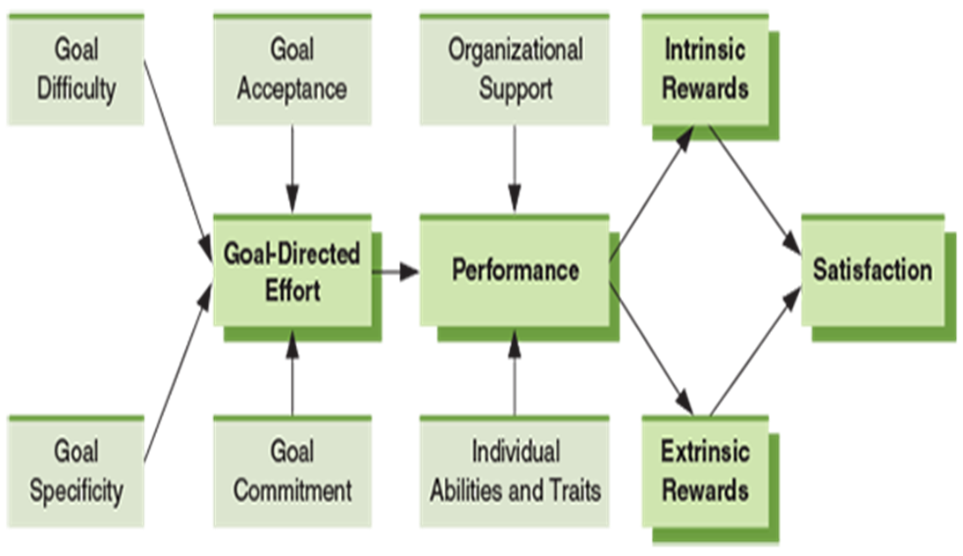
Lecture
Motivating Behavior with Work and Rewards
8
Goal Setting and Motivation (expanded model of the goal-setting process)
Figure 6.4. The Goal-Setting Theory of Motivation
The goal-setting theory of motivation provides an important means of enhancing the motivation of employees. As illustrated here, appropriate goal difficulty, specificity, acceptance, and commitment contribute to goal-directed effort. This effort, in turn, has a direct impact on performance.
www.midocean.ae

Slide 12
Lecture
Motivating Behavior with Work and Rewards
8
Goal Setting and Motivation (Broader Perspectives on Goal Setting)
 | Some organizations undertake goal setting from the somewhat broader perspective of management by objectives (MBO). Management by Objectives (MBO): A collaborative goal-setting process through which organizational goals cascade down throughout the organization A successful MBO program starts with top managers’ establishing overall goals for the organization. After these goals have been set, managers and employees throughout the organization collaborate to set subsidiary goals. First, the overall goals are communicated to everyone. Then each manager meets with each subordinate. During these meetings, the manager explains the unit goals to the subordinate, and the two together determine how the subordinate can contribute to the goals most effectively.
www.midocean.ae

Slide 13
Lecture
Motivating Behavior with Work and Rewards
8
Goal Setting and Motivation (Broader Perspectives on Goal Setting)
Broader Perspectives on Goal Setting | The manager acts as a counselor and helps ensure that the subordinate develops goals that are verifiable. For example, a goal of “cutting costs by 5 percent” is verifiable, whereas a goal of “doing my best” is not. Finally, manager and subordinate ensure that the subordinate has the resources needed to reach his or her goals. The entire process flows downward as each subordinate manager meets with his or her own subordinates to develop their goals. Thus, as we noted earlier, the initial goals set at the top cascade down through the entire organization.
www.midocean.ae

Slide 14
Lecture
Motivating Behavior with Work and Rewards
8
Goal Setting and Motivation (Broader Perspectives on Goal Setting)
Broader Perspectives on Goal Setting | During the time frame set for goal attainment (usually one year), the manager periodically meets with each subordinate to check progress. It may be necessary to modify goals in light of new information, to provide additional resources, or to take some other action. At the end of the specified time period, managers hold a final evaluation meeting with each subordinate. At this meeting, manager and subordinate assess how well goals were met and discuss why. This meeting often serves as the annual performance review as well, determining salary adjustments and other rewards based on reaching goals. This meeting may also serve as the initial goal-setting meeting for the next year’s cycle.
www.midocean.ae

Slide 15
Lecture
Motivating Behavior with Work and Rewards
8
Performance Management
effective performance management is essential in order for rewards to be used effectively. The core of performance management is the actual measurement of the performance of an individual or group.
Performance appraisal :The process of assessing and evaluating an employee’s work behaviors by measurement
Performance appraisal is the process by which someone
evaluates an employee’s work behaviors by measurement and comparison with previously established standards,
documents the results, and
communicates the results to the employee.
Performance management comprises the processes and activities involved in performance appraisals.
www.midocean.ae

Slide 16
Lecture
Motivating Behavior with Work and Rewards
8
Performance Management (Purposes of Performance Measurement)
Performance appraisal may serve many purposes. The ability to provide valuable feedback is one critical purpose.
Feedback, in turn, tells the employee where he or she stands in the eyes of the organization. Appraisal results, of course, are also used to decide and justify reward allocations.
Performance evaluations may be used as a starting point for discussions of training, development, and improvement.
Finally, the data produced by the performance appraisal system can be used to forecast future human resource needs, to plan management succession, and to guide other human resource activities such as recruiting, training, and development programs.
www.midocean.ae

Slide 17
Lecture
Motivating Behavior with Work and Rewards
8
Performance Management (Purposes of Performance Measurement)
Purposes of Performance Measurement | Providing job performance feedback is the primary use of appraisal information. Performance appraisal information can indicate that an employee is ready for promotion or that he or she needs additional training to gain experience in another area of company operations. It may also show that a person does not have the skills for a certain job and that another person should be recruited to fill that particular role. Other purposes of performance appraisal can be grouped into two broad categories, judgment and development.
www.midocean.ae

Slide 18
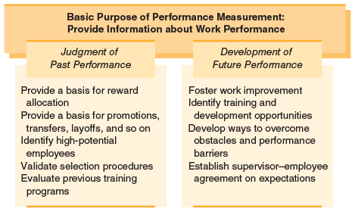
Lecture
Motivating Behavior with Work and Rewards
8
Performance Management (Purposes of Performance Measurement)
Figure 6.5. Purposes of Performance Management
Performance measurement plays a variety of roles in most organizations. This figure illustrates how these roles can help managers judge an employee’s past performance and help managers and employees improve future performance.
www.midocean.ae

Slide 19
Lecture
Motivating Behavior with Work and Rewards
8
Performance Management (Purposes of Performance Measurement)
Purposes of Performance Measurement | Performance appraisals with a judgmental orientation focus on past performance and are concerned mainly with measuring and comparing performance and with the uses of this information. Appraisals with a developmental orientation focus on the future and use information from evaluations to improve performance. If improved future performance is the intent of the appraisal process, the manager may focus on goals or targets for the employees, on eliminating obstacles or problems that hinder performance, and on future training needs.
www.midocean.ae

Slide 20
Lecture
Motivating Behavior with Work and Rewards
8
Performance Management (Elements of Performance Management)
 | Employee appraisals are common in every type of organization, but how they are performed may vary. Many issues must be considered in determining how to conduct an appraisal. Three of the most important issues are who does the appraisals, how often they are done, and how performance is measured. The Appraiser: In most appraisal systems, the employee’s primary evaluator is the supervisor. This stems from the obvious fact that the supervisor is presumably in the best position to be aware of the employee’s day-to-day performance. For example, the supervisor may have little firsthand knowledge of the performance of an employee who works alone outside the company premises, such as a salesperson making solo calls on clients or a maintenance person handling equipment problems in the field.
www.midocean.ae

Slide 21
Lecture
Motivating Behavior with Work and Rewards
8
Performance Management (Elements of Performance Management - The Appraiser: )
Elements of Performance Management | One of the more interesting multi-rater approaches being used in some companies today is something called 360-degree feedback (it is also called multi-source feedback). This method involves employees receiving performance feedback from those on all “sides” of them in the organization—their boss, their colleagues and peers, and their own subordinates. Thus, the feedback comes from all around them, or from 360 degrees.
www.midocean.ae

Slide 22
Lecture
Motivating Behavior with Work and Rewards
8
Performance Management (Elements of Performance Management - The Appraiser: )
Elements of Performance Management | For example, one person may learn that she stands too close to other people when she talks; another person may learn that he has a bad temper. These are the kinds of things a supervisor might not even be aware of, much less report as part of a performance appraisal. Subordinates or peers are much more willing to provide this sort of feedback than direct performance feedback, especially if it is used for development purposes and does not influence rewards or punishments. AT&T, Nestlé, Pitney Bowes, and JPMorgan Chase are a few of the major companies today using 360-degree feedback to help managers improve a wide variety of performance-related behaviors.
www.midocean.ae

Slide 23
Lecture
Motivating Behavior with Work and Rewards
8
Performance Management (Elements of Performance Management - Frequency of the Appraisal )
 | 2- Frequency of the Appraisal: Another important issue is the frequency of appraisals. Regardless of the employee’s level of performance, the types of tasks being performed, or the employee’s need for information on performance, the organization usually conducts performance appraisals on a regular basis, typically once a year. Annual performance appraisals are convenient for administrative purposes such as record keeping and maintaining a level of routine that helps keep everyone comfortable. Some organizations also conduct appraisals semiannually Several systems for monitoring employee performance on an “as-needed” basis have been proposed as an alternative to the traditional annual system.
www.midocean.ae

Slide 24
Lecture
Motivating Behavior with Work and Rewards
8
Performance Management (Elements of Performance Management - Frequency of the Appraisal )
Elements of Performance Management | Managers in international settings must ensure that they incorporate cultural phenomena into their performance-appraisal strategies. For example, in highly individualistic cultures such as that of the United States, appraising performance at the individual level is both common and accepted. But in collectivistic cultures such as Japan, performance appraisals almost always need to be focused more on group performance and feedback. And in countries where people put a lot of faith in destiny, fate, or some form of divine control, employees may not be receptive to performance feedback at all, believing that their actions are irrelevant to the results that follow them.
www.midocean.ae

Slide 25
Lecture
Motivating Behavior with Work and Rewards
8
Performance Management (Elements of Performance Management -Measuring Performance)
 | 3. Measuring Performance: The foundation of good performance management is correctly identifying what should be measured and the selection of the best method(s) for measuring it. Accurately defining job performance is critical; measuring the wrong things well is not good performance management. Once the critical performance dimensions are known, the best way(s) of assessing them can be identified. The measurement method provides the information that managers use to make decisions about salary adjustment, promotion, transfer, training, and discipline.
www.midocean.ae

Slide 26
Lecture
Motivating Behavior with Work and Rewards
8
Performance Management (Elements of Performance Management -Measuring Performance)
Elements of Performance Management | The courts and Equal Employment Opportunity guidelines have mandated that performance measurements be based on job-related criteria rather than on some other factor such as friendship, age, sex, religion, or national origin. In addition, to provide useful information for the decision maker, performance appraisals must be valid, reliable, and free of bias. They must not produce ratings that are consistently too lenient or too severe or that all cluster in the middle. They must also be free of perceptual and timing errors.
www.midocean.ae

Slide 27
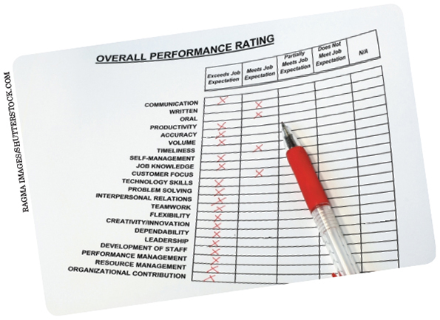
Lecture
Motivating Behavior with Work and Rewards
8
Performance Management (Elements of Performance Management -Measuring Performance)
Key elements of performance management are measuring and assessing performance. Performance rating scales such as this one are commonly used for assessing performance in organizations.
www.midocean.ae

Slide 28
Lecture
Motivating Behavior with Work and Rewards
8
Performance Management (Elements of Performance Management -Measuring Performance)
 | Some of the most popular methods for evaluating individual performance are graphic rating scales, checklists, essays or diaries, behaviorally anchored rating scales, and forced choice systems. These systems are easy to use and familiar to most managers. However, two major problems are common to all individual methods: a tendency to rate most individuals at about the same level and the inability to discriminate among variable levels of performance. Comparative methods evaluate two or more employees by comparing them with each other on various performance dimensions. The most popular comparative methods are ranking, forced distribution, paired comparisons, and the use of multiple raters in making comparisons.
www.midocean.ae

Slide 29
Lecture
Motivating Behavior with Work and Rewards
8
The Balanced Scorecard Approach to Performance Management
Elements of Performance Management | A relatively new and increasingly popular form of performance management system is the balanced scorecard approach. The balanced scorecard, or BSC: A relatively structured performance management technique that identifies financial and nonfinancial performance measures and organizes them into a single model The basic BSC is shown in Figure 6.6.
www.midocean.ae

Slide 30
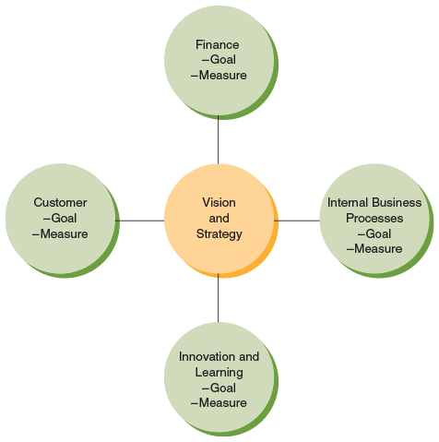
Lecture
Motivating Behavior with Work and Rewards
8
The Balanced Scorecard Approach to Performance Management
The balanced scorecard is a structured performance management technique. In its most basic form, managers establish both goals and measures for how they want to assess customer perceptions, financial performance, internal business process, and innovation and learning. Each of these sets of goals and measures need to be consistent with each other as well as with the organization’s overall vision and strategy.
www.midocean.ae

Slide 31
Lecture
Motivating Behavior with Work and Rewards
8
The Balanced Scorecard Approach to Performance Management
Elements of Performance Management | At the core of the BSC is organizational vision and strategy. These must be clearly established and communicated throughout the organization by the top management team. Next, managers establish a small number of objective goals and measures to support four key components of organizational success. These components are customer perceptions, financial performance, internal business processes, and innovation and learning. All subsequent performance measures are derived from this framework.
www.midocean.ae

Slide 32
Lecture
Motivating Behavior with Work and Rewards
8
The Balanced Scorecard Approach to Performance Management
Elements of Performance Management | Not surprisingly, many commercially available business software systems exist that help support the balanced scorecard approach. Moreover, a wide array of businesses report using the original BSC, a newer revised version of the BSC, or an alternative model that is patterned after the BSC. On the other hand, most of the evidence used to support the validity of the BSC is anecdotal in nature. That is, its value as a performance management system has not been demonstrated in a rigorous and empirical manner.
www.midocean.ae

Slide 33
Lecture
Motivating Behavior with Work and Rewards
8
Individual Rewards in Organizations
The reward system | The reward systems consist of All organizational components, including people, processes, rules and procedures, and decision-making activities, involved in allocating compensation and benefits to employees in exchange for their contributions to the organization Rewards constitute many of the inducements that organizations provide to employees as their part of the psychological contract, for example. Rewards also satisfy some of the needs employees attempt to meet through their choice of work-related behaviors.
www.midocean.ae

Slide 34
Lecture
Motivating Behavior with Work and Rewards
8
Individual Rewards in Organizations (Roles, Purposes, and Meanings of Rewards)
Roles, Purposes, and Meanings of Rewards | The purpose of the reward system in most organizations is to attract, retain, and motivate qualified employees. It is also important for the organization to recognize that organizational rewards have many meanings for employees. Intrinsic and extrinsic rewards carry both surface and symbolic value. The surface value of a reward to an employee is its objective meaning or worth. The symbolic value Subjective and personal meaning or worth of a reward
www.midocean.ae

Slide 35
Lecture
Motivating Behavior with Work and Rewards
8
Individual Rewards in Organizations (Types of Rewards)
Types of Rewards | Most organizations use several different types of rewards. The most common are base pay (wages or salary), incentive systems, benefits, perquisites, and awards. These rewards are combined to create an individual’s compensation package Base Pay: For most people, the most important reward for work is the pay they receive.
www.midocean.ae

Slide 36
Lecture
Motivating Behavior with Work and Rewards
8
Individual Rewards in Organizations (Types of Rewards)
Types of Rewards | Pay is very important to an organization for a variety of reasons. For one thing, an effectively planned and managed pay system can improve motivation and performance. For another, employee compensation is a major cost of doing business—well over 50 percent in many organizations—so a poorly designed system can be an expensive proposition. Finally, since pay is considered a major source of employee dissatisfaction, a poorly designed system can result in problems in other areas such as turnover and low morale.
www.midocean.ae

Slide 37
Lecture
Motivating Behavior with Work and Rewards
8
Individual Rewards in Organizations (Types of Rewards)
Types of Rewards | Incentive systems are plans in which employees can earn additional compensation in return for certain types of performance. Examples of incentive programs include the following: Piecework programs, which tie a worker’s earnings to the number of units produced Gain-sharing programs, which grant additional earnings to employees or workgroups for cost-reduction ideas
www.midocean.ae

Slide 38
Lecture
Motivating Behavior with Work and Rewards
8
Individual Rewards in Organizations (Types of Rewards)
Types of Rewards | 3. Bonus systems, which provide managers with lump-sum payments from a special fund based on the financial performance of the organization or a unit 4. Long-term compensation, which gives managers additional income based on stock price performance, earnings per share, or return on equity
www.midocean.ae

Slide 39
Lecture
Motivating Behavior with Work and Rewards
8
Individual Rewards in Organizations (Types of Rewards)
Types of Rewards | Incentive systems are plans in which employees can earn additional compensation in return for certain types of performance. Examples of incentive programs include the following: 5. Merit pay plans, which base pay raises on the employee’s performance 6. Profit-sharing plans, which distribute a portion of the firm’s profits to all employees at a predetermined rate 7. Employee stock option plans, which set aside stock in the company for employees to purchase at a reduced rate
www.midocean.ae

Slide 40

Lecture
Motivating Behavior with Work and Rewards
8
Individual Rewards in Organizations (Types of Rewards)
One common form of indirect compensation is being paid for time not worked. Vacation time is one frequent form of paid time off. Of course, as shown here, in today’s business world many people still check their email and communicate with their colleagues even while on vacation.
www.midocean.ae

Slide 41
Lecture
Motivating Behavior with Work and Rewards
8
Individual Rewards in Organizations (Types of Rewards)
Types of Rewards | Indirect Compensation Another major component of the compensation package is indirect compensation, also commonly referred to as the employee benefits plan. Typical benefits provided by businesses include the following: Payment for time not worked, both on and off the job: On-the-job free time includes lunch, rest, coffee brakes, and wash-up or get-ready time. Off-the-job time not worked includes vacation, sick leave, holidays, and personal days. Social Security contributions: The employer contributes half the money paid into the system established under the Federal Insurance Contributions Act (PICA). The employee pays the other half.
www.midocean.ae

Slide 42
Lecture
Motivating Behavior with Work and Rewards
8
Individual Rewards in Organizations (Types of Rewards)
Types of Rewards | Indirect Compensation 3. Unemployment compensation: People who have lost their jobs or are temporarily laid off get a percentage of their wages from an insurance-like program. 4. Disability and workers’ compensation benefits: Employers contribute funds to help workers who cannot work due to occupational injury or ailment. 5. Life and health insurance programs: Most organizations offer insurance at a cost far below what individuals would pay to buy insurance on their own. 6. Pension or retirement plans: Most organizations offer plans to provide supplementary income to employees after they retire.
www.midocean.ae

Slide 43
Lecture
Motivating Behavior with Work and Rewards
8
Individual Rewards in Organizations (Types of Rewards)
Types of Rewards | Perquisites Perquisites are special privileges awarded to selected members of an organization, usually top managers. For years, the top executives of many businesses were allowed privileges such as unlimited use of the company jet, motor home, vacation home, and executive dining room. In Japan, a popular perquisite is a paid membership in an exclusive golf club; a common perquisite in England is first-class travel. In the United States, the Internal Revenue Service has ruled that some “perks” constitute a form of income and thus can be taxed.
www.midocean.ae

Slide 44
Lecture
Motivating Behavior with Work and Rewards
8
Individual Rewards in Organizations (Types of Rewards)
Types of Rewards | Awards At many companies, employees receive awards for everything from seniority to perfect attendance, from zero defects (quality work) to cost reduction suggestions. Award programs can be costly in the time required to run them and in money if cash awards are given, but award systems can improve performance under the right conditions.
www.midocean.ae

Slide 45

Lecture
Motivating Behavior with Work and Rewards
8
Individual Rewards in Organizations (Types of Rewards)
Awards and prizes are frequently used to reward outstanding performance. This manager is getting an award for achieving the most revenue growth in the company.
www.midocean.ae

Slide 46
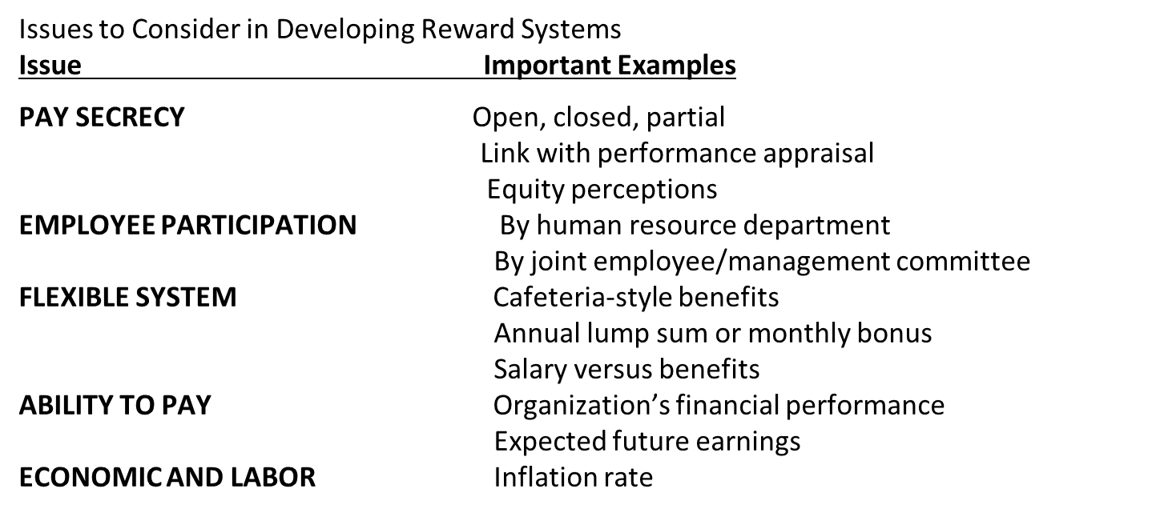
Lecture
Motivating Behavior with Work and Rewards
8
Individual Rewards in Organizations (Related Issues in Rewarding Performance)
www.midocean.ae

Slide 47
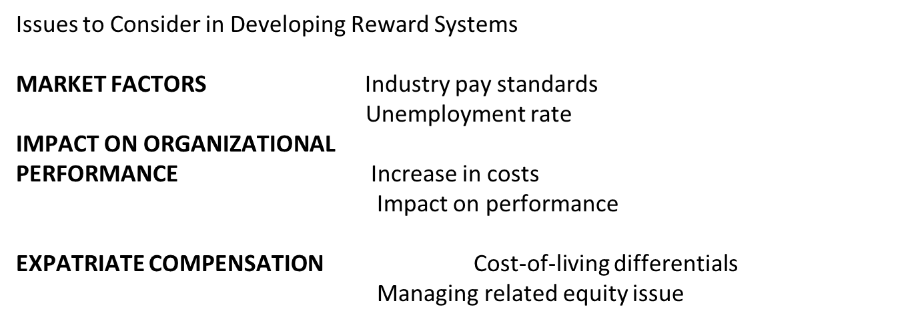
Lecture
Motivating Behavior with Work and Rewards
8
Individual Rewards in Organizations (Related Issues in Rewarding Performance)
www.midocean.ae

Slide 48
Lecture
Motivating Behavior with Work and Rewards
8
Many different management challenges related to employee motivation can be addressed through methods related to work and rewards.
Managerial Challenges | Motivation Methods and Techniques
 | Job Design | Participation & Empowerment | Flexible Work | Goal Setting | Performance Management | Rewards
Firm has a low-cost business strategy but needs to motivate employees | x | x |  | x | x | x
An employee feels he cannot meet his performance goals |  | x |  | x | x | x
An employee feels underpaid relative to her coworkers |  |  | x | x | x | x
An employee engages in inappropriate behavior (bullying, ridiculing coworkers) |  | x |  | x | x | x
A talented employee is not feeling challenged at work | x | x |  | x | x | x
Because the work is repetitive, some employees find it boring and hard to stay motivated |  | x | x |  | x | x
www.midocean.ae

Slide 49
Lecture
Motivating Behavior with Work and Rewards
8
Summary and Application
The goal-setting theory of motivation suggests that appropriate goal difficulty, specificity, acceptance, and commitment will result in higher levels of motivated performance. Management by objectives, or MBO, extends goal setting throughout an organization by cascading goals down from the top of the firm to the bottom.
Performance measurement is the process by which work behaviors are measured and compared with established standards and the results recorded and communicated. Its purposes are to evaluate employees’ work performance and to provide information for organizational uses such as compensation, personnel planning, and employee training and development.
www.midocean.ae

Slide 50
Lecture
Motivating Behavior with Work and Rewards
8
Summary and Application
The purpose of the reward system is to attract, retain, and motivate qualified employees and to maintain a pay structure that is internally equitable and externally competitive. Rewards have both surface and symbolic value. Rewards take the form of money, indirect compensation or benefits, perquisites, awards, and incentives
www.midocean.ae

Slide 51



Thank You

