Slide 1



The manager and his leading skills
Lecture 3
MGM111
Principle of Management
Prepared by
Dr. Bothaina Mahmoud Fouad

Slide 2

www.midocean.ae
Who is the manager and his needed skills
Difference between Manager and Leader
Explain the Managers and their types
Summarize the essential Management Roles
Describe the essential skills for managers
Understand organization and its performance
The managers challenges
Learning Outcomes of the Lecture

Slide 3
“Management is doing things right, leadership is doing the right things”
(Warren Bennis and Peter Drucker)

Slide 4
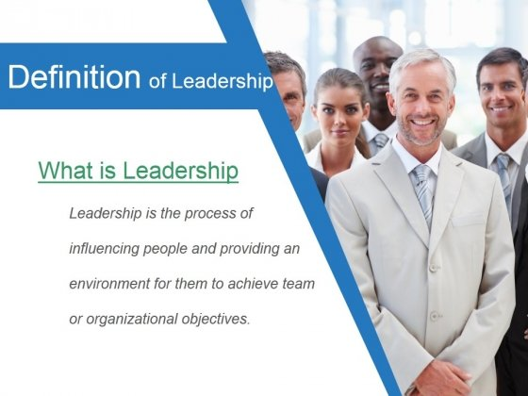
Leadership is the ability to develop a vision that motivates others to move with a passion toward a common goal
Leadership Definition

Slide 5
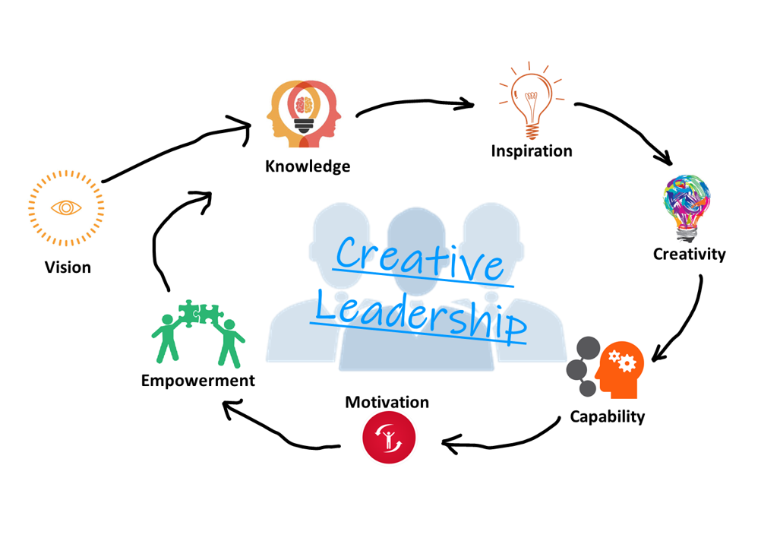
Creative leadership is
The combination of creativity ( the ability to generates ideas ) with leadership ( the ability to execute them through actions of others).
the ability to create and realize innovative solutions especially in the face of structurally complex or changing situations. It refers to those people who, when all is shifting and new approaches are yet unknown, can still create clarity of purpose for their teams.

Slide 6
WHO IS A LEADER......?
One that leads or guides.
One who is in charge or in command of others.
One who heads a political party or organization.
One who has influence or power, especially of a political nature.
www.midocean.ae

Slide 7
A leader is a person who helps an individual or a group of individuals in achieving their goals.
A leader does not always have to be the president, or the elected leader. It may be an active leader of the group, or someone who reaches out to help another person.
A follower is an individual who follows the ideas, goals, or tasks of a leader. Followers are developed by working together to identify goals and strategies for achieving the goals.

Slide 8
REMEMBER…
If there are no followers, there are no leaders. If roles are not understood, the group will not operate effectively!!

Slide 9
Leaders can be found in every day life. They range from people in charge of businesses and schools, to the people that are running our government.

Slide 10
Leaders inspire - Motivate - others to take on challenges and to achieve goals that they don’t believe they’re capable of or motivated to achieve.

Slide 11
IMPORTANCE OF LEADERSHIP
Initiates action
Motivation
Providing guidance
Creating confidence
Co-ordination
Effective planning
Inspiration & motivation

Slide 12

Management Vs. Leadership
Management
Leadership
is the ability to organize resources and coordinate the execution of tasks necessary to reach a goal in a timely and cost effective manner
is the process of influencing people and providing an environment for them to achieve team or organizational objectives

Slide 13
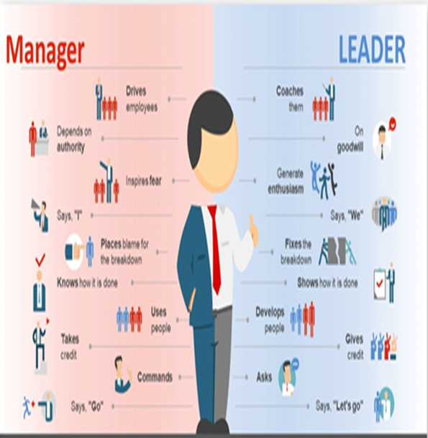
www.midocean.ae
Manager is
a person controlling or administering a business or a part of a business.
A person regarded in
terms of skill in household or financial or other management.
Leader is
a person who is followed by others.
Manager vs Leader

Slide 14
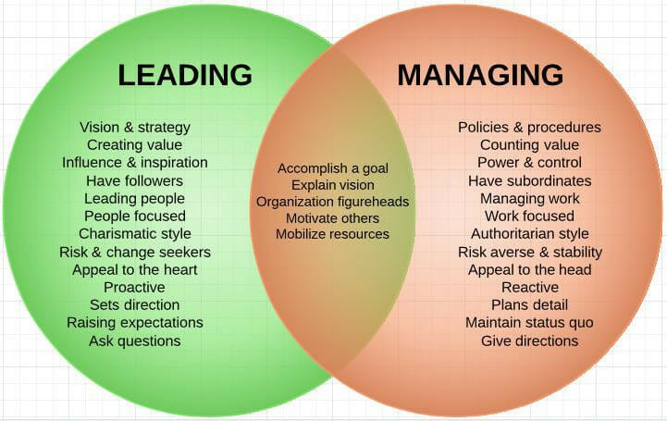

Slide 15
Leaders Vs. Managers attributes
leader | Manager
innovator | Administrator
ensures trust and results | represents control and authority
asks questions about what and why | asks questions in how and when
give solutions | create strategies
make followers | look for subordinates
Do the right thing | Do things right

Slide 16
Leadership & Management Skills
Leadership - soft skills
Communications
Motivation
Stress Management
Team Building
Change Management
Management - hard skills
Scheduling
Staffing
Activity Analysis
Project Controls

Slide 17
REMEMBER…
All the leaders can be managers
But
Not all the managers can be leaders

Slide 18
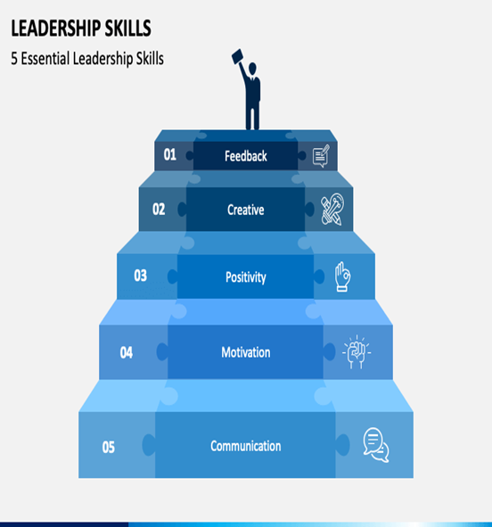
Chapter
What Makes an Effective Leader
01
Effective leaders have the ability to communicate well, motivate their team, handle and delegate responsibilities, listen to feedback, and have the flexibility to solve problems in an ever-changing workplace.

Slide 19
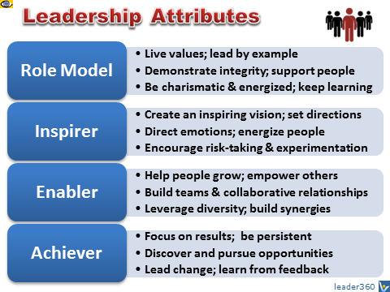
LEADERSHIP attributes are the inner or personal qualities that constitute effective leadership. These attributes include a large array of Are-Know-Do characteristics such as vision, values, character, motives, habits, traits, competencies, style, behaviors, and SKILLS.

Slide 20
Characteristics of a Leader
Honesty - Display sincerity, integrity, and candor in all your actions. Deceptive behavior will not inspire trust.
Competent - Your actions should be based on reason and moral principles. Do not make decisions based on childlike emotional desires or feelings.
Forward-looking Set goals and have a vision of the future. The vision must be owned throughout the organization. Effective leaders envision what they want and how to get it. They habitually pick priorities stemming from their basic values.
Inspiring - Display confidence in all that you do. By showing endurance in mental, physical, and spiritual stamina, you will inspire others to reach for new heights. Take charge when necessary.
www.midocean.ae

Slide 21
Characteristics of a Leader
Characteristics of a Leader
Straightforward - Use sound judgment to make a good decision at the right time.
Imaginative - Make timely and appropriate changes in your thinking, plans, and methods. Show creativity by thinking of new and better goals, ideas, and solutions to problems. Be innovative!
www.midocean.ae

Slide 22
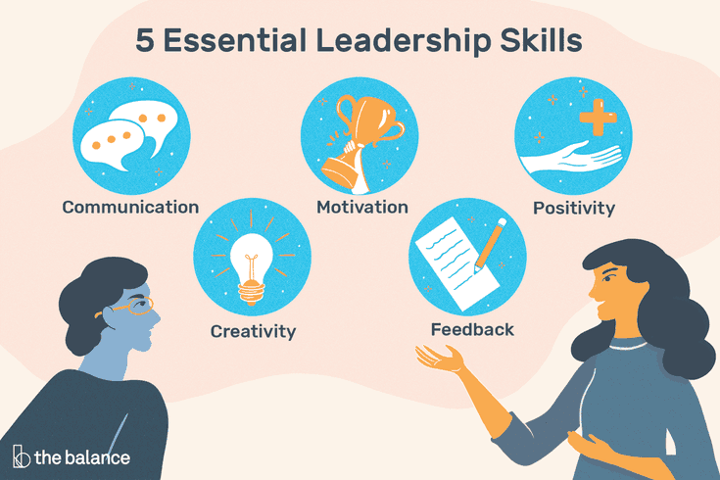
Characteristics of a Leader
www.midocean.ae

Slide 23
Characteristics of a Leader
Other 10 skills every leader/ Manager should have
Ability to delegate: sharing tasks with others saves you time at work and reduces your stress levels.
2. Ability to inspire and motivate: Employees depend on leaders for support and guidance. By providing goals and objectives and a clear vision for how to meet them, you can keep employees motivated to perform their best.
3. Conflict-management: Workplaces typically have occasional conflicts, so knowing how to navigate them makes managing easier.
4. Decision-making: Decision-making involves identifying an issue, weighing options, and taking action. The ability to make decisions can save time, boost productivity, build trust, and reduce confusion in the workplace.
5. Effective communication: Being a manager involves interacting with people regularly. On any given day, you might run a staff meeting, make a presentation to board members, or resolve a conflict between two employees. In addition to conveying information, listening when communicating is essential. Practicing good listening helps you be present, maintain eye contact, and paraphrase what your speaker says.
www.midocean.ae
https://www.coursera.org/enterprise/articles/essential-managerial-skills

Slide 24
Characteristics of a Leader
Other 10 skills every leader should have, Con’t
6. Emotional intelligence: Emotionally intelligent leaders often have empathy for others, a sense of self-awareness, an ability to think before speaking or acting, and a high degree of resilience.
7. Flexibility: Flexibility involves finding multiple ways to manage a team, complete a task, or solve a problem.
8. Organization: you may have much to handle at once, including tasks, reports, meetings, projects, and presentations. Good organizational skills can help. These include goal setting, scheduling, time management, and recordkeeping.
9. Problem-solving: Problem-solving goes hand-in-hand with decision-making. The process involves identifying a problem, weighing solutions, choosing the best one, and evaluating whether or not it works. Managers who are good problem solvers have an easier time meeting company goals and objectives.
10. Strategic thinking: Strategic thinking involves: Analyzing data to come up with strategies, Creating strategies for meeting company goals and objectives, Thinking of ways to implement strategies, Directing others in the completion of goal-related tasks, Communicating the results to company stakeholders
www.midocean.ae
https://www.coursera.org/enterprise/articles/essential-managerial-skills

Slide 25
Take initiative
Look beyond the tasks in your job description. Think long-term about what would be beneficial for your department and the company. Try to brainstorm ideas and commit to doing work that goes beyond the daily routine.
Request more responsibility
Target specific skills
If you have a specific skill that you want to develop, create a plan to improve your abilities in this area. This could mean taking a class, finding a mentor to help, reading books, or setting a small goal that forces you to develop this skill.
you can share with your manager that you're eager to grow your leadership abilities
How You Can Build Leadership Skills

Slide 26
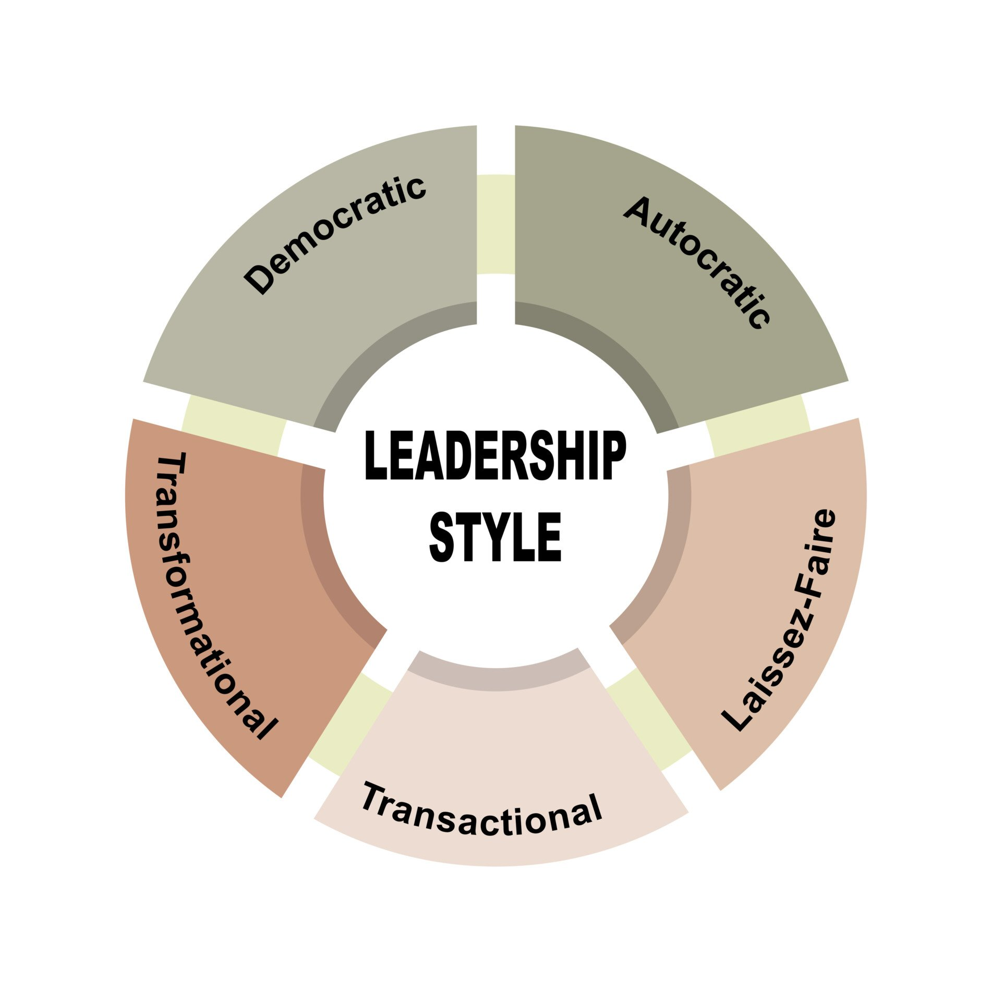
Types of Leadership Style

Slide 27

Autocratic leadership
  Leader makes decisions without reference to anyone else.
  High degree of dependency on the leader.
  Can create de-motivation and alienation of staff.
  Authoritarian leaders provide clear expectations around what needs to be done, when it should be done, and when it should be done.
  May be valuable in some types of business where decisions need to be made quickly and decisively.
  As a result, there is a division between the leader and members as the leader makes decisions independent of the group.

Slide 28
Autocratic leadership
For example,
if Sam assigns work and gives orders to complete the work as per his discretion without consulting his subordinates, then Sam is an Autocratic Leader.

Slide 29

Democratic Leadership
Encourages decision making from different perspectives – leadership may be emphasised throughout the organisation
  Consultative: process of consultation before decisions are taken
  Persuasive: Leader takes decision and seeks to persuade others that the decision is correct

Slide 30
Democratic Leadership, Con’t
  May help motivation and involvement
  Workers feel ownership of the firm and its ideas
  Improves the sharing of ideas and experiences within the business
  Can delay decision making

Slide 31
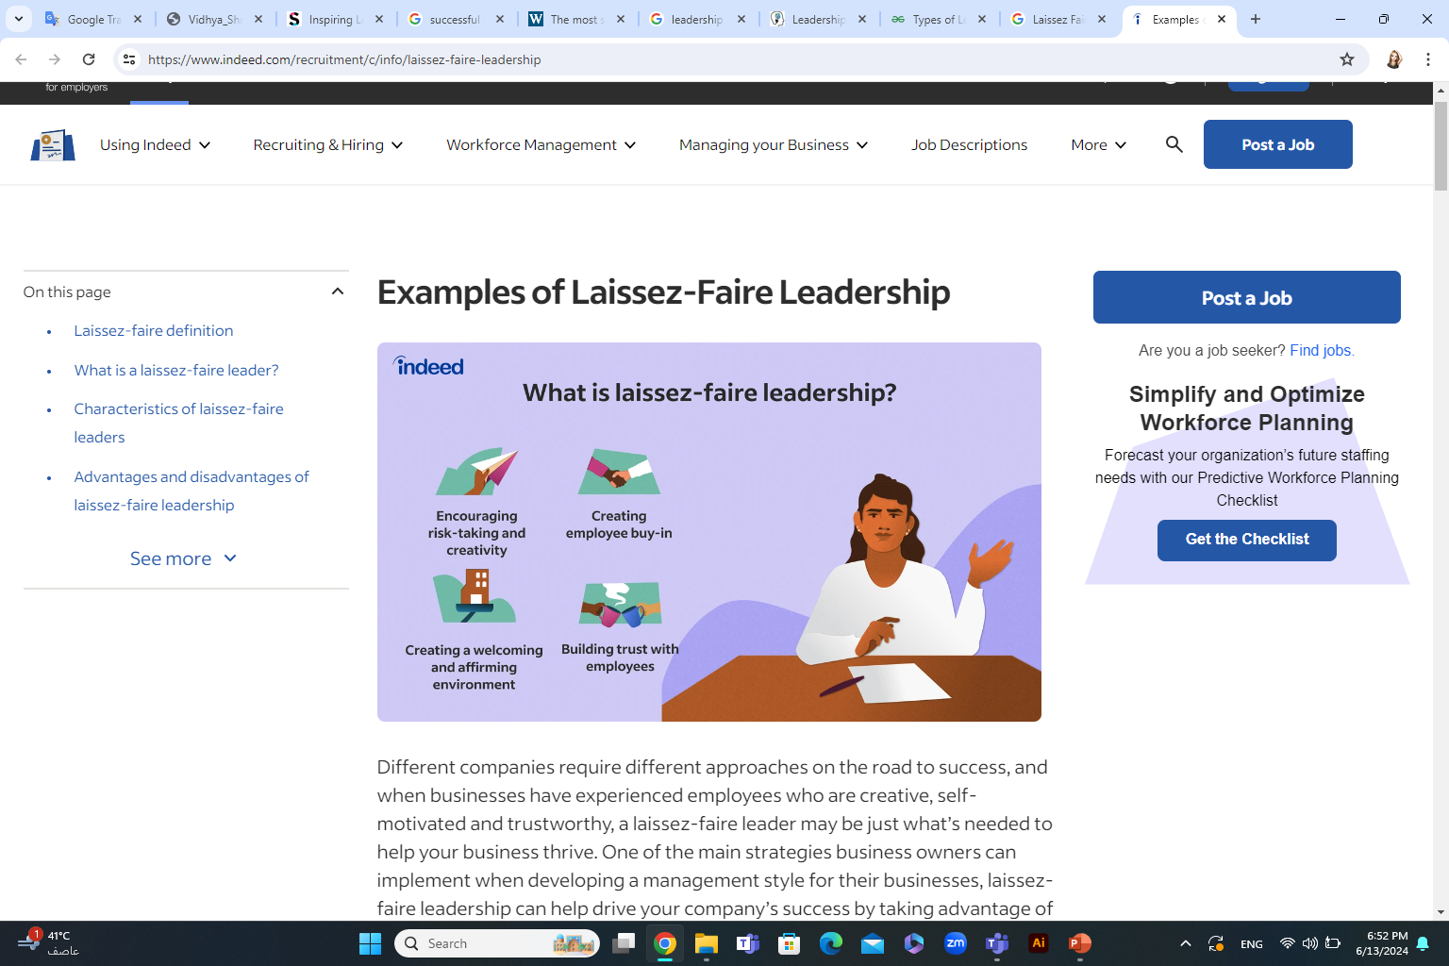
Laissez Faire Leadership
  ‘Let it be’ – the leadership responsibilities are shared by all
  Can be very useful in businesses where creative ideas are important
  Can be highly motivational, as people have control over their working life
  Can make coordination and decision making time-consuming and lacking in overall direction
  Relies on good team work
  Relies on good interpersonal relations

Slide 32

Paternalistic Leadership
Leader acts as a ‘father figure’
Paternalistic leader makes decision but may consult
Believes in the need to support staff

Slide 33
Using all
A good leader uses all three styles, depending on what forces are involved between the followers, the leader, and the situation.
Examples:
  Using an authoritarian style on a new employee who is just learning the job.
  Using a participative style with a team of workers who know their job.
  Using a delegative style with a worker who knows more about the job than you.
  Using all three: Telling your employees that a procedure is not working correctly and a new one must be established (authoritarian). Asking for their ideas and input on creating a new procedure (participative). Delegating tasks in order to implement the new procedure (delegative).

Slide 34
Motivating Your Employees
What is Motivation?
The willingness to do something conditioned by the action’s ability to satisfy some need for the individual.

Slide 35
A Need
Is a physiological or psychological deficiency that makes certain outcomes seem attractive.

Slide 36
Maslow’s Hierarchy
Self-
Actualization
Esteem
Affiliation
Security
Physiological

Slide 37
Physiological/Survival needs
  Food, Clothing, Shelter, Air
Security
  Feel safe, absence of pain, threat, or illness
Affiliation
  friendship, company, love, belonging
  first clear step up from physical needs

Slide 38
Esteem Needs
  self-respect, achievement, recognition, prestige
  cues a persons worth
Self-Actualization
  personal growth, self-fulfillment, realization of full potential
  Where are YOU on the hierarchy???

Slide 39
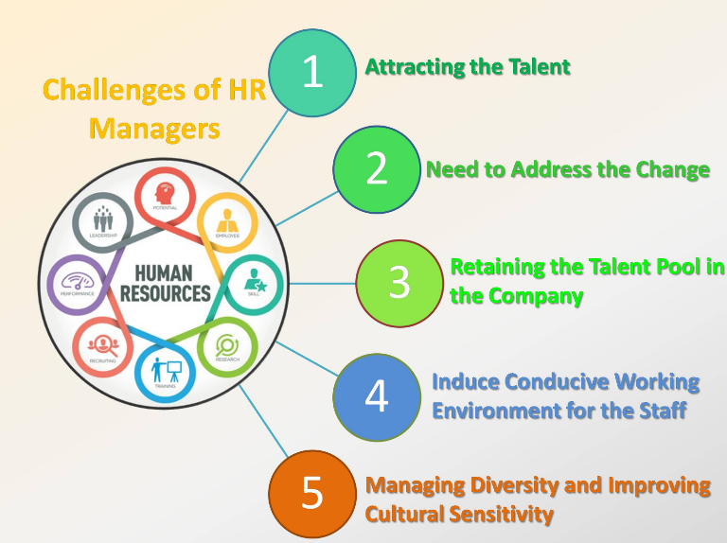
The managers challenges
1. Effective communication with the team
2. Evaluating and confronting performance problems
3. Hiring the right people
4. Managing conflicts within your team
5. Retaining star employees

Slide 40
Ways to develop managerial skills
Gaining new skills or improving the ones you have can help you be more successful in a management position. Whether you're a current manager or hoping to become one, consider these tips for developing management skills:
Seek advice and guidance from a mentor.
Read books about management theories, techniques, and styles.
Think about areas you need to improve, set goals, and take steps to achieve them.
Go back to school and get a certificate or a degree.
Attend industry-related training, conferences, and workshops.
Practice skills like active listening, delegating, and organization.
Join a public speaking group or take a public speaking or business writing class.
Look for opportunities to be a leader at work, home, class, or through volunteering or sports.

Slide 41

Musk was born in South Africa and is a businessman, inventor, and investor. Musk is most widely known for his founding of PayPal and SpaceX and his heavy involvement in Tesla Motors. His innovative vision and unrelenting passion for pushing the boundaries of technology and consumer integration have led to increased exposure to solar power, high-speed transportation, and artificial intelligence.

Slide 42
Leadership Style Of Elon Musk
Elon Musk's leadership approach is often characterized by his visionary approach, relentless pursuit of innovation and willingness to take significant risks.
He is known for setting ambitious, sometimes seemingly unattainable goals and driving his teams hard to achieve them. While sometimes controversial,
this approach has led to extraordinary achievements, such as launching the first privately subsidized spacecraft to reach the International Space Station by SpaceX.

Slide 43
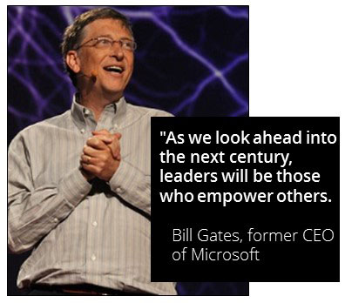

Slide 44



Thank You

