Slide 1



Master of Science in Artificial intelligent
Lecture 8
AI511
Foundations of Artificial Intelligence
Prepared by
Prof. Lamiaa Fattouh Ibrahim
www.midocean.ae

Slide 2

OUTLINES
Propositional Logic (Propositional Calculus)
The Language of Propositions
  Connectives
  Truth Values
  Truth Tables
Applications
  Translating English Sentences
www.midocean.ae

Slide 3
OUTLINES
Predicate Logic (First-Order Logic (FOL), Predicate Calculus)
  The Language of Quantifiers
  Translation from Predicate Logic to English
  Translation from English to Predicate Logic

Slide 4
OUTLINES
  Conceptual Graphs
  Definition of Conceptual Graphs
  Basic building blocks
  Concept node representation
  Exercise

Slide 5
Knowledge Representation
There are many methods used to knowledge representation for example:
Production Rule
Frames Representation
Propositional Calculus (Logic)
Predicate Calculus (Logic)
Conceptual Graph
Semantic Network
Script Representation

Slide 6
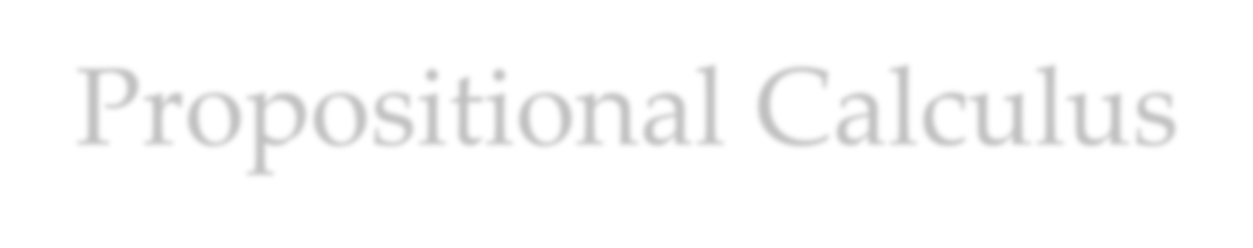
Propositional Calculus
A proposition is a statement or an argument that can be True or False.
A proposition is a declarative sentence (that is, a sentence that declares a fact) that is either true or false, but not both.
Propositional logic is a representation language for AI.
Using words, phrases, and sentences, we can represent and reason about properties and relationships in the world.

Slide 7
Propositions
A proposition is a declarative sentence that is either true or false.
Examples of propositions:
  The Moon is made of green cheese. false
  Trenton is the capital of New Jersey. true
  Toronto is the capital of Canada. false
  1 + 0 = 1 true
  0 + 0 = 2 false
Examples that are not propositions.
  Sit down!
  What time is it?
  x + 1 = 2
  x + y = z
Sentences a and b are not propositions because they are not declarative sentences. Sentences c and d are not propositions because they are neither true nor false. X is variable. Note that each of sentences c
and d can be turned into a proposition if we assign values to the variables.

Slide 8


PROPOSITIONAL CALCULUS SYMBOLS
Propositional symbols denote propositions, or statements about the world that may be either true or false, such as “the car is red” or “the street is wet.”
The symbols of propositional calculus are:
Propositional symbols: P, Q, R, S, …
Truth symbols: true, false,
Connectives: ∧, ∨, ¬, →, ≡

Slide 9

PROPOSITIONAL CALCULUS SENTENCES
Every propositional symbol and truth symbol is a
sentence.
For example: true, P, Q, and R are sentences.

Slide 10
Negation
The negation of a sentence is a sentence.
For example: ¬ P and ¬ false are sentences.

Slide 11

Conjunction
The conjunction, or and, of two sentences is a
sentence.
For example: P ∧ Q is a sentence.
P and Q are called Conjuncts.

Slide 12
Disjunction
The disjunction, or or, of two sentences is a
sentence.
For example: P ∨ Q is a sentence.
P and Q are called Disjuncts.

Slide 13
Implication
The implication of one sentence from another is a
sentence.
For example: P → Q is a sentence.
P is called premise / antecedent.
Q is called conclusion / consequent.

Slide 14

Equivalence
The equivalence of two sentences is a sentence.
For example: P ∨ Q ≡ R is a sentence.

Slide 15

Grouping of sentences
In propositional calculus sentences, the symbols ( ) and [ ] are used to group symbols into sub- expressions and so to control their order of evaluation and meaning.
(P ∨ Q) ≡ R is different from P ∨ (Q ≡ R)

Slide 16
Well Formed Formula
Legal sentences are also called well-formed
formulas or WFFs.
An expression is a sentence, or well-formed formula, of the propositional calculus if and only if it can be formed of legal symbols through some sequence of these rules.

Slide 17

Example
((P ∧ Q) → R) ≡ ¬ P ∨ ¬ Q ∨ R
is a well-formed sentence in the propositional calculus
because:
P, Q, and R are propositions and thus sentences.
P ∧ Q, the conjunction of two sentences, is a sentence.
(P ∧ Q) → R, the implication of a sentence for another, is a sentence.
¬ P and ¬ Q, the negations of sentences, are sentences.
¬ P ∨ ¬ Q, the disjunction of two sentences, is a sentence.
¬ P ∨ ¬ Q ∨ R, the disjunction of two sentences, is a sentence.
((P ∧ Q) → R) ≡ ¬ P ∨ ¬ Q ∨ R, the equivalence of two
sentences, is a sentence.
We constructed the original expression through a series of
applications of legal rules and is therefore “well formed”.

Slide 18

Semantics
The semantic of a statement is its meaning
A proposition must be either true or false, given some state of the world.
The truth value assignment to propositional sentences is called an interpretation, which is an assertion about their truth in some possible world.
Formally, an interpretation is a mapping from the propositional symbols into the set {T, F}.

Slide 19
Example
if P denotes the proposition “it is raining” and
Q denotes “I am at work,” then
the set of propositions {P, Q} has four different functional mappings into the truth values {T, F}.
These mappings correspond to four different interpretations.

Slide 20

PROPOSITIONAL CALCULUS SEMANTICS
An interpretation of a set of propositions is the assignment of a truth value, either T or F, to each propositional symbol.
The truth symbol true is always assigned T, and
the symbol false is always assigned F.

Slide 21

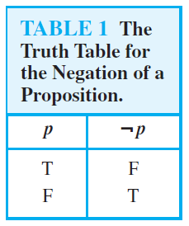
Negation
The truth assignment of negation, ¬ P, where P is any propositional symbol, is F if the assignment to P is T, and T if the assignment to P is F.
How many rows are there in a truth table with n propositional variables?
Solution: 2^{n}

Slide 22
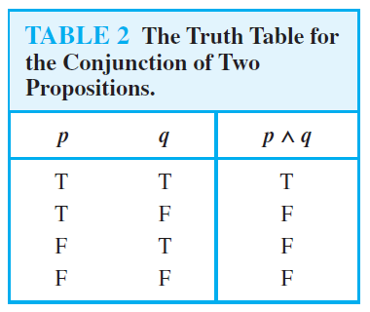
Conjunction
The truth assignment of conjunction, ∧, is T only when both conjuncts have truth value T; otherwise it is F.

Slide 23

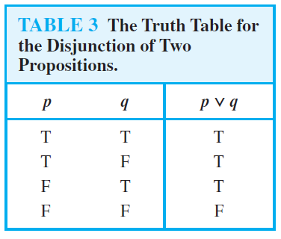
Disjunction
The truth assignment of disjunction, ∨, is F only when
both disjuncts have truth value F; otherwise it is T.

Slide 24

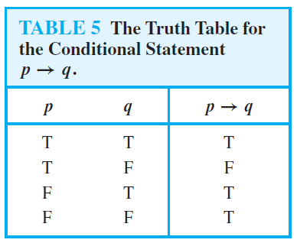
Implication
The truth assignment of implication, →, is F only when the premise or symbol before the implication is T and the truth value of the consequent or symbol after the implication is F; otherwise it is T.

Slide 25
Different Ways of Expressing p →q
if p, then q
p implies q
if p, q
p only if q
q unless ¬p
q when p
q if p
q whenever p
p is sufficient for q
q follows from p
q is necessary for p
a necessary condition for p is q
a sufficient condition for q is p

Slide 26
Equivalence
The truth assignment of equivalence, ≡, is T only when both expressions have the same truth assignment for all possible interpretations; otherwise it is F.

Slide 27
Converse, Contrapositive, and Inverse
From p →q we can form new conditional statements .
  q →p is the converse of p →q
  ¬q → ¬ p is the contrapositive of p →q
  ¬ p → ¬ q is the inverse of p →q
Example: Find the converse, inverse, and contrapositive of “It raining is a sufficient condition for my not going to town.”
Solution:
  converse: If I do not go to town, then it is raining.
  contrapositive: If I go to town, then it is not raining.
  inverse: If it is not raining, then I will go to town.

Slide 28

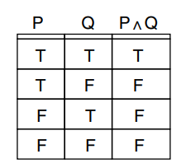
Truth Tables
A truth table lists all possible truth value assignments to the atomic propositions of an expression and gives the truth value of the expression for each assignment.
A truth table enumerates all possible worlds of interpretation that may be given to an expression.
Example:

Slide 29
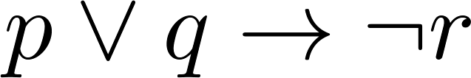
Example Truth Table
Construct a truth table for
p | q | r | ¬r | p ∨ q | p ∨ q → ¬r
T | T | T | F | T | F
T | T | F | T | T | T
T | F | T | F | T | F
T | F | F | T | T | T
F | T | T | F | T | F
F | T | F | T | T | T
F | F | T | F | F | T
F | F | F | T | F | T

Slide 30
Equivalent Propositions
Two propositions are equivalent if they always have the same truth value.
Example: Show using a truth table that the conditional is equivalent to the contrapositive.
Solution:
p | q | ¬ p | ¬ q | p →q | ¬q → ¬ p
T | T | F | F | T | T
T | F | F | T | F | F
F | T | T | F | T | T
F | F | T | T | T | T

Slide 31
Using a Truth Table to Show Non-Equivalence
Example: Show using truth tables that neither the converse nor inverse of an implication are not equivalent to the implication.
Solution:
p | q | ¬ p | ¬ q | p →q | ¬ p →¬ q inverse | q → p converse
T | T | F | F | T | T | T
T | F | F | T | F | T | T
F | T | T | F | T | F | F
F | F | T | T | T | T | T

Slide 32

Exercise
Prove that the statement (P → Q) is equivalent to
the statement (¬ P ∨ Q) using truth tables.

Slide 33
Applications of Propositional Logic
Translating English Sentences
Once we have translated sentences from English into logical expressions we can analyze these logical expressions to determine their truth values, we can manipulate them, and we can use rules of inference to reason about them.

Slide 34
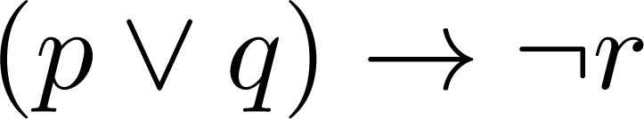
Translating English Sentences
Steps to convert an English sentence to a statement in propositional logic
  Identify atomic propositions and represent using propositional variables.
  Determine appropriate logical connectives
“If I go to Harry’s or to the country, I will not go shopping.”
  p: I go to Harry’s
  q: I go to the country.
  r: I will go shopping.
If p or q then not r.

Slide 35
Example
Problem: Translate the following sentence into propositional logic:
“You can access the Internet from campus only if you are a computer science major or you are not a freshman.”
One Solution: Let a, c, and f represent respectively “You can access the internet from campus,” “You are a computer science major,” and “You are a freshman.”
a→ (c ∨ ¬ f )

Slide 36

Equivalences
¬ (¬ P) ≡ P
(P ∨ Q) ≡ (¬ P → Q)
the contrapositive law: (P → Q) ≡ (¬ Q → ¬ P)
de Morgan’s law:
de Morgan’s law:
the commutative laws:
the commutative laws:
the associative law: ((P ∧ Q) ∧ R) ≡ (P ∧ (Q ∧ R))
the associative law: ((P ∨ Q) ∨ R) ≡ (P ∨ (Q ∨ R))
the distributive law: P ∨ (Q ∧ R) ≡ (P ∨ Q) ∧ (P ∨ R)
the distributive law: P ∧ (Q ∨ R) ≡ (P ∧ Q) ∨ (P ∧ R)
¬ (P ∨ Q) ≡ (¬ P ∧ ¬ Q)
¬ (P ∧ Q) ≡ (¬ P ∨¬ Q)
(P ∧ Q) ≡ (Q ∧ P)
(P ∨ Q) ≡ (Q ∨ P)

Slide 37
Identities such as these can be used to change propositional calculus expressions into a syntactically different but logically equivalent form.
These identities may be used instead of truth tables to prove that two expressions are equivalent by finding a series of identities that transform one expression into the other.

Slide 38

Exercises
Using identities, prove the following equivalences:
¬ (P → Q) ≡ (P ∧ ¬ Q)
P V (P ∧ Q) ≡ P

Slide 39
Predicate Calculus

Slide 40



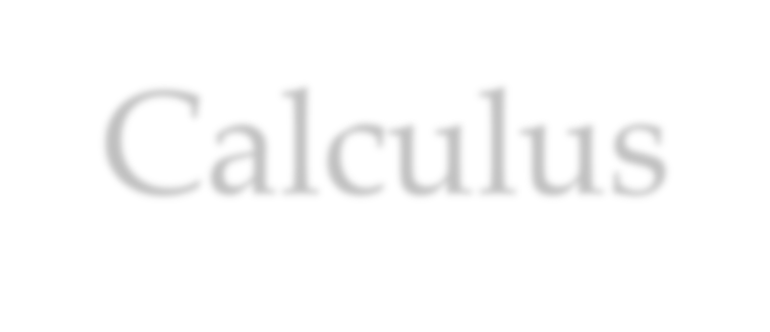
Propositional vs Predicate Calculus
There is no way to access the components of an individual assertion using propositional calculus, while we can do this in predicate calculus.
Through inference rules we can manipulate predicate calculus expressions, accessing their individual components and inferring new sentences.
Predicate calculus also allows expressions to contain variables. Variables let us create general assertions about classes of entities.

Slide 41


PREDICATE CALCULUS ALPHABET
The alphabet that makes up the symbols of the
predicate calculus consists of:
The set of letters, both upper- and lowercase, of the English alphabet.
The set of digits, 0, 1, …, 9.
The underscore, _.
  Symbols begin with a letter and are followed by any sequence of these legal characters.

Slide 42
Predicate Calculus SYMBOLS
Predicate calculus symbols include:
Truth symbols true and false (these are reserved symbols).
Constant symbols are symbol expressions having the first character lowercase.
Variable symbols are symbol expressions beginning with an uppercase character.
Function symbols are symbol expressions having the first character lowercase.
  Functions have an attached arity indicating the number of elements of the domain mapped onto each element of the range.
  A function expression consists of a function constant of arity n, followed by n terms, enclosed in parentheses and separated by commas.
  The act of replacing a function with its value is called evaluation.

Slide 43

TERMS
A predicate calculus term is either a constant,
variable, or function expression.
Term may be used to denote objects and properties in a problem domain.

Slide 44

PREDICATES
Predicate symbols are symbols beginning with a
lowercase letter.
Predicates have an associated positive integer referred to as the arity or “argument number” for the predicate.
Predicates with the same name but different arities
are considered distinct.

Slide 45

ATOMIC SENTENCES
An atomic sentence is a predicate constant of arity n, followed by n terms, enclosed in parentheses and separated by commas.
The truth values, true and false, are also atomic
sentences.
Atomic sentences are also called atomic
expressions, atoms, or propositions.

Slide 46
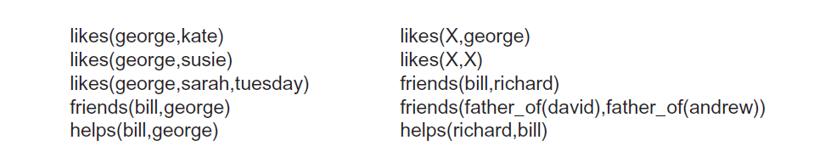
Examples of atomic sentence are:
In the predicates above, bill, george, kate, etc., are constant symbols and represent
objects in the problem domain. The arguments to a predicate are terms and may also
include variables or function expressions. For example,
friends(father_of(david),father_of(andrew))

Slide 47


PREDICATE CALCULUS SENTENCES
Every atomic sentence is a sentence.
If s is a sentence, then so is its negation, ¬ s.
If s1 and s2 are sentences, then so is their conjunction, s1 ∧ s2.
If s1 and s2 are sentences, then so is their disjunction, s1 ∨ s2.
If s1 and s2 are sentences, then so is their implication, s1 → s2.
If s1 and s2 are sentences, then so is their equivalence, s1≡ s2.
If X is a variable and s a sentence, then ∀ X s is a sentence.
If X is a variable and s a sentence, then ∃ X s is a sentence.

Slide 48
Example
mother(eve, abel)
mother(eve, cain)
father(adam, abel)
father(adam, cain)
∀ X ∀ Y father(X, Y) ∨ mother(X, Y) → parent(X, Y)
∀ X ∀ Y ∀ Z parent(X, Y) ∧ parent(X, Z) → sibling(Y, Z)

Slide 49
DEFINITION : INTERPRETATION
Let the domain D be a nonempty set.
An interpretation over D is an assignment of the entities of D to each of the constant, variable, predicate, and function symbols of a predicate calculus expression, such that:
Each constant is assigned an element of D.
Each variable is assigned to a nonempty subset of D;
these are the allowable substitutions for that variable.
Each function f of arity m is defined on m arguments of D
and defines a mapping from D^{m} into D.
Each predicate p of arity n is defined on n arguments from D and defines a mapping from D^{n} into {T, F}.

Slide 50



TRUTH VALUE OF PREDICATE CALCULUS EXPRESSIONS
Assume an expression E and an interpretation I for E over a nonempty domain D.
The truth value for E is determined by:
The value of a constant is the element of D it is assigned to by I.
The value of a variable is the set of elements of D it is assigned to by I.
The value of a function expression is that element of D obtained by evaluating the function for the parameter values assigned by the interpretation.
The value of truth symbol “true” is T and “false” is F.
The value of an atomic sentence is either T or F, as determined by the interpretation I.

Slide 51


PREDICATE CALCULUS EXPRESSIONS
6. The value of the negation of a sentence is T if the value of the sentence is F and is F if the value of the sentence is T.
7. The value of the conjunction of two sentences is T if the value of both sentences is T and is F otherwise.
8. The truth value of expressions using ∨, →, and ≡ is determined from the value of their operands.
9. For a variable X and a sentence S containing X:
The value of ∀ X S is T if S is T for all assignments to X under I, and it is F otherwise.
10. The value of ∃ X S is T if there is at least one assignment to X in the interpretation under which S is T; otherwise it is F.

Slide 52
Examples
If it doesn’t rain on Monday, Tom will go to the mountains.
¬ weather(rain, monday) → go(tom, mountains)
Emma is a Doberman pinscher and a good dog.
gooddog(emma) ∧ isa(emma, doberman)
All basketball players are tall. ∀ X (basketball_player(X) → tall(X))
Some people like anchovies.
∃ X (person(X) ∧ likes(X, anchovies))
If wishes were horses, beggars would ride.
equal(wishes, horses) → ride(beggars)
Nobody likes taxes.
¬ ∃ X likes(X, taxes)

Slide 53
Definition of Conceptual Graphs
A conceptual graph consists of concept nodes and relation nodes
  The concept nodes represent entities, attributes, states, and events
  concept nodes represent either:
  a- Concrete concepts: such as a cat, telephone, or restaurant, are characterized by our ability to form an image of them in our minds.
  b- abstract concepts: include things such as love, beauty, and loyalty that do not correspond to image in our minds.
  The relation nodes show how the concepts are interconnected.

Slide 54
A Graph-Theoretic Definition
Conceptual Graphs are finite, connected, bipartite graphs.
  Finite: because any graph (in 'human brain' or 'computer storage') can only have a finite number of concepts and conceptual relations.
  Connected: because two parts that are not connected would simply be called two conceptual graphs.
  Bipartite: because there are two different kinds of nodes: concepts and conceptual relations, and every arc links a node of one kind to a node of another kind

Slide 55
A relation of arity n is represented by a conceptual relation node having n arcs.
Each conceptual graph represents a single proposition.
A typical knowledge base will contain a number of such graphs.
Graphs may be arbitrarily complex but must be finite.

Slide 56
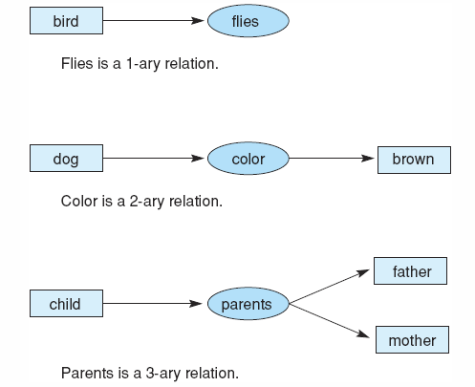
Fig 7.14 Conceptual relations of different arities.
Luger: Artificial Intelligence, 5th edition. © Pearson Education Limited, 2005
15

Slide 57
Concept Nodes
In conceptual graphs CG, every concept is a unique individual of a particular type. Each box is labeled with a type label, which indicates the class or type of individual represented by that node.
CG allows nodes to be labelled simultaneously with the name of the individual the node represents and its type. The two are separated by a colon (":")
Boxes with the same type label represent concepts of the same type; however, these boxes may or may not represent the same individual concept.

Slide 58
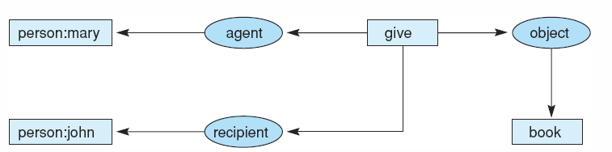
Fig 7.15 Graph of “Mary gave John the book.”
This graph uses conceptual relations to represent the cases of the verb “to give” and indicates the way in which conceptual graphs are used to model the semantics of natural language.

Slide 59
Concept Nodes: Unnamed Individuals
Consider the example that we do not know the name of a cat that is brown:
Each concept node in a CG may be used to represent specific but unnamed individuals.
A unique token called a marker indicates each individual in the world of discourse.
This marker is written as a number preceded by a #.
cat: #12345
colour
brown

Slide 60
Concept Nodes: Multiple Names
We subsequently found out that the cat is called by different names: "Sylvester", "Sugar Pie" and "Squidgy Bod“. The name is enclosed in double quotes to indicate that it is a string.
name
"Sylvester"
cat: #12345
name
"Sugar Pie"
name
"Squidgy Bod"

Slide 61
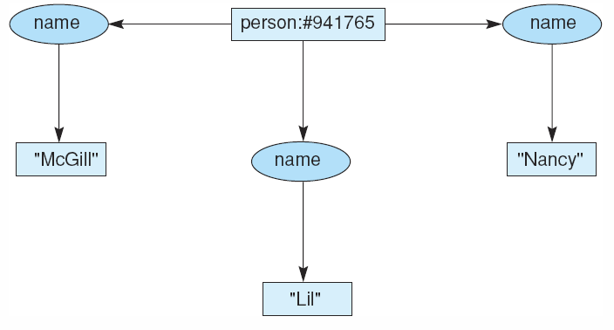
Fig 7.19 Conceptual graph of a person with three names.

Slide 62
Concept Nodes: Unspecified Individuals
General markers can also be used to refer to an unspecified individual. The CG:
Refers to an unspecified cat. Notationally, unspecified individuals are shown by the existence of an asterisk ("*")
BUT… this is usually omitted (cat = cat:*).
cat
colour
brown
cat: *
colour
brown

Slide 63
Concept Nodes: Named Variables
Named variables can also be used to refer to an individual. These are represented by an asterisk followed by the variable name.
This is useful to indicate nodes that are the same unspecified individual.
dog:*X
agent
scratch
object
ear
instrument
part
paw
part
dog:*X

Slide 64
Exercises
Please create the conceptual graph of the following sentence:
  John is between a rock and a hard place

Slide 65
Solution 1
"John is between a rock and a hard place"
rock
person: John
between
place
attribute
hard

Slide 66
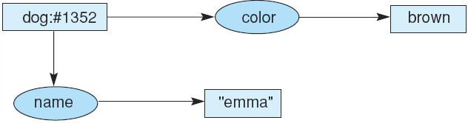
Fig 7.16 Conceptual graph indicating that the dog named Emma is brown.
Fig 7.17 Conceptual graph indicating that a particular (but unnamed) dog is brown.
Fig 7.18 Conceptual graph indicating that a dog named Emma is brown.
We can simplify the graph and refer to the individual directly by name. under this convention, The graph of figure 7.18 is equivalent to the graph of figure 7.16

Slide 67
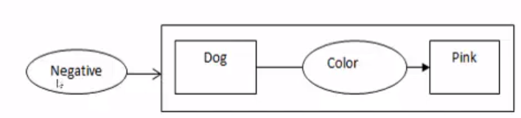
proposition
Neg

Slide 68
Summary
knowledge representation
Propositional Logic (Propositional Calculus)
Predicate Logic (First-Order Logic (FOL), Predicate Calculus)
Conceptual Graphs

Slide 69


Thank You

