Slide 1


Outsourcing – Managing interorganizational relationships
Lecture 11
Chapter 10
Presented by/ Dr. Walaa Mohamed
Everyone’s Smart
University
PMG101
Foundations of Project Management

Slide 2


Learning outcomes
Outsourcing Project Work
Best Practices in Outsourcing Project Work
The Art of Negotiating
A Note on Managing Customer Relations
Procurement management process
Types of contracts
Risk associated with different types of contracts.

Slide 3
Outsourcing Project Work
The term outsourcing has traditionally been applied to the transferring of business functions or processes (e.g., customer support, IT, accounting) to other, often foreign companies. For example, when you call your Internet provider to solve a technical problem you are likely to talk to a technician in Bangalore, India, or Bucharest, Romania. Outsourcing is now being applied to contracting significant chunks of project work. For example, HP and Dell work closely with hard drive manufacturers to develop next-generation laptops. Toyota and DaimlerChrysler collaborate with suppliers to develop new automobile platforms.

Slide 4
Introduction to Project Partnering
Partnering
  The process of transforming contractual arrangements into a cohesive, collaborative team that deals with issues and problems encountered to meet a customer’s needs.
    Assumes that the traditional adversarial relationship between the owner and contractor is ineffective and self-defeating.
    Assumes that both parties share common goals and mutually benefit from the successful completion of projects.
  Factors favoring partnering:
    Existence of common goals
    High costs of the adversarial approach
    Shared benefits of the collaborative approach
12–4

Slide 5
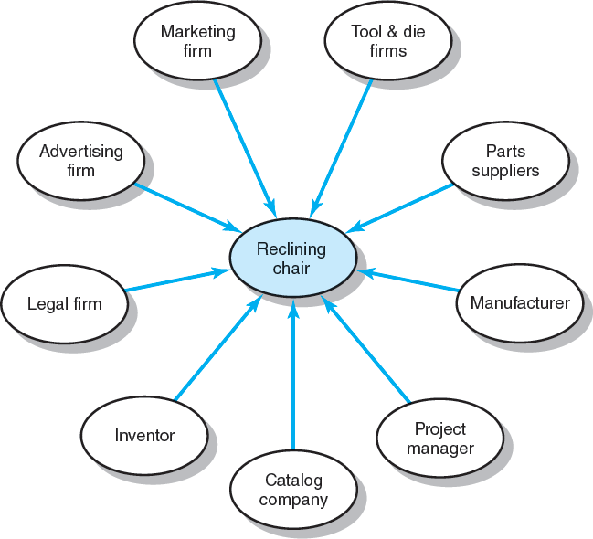
Reclining Chair Project
FIGURE 12.1
12–5

Slide 6
Reclining Chair Project
Figure 12.1 depicts a situation in which a zero-gravity reclining chair is being developed. The genesis for the chair comes from a mechanical engineer who developed the idea in her garage. The inventor negotiates a contract with a catalog firm to develop and manufacture the chair. The catalog company in turn creates a project team of manufacturers, suppliers, and marketing firms to create the new chair. Each participant adds requisite expertise to the project. The catalog firm brings its brand name and distribution channels to the project. Tool and die firms provide customized parts which are delivered to a manufacturing firm that will produce the chair. Marketing firms refine the design, develop packaging, and test market potential names. A project manager is assigned by the catalog firm to work with the inventor and the other parties to complete the project.

Slide 7

Outsourcing Project Work
Advantages
  Cost reduction
  Faster project completion
  High level of expertise
  Flexibility
Disadvantages
  Coordination breakdowns
  Loss of control
  Interpersonal conflict
  Security issues
  Political hot potato
12–7

Slide 8
The advantages of outsourcing project work are many:
  Cost reduction. Companies can secure competitive prices for contracted services, especially if the work can be outsourced offshore. Furthermore, overhead costs are dramatically cut since the company no longer has to internally maintain the contracted services.
  Faster project completion. Not only can work be done more cheaply, but it can also be done faster. Competitive pricing means more resources for the dollar. For example, you can hire three Indian software engineers for the price of one American software engineer. Furthermore, outsourcing can provide access to equipment that can accelerate completion of project tasks. For example, by contracting a backhoe operater you are able to accomplish in four hours what it would take a landscaping crew four days to complete.
  High level of expertise. A high level of expertise and technology can be brought to bear on the project. A company no longer has to keep up with technological advances. Instead, it can focus on developing its core competencies and hire firms with the know-how to work on relevant segments of the project.
  Flexibility. Organizations are no longer constrained by their own resources but can pursue a wide range of projects by combining their resources with talents of other companies. Small companies can instantly go global by working with foreign partners.

Slide 9
The disadvantages of outsourcing project work are less well documented:
Coordination breakdowns. Coordination of professionals from different organizations can be challenging, especially if the project work requires close collaboration and mutual adjustment. Breakdowns are exacerbated by physical separation with people working in different buildings, different cities, if not different countries.
Loss of control. There is potential loss of control over the project. The core team depends on other organizations that they have no direct authority over. While long-term survival of participating organizations depends on performance, a project may falter when one partner fails to deliver.
Conflict. Projects are more prone to interpersonal conflict since the different participants do not share the same values, priorities, and culture. Trust, which is essential to project success, can be difficult to forge when interactions are limited, and people come from different organizations.
Security issues. Depending on the nature of the project, trade and business secrets may be revealed. This can be problematic if the contractor also works for your competitor. Confidentiality is another concern and companies have to be very careful when outsourcing processes like payroll, medical transcriptions, and insurance information.

Slide 10
Best Practices in Outsourcing Project Work
Well-defined requirements and procedures.
Extensive training and team-building activities.
Well-established conflict management processes in place.
Frequent review and status updates.
Co-location when needed.
Fair and incentive-laden contracts.
Long-term outsourcing relationships.
FIGURE 12.2
12–10

Slide 11
Well-Defined Requirements and Procedures
Convincing people from different professions, organizations, and cultures to work together is difficult. If expectations and requirements are fuzzy or open to debate, this is even harder. Successful firms are very careful in selecting the work to be out- sourced. They often choose to contract only work with clearly defined deliverables with measurable outcomes. For example, contractors hire electric firms to install heating and air-conditioning systems, electronic firms use design firms to fabricate enclosures for their products, and software development teams outsource the testing of versions of their programs. In all of these cases, the technical requirements are spelled out in detail. Even so, communicating requirements can be trouble- some, especially with foreign providers, and extra care has to be taken to ensure that expectations are understood.

Slide 12
Extensive Training and Team-Building Activities
Too often managers become preoccupied with the plans and technical challenges of the project and assume that people issues will work themselves out over time. Smart firms recognize that people issues are as important, if not more important than technical issues. They train their personnel to work effectively with people from other organizations and countries. This training is pervasive. It is not limited to management but involves all the people, at all levels, who interact with and are dependent upon outsourcers. Whether in a general class on negotiation or a specific one on working with Chinese programmers, team members are provided with a theoretical understanding of the barriers to collaboration as well as the skills and procedures to be successful.

Slide 13
Well-Established Conflict Management Processes in Place
Escalation is the primary control mechanism for dealing with and resolving problems. The basic principle is that problems should be resolved at the lowest level within a set time limit (say, 24 hours), or they are “escalated” to the next level of management. If so, the principals have the same time limit to resolve the problem, or it gets passed on to the next higher level. No action is not an option. Nor can one participant force concessions from the other by simply delaying the decision. There is no shame in pushing significant problems up the hierarchy; at the same time, managers should be quick to point out to subordinates those problems or questions that they should have been able to resolve on their own.
In addition, principled negotiation is the norm for resolving problems and reaching agreements. This approach, which emphasizes collaborative problem solving

Slide 14
Frequent Review and Status Updates
Project managers and other key personnel from all involved organizations meet on a regular basis to review and assess project performance. Collaborating as partners is considered a legitimate project priority which is assessed along with time, cost, and performance. Teamwork, communication, and timely problem resolution are evaluated. This provides a forum for identifying problems not only with the project but also with working relationships so that they can be resolved quickly and appropriately.
More and more companies are using online surveys to collect data from all project participants about the quality of working relations.

Slide 15
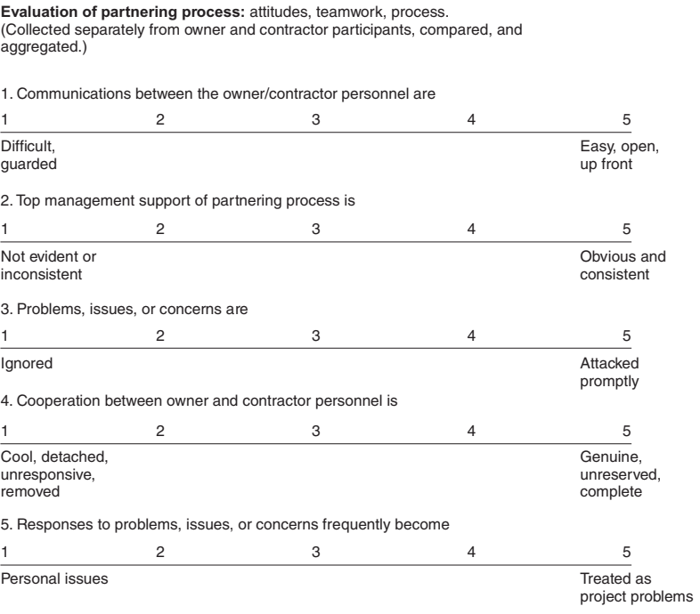
Sample Online Survey

Slide 16
Co-Location When Needed
One of the best ways to overcome interorganizational friction is to have people from each organization working side by side on the project. Smart companies rent or make available the necessary accommodations so that all key project personnel can work collectively together. This allows the high degree of face-to-face interaction needed to coordinate activities, solve difficult problems, and form a common bond. This is especially relevant for complex projects in which close collaboration from different parties is required to be successful. For example, the U.S government pro- vides housing and common office space for all key contractors responsible for developing disaster response plans.

Slide 17
Fair and Incentive-Laden Contracts
When negotiating contracts, the goal is to reach a fair deal for all involved. Managers recognize that cohesion and cooperation is undermined if one party feels he or she is being unfairly treated by others. They also realize that negotiating the best deal in terms of price can come back to haunt them with shoddy work and change order gouging.
Performance-based contracts, in which significant incentives are established based on priorities of the project, are becoming increasingly popular. For exam- ple, if time is critical, then contractors accrue payoffs for beating deadlines; if scope is critical, then bonuses are issued for exceeding performance expectations. At the same time contractors are held accountable with penalty clauses for failure to perform up to standard, meet deadlines, and/or control costs.

Slide 18
Long-Term Outsourcing Relationships
Many companies recognize that major benefits can be enjoyed when outsourcing arrangements extend across multiple projects and are long term. For example, Corning and Toyota are among the many firms that have forged a network of long-term strategic partnerships with their suppliers. Among the many advantages for establishing a long- term partnership are the following:
• Reduced administrative costs—The costs associated with bidding and selecting a contractor are eliminated. Contract administration costs are reduced as partners become knowledgeable of their counterpart’s legal concerns.
• More efficient utilization of resources—Contractors have a known forecast of work while owners are able to concentrate their workforce on core businesses and avoid the demanding swings of project support.

Slide 19
Long-Term Outsourcing Relationships
• Improved communication—As partners gain experience with each other, they develop a common language and perspective, which reduces misunderstanding and enhances collaboration.
• Improved innovation—The partners are able to discuss innovation and associated risks in a more open manner and share risks and rewards fairly.
• Improved performance—Over time partners become more familiar with each other’s standards and expectations and are able to apply lessons learned from previous projects to current projects.

Slide 20
Principled Negotiation
1. Separate the people from the problem
2. Focus on interests, not positions
3. Invent options for mutual gain
4. When possible, use objective criteria

Slide 21
1. Separate the People from the Problem
Too often personal relations become entangled with the substantive issues under consideration. Instead of attacking the problem(s), people attack each other. Once people feel attacked or threatened their energy naturally goes to defending them- selves, and not to solving the problem. The key, then, is to focus on the problem—not the other person—during the negotiation. Avoid personalizing the negotiation and framing the negotiation as a contest. Instead, try to keep the focus on the problem to be resolved. In Fisher and Ury’s words: Be hard on the problem, soft on the people.
By keeping the focus on the issues and not the personalities, negotiators are better able to let the other person blow off steam. On important problems it is not uncommon for people to become upset, frustrated, and angry. However, one angry attack produces an angry counterattack, and the discussion quickly escalates into a heated argument, an emotional chain reaction.

Slide 22
2. Focus on Interests, Not Positions
Negotiations often stall when people focus on positions:
I’m willing to pay $10,000. No, it will cost $15,000.
I need it done by Monday. That’s impossible, we can’t have it ready until Wednesday.
While such interchanges are common during preliminary discussions, managers must prevent this initial posturing from becoming polarized. When such positions are stated, attacked, and then defended, each party figuratively begins to draw a line he or she will not cross. This line creates a win/lose scenario in which someone has to lose by crossing the line in order to reach an agreement. As such, the negotiations can become a war of wills, with concessions being seen as a loss of face.
The key is to focus on the interests behind your positions (what you are trying to achieve) and separate these goals from your ego as best you can. Not only should you be driven by your interests, but you should try to identify the interests of the other party.

Slide 23
3. Invent Options for Mutual Gain
Once the individuals involved have identified their interests, then they can explore options for mutual gain. This is not easy. Stressful negotiations inhibit creativity and free exchange. What is required is collaborative brainstorming in which people work together to solve the problem in a way that will lead to a win/win scenario.
The key to brainstorming is separating the inventing from the deciding. Begin by taking 15 minutes to generate as many options as possible. No matter how outlandish any option is, it should not be subject to criticism or immediate rejection. People should feed off the ideas of others to generate new ideas. When all the possible options are exhausted, then sort through the ideas that were generated to focus on those with the greatest possibilities.

Slide 24
4. When Possible, Use Objective Criteria
Most established industries and professions have developed standards and rules to help deal with common areas of dispute. Both buyers and sellers rely on the blue book to establish price parameters for a used car. The construction industry has building codes and fair practice policies to resolve proof of quality and safe work procedures.
The legal profession uses precedents to adjudicate claims of wrongdoing. Whenever possible, you should insist on using external, objective criteria to settle disagreements.

Slide 25

Key Differences Between Partnering and Traditional Approaches to Managing Contracted Relationships
Partnering Approach
Mutual trust forms the basis for strong working relationships.
Shared goals and objectives
ensure common direction.
Joint project team exists with high level of interaction.
Open communications avoid misdirection and bolster effective working relationships.
Long-term commitment provides the opportunity to attain continuous improvement.
Traditional Approach
Suspicion and distrust; each party is wary of the motives of the other.
Each party’s goals and objectives, while similar, are geared to what is best for them.
Independent project teams; teams are spatially separated with managed interactions.
Communications are structured and guarded.
Single project contracting is normal.
TABLE 12.1
12–7

Slide 26
Key Differences Between Partnering and Traditional Approaches …(cont’d)
Partnering Approach
Objective critique is geared to candid assessment of performance.
Access to each other’s organization resources is available.
Total company involvement requires commitment from CEO to team members.
Risk is shared jointly among the partners, encouraging innovation and continuous improvement.
Traditional Approach
Objectivity is limited due to fear of reprisal and lack of continuous improvement opportunity.
Access is limited with structured procedures and self-preservation taking priority over total optimization.
Involvement is normally limited to project-level personnel.
.
Risk is transferred to the other party.
TABLE 12.1 (cont’d)

Slide 27

Strategies for Communicating with Outsourcers
STRATEGY 1: Recognize cultural differences
STRATEGY 2: Choose the right words
STRATEGY 3: Confirm your requirements
STRATEGY 4: Set deadlines

Slide 28
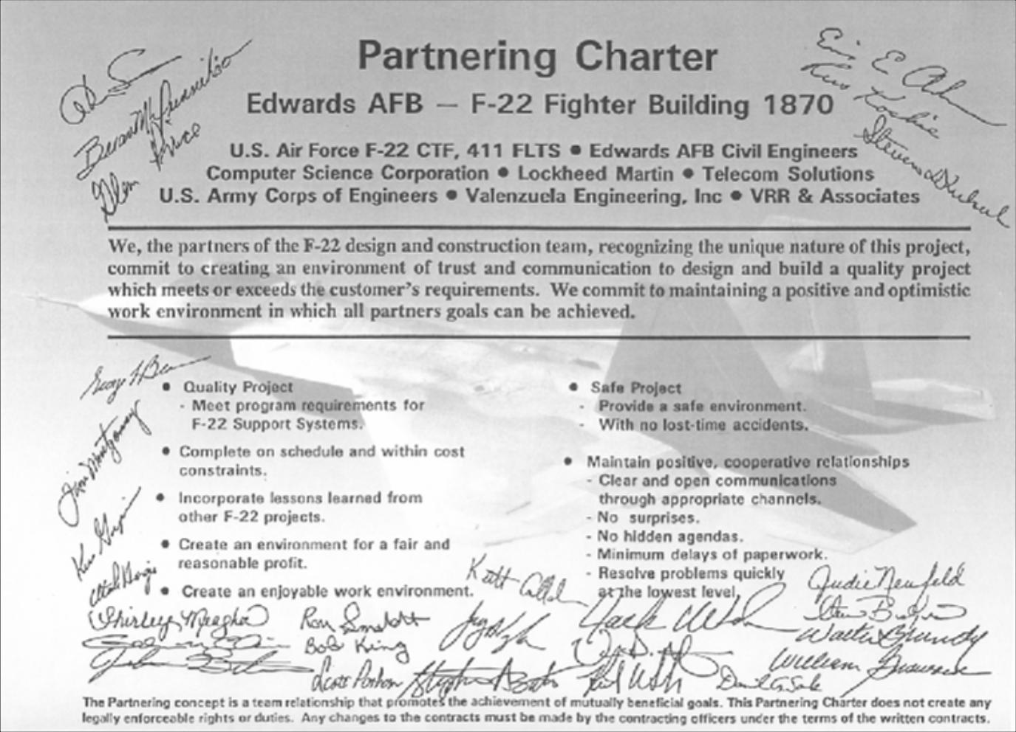
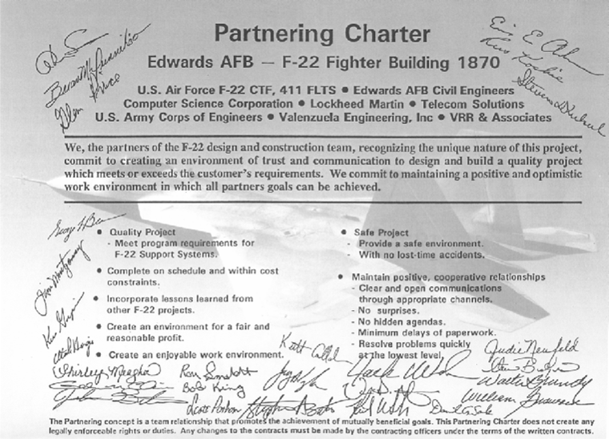
Project Partnering Charter
FIGURE 12.2

Slide 29

Preproject Activities—Setting the Stage for Successful Partnering
Selecting a Partner(s)
  Voluntary, experienced, willing, with committed top management.
Team Building: The Project Managers
  Build a collaborative relationship among the project managers.
Team Building: The Stakeholders
  Expand the partnership commitment to include other key managers and specialists.

Slide 30

Project Implementation—Sustaining Collaborative Relationships
Establish a “we” as opposed to “us and them” attitude toward the project.
  Co-location: employees from different organizations work together at the same location.
Establish mechanisms that will ensure the relationship withstands problems and setbacks.
  Problem resolution
  Continuous improvement
  Joint evaluation
  Persistent leadership

Slide 31

Project Completion—Celebrating Success
Conduct a joint review of accomplishments and disappointments.
Hold a celebration for all project participants.
Recognize special contributions.

Slide 32
Why Project Partnering Efforts Fail
Causes of Partnering Failures
  Senior management fails to address problems or does not empower team members to solve problems.
  Cultural differences are not adequately dealt with such that a common team culture develops.
  No formal evaluation process is in place to identify problems and opportunities at the operating level or to assess the current state of the partnering relationship.
  A lack of incentive for continuous improvement by contractors participating in the partnering relationship.

Slide 33

Advantages of Long-term Partnerships
Reduced administrative costs
More efficient utilization of resources
Improved communication
Improved innovation
Improved performance

Slide 34
The Art of Negotiating
Project management is NOT a contest.
  Everyone is on the same side—OURS.
  Everyone is bound by the success of the project.
  Everyone has to continue to work together.
Principled Negotiations
Separate the people from the problem
Focus on interests, not positions
Invent options for mutual gain
When possible, use objective criteria
TABLE 12.2

Slide 35
The Art of Negotiating (cont’d)
Dealing with Unreasonable People
  If pushed, don’t push back.
  Ask questions instead of making statements.
  Use silence as a response to unreasonable demands.
  Ask for advice and encourage others to criticize your ideas and positions.
  Use Fisher and Ury’s best alternative to a negotiated agreement (BATNA) concept to work toward a win/win scenario.

Slide 36
Managing Customer Relations
Customer Satisfaction
  The negative effect of dissatisfied customers on a firm’s reputation is far greater than the positive effect of satisfied customers.
  Every customer has a unique set of performance expectations and met-performance perceptions.
  Satisfaction is a perceptual relationship:
Perceived performance Expected performance
  Project managers must be skilled at managing both customer expectations and perceptions.

Slide 37

The Met-Expectations Model of Customer Satisfaction
0.90
Perceived performance
1.10
=
=
Dissatisfied
Expected performance
Very satisfied
When performance falls short of expectations (ratio < 1), the customer is dissatisfied. If the performance matches expectations (ratio = 1), the customer is satisfied. If the performance exceeds expectations (ratio > 1), the customer is very satisfied or even delighted.
FIGURE 12.5

Slide 38
Managing Customer Relations (cont’d)
Managing Customer Expectations
  Don’t oversell the project; better to undersell.
  Develop a well-defined project scope statement.
  Share significant problems and risks.
  Keep everyone informed about the project’s progress.
  Involve customers early in decisions about project development changes.
  Handle customer relationships and problems in an expeditious, competent, and professional manner.
  Speak with one voice.
  Speak the language of the customer.

Slide 39
Project Roles, Challenges, and Strategies
Project Manager Roles
Challenges
Strategies
Entrepreneur
Navigate unfamiliar surroundings
Understand two diverse cultures (parent and client organization)
Determine the important relationships to build and sustain outside the team itself
Understand the strategic objectives of the client organization
Motivate client team members without formal authority
Use persuasion to influence others
Align with the powerful individuals
Politician
Friend
Identify common interests and experiences to bridge a friendship with the client
Marketer
Align new ideas/proposals with the strategic objectives of the client organization
Provide challenging tasks
to build the skills of the team members
Coach
TABLE 12.3

Slide 40



Procurement Management Process
Includes the processes necessary to purchase or acquire products, services, or results needed from outside the project team.

Slide 41
Project Procurement Management processes:
1- Plan Procurements: The process of documenting project purchasing decisions, specifying the approach and identifying potential sellers
2- Conduct Procurements: The process of obtaining sellers responses, selecting a seller, and awarding a contract

Slide 42
Project Procurement Management processes:
3- Administer Procurements: the process of managing procurement relationships, monitoring contract performance, and making changes and corrections as needed
4- Close procurements: The process of completing each project procurement

Slide 43

Plan Procurements (Tools & Tech.)
1.1 Make –or –buy Analysis: means figuring out whether or not you should be contracting the work or doing it yourself. It could also mean deciding whether to build your own solution to your problem or buy one that is already available.
1.2 Expert Judgment: means asking someone who’s made the same kind of decision before to help you look at all the information you have for your project and make the right decision

Slide 44
Plan Procurements (Tools & Tech.)
1.1 Make –or –buy Analysis: means figuring out whether or not you should be contracting the work or doing it yourself. It could also mean deciding whether to build your own solution to your problem or buy one that is already available.
1.2 Expert Judgment: means asking someone who’s made the same kind of decision before to help you look at all the information you have for your project and make the right decision

Slide 45
Plan Procurements (Tools & Tech.)
1.3 Contract Type: determine the risk shared between the buyer and seller
TYPE OF CONTRACTS
Fixed-Price Contracts
Firm Fixed Price Contract (FFP)
Cost-Reimbursable Contract
Cost Plus Fixed fee Contract (CPFF)
Time and Material Contract (T&M)
Fixed Price Incentive Fee Contracts (FPIF)
Fixed Price with Economic Price Adjustment Contract (FP-EPA)
Cost Plus Incentive fee Contract (CPIF)
Cost Plus Award fee Contract (CPAF)

Slide 46
Plan Procurements (Tools & Tech.)
Firm Fixed Price Contract (FFP)
means that you are going to pay one amount regardless of how much it costs the contractor to do the work. A fixed price contract only makes sense in cases where the scope is very well known.
Fixed Price Incentive Fee Contracts (FPIF)
means that you are going to pay a fixed price for the contract and give a bonus based on some performance goal.

Slide 47
Plan Procurements (Tools & Tech.)
Fixed Price with Economic Price Adjustment Contract (FP-EPA)
means that you are going to pay fixed price with adjustment that can be changed due to the economic price. This contract is only makes sense in cases where the contract period is very long.
Cost Plus Fixed fee Contract (CPFF)
means you pay the seller back for the costs involved in doing the work, plus you agree to an amount that you will pay on top of that.

Slide 48
Plan Procurements (Tools & Tech.)
Cost Plus Award fee Contract (CPAF)
is similar to the CPFF contract, except that instead of paying a fee on top of the costs, you agree to pay a fee based on the buyer’s evaluation of the seller’s performance.
Cost Plus Incentive fee Contract (CPIF)
means you will reimburse costs on the project and pay a fee if some performance goals are met.

Slide 49
Plan Procurements (Tools & Tech.)
Time and Material Contract (T&M)
In which the employer agrees to pay the contractor based upon the time spent by the contractor's employees and subcontractors employees to perform the work, and for materials used in the construction. Time and Materials is generally used in projects in which it is not possible to accurately estimate the size of the project, or when it is expected that the project requirements would most likely change.

Slide 50

Contract Types Versus Risk

