Slide 1


College of Management
Business Ethics
Lecturer: Dr. Raef Baraka
PMG 750
Lecture 04

Slide 2

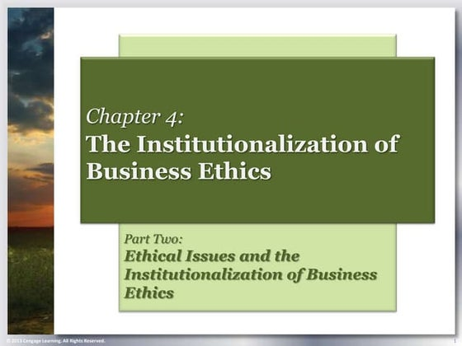
Chapter 4: THE INSTITUTIONALIZATION OF BUSINESS ETHICS
CHAPTER OBJECTIVES:
Distinguish between the voluntary and mandated boundaries of ethical conduct.
Provide specific mandated requirements for legal compliance in specific subject matter areas related to competition, consumers, and safety.
Provide an overview of regulatory efforts that provide incentives for ethical behavior.

Slide 3
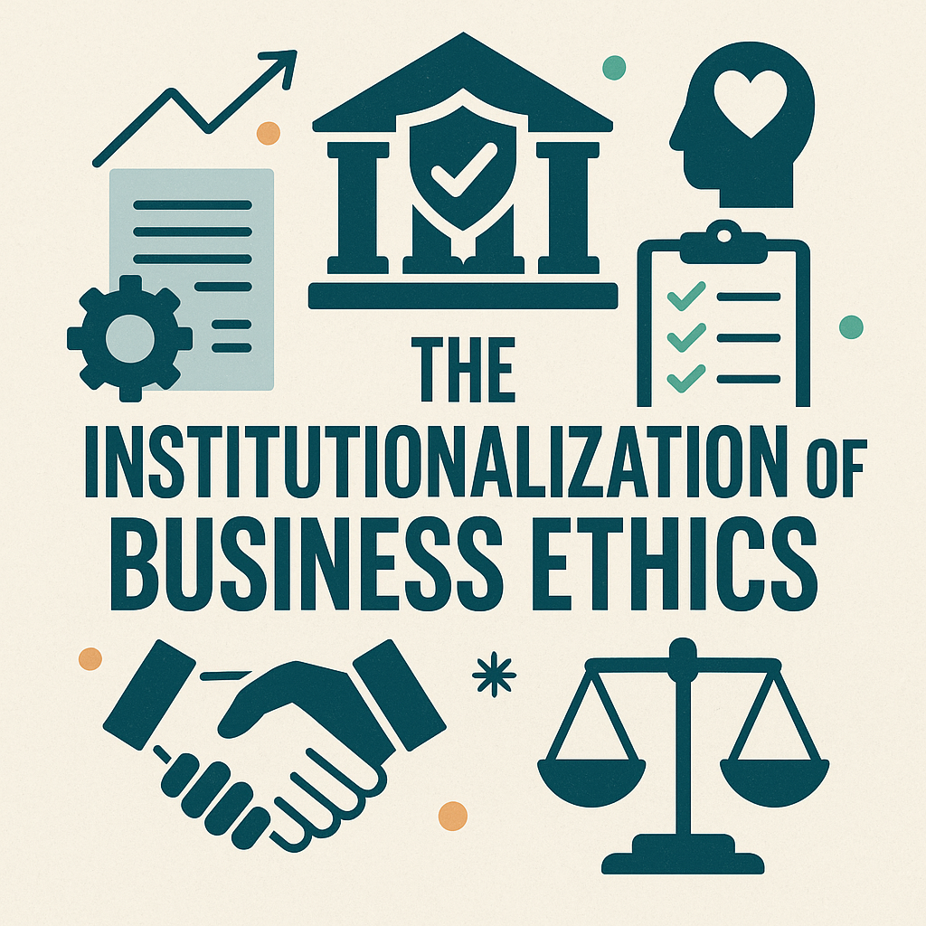
THE INSTITUTIONALIZATION OF BUSINESS ETHICS
MANAGING ETHICAL RISK THROUGH MANDATED AND VOLUNTARY PROGRAMS

Slide 4
THE INSTITUTIONALIZATION OF BUSINESS ETHICS
Managing Ethical Risk Through Mandated And Voluntary Programs
The effective organizational practice of business ethics requires all three dimensions (legal, voluntary, and core practices) to be integrated into ethics and compliance programs.
This integration can create an ethical culture that effectively manages the risks of misconduct.
Institutionalization relates to legal and societal forces that provide both rewards and punishment to organizations based on stakeholder evaluations of specific conduct.
Institutionalization of business behavior relates to established laws, corporate culture, and industry best practices in establishing an ethical reputation.

Slide 5
THE INSTITUTIONALIZATION OF BUSINESS ETHICS
Managing Ethical Risk Through Mandated And Voluntary Programs
The effective organizational practice of business ethics requires all three dimensions (legal, voluntary, and core practices) to be integrated into ethics and compliance programs.
This means deviations from expected conduct are often considered ethical issues and are therefore a concern to stakeholders.
Various institutions provide requirements, structure, and societal expectations that reward and sanction ethical decision making.
For example, institutions, such as federal regulatory agencies, establish rules and procedures for legal conduct and even suggest core practices for ethical corporate cultures.

Slide 6
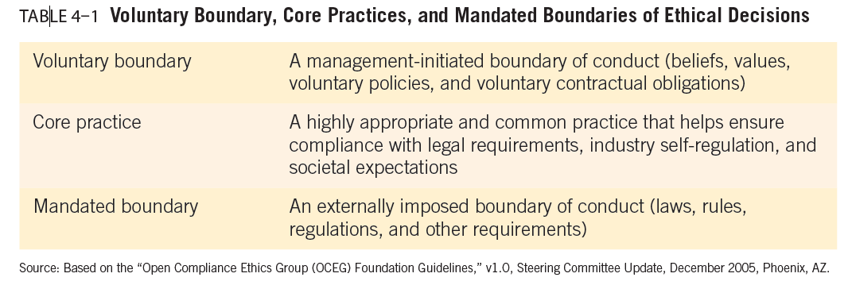
THE INSTITUTIONALIZATION OF BUSINESS ETHICS

Slide 7
THE INSTITUTIONALIZATION OF BUSINESS ETHICS
Managing Ethical Risk Through Mandated And Voluntary Programs
Dimensions of institutionalization:
Voluntary practices: include the beliefs, values, and voluntary contractual obligations of a business.
All businesses engage in some level of commitment to voluntary activities to benefit both internal and external stakeholders.
Most firms engage in strategic philanthropy—giving back to communities and causes.
There is strong evidence to suggest that voluntary corporate social responsibility practices provide benefits to stakeholders and increase performance.

Slide 8
THE INSTITUTIONALIZATION OF BUSINESS ETHICS
Managing Ethical Risk Through Mandated And Voluntary Programs
Dimensions of institutionalization:
Example: The U.S. Foreign Corrupt Practices Act (FCPA).
The FCPA makes it illegal for companies to bribe foreign officials to gain a business advantage.
Multinational corporations like Siemens AG and Goldman Sachs have faced major legal consequences for violating these laws, leading them to build robust legal compliance systems that include anti-bribery training, whistleblower protections, and internal audits.

Slide 9
THE INSTITUTIONALIZATION OF BUSINESS ETHICS
Managing Ethical Risk Through Mandated And Voluntary Programs
Dimensions of institutionalization:
Core practices are documented best practices, often encouraged by legal and regulatory forces as well as industry trade associations.
Core practices are appropriate and common practices that have industry acceptance and meet societal expectations.
Although these practices are not enforced, there are consequences for ignoring them that lead to misconduct.
In institutionalizing core practices, the government provides organizations with the opportunity to structure their own approaches and only takes action if violations occur.

Slide 10
THE INSTITUTIONALIZATION OF BUSINESS ETHICS
Managing Ethical Risk Through Mandated And Voluntary Programs
Dimensions of institutionalization:
Example: Patagonia’s Environmental Stewardship.
Patagonia voluntarily exceeds environmental regulations by ensuring sustainable sourcing, reducing carbon emissions, and donating 1% of sales to environmental causes.
These initiatives are not legally required but are rooted in the company’s ethical philosophy and stakeholder expectations, enhancing its brand trust and loyalty.

Slide 11
THE INSTITUTIONALIZATION OF BUSINESS ETHICS
Managing Ethical Risk Through Mandated And Voluntary Programs
Dimensions of institutionalization:
Mandated boundaries are externally imposed levels of appropriate conduct, such as laws, rules, and regulations.
For example, antitrust and consumer protection laws create boundaries of propriety that must be respected by companies. Failure to do so results in civil and criminal penalties.
Organizations need to maintain an ethical culture and manage stakeholder expectations for appropriate conduct. They achieve these ends through corporate governance, compliance, risk management, and voluntary activities.

Slide 12
THE INSTITUTIONALIZATION OF BUSINESS ETHICS
Managing Ethical Risk Through Mandated And Voluntary Programs
Dimensions of institutionalization:
Example: Johnson & Johnson’s Credo-Based Culture.
J&J integrates ethical decision-making into its core operations through its long-standing Credo, which prioritizes responsibilities to customers, employees, communities, and shareholders.
This foundational document influences company-wide decisions and actions, shaping an ethical corporate culture beyond mere compliance.

Slide 13
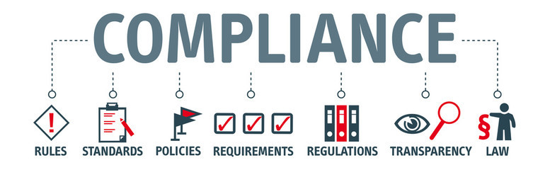
THE INSTITUTIONALIZATION OF BUSINESS ETHICS
MANDATED REQUIREMENTS FOR LEGAL COMPLIANCE

Slide 14
THE INSTITUTIONALIZATION OF BUSINESS ETHICS
Mandated Requirements For Legal Compliance
Laws and regulations are established by governments to set minimum standards for responsible behavior—society’s codification of what is right and wrong.
Laws regulating business conduct are passed because some stakeholders believe business cannot be trusted to do what is right in certain areas, such as consumer safety and environmental protection.
Because public policy is dynamic and often changes in response to business abuses and consumer demands for safety and equality, many laws have been passed to resolve specific problems and issues.

Slide 15
THE INSTITUTIONALIZATION OF BUSINESS ETHICS
Mandated Requirements For Legal Compliance
The role of laws is not so much to distinguish what is ethical or unethical as to determine the appropriateness of specific activities or situations. In other words, laws establish the basic ground rules for responsible business activities. Laws become the floor of appropriate conduct.
Most of the laws and regulations that govern business activities fall into one of five groups:
(1) regulation of competition,
(2) protection of consumers,
(3) promotion of equity and safety,
(4) protection of the natural environment, and
(5) incentives to encourage organizational compliance programs to deter misconduct that we will examine later.

Slide 16
THE INSTITUTIONALIZATION OF BUSINESS ETHICS
Mandated Requirements For Legal Compliance
Laws Regulating Competition:
The issues surrounding the impact of competition on businesses’ social responsibility arise from the rivalry among businesses for customers and profits.
When businesses compete unfairly, legal and social responsibility issues can result.
Intense competition sometimes makes managers feel their company’s survival is threatened. In these situations, managers may begin to see unacceptable alternatives as acceptable, and they begin engaging in questionable practices to ensure the survival of their organizations.
Being aware of antitrust laws is important for all large corporations around the world.

Slide 17
THE INSTITUTIONALIZATION OF BUSINESS ETHICS
Mandated Requirements For Legal Compliance
Laws Regulating Competition:
Example: Amazon and U.S. Antitrust Laws.
In 2023, the U.S. Federal Trade Commission (FTC) sued Amazon for allegedly violating antitrust laws by using its market dominance to suppress competition, such as punishing sellers who offered lower prices elsewhere.
This case reflects a mandated legal compliance issue under the Sherman Antitrust Act, which prohibits monopolistic and anti-competitive practices.
It highlights how companies must align their competitive strategies with legal standards to avoid legal penalties and protect ethical credibility.

Slide 18
THE INSTITUTIONALIZATION OF BUSINESS ETHICS
Mandated Requirements For Legal Compliance
Laws Protecting Consumers:
FTC’s Bureau of Consumer Protection monitors compliance with and investigates violations of laws, including unfulfilled holiday delivery promises by online shopping sites, employment opportunities fraud, scholarship scams, misleading advertising for health care products, high-tech and telemarketing fraud, data security, and financial practices.
The FDA regulates food safety, human drugs, tobacco, dietary supplements, vaccines, veterinary drugs, medical devices, cosmetics, products that give off radiation, and biological products.

Slide 19
THE INSTITUTIONALIZATION OF BUSINESS ETHICS
Mandated Requirements For Legal Compliance
Laws Protecting Consumers:
Example: Apple and the “Batterygate” Controversy.
In 2020, Apple was fined by regulatory authorities in multiple countries, including the U.S. and France, for failing to inform consumers that software updates were intentionally slowing down older iPhones.
This led to lawsuits under consumer protection laws, which require companies to provide clear, honest information about product performance.
The case demonstrates how Laws Protecting Consumers serve as mandated legal compliance, ensuring transparency, preventing deceptive practices, and safeguarding consumer rights.

Slide 20
THE INSTITUTIONALIZATION OF BUSINESS ETHICS
Mandated Requirements For Legal Compliance
Laws Promoting Equity and Safety:
Laws promoting equity in the workplace were passed to protect the rights of minorities, women, older persons, and persons with disabilities; other legislation sought to protect the safety of all workers.
Laws specifically prohibits discrimination in employment on the basis of race, sex, religion, color, or national origin.
Even with the passage and enforcement of safety laws, many employees still work in unhealthy or dangerous environments. Safety experts suspect that companies underreport industrial accidents to avoid state and federal inspection and regulation.

Slide 21
THE INSTITUTIONALIZATION OF BUSINESS ETHICS
Mandated Requirements For Legal Compliance
Laws Promoting Equity and Safety:
Example: Tesla and Workplace Safety Violations.
Tesla has faced multiple investigations by the Occupational Safety and Health Administration (OSHA) over unsafe working conditions at its factories, including injuries due to a lack of proper training and inadequate safety protocols.
These cases fall under Laws Promoting Equity and Safety, which mandate employers to provide safe, non-discriminatory workplaces under acts like the Occupational Safety and Health Act and the Equal Employment Opportunity laws.
Compliance with these laws is legally required to protect employees' health, well-being, and fair treatment, making it a key component of mandated ethical and legal responsibility.

Slide 22
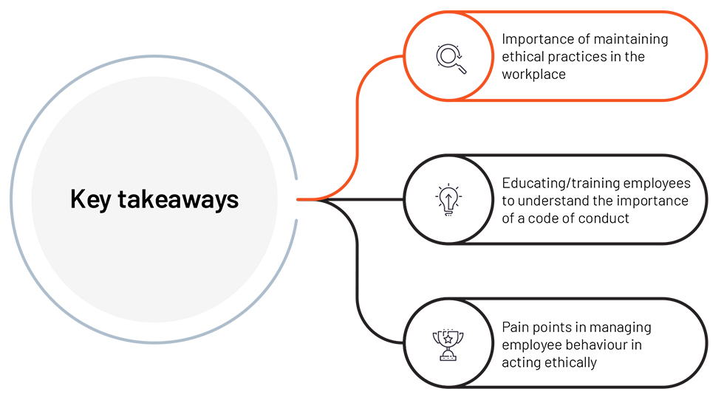
THE INSTITUTIONALIZATION OF BUSINESS ETHICS
CORE OR BEST PRACTICES

Slide 23
THE INSTITUTIONALIZATION OF BUSINESS ETHICS
Core or Best Practices
The focus of core or best practices is on integrity in developing structurally sound organizational practices and integrity for financial and nonfinancial performance measures, rather than on an individual’s morals.
Developing organizational systems and processes is a requirement of the regulatory environment, but organizations are given considerable freedom in developing these programs.
Core practices usually exist and can be identified in every industry.
Trade associations, self-regulatory groups, and research studies often provide insights into the expected best practices.

Slide 24
THE INSTITUTIONALIZATION OF BUSINESS ETHICS
Core or Best Practices
An important priority is for each firm to assess its legal and ethical risk areas, and then develop structures to prevent, detect, and quickly correct any misconduct.
The use of gatekeepers is an important part of core practices.
Trust allows businesses to depend upon one another as they make transactions or exchange value.
Ethics creates the foundational trust between two parties in a transaction.
Many people must trust and be trusted to make business work properly.
Sometimes these parties are referred to as gatekeepers.

Slide 25
THE INSTITUTIONALIZATION OF BUSINESS ETHICS
Core or Best Practices
Gatekeepers include accountants, who are essential to certifying the accuracy of financial information, as well as lawyers, financial rating agencies, and even financial reporting services.
These groups are critical in providing information, allowing stakeholders to gain an understanding of the financial position of an organization.
Most of these gatekeepers operate with professional codes of ethics and face legal consequences, or even disbarment, if they fail to operate within agreed-upon principles of conduct.
Therefore, there is a strong need for gatekeepers to uphold ethical standards and remain independent through using standard methods and procedures that can be audited by other gatekeepers, the regulatory system, and investors.

Slide 26
THE INSTITUTIONALIZATION OF BUSINESS ETHICS
Core or Best Practices
Voluntary Responsibilities:
Businesses that address their voluntary responsibilities provide four major benefits to society:
Improve quality of life and make communities the places where people want to do business, raise families, and enjoy life. Thus, improving the quality of life in a community makes it easier to attract and retain employees and customers.
Reduce government involvement by assisting stakeholders.
Develop employee leadership skills. Many firms, for example, use campaigns by the United Way and other community service organizations as leadership and skill-building exercises for their employees.
Create an ethical culture and values that act as a buffer to organizational misconduct.

Slide 27
THE INSTITUTIONALIZATION OF BUSINESS ETHICS
Core or Best Practices
Voluntary Responsibilities:
The most common way businesses demonstrate their voluntary responsibilities is through donations to local and national charitable organizations.
The money supports a variety of causes such as child development, education, the environment, disaster relief, and others.

Slide 28
THE INSTITUTIONALIZATION OF BUSINESS ETHICS
Mandated Requirements For Legal Compliance
Voluntary Responsibilities:
Example: Microsoft’s Carbon Negative Commitment.
Microsoft voluntarily committed to becoming carbon negative by 2030, going beyond regulatory environmental requirements.
The company also pledged to remove all the carbon it has emitted since its founding in 1975.
This action reflects voluntary responsibilities, where a company chooses to exceed legal obligations to address environmental and social concerns.
Such initiatives enhance stakeholder trust and demonstrate ethical leadership, even though they are not legally mandated.

Slide 29
THE INSTITUTIONALIZATION OF BUSINESS ETHICS
Core or Best Practices
Cause-Related Marketing:
Cause-related marketing ties an organization’s product(s) directly to a social concern through a marketing program.
More than 80 percent of customers claim they view firms more positively when they support issues that they care about.
Many marketing directors feel that cause-related marketing will increase shortly.
With cause-related marketing, a percentage of a product’s sales is donated to a cause that appeals to the target market. Target, for example, launched a back-to-school initiative called Buy One Give One.

Slide 30
THE INSTITUTIONALIZATION OF BUSINESS ETHICS
Core or Best Practices
Cause-Related Marketing:
Cause-related marketing also affects buying patterns.
For such a campaign to be successful, consumers must sympathize with the cause, the brand and cause must be perceived as a good fit, and consumers should be able to transfer their feelings about the cause to their brand perceptions and purchase intentions.
When consumers identify with a cause, this identification leads to more positive evaluations of the campaign, lending support that cause-related marketing can bolster a firm’s reputation.

Slide 31
THE INSTITUTIONALIZATION OF BUSINESS ETHICS
Mandated Requirements For Legal Compliance
Cause-Related Marketing:
Example: TOMS Shoes – One for One Campaign.
TOMS Shoes became widely known for its “One for One” model, where the company donated a pair of shoes to a child in need for every pair sold.
This is a clear example of cause-related marketing, where a business ties its product sales to a social cause.
While not required by law, this strategy builds brand loyalty, enhances corporate reputation, and aligns marketing efforts with ethical and philanthropic values.

Slide 32
THE INSTITUTIONALIZATION OF BUSINESS ETHICS
Core or Best Practices
Strategic Philanthropy:
Strategic philanthropy is the synergistic and mutually beneficial use of an organization’s core competencies and resources to deal with key stakeholders to bring about organizational and societal benefits.
It uses, as all do, the profit motive, but argues that philanthropy must have a long-term positive impact.
Companies that utilize strategic philanthropy recognize that companies do not operate independently of society, and that improved social conditions could lead to improved economic benefits.

Slide 33
THE INSTITUTIONALIZATION OF BUSINESS ETHICS
Core or Best Practices
Strategic Philanthropy:
A strategic approach to philanthropy tends to create a better image for the company, increase customer loyalty, and enhance customer relationships.
To be successful, a strategic philanthropy program should pertain to the mission and operations of the company.
It must also have strong support from top managers.

Slide 34
THE INSTITUTIONALIZATION OF BUSINESS ETHICS
Mandated Requirements For Legal Compliance
Strategic Philanthropy:
Example: Google.org’s Support for Digital Education.
Google, through its philanthropic arm Google.org, invests millions in strategic philanthropy by funding global digital education initiatives, such as supporting nonprofits that provide coding and tech skills to underprivileged communities.
Unlike general charitable giving, this form of philanthropy aligns with Google’s core mission—advancing technology and digital literacy—while creating long-term social impact.
It’s a voluntary, strategic approach that enhances both community development and the company’s broader purpose.

Slide 35
THE INSTITUTIONALIZATION OF BUSINESS ETHICS
Core or Best Practices
Social Entrepreneurship:
Social entrepreneurship occurs when an entrepreneur founds an organization to create social value.
Social entrepreneurs desire to find a solution to a social problem rather than to simply earn profits.
These types of organizations, also called social enterprises, can be for-profit, nonprofit, government-based, or hybrids.
Social enterprises directly implement their programs and are organized around achieving social objectives. Social enterprises and strategic philanthropy are important in supporting the growth of social responsibility among businesses.

Slide 36
THE INSTITUTIONALIZATION OF BUSINESS ETHICS
Mandated Requirements For Legal Compliance
Social Entrepreneurship:
Example: Grameen Bank by Muhammad Yunus.
Grameen Bank, founded by Nobel laureate Muhammad Yunus in Bangladesh, is a classic example of social entrepreneurship.
The bank provides microloans to low-income individuals—especially women—without requiring collateral, helping them start small businesses and lift themselves out of poverty.
The primary goal is social impact, not profit. This model demonstrates how business principles can be used to solve social problems sustainably, blending entrepreneurship with ethical commitment to community empowerment.

Slide 37
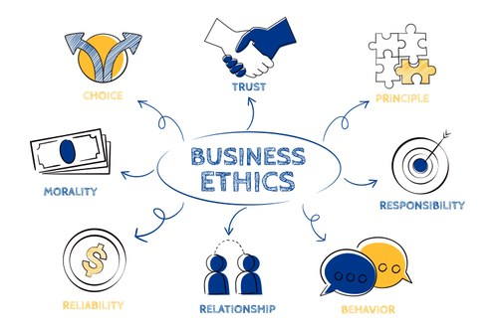
THE INSTITUTIONALIZATION OF BUSINESS ETHICS
THE IMPORTANCE OF INSTITUTIONALIZATION IN BUSINESS ETHICS

Slide 38
THE INSTITUTIONALIZATION OF BUSINESS ETHICS
The Importance of Institutionalization in Business Ethics
The Importance of Institutionalization in Business Ethics:
Institutionalization involves embedding values, norms, and artifacts in organizations, industries, and society.
In the United States and many other countries, institutionalization involves legislation often finalized through Supreme Court decisions.
This chapter provides an overview of legal as well as cultural institutions that work both outside and inside the organizational environment to support and control ethical decision making in organizations.

Slide 39
THE INSTITUTIONALIZATION OF BUSINESS ETHICS
The Importance of Institutionalization in Business Ethics
The Importance of Institutionalization in Business Ethics:
Those in charge of corporate governance should be especially mindful of the institutions, including mandated requirements for legal compliance as well as core industry practices and voluntary actions that support ethics and social responsibility.
Voluntary conduct, including strategic philanthropic activities, is not required to run a business.
The failure to understand highly appropriate common practices, referred to as core practices, provides the opportunity for unethical conduct.

Slide 40
THE INSTITUTIONALIZATION OF BUSINESS ETHICS
The Importance of Institutionalization in Business Ethics
The Importance of Institutionalization in Business Ethics:
It is important to recognize that the institutionalization of business ethics has advanced rapidly over the last 20 years as stakeholders recognized the need to improve business ethics.
If firms do not implement compliance items, governments usually step in.
More recently, gatekeepers such as lawyers, financial rating agencies, and financial reporting services have been questioned because of their decisions that contributed to major scandals.

Slide 41



Thank You

