Slide 1


Human Resource
Management
HRM 611
Lecture 3
Prepared by Dr. Sahar Ahmed

Slide 2

Ch.
03
Main Topics
Explain why talent management is important.
Discuss the nature of job analysis, including what it is and how it’s used.
Explain methods of collecting job analysis information
Write job descriptions, including summaries and job functions, using the Internet and traditional methods.
Write a job specification.
Understand Competency-based job description
Using models and profiles in talent management
www.midocean.ae

Slide 3
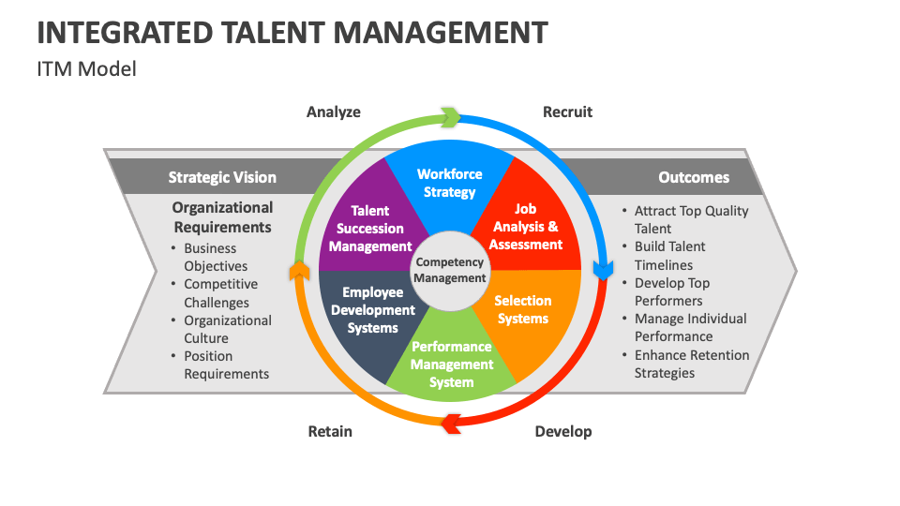
www.midocean.ae

Slide 4
Ch.
Talent Management
03
What is Talent Management?
Talent management is the goal-oriented and integrated process of planning, recruiting, developing, managing, and compensating employees.
Key Characteristics:
Everything is connected: All HR activities, like hiring, teaching, and paying employees, are parts of a big puzzle. They need to fit together to create a strong and effective team.
Focus on goals: When you manage talent, you're not just doing things for the sake of it. Every decision, from who to hire to what training to provide, should help your company achieve its goals.
www.midocean.ae

Slide 5
Ch.
Talent Management Characteristics
03
3. Use the same plan: For each job, you should have a clear idea of what skills, knowledge, and experience are needed. This plan should guide everything from hiring to performance reviews.
4. Treat people differently: Not everyone is the same. Some employees are more important to your company's success than others. Talent management helps you identify these key people and give them extra attention and support.
5. Make it all work together: All the different HR activities should work together smoothly. For example, if you hire someone based on their skills, you should provide training to help them develop those skills further.
www.midocean.ae

Slide 6
Chapter
Uses of Job Analysis Information
03
Job analysis
Job description
and specification
Recruiting
and selection decisions
Performance appraisal
Job evaluation—wage and salary decisions (compensation)
Training requirements
www.midocean.ae
Notes:
job analysis is important because managers use it to support just about all their human resource management activities.

Slide 7
Ch.
Job Analysis
03
Job Analysis
  The procedure for determining the duties and skill requirements of a job and the kind of person who should be hired for it.
Job Description
  A list of a job’s duties, responsibilities, reporting relationships, working conditions, and supervisory responsibilities—one product of a job analysis.
Job Specifications
  A list of a job’s “human requirements,” that is, the requisite education, skills, personality, and so on—another product of a job analysis.
www.midocean.ae

Slide 8
Ch.
Job Analysis
03
What does the job involve? This includes the specific tasks, duties, and responsibilities of the job.
What kind of person do you need? This includes the skills, knowledge, experience, and personal qualities that are necessary for the job.
How is the job done? This includes the tools, equipment, and resources used in the job.
What are the performance expectations? This includes the standards of quality and quantity that are expected of the person in the job.
What is the work environment like? This includes factors like working conditions, hours, and the number of people the employee will interact with.
www.midocean.ae

Slide 9
Ch.
Why Job Analysis Is Important?
03
Why is job analysis important?
Job analysis is the foundation for many HR activities, including:
Recruiting: Knowing what the job entails helps you find the right people to apply.
Selection: Understanding the job requirements helps you choose the best candidate from among the applicants.
Training: Job analysis identifies the training needs of employees.
Performance evaluation: Knowing the job expectations helps you assess how well employees are performing.
www.midocean.ae

Slide 10
Chapter
Steps in Job Analysis
03
Steps in doing a job analysis:
1
Decide how you’ll use the information.
2
Review relevant background information.
3
Select representative positions.
4
Actually analyze the job.
5
Verify the job analysis information.
6
Develop a job description and job specification.
www.midocean.ae

Slide 11
Ch.
Job Analysis Steps
03
Decide how the information will be used: This determines the data collection technique.
Review relevant background information: This includes organization charts, process charts, and existing job descriptions.
Select representative positions: Choose which positions to focus on for the analysis.
Analyze the job: Collect data on job activities, working conditions, and human traits and abilities.
Verify the information: Confirm the accuracy and completeness of the data with the employee and supervisor.
Develop a job description and job specification: Write a description of the job's activities and responsibilities and a specification of the required human qualities.
www.midocean.ae

Slide 12
Chapter
Collecting Job Analysis Information
03
Methods for Collecting Job Analysis Information
Interviews
Questionnaires
Observations
Diaries/Logs
www.midocean.ae
Notes:
There are various ways to collect information on a job’s duties, responsibilities, and activities. In practice, you could use any one of them, or combine several. The basic rule is to use those that best fit your purpose.
Interviews, questionnaires, observations, and diaries/logs are the most popular methods for gathering realistic information about what job incumbents actually do. Managers use these methods for developing job descriptions and job specifications.

Slide 13
Chapter
Methods for Collecting Job Analysis Information: The Interview
03
Information Sources
  Individual employees
  Groups of employees
  Supervisors with knowledge of the job
Advantages
  Quick, direct way to find overlooked information
Disadvantage
  Distorted information
Interview Formats
  Structured (Checklist)
  Unstructured
www.midocean.ae
Notes:
Job analysis interviews range from completely unstructured interviews to highly structured ones containing hundreds of specific items to check off.
Managers may conduct individual interviews with each employee, group interviews with groups of employees who have the same job, and/or supervisor interviews with one or more supervisors who know the job.
Distortion of information is interviewing’s main problem—whether due to outright falsification, honest misunderstanding, or statements inflating the importance of their jobs by interviewees.

Slide 14
Chapter
Methods for Collecting Job Analysis Information: Questionnaires
03
Information Source
  Have employees fill out questionnaires to describe their job-related duties and responsibilities
Questionnaire Formats
  Structured checklists
  Open-ended questions
Advantages
  Quick and efficient way
  to gather information
  from large numbers of employees
Disadvantages
  Expense and time consumed in preparing and testing the questionnaire
www.midocean.ae
Notes:
Questionnaires can be structured or opened-ended. A questionnaire is a quick, efficient, and cost-effective way to obtain information from a large number of employees. However, developing the questionnaire and testing it to make sure the workers understand the questions can be time consuming. And as with interviews, employees may distort their answers, consciously or unconsciously.

Slide 15
Chapter
Methods for Collecting Job Analysis Information: Observation
03
Information Source
  Observing and noting the physical activities of employees as they go about their jobs by managers.
Advantages
  Provides first-hand information
  Reduces distortion of information
Disadvantages
  Time consuming
  Reactivity response distorts employee behavior
  Difficulty in capturing entire job cycle
  Of little use if job involves a high level of mental activity
www.midocean.ae
Notes:
Direct observation is especially useful when jobs consist mainly of observable physical activities. Observation is usually not appropriate when the job entails a lot of mental activity or if the employee only occasionally engages in important activities. Reactivity—the worker’s changing what he or she normally does because you are watching—can also be a problem.

Slide 16
Chapter
Methods for Collecting Job Analysis Information: Participant Diaries/Logs
03
Information Source
  Workers keep a chronological diary or log of what they do and the time spent on each activity.
Advantages
  Produces a more complete picture of the job
  Employee participation
Disadvantages
  Distortion of information
  Depends upon employees to accurately recall their activities
www.midocean.ae
Notes:
Workers are asked to keep a record of what they do during the day by writing a diary/log. Employees record each of their activities (along with the time) in a log. This can produce a very complete picture of the job, especially when supplemented with subsequent interviews with the worker and the supervisor.
The employee, of course, might try to exaggerate some activities and underplay others. However, the detailed, chronological nature of the log tends to mediate against this.
Diaries/logs have gone high-tech. Some firms give employees pocket dictating machines and pagers. Then at random times during the day, they page the workers, who dictate what they are doing at that time. This approach can avoid one pitfall of the traditional diary/log method: relying on workers to remember what they did hours earlier when they complete their logs at the end of the day.

Slide 17
Chapter
Job Analysis: Interviewing Guidelines
03
The job analyst and supervisor should work together to identify the workers who know the job best.
Quickly establish rapport with the interviewee.
Follow a structured guide or checklist, one that lists open-ended questions and provides space for answers.
Ask the worker to list his or her duties in order of importance and frequency of occurrence.
After completing the interview, review and verify the data.
www.midocean.ae

Slide 18
Chapter
Quantitative Job Analysis Techniques
03
Quantitative Job Analysis
Position Analysis Questionnaire
Department of Labor (DOL) Procedure
Functional Job Analysis
www.midocean.ae
Notes:
Qualitative methods like interviews and questionnaires are not always suitable. For example, if your aim is to compare jobs for pay purposes, a mere listing of duties may not suffice.
You may need to say that, in effect, “Job A is twice as challenging as Job B, and so is worth twice the pay.” To do this, it helps to have quantitative ratings for each job. The position analysis questionnaire and the Department of Labor approach are quantitative methods for doing this.

Slide 19
Ch.
Quantitative Job Analysis Techniques
01
Qualitative methods like interviews and questionnaires don't always suffice for tasks like job comparisons for compensation purposes. Quantitative methods provide numerical ratings on various aspects of the job. Two examples are:
Position Analysis Questionnaire (PAQ): This widely used questionnaire has 194 items representing basic job elements categorized into five activities:
  Decision-making/communication/social responsibilities
  Skilled activities
  Physical activity
  Operating vehicles/equipment
  Processing information
www.midocean.ae

Slide 20
Ch.
Quantitative Job Analysis Techniques
01
Department of Labor Approach: This method assigns specific points based on factors like job complexity, responsibility level, and working conditions. These points can then be used to determine pay levels.
Functional Job Analysis (FJA) is a structured job analysis method that focuses on identifying the observable work behaviors required to perform a job effectively. It is based on the premise that all jobs can be broken down into a set of observable work activities or functions.
www.midocean.ae

Slide 21
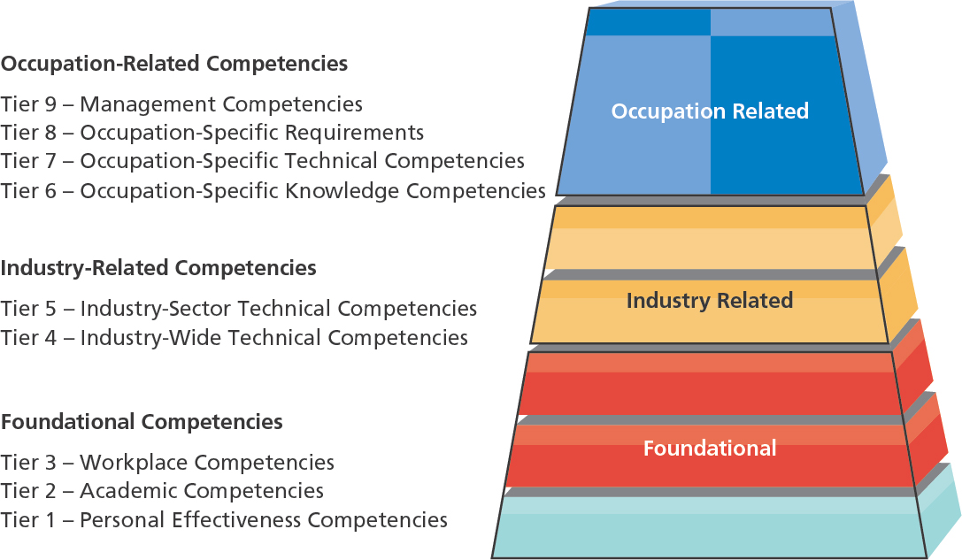
U.S. Department of Labor Competency Model
www.midocean.ae

Slide 22
Ch.
Internet-Based Job Analysis
01
With a geographically dispersed workforce, online job analysis tools offer a convenient solution. However, clear instructions and testing are crucial to avoid misunderstandings and ensure accurate results.
Advantages
  Collects information in a standardized format from geographically dispersed employees
  Requires less time than face-to-face interviews
  Collects information with minimal intervention or guidance
www.midocean.ae

Slide 23
Ch.
Job Analysis Guidelines
01
Joint effort: Involve HR, the employee, and the supervisor. Observe the worker, have them fill out questionnaires, and review the results collaboratively.
Clarity: Ensure everyone understands the questions and the process. Explain terms like "mental demands."
Multiple tools: Combine various methods. Don't rely solely on questionnaires; follow up with interviews to capture all relevant information.
www.midocean.ae

Slide 24
Chapter
Uses of Job Analysis Information
03
Job analysis
Job description
and specification
Recruiting
and selection decisions
Performance appraisal
Job evaluation—wage and salary decisions (compensation)
Training requirements
www.midocean.ae
Notes:
job analysis is important because managers use it to support just about all their human resource management activities.

Slide 25
Chapter
Writing Job Descriptions
03
Job
identification
Job
specifications
Job
summary
Sections of a Typical Job Description
Working
conditions
Responsibilities and duties
Standards of performance
Authority of
the incumbent
www.midocean.ae
Notes:
There is no standard format for writing a job description. However, most descriptions contain sections that cover:
1. Job identification
2. Job summary
3. Responsibilities and duties
4. Authority of incumbent
5. Standards of performance
6. Working conditions
7. Job specifications

Slide 26
Chapter
The Job Description
03
Job Identification
  Job title
  Preparation date
  Preparer
Job Summary
  General nature of the job
  Major functions/activities
Relationships
  Reports to:
  Supervises:
  Works with:
  Outside the company:
Responsibilities and Duties
  Major responsibilities and duties (essential functions)
  Decision-making authority
  Direct supervision
  Budgetary limitations
Standards of Performance and Working Conditions
  What it takes to do the job successfully
www.midocean.ae
Notes:
A job description is a written statement of what the worker actually does, how he or she does it, and what the job’s working conditions are. You use this information to write a job specification; this lists the knowledge, abilities, and skills required to perform the job satisfactorily.

Slide 27
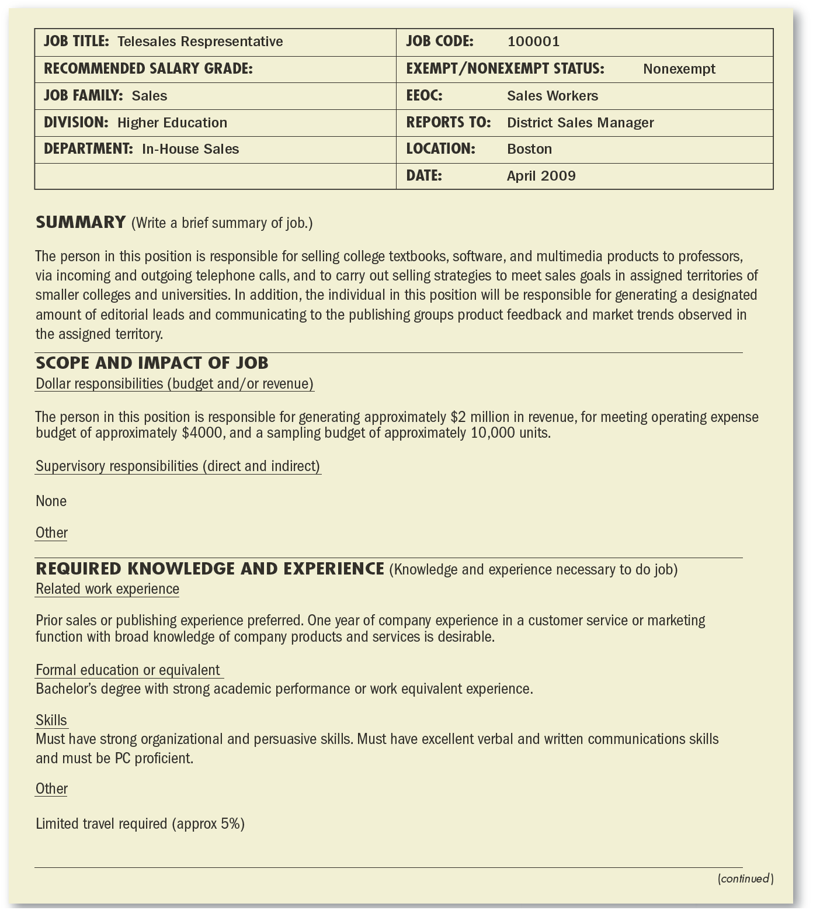
Sample Job Description

Slide 28
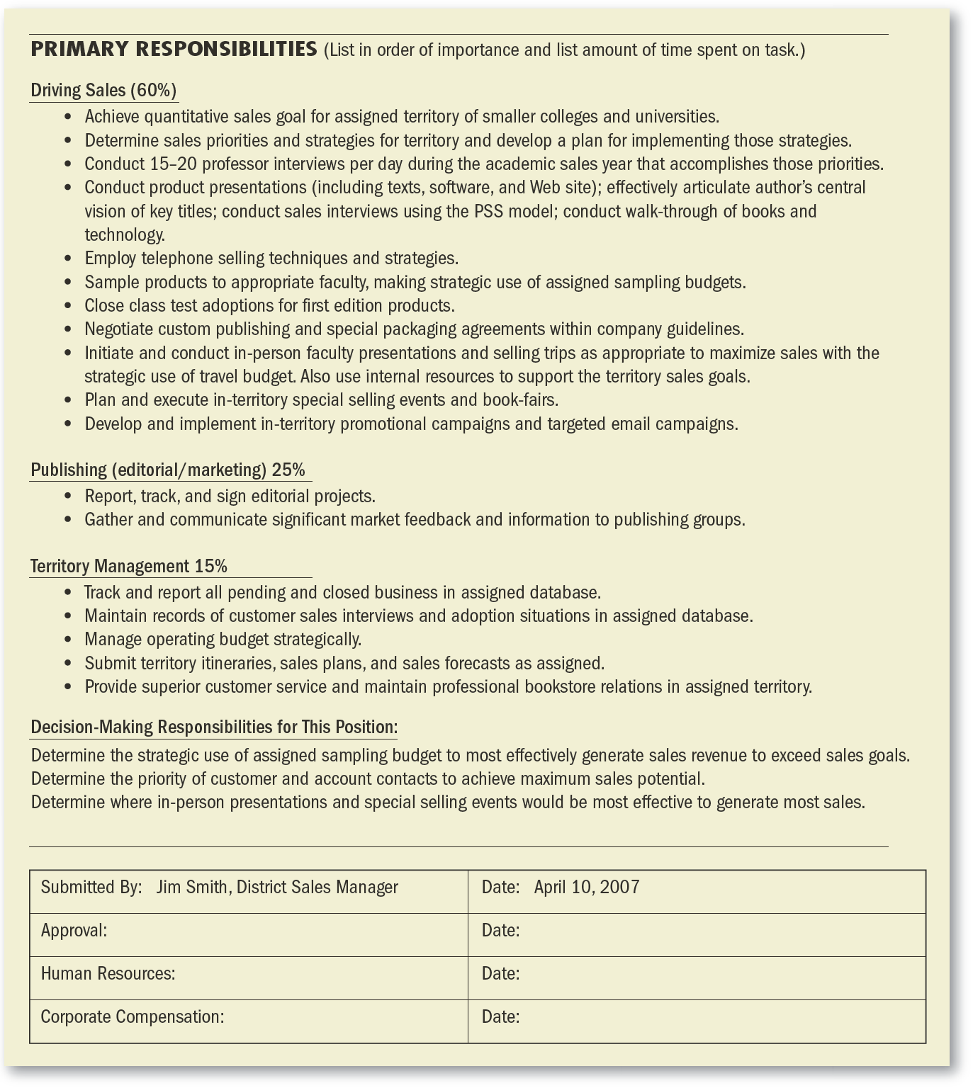
Sample Job Description

Slide 29
Chapter
Writing Job Specifications
03
“What human traits and experience are required to do this job well?”
Job specifications
for trained versus untrained personnel
Job specifications based on judgment
Job specifications based on statistical analysis
www.midocean.ae
Notes:
The job specification focuses on the person in answering the question, “What human traits and experience are required to do this job effectively?”
It shows what kind of person to recruit and for what qualities you should test that person. The job specification may be a section of the job description, or a separate document.
Job specifications for trained employees focus on traits like length of previous service, quality of relevant training, and previous job performance.
Job specifications can be based on the best judgments of the common-sense experiences of supervisors and human resource managers. The basic procedure here is to ask, “What does it take in terms of education, intelligence, training, and the like to do this job well?”
Basing job specifications on statistical analysis is more defensible than the judgmental approach because equal rights legislation forbids using traits that can’t be proved to distinguish between high and low job performers.

Slide 30
Chapter
03
Using Statistical Approach in Job Specification
  Analyze the job and decide how to measure job performance.
  Select personal traits that you believe should predict successful performance.
  Test candidates for these traits.
  Measure the candidates’ subsequent job performance.
  Statistically analyze the relationship between the human traits and job performance.
www.midocean.ae
Notes:
The aim of the statistical approach is to determine the statistical relationship between (1) some predictor (human trait, such as height, intelligence, or finger dexterity), and (2) some indicator or criterion of job effectiveness, such as performance as rated by the supervisor.

Slide 31
Chapter
03
Using Statistical Approach in Job Specification
  Analyze the job and decide how to measure job performance.
  Select personal traits that you believe should predict successful performance.
  Test candidates for these traits.
  Measure the candidates’ subsequent job performance.
  Statistically analyze the relationship between the human traits and job performance.
www.midocean.ae
Notes:
The aim of the statistical approach is to determine the statistical relationship between (1) some predictor (human trait, such as height, intelligence, or finger dexterity), and (2) some indicator or criterion of job effectiveness, such as performance as rated by the supervisor.

Slide 32
Chapter
03
Using Statistical Approach
Advantages of Statistical Analysis
Objectivity: Provides a more objective basis for hiring decisions, reducing bias.
Defensibility: Can help justify hiring practices in legal challenges.
Predictive Validity: Can accurately predict future job performance.
Challenges
Complexity: Requires expertise in statistical methods and data analysis.
Time-consuming: Can be a lengthy and resource-intensive process.
Cost: May involve costs for developing and administering tests.
Limited Generalizability: Results may not apply to all jobs or organizations.
www.midocean.ae
Notes:
The aim of the statistical approach is to determine the statistical relationship between (1) some predictor (human trait, such as height, intelligence, or finger dexterity), and (2) some indicator or criterion of job effectiveness, such as performance as rated by the supervisor.

Slide 33
Chapter
Competency-Based Job Analysis
03
Competencies
  Demonstrable characteristics of a person that enable performance of a job.
Reasons for Competency-Based Job Analysis
  To support a high-performance work system (HPWS).
  To create strategically-focused job descriptions.
  To support the performance management process in fostering, measuring, and rewarding:
    General competencies
    Leadership competencies
    Technical competencies
www.midocean.ae
Notes:
Changes in how work is organized is evidenced by flattening of the organization, the rise of self-managed teams, and the constant focus on improving productivity through reengineering.

Slide 34
Chapter
Developing Competency Models and Job Profiles
03
Identify Critical Success Factors: Determine the key competencies or behaviors that contribute to exceptional performance in the job. This involves analyzing the job's requirements, observing successful employees, and gathering feedback from stakeholders.
Define Competencies: Develop clear and concise definitions for each competency, including observable behaviors and proficiency levels.
Link Competencies to Job Requirements: Connect the identified competencies to the specific tasks, responsibilities, and challenges of the job.
Assess Competency Levels: Determine the desired level of proficiency for each competency based on the job's demands and the organization's expectations.
Validate Competencies: Ensure that the competencies are valid and reliable predictors of job performance through empirical research or expert judgment.
www.midocean.ae
Notes:
Changes in how work is organized is evidenced by flattening of the organization, the rise of self-managed teams, and the constant focus on improving productivity through reengineering.

Slide 35
Chapter
How to Write Job Competencies-Based Job Descriptions
03
Interview job officeholders (incumbents) and their supervisors
  Ask open-ended questions about job responsibilities and activities.
  Identify critical incidents that pinpoint success on the job.
www.midocean.ae
Notes:
Defining the job’s competencies and writing them up involves a process that is similar to traditional job analysis. In other words, you might interview job incumbents and their supervisors, ask open-ended questions regarding job responsibilities and activities, and perhaps identify critical incidents that pinpoint success on the job.
But there the similarity ends. Instead of compiling lists of job duties, you will ask, “In order to perform this job competently, the employee should be able to . . . ?” You can use your knowledge of the job to answer this, or use a list like that mentioned at O*NET. There are also off-the-shelf competencies databanks.

Slide 36
Chapter
Benefits of Using Competency Models and Job Profiles
03
Clearer Job Expectations: Employees understand the behaviors and skills expected of them, leading to better alignment and performance.
Enhanced Recruitment and Selection: Hiring decisions can be based on the specific competencies required for the job, improving the quality of new hires.
Targeted Training and Development: Training programs can be tailored to address specific competency gaps, maximizing their effectiveness.
.
www.midocean.ae
Notes:
Defining the job’s competencies and writing them up involves a process that is similar to traditional job analysis. In other words, you might interview job incumbents and their supervisors, ask open-ended questions regarding job responsibilities and activities, and perhaps identify critical incidents that pinpoint success on the job.
But there the similarity ends. Instead of compiling lists of job duties, you will ask, “In order to perform this job competently, the employee should be able to . . . ?” You can use your knowledge of the job to answer this, or use a list like that mentioned at O*NET. There are also off-the-shelf competencies databanks.

Slide 37
Chapter
Benefits of Using Competency Models and Job Profiles
03
Objective Performance Evaluation: Performance appraisals can be based on observable behaviors and competencies, rather than subjective judgments.
Improved Talent Management: Organizations can identify high-potential employees, develop their skills, and create career paths based on their competencies.
Increased Adaptability: Employees with a strong foundation of competencies are better equipped to adapt to changing job demands and organizational needs.
www.midocean.ae
Notes:
Defining the job’s competencies and writing them up involves a process that is similar to traditional job analysis. In other words, you might interview job incumbents and their supervisors, ask open-ended questions regarding job responsibilities and activities, and perhaps identify critical incidents that pinpoint success on the job.
But there the similarity ends. Instead of compiling lists of job duties, you will ask, “In order to perform this job competently, the employee should be able to . . . ?” You can use your knowledge of the job to answer this, or use a list like that mentioned at O*NET. There are also off-the-shelf competencies databanks.

Slide 38
Chapter
Competency Models Challenges and Considerations
03
Developing Competencies: Creating clear and measurable competency definitions can be challenging.
Alignment with Organizational Goals: Ensure that competencies align with the organization's overall strategy and objectives.
Resistance to Change: Employees may resist changes to their job roles or expectations based on competency models.
Measurement and Assessment: Developing valid and reliable assessments to measure competencies can be time-consuming and resource-intensive.
www.midocean.ae
Notes:
Defining the job’s competencies and writing them up involves a process that is similar to traditional job analysis. In other words, you might interview job incumbents and their supervisors, ask open-ended questions regarding job responsibilities and activities, and perhaps identify critical incidents that pinpoint success on the job.
But there the similarity ends. Instead of compiling lists of job duties, you will ask, “In order to perform this job competently, the employee should be able to . . . ?” You can use your knowledge of the job to answer this, or use a list like that mentioned at O*NET. There are also off-the-shelf competencies databanks.

Slide 39
Chapter
Competency Models Challenges and Considerations
03
Overcoming Challenges
Involve Stakeholders: Collaborate with employees, managers, and HR professionals to develop and validate competency models.
Communicate Effectively: Clearly communicate the benefits of competency models and address concerns.
Provide Training and Support: Offer training and support to employees to help them develop the required competencies.
Continuously Evaluate and Update: Regularly review and update competency models to reflect changes in job requirements and organizational needs.
www.midocean.ae
Notes:
Defining the job’s competencies and writing them up involves a process that is similar to traditional job analysis. In other words, you might interview job incumbents and their supervisors, ask open-ended questions regarding job responsibilities and activities, and perhaps identify critical incidents that pinpoint success on the job.
But there the similarity ends. Instead of compiling lists of job duties, you will ask, “In order to perform this job competently, the employee should be able to . . . ?” You can use your knowledge of the job to answer this, or use a list like that mentioned at O*NET. There are also off-the-shelf competencies databanks.

Slide 40
Chapter
Job Redesign: Changing the Way People Work
03
Job description is not static, you often need to review and update to reflect changes in the way work is done.
Job enlargement: Giving employees more tasks at the same level of responsibility. For example, a worker might assemble the entire product instead of just a part of it.
Job rotation: Moving employees from one job to another to give them more variety and experience.
Job enrichment: Giving employees more responsibility and authority over their work. For example, an employee might be able to make decisions about how their work is done.
www.midocean.ae
Notes:
Defining the job’s competencies and writing them up involves a process that is similar to traditional job analysis. In other words, you might interview job incumbents and their supervisors, ask open-ended questions regarding job responsibilities and activities, and perhaps identify critical incidents that pinpoint success on the job.
But there the similarity ends. Instead of compiling lists of job duties, you will ask, “In order to perform this job competently, the employee should be able to . . . ?” You can use your knowledge of the job to answer this, or use a list like that mentioned at O*NET. There are also off-the-shelf competencies databanks.

Slide 41
Chapter
Conclusion
03
All managers need to be familiar with the basics of job analysis.
Job analysis is the procedure through which you determine the duties of the department's positions and the characteristics of the people to hire for them.
Job descriptions are a list of what the job entails, while job specifications identify what kind of people to hire for the job.
The job analysis itself involves collecting information on matters such as work activities; required human behaviors; and machines, tools, and equipment used.
www.midocean.ae
Notes:
Defining the job’s competencies and writing them up involves a process that is similar to traditional job analysis. In other words, you might interview job incumbents and their supervisors, ask open-ended questions regarding job responsibilities and activities, and perhaps identify critical incidents that pinpoint success on the job.
But there the similarity ends. Instead of compiling lists of job duties, you will ask, “In order to perform this job competently, the employee should be able to . . . ?” You can use your knowledge of the job to answer this, or use a list like that mentioned at O*NET. There are also off-the-shelf competencies databanks.

Slide 42
Chapter
Conclusion
03
Managers use job analysis information in recruitment and selection, compensation, training, and performance appraisal.
The basic steps in job analysis include deciding the use of the job analysis information, reviewing relevant background information including organization charts, analyzing the job, verifying the information, and developing job descriptions and job specifications.
www.midocean.ae
Notes:
Defining the job’s competencies and writing them up involves a process that is similar to traditional job analysis. In other words, you might interview job incumbents and their supervisors, ask open-ended questions regarding job responsibilities and activities, and perhaps identify critical incidents that pinpoint success on the job.
But there the similarity ends. Instead of compiling lists of job duties, you will ask, “In order to perform this job competently, the employee should be able to . . . ?” You can use your knowledge of the job to answer this, or use a list like that mentioned at O*NET. There are also off-the-shelf competencies databanks.

Slide 43
Chapter
Conclusion
03
There are various methods for collecting job analysis information. These include interviews, questionnaires, observation, participant diary/logs, and quantitative techniques such as position analysis questionnaires. Employers increasingly collect information from employees via the Internet.
Managers should be familiar with the process for writing job descriptions. While there is no standard format, most descriptions contain sections that cover job identification, a job summary, a listing of responsibilities and duties, the job incumbent s authority, and performance standards.
The job description may also contain information regarding the job s working conditions, and the job specifications. Many employers use Internet sources such as www.jobdescription.com to facilitate writing job descriptions.
www.midocean.ae
Notes:
Defining the job’s competencies and writing them up involves a process that is similar to traditional job analysis. In other words, you might interview job incumbents and their supervisors, ask open-ended questions regarding job responsibilities and activities, and perhaps identify critical incidents that pinpoint success on the job.
But there the similarity ends. Instead of compiling lists of job duties, you will ask, “In order to perform this job competently, the employee should be able to . . . ?” You can use your knowledge of the job to answer this, or use a list like that mentioned at O*NET. There are also off-the-shelf competencies databanks.

Slide 44
Week
01
References
Main Reference
Dessler, G. (2011). Human resource management. Thirteenth edition. Pearson International Edition.
Additional Resources for extra reading.
Armstrong, M. (2023). Armstrong's Handbook of Human Resource Management Practice (16th Ed.). Kogan Page.
Noe, R. A., Hollenbeck, J. R., Gerhart, B., & Wright, P. M. (2023). Human Resource Management in Canada (10th Ed.). McGraw-Hill Ryerson.
www.midocean.ae

Slide 45




Thank You

