Slide 1


English Pronunciation Course
Prepared by
Ahmed Soliman

Slide 2



Lecture 1

Slide 3
-ed Endings Pronunciation

Slide 4
asked
missed
moved
watched
wanted
ended

Slide 5
Pronunciation of ED Ending
We pronounce the final ed in three ways:
/t/ - /d/ - /id/
Watch the video in the next slide to know the rule

Slide 6


Slide 7
The Rule
voiceless + ed /t/
voiced + ed /d/
t / d + ed /id/
s

Slide 8
Voiceless Sounds (no vibration): /p/ - /k/ - /f/ - /s/ - /θ/ (th) - /ʃ/ (sh) - /tʃ/ (ch)
Voiced Sounds (vibration): /b/ - /g/ - /l/ - /m/ - /n/ - /r/ - /v/ - /z/ - /ð/ (th) - /ʒ/ - /dʒ/

Slide 9
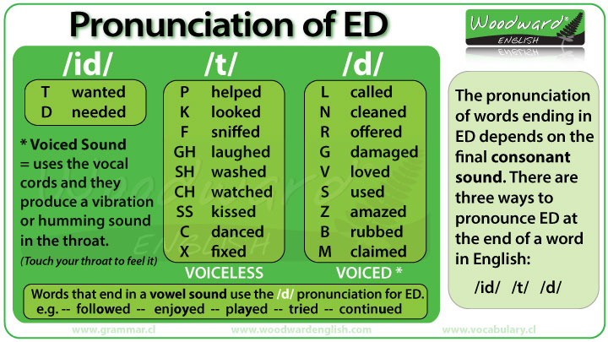

Slide 10
Exercise: Classify the words according to their pronunciation
asked - wanted - moved - watched -helped - kissed - ended - played - missed- offered – claimed
/t/ | /d/ | /id/
Asked Watched Helped Kissed missed | Moved Played Offered claimed | Wanted ended

Slide 11



Thank You

