Slide 1

Orientation Lecture
Week 1

Slide 2


Slide 3


Who Am I?
Name
Hamada Ibrahim AbdulWakel
B.Sc. degree
Faculty of Computers & Information, Minia University, Minia, Egypt.
M.Sc. & Ph.D. degrees
In Computer Science from Faculty of Computers and Artificial Intelligence, Cairo University.
Semantic web & Social networking
Internet of Things

Slide 4
Who Am I?
Jobs
Lecturer at Faculty of Computers & Information, Minia University, Minia, Egypt.
Lecturer at Elsadat Academy.

Slide 5



Who Am I?
Google Scholar
Publons
ORCID

Slide 6

Your Turn

Slide 7
Course Details
Programming Foundations In Python - CYB550
Coordinating Unit
Everyone's Smart University.
Introduction to Programming - IT121
Course Name

Slide 8
Course Contact
ESU email:
  hamada@esu.ac.ae
  (Subject name: "Programming Course: Question")

Slide 9
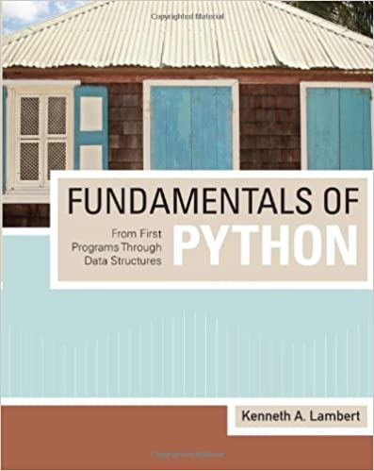

Course Materials
The main contents:
"Fundamentals of Python From First Programs
Through Data Structures", by Kenneth A. Lambert
Recorded lectures available on course Moodle page.

Slide 10

Learning Objectives of this Course
What you'll learn?
New programming language "Python".
Problem-solving techniques.
Application development and prototyping.
Best practice in software development.

Slide 11

Topics Covered in this Course
The main contents:
Introduction to computer programming and Python.
Data types and basic input output operations.
Conditional and loop instructions.
Lists and dictionaries data processing.

Slide 12
Topics Covered in this Course
The main contents:
Functions, modules, and packages.
Object-oriented programming.
Graphical user interface.

Slide 13
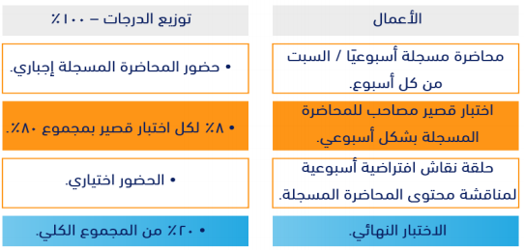
Course Assessment

Slide 14
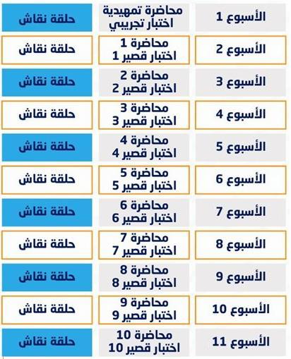

Academic Calendar

Slide 15


Course Exams
Exam rules:
Exam password: agree.
Eight must answer questions/exam.
One-Try exam.
24 min/exam.
You must be sure of your selected answer before pass to the next question.

Slide 16
Course Exams
Exam rules:
Exam begins on Saturday 10:00 PM
to next Saturday 9:00 PM.
Exam question types are Multiple-choice
and T/F questions.

Slide 17


Slide 18


