Slide 1

Marketing Management
MGM612
Dr. Magdy alhaj
Marketing strategy

Slide 2
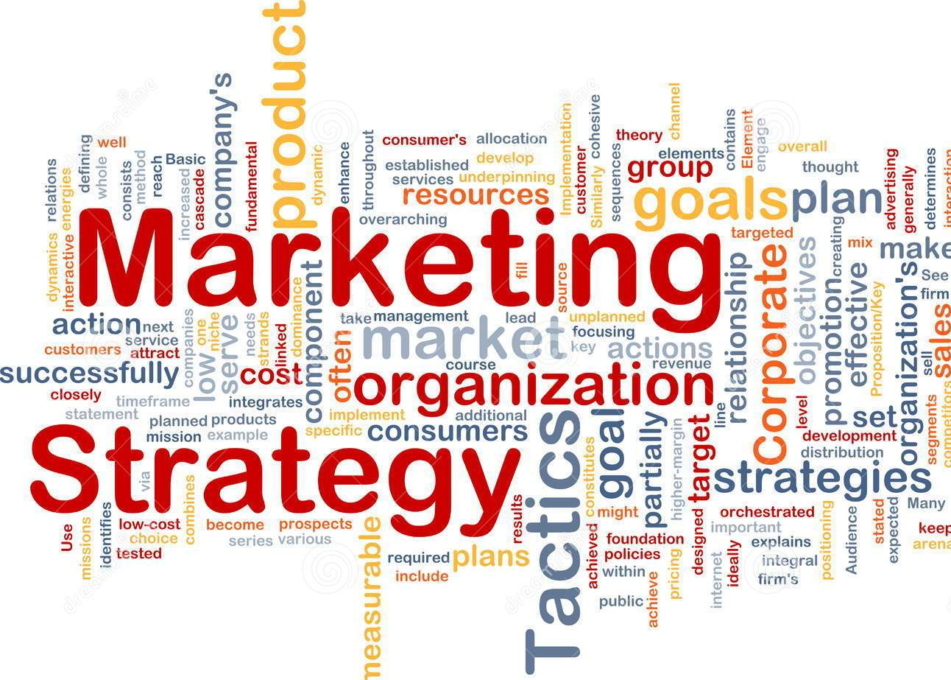
Marketing strategy concept
Chapter-3

Slide 3
Objective
Chapter-3
Marketing strategy (Introduction, define, Developing and Creating )
History of strategic marketing management
Marketing strategy vs. marketing plan
Market Analysis
Explain The (4 P’s) and (7 P’s) of Marketing

Slide 4
Marketing Strategy: Introduction
Chapter-3
Marketing:
is the process by which companies create value for customers and build strong customer relationships in order to capture value from customers in return.
What is strategy?
A fundamental pattern of present and planned objectives, resource deployments, and interactions of an organization with markets, competitors, and other environmental factors.
Your strategy comes before your plan
As soon as you have determined what your marketing strategy is, you can draw up a marketing plan. The plan describes how you are going to execute your strategy. It also shows how you will evaluate its effectiveness or success.

Slide 5
Marketing Strategy: Introduction
Chapter-3
Corporate strategy
-organizations scope and resource deployment
Business-level strategy
-competitive strategy of a business unit in its industry
Marketing strategy
-targeting, segmenting and positioning for a product. Figuring out the marketing mix

Slide 6
Marketing strategy define
Chapter-3
Marketing strategy
can be defined as a process that can allow an organization to concentrate its resources on the optimal opportunities with the goals of increasing sales and achieving a sustainable competitive advantage.
Marketing strategy
includes all basic and long-term activities in the field of marketing that deal with the analysis of the strategic initial situation of a company and the formulation, evaluation and selection of market-oriented strategies and therefore contribute to the goals of the company and its marketing objectives.

Slide 7
Developing a marketing strategy
Chapter-3
Marketing strategy involves careful and precise scanning of the internal and external environments:
Internal environmental factors include the marketing mix and marketing mix modeling, plus performance analysis and strategic constraints.
External environmental factors include customer analysis, competitor analysis, target market analysis, as well as evaluation of any elements of the technological, economic, cultural or political/legal environment likely to impact success.

Slide 8
Marketing strategy vs. marketing plan
Chapter-3
Many people use the two terms interchangeably, but their meanings are quite different.
Marketing strategy
This includes an explanation of the goals a company needs to achieve with its marketing efforts. A company’s business goals shape its strategy.
Marketing plan
A business’ marketing plan describes how it is going to achieve its marketing goals.

Slide 9
Creating a marketing strategy
Chapter-3
To Creating a marketing strategy:
Targeting and positioning
promotional tactics
Monitoring and evaluation

Slide 10
Creating a marketing strategy
Chapter-3
Creating a marketing strategy
Targeting and positioning
You must target the market segments that represent the greatest profits for your business. What your product or service offers must meet the needs and expectations of the target market you have selected.
promotional tactics
When you have designed your marketing strategy, you need to decide how to make sure your target segment knows about your product or service. You must also tell them why and how your product can meet their needs.
Monitoring and evaluation
You must monitor and evaluate or assess your strategy. It is important. Unfortunately, many people in business skip this part

Slide 11
The marketing concept
Chapter-3
What is the marketing concept?
“…determining the needs and wants of target markets and delivering the desired satisfactions more effectively and efficiently than competitor’s do.”
(Kotler et al, ‘96)

Slide 12
What is strategic marketing management?
Chapter-3
Definition of strategic marketing management
Strategic marketing management is the process of implementing your business’ mission through specific and strategic processes in order to maximize your current marketing plan.
Essentially, it is the act of making strategic decisions within a marketing plan in order to better that plan.

Slide 13
History of strategic marketing management
Chapter-3
Over the past nearly 30 years, strategic management has evolved considerably compared to what it is today.
Budgeting
Long-range planning
Strategic planning
Strategic marketing management

Slide 14
History of strategic marketing management
Chapter-3
1.Budgeting
Initially, strategic management, marketing, and otherwise were simply referred to as budgeting. Just as the name suggests, the methodology was mainly concerned with budgetary and control mechanisms. The methodology itself used the budget and its many variants as a way to manage marketing plans and marketing audits.
2.Long-range planning
After budgeting, long-range planning emerged as the focus shifted towards forecasting. Using trends at the time, predictions were made concerning sales, costs, and profits.

Slide 15
History of strategic marketing management
Chapter-3
3. Strategic planning
During the 70s and 80s, strategic planning placed focus on overall direction and control over planning. There was still a bit of forecasting involved, but the main focus was on the business side of things.
4. Strategic marketing management
The idea behind strategic marketing management is to adapt to your market as things change around you. The goal remains the same, but the path that leads you towards your goal can change.

Slide 16
The benefits of strategic marketing management con. ….
Chapter-3
Here are a few of the advantages in implementing a strategic marketing strategy:
A better understanding of the market
Helps identify the strategic direction
Can have a big pay off

Slide 17
A better understanding of the market
Chapter-3
A better understanding of the market
The research involved in properly implementing strategic marketing management will inevitably end in a better understanding of your given market. Research regarding domestic and international markets, competition, and market trends will need to be conducted.

Slide 18
Helps identify the strategic direction
Chapter-3
Helps identify the strategic direction
Strategic marketing management involves making better decisions that align your plan with the company’s goals.

Slide 19
Can have a big pay off
Chapter-3
Can have a big pay off
If implemented correctly, strategic marketing management can yield some impressive results for a business. The result could be a better handle on budget, and an overall increase in the longevity of a business

Slide 20
Examples of strategic marketing management
Chapter-3
Remember, strategic marketing management involves making strategic decisions within your current marketing plan in order to maximize your plan. A good example of this would be tesla and how they market themselves.

Slide 21
Market Analysis
Chapter-3
Market analysis is a procedure of assessing and identifying various internal and external factors and conditions in a market within a specific niche. Essentially, the key insights that are gained from market analysis relate to:
Evaluating the market size
Pinpointing growth trends
Defining and learning about the target audience
Getting an in-depth look at the competitive landscape; and
Identifying business goals

Slide 22
Market Analysis Techniques for Building a Solid Marketing Strategy
Chapter-3
  Step 1: Defining Business Goals
  Step 2: Assessing Market Size
  Step 3: Identifying Market Trends And Growth Rate
  Step 4: Getting an In-Depth Look at Competitors
  Step 5: Identifying the Right Demographic
  Step 6: Accounting for Internal and External Factors

Slide 23
What Does Market Analysis Include?
Chapter-3
Market analysis can take into account a whole variety of factors, but there are a few key points we suggest you focus on. They are:
Market volume
Market value
Market need
Competition
Regulation

Slide 24
The Difference Market Analysis and Marketing Plan
Chapter-3
Market Analysis
Describes Targets (Who & Why)
Marketing Plan
Describes Tactics (How)
Customers
Competition
Competitive Advantage
Critical Success Factors
Critical Risks
Potential Sales/Market Share
Product Positioning
Price
Placement
Promotion
Sales Process
Partnerships

Slide 25
Ways to Target the Market
Chapter-3
Geographic
  local, regional, national, international
Demographic
  B2C: gender, age, income, education, ethnicity
  B2B: revenues, employees, industry
Psychographic
  values, lifestyles, hobbies
Behavioral
  benefits sought, usage rate

Slide 26
Who Is My Competition?
Chapter-3
Competition = everybody who’s after the same consumer dollar you are.
Direct Competitors
Indirect Competitors
Possible New Entrants

Slide 27
Creating a Competitive Advantage
Chapter-3
Having a Sustainable Competitive Advantage allows you to distinguish your product from the competition’s. It’s what gives you a significant edge. The basis of your SCA must not be able to be duplicated or imitated and is not substitutable.

Slide 28
Creating a Competitive Advantage
Chapter-3
Intangible Items
  Superior Product/Brand
    Quality
    Selection
    Availability
  Operational Excellence
  Innovation Leadership
  Intimate Customer Relationships/Experiences
  Cost Advantage

Slide 29
The Marketing Plan
Chapter-3
What Is a Marketing Plan?
A marketing plan is an operational document that outlines an advertising strategy that an organization will implement to generate leads and reach its target market.
A marketing plan details the outreach and Public relations campaigns to be undertaken over a period, including how the company will measure the effect of these initiatives.

Slide 30
The Marketing Plan Cont. …
Chapter-3
The functions and components of a marketing plan include the following:
Market research to support pricing decisions and new market entries
Tailored messaging that targets certain demographics and geographic areas
Platform selection for product and service promotion—digital, radio, Internet, trade magazines, and the mix of those platforms for each campaign
Metrics that measure the results of marketing efforts and their reporting timelines

Slide 31
Structure of a Marketing Plan
Chapter-3
The structure of a marketing plan can include the following sections:
Marketing Plan Objectives
Market Research – Market Analysis/Consumer Analysis
Target Market
SWOT Analysis
Marketing Strategy
Marketing Budget

Slide 32
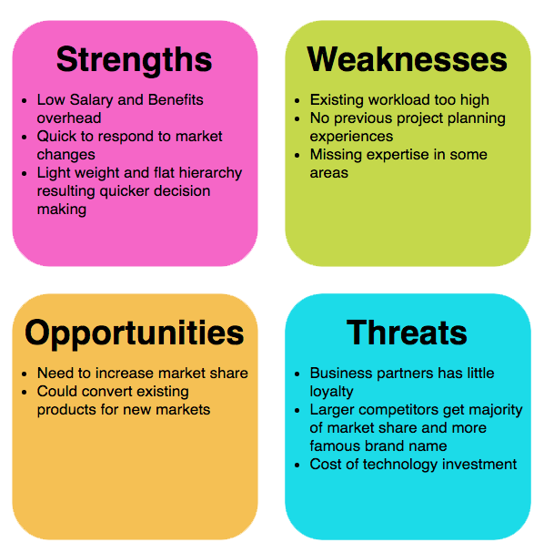
SWOT Analysis
Chapter-3

Slide 33
Marketing Objectives
Chapter-3
Marketing objectives are goals set by business houses to promote its goods and services to its consumers within a specific timeframe. Marketing objectives are the strategy’s set to attain the overall growth of the organization.

Slide 34
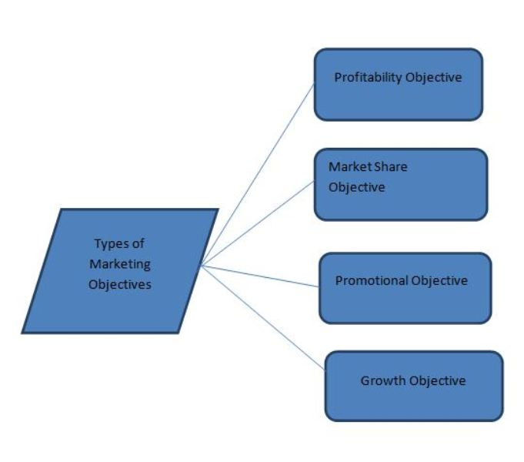
TYPES OF MARKETING OBJECTIVES
Chapter-3

Slide 35
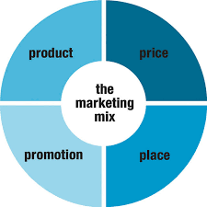
The marketing mix
Chapter-3
The marketing mix is the combination of variables that a business uses to carry out its marketing strategy and meet customer needs.
The marketing mix is often called the 4Ps:
Product
Price
Place
Promotion

Slide 36
The 4 P’s of Marketing explained
Chapter-3
Product | Promotion | Place | Price
Is there a demand for the product or service? How to make the product appeal to consumer Packaging—includes the design, color, size, and brand names | Making customers aware of a product Advertising Coupons Rebates Sales Free give aways Publicity | Distribution is getting the right product to the right place at the right time in the right amount and in the right condition Storage Warehousing Transporting | How much are customers willing to pay? Is the price competitive with other products? Can the company make a profit?

Slide 37
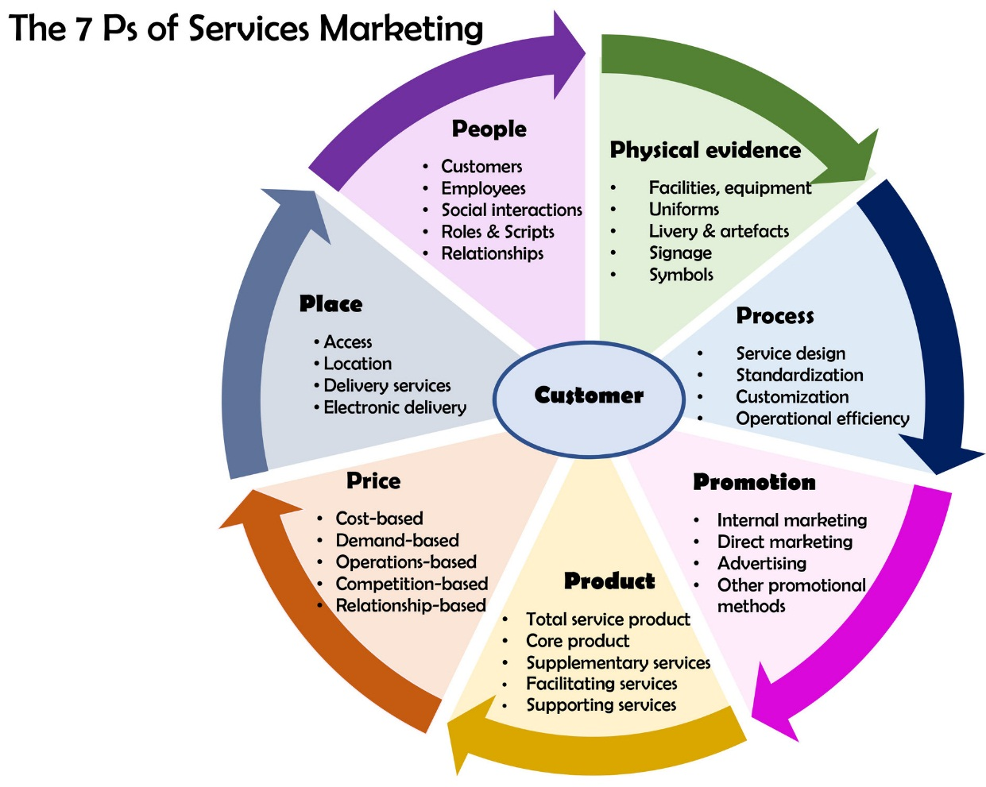
Chapter-3
The 7 P’s of services marketing

