Slide 1


Introduction to
Research Methods
Prepared by Associate Professor/
Ahmed Rageh Ismail
MGM333
Introduction to Research Methods
Lecture 10

Slide 2


Chapter
10
www.midocean.ae

Slide 3
Chapter
Learning Outcomes
10
Discuss the nature of numerical datasets
Explore the appropriateness of statistical analysis
Understand the fundamental principles of data analysis procedures
www.midocean.ae

Slide 4
Chapter
Key Topics
10
Techniques for processing and displaying data
Methods for exploring datasets
Analysis of relationships between datasets
Understanding when and why to perform specific analyses
www.midocean.ae

Slide 5
Chapter
Understanding Variables in Research
10
Types of Variables
Nominal Variables
Ordinal Variables
Interval Variables
Importance
Selecting appropriate variables is crucial for meaningful analysis
www.midocean.ae

Slide 6
Chapter
Nominal Variables
10
Definition
Categorical, qualitative, or discrete data
Categories with no rank order (e.g., eye color, religion)
Key Analytical Processes
Frequency distribution
Chi-square (c²) test
www.midocean.ae

Slide 7
Chapter
Ordinal Variables
10
Definition
Data with inherent logical order or rank
Relative magnitude has meaning (e.g., letter grades, top four favorite genres)
Characteristics
Rank-ordered but no meaningful distance between data points
www.midocean.ae

Slide 8
Chapter
10
Key Analytical Processes
Includes nominal data methods
Mann-Whitney U-test for differences between two groups
Wilcoxon signed-rank test for comparing the same subjects under different conditions
www.midocean.ae

Slide 9
Chapter
Interval Variables
10
Definition
Strongest level of measurement in statistical analysis
Categories can be rank-ordered and intervals have meaningful numerical value
Examples
Age, population size, years in occupation, distance between locations
Characteristics
Quantifiable and open to arithmetic manipulation
Provides specific numerical value, allowing for advanced statistical analysis
www.midocean.ae

Slide 10
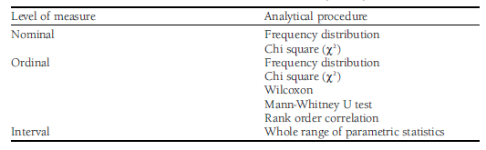

Slide 11
Chapter
Frequency Distribution
10
Importance
First step in analyzing data
Considered the "bedrock" of data analysis
Provides an overview of the dataset
www.midocean.ae

Slide 12
Chapter
Purpose of Frequency Distribution
10
Presents the number of responses to each option in your questions
Essential for giving readers the basic facts before more complex analysis
Misconception
Often seen as merely data processing, but crucial for understanding data and influencing subsequent analysis
www.midocean.ae

Slide 13
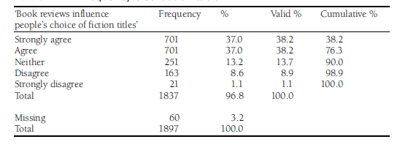

Slide 14
Chapter
Cross-Tabulation
10
A method to explore relationships between two variables
Expands on frequency distribution by showing potential links between variables
Allows you to see if and how two variables might be related
Example: Exploring the relationship between gender and influence of book reviews on fiction title choices
www.midocean.ae

Slide 15
Chapter
Measures of Central Tendency
10
Purpose
Summarize an entire distribution with a single score
Show the grouping of data around a central point
Types
Mean
Median
Mode
www.midocean.ae

Slide 16
Chapter
Mean
10
Definition
Arithmetic average of a dataset
Advantages
Easily understood and calculated
Responsive to all scores equally
Fundamental for further calculations (e.g., standard deviation)
Most stable measure of central tendency
www.midocean.ae

Slide 17

Chapter
10
Disadvantages
Can be misleading with skewed data
Applicable only to interval data
www.midocean.ae

Slide 18
Chapter
Median
10
The mid-point or middle value in a ranked dataset
Calculation involves ordering data and finding the central value
Advantages
Insensitive to extreme scores in skewed distributions
Useful for skewed data as it divides the dataset into two equal parts
www.midocean.ae

Slide 19

Chapter
10
Disadvantages
May not be representative of the entire dataset
Only provides the value of one score
www.midocean.ae

Slide 20
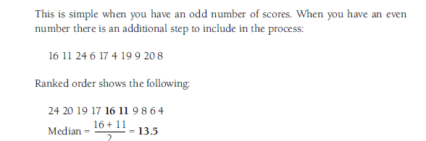

Slide 21
Chapter
Mode
10
Most frequently occurring score in a dataset
Can be used for nominal data
Advantages
Easy to obtain
Unaffected by extreme scores
Represents a ‘typical’ value if most values cluster around the mode
www.midocean.ae

Slide 22
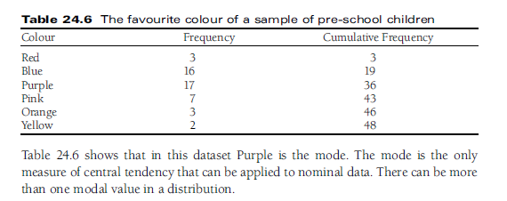

Slide 23
Chapter
10
Disadvantages
Lacks precision compared to other measures
Dataset may have more than one mode (bimodal or multimodal distributions)
Less useful in advanced analysis
www.midocean.ae

Slide 24
Chapter
Measures of Dispersion
10
Provide additional information about the spread of data around a central point
Complement measures of central tendency
Types
Range
Variance
Standard Deviation
www.midocean.ae

Slide 25
Chapter
The Range
10
Definition
Difference between the highest and lowest score in a dataset
Application
Simple measure but only uses two scores
www.midocean.ae

Slide 26
Chapter
The Variance
10
Definition
Measures how each score varies from the mean
Application
Helps in understanding the spread of data points around the mean
www.midocean.ae

Slide 27
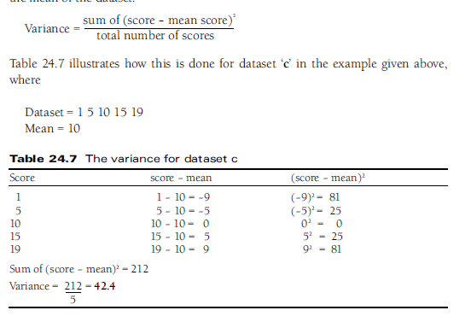

Slide 28
Chapter
Standard Deviation
10
Definition
Most important measure of dispersion
Indicates the spread of scores around the mean in original units
​
Application
Larger standard deviation indicates greater dispersal of scores
Use caution with skewed data as it may give unrepresentative results
www.midocean.ae

Slide 29


Slide 30
Chapter
Correlation
10
Definition
Correlation examines the relationship between two sets of data.
Types of Correlation
Positive Correlation: Both variables increase together.
Negative Correlation: One variable increases while the other decreases.
Zero Correlation: No relationship between the variables.
Correlation indicates a general trend but does not establish a fixed rule or causality.
www.midocean.ae

Slide 31
Chapter
Displaying Data Visually
10
Importance of Visuals
Visual representations help communicate patterns in data effectively.
Commonly used visual tools include bar charts.
Types of Bar Charts
Simple Bar Charts: Display frequencies or percentages for individual categories.
Compound Bar Charts: Compare data from multiple groups within the same category.
Component Bar Charts: Show the breakdown of data within a category.
www.midocean.ae

Slide 32
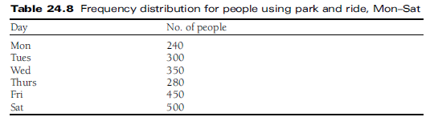

Slide 33
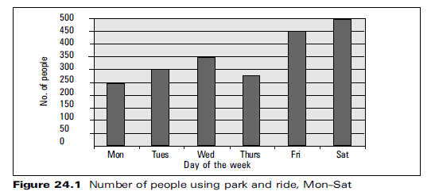

Slide 34
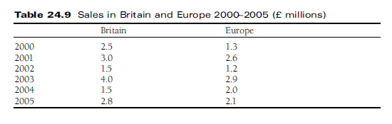

Slide 35
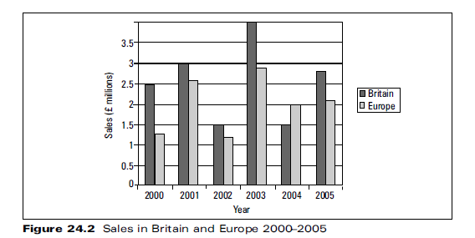

Slide 36
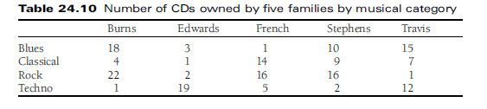

Slide 37
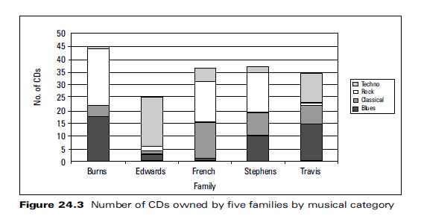

Slide 38
Chapter
Pie Chart
10
Purpose
Show figures in proportion to the whole and in relation to other figures.
Each segment represents a proportion of the total.
Clear visualization of data distribution within a whole.
www.midocean.ae

Slide 39
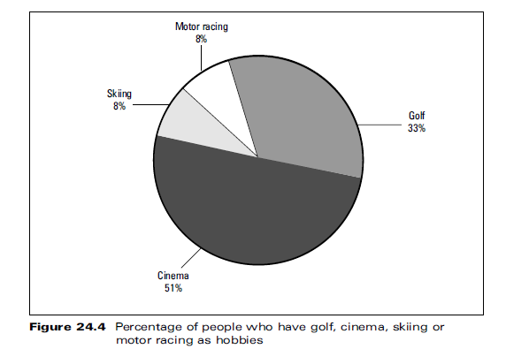

Slide 40
Chapter
Software for Quantitative Analysis
10
Statistical software has revolutionized data analysis by reducing time and human error.
Manual analysis is still taught initially to ensure understanding of data handling before using software.
Software automates analysis, but the researcher must understand which tests to apply and why.
Incorrect application can lead to misleading results.
www.midocean.ae

Slide 41
Chapter
SPSS (Statistical Package for Social Sciences)
10
Launched in 1989, SPSS is a powerful and flexible statistical tool used widely across disciplines.
Parametric and Non-Parametric Tests: Includes regression techniques, linear, non-linear, logistic, etc.
Multivariate Analyses: Cluster, discriminant, principal components, scaling analyses.
Survival Analysis: Cox proportional hazards with or without time-dependent variables.
High-Resolution Graphics: Descriptive charts, scatter plots.
www.midocean.ae

Slide 42



Thank You

