Slide 1

Lecture 6:
Outsourcing
PMG 605
Project Resources and Time Management
Dr. Eng.
Abdullah Jameel Halawany

Slide 2
Session Outline
Outsourcing
Outsourcing Definition
Disadvantages Outsourcing
Partnering Relationships versus Traditional Practices
Best Practices in Outsourcing Project Work
Four Strategies for Communicating with Outsourcers
Request for Proposal (RFP)
Outsourcing Environment
Advantages of Outsourcing

Slide 3

Outsourcing:
Definition
Environment
Advantages
Disadvantages

Slide 4
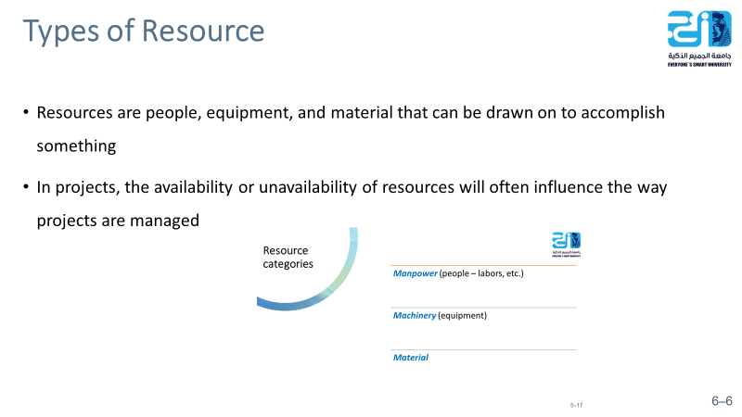
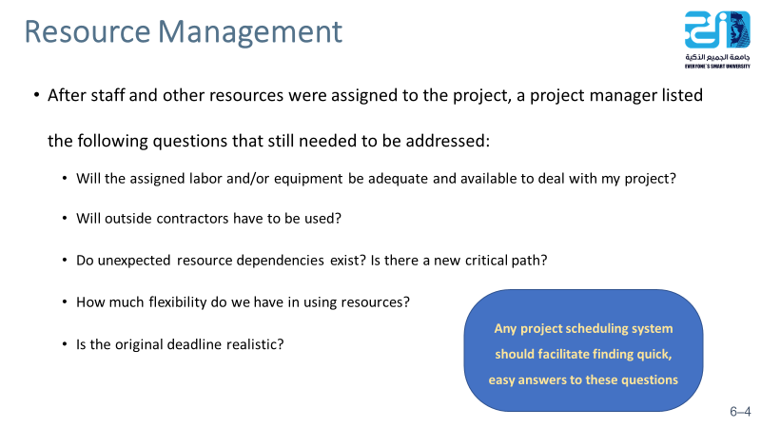
6–4

Slide 5
Outsourcing
The term outsourcing has traditionally been applied to the transferring of business functions or processes (e.g., customer support, IT, accounting) to other, often foreign companies. For example, when you call your Internet provider to solve a technical problem you are likely to talk to a technician in Bangalore, India, or Bucharest, Romania.
Outsourcing is now being applied to contracting significant chunks of project work.
6–5

Slide 6
Outsourcing
It is rare in today’s flat world to find important projects that are being completed totally in-house.
Outsourcing or Contracting significant segments of project work to other companies is commonplace.
Why? Do not have the internal resources to carry on the project.
6–6

Slide 7
Outsourcing
Contracting project work has long been the norm in the construction industry, where firms hire general contractors who, in turn, hire and manage cadres of subcontractors to create new buildings and structures.
For example, the Chunnel project, which created a transportation tunnel between France and England, involved more than 250 organizations.
Contracting is not limited to large projects
The trend for the future suggests that more and more projects will involve working with people from different organizations
6–7

Slide 8
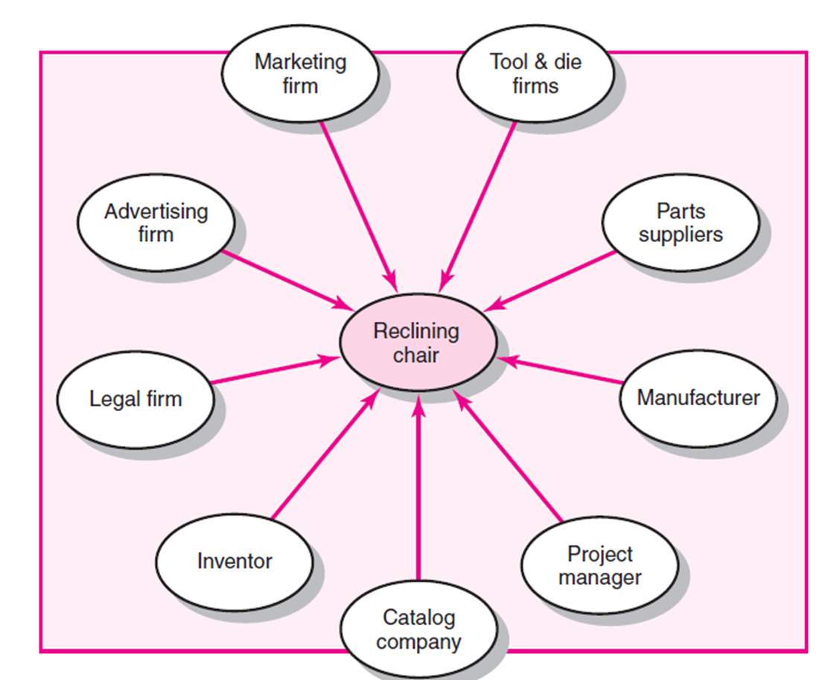
Zero-gravity Reclining Chair Project
6–8

Slide 9
Outsourcing Environment
Many outsourced projects operate in a virtual environment in which people are linked by computers, emails, computer-aided design systems, and video teleconferencing.
They rarely, if ever, see one another face-to-face.
On other projects, participants from different organizations work closely together, for example, at a construction site or in shared office space.
In either case, people come and go as services are needed, they are not formal members of one organization, just technical experts who form a temporary alliance with an organization, fulfill their contractual obligations, and then move on to the next project.
6–9

Slide 10
Advantages of Outsourcing
Cost reduction
Faster project completion
High level of expertise
Flexibility
6–10

Slide 11
Advantages of Outsourcing
1- Cost reduction
Companies can secure competitive prices for contracted services, especially if the work can be outsourced offshore.
Furthermore, overhead costs are dramatically cut since the company no longer has to internally maintain the contracted services.
6–11

Slide 12
Advantages of Outsourcing
2- Faster project completion
Competitive pricing means more resources for the dollar.
For example, you can hire three Indian software engineers for the price of one American software engineer.
Furthermore, outsourcing can provide access to equipment that can accelerate completion of project tasks. For example, by contracting a backhoe operator you are able to accomplish in four hours what it would take a landscaping crew four days to complete.
6–12

Slide 13
Advantages of Outsourcing
3- High level of expertise
A high level of expertise and technology can be brought to bear on the project.
A company no longer has to keep up with technological advances.
Instead, it can focus on developing its core competencies and hire firms with the know-how to work on relevant segments of the project.
6–13

Slide 14
Advantages of Outsourcing
4- Flexibility
Organizations are no longer constrained by their own resources but can pursue a wide range of projects by combining their resources with talents of other companies.
Small companies can instantly go global by working with foreign partners.
6–14

Slide 15
Disadvantages of Outsourcing
Coordination breakdowns
Loss of control
Conflict
Security issues
Political hot potato
6–15

Slide 16
Disadvantages of Outsourcing
1- Coordination breakdowns
Coordination of professionals from different organizations can be challenging, especially if the project work requires close collaboration and mutual adjustment.
Breakdowns are worsened by physical separation with people working in different buildings, different cities, if not different countries.
6–16

Slide 17
Disadvantages of Outsourcing
2- Loss of control
There is potential loss of control over the project.
The core team depends on other organizations that they have no direct authority over.
While long-term survival of participating organizations depends on performance, a project may falter when one partner fails to deliver.
6–17

Slide 18
Disadvantages of Outsourcing
3- Conflict
Projects are more likely to to interpersonal conflict since the different participants do not share the same values, priorities, and culture.
Trust, which is essential to project success, can be difficult to forge when interactions are limited, and people come from different organizations.
6–18

Slide 19
Disadvantages of Outsourcing
4- Security issues
Depending on the nature of the project, trade and business secrets may be revealed.
This can be problematic if the contractor also works for your competitor.
Confidentiality is another concern and companies have to be very careful when outsourcing processes like payroll, medical transcriptions, and insurance information.
6–19

Slide 20
Disadvantages of Outsourcing
5- Political hot potato
Foreign outsourcing of work is perceived as a major cause of underemployment
companies are under increased pressure to keep jobs local.
Few people disagree that reducing costs is the primary motive behind outsourcing project work.
However, there are limits to outsourcing there appears to be a shift away from simply nailing the best low-cost deal to securing services from companies that provide the best value in terms of both cost and performance.
Performance is not limited to simply the quality of specific work but also ability to collaborate and work together. “Can we work with these people?”
6–20

Slide 21

- Partnering Relationships versus Traditional Practices
- Best Practices in Outsourcing Project Work

Slide 22
Key Practices in Partnering Relationships versus Traditional Practices
Partnering Relationships
Mutual trust forms the basis for strong working relationships.
Shared goals and objectives ensure common direction.
Joint project team exists with high level of interaction.
Open communications avoid misdirection and bolster effective working relationships.
Long-term commitment provides the opportunity to attain continuous improvement.
Traditional Practices
Suspicion and distrust; each party is wary of the other.
Each party’s goals and objectives, while similar, are geared to what is best for them.
Independent project teams; teams are spatially separated with managed interactions.
Communications are structured and guarded.
Single project contracting is normal.
TABLE 12.1
6–22

Slide 23
Key Practices in Partnering Relationships versus Traditional Practices (cont’d)
Partnering Relationships
Objective critique is geared to candid assessment of performance.
Access to each other’s organization resources is available.
Total company involvement requires commitment from CEO to team members.
Integration of administrative systems equipment takes place.
Risk is shared jointly among the partners, encouraging innovation and continuous improvement.
Traditional Practices
Objectivity is limited due to fear of reprisal and lack of continuous improvement opportunity.
Access is limited with structured procedures and self-preservation taking priority over total optimization.
Involvement is normally limited to project-level personnel.
Duplication and/or translation takes place with attendant costs and delays.
Risk is transferred to the other party.
TABLE 12.1 (cont’d)
6–23

Slide 24
Best Practices in Outsourcing Project Work
Well-Defined Requirements and Procedures
Extensive Training and Team-Building Activities
Well-Established Conflict Management Processes in Place
Frequent Review and Status Updates
Co-Location When Needed
Fair and Incentive-Laden Contracts
Long-Term Outsourcing Relationships
6–24

Slide 25
Best Practices in Outsourcing Project Work
Well-Defined Requirements and Procedures
Convincing people from different professions, organizations, and cultures to work together is difficult.
If expectations and requirements are fuzzy or open to debate, this is even harder.
work with clearly defined deliverables with measurable outcomes.
For example, the technical requirements are spelled out in detail.
This can be problematic when you have firms with more advanced project management systems working with less developed organizations.
6–25

Slide 26
Best Practices in Outsourcing Project Work
Extensive Training and Team-Building Activities
Smart firms recognize that people issues are as important if not more important, than technical issues.
They train their personnel to work effectively with people from other organizations and countries.
It is not limited to management but involves all the people, at all levels, who interact with and are dependent upon outsourcers.
6–26

Slide 27
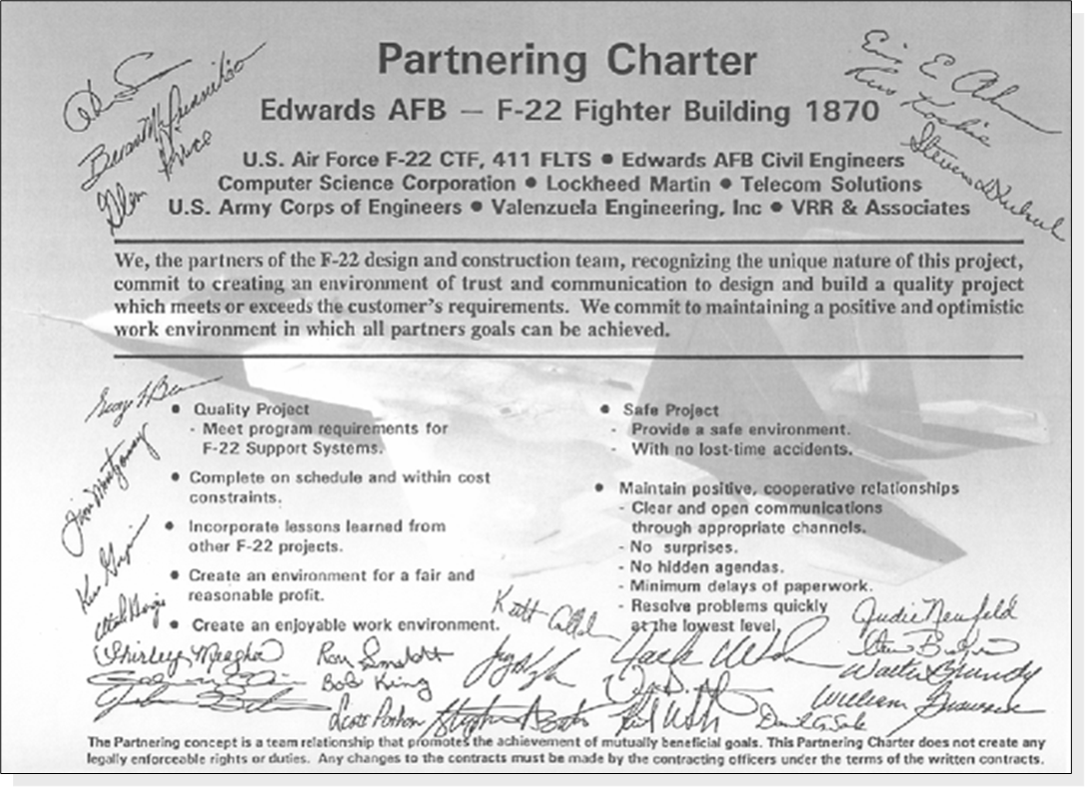
Best Practices in Outsourcing Project Work
Project Partnering Charter
6–27

Slide 28
Best Practices in Outsourcing Project Work
Well-Established Conflict Management Processes in Place
Conflict is inevitable on a project.
Dysfunctional conflict can catch fire and severely undermine project success.
Outsourced projects are susceptible to conflicts since people are unaccustomed to working together and have different values and perspectives.
Successful firms invest significant time and energy up front in establishing the “rules of engagement” so that disagreements are handled constructively.
Escalation is the primary control mechanism for dealing with and resolving problems.
The basic principle is that problems should be resolved at the lowest level within a set time limit (say, 24 hours), or they are “escalated” to the next level of management.
6–28

Slide 29
Best Practices in Outsourcing Project Work
Frequent Review and Status Updates
Project managers and other key personnel from all involved organizations meet on a regular basis to review and assess project performance.
Collaborating as partners is considered a legitimate project priority which is assessed along with time, cost, and performance.
Teamwork, communication, and timely problem resolution are evaluated.
This provides a forum for identifying problems not only with the project but also with working relationships so that they can be resolved quickly and appropriately.
6–29

Slide 30
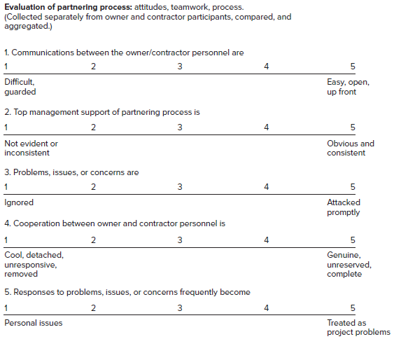
Best Practices in Outsourcing Project Work
Frequent Review and Status Updates
More and more companies are using online surveys to collect data from all project
participants about the quality of working .
With this data one can gauge the “pulse” of the project and identify issues that need to be addressed.
6–30

Slide 31
Best Practices in Outsourcing Project Work
Co-Location When Needed
One of the best ways to overcome interorganizational.
Smart companies rent or make available the necessary accommodations so that all key project personnel can work collectively together.
Experience tells us that co-location is critical and well worth the added expense and inconvenience.
Co-location is less relevant for independent work that does not require ongoing coordination between professionals from different organizations. This would be the case if you are outsourcing discrete, independent deliverables like beta testing or a marketing campaign.
6–31

Slide 32
Best Practices in Outsourcing Project Work
Fair and Incentive-Laden Contracts
When negotiating contracts, the goal is to reach a fair deal for all involved.
Performance-based contracts, in which significant incentives are established based on priorities of the project, are becoming increasingly popular.
For example, if time is critical, then contractors accrue payoffs for beating deadlines; if scope is critical, then bonuses are issued for exceeding performance expectations.
6–32

Slide 33
Best Practices in Outsourcing Project Work
Long-Term Outsourcing Relationships
Major benefits can be enjoyed when outsourcing arrangements extend across multiple projects and are long term.
  Reduced administrative costs—The costs associated with bidding and selecting a contractor are eliminated.
  More efficient utilization of resources—Contractors have a known forecast of work while owners can concentrate their workforce on core businesses and avoid the demanding swings of project support.
  Improved communication—As partners gain experience with each other, they develop a common language and perspective, which reduces misunderstanding and enhances collaboration.
  Improved innovation—The partners can discuss innovation and associated risks in a more open manner and share risks and rewards fairly.
  Improved performance—Over time partners become more familiar with each other’s standards and expectations and can apply lessons learned from previous projects to current projects.
6–33

Slide 34

Strategies for Communicating with Outsourcers
Request for Proposal (RFP)

Slide 35
Four Strategies for Communicating with Outsourcers
Strategy 1: Recognize Cultural Differences
Strategy 2: Choose The Right Words
Strategy 3: Confirm Your Requirements
Strategy 4: Set Deadlines
Not everyone you communicate with shares your assumptions. Especially true with foreign outsourcers.
Language barrier.
Speak in a direct manner using short sentences made of basic, simple words.
Document your requirements.
Insist your outsourcer re-document your requirements.
Request a prototype.
Add a penalty clause to your contract or enforce late fees.
6–35

Slide 36
Request for Proposal (RFP)
The responsible project manager will require input from all stakeholders connected to the activities covered in the RFP.
The RFP will be announced to external contractors/ vendors with adequate experience to implement the project.
For example, government projects frequently advertise with a “request for proposal” to outside contractors for roads, buildings, airports, military hardware, space vehicles.
Similarly, businesses use RFPs to solicit bids for building a clean room, developing a new manufacturing process, delivering software for insurance billing, conducting a market survey.
6–36

Slide 37
Request for Proposal (RFP)
Requirements and features should be in enough detail that contractors have a clear description of the final deliverable that will meet the customer’s needs.
In practice, the most common error is to offer an RFP that lacks sufficient detail.
This lack of detail typically results in conflict issues, misunderstandings, often legal claims between the contractor and owner, and, ultimately, a dissatisfied customer.
All RFPs are different, but the following outline is a good starting point for the development of a detailed RFP.
6–37

Slide 38
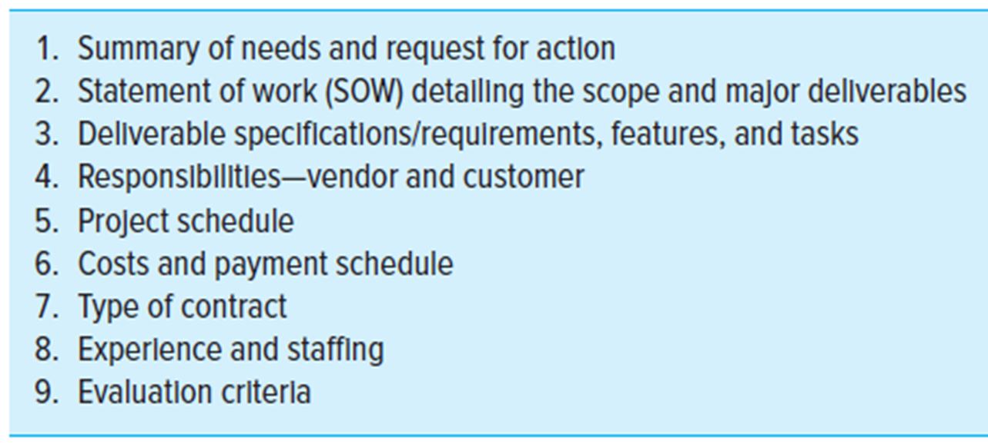
Request for Proposal (RFP)
6–38

Slide 39
Summary of Today Session

Slide 40
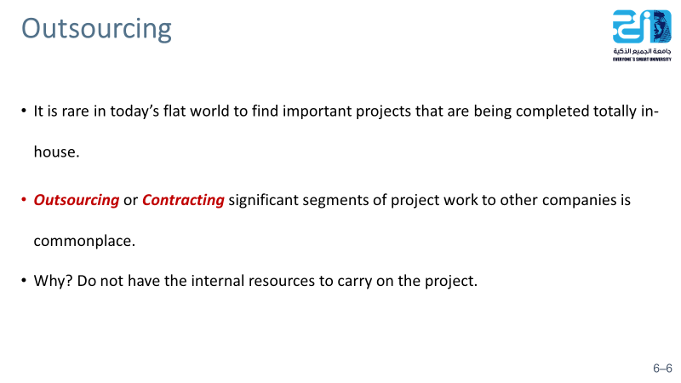
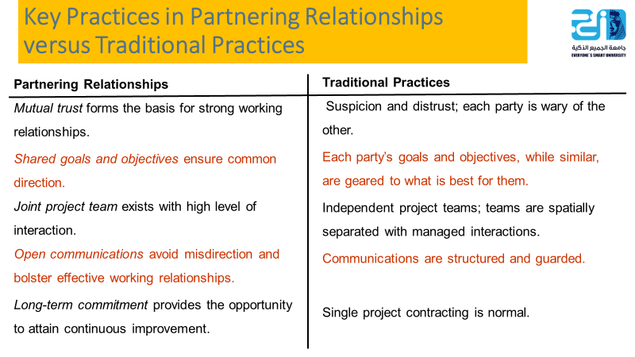
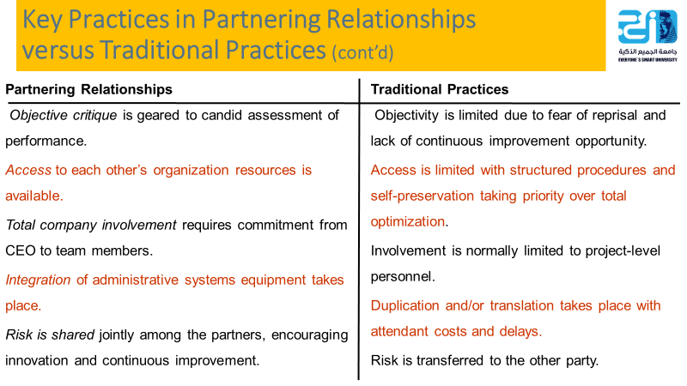
6–40

Slide 41
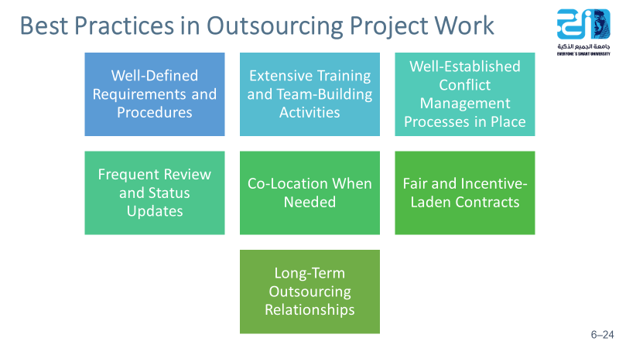
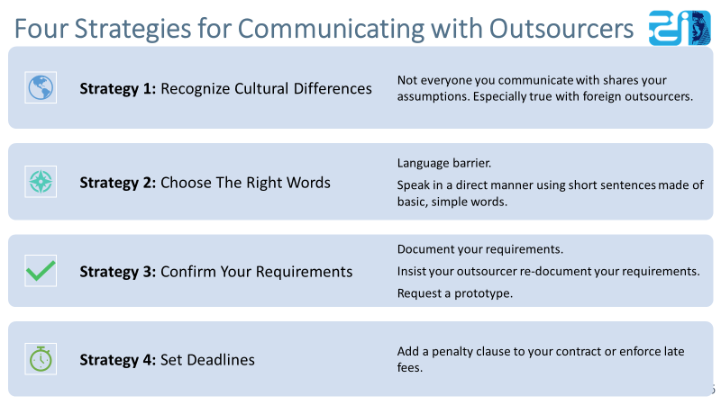
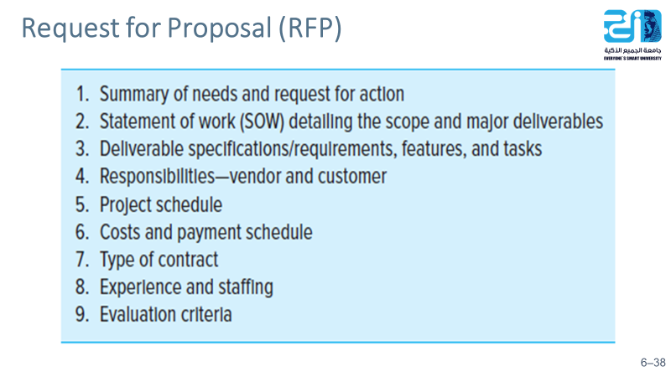
6–41

Slide 42
Resources
Project Management
The Managerial Process
Fifth Edition
By: Erik W. Larson
Oregon State University
Clifford F. Gray
Oregon State University
6–42

