Slide 1


Market Segmentation and Targeting, and Positioning for Competitive Advantage
Prepared by Dr. Magdy Alhaj
MGM612
Marketing Management
Lecture 2

Slide 2



Market Segmentation and Targeting, and Positioning for Competitive Advantage
Lecture 2
Marketing Management
MGM612
Prepared by
Dr. Magdy Al-haj
www.midocean.ae

Slide 3

Learn outcomes
Chapter
8
After studying this chapter, you should be able to:
Explain how companies find and develop new-product ideas
List and define the steps in the new-product development process and the major considerations in managing this process
Describe the stages of the product life cycle
Describe how marketing strategies change during the product’s life cycle
Discuss two additional product and services issues: socially responsible product decisions and international product and services marketing
www.midocean.ae

Slide 4

Learning Outcomes
After studying this chapter you should be able to:
Define and explain market segmentation, target markets, and product differentiation and positioning.
Understand the criteria for Effective Segmentation
Know the role of market segmentation in the development of marketing strategies and programs.
Understand the Positioning for Competitive Advantage
Steps in Segmentation, Targeting, and Positioning
www.midocean.ae

Slide 5
Chapter
Market Segmentation
2
Market Segmentation:
  Divides a market into subsets of prospective customers who behave in the same way, have similar wants, or have similar characteristics that relate to purchase.
Intermarket Segments:
  Well-defined, similar clusters of customers across national boundaries.
www.midocean.ae

Slide 6
Chapter
2
The Importance of Market Segmentation
Markets have a variety of product needs and preferences.
Marketers can better define customer needs.
Decision makers can define objectives and allocate resources more accurately.
www.midocean.ae

Slide 7
Chapter
Top 10 benefits of the Market Segmentation
2
Higher Rate of Success
Increases Profitability
Increases Competitiveness
Retention of Customer
Creates and Provides Market Opportunities
6. Effective Market Campaigning
7.Wise and Efficient Use of Resources.
8. Higher Customer Satisfaction
9.Cost-Efficient
10.Know your Customer Better
www.midocean.ae

Slide 8
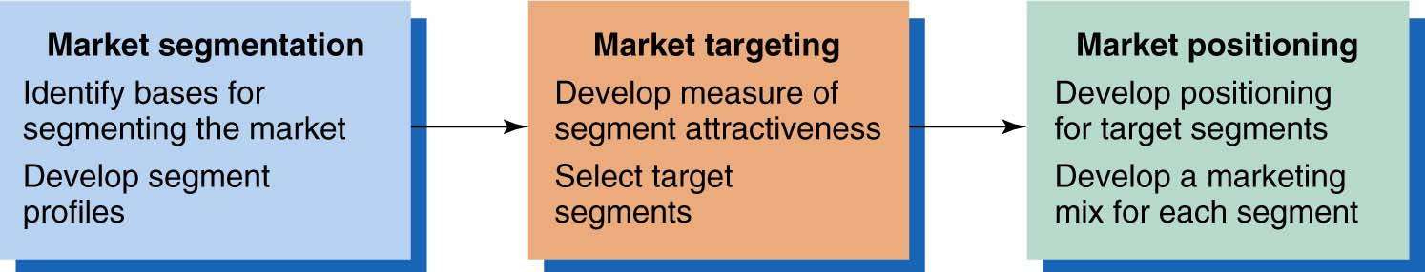
Chapter
2
Steps in Market Segmentation, Targeting, and Positioning
www.midocean.ae

Slide 9
Chapter
Market Segmentation
2
Market Segmentation define:
Dividing Markets into Smaller Segments that Can be Reached More Efficiently And Effectively With Products and Services That Match Their Unique Needs..
www.midocean.ae

Slide 10
Chapter
2
Target Markets
Targeting:
Selecting which segments in a market are appropriate to focus on and designing the means of reaching them.
www.midocean.ae

Slide 11
Chapter
2
Positioning
Positioning:
  Designing a marketing program, including
  the product mix, that is consistent with how
  the company wants its products or
  services to be perceived.
Repositioning:
  When a firm wants to shift consumer
  opinions about an existing brand.
www.midocean.ae

Slide 12

Chapter
Criteria for Effective Segmentation
2
Five Criteria:
  Measurability
  Accessibility
  Sub stantialness
  Durability
  Differential Responsiveness
www.midocean.ae

Slide 13
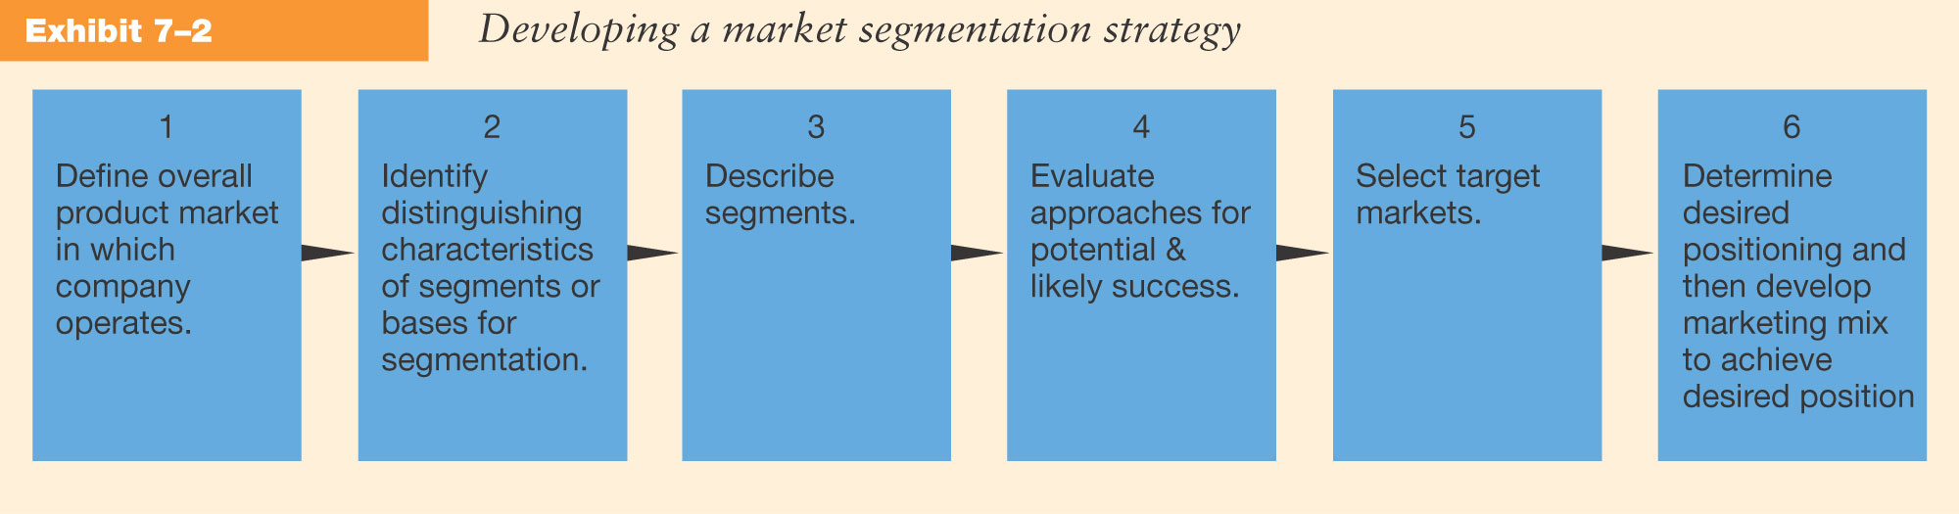
Chapter
2
Stages in Developing Market Segmentation Strategies
www.midocean.ae

Slide 14
Chapter
Bases for Segmentation
2
Demographics
Geographic's
Psychographics & Lifestyles
Benefit Segmentation
Economic Segmentation
International Segmentation
www.midocean.ae

Slide 15
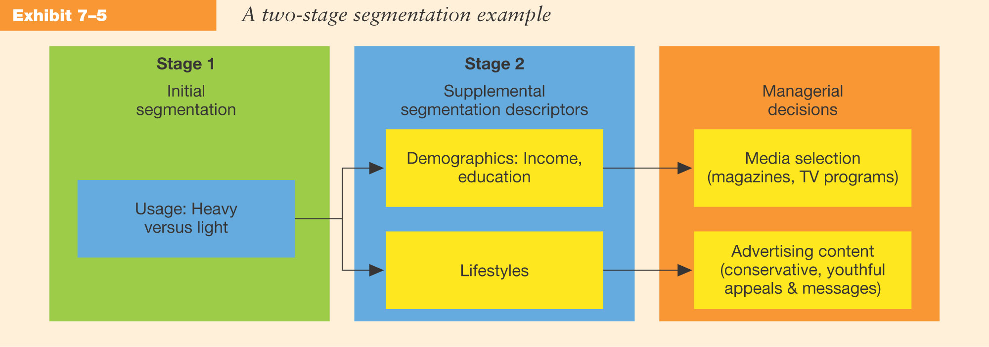
Chapter
2
Combining Bases of Market Segmentation
www.midocean.ae

Slide 16
Chapter
Segmentation Strategies
2
Undifferentiated Strategy
Differentiated Strategy
Concentrated Strategy
www.midocean.ae

Slide 17
Chapter
Factors Influencing Segmentation Strategy
2
Size and type of the market
Competitive factors
Product-related factors:
  Stage in the product life cycle.
  Degree to which the product may be varied or modified.
Firm’s size and financial position
www.midocean.ae

Slide 18
Chapter
2
Estimating Segment Potentials
Set time period of interest.
Define product level.
Specify segment characteristics or bases.
Identify geographic market boundaries.
www.midocean.ae

Slide 19
Chapter
Estimating Segment Potentials.. CONT
2
Make assumptions about the marketing environment.
Make assumptions about company’s own marketing efforts and programs (controllable factors).
Make estimates of market potential, industry sales, and company sales.
www.midocean.ae

Slide 20
Chapter
2
Developing Forecasts
Qualitative Procedures:
  Survey of Buyers’ Intentions
  Expert Opinion
  Composite of Salesforce Estimates
Quantitative Methods:
  Trend Analysis
  Market Tests
  Statistical Demand Analysis
www.midocean.ae

Slide 21
Chapter
2
Targeting Market Segments
To select target segments, the firm must consider:
  The segment’s potential sales volume and profits.
  Competition currently selling to the segments.
  The firm’s abilities and objectives.
www.midocean.ae

Slide 22
Chapter
2
Micromarketing
Micromarketing:
  Combines census and
  Demographic data to identify
  clusters of households
  that share similar
  consumption patterns.
www.midocean.ae

Slide 23
Chapter
2
Micromarketing
Enhances the effectiveness of marketing efforts by:
  Identifying potential markets for direct selling through mail and telemarketing campaigns.
  Profiling customers by matching them to demographic and lifestyle clusters.
  Learning which areas offer the greatest potential in site selection for new stores or offices.
  Tailoring advertising themes and planning media.
www.midocean.ae

Slide 24
Chapter
2
Market Segmentation and Ethics
  Advertising to Children
  Harmful Products
  Privacy Issues
  Product Proliferation
www.midocean.ae

Slide 25
Positioning for Competitive Advantage

Slide 26
Chapter
2
What is Positioning?
A couple of definitions
  Creating distinct and valued physical and perceptual differences between one’s product and its competitors, as perceived by the target customer.
  The act of designing the firm’s market offering so that it occupies a distinct and valued place in the minds of its target customers.
www.midocean.ae

Slide 27
Chapter
Steps in Segmentation, Targeting, and Positioning
2
Target
6. Develop Marketing
Mix for Each Target Segment
Market
Positioning
5. Develop Positioning
for Each Target Segment
4. Select Target
Segment
Market
Targeting
3. Develop Measures
of Segment Attractiveness
2. Develop Profiles
of Resulting Segments
1. Identify Bases
for Segmenting the Market
Market Segmentation
www.midocean.ae

Slide 28
Mass Marketing
Same product to all consumers
(no segmentation)
Mass Marketing
Same product to all consumers
(no segmentation)
Segment Marketing
Different products to one or more segments
(some segmentation)
Chapter
Step 1. Market Segmentation
Levels of Market Segmentation
2
Niche Marketing
Different products to subgroups within segments
( more segmentation)
Micromarketing
Products to suit the tastes of individuals or locations
(complete segmentation)
www.midocean.ae

Slide 29
Chapter
Step 1. Market Segmentation
Bases for Segmenting Consumer Markets
2
Geographic
Nations, states,
regions or cities
Demographic
Age, gender, family size and life cycle, or income
Psychographic
Social class, lifestyle, or personality
Behavioral
Occasions, benefits, uses, or responses
www.midocean.ae

Slide 30
Chapter
2
Step 1. Market Segmentation
Bases for Segmenting Business Markets
Personal
Characteristics
Demographics
Personal
Characteristics
Bases
for Segmenting
Business
Markets
Bases
for Segmenting
Business
Markets
Situational
Factors
Operating
Characteristics
Operating
Characteristics
Purchasing
Approaches
Purchasing
Approaches
www.midocean.ae

Slide 31
Chapter
2
Step 1. Market Segmentation
Bases for Segmenting International Markets
Industrial Markets
Geographic
Economic
Political/
Legal
Cultural
Intermarket
www.midocean.ae

Slide 32
Measurable
Chapter
Step 1. Market Segmentation
Requirements for Effective Segmentation
2
Accessible
Substantial
Size, purchasing power, profiles
of segments can be measured.
Differential
Segments must be effectively
reached and served.
Actionable
Segments must be large or profitable enough to serve.
Actionable
Segments must respond differently to different marketing mix elements & actions.
Must be able to attract and serve the segments.
www.midocean.ae

Slide 33
Chapter
2
Step 2. Market Targeting
Evaluating Market Segments
Segment Size and Growth
  Analyze sales, growth rates and expected profitability.
Segment Structural Attractiveness
  Consider effects of: Competitors, Availability of Substitute Products and, the Power of Buyers & Suppliers.
Company Objectives and Resources
  Company skills & resources relative to the segment(s).
  Look for Competitive Advantages.
www.midocean.ae

Slide 34
Chapter
Step 2. Market Targeting
Market Coverage Strategies
2
Company
Marketing
Mix
Market
Company
Marketing Mix 1
Segment 1
Company
Marketing Mix 2
A. Undifferentiated Marketing
Segment 2
Segment 3
Company
Marketing Mix 3
Segment 1
Company
Marketing
Mix
Segment 2
B. Differentiated Marketing
Segment 3
C. Concentrated Marketing
www.midocean.ae

Slide 35
Chapter
Step 2. Market Targeting
Choosing a Market-Coverage Strategy
2
Company
Resources
Product
Variability
Product’s Stage
in the Product Life Cycle
Market
Variability
Competitors’
Marketing Strategies
www.midocean.ae

Slide 36
Chapter
2
Step 3. Positioning for Competitive Advantage
Product’s Position - the place the product occupies in consumers’ minds relative to competing products; i.e. Volvo positions on “safety”.
Marketers must:
  Plan positions to give products the greatest advantage
  Develop marketing mixes to create planned positions
www.midocean.ae

Slide 37
Chapter
2
Step 3. Positioning for Competitive Advantage: Strategies
Product
Class
Product
Attributes
Away from
Competitors
Benefits
Offered
G
Usage
Occasions
Against a
Competitor
H
C
A
E
D
Users
B
F
www.midocean.ae

Slide 38
Chapter
2
Steps to Choosing and Implementing a Positioning Strategy
Step 1. Identifying a set of possible competitive advantages: Competitive Differentiation.
Step 2. Selecting the right competitive advantage.
Step 3. Effectively communicating and delivering the chosen position to the market.
www.midocean.ae

Slide 39
Chapter
Product
Service
2
Areas for Competitive
Differentiation
Developing Competitive Differentiation
Personnel
Image
www.midocean.ae

Slide 40
Chapter
2
Selecting the Right Competitive Advantages
Important
Profitable
Distinctive
Criteria
for
Determining
Which
Differences
to
Promote
Affordable
Superior
Preemptive
Communicable
www.midocean.ae

Slide 41
Chapter
2
Segmenting Business Markets
Operating Characteristics
Purchasing Approaches
Business Marketers Use Many of the Same Consumer Variables, Plus:
Situational Factors
Personal Characteristics

Slide 42
Segmenting International Markets
Geographic
Location
Factors Used to Segment International Markets
Cultural
Factors
Economic
Factors
Political and Legal Factors
May Also Use Intermarket Segmentation

Slide 43


Thank You

