Slide 1


Introduction to
Research Methods
Prepared by Associate Professor/
Ahmed Rageh Ismail
MGM333
Introduction to Research Methods
Lecture 3

Slide 2

Chapter
Learning Outcomes
3
Differentiate between research aims and objectives, and understand the essential components of writing a comprehensive research proposal.
Understand the transition from theoretical to conceptual frameworks and the role of hypotheses in research design.
Learn how to operationalize concepts into variables and recognize the importance of selecting appropriate variables for research.
www.midocean.ae

Slide 3
Chapter
Learning Outcomes
3
Present and justify methodological choices, including identifying and describing appropriate research instruments for data collection.
Structure of Research Proposal and its essential components.
Recognize the importance of ethical considerations and constraints in research, and develop strategies to address them effectively.
www.midocean.ae

Slide 4
Chapter
Research Aims and Objectives in Qualitative Research
3
Qualitative Research Focus
Investigates phenomena in rich detail.
Exploration, not testing or measuring, is the primary goal.
Rare to test a hypothesis in qualitative research.
Aims to explore a research question deeply.
www.midocean.ae

Slide 5

Chapter
Establishing Aims and Objectives
3
Guiding Questions
Why am I doing this research?
What is the purpose of this research?
What do I hope to learn?
What do I need to know?
Who can provide access to that knowledge?
What will be the likely output?
These questions help frame research aims and objectives.
www.midocean.ae

Slide 6
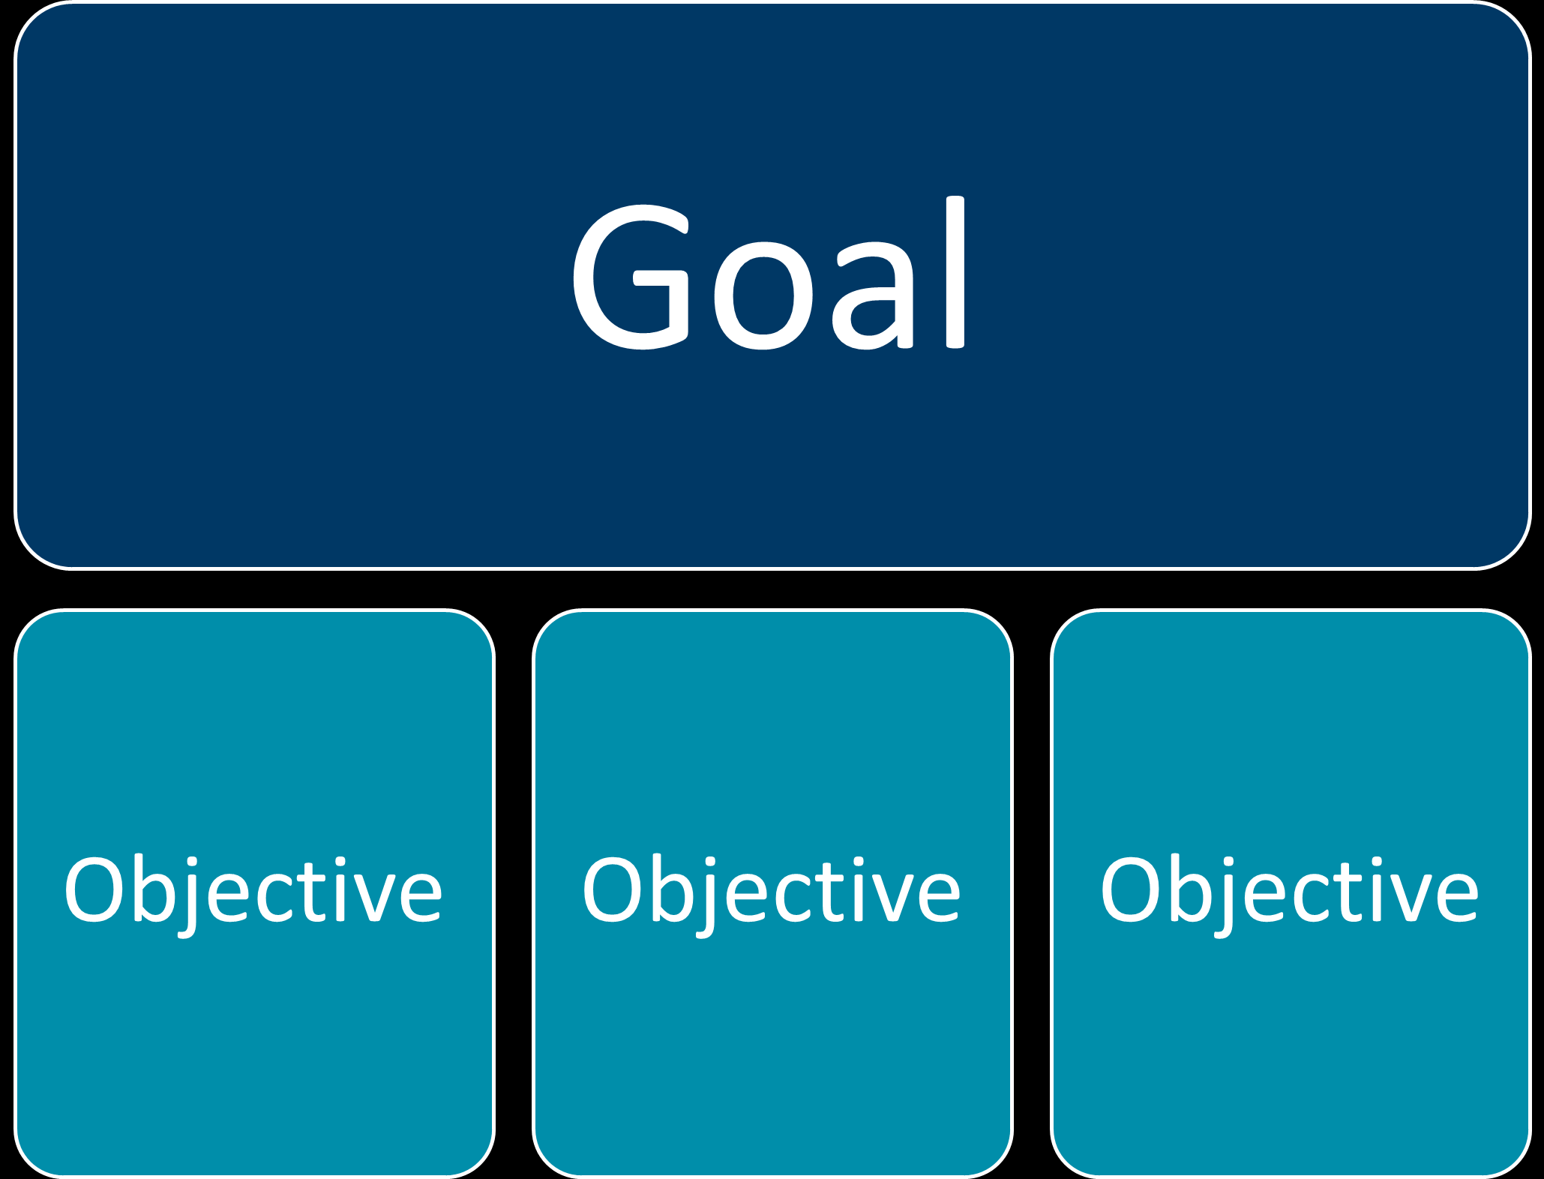
Chapter
Differentiating Aims and Objectives
3
Research Aim
Conceptual level of research.
Overall purpose, not necessarily time-bound.
Answers "What is the purpose of this research?"
Example
Aim: Answer the research question and provide evidence-based guidelines.
www.midocean.ae

Slide 7
Chapter
3
Research Objective
Operational level of research.
Defines how to achieve the aims.
Often begins with a verb (e.g., examine, identify, establish).
Example
Objectives: Examine specific variables, identify key factors, establish relationships.
www.midocean.ae

Slide 8

Chapter
3
Practical Guidance
Objectives are the tasks leading to achieving the aims.
They break down the aim into actionable steps.
www.midocean.ae

Slide 9

Chapter
Introduction to Conceptual Frameworks
3
Constructing a Conceptual Framework
Developed from the literature review.
Essential foundation for both qualitative and quantitative research.
Key Influences in Research Design:
Your own research agenda.
External requirements and constraints.
Available resources.
Personal experience and background in research.
www.midocean.ae

Slide 10
Chapter
Designing a Conceptual Framework
3
Influences on Research Design:
Research question should drive the design of the study.
Methodological Choices:
Determined by the research question and conceptual framework.
Theoretical frameworks guide the focus on specific concepts.
Influenced by researcher’s preferred approach and intended research output.
www.midocean.ae

Slide 11
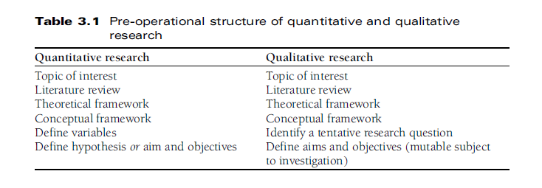

Slide 12
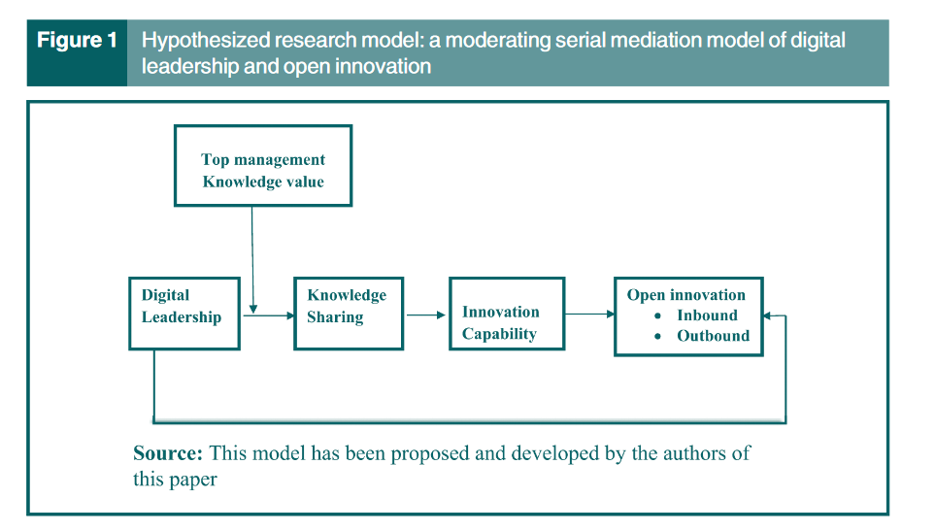

Slide 13
H1 | Digital leadership is positively associated with open innovation
H2 | Digital leadership is positively associated with knowledge sharing
H3 | Digital leadership is positively associated with innovation capability
H4 | Knowledge sharing is positively associated with innovation capability
H5 | Knowledge sharing is positively associated with open innovation

Slide 14
Chapter
The Research Hypothesis in Quantitative Research
3
Hypothesis Testing in Research
Primarily used in quantitative or positivist research.
In qualitative or interpretivist research, hypotheses may emerge during the study but are not central to the research design.
www.midocean.ae

Slide 15
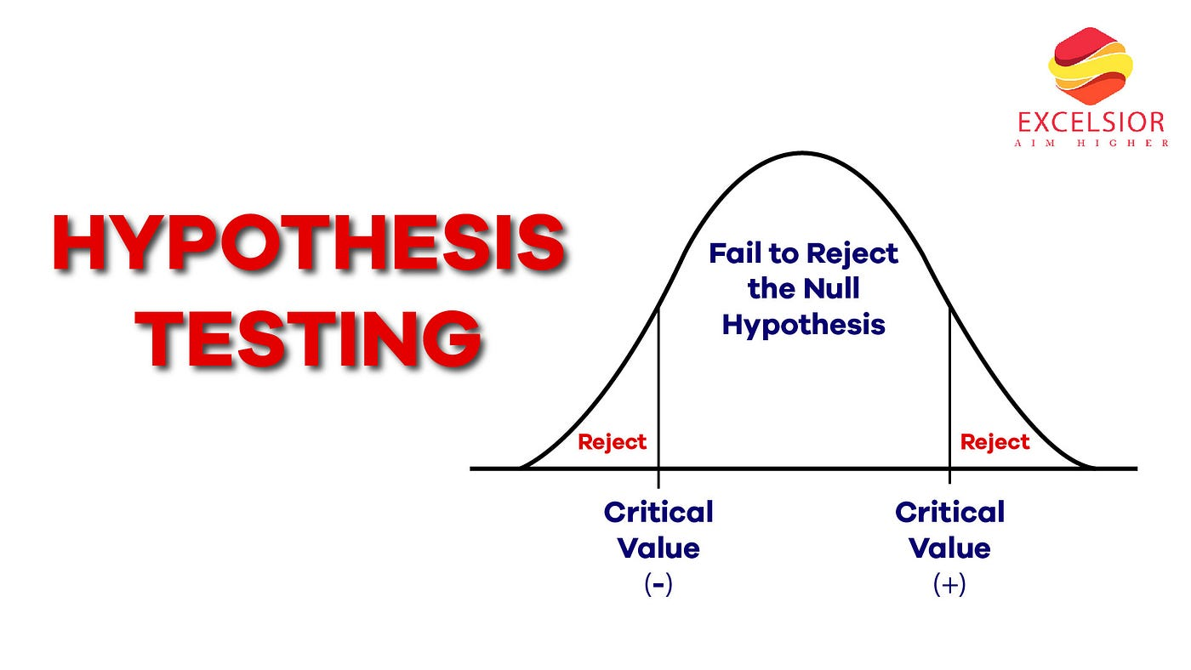
Chapter
3
Role of Hypotheses
Essential for statistical inference in quantitative research.
Hypothesis testing investigates relationships between variables.
Hypothesis: A 'scientific guess' about the relationship, based on the theoretical framework.
www.midocean.ae

Slide 16
Chapter
3
Popper's View on Hypotheses
Hypotheses arise from researchers' interests and theoretical knowledge.
Proving a hypothesis is nearly impossible in social research.
More valuable to falsify a hypothesis, as falsification is definitive.
www.midocean.ae

Slide 17
Chapter
Challenges and Considerations in Hypothesis Testing
3
Proving relationships between variables is difficult in social research.
Experimental research provides the closest approach but still has limitations.
According to Schwartz and Ogilvy (1979), it is impossible to separate a subject from its environment.
Heisenberg Indeterminacy Principle: Experimentation itself affects the subject being studied.
Data from empirical investigations may be influenced by the research process. Hypothesis testing must consider these influences to make realistic claims.
www.midocean.ae

Slide 18

Chapter
Steps and Criteria for Effective Hypothesis Testing
3
Burns' Steps for Scientific Discovery
Propose a hypothesis to explain a phenomenon.
Deduce expected observations from the hypothesis.
Check the deduction through observation.
www.midocean.ae

Slide 19
Chapter
3
Criteria for a Testable Hypothesis
Must imply a relationship between two or more concepts.
Should be less abstract and more specific than the theory.
Must be transformable into testable, empirical terms.
www.midocean.ae

Slide 20
Chapter
Identifying and Defining Variables
3
From Theoretical to Operational
Identify concepts from the theoretical framework.
Translate these concepts into operational variables.
“A variable is an operationalized concept” (Corbetta, 2003, 68).
www.midocean.ae

Slide 21
Chapter
3
Constructing Your Hypothesis
Start with a research question and list of potential variables.
Determine potential relationships between variables.
Consider practical limitations and resources available.
www.midocean.ae

Slide 22
Chapter
Types of Variables and Hypothesis Testing
3
Nominal Variables: Classified by categories (e.g., gender, color).
Ordinal Variables: Order of data points can be determined (e.g., education level, social background).
Interval Variables: Order and distance between data points can be determined (e.g., percentage scores).
www.midocean.ae

Slide 23
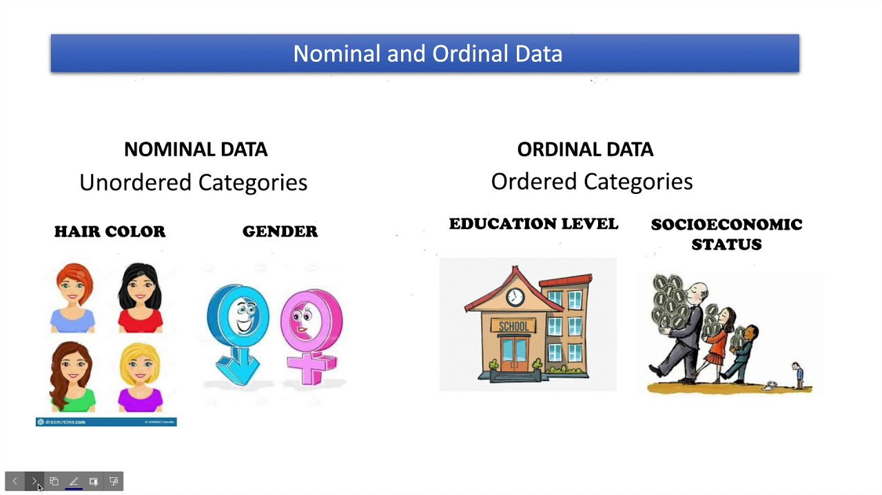

Slide 24


Slide 25
Chapter
3
Implications for Research
Choice of variables influences data collection and analysis.
Avoid selecting variables that do not lend themselves to practical data collection.
www.midocean.ae

Slide 26
Chapter
Why Writing Academic Research Proposals
3
Necessary for dissertations and academic projects.
May be part of a taught course or dissertation module.
General elements of a research proposal:
What needs to be said?
Why it needs to be said?
How to best say it?
www.midocean.ae

Slide 27
Chapter
Structure of a Research Proposal
3
Formal Document
A research proposal follows a specific format or formula.
This formula ensures that all necessary areas are covered.
Consistency Across Requirements
Although different funding bodies or academic institutions may have slightly different requirements, there is a generally accepted list of contents.
Pay close attention to specific instructions from your target audience (e.g., funding bodies, academic supervisors, line managers).
www.midocean.ae

Slide 28
Chapter
3
Word Count and Character Limits
Research proposals often have strict word or character limits for each section.
Ensure that you can effectively communicate your ideas within these limits.
www.midocean.ae

Slide 29

Chapter
Essential Components of a Research Proposal
3
Title and Introduction
Clearly defined and concise.
Sets the stage for your proposed research.
Aims and Objectives or Hypothesis
Clearly state the research aims and objectives.
Alternatively, present a hypothesis to be tested.
www.midocean.ae

Slide 30
Chapter
3
Literature Review
Review of existing literature relevant to your research.
Establishes the context and significance of your study.
Research Design
Detailed description of the methodology.
Explains how the research will be conducted.
www.midocean.ae

Slide 31
Chapter
3
Intended Sample
Description of the sample population.
Justification for sample selection.
Data Processing and Analysis Procedures
List of procedures for data collection and analysis.
Ensures transparency and replicability.
Anticipated Research Outputs
Definition of expected results and contributions to the field.
www.midocean.ae

Slide 32
Chapter
3
Anticipated Constraints
Statement of potential limitations and challenges.
Strategies for addressing these constraints.
Ethical Considerations
Discussion of ethical issues and how they will be handled.
Project Timetable
Detailed schedule of the research timeline.
Helps in planning and managing the research process.
www.midocean.ae

Slide 33
Chapter
Clearly Defined Title and Introduction
3
Importance of a Clear Title
First Impression: The title is the first element reviewed.
Accuracy and Clarity: Must reflect the essence of the proposed research.
Conciseness: Keep it brief but descriptive.
Working Title: It can evolve as the research progresses, but clarity is essential from the start.
www.midocean.ae

Slide 34
Chapter
3
Crafting the Introduction
Brief Rationale
Explain the origin of the research idea. Provide initial evidence from the literature indicating a need for the investigation.
Setting the Scene
Give a short background that explains the context of the research. Highlight the potential contribution to the existing body of knowledge.
Contribution to Knowledge
Emphasize how the research will add to existing knowledge. Acknowledge that most contributions are incremental but valuable.
www.midocean.ae

Slide 35
Chapter
Statement of Aims and Objectives, or a Hypothesis
3
Clearly state what you intend to achieve with your research.
Reflect your understanding of the problem or question.
Clearly state the hypothesis or hypotheses you intend to test.
Ensure that your aims, objectives, or hypotheses are realistic and achievable.
www.midocean.ae

Slide 36
Chapter
Review of the literature
3
Acquaint yourself with current thinking in your subject area.
Understand methods and research processes used by others.
Nobody expects you to know everything published on your topic.
Provide a broad overview of the topic area.
Identify major theories and prominent researchers in the field.
Highlight what is already known.
Identify gaps or neglected areas in empirical research.
www.midocean.ae

Slide 37
Chapter
Content and Focus of the Literature Review
3
Review contents depend on your research topic.
Extensive literature may exist, or the topic may be less explored.
Undergraduate research is likely not completely new.
Doctoral research requires an element of novelty and contribution to knowledge.
Small-scale studies focus on the local setting and current thinking on a phenomenon.
www.midocean.ae

Slide 38

Chapter
Key Themes and Structure of the Literature Review
3
Provide an overview of current thinking.
Describe how theories have evolved.
Highlight significant published studies.
Identify unresolved issues and gaps in the literature.
Follow the conventions of a detailed literature review.
Ensure your review is clear, concise, and shows your understanding of the field.
www.midocean.ae

Slide 39
Chapter
Research Design Overview
3
Present the major processes and procedures for your research.
Applicable to both quantitative and qualitative designs.
Begin with a broad design but remain responsive to field discoveries.
Explain and justify your choices using appropriate research methods literature.
Reference your sources to demonstrate understanding and background reading.
www.midocean.ae

Slide 40
Chapter
Structured Approach to Research Design
3
Hierarchy of Research Design
Methodology
Broad approach guiding the research (e.g., qualitative, quantitative, mixed methods).
Methods
Specific strategies or techniques used to gather data (e.g., surveys, interviews, experiments).
Data Collection Techniques
Tools and procedures for gathering data (e.g., questionnaires, observation protocols).
www.midocean.ae

Slide 41
Chapter
Referencing and Justification
3
Reference Your Sources
Not as extensive as the literature review but necessary.
Show you have read and understood the relevant methodology literature.
Justify Your Research Design
Every choice must be supported by published research.
Ensure your plan is robust and credible.
www.midocean.ae

Slide 42
Chapter
Methodology
3
Begin by stating your methodological position; the questions you should be answering are:
Is this study qualitative, quantitative or mixed methodology?
Why have you made this decision?
Why is this the most appropriate decision?
What are your research methods?
www.midocean.ae

Slide 43
Chapter
3
Once you have discussed your methodological choices you can then go on to state which research method(s) you will be applying to this investigation. The questions you should be answering are:
What research method(s) are you applying to the study?
Why have you made this choice?
How do you intend to structure the method(s) for your investigation?
www.midocean.ae

Slide 44
Chapter
Data collection techniques
3
Defining your method(s) may well imply you will use a particular data collection technique but, whether this is the case or not, it is necessary to explain how you intend to collect the data you need for your investigation. The questions you should be answering here are:
What data collection techniques will you be using?
Why have you decided to use these techniques?
www.midocean.ae

Slide 45
Chapter
Research Instruments
3
Research instruments are tools used for data collection.
They ensure the effective application of your chosen techniques.
Types of Research Instruments
Questionnaires: Pencil and paper or online.
Explain how they will be distributed and collected.
Interviews: Formal interview schedule or open-ended interviews.
In open-ended interviews, the researcher becomes the primary instrument.
www.midocean.ae

Slide 46
Chapter
Justifying Your Choices
3
Ensure your instrument choices are directly related to your research question.
Clearly explain why these instruments are suitable.
Demonstrate understanding of your choices and their implications.
Back up your choices with relevant research literature.
Show thorough understanding of the instruments and their application.
www.midocean.ae

Slide 47
Chapter
Procedures for Data Processing and Analysis
3
Explain how data processing and analysis will be conducted.
Relate procedures directly to the type of data collected.
Specify statistical tests to be performed (t-test, regression analysis etc).
Highlight major variables and how they will be tested.
Acknowledge the complexity of analyzing descriptive data.
Mention specific qualitative analysis methods (e.g., thematic analysis, coding).
www.midocean.ae

Slide 48

Chapter
Tools and Software for Analysis
3
Discuss any software planned for use (e.g., SPSS for quantitative, NVivo for qualitative).
Explain why the chosen software is appropriate for your analysis.
Show a clear understanding of data processing techniques.
Justify your choices with references to relevant literature.
www.midocean.ae

Slide 49
Chapter
Anticipated Research Outputs
3
Often overlooked by students who see research as just an academic exercise.
Good research makes a contribution, no matter how small.
Clearly state the potential contribution in your proposal.
Highlight what you realistically hope to achieve.
Ensure honesty in stating your expected outcomes.
Outputs should directly relate back to the research aims.
Clarify intended outputs by referring to the original research purpose.
www.midocean.ae

Slide 50
Chapter
Anticipated constraints
3
All research is restricted to some degree by constraints, and these constraints fall into two major categories: limitations of the study based on design, and potential problems relating to logistics.
It is important to state any potential constraints in the proposal;
it is highly likely that other things may occur during the course of your investigation but at this stage it is still possible to highlight constraints that you know will in some way impact on the overall output of the investigation
www.midocean.ae

Slide 51
Chapter
Limitations Based on Design
3
Common Limitations
Sample size may be smaller than ideal.
Research method may not be perfect but is the best under the circumstances.
Impact on Data
Explain why limitations exist.
Discuss the potential impact on data collection and analysis.
Show awareness of these limitations.
Plan to address and adapt to these constraints during the research process.
www.midocean.ae

Slide 52
Chapter
Problems relating to logistics
3
Problems with the research design are related to the actual logistics of the research.
It may not be possible to foresee every problem at this stage but you need to highlight the obvious ones and suggest possible ways of minimizing the impact they will have.
Usually problems relate to difficulties in contacting research participants, gaining access to data and the quantity of data that is collected
www.midocean.ae

Slide 53
Chapter
Ethical Considerations
3
Essential for all research involving human participants.
Ensures the rights and well-being of participants are protected.
Universities and organizations have specific ethics policies.
Understand and adhere to these regulations.
Demonstrate awareness of relevant ethical standards.
Show that your study is designed to conform to these standards.
www.midocean.ae

Slide 54
Chapter
Project Timetable
3
Creating an Effective Timetable
Provide a clear, organized schedule of work.
Include all key elements and phases of the research.
Realism and Practicality
Schedule activities realistically to avoid overestimating capabilities.
Ensure all critical milestones are highlighted.
www.midocean.ae

Slide 55

Chapter
3
Benefits
Helps manage time effectively.
Provides a clear roadmap for the research process.
Ensures all tasks are completed within the proposed timeline.
www.midocean.ae

Slide 56



Thank You

