Slide 1


Descriptive Statistics and Data Analysis
Prepared by Dr. Mohamed Sleem
Subject code : FNT 631
Data Analysis
Lecture 3

Slide 2



Descriptive Statistics and Data Analysis
Lecture 3
Subject code : FNT 631
Data Analysis
Prepared by
Dr. Mohamed Sleem

Slide 3

Introduction to Descriptive Statistics and Data Analysis
Chapter
01

Slide 4
Answer Chapter 2 Revision Questions
Compare and contrast three different data visualization programs, highlighting their key features and capabilities.
1. Tableau:
- User-Friendly Interface: Easy to learn and use without extensive programming knowledge.
- Data Integration: Connects to various data sources like databases, Excel, and cloud data.
- Real-Time Data Updates: Automatically updates data from multiple sources.
- Advanced Analytics: Supports predictive analytics, statistical analysis, and forecasting.
- Interactive Dashboards: Create and share interactive visualizations easily.
- Security: Offers advanced security features to protect sensitive data.
2. Microsoft Power BI:
- Integration with Microsoft Ecosystem: Integrates smoothly with other Microsoft products like Excel, Azure, and SharePoint.
- Ease of Use: Intuitive and easy-to-navigate interface with drag-and-drop functionality.
- Real-Time Data Access: Provides real-time dashboards and automatic data refreshes.
- Advanced Data Modeling: Uses powerful DAX language for complex calculations and built-in Power Query for data transformation.
- Interactive Visualizations: Dynamic visuals with drill-through capabilities.
3. Google Data Studio:
- Free to Use: Completely free with a Google account.
- Google Ecosystem Integration: Seamlessly integrates with Google Analytics, Google Ads, and BigQuery.
- Customizable Reports: Highly customizable and visually appealing reports and dashboards.
- Real-Time Data: Offers real-time data updates and live data connections.
- Collaboration: Features easy sharing and collaboration.

Slide 5
Answer Chapter 2 Revision Questions
2. Question: What are the four main strategies of data analysis and briefly explain each?
Answer:
Descriptive Analysis: Summarizes data to show patterns.
Diagnostic Analysis: Explains why something happened.
Predictive Analysis: Predicts future trends based on data.
Prescriptive Analysis: Suggests actions to achieve desired outcomes.
3. Question: Outline the steps involved in the data visualization process.
Answer:
Data Collection: Gather relevant data from various sources.
Data Preparation: Clean and preprocess the data to ensure accuracy and consistency.
Data Analysis: Explore the dataset to identify patterns, trends, and relationships using statistical methods and visualization techniques.
Visualization Design: Select appropriate visualization types based on the data characteristics and analysis goals.
Visualization Creation: Create visualizations using data visualization tools or programming languages.
Interpretation: Interpret the visualizations to extract meaningful insights and actionable recommendations.
Communication: Present the visualizations and findings to stakeholders through reports, dashboards, presentations, or interactive tools, ensuring clear and effective communication of insights.

Slide 6
Chapter’s Objectives
Chapter
03
Understand the concept and importance of descriptive statistics in data analysis.
Identify key descriptive statistical measures and their role in summarizing datasets.
Explore real-life applications of descriptive statistics in business, healthcare, and education.
Integrate descriptive statistics into the broader data analysis process to make informed decisions.

Slide 7
Introduction to Descriptive Statistics and Data Analysis
Chapter
Descriptive statistics serve as fundamental tools in analyzing and interpreting data.
2. They play a crucial role in various fields, including business, healthcare, and social sciences.
3. Descriptive statistics help in summarizing and presenting data in a meaningful way.

Slide 8
Chapter
Introduction to Descriptive Statistics and Data Analysis
4. Understanding descriptive statistics is essential for making informed decisions based on data.
5. This presentation will explore the significance of descriptive statistics and their relationship with data analysis across different sectors.

Slide 9
What are Descriptive Statistics?
Definition: Descriptive statistics are numerical and graphical techniques used to summarize and describe the main features of a dataset.
  Descriptive statistics provide concise summaries about the characteristics of data samples.

Slide 10
What are Descriptive Statistics?
Examples:
  Mean: The average value of a dataset.
  Median: The middle value of a dataset when arranged in ascending order.
  Mode: The value that appears most frequently in a dataset.
  Standard Deviation: A measure of the dispersion or spread of data around the mean.
  Range: The difference between the maximum and minimum values in a dataset.

Slide 11
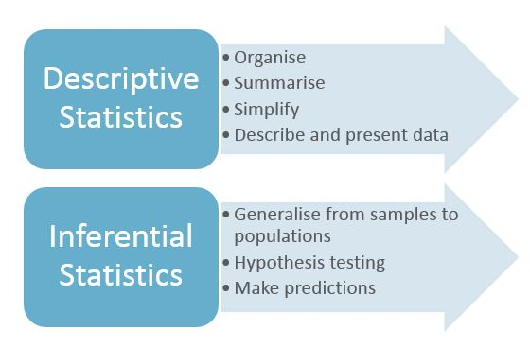
What are Descriptive Statistics?

Slide 12
Types of Data Visualizations:
Visual Tools: Descriptive statistics are often represented visually through graphs, charts, and tables.
  Graphs: Histograms, bar charts, pie charts, box plots, and scatter plots are commonly used to visually represent descriptive statistics.
  Charts and Tables: Tables can provide a detailed breakdown of descriptive statistics, while charts offer visual representations for easier interpretation.

Slide 13
Descriptive Statistics in FinTech
Trend Identification:
  Example: Using moving averages in algorithmic trading to identify long-term market trends and make informed trading decisions.
Credit Risk Assessment:
  Example: Calculating the average credit score to determine the creditworthiness of borrowers, minimizing the risk of defaults.
Performance Benchmarking:
  Example: Comparing the average return of a fintech product to market indices like the S&P 500 to gauge performance.
Portfolio Risk Management:
  Example: Analyzing the standard deviation of returns in a portfolio to understand the average risk level and adjust asset allocation accordingly.
Customer Segmentation:
  Example: Using mean and median income levels to segment customers for targeted financial products and services, improving marketing efficiency.

Slide 14

Key Descriptive Statistical Measures:
Central Tendency:
Mean (μ): The mean, also known as the average, is the sum of all values divided by the number of values.
Example in FinTech:
Algorithmic Trading:
Application: Mean is used to calculate the average price of a stock over a specific period.
Example: For stock prices over five days: $100, $105, $102, $108, $110, the mean price is: Mean= {100 + 105 + 102 + 108 + 110}/5 = 105Mean=5100+105+102+108+110​=105
Importance: This average helps in identifying trends and making buy/sell decisions.
Example in FinTech:
Algorithmic Trading:
  Application: Mean is used to calculate the average price of a stock over a specific period.
  Example: For stock prices over five days: $100, $105, $102, $108, $110, the mean price is: Mean=100+105+102+108+1105=105\text{Mean} = \frac{100 + 105 + 102 + 108 + 110}{5} = 105Mean=5100+105+102+108+110​=105
  Importance: This average helps in identifying trends and making buy/sell decisions.

Slide 15
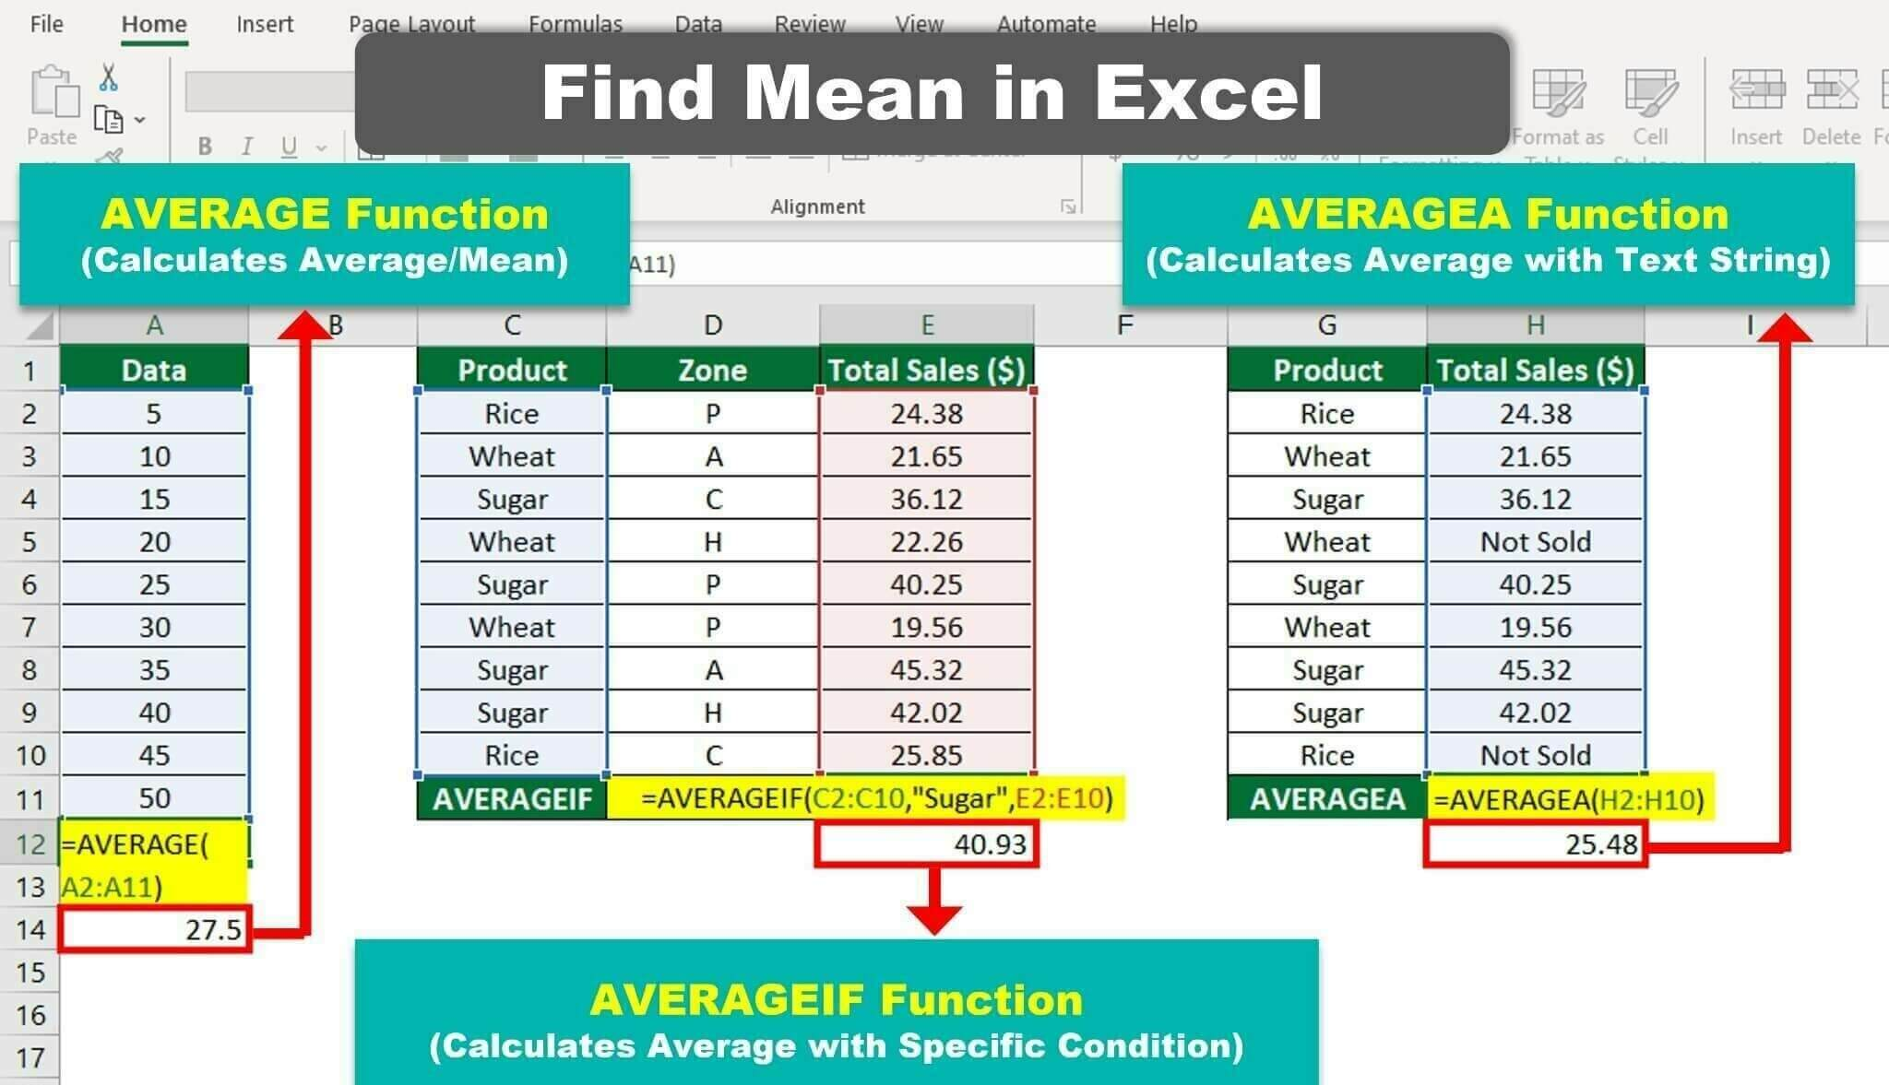
Central Tendency:

Slide 16
Key Descriptive Statistical Measures:
Central Tendency:
Median: The middle value of a dataset when arranged in ascending order.
  Less Sensitive to Outliers: Unlike the mean, the median is not affected by extreme values.
  Realistic Data Representation: Provides a better central tendency measure for skewed distributions.
Example in Finance:
Income Analysis:
  Scenario: A financial firm analyzes client incomes.
  Data: $30,000, $40,000, $50,000, $60,000, $100,000.
  Calculation: Arranged incomes: $30,000, $40,000, $50,000, $60,000, $100,000.
    Median: $50,000.
  Explanation: The median income ($50,000) provides a more accurate picture of a typical client’s income than the mean, which could be skewed by the high $100,000 value.

Slide 17
Central Tendency:
Median:
Real-Life Application:
- In Banking: Identifying the median credit score of loan applicants helps banks understand the creditworthiness profile of their typical client base.
- In Banking: Finding the median loan amount requested by customers provides a better representation of the typical loan demand compared to the mean, especially in cases where there are a few extremely large loan requests.

Slide 18
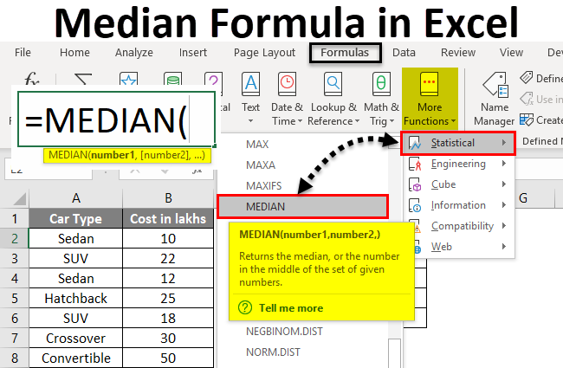
Key Descriptive Statistical Measures:

Slide 19
Key Descriptive Statistical Measures:
Central Tendency:
Mode: The value that appears most frequently in a dataset.
Identifies Common Data Points: Highlights the most frequent occurrences in the dataset.
Useful for Categorical Data: Especially valuable for identifying the most common category.
Example in Finance:
Customer Transaction Analysis:
Scenario: A fintech company analyzes transaction types. Data: "Deposit", "Withdrawal", "Deposit", "Transfer", "Deposit". Calculation: The most frequent transaction type is "Deposit". Explanation: Knowing that "Deposit" is the mode helps the company focus on enhancing deposit-related services and promotions.

Slide 20
Central Tendency:
Mode:
Real-Life Application:
- In Marketing: Identifying the most frequently purchased product in a store helps retailers understand consumer preferences and optimize inventory management.
- In Transportation: Determining the most common mode of transportation used by commuters in a city aids urban planners in improving transportation infrastructure.

Slide 21
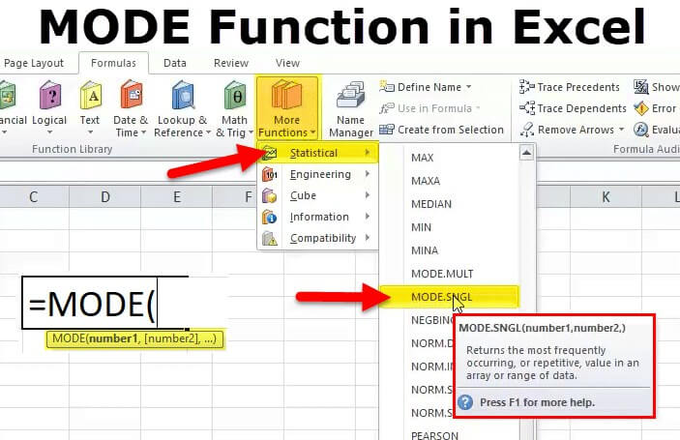
Key Descriptive Statistical Measures:

Slide 22
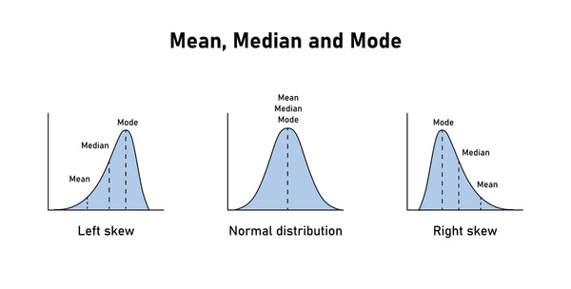
Key Descriptive Statistical Measures:
Central Tendency:

Slide 23
Key Descriptive Statistical Measures:
Measures of Dispersion:
-Range: The difference between the maximum and minimum values in a dataset.
-Variance (σ²): The average of the squared differences from the mean.
-Standard Deviation (σ): The square root of the variance.

Slide 24
Key Descriptive Statistical Measures:
Dispersion:
Dispersion: Real Applications
Range:
Real-Life Application:
In Weather Forecasting: Calculating the range of temperatures within a day helps meteorologists understand the variation in weather conditions and predict temperature fluctuations.
In Sports Analytics: Determining the range of scores in a game provides insight into the competitiveness and variability of team performances.

Slide 25
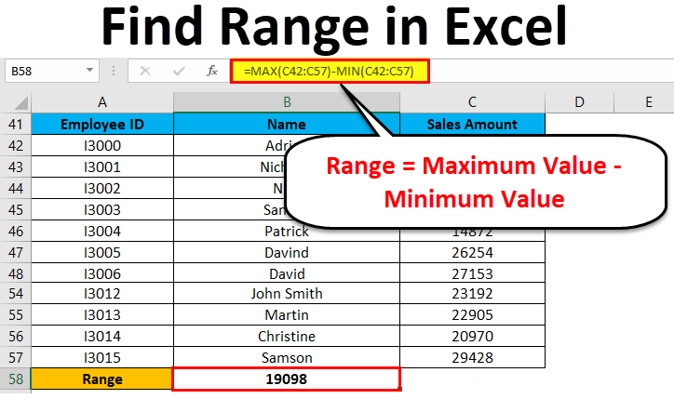
Key Descriptive Statistical Measures:
Dispersion :

Slide 26
Key Descriptive Statistical Measures:
Dispersion:
Dispersion: Real Applications
Variance (σ²):
Real-Life Application:
In Financial Risk Management: Assessing the variance of stock prices helps investors understand the volatility of a stock, which is crucial for risk management and portfolio diversification.
In Quality Control: Analyzing the variance of product dimensions in manufacturing processes helps identify potential issues and improve product consistency.

Slide 27
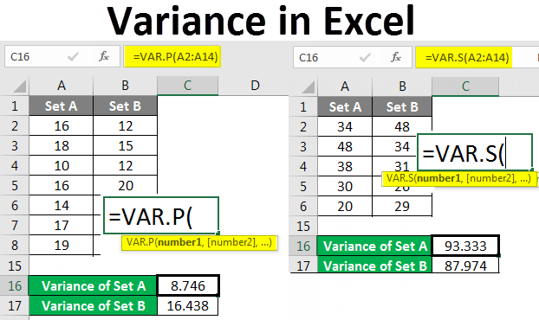
Key Descriptive Statistical Measures:
Dispersion :

Slide 28
Key Descriptive Statistical Measures:
Dispersion:
Dispersion: Real Applications
Standard Deviation (σ):
Real-Life Application:
In Healthcare: Calculating the standard deviation of patient wait times in a hospital emergency room helps administrators optimize staffing levels and improve efficiency.
In Education: Determining the standard deviation of test scores within a classroom provides insight into the level of academic achievement and helps identify students who may need additional support.

Slide 29
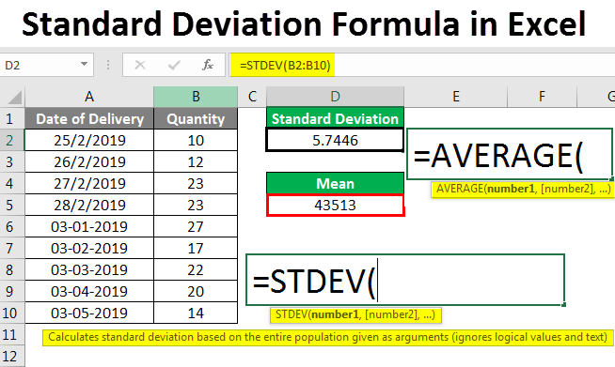
Key Descriptive Statistical Measures:
Dispersion :

Slide 30
Key Descriptive Statistical Measures:
Understanding Skewness in Statistics
Skewness measures the asymmetry of a data distribution.
It indicates whether the data points are more concentrated on one side of the mean.
Understanding skewness helps in identifying the direction and extent of asymmetry in the data, which is crucial for statistical analysis and decision-making.

Slide 31
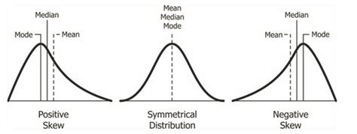
Key Descriptive Statistical Measures:
Understanding Skewness in Statistics
Types of Skewness
1. Positive Skewness (Right-Skewed)
- Description: The tail on the right side of the distribution is longer or fatter. Most values are concentrated on the left side of the mean.
- Implication: Indicates that there are a few exceptionally high values.
- Example: Income distribution, where a small number of people earn significantly more than the average.
2. Negative Skewness (Left-Skewed)
- Description: The tail on the left side of the distribution is longer or fatter. Most values are concentrated on the right side of the mean.
- Implication: Indicates that there are a few exceptionally low values.
- Example: Age at retirement, where most people retire around a common age, but a few retire very early.
3. No Skewness (Symmetrical)
- Description: The distribution is symmetrical, with data points evenly distributed around the mean.
- Implication: Indicates that the data is balanced, with no extreme values skewing the distribution.
- Example: Heights of adults in a population where the majority of values cluster around the mean.
-

Slide 32
Key Descriptive Statistical Measures:
Distribution Shape: Real Applications:
Real-Life Application:
- In Finance: Evaluating the skewness of interest rate movements aids financial institutions in assessing interest rate risk and optimizing their investment strategies. Positive skewness may suggest a higher probability of large interest rate increases, while negative skewness may indicate a higher likelihood of significant interest rate decreases.

Slide 33
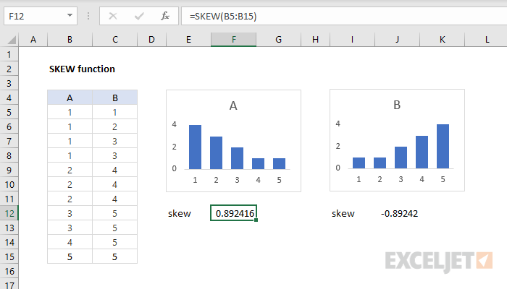
Key Descriptive Statistical Measures:
Distribution Shape: Real Applications:

Slide 34
Key Descriptive Statistical Measures:
Distribution Shape:
Kurtosis:
Real-Life Application:
In Insurance: Assessing the kurtosis of insurance claim amounts helps insurers understand the likelihood of extreme claim events. High kurtosis indicates a higher probability of rare, high-impact claims, which is essential for pricing and risk management.

Slide 35
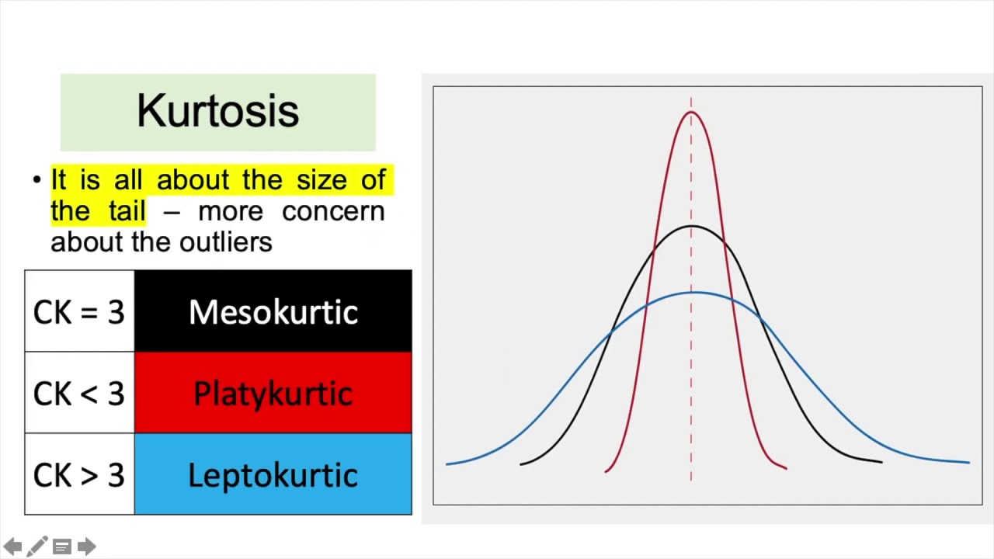
Key Descriptive Statistical Measures:
Distribution Shape:

Slide 36
Real-Life Application: Customer Data Analysis in a Bank:
Banks collect extensive data on customers, including demographics, transaction history, loan repayments, and service usage.
Descriptive Statistics Used:
- Average Account Balance: Helps understand the financial profile of customers.

Slide 37
Real-Life Application: Customer Data Analysis in a Bank:
Example: Calculating the mean account balance of customers to tailor financial products to different customer segments.
- Application: A bank may find that the average account balance of its customers is $10,000. With this information, they could develop premium banking services for customers with balances above this average, offering personalized investment advice and higher interest rates for higher balances.

Slide 38
Real-Life Application: Customer Data Analysis in a Bank:
- Loan Repayment Times: Measures the time taken for customers to repay their loans.
- Example: Analyzing the median repayment time for different types of loans (e.g., mortgages, personal loans, car loans) to assess credit risk and adjust lending policies.
- Application: If the median repayment time for personal loans is found to be 3 years, the bank could design repayment plans and interest rates that align with this typical repayment period, ensuring better cash flow management and risk assessment.

Slide 39
Real-Life Application: Customer Data Analysis in a Bank:
- Transaction Frequency: Measures how often customers engage in transactions within a specific period.
- Example: Calculating the average number of transactions per month per customer to identify active users and tailor marketing strategies.
- Application: A bank might find that customers on average make 25 transactions per month. They could then target customers making fewer transactions with incentives to increase their usage, such as cashback offers or reduced fees for increased activity.

Slide 40
Real-Life Application: Customer Data Analysis in a Bank:
-Customer Demographics: Analyzing age, income, employment status, and other demographic factors to understand customer segments.
- Example: Determining the average age and income of customers to develop targeted financial products and services.

Slide 41
Real-Life Application: Customer Data Analysis in a Bank:
- Application: If the bank finds that a significant portion of their customers are young professionals with an average income of $70,000, they might create tailored financial planning services, investment options, and loan products that cater to the needs and aspirations of this demographic.
These descriptive statistics help banks tailor their products and services to better meet the needs of their customers, manage risk, and enhance customer satisfaction and loyalty.

Slide 42

Conclusion..:
In education, analyzing student performance data through descriptive statistics like mean test scores, grade distributions, and outlier identification enables tailored educational programs to meet individual student needs, fostering academic success and personal growth.
Chapter
03
Summary of chapter

Slide 43
Chapter
Review Questions
03
Question 1:
Explain the concepts of mean, median, and mode, and provide an example of how each is used in financial data analysis.
Question 2:
What are the measures of dispersion, and why are they important in statistical analysis? Provide an example in finance.
Question 3:
Describe skewness and kurtosis and their significance in data analysis. Provide an example of how each is applied in financial analysis.

Slide 44

Thank You

