Slide 1


Introduction
Introduction to Finance
Prepared by Dr. Mohamed Hamouda
Introduction

Slide 2


Dr. Mohamed Hamouda
Credit Risk Manager with 15 years of experience in the finance industry, Skilled in Enterprise credit Risk Management.
Corporate trainer of finance and credit in the National Bank of Egypt with 5years of experience,
Adjunct Finance Professor in Arab academy for banking ‘financial science.
Doctor of business administration - Cairo university- September 2019 - Major finance and investment.
Certified Trainer-ESLSCA

Slide 3
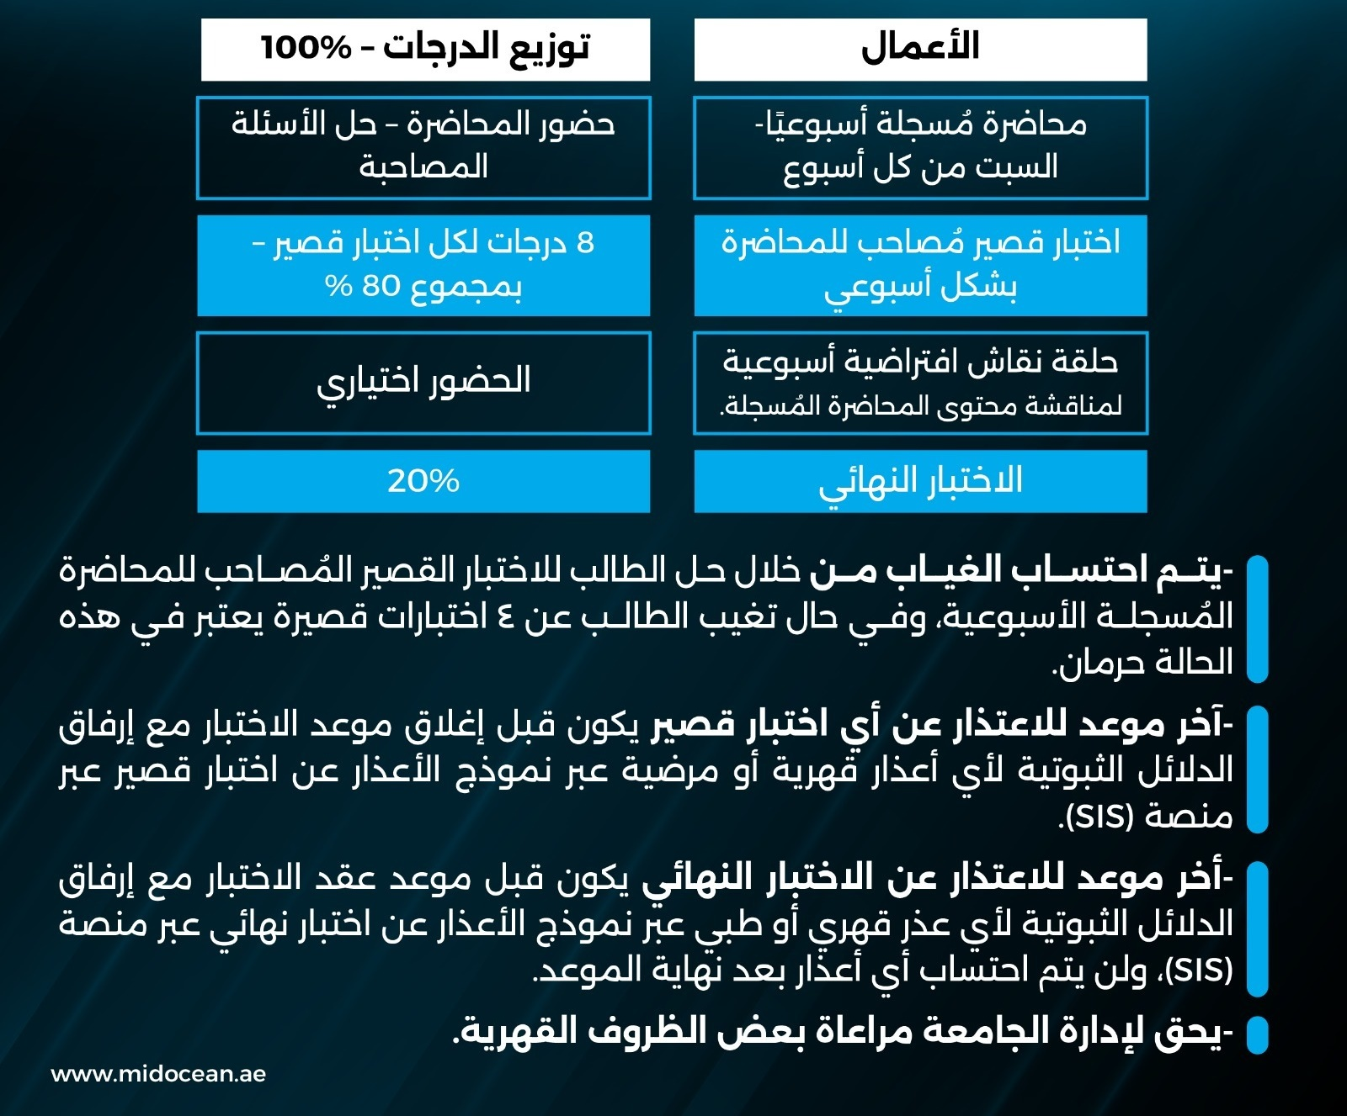
Introduction

Slide 4
Introduction
Course Description:
The course provides an overview of financial decision-making from the perspective of the corporate financial manager. Students discover how managers maximize shareholders’ wealth by choosing the optimal allocation of capital and the optimal financial structure of the firm. Topics include risk-return relationships, the time value of money, the valuation of stocks and bonds, capital budgeting, the cost of capital and a brief introduction to financial markets. Parts of the material are quantitative.

Slide 5
Introduction
Course Objectives:
To give an understanding of the role of financial management in industry.
To develop an appreciation of the impact of finance on business decisions
To develop techniques and skills related to finance.

Slide 6
Introduction
Learning Outcomes
Students will learn how to:
•Evaluate investment opportunities.
•Analyze a company’s financial statements to answer business questions.
•Use financial formulas to evaluate cost of capital for decisions related to financing the operations of a corporation.
•Anticipate corporate financial needs through budgeting and forecasting techniques.
•Explain working capital concepts.

Slide 7
Introduction
Course Outline:
Module 01: Introduction To Financial Management
Module 02: Understanding Financial Statement
Module 03: Evaluating Firm's Financial Performance

Slide 8
Introduction
Course Outline:
Module 04: Financial Forecasting and Planning
Module 05: Time Value of Money
Module 06: Valuation of Bonds Introduction
Module 07 : Valuation of Stocks
Module 08: Capital Budgeting Techniques Introduction
Module09: Cases and Report
Module10 : Finance Career Tips

Slide 9
Introduction
4- List of References:
- The main material and reference for each course will be the textbook mentioned in the course specifications. Lecture notes and slides are additional resources that are prepared by the professor.
Required Textbook:
Introduction to Finance: Markets, Investments, and Financial Management 17th Edition
by Ronald W. Melicher (Author), Edgar A. Norton (Author)

Slide 10
Thank You

