Slide 1



Object Oriented Programming
Prepared by Dr. Yasser Abdelhamid
IT223
Object Oriented Programming
Lecture 09

Slide 2

outline
Arrays
2D arrays

Slide 3
arrays

Slide 4
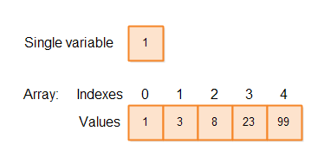
Array
An array is a collection of elements of similar type stored in contiguous memory locations.
The element type can be a primitive data type or an object reference.

Slide 5
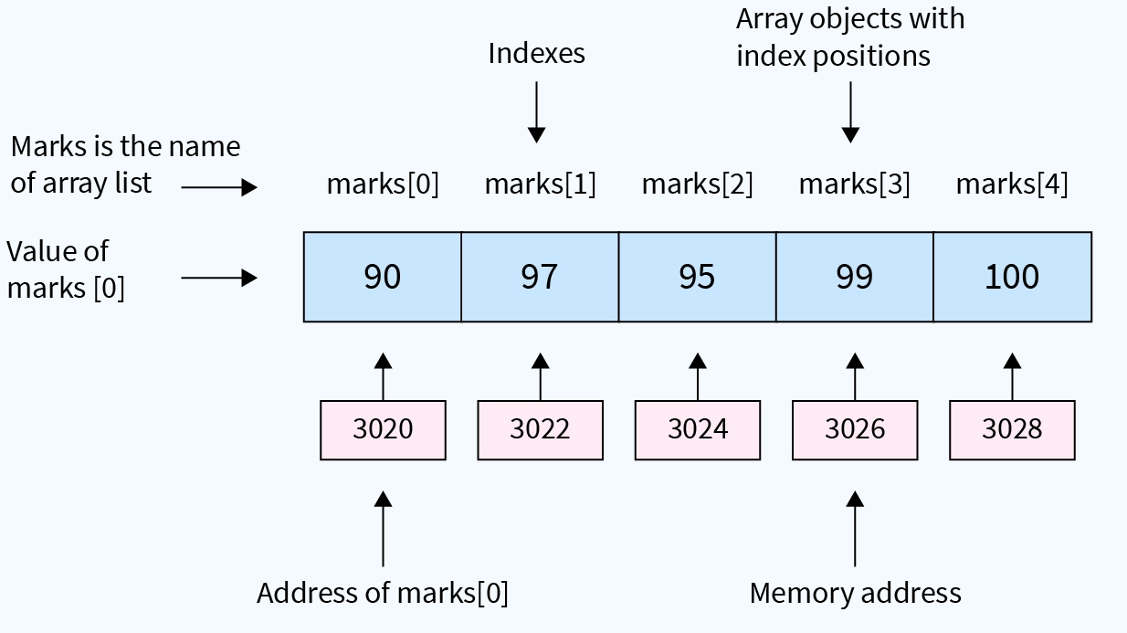
Example
int [] marks = new int[5];

Slide 6
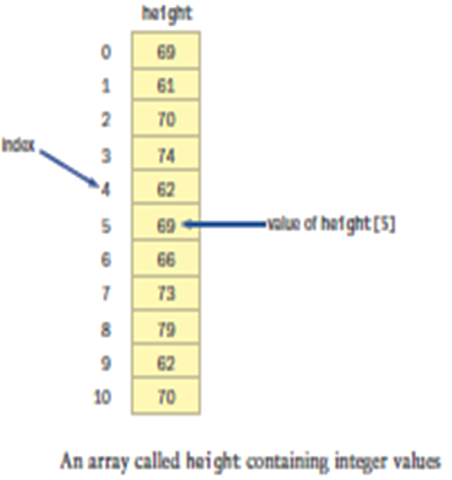
Example
Based on the following array, what is the value for each statement?
a. height[1]
b. height[2] + height[5]
c. height[2 + 5]
d. the value stored at index 8
e. the fourth value
f. height.length

Slide 7
Arrays in java
In Java, the array itself is an object that must be instantiated
Another way to depict the scores array:
scores
79
87
94
The name of the array
is an object reference
variable
82
67
98
87
81
74
91

Slide 8
Declaring Arrays
The scores array could be declared as follows:
int[] scores = new int[10];
The type of the variable scores is int[] (an array of integers)
Note that the array type does not specify its size, but each object of that type has a specific size.
The reference variable scores is set to a new array object that can hold 10 integers

Slide 9
array Declaration examples
Some other examples of array declarations:
int[] weights = new int[2000];
double[] prices = new double[500];
boolean[] flags;
flags = new boolean[20];
char[] codes = new char[1750];

Slide 10
Using Arrays
The for-each version of the for loop can be used when processing array elements:
for (int score : scores)
System.out.println(score);
This is only appropriate when processing all array elements starting at index 0
It can't be used to set the array values

Slide 11
//********************************************************************
// BasicArray.java Author: Lewis/Loftus
//
// Demonstrates basic array declaration and use.
//********************************************************************
public class BasicArray
{
//-----------------------------------------------------------------
// Creates an array, fills it with various integer values,
// modifies one value, then prints them out.
//-----------------------------------------------------------------
public static void main(String[] args)
{
final int LIMIT = 15, MULTIPLE = 10;
int[] list = new int[LIMIT];
// Initialize the array values
for (int index = 0; index < LIMIT; index++)
list[index] = index * MULTIPLE;
list[5] = 999; // change one array value
// Print the array values
for (int value : list)
System.out.print(value + " ");
}
}

Slide 12
//********************************************************************
// BasicArray.java Author: Lewis/Loftus
//
// Demonstrates basic array declaration and use.
//********************************************************************
public class BasicArray
{
//-----------------------------------------------------------------
// Creates an array, fills it with various integer values,
// modifies one value, then prints them out.
//-----------------------------------------------------------------
public static void main(String[] args)
{
final int LIMIT = 15, MULTIPLE = 10;
int[] list = new int[LIMIT];
// Initialize the array values
for (int index = 0; index < LIMIT; index++)
list[index] = index * MULTIPLE;
list[5] = 999; // change one array value
// Print the array values
for (int value : list)
System.out.print(value + " ");
}
}
Output
0 10 20 30 40 999 60 70 80 90 100 110 120 130 140

Slide 13
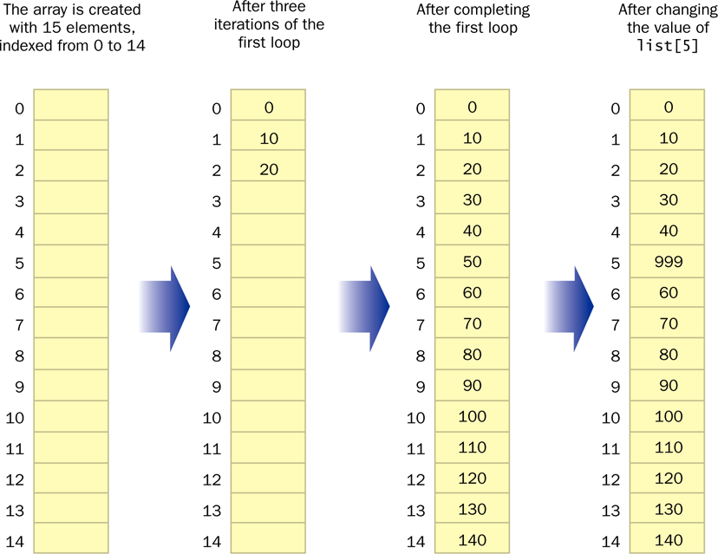
BasicArray example

Slide 14
Exercises
Write an array declaration to represent the ages of 100 children.
Write code that prints each value in an array of integers named values.

Slide 15
Answer
Write an array declaration to represent the ages of 100 children.
Write code that prints each value in an array of integers named values.
int[] ages = new int[100];
for (int value : values)
System.out.println(value);

Slide 16
Bounds Checking
Once an array is created, it has a fixed size
An index used in an array reference must specify a valid element
That is, the index value must be in range 0 to N-1
The Java interpreter throws an ArrayIndexOutOfBoundsException if an array index is out of bounds
This is called automatic bounds checking

Slide 17
Bounds Checking
For example, if the array codes can hold 100 values, it can be indexed from 0 to 99
If the value of count is 100, then the following reference will cause an exception to be thrown:
System.out.println(codes[count]);
It’s common to introduce off-by-one errors when using arrays:
problem
for (int index=0; index <= 100; index++)
codes[index] = index*50 + epsilon;

Slide 18
Bounds Checking
Each array object has a public constant called length that stores the size of the array
It is referenced using the array name:
scores.length
Note that length holds the number of elements, not the largest index
See ReverseOrder.java
See LetterCount.java

Slide 19
//********************************************************************
// ReverseOrder.java Author: Lewis/Loftus
//
// Demonstrates array index processing.
//********************************************************************
import java.util.Scanner;
public class ReverseOrder
{
//-----------------------------------------------------------------
// Reads a list of numbers from the user, storing them in an
// array, then prints them in the opposite order.
//-----------------------------------------------------------------
public static void main(String[] args)
{
Scanner scan = new Scanner(System.in);
double[] numbers = new double[10];
System.out.println("The size of the array: " + numbers.length);
// continue next page

Slide 20
for (int index = 0; index < numbers.length; index++)
{
System.out.print("Enter number " + (index+1) + ": ");
numbers[index] = scan.nextDouble();
}
System.out.println("The numbers in reverse order:");
for (int index = numbers.length-1; index >= 0; index--)
System.out.print(numbers[index] + " ");
}
}

Slide 21
Sample Run
The size of the array: 10
Enter number 1: 18.36
Enter number 2: 48.9
Enter number 3: 53.5
Enter number 4: 29.06
Enter number 5: 72.404
Enter number 6: 34.8
Enter number 7: 63.41
Enter number 8: 45.55
Enter number 9: 69.0
Enter number 10: 99.18
The numbers in reverse order:
99.18 69.0 45.55 63.41 34.8 72.404 29.06 53.5 48.9 18.36

Slide 22
//********************************************************************
// LetterCount.java Author: Lewis/Loftus
//
// Demonstrates the relationship between arrays and strings.
//********************************************************************
import java.util.Scanner;
public class LetterCount
{
//-----------------------------------------------------------------
// Reads a sentence from the user and counts the number of
// uppercase and lowercase letters contained in it.
//-----------------------------------------------------------------
public static void main(String[] args)
{
final int NUMCHARS = 26;
Scanner scan = new Scanner(System.in);
int[] upper = new int[NUMCHARS];
int[] lower = new int[NUMCHARS];
char current; // the current character being processed
int other = 0; // counter for non-alphabetics
// continue next page

Slide 23
// Read a line
System.out.println("Enter a sentence:");
String line = scan.nextLine();
// Count the number of each letter occurence
for (int ch = 0; ch < line.length(); ch++)
{
current = line.charAt(ch);
if (current >= 'A' && current <= 'Z')
upper[current-'A']++;
else
if (current >= 'a' && current <= 'z')
lower[current-'a']++;
else
other++;
}
// continue next page

Slide 24
// Print the results
System.out.println();
for (int letter=0; letter < upper.length; letter++)
{
System.out.print( (char) (letter + 'A') );
System.out.print(": " + upper[letter]);
System.out.print("\t\t" + (char) (letter + 'a') );
System.out.println(": " + lower[letter]);
}
System.out.println();
System.out.println("Non-alphabetic characters: " + other);
}
}

Slide 25
Sample Run
Enter a sentence:
In Casablanca, Humphrey Bogart never says "Play it again, Sam."
A: 0 a: 10
B: 1 b: 1
C: 1 c: 1
D: 0 d: 0
E: 0 e: 3
F: 0 f: 0
G: 0 g: 2
H: 1 h: 1
I: 1 i: 2
J: 0 j: 0
K: 0 k: 0
L: 0 l: 2
M: 0 m: 2
N: 0 n: 4
O: 0 o: 1
P: 1 p: 1
Q: 0 q: 0
continue
Sample Run (continued)
R: 0 r: 3
S: 1 s: 3
T: 0 t: 2
U: 0 u: 1
V: 0 v: 1
W: 0 w: 0
X: 0 x: 0
Y: 0 y: 3
Z: 0 z: 0
Non-alphabetic characters: 14

Slide 26
Exercises
Write a Java program that accepts an array of integers and returns the sum of all the even numbers in the array. For example, if the input array is {1, 2, 3, 4, 5, 6}, the program should return 12 (which is the sum of 2, 4, and 6).
Write a Java program that accepts an array of strings and returns the length of the longest string in the array. For example, if the input array is {"cat", "dog", "elephant", "bird"}, the program should return 8 (which is the length of "elephant").
Write a Java program that accepts two arrays of integers and returns a new array that contains only the common elements between the two arrays. For example, if the first array is {1, 2, 3, 4, 5} and the second array is {3, 4, 5, 6, 7}, the program should return an array with {3, 4, 5}.

Slide 27
Alternate Array Syntax
The brackets of the array type can be associated with the element type or with the name of the array
Therefore the following two declarations are equivalent:
double[] prices;
double prices[];
The first format generally is more readable and should be used

Slide 28
Initializer Lists
An initializer list can be used to instantiate and fill an array in one step
The values are delimited by braces and separated by commas
Examples:
int[] units = {147, 323, 89, 933, 540,269, 97, 114, 298, 476};
char[] grades = {'A', 'B', 'C', 'D', ’F'};

Slide 29
Initializer Lists
Note that when an initializer list is used:
  the new operator is not used
  no size value is specified
The size of the array is determined by the number of items in the list
An initializer list can be used only in the array declaration
See Primes.java

Slide 30
//********************************************************************
// Primes.java Author: Lewis/Loftus
//
// Demonstrates the use of an initializer list for an array.
//********************************************************************
public class Primes
{
//-----------------------------------------------------------------
// Stores some prime numbers in an array and prints them.
//-----------------------------------------------------------------
public static void main(String[] args)
{
int[] primeNums = {2, 3, 5, 7, 11, 13, 17, 19};
System.out.println("Array length: " + primeNums.length);
System.out.println("The first few prime numbers are:");
for (int prime : primeNums)
System.out.print(prime + " ");
}
}

Slide 31
Output
Array length: 8
The first few prime numbers are:
2 3 5 7 11 13 17 19
//********************************************************************
// Primes.java Author: Lewis/Loftus
//
// Demonstrates the use of an initializer list for an array.
//********************************************************************
public class Primes
{
//-----------------------------------------------------------------
// Stores some prime numbers in an array and prints them.
//-----------------------------------------------------------------
public static void main(String[] args)
{
int[] primeNums = {2, 3, 5, 7, 11, 13, 17, 19};
System.out.println("Array length: " + primeNums.length);
System.out.println("The first few prime numbers are:");
for (int prime : primeNums)
System.out.print(prime + " ");
}
}

Slide 32
2D arrays

Slide 33
Two-Dimensional Arrays
A one-dimensional array stores a list of elements
A two-dimensional array can be thought of as a table of elements, with rows and columns
one
dimension
two
dimensions

Slide 34
Two-Dimensional Arrays
To be precise, in Java a two-dimensional array is an array of arrays
A two-dimensional array is declared by specifying the size of each dimension separately:
int[][] table = new int[12][50];
An array element is referenced using two index values:
value = table[3][6]
The array stored in one row can be specified using one index

Slide 35
//********************************************************************
// TwoDArray.java Author: Lewis/Loftus
//
// Demonstrates the use of a two-dimensional array.
//********************************************************************
public class TwoDArray
{
//-----------------------------------------------------------------
// Creates a 2D array of integers, fills it with increasing
// integer values, then prints them out.
//-----------------------------------------------------------------
public static void main(String[] args)
{
int[][] table = new int[5][10];
// Load the table with values
for (int row=0; row < table.length; row++)
for (int col=0; col < table[row].length; col++)
table[row][col] = row * 10 + col;
// Print the table
for (int row=0; row < table.length; row++)
{
for (int col=0; col < table[row].length; col++)
System.out.print(table[row][col] + "\t");
System.out.println();
}
}
}

Slide 36
//********************************************************************
// TwoDArray.java Author: Lewis/Loftus
//
// Demonstrates the use of a two-dimensional array.
//********************************************************************
public class TwoDArray
{
//-----------------------------------------------------------------
// Creates a 2D array of integers, fills it with increasing
// integer values, then prints them out.
//-----------------------------------------------------------------
public static void main(String[] args)
{
int[][] table = new int[5][10];
// Load the table with values
for (int row=0; row < table.length; row++)
for (int col=0; col < table[row].length; col++)
table[row][col] = row * 10 + col;
// Print the table
for (int row=0; row < table.length; row++)
{
for (int col=0; col < table[row].length; col++)
System.out.print(table[row][col] + "\t");
System.out.println();
}
}
}
Output
0 1 2 3 4 5 6 7 8 9
10 11 12 13 14 15 16 17 18 19
20 21 22 23 24 25 26 27 28 29
30 31 32 33 34 35 36 37 38 39
40 41 42 43 44 45 46 47 48 49

Slide 37
Example
Which of the following are valid declarations? Which instantiate an array object? Explain your answers.
  int primes = {2, 3, 4, 5, 7, 11};
Invalid; an int cannot be declared and initialized using an intializer list. The brackets are missing.
  float elapsedTimes[] = {11.47, 12.04, 11.72, 13.88};
Valid; the brackets can be placed either after the element type or after the reference variable. However, this is not the preferred technique. This declaration creates an array object.
  int[] scores = int[30];
Invalid; the right hand side of the assignment operator must contain either an initializer list or a new operation.
  int[] primes = new {2,3,5,7,11};
Invalid; “new” on the right hand side of the assignment operator is neither necessary nor acceptable.

Slide 38
Example
  int[] scores = new int[30];
  Valid; the assignment is correct Java syntax. This declaration creates an array object.
  char grades[] = {'a', 'b', 'c', 'd', 'f'};
  Valid; the brackets can be placed either after the element type or after the reference variable. However, this is not the preferred technique. This declaration creates an array object.
  char[] grades = new char[];
  Invalid; the size of the array must be indicated when the array is instantiated.

Slide 39
Example
Write an array declaration and any necessary supporting classes to represent the following statements:
a. students’ names for a class of 25 students
String[] students = new String[25];
b. students’ test grades for a class of 40 students
int[] grades = new int[40];
or, for simple letter grades:
char[] grades = new char[40];
or, for letter grades that include pluses and minuses
String[] grades = new String[40];
c. students’ names for a class and homework grades for each student
Student[] myClass = new Student[MAX];
public class Student
{
private String name;
private int[] grades;
}

Slide 40
d. for each employee of the L&L International Corporation: the employee number, hire date, and the amount of the last five raises
Employee[]employees = new Employee[MAX];
public class Employee
{
private int employeeNumber;
private String hireDate;
private double raise[] = new double[5];
}

Slide 41
Example
Describe what problem occurs in the following code. What modifications should be made to it to eliminate the problem?
int[] numbers = {3, 2, 3, 6, 9, 10, 12, 32, 3, 12, 6};
for (int count = 1; count <= numbers.length; count++)
System.out.println(numbers[count]);
The for loop fails to print the 0th element of the array, and attempts to print the nonexistent 11th element of the array. As a consequence, an ArrayIndexOutOfBoundsException is thrown. The problem can be eliminated by providing a for loop which initializes count to 0 (rather than 1) and tests if count is less than (rather than less than or equal to) numbers.length.

Slide 42
SUmmary
Arrays
2D Arrays

Slide 43


Thank You

