Slide 1



Project Resources and Time Management
PMG 605
Lecture 10
MS Project as a Tool for Resources and Time Management
Prepared by
Dr. Eng. Abdullah Jameel Halawany

Slide 2

Lecture
Session Outline
10
MS Project as a Tool for Resources and Time Management
MS Project 2019 Overview
Set Project Calendar
WBS
Task Type
Add and Level Resources
Timeline
Reports
10–2

Slide 3
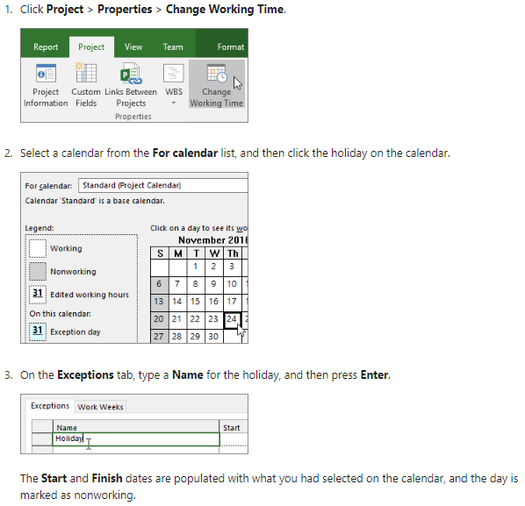
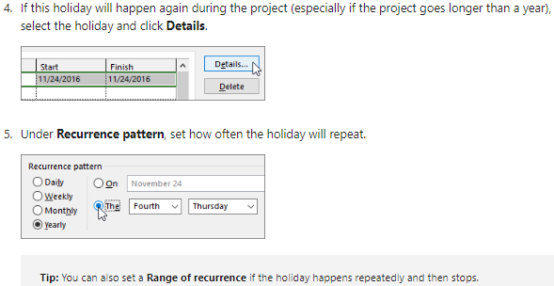
Add A Holiday To The Project Calendar
10–3

Slide 4
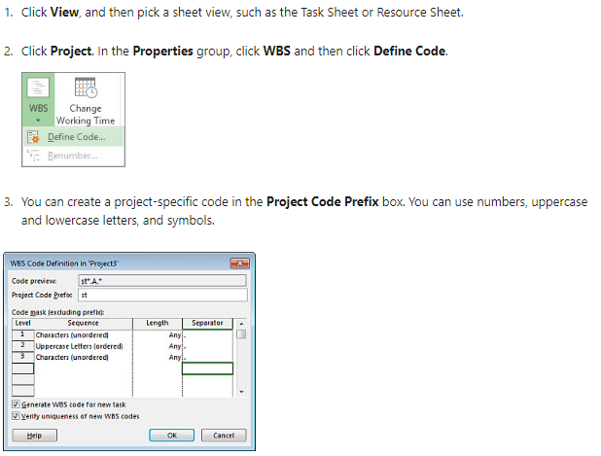
Lecture
Create WBS codes in Project desktop
10
10–4

Slide 5
Lecture
Add A Milestone
10
Before your project gets rolling, you will probably want to mark its major goals with milestones.
Create a milestone with zero duration
Add a milestone with a duration
10–5

Slide 6
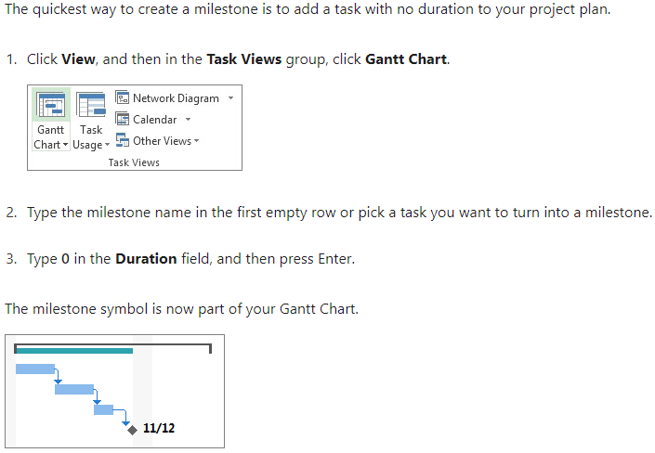
Create A Milestone With Zero Duration
10–6

Slide 7
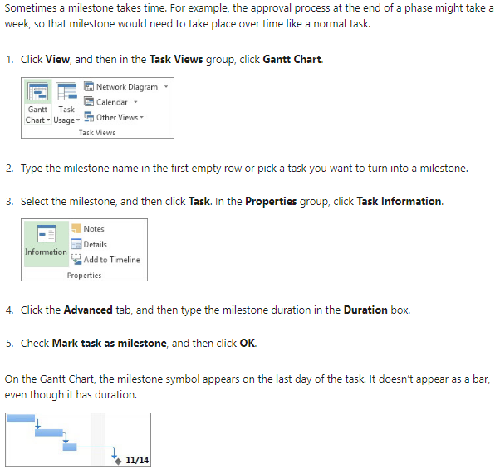
Add A Milestone With A Duration
10–7

Slide 8
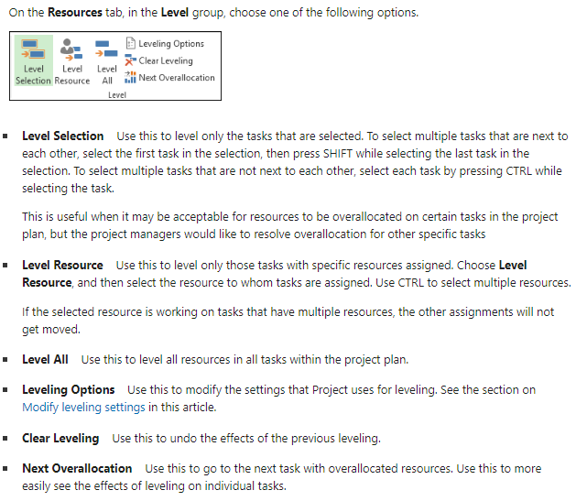
Level Resource Assignments
10–8

Slide 9
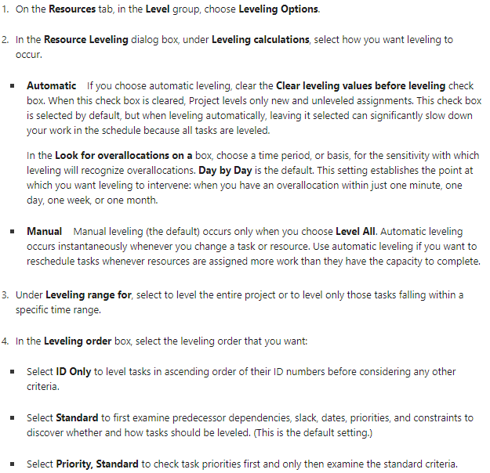
Modify Leveling Settings
10–9

Slide 10
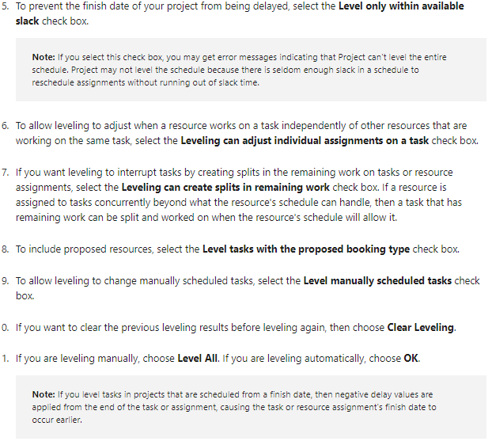
Modify Leveling Settings
10–10

Slide 11
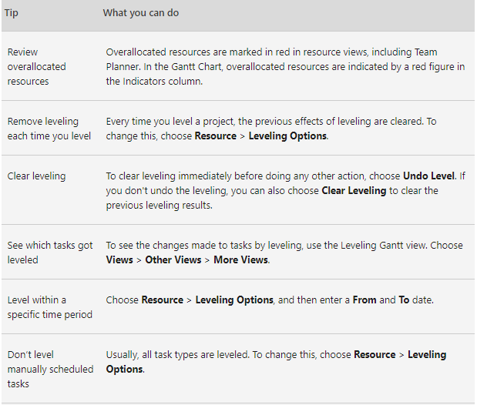
Some Tips You Can Use While Leveling
10–11

Slide 12
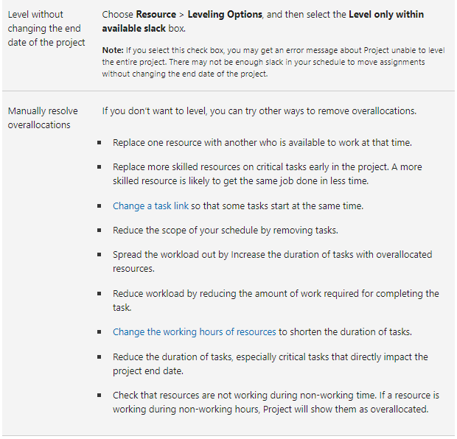
Some Tips You Can Use While Leveling
10–12

Slide 13
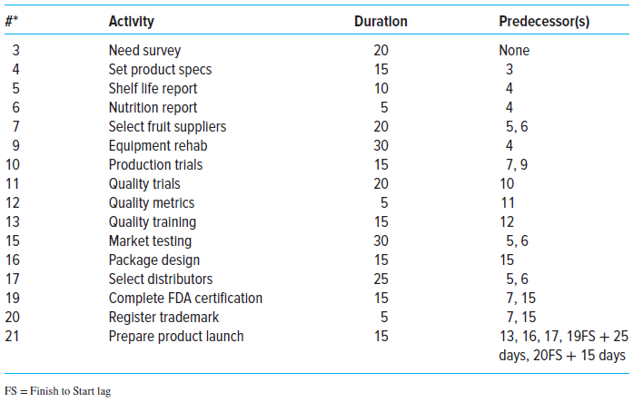
Lecture
The POM+ Project - Big Kola Company
10
10–13

Slide 14
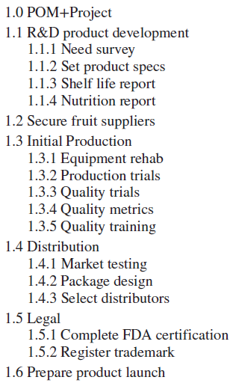
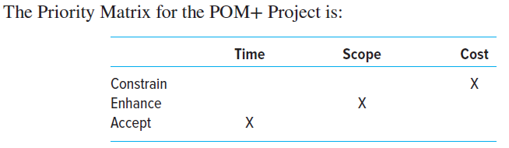
The POM+ Project - Big Kola Company – Part 1
10–14

Slide 15
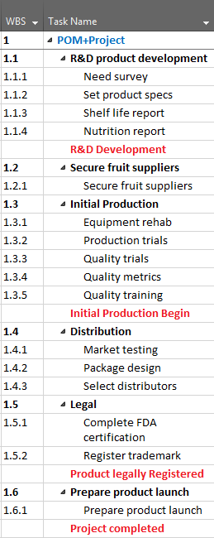
Lecture
The POM+ Project - Big Kola Company
10
Develop the WBS outline using the software available.
10–15

Slide 16
Lecture
The POM+ Project - Big Kola Company
10
2. Use this file and the information provided below to create a project schedule.
The following holidays are observed:
  New Yer January 1,
  July 4th,
  Labor Day (first Monday in September),
  Thanksgiving Day (4th Thursday in November),
  December 25 and 26.
The project team works eight-hour days, Saturday through Thursday.
10–16

Slide 17
Lecture
The POM+ Project - Big Kola Company
10
The project will begin on November 3 , 2025
Based on this schedule, submit a memo that answers the following questions:
  a. When is the project estimated to be completed? How many working days will it take?
  b. What is the critical path?
  c. Which activity has the most total slack?
  d. How sensitive is this network?
  e. Identify two sensible milestones and explain your choice.
10–17

Slide 18
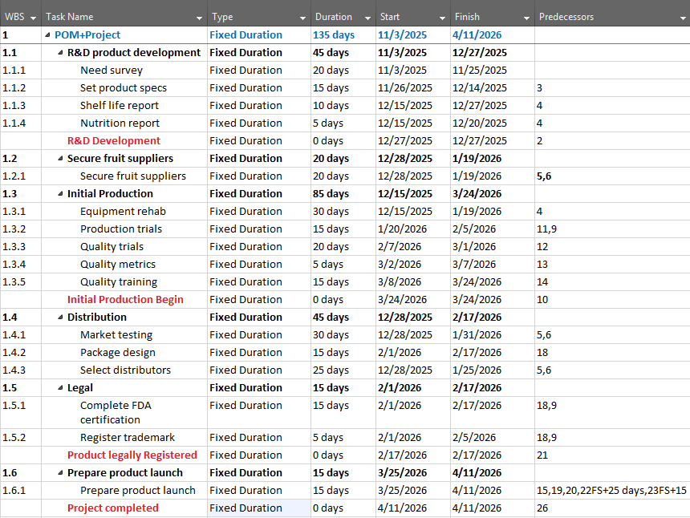
The POM+ Project - Big Kola Company
10–18

Slide 19
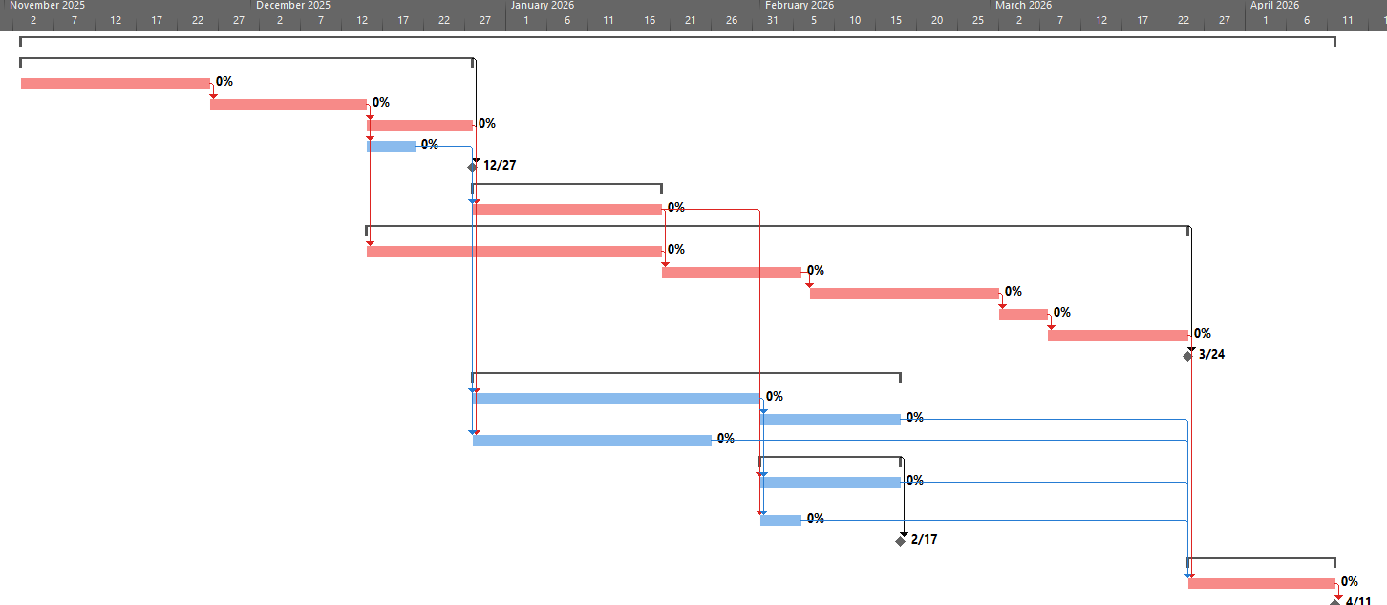
The POM+ Project - Big Kola Company
10–19

Slide 20
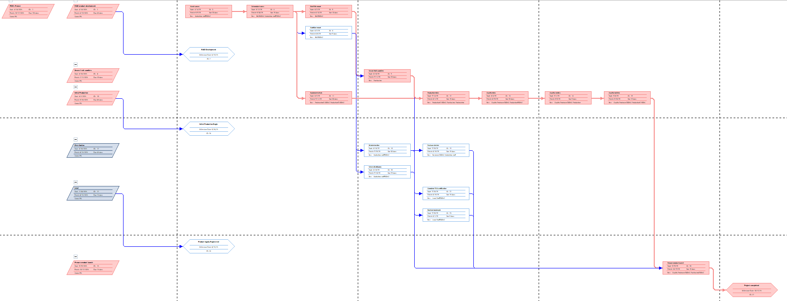
The POM+ Project - Big Kola Company
10–20

Slide 21
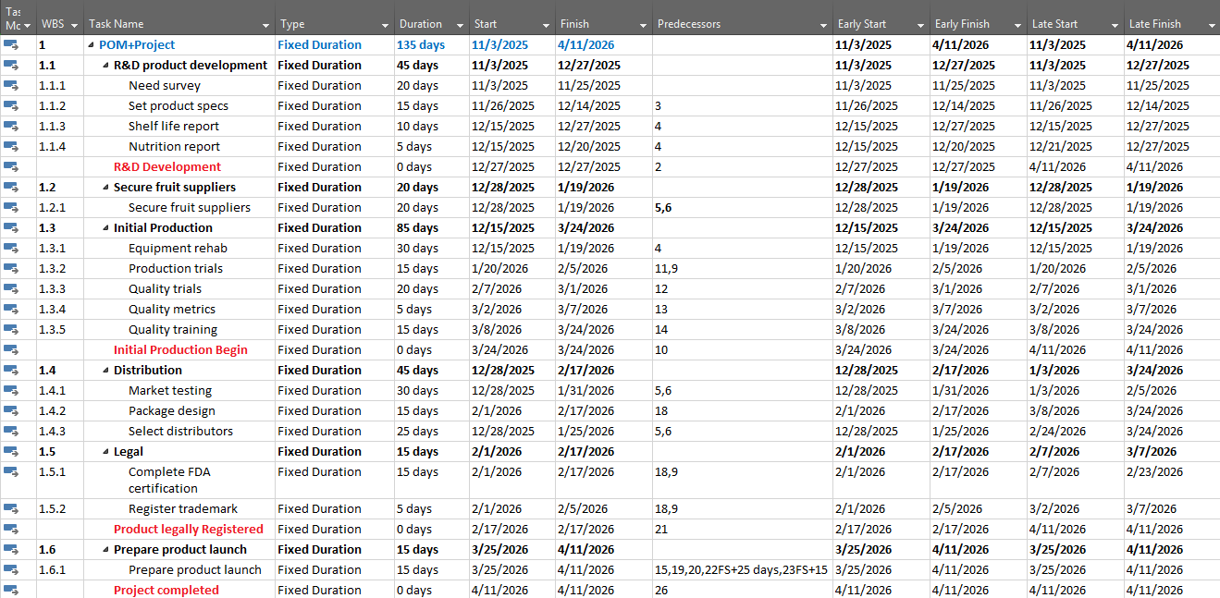
The POM+ Project - Big Kola Company
10–21

Slide 22
Lecture
The POM+ Project - Big Kola Company – Part 2
10
Remember the old saying, “A project plan is not a schedule until resources are committed.” This exercise illustrates this sometime subtle, but important point.
Using your files from Part 1, input resources and their costs if you have not already done so.
10–22

Slide 23
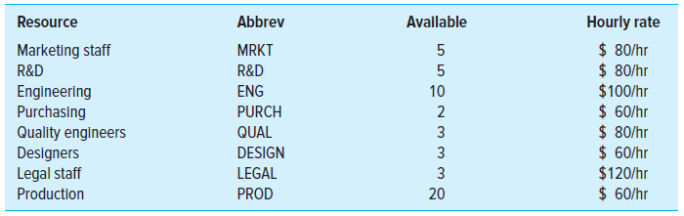
Lecture
The POM+ Project - Big Kola Company – Part 2
10
10–23

Slide 24
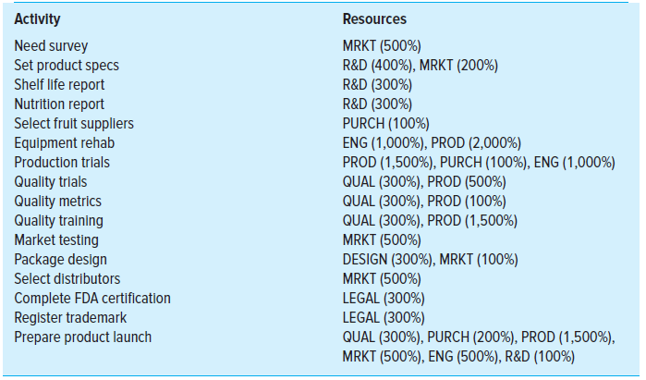
Lecture
The POM+ Project - Big Kola Company – Part 2
10
10–24

Slide 25
Lecture
The POM+ Project - Big Kola Company – Part 2
10
Remember the old saying, “A project plan is not a schedule until resources are committed.” This exercise illustrates this sometime subtle, but important point.
Using your files from Part 1, input resources and their costs if you have not already done so.
Prepare a memo that addresses the following questions:
1. Which if any of the resources are over allocated?
2. Assume that the project is time constrained and try to resolve any over allocation problems by leveling within slack. What happens?
3. Assume the project is resource constrained and resolve any over allocation problems by leveling outside of slack. What happens?
10–25

Slide 26
Lecture
The POM+ Project - Big Kola Company – Part 2
10
1. Which if any of the resources are over allocated?
10–26

Slide 27
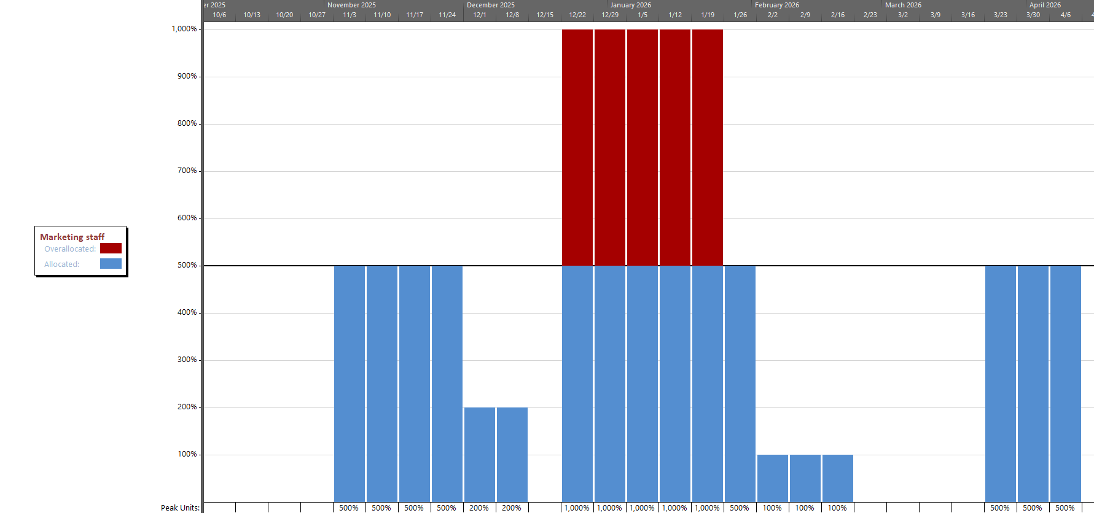
Lecture
The POM+ Project - Big Kola Company – Part 2
10
1. Which if any of the resources are over allocated?
10–27

Slide 28
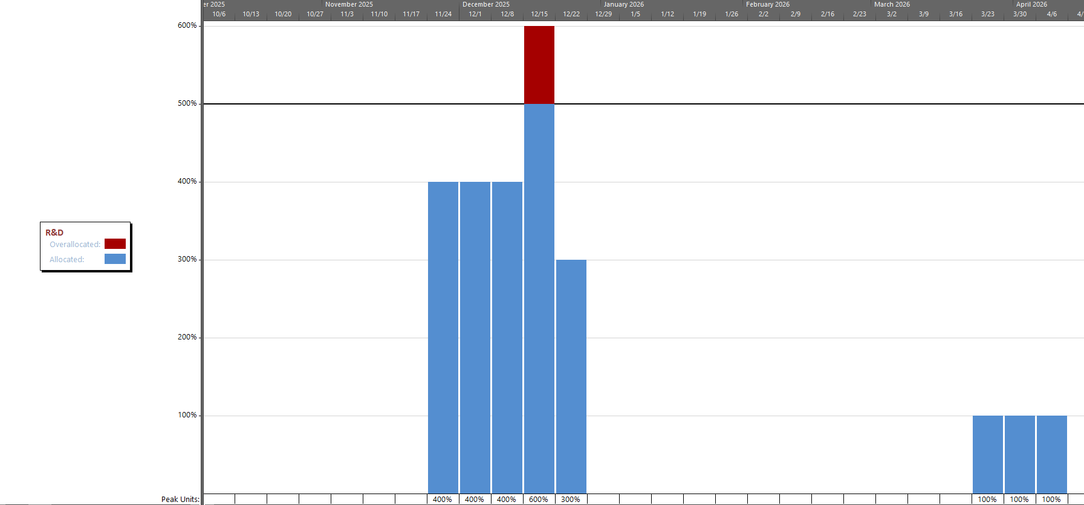
Lecture
The POM+ Project - Big Kola Company – Part 2
10
1. Which if any of the resources are over allocated?
10–28

Slide 29
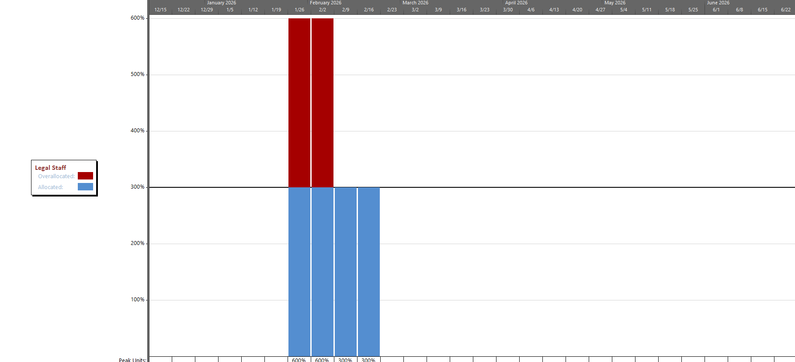
Lecture
The POM+ Project - Big Kola Company – Part 2
10
1. Which if any of the resources are over allocated?
10–29

Slide 30
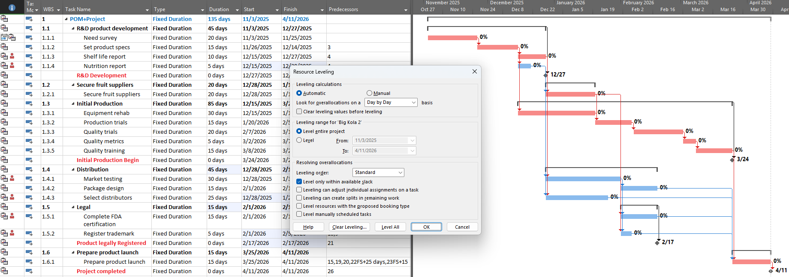
The POM+ Project - Big Kola Company – Part 2
2. Assume that the project is time constrained and try to resolve any overallocation problems by leveling within slack. What happens?
10–30

Slide 31
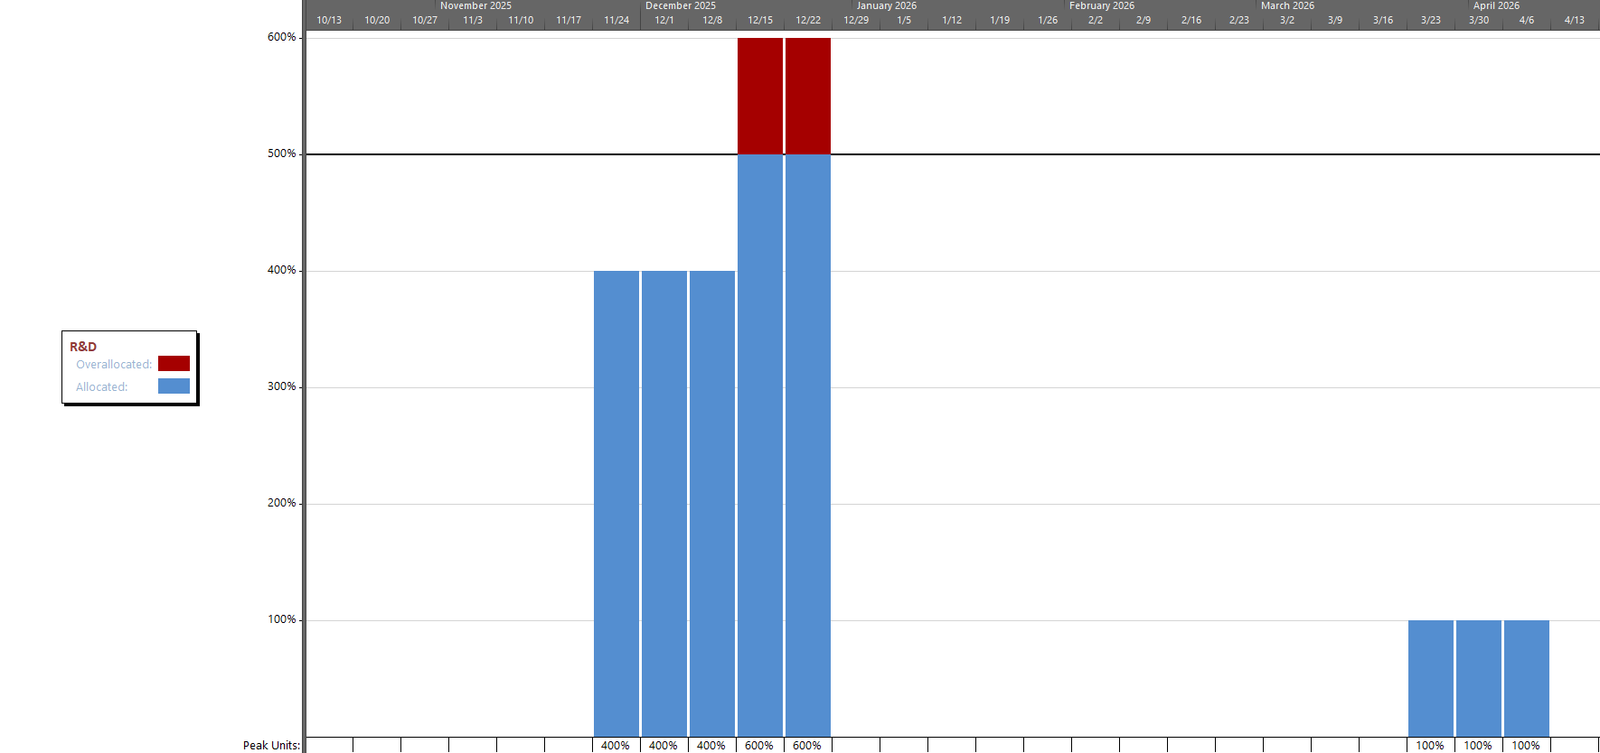
The POM+ Project - Big Kola Company – Part 2
2. Assume that the project is time constrained and try to resolve any over allocation problems by leveling within slack. What happens?
10–31

Slide 32

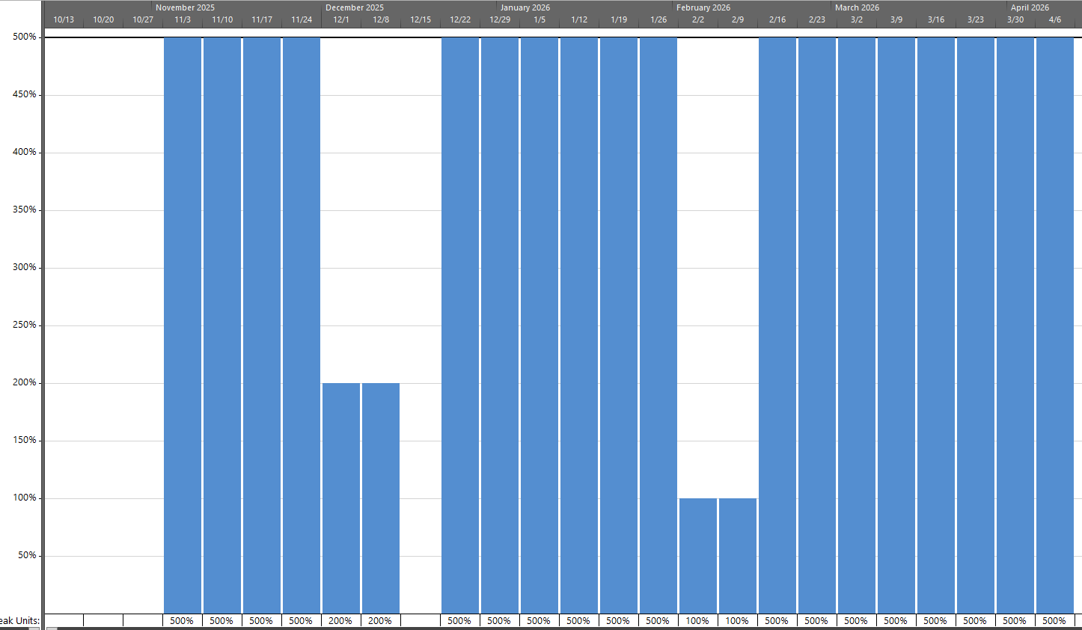
The POM+ Project - Big Kola Company – Part 2
Before Leveling within Slack
After Leveling within Slack
10–32

Slide 33
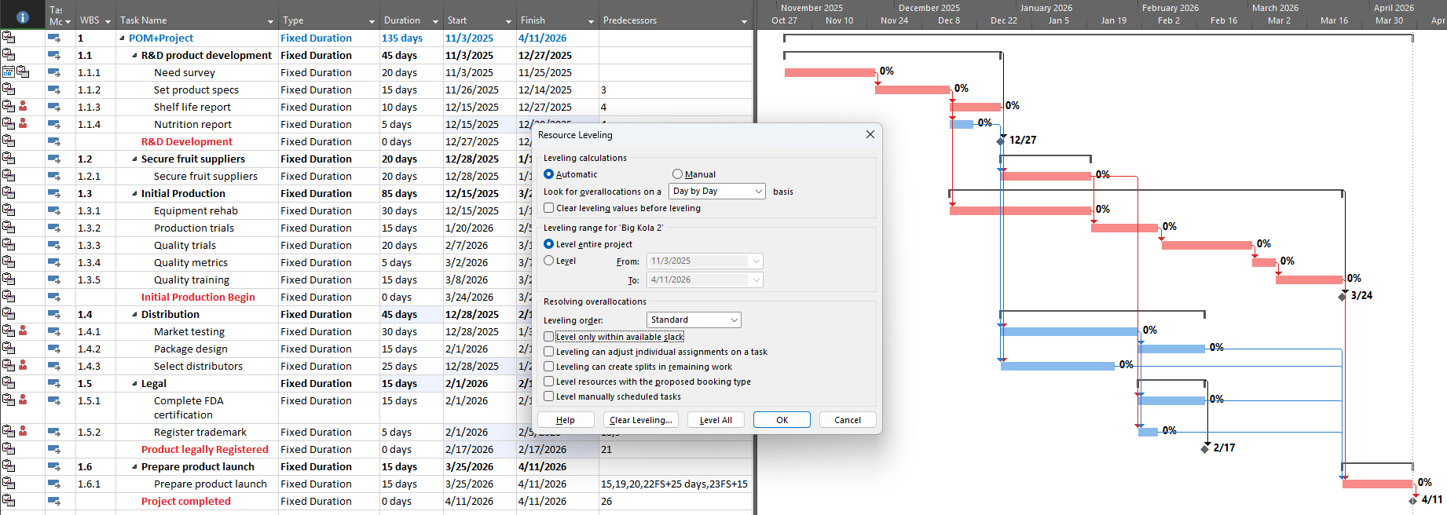
The POM+ Project - Big Kola Company – Part 2
3. Assume the project is resource constrained and resolve any over allocation problems by leveling outside of slack. What happens?
10–33

Slide 34
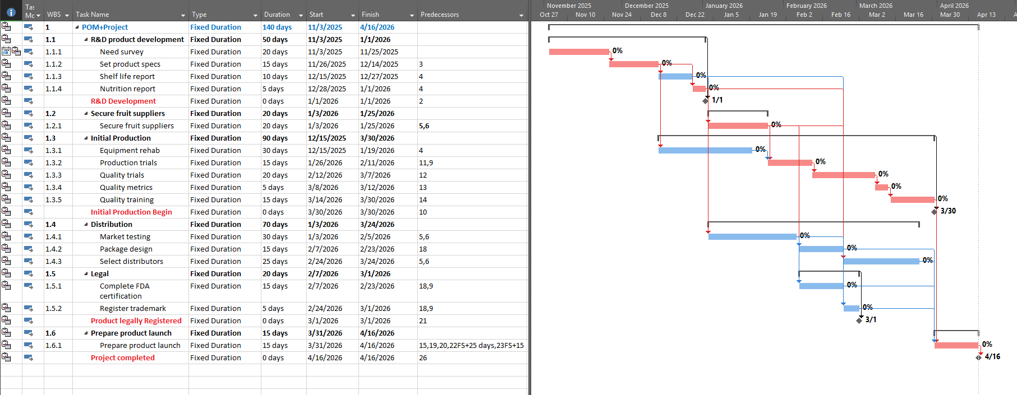
The POM+ Project - Big Kola Company – Part 3
3. Assume the project is resource constrained and resolve any over allocation problems by leveling outside of slack. What happens?
10–34

Slide 35
The POM+ Project - Big Kola Company – Part 3
3. Assume the project is resource constrained and resolve any over allocation problems by leveling outside of slack. What happens?
10–35

Slide 36
Lecture
The POM+ Project - Big Kola Company – Part 3
10
Top management has accepted the April 16th completion schedule created at the end of Part 2. Prepare a brief memo that addresses the following questions:
1. How much will the project cost? What is the most expensive activity?
10–36

Slide 37
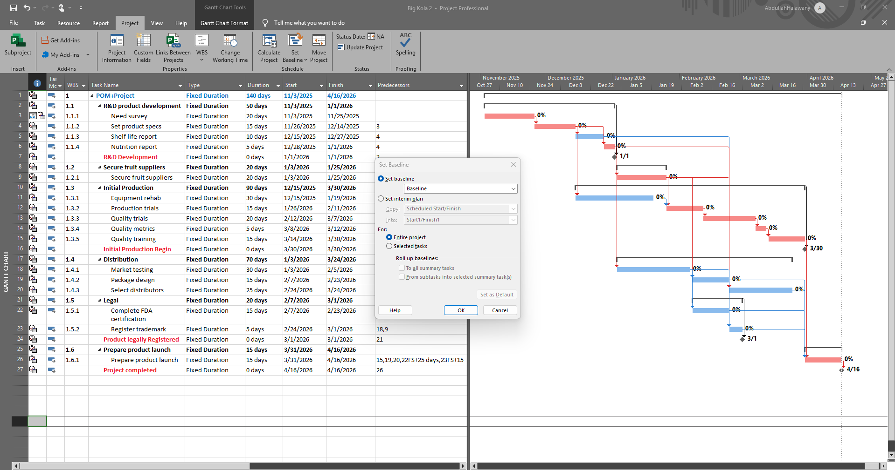
The POM+ Project - Big Kola Company – Part 3
10–37

Slide 38
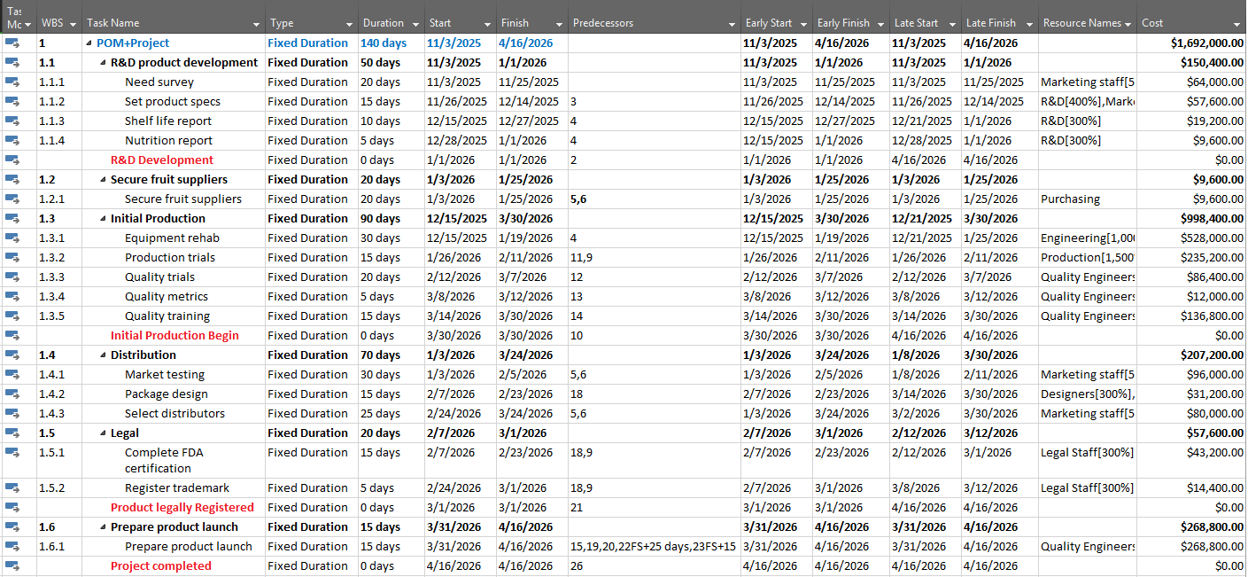
The POM+ Project - Big Kola Company – Part 3
10–38

Slide 39
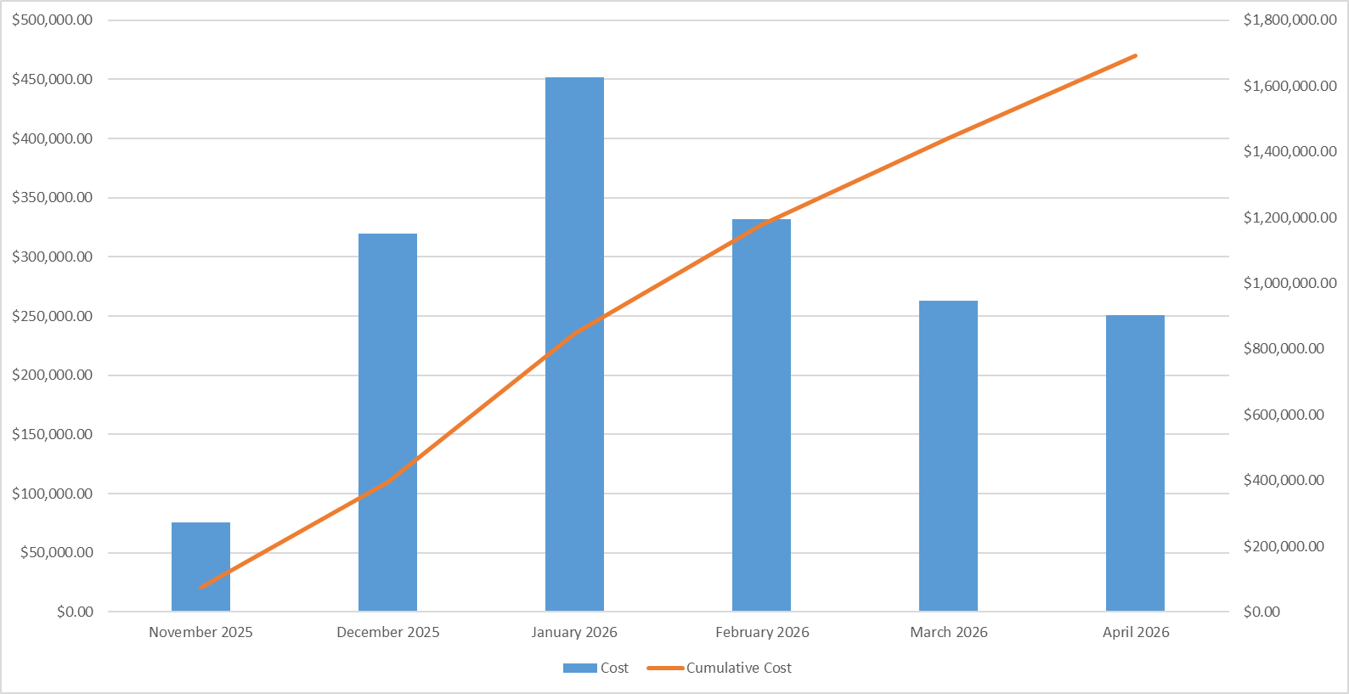
The POM+ Project - Big Kola Company – Part 3
Baseline Cost
$1,692,000.00
10–39

Slide 40
The POM+ Project - Big Kola Company – Part 3
10–40

Slide 41
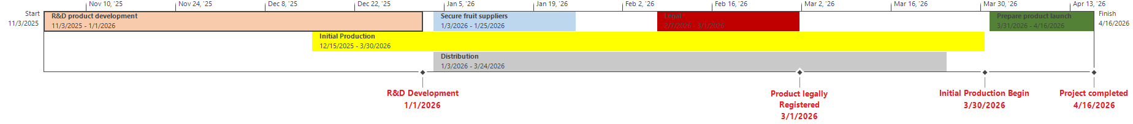
Lecture
Timeline
10
10–41

Slide 42
Lecture
The POM+ Project - Big Kola Company – Part 4
10
Assume that today is February 8, 2026, and Table A2.3 contains the tracking information for the project up till now. Enter this information into your saved baseline file and prepare a status report for the first three months of the POM+ project.
Your status report should also address the following questions:
1. How is the project progressing in terms of cost and schedule?
2. What activities have gone well? What activities have not gone well?
3. What are the CPI and SPI of the project?
4. What is the forecasted cost at completion (EAC_{f})?
5. What is the estimated date of completion?
10–42

Slide 43
Lecture
The POM+ Project - Big Kola Company – Part 4
10
Status Report February 8, 2026
Task Name | Actual Start | Actual Finish | Actual Duration
Need survey | 11/3/2025 | 11/29/2025 | 22 days
Set product specs | 11/30/2025 | 12/20/2025 | 18 days
Shelf-life report | 12/23/2025 | 1/4/2026 | 10 days
Nutrition report | 1/7/2026 | 1/11/2026 | 4 days
Equipment rehab | 12/23/2025 | NA | 23 days
10–43

Slide 44
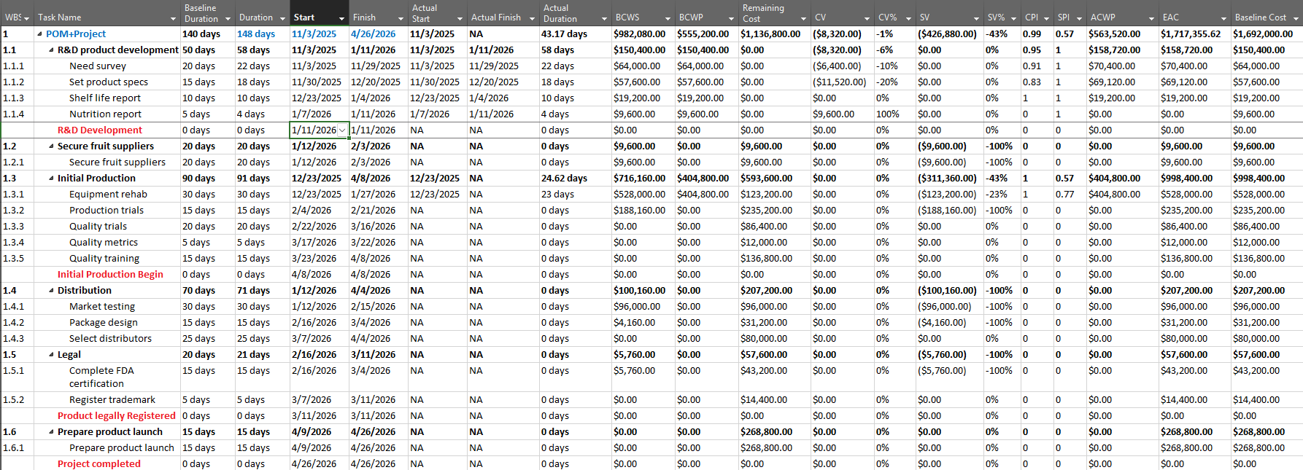
The POM+ Project - Big Kola Company – Part 4
10–44

Slide 45
Lecture
The POM+ Project - Big Kola Company – Part 4
10
SPI = EV/PV = $555,200.00 / $982,080.00 = 0.57
CPI = EV / AC = $555,200.00 / $563,520.00 = 0.99
SPI | CPI
0.57 | 0.99
Name | Remaining Cost | Baseline Cost | Cost Variance | EAC | ACWP | BCWS | BCWP | Finish
POM+Project | $1,136,800.00 | $1,692,000.00 | $8,320.00 | $1,717,355.62 | $563,520.00 | $982,080.00 | $555,200.00 | 4/26/2026
10–45

Slide 46
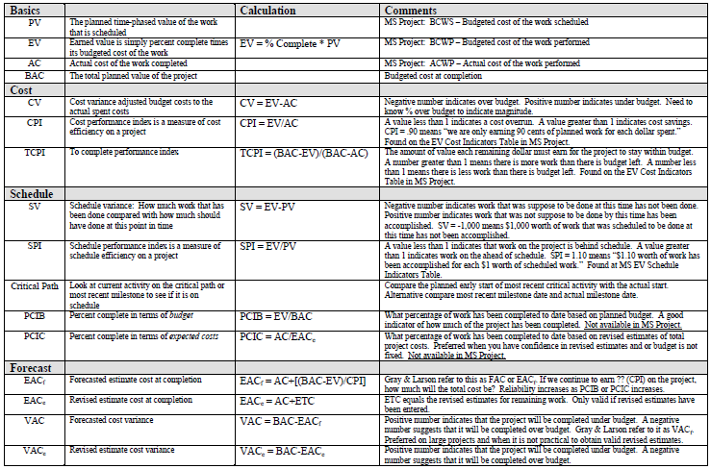
10–46

Slide 47
Lecture
10
Change The Task Type For More Accurate Scheduling
You just assigned a few people to a task, and the task duration got longer, not shorter as you expected. Or maybe the reverse happened. Either way, you’re stumped.
Some tasks, such as curing cement, take a fixed amount of time no matter how workers are assigned to pouring the cement.
Others, like building roads or software, grow or shrink in their durations, depending on the people and resources applied to them.
To change the task types to better reflect these realities, double-click the task, click Advanced, and change the task type.
10–47

Slide 48
Lecture
How Task Types Change Your Schedule
10
Project uses a scheduling formula that relates the three values of work, duration, and assignment units:
Work = Duration x Units
Setting a task’s type allows you to “fix” (or make unchangeable) one of these values.
Fixing one of the values places a priority on that value by telling Project not to change it when the other two values change.
10–48

Slide 49
Lecture
How Task Types Change Your Schedule
10
Work = Duration x Units
Work: Total Resource Hours required to Complete the task (Hours)
Duration: Number of Days to complete the task (Days)
Units: Number of Resource (Hours/Day) required to Complete the Task
Here’s a handy table to help keep all the moving parts of the scheduling formula in mind.
10–49

Slide 50
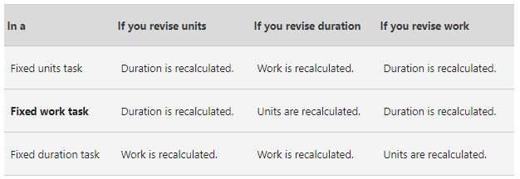
Lecture
How Task Types Change Your Schedule
10
https://support.microsoft.com/en-us/office/change-the-task-type-for-more-accurate-scheduling-b0b969ad-45bc-4e9e-8967-435587548a72
10–50

Slide 51
Project Resources And Time Management: Latest Developments
Lecture
10
The field is shifting fast toward AI-augmented planning, data-driven resourcing, and human-centered time practices.
Artificial intelligence (AI) is revolutionizing how project managers handle resource allocation and time management, especially in distributed and hybrid teams.
10–51

Slide 52
AI for Resource Optimization in Project Management
Lecture
10
Data-driven allocation: AI analyzes skills, availability, and workload across multiple locations to recommend the best resource assignments.
  Example: A global IT project uses AI to match cybersecurity experts in Europe with urgent tasks while balancing workloads for developers in Asia.
Predictive issue detection: AI forecasts bottlenecks, overallocations, or risks before they occur.
  Example: In a construction project, AI predicts that a shortage of skilled electricians will delay milestones, prompting managers to hire contractors early.
10–52

Slide 53
Lecture
Advanced Strategies Enabled by AI
10
Skills-based allocation: AI ensures tasks are assigned to the most qualified person, not just the next available.
Scenario modeling: Managers can simulate “what-if” situations (e.g., losing a resource, shifting deadlines) to see impacts instantly.
Dynamic prioritization: AI continuously reorders tasks based on changing dependencies and deadlines.
10–53

Slide 54
Resources
Project Management
The Managerial Process
Fifth Edition
By: Erik W. Larson
Oregon State University
Clifford F. Gray
Oregon State University
10-48

Slide 55



Thank You

