Slide 1


Strategic Capacity Planning for Products and Services
Prepared by Dr. Nagwan Al-Qershi
Lecture 5

Slide 2
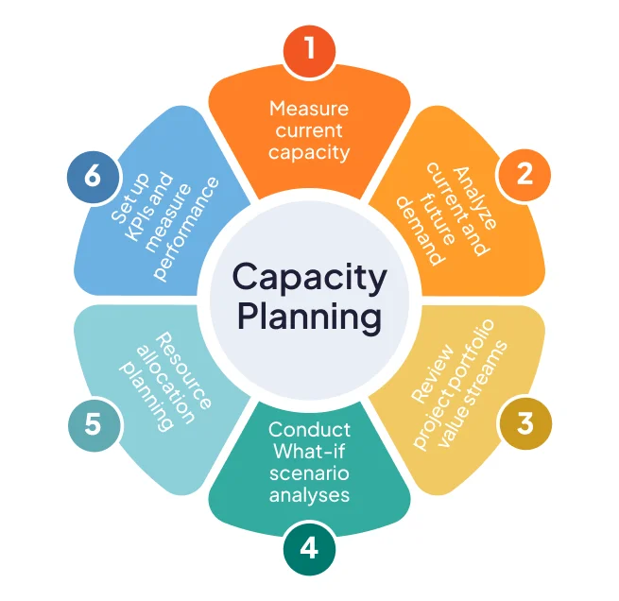
Capacity Planning
Capacity
  The upper limit or ceiling on the load that an operating unit can handle
  Capacity needs include
    Equipment
    Space
    Employee skills

Slide 3
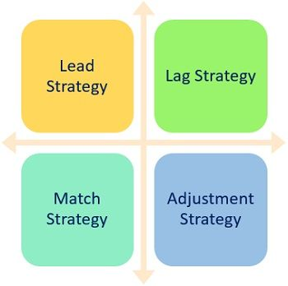
Strategic Capacity Planning
Goal
To achieve a match between the long-term supply capabilities of an organization and the predicted level of long-run demand
    Overcapacity→ operating costs that are too high
    Undercapacity→ strained resources and possible loss of customers

Slide 4
Capacity Planning Questions
Key Questions:
  What kind of capacity is needed?
  How much capacity is needed to match demand?
  When is it needed?
Related Questions:
  How much will it cost?
  What are the potential benefits and risks?
  Are there sustainability issues?
  Can the supply chain handle the necessary changes?

Slide 5
Capacity Decisions are Strategic
  impact the ability of the organization to meet future demands
  affect operating costs
  are a major determinant of initial cost but can be changed
  often involve long-term commitment of resources
  can affect competitiveness
  need to be planned for in advance due to their consumption of financial and other resources

Slide 6
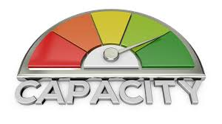
Capacity
Design capacity
  maximum output rate or service capacity an operation, process, or facility is designed for
Effective capacity
  Design capacity disadvantage allowances such as personal time, maintenance, and scrap
Actual output
  rate of output achieved--cannot exceed effective capacity.

Slide 7
Measuring System Effectiveness
Measured as percentages
Waiting line analysis can be useful for capacity design, especially for service systems
Actual output
  The rate of output achieved
  It cannot exceed effective capacity
Efficiency
Utilization

Slide 8
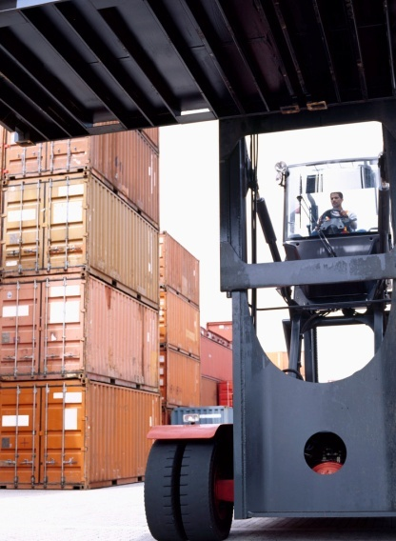
Example– Efficiency and Utilization
Design Capacity = 50 trucks per day
Effective Capacity = 40 trucks per day
Actual Output = 36 trucks per day

Slide 9
Factors of Effective Capacity
Facilities
Product and service factors
Process factors
Human factors
Policy factors
Supply chain factors
External factors
An example of an external factor that influences effective capacity is government safety regulations

Slide 10
Capacity Strategies
Leading
  Build capacity in anticipation of future demand increases
Following
  Build capacity when demand exceeds current capacity
Tracking
  Like the following strategy, but adds capacity in relatively small increments to keep pace with increasing demand

Slide 11
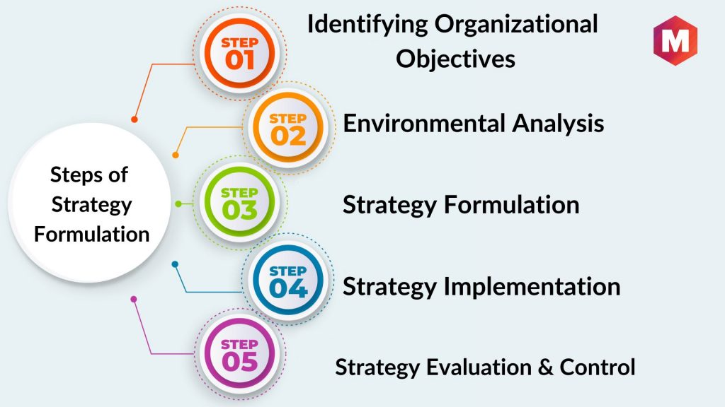
Strategy Formulation
Strategies are typically based on assumptions and predictions about:
  Long-term demand patterns
  Technological change
  Competitor behavior

Slide 12
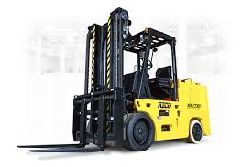
Capacity Cushion
  Extra capacity used to offset demand uncertainty
  Capacity cushion = 100% - Utilization
  Capacity cushion strategy
    Organizations that have greater demand uncertainty typically have greater capacity cushion
    Organizations that have standard products and services generally have greater capacity cushion

Slide 13
Steps in Capacity Planning
Estimate future capacity requirements
Evaluate existing capacity and facilities; identify gaps
Identify alternatives for meeting requirements
Conduct financial analyses
Assess key qualitative issues
Select the best alternative for the long term
Implement alternative chosen
Monitor results

Slide 14
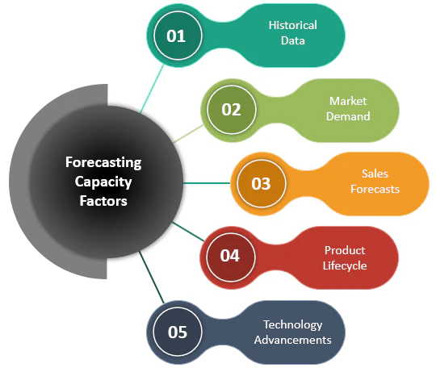
Forecasting Capacity Requirements
Long-term considerations relate to overall level of capacity requirements
Short-term considerations relate to probable variations in capacity requirements
Increasing capacity right before an unplanned operation will destruction the process's output

Slide 15
Service Capacity Planning
Service capacity planning can present several challenges related to:
  The need to be near customers
    Convenience
  The inability to store services
    Cannot store services for consumption later
  The degree of demand volatility
    Volume and timing of demand
    Time required to service individual customers

Slide 16
Demand Management Strategies
Strategies used to offset capacity limitations and that are intended to achieve a closer match between supply and demand
  Pricing
  Promotions
  Discounts
  Other tactics to shift demand from peak periods into slow periods

Slide 17
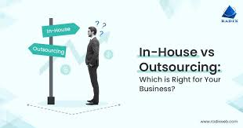
In-House or Outsource?
Increasing productivity and quality will result in increased capacity
Once capacity requirements are determined, the organization must decide whether to produce a good or service itself or outsource
Factors to consider:
  Available capacity
  Expertise
  Quality considerations
  The nature of demand
  Cost
  Risks

Slide 18

Developing Capacity Alternatives
Things that can be done to enhance capacity management
  Design flexibility
  Take stage of life cycle into account
  Take a “big-picture” approach to capacity changes
  Prepare to deal with capacity “chunks”
  Attempt to smooth capacity requirements
  Identify the optimal operating level
  Choose a strategy if expansion is involved

Slide 19
Optimal Operating Level
Average cost per unit
Minimum
cost
Optimal
Output
Rate
Rate of output

Slide 20
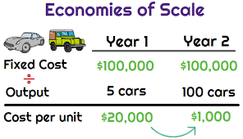
Economies of Scale
  If output rate is less than the optimal level, increasing the output rate results in decreasing average per unit costs
  Reasons for economies of scale:
    Fixed costs are spread over a larger number of units
    Construction costs increase at a decreasing rate as facility size increases
    Processing costs decrease due to standardization

Slide 21
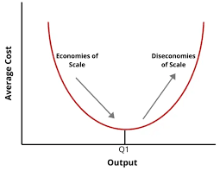
Diseconomies of Scale
Diseconomies of Scale
  If the output rate is more than the optimal level, increasing the output rate results in increasing average per unit costs
  Reasons for diseconomies of scale
    Distribution costs increase due to traffic congestion and shipping from a centralized facility rather than multiple smaller facilities
    Complexity increases costs
    Inflexibility can be an issue
    Additional levels of bureaucracy

Slide 22
Facility Size and Optimal Operating Level
Minimum cost & optimal operating rate are
functions of size of production unit.
Average cost per unit
Small
plant
Medium
plant
Large
plant
Output rate

Slide 23
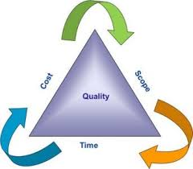
Constraint Management
  Something that limits the performance of a process or system in achieving its goals
  Categories
    Market
    Resource
    Material
    Financial
    Knowledge or competency
    Policy
Outsourcing some production is a means of supporting a constraint

Slide 24
Resolving Constraint Issues
Identify the most pressing constraint
Change the operation to achieve maximum benefit, given the constraint
Make sure other portions of the process are supportive of the constraint
Explore and evaluate ways to overcome the constraint
Repeat the process until the constraint levels are at acceptable levels

Slide 25
Financial Analysis
Cash flow
  The difference between cash received from sales and other sources, and cash outflow for labor, material, overhead, and taxes
Present value
  The sum, in current value, of all future cash flow of an investment proposal

Slide 26


Decision Theory

Slide 27

Decision Theory
A general approach to decision making that is suitable to a wide range of operations management decisions
  Capacity planning
  Product and service design
  Equipment selection
  Location planning

Slide 28
Characteristics of Suitable Problems
Characteristics of decisions that are suitable for using decision theory
  A set of possible future conditions that will have a bearing on the results of the decision
  A list of alternatives from which to choose
  A known payoff for each alternative under each possible future condition

Slide 29
Process for Using Decision Theory
Identify the possible future states of nature
Develop a list of possible alternatives
Estimate the payoff for each alternative for each possible future state of nature
If possible, estimate the likelihood of each possible future state of nature
Evaluate alternatives according to some decision criterion and select the best alternative

Slide 30
Causes of Poor Decisions
Decisions occasionally turn out poorly due to unforeseeable circumstances; however, this is not the norm.
More frequently poor decisions are the result of a combination of
  Mistakes in the decision process
  Bounded rationality
  Suboptimization

Slide 31
Decision Process
Steps:
  Identify the problem
  Specify objectives and criteria for a solution
  Develop suitable alternatives
  Analyze and compare alternatives
  Select the best alternative
  Implement the solution
  Monitor to see that the desired result is achieved
Errors
Failure to recognize the importance of each step
Skipping a step
Failure to admit mistakes
The greater the gap between the current and desired capacity the greater the opportunity to fail

Slide 32
Bounded Rationality & Suboptimization
Bounded rationality
  The limitations on decision making caused by costs, human abilities, time, technology, and availability of information
Suboptimization
  The results of different departments each attempting to reach a solution that is optimum for that department

Slide 33
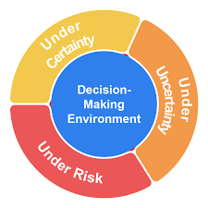
Decision Environments
There are three general environment categories:
  Certainty
    Environment in which relevant parameters have known values
  Risk
    Environment in which certain future events have probable outcomes
  Uncertainty
    Environment in which it is impossible to assess the likelihood of various future events

Slide 34
Decision Making Under Uncertainty
Decisions are sometimes made under complete uncertainty: No information is available on how likely the various states of nature are.
Decision Criteria:
  Maximin
    Choose the alternative with the best of the worst possible payoffs
  Maximax
    Choose the alternative with the best possible payoff
  Laplace
    Choose the alternative with the best average payoff
  Minimax regret
    Choose the alternative that has the least of the worst regrets

Slide 35
Example – Payoff Table
 | Possible Future Demand
Alternatives | Low | Moderate | High
Small Facility | $10 | $10 | $10
Medium Facility | 7 | 12 | 12
Large Facility | (4) | 2 | 16
A decision is being made concerning which size facility should be constructed
The present value (in millions) for each alternative under each state of nature is expressed in the body of the above payoff table

Slide 36
Example – Maximin Criterion
 | Possible Future Demand
Alternatives | Low | Moderate | High
Small Facility | $10 | $10 | $10
Medium Facility | 7 | 12 | 12
Large Facility | (4) | 2 | 16
The worst payoff for each alternative is
  Small facility: $10 million
  Medium facility $7 million
  Large facility -$4 million
Choose to construct a small facility

Slide 37
Example – Maximax Criterion
 | Possible Future Demand
Alternatives | Low | Moderate | High
Small Facility | $10 | $10 | $10
Medium Facility | 7 | 12 | 12
Large Facility | (4) | 2 | 16
The best payoff for each alternative is
  Small facility: $10 million
  Medium facility $12 million
  Large facility $16 million
Choose to construct a large facility

Slide 38
Example – Laplace Criterion
 | Possible Future Demand
Alternatives | Low | Moderate | High
Small Facility | $10 | $10 | $10
Medium Facility | 7 | 12 | 12
Large Facility | (4) | 2 | 16
The average payoff for each alternative is
  Small facility: (10+10+10)/3 = $10 million
  Medium facility (7+12+12)/3 = $10.33 million
  Large facility (-4+2+16)/3 = $4.67 million
Choose to construct a medium facility

Slide 39
Example – Minimax Regret
 | Possible Future Demand
Alternatives | Low | Moderate | High
Small Facility | $10 | $10 | $10
Medium Facility | 7 | 12 | 12
Large Facility | (4) | 2 | 16
Construct a regret (or opportunity loss) table
  The difference between a given payoff and the best payoff for a state of nature
 | Regrets
Alternatives | Low | Moderate | High
Small Facility | $0 | $2 | $6
Medium Facility | 3 | 0 | 4
Large Facility | 14 | 10 | 0

Slide 40
Example – Minimax Regret
 | Regrets
Alternatives | Low | Moderate | High
Small Facility | $0 | $2 | $6
Medium Facility | 3 | 0 | 4
Large Facility | 14 | 10 | 0
Identify the worst regret for each alternative
  Small facility $6 million
  Medium facility $4 million
  Large facility $14 million
Select the alternative with the minimum of the maximum regrets
  Build a medium facility

Slide 41



Thank You

