Slide 1


Design Thinking
Prepared by Dr. Aya Mohamed
ENT 621
Master of Entrepreneurship (semester 2)
Lecture 1

Slide 2

Design Thinking
Topics
v
The Emergence of Design thinking
The core concepts of design thinking
What is Design Thinking?
Features
Process
Thinking

Slide 3
Design Thinking
Topics
v
The Emergence of Design thinking
The core concepts of design thinking
What is Design Thinking?
The features of Design Thinking
Convergent Vs Divergent Thinking
The Meaning of Co-design
Features
Process
Thinking

Slide 4
What is Design Thinking?
1-
v
•The future has many names.
For the weak it is the unattainable.
For the fearful it is the unknown
For the brave it is the chance.“ – Victor Hugo, French poet and novelist

Slide 5
What is Design Thinking?
1-
v
•The future has many names.
For the weak it is the unattainable.
For the fearful it is the unknown
For the brave it is the chance.“ – Victor Hugo, French poet and novelist
unattainable
unknown
Chance

Slide 6
The emergence of design thinking
v
The origins of design thinking are generally associated with Rolf Faste in Stanford and David Kelley in IDEO
It grew from growing realisation in the 1970s onwards that design problems are not like the ‘solvable’ and quasi-mathematical problems in the natural sciences
Design thinking is now one of the leading business concepts in a range of industries

Slide 7

The core concepts of design thinking
v
Design problems are ‘wicked’
  Not bounded – limitless number of variables
  No stopping rule – they are never completed and each problem is in some way(s) unique
  Solutions are not correct/incorrect – some are better/some are worse

Slide 8
The core concepts of design thinking
v
Design problems are ‘wicked’
  Not bounded – limitless number of variables
  No stopping rule – they are never completed and each problem is in some way(s) unique
  Solutions are not correct/incorrect – some are better/some are worse
At its core, design thinking is about understanding users’ needs
  The better defined a problem, the better it can be solved

Slide 9

The core concepts of design thinking
v
Design thinking is as much a mindset, central to which is
  Human-centrism
  Empathy/contact with users
  Open-mindedness

Slide 10
The core concepts of design thinking
v
Design thinking is as much a mindset, central to which is
  Human-centrism
  Empathy/contact with users
  Open-mindedness
Design thinking also emphasises the diversity of teams
  A good designer is ‘T-shaped’
  Duplicate expertise is not so much valued

Slide 11


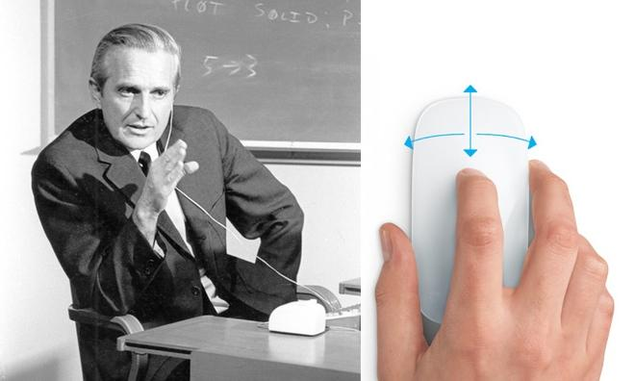

Design Thinking
• Design Thinking is a comprehensive customer-oriented innovation approach that aims to generate and develop creative business ideas or entire business models.
• The approach is ultimately applicable to all kinds of business ideas – whether they have a product or service character.
The first mouse for the Macintosh computer was created after a similar approach,
the first toothbrush with a wider ergonomic shaft.

Slide 12
The features of Design Thinking
2-
v
1- Design Thinking is an integrative approach: This means that for problem solving, the process of problem solving is considered together with its framework conditions.
The problem analysis and solution development are considered systematically and holistically in the form of a process.
The various experts necessary for problem analysis and solution development are involved and enter exchange with each other

Slide 13
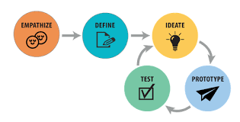
The features of Design Thinking
2-
v
1- Design Thinking is an integrative approach: This means that for problem solving, the process of problem solving is considered together with its framework conditions.
The problem analysis and solution development are considered systematically and holistically in the form of a process.
The various experts necessary for problem analysis and solution development are involved and enter exchange with each other

Slide 14
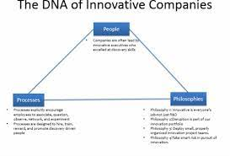

The features of Design Thinking
2-
v
The working environment for this process is designed to promote creativity.
The three Ps of Design Thinking: People (the human being),
Process (the problem-solving process) and Place (the working spaces) must be considered for a successful idea development.
A fourth P can be Partnerships, since many partners must be involved in the development and implementation of ideas

Slide 15
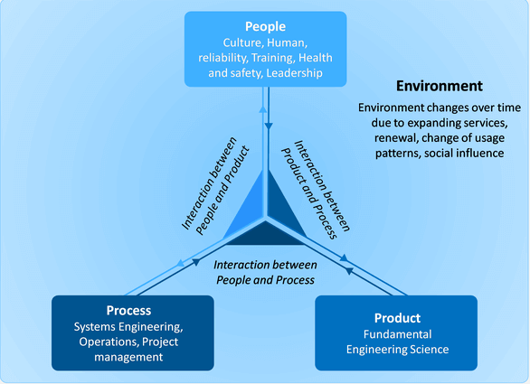
The features of Design Thinking
2-
v
The DNA of Innovative Companies

Slide 16

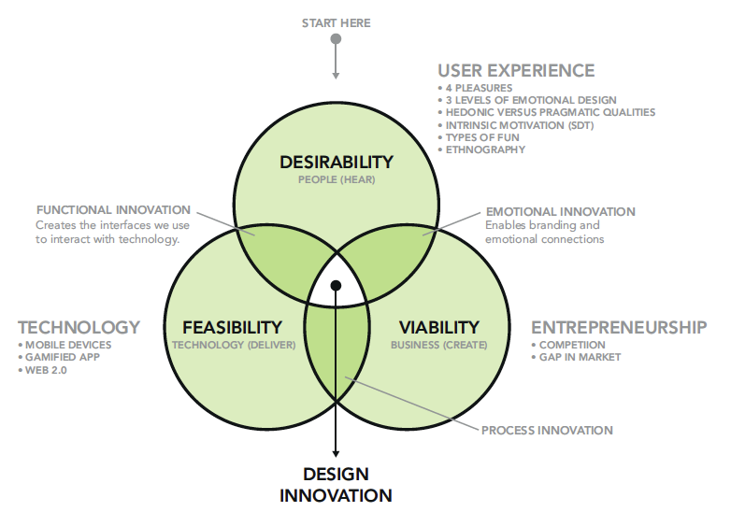

Slide 17

Amazon:
Amazon has grown to become the world’s largest on-line retailer, disrupting industries and dismantling market leaders. Amazon grew from an on-line bookstore to the world's largest on-line retailer, greatly expanding its product and service offerings through a series of innovations. Working on offering the best customer service, lowest prices and convenience, Amazon has earned customer acceptability and loyalty, becoming a dominant force diversifying into many digital businesses.

Slide 18

Google:
Google has made innovation an everyday process. While some companies worked on perfecting their product before its initial release, Google followed a unique ‘launch and iterate’ process to innovation. Google relies on its employees to augment its culture of innovation. Google’s “70/20/10’ innovation model gives lot of freedom to Google’s employees to work on their preferred projects.

Slide 19

Apple :
Apple is one of the most valuable companies in the world in terms of market capitalization. Apple has led the global technology market by developing innovative products such as the Mac, the iPod, the iPhone, and the iPad which redefined their respective markets. Innovation is of Apple's corporate DNA. Apple is innovative because of its ability to iterate designs, devices, and functionality and create products that became breakthrough products. Apple challenge is to keep Apple cutting edge

Slide 20
The features of Design Thinking
2-
v
2- Focuses on early customer orientation:
Design Thinking starts with people and not with a technology or a business goal.
Ultimately, the customer should have a decisive influence on the
"go/stop" decisions in the process.

Slide 21
The features of Design Thinking
2-
v
2- Focuses on early customer orientation:
Design Thinking starts with people and not with a technology or a business goal.
Ultimately, the customer should have a decisive influence on the
"go/stop" decisions in the process.
It is no longer sufficient to question customers about the classic market research instruments. Traditional methods of (testing) market research often only deliver disappointing results in the search for innovations

Slide 22
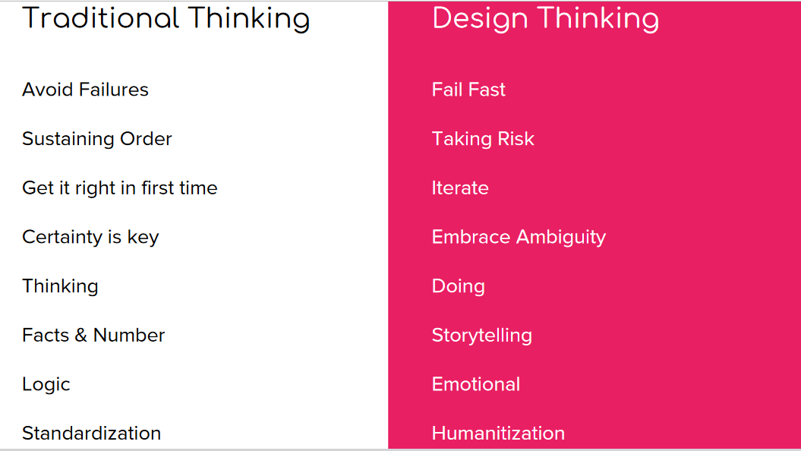

Slide 23
The features of Design Thinking
2-
v
3- Emphasizes Empathy:
The central element is to put oneself in the position of the customer/user and to observe him in detail.
Empathy can create distance to the innovator’s own person on the one hand and proximity to the customer on the other. In other words, this approach creates customer orientation.
Developments can thus be better aligned with the customers and, if necessary, prioritized to what extent they can satisfy the needs and wishes of these customers.

Slide 24
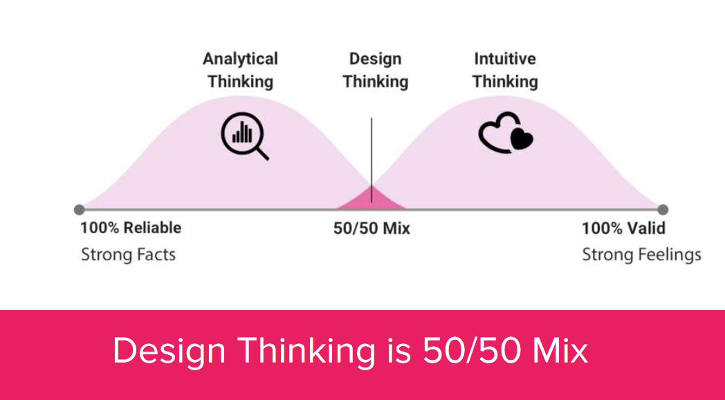

Slide 25
The features of Design Thinking
2-
v
4- Strives to make ideas tangible at an early stage:
Prototypes must be created as quickly as possible – this also applies to services.
It is not a question of testing a perfect product, but quite the opposite: individual functions/features/characteristics or activities of the product/service offer are to be checked by the customer.
The maxim when creating or selecting a prototype is: as simple as possible, as meaningful as necessary

Slide 26
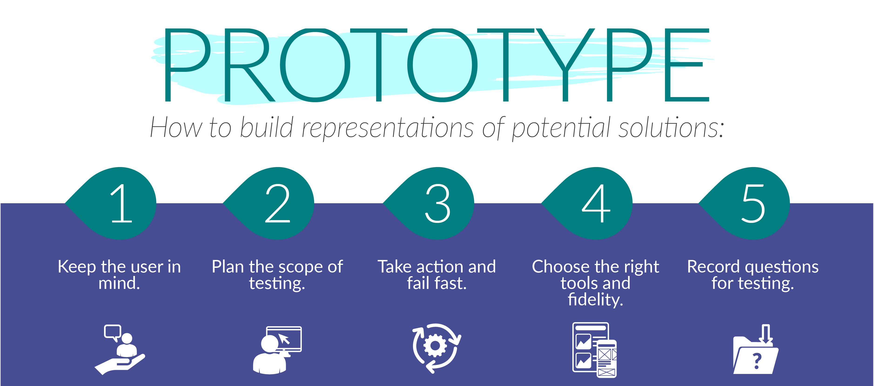

Slide 27
The features of Design Thinking
2-
5- Frequent iteration loops between the development phases:
The return to a previous phase is not a mistake but shows the learning success in this process.
Failure is an integral part of this approach and should be tolerated, accepted and even expected by all participants.
"Fail fast to succeed sooner"
v

Slide 28
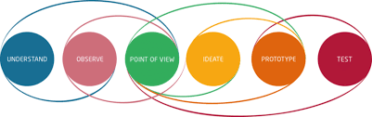
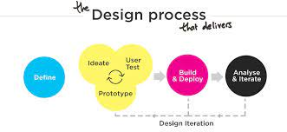
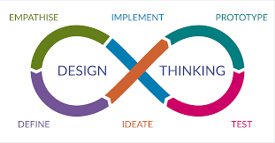
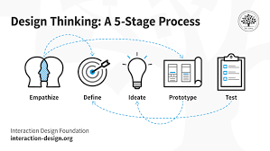

Slide 29
The features of Design Thinking
2-
6- Creates team-oriented, creative working spaces:
"Me"-spaces (for individual work) and "We"-spaces (for group work) are flexible and inspiring to equip for individual, group and
plenary work.
It can be advisable to choose different locations, rooms or furniture
arrangements for the different Design Thinking phases in order to create new atmospheres (suitable for the respective work) again and again
v

Slide 30
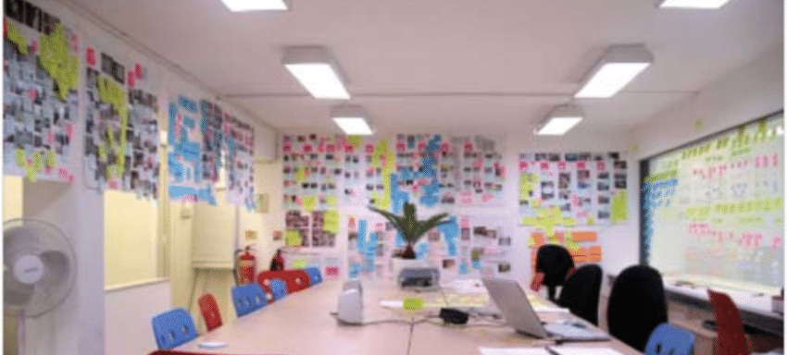
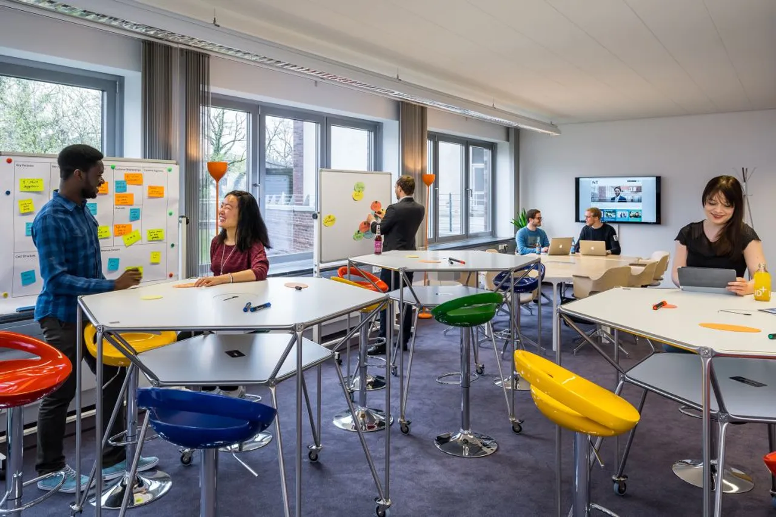
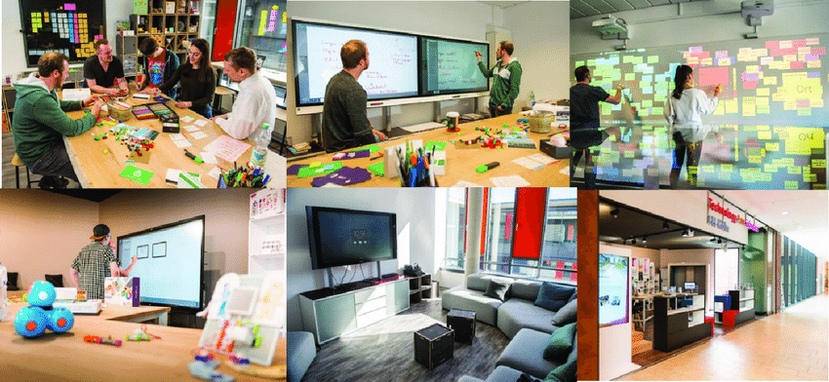

Slide 31
The features of Design Thinking
2-
v
6- Creates team-oriented, creative working spaces:
Pay attention to the diversity of the participants.
Design Thinking combines interdisciplinary breadth and technical depth: The knowledge, experience and perspectives of a team of engineers, natural scientists, humanists, social scientists and economists, etc., who have the ability for multidisciplinary cooperation, are put to good use.
Furthermore, differences in age, gender, affiliation to the company (long-time/for the time being short in the company), experience with the topic (intensive, little, not at all) and/or personality type (introverted, extroverted, etc.) should be considered

Slide 32
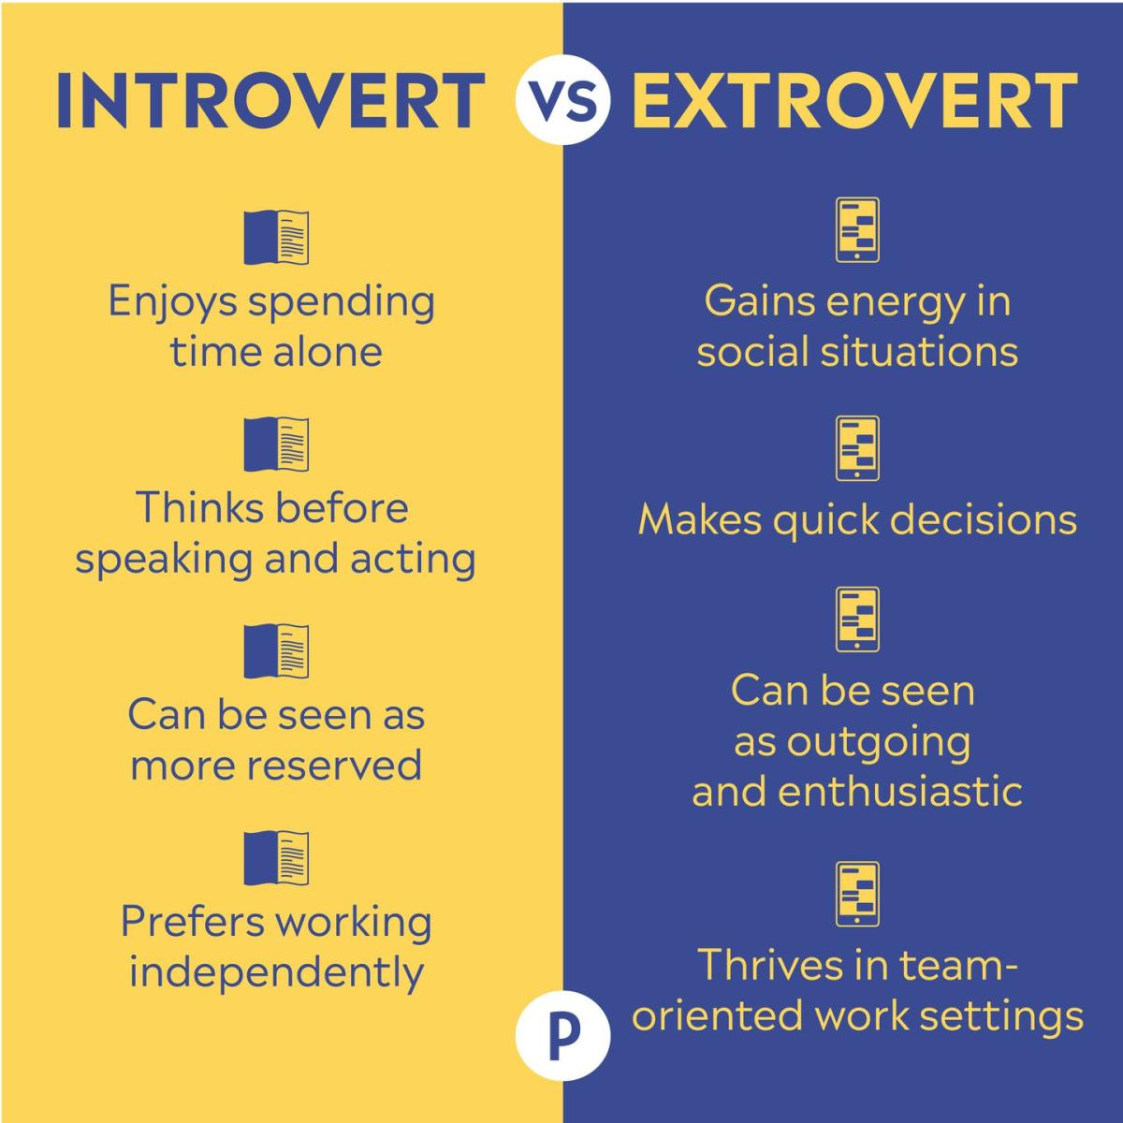

Slide 33
The features of Design Thinking
2-
v
7- Combines analytical phases (collecting, organizing, evaluating information) and synthetic phases (developing, testing, improving solutions).
In the first part, the problem is analyzed in detail (so-called problem space), where the focus is on what? and why? (what is the problem?
why is it a problem?).

Slide 34
The features of Design Thinking
2-
v
7- Combines analytical phases (collecting, organizing, evaluating information) and synthetic phases (developing, testing, improving solutions).
In the first part, the problem is analyzed in detail (so-called problem space), where the focus is on what? and why? (what is the problem?
why is it a problem?).
Only in the second part concrete solutions are developed and tested (so-
called solution space): Here the question is asked about the "how (something can be solved)".

Slide 35
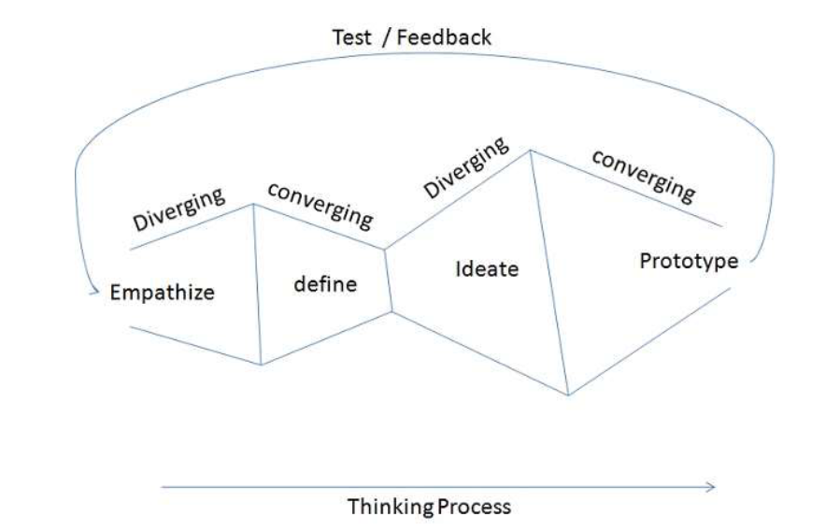

Slide 36
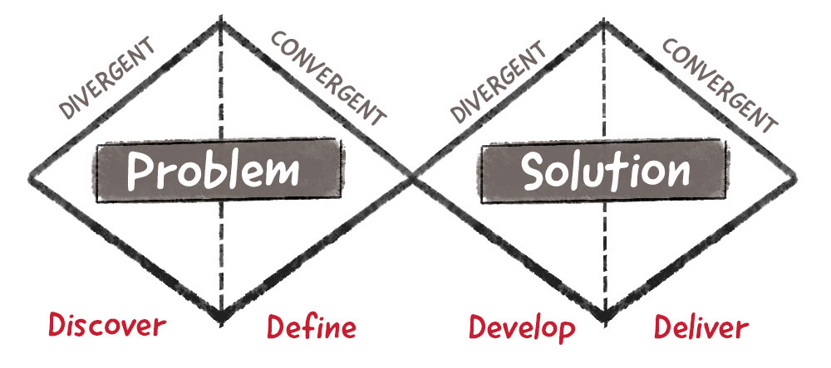
Conclusion:
problem-solving isn’t “one size fits all”
In summary, the interplay between divergence and convergence allows us to explore a wide range of possibilities and ideas, evaluate them, and refine them until we arrive at an effective, human-centered solution. This process is non-linear and should place stakeholders and users at the very heart of the creative process.

Slide 37
Integrative Approach
Early customer Orientation
Emphasize Empathy
Make Ideas Tangible

Slide 38
Integrative Approach
Early customer Orientation
Emphasize Empathy
Make Ideas Tangible
Iteration Loops
Team Oriented- Creative Working Space
Analytical phase + synthetic phase

Slide 39
Design Thinking
Wrap Up
v
The Emergence of Design thinking
The core concepts of design thinking
What is Design Thinking?
The features of Design Thinking
Convergent Vs Divergent Thinking
The Meaning of Co-design
Features
Process
Thinking

Slide 40


Thank You

