Slide 1


Project Management Technologies
PMG 312
Prepared by Dr. Majid Saad
PMP, PMI-ACP, PMI –ACP
PMG 312- L6
Ch. 7 - Developing the WBS
5

Slide 2



Project Management Technologies
PMG 312
PMG 312- L6
Ch. 7 - Developing the WBS
Prepared by
Dr. Majid Saad

Slide 3
Revision
CH 6-Defining Project
Scope planning and definition.
Staffing and team management
Scope statement
Project and product objectives
Product or service requirements and characteristics
Product acceptance criteria
Project boundaries
Project requirements and deliverables

Slide 4
Revision
CH6- Defining Project
Project constraints
Cost estimate
Project assumptions
Project organization/team assessment
Defined risks
Milestones
Project configuration management requirements
Approval requirements

Slide 5
Lecture outline
Developing the work breakdown structure
Standards organizations
Product-oriented WBS.
Defining project work units
Work package dictionary variables
Role and structure of the project WBS
Requirements “ibilities”
WBS design rules of thumb
x Contents
WBS decomposition mechanics
Sample WBS
WBS numbering scheme
Standardized templates
WBS dictionary
Project templates
Project scope baseline

Slide 6
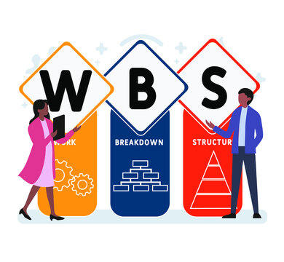
Developing the work breakdown structure

Slide 7
Standards organizations
The U.S. Department of Defense (DoD)
PMI organizations are two of the most recognized WBS thought and standards leaders for this topic.

Slide 8
Create WBS
Create WBS is the process of subdividing project deliverables and project work into smaller, more manageable components. The key benefit of this process is that it provides a framework of what has to be delivered. This process is performed once or at predefined points in the project.
The WBS is a hierarchical decomposition of the total scope of work to be carried out by the project team to accomplish the project objectives and create the required deliverables. The WBS organizes and defines the total scope of the project and represents the work specified in the current approved project scope statement.

Slide 9
Standards organizations
The DoD model has extensive definition of terms focusing on tangible products and standardized templates, while the PMI description softens that view to a more general “deliverable,” which could be interpreted to be any project objective.
“you cannot control what
you have not planned.”

Slide 10
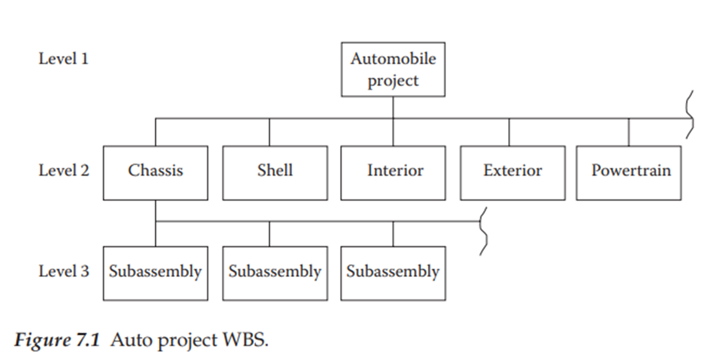
Product-oriented WBS
A WBS essentially divides overall project scope requirements into a tree structure of work units that are created by decomposing the project scope statement into smaller and smaller segments until all work and required deliverables are defined.

Slide 11
Product-oriented WBS
The top one or two decomposition levels of a WBS identify a high-level view of the project’s logical requirement, with little regard for the technical work required to achieve those goals (i.e., note the main auto components).
As the lower levels are defined, these logical groupings are further decomposed into work units required to produce that segment of the overall project.

Slide 12
Product-oriented WBS
The goal of this scoping exercise is to identify all of the work required to execute the entire project. In other words, if it is not shown in the WBS, it is not considered to be included in the project scope.
This process helps one to ensure that project requirements are properly translated into understandable work units and this definition later helps in status tracking.

Slide 13
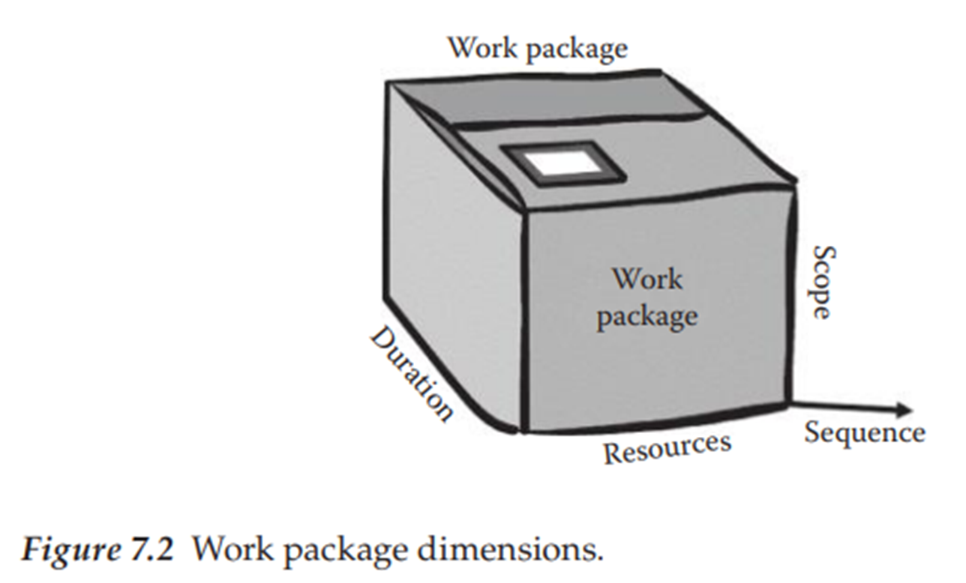
Defining project work units
In addition to the schematic تخطيطيbox and hierarchy structure shown in Figure 7.1, it is also necessary to supplement this view with a companion WBS Dictionary that further defines specifics related to each work unit.
Envision a “package” of work that has been defined as part of a larger project.
These “packages” can be any type of project task such as installing piping, testing software, creating a subassembly, or producing a user guide.
For now, simply view each box as a work activity or collection of lower-level work units.

Slide 14
Defining project work units
The official vocabulary term for the lowest-level work units in the tree structure is a work package (WP).
One metaphor for a WP is to view it as a box such as the one illustrated in Figure 7.2.
In this view, the focus is on the three dimensions representing time, cost, and scope (of work).
This visual metaphor will be used throughout the textbook to symbolize various aspects of project management roles.

Slide 15
Defining project work units
To complete a comprehensive plan that includes more than surface level definitions, the project team must make appropriate technical decisions regarding how to organize and view the work necessary to produce the desired output.
One model view of project management is to envision the WP as a micro-building block for schedule development.
If each WP has a defined duration and cost dimension, then stacking them into some technical sequence defines both the initial direct schedule and budget for the project.
Because of this definitional role, the WP becomes a major ingredient in the management process.

Slide 16
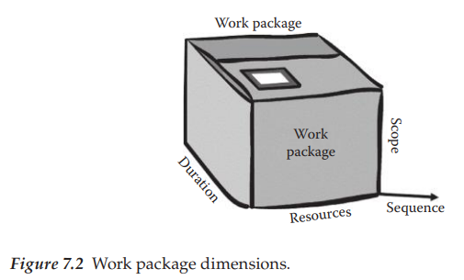
Defining project work units

Slide 17
Defining project work units
As the WBS boxes are defined, there is a common nomenclature for the basic elements.
The following titles will be used here to identify the role of each box type:
  Top box—project goal
  First-level boxes—major subsets of the project goal
  Summary boxes—collections of lower-level boxes (e.g., subsystems and phases)
  Planning boxes—larger boxes not yet decomposed but needed to define the full project scope
  Work packages—lowest-level boxes that represent the fundamental work units of the project assigned to specific organizations teams

Slide 18
Work package dictionary variables
Effective project WP definition requires many related items of information to fully assess the content of the work and integrate it into the rest of the project.
Conceptually, it is desirable to capture this information into a single data repository that is officially called a WBS Dictionary (PMI 2008).
Such a repository may not actually be visible by that name in real world projects, but the type of data described below will need to exist somewhere in project records.

Slide 19
Work package dictionary variables
To estimate and track project activities, it is necessary to define the following types of parameters for each WBS box:
  ID reference—this is a WBS box code used to identify where the work unit fits into the overall structure (e.g., the WBS chart of accounts).
  Work effort estimated for each skill group (e.g., hours and skills of each skill type).
  Estimated duration for the task given the planned labor resource allocation.
  Material requirements and other cost associated with each work unit.
  Name of individual responsible for managing the activity.
  Organizational unit assigned to do the work (e.g., performing organization).

Slide 20
Work package dictionary variables
  Defined constraints (e.g., activity must be finished by . . .).
  Key assumptions made in the course of the planning activity.
  Risk level for the activity—more work will be needed on this aspect later. For now, we will simply indicate the perceived risk level (e.g., H, M, or L)
  General comments—free-form statements that help describe the technical aspects of the work required.

Slide 21
Role and structure of the project WBS
As the project definition moves from the high-level vision-oriented what definition of requirements downward toward the technical how, there is a need to translate this into something more akin to a structured technical work definition.
This translation process is reflected in the WBS box structure and embedded in the box definitions is both a requirements and a corresponding work relationship.

Slide 22
Role and structure of the project WBS
A related value of this approach is that it serves as a good communication tool between the user’s plain language requirement statement and the technical work required to produce those requirements.
Both technical and nontechnical groups are able to understand what the tree structure represents and for that reason, it provides a communications bridge to confirm that the stated requirements are being recognized by the defined project work units.

Slide 23
Requirements “ibilities”
On the surface, the process of defining requirements sounds pretty simple: identify what the customer wants and then proceed to translate that into technical goals that will guide the design process.
Beyond the basic mechanics of developing project work units, there are several other scope-related issues that are not obvious in this process.

Slide 24
Requirements “ibilities”
We will describe these as the following nine ibilities and one more general design attribute:
  Traceability
  Affordability
  Feasibility
  Usability
  Producibility
  Maintainability
  Operability
  Scalability
  Sustainability
  Simplicity
التتبع
القدرة على تحمل التكاليف
جدوى المشروع
سهولة الاستخدام
قابلية الإنتاج
قابلية الصيانة
قابلية التشغيل
قابلية التوسع
الاستدامة
البساطة

Slide 25
Requirements “ibilities”
These items represent supplementary definition to the defined product or process goal. Each of the ibilities should be quantified as part of the overall specification elaboration to ensure that the best design choices are made.
In many situations, the design question becomes one of trade-offs between time, cost, scope, and quality.
Examples of these trade-offs are listed below:
  Cost of development versus future maintenance cost
  Quicker development versus more custom fit
  Ease of use versus lower development cost or time
  Value engineering (VE)—how to produce the product more efficiently based on ibilities priorities
  Risks associated with a particular approach

Slide 26
WBS design rules of thumb
Regardless of the specific methodology used, the key construction principle is to capture the project requirements, organize those into a single tree structure, and then manage the project using this structure.

Slide 27
WBS design rules of thumb
There are several alternative design groupings for the higher layers of a WBS structure. Samples of these are as follows:
  Using standard templates created from similar recurring project types.
  Modifying the structure used from a successful similar effort.
  Defining the major physical product groups and then decomposing that structure downward (e.g., note the physical house components).
  Starting with lower-level defined work elements and aggregating them upward into a logical hierarchical structure (i.e., bottom-up design).
  Packaging the structure using the required deliverables as guidance (Schwalbe 2006, 163).
  Defining major phases at the top level and then structuring downward using one of the other schemes mentioned above.

Slide 28
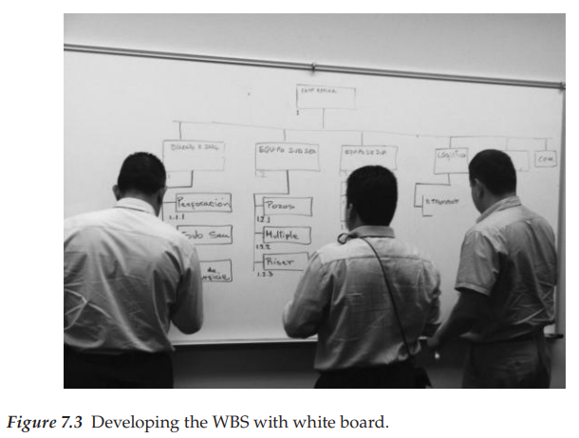
WBS decomposition mechanics

Slide 29
WBS decomposition mechanics
Regardless of the method used, the resulting structure must represent the total project work required.
In the ideal model, each box in the WBS will contain a corresponding SOW that can be used by the assigned resources to execute that incremental element and its associated deliverables.
In addition, quality and other related technical items would be documented sufficiently to support future testing and other operational aspects.
At some point in the planning process, the decision could be made to move forward into execution with the components that are defined adequately and then leave further elaboration of the remainder for later in the execution phase.

Slide 30
WBS decomposition mechanics
Recognize that this also means that there will be a higher potential for error in the defined planned time and cost values and possibly other “hidden” issues that were not defined.
These higher-level non-decomposed work units are called planning packages (PP).

Slide 31
WBS decomposition mechanics
The development of the WBS top level represents the project’s highest view.
There is no right or wrong answer to this structure, but it should represent the way in which the overall project scope is best understood and managed.
The theory and concepts related to a WBS are quite easy to understand; however, a basic question remains regarding how to identify the correct structure for a specific project.

Slide 32
WBS decomposition mechanics
The list below contains items that may help decide on the proper high-level packaging structure:
  Are there logical partitions in the project? What major phases make sense? These could be candidates for the second-level grouping.
  Are there major milestones that could represent phases?
  Are there business cycle constraints that need to be considered (e.g., tax period and scheduled down time)?
  Are there financial constraints that might dictate phases?
  What external company life cycles might impact the project?
  Are there risk areas that need to be specifically recognized (e.g., technical, organizational, political, ethical, user, and legal)?

Slide 33
WBS decomposition mechanics
In addition, the list offers some basic decomposition steps to consider in evolving the structure below the top layer (adapted from Haugan 2002):
  Identify the top-level view that represents how the project will be defined within its program, phase, or project component structure.
  Identify the goals of the entire project. Consider each primary objective as a possible top-level element in the WBS hierarchy. Review the SOW and project scope documents to aid in this decision.
  Identify each phase or component needed to deliver the objectives in step one. These will become second-level elements in the structure.
  Break down each project phase into the component activities necessary to deliver the above levels. These will become third-level WBS elements.
  Continue to break down the higher-level activities into appropriate work units.

Slide 34
WBS decomposition mechanics
This process should continue downward until the work units are well-defined and linked to a single organizational unit owner.
The lowest level defined work units should fit into the size definition supported by the organization but be small enough to support manageability.
If this is not feasible at this stage, the unit should be labeled a PP and handled accordingly.
The group development process should normally work from a top-down view.

Slide 35
WBS decomposition mechanics
Once a particular WBS high level is defined, it may be possible for a portion of that structure to be allocated to a sub-team for more segmented and detailed discussion for that portion.
This review should generally occur on a level-by-level basis through at least the major project segments.
As the process moves downward, the horizontal level of interaction across the structure often declines as the work begins to align itself into more independent units.
As the final WBS structure is completed, it is still necessary to make formal scope-oriented presentations to key organization and technical stakeholders to ensure that the overall plan is coherent.

Slide 36
WBS decomposition mechanics
The process of decomposition into lower levels of detail and review remains essentially the same.
Failure to resolve the scope of work issue at this stage creates multiplied negative consequences later.
Some level of the overall project design should be shared with future users and key management.
This activity is technical and marketing oriented.
Later, as the project is completed, the WBS helps in the review of the outcome status.
As new project team members arrive on the scene, a WBS and its dictionary serve an equally valuable role in providing technical and work insights into the project. This helps with team communication and provides a spirit of collaboration.

Slide 37
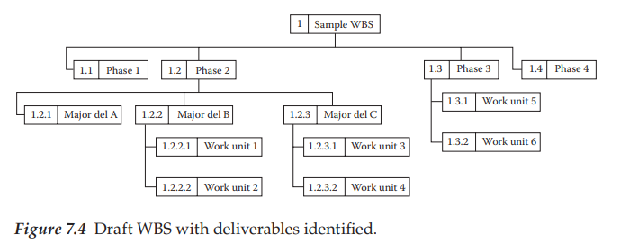
Sample WBS
Figure 7.4 illustrates a sample abstract WBS, except in this case, the higher-level boxes has been labeled as a phase-oriented structure rather than physical product decomposition.
In this format, the focus is on ensuring that the defined project deliverables are covered in each phase.
This format helps to link requirements to the associated work units.

Slide 38
Sample WBS
In other words, if work unit 1.2.3.1 is to produce a specified deliverable, that should be part of a future quality check upon completion of that activity.
Keep in mind that the number of levels in a WBS structure depends on the size and complexity of the project.

Slide 39
Sample WBS
Figure 7.4 illustrates a sample abstract WBS, except in this case, the higher-level boxes has been labeled as a phase-oriented structure rather than physical product decomposition.
In this format, the focus is on ensuring that the defined project deliverables are covered in each phase.
This format helps to link requirements to the associated work units.
www.midocean.ae

Slide 40
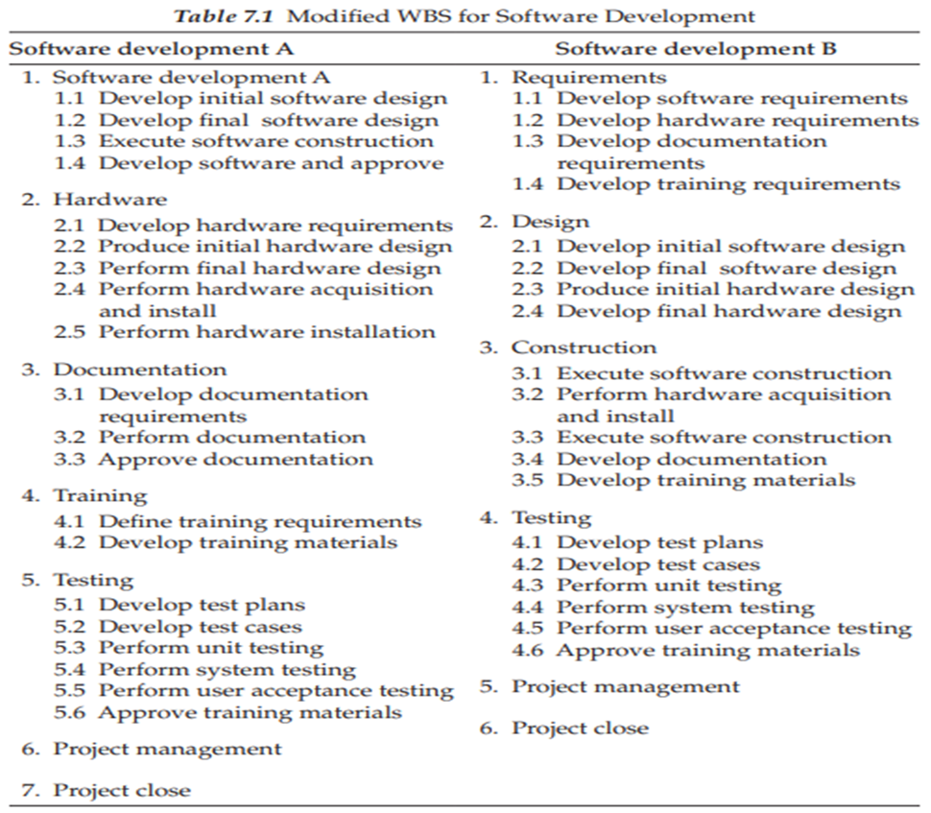
WBS structure model comparison
Which one is right? Which one is best?
If the performing organization had a strong departmental culture, option A might reflect that view best, whereas option B looks at the effort more as an organizationally coordinated group of activities evolving through life cycle phases and that may be the preferred view.
Note that the traditional method for software development is to view the preferred work process as one that moves through a defined life cycle process similar to option B.
Regardless of the actual structure used, the design of the overall WBS architecture should be one of the early project team conversations.
www.midocean.ae

Slide 41
Project scope baseline
Once the overall project scope as represented by the WBS has been approved, this view with all of its related data is baselined (frozen).
The approved base point then serves as a control framework for the follow-on stages of the project.
For example, the initial scope baseline represents an overall project deliverable and work definition specification that has been formally agreed upon by the customer and the management as representing the project requirements.
However, as other related planning decisions are made in areas such as procurement, risk, quality, HR, and others, the early project work definition can change somewhat.

Slide 42
Project scope baseline
This has the impact of changing the WBS box detail. As these decisions evolve through the formal planning phase, a final WBS scope view will be presented to the management that includes all of the planning stage decisions.
This view would represent the approved scope baseline and becomes an official control definition artifact.
Actually, recognize that the term baseline can apply to other project metrics such as time, cost, quality, technical performance, and so on.
Also, as the project moves into execution and major changes occur, the project management board might decide to approve yet another set of baselines based on the newly approved and revised project definition.

Slide 43
Project scope baseline
This version could be titled revised baseline and this change process is called rebase-lining. From a management viewpoint, a defined baseline is used to compare actual project performance.
In most cases, the initially approved baseline will be the one used to compare project performance.
Changing the schedule every week and saying you are on schedule is similar to changing the baseline frequently and saying that you are working on the same project. Both are misleading.
The iron law of control says that the project would always be comparatively measured from the original approved version, regardless of any other comparisons.

Slide 44
summary
The Work Breakdown Structure (WBS) is a hierarchical decomposition of the total scope of work to be carried out by the project team to accomplish the project objectives and create the required deliverables.
It organizes and defines the total scope of the project, subdividing the work into smaller, more manageable components.
Each descending level of the WBS represents an increasingly detailed definition of the project work. The lowest level components, known as work packages, can be scheduled, cost estimated, monitored, and controlled.

Slide 45
Benefits of the WBS:
Provides a clear and organized view of the project scope.
Facilitates communication and understanding among stakeholders.
Helps in assigning responsibilities and resources.
Serves as a foundation for cost estimation, scheduling, and risk management.

Slide 46



Thank You

