Slide 1

The Cultures of New Media (DGM 715)
Prepared by
Dr. Mohamed Owies
Lecture No.7
The Cultures of New Media (DGM 715)

Slide 2


Lecture 7
The content of Lecture 7
The lecture 7 sheds light on a number of important topics, including the following:
Videos of Affinity
Is YouTube a social medium?
What Is Social Media?
Types of Social Media Platforms
Online Videos as Social Actions
Layers of Visual Sociality
Digital Citizens and Divides

Slide 3


Lecture 7
Videos of Affinity
Affinity spaces is a name for a type of social setting that sometimes takes shape online. The term was coined by linguist and educational psychologist James Paul Gee (2005), who suggests that rather than communities, we should talk of spaces of affinity in order to capture current forms of digitally social affiliation. In affinity spaces, people come together because of a feeling of similarity or like-mindedness. Gee says that such ways of relating to, and connecting with, each other have become increasingly prominent in today’s digital world. Affinity can be defined as feelings of connection between people.

Slide 4
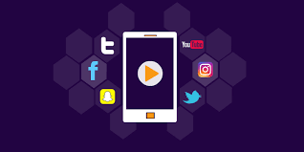
Lecture 7
Videos of Affinity
Anthropologist Bonnie Nardi (2005: 99) writes: A feeling of connection, is an openness to interacting with another person.
Affinity is achieved through activities of social bonding in which people come to feel connected with one another, readying them for further communication. Affinity in this sense is based on things other than broad categorizations such as nationality, ethnicity, class, gender, disability, and so on.

Slide 5
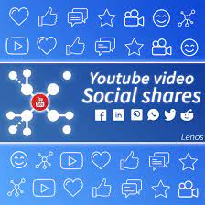
Lecture 7
Videos of Affinity
In her research on YouTube, Patricia Lange has been interested in how visually enhanced communication through YouTube videos relates to establishing affinities. In a study mapping the patterns and principles by which video creators get the attention of viewers, she introduced the notion of videos of affinity. She underlines the social aspects of communication by means of YouTube videos, specifically focusing on how videos are used socially to generate feelings of connection between people.

Slide 6
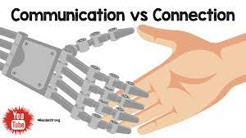
Lecture 7
Videos of Affinity
In her two-year ethnographic study, she looked closely at videos that seemed to try to establish some sort of ‘communicative connection’.
Lange (2009: 71) writes that: Videos of affinity attempt to maintain feelings of connection with potential others who identify themselves as intended viewers of the video.

Slide 7
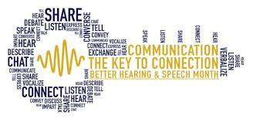
Lecture 7
Videos of Affinity
In order for the creator of a video to be able to (address) the potential others, he or she needs to capture their attention. However, Lange continues, attention does not come for free. Rather, it is an achievement that requires work, and the point here is that this work is done visually — through video.

Slide 8
Lecture 7
Videos of Affinity
The definition of videos of affinity is that they are focused on the present, that they aim to create feelings of connection, and they fulfill the function of maintaining a certain communication channel as open and active. The videos seem to say: I am (still) here! This is what I look like! This is my life at present! You can still subscribe/like/comment on what I do! We continue to be connected! In that sense, these videos are social actions that foster communities or networks.

Slide 9
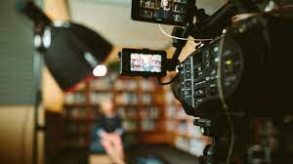
Lecture 7
Videos of Affinity
In other words, videos of affinity are not meant for everyone. Even though anyone can watch them — as long as they are posted as public videos — they typically are interesting only for certain groups of people who desire a connection — who feel an affinity — with the topic, attitude, values, or maker of the video.
Lange (2009: 83) writes that these videos often lack any traditional form of content. Such videos are often neither original nor very ‘interesting’ — in the most common sense of the word. Instead, they tend to be stereotypical, stylised, and draw heavily on in-jokes and other jargon.

Slide 10

Lecture 7
Videos of Affinity
Historically, we can think of the genre of home movies — analogue or digital —traditionally recorded by fathers during specific rituals, such as graduations, birthdays, weddings, and Christmases, often simply as a means of remembering the occasions. In some sense, these are videos of affinity: they connect the family members, relatives, and friends who get to watch them.

Slide 11

Lecture 7
Videos of Affinity
Home movies are also mildly interesting to a wider audience — not counting the genre in its own right created through the wider dissemination of bloopers and fails captured in such settings. The proliferation of affordable digital cameras and camera phones, however, has made it possible to capture more personal things and smaller everyday moments.

Slide 12
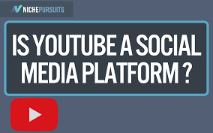
Lecture 7
Is YouTube a social medium?
YouTube is a huge video archive with more than a billion users who watch hundreds of millions of hours of video every day, and who upload 300 hours of video every minute.
YouTube is the most popular video-sharing website in the world. With over a billion monthly active users, it has become an important part of many people's online experience.

Slide 13
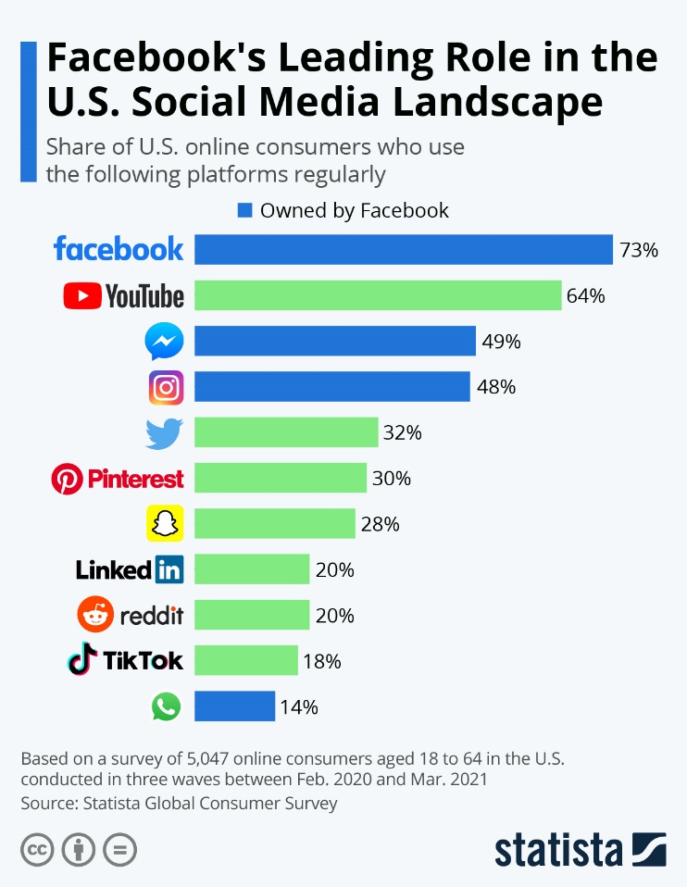
Lecture 7
Is YouTube a social medium?
The platform is regarded mainly as a video-sharing site where users can watch and upload videos. However, its other features like comments, polls, and community posts also provide interaction between users.
This begs the question: is YouTube a social media platform?

Slide 14
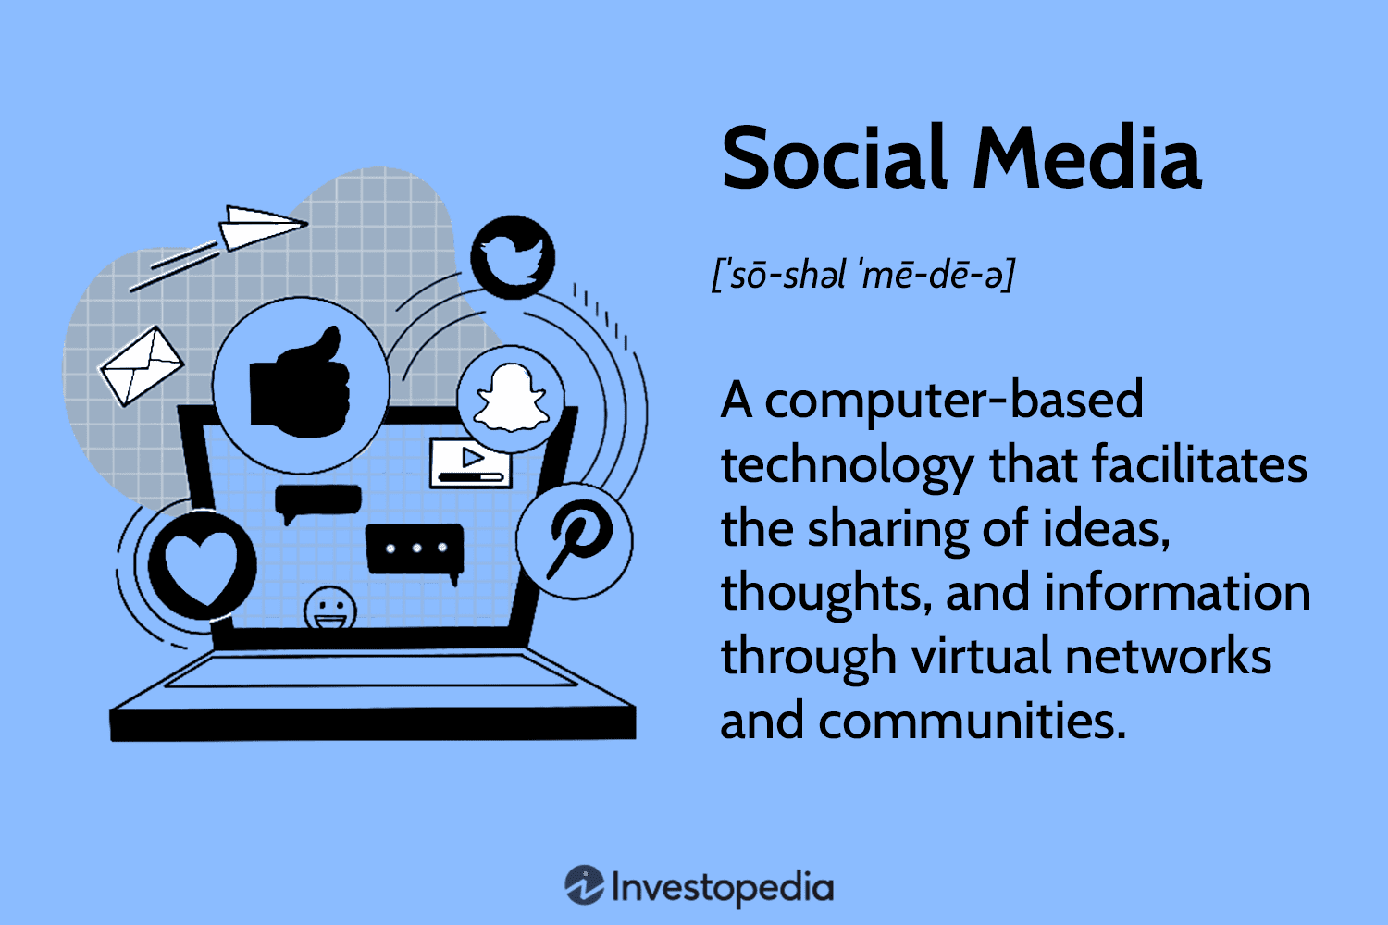
Lecture 7
What Is Social Media?
Social media is a broad term that encompasses many different types of platforms. Thus, the question “What counts as a social media platform?” may be more difficult to answer than one might think.
In its most basic form, a social media platform can be defined as an online service that allows users to share information or interests with other users in an interactive manner.
There are some generally accepted social media platforms. These range from social networking sites such as Facebook and Twitter.

Slide 15
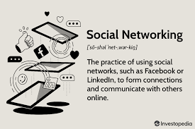
Lecture 7
What Is Social Media?
The argument over whether or not YouTube is considered a social media platform has been going on for a while. It can be argued that YouTube does not meet the definition of a social media platform because it doesn't have instant messaging capabilities like other social media platforms such as Facebook and Twitter.
But it can also be argued that YouTube qualifies as a social media platform because it provides some degree of interactivity with other users through its community posts, comments, likes, and shares.

Slide 16
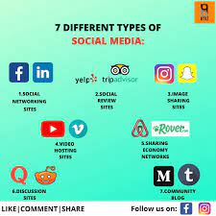
Lecture 7
Types of Social Media Platforms
To better understand whether YouTube is social media, let’s look at the general classification of social media platforms.
There are five broad categories of social media platforms, they are:
Social networking sites, such as LinkedIn.
Image sharing & messaging sites, such as Facebook and Instagram.
Video-sharing sites like TikTok.
Social blogging, such as Twitter.
Social community and discussion sites, for example, Quora and Reddit.

Slide 17

Lecture 7
Is YouTube a social medium?
There are many different aspects of YouTube that make it worthy to be considered a social media platform. as the following:
1. Subscriptions, Comments, and Likes
YouTube channel subscriptions offer a medium of interaction between creators and viewers. This is, in a sense, is similar to how following works on Facebook and Twitter. If you subscribe to a YouTube channel, it means that you are following the updates of the creator and want to stay up-to-date with their content.

Slide 18
Lecture 7
Is YouTube a social medium?
Likes and comments also serve as points of interaction between creators and their fans. Some users use the comment section as a way to message people on YouTube.
2- Community Posts
In the early days of YouTube, it was mainly used for viewing videos. But this is no longer the case as there’s now a vast array of content on offer on the platform.
The Community Post feature allows creators with over 1,000 subscribers to publish traditional social media posts like images, text, GIFs, playlists, and polls on YouTube. If nothing else, the addition of this feature shows that the platform considers itself a social media platform.

Slide 19
Lecture 7
Is YouTube a social medium?
3- User-Generated Content
YouTube is often categorized with video-streaming services such as Netflix, Amazon, and Hulu. However, YouTube is different from the traditional video-streaming services because its content is user-generated.
Registered users can upload videos to the platform. Meanwhile, anyone, registered or not, can view them for free. This ability to share information (in this case, videos) with a wide audience is another reason why YouTube should be regarded as a social media platform.

Slide 20
Lecture 7
Is YouTube a social medium?
4- Its Revenue Model
Another reason YouTube is considered a social media platform is its revenue model. Users get a free platform to share and consume content, while the platform sells ads to generate revenue.
This is similar to the way other social media platforms operate. Instagram, for instance, allows users to share photos and short videos for free and generates revenue by selling ads.
The initial version of YouTube may not have been built to be a social media platform, however, with new features that provide opportunities for interaction between users, it now qualifies as one.

Slide 21
Lecture 7
Is YouTube a social medium?
Which Category of Social Media Platforms Does YouTube Fit Into?
YouTube is mainly used for watching videos and interacting with creators, through comments and replies. This puts it more up TikTok’s alley.
Hence, YouTube can be considered as a video-sharing social media platform.

Slide 22
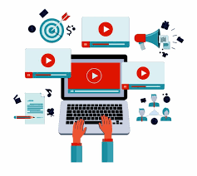
Lecture 7
Online Videos as Social Actions
Lange (2009: 83) says that a video of affinity is not a ‘cinematic end point’, but rather ‘a mediated moment in an ongoing social relationship’.
The point of the videos is not their particular content, but their role of maintaining connections between people simply through keeping channels open. And videos of affinity do this largely through visual means, as they tend to revolve around evidence of the live body of their creators.

Slide 23
Lecture 7
Online Videos as Social Actions
So even though the creators of the videos may be talking to the camera throughout, the creation of affinity — as Lange shows — relies on a number of aspects of visuality and visibility that are conveyed in the videos.
Videos of affinity, often shot in home environments, tend to be spontaneous recordings — or maybe carefully staged to appear spontaneous.

Slide 24

Lecture 7
Online Videos as Social Actions
The body is often at the centre of these videos, as they will likely be shot at quite close range, enabling close inspection of the facial attributes and expressions of the speaker.
Nardi (2005: 114), referring to social presence theory, writes of how bonding and commitment is best promoted when people meet, and see, each other in person ‘with the body in full view’.

Slide 25
Lecture 7
Online Videos as Social Actions
In line with this, videos of affinity quite often feature their subjects eating or drinking in front of the camera. Having an apple, drinking water, coffee, or a cup of tea, while addressing the viewers, enhances the casual character of the videos.
One will quite often see video bloggers discussing things such as whether they are tired, hungry, bored, and in other ways providing social ‘proof’ of their (recorded) bodies.

Slide 26
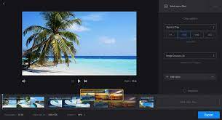
Lecture 7
Online Videos as Social Actions
In other words, videos of affinity are social tools — drawing on visibility — that lack any traditional artistic, narrative, or informational content. Instead, they simply ‘show’ the online presence of individuals in order to establish communicative connections with others. In this sense, like selfies, they are uniquely and natively digital and visual social phenomena.

Slide 27
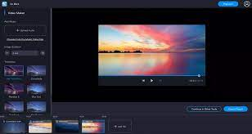
Lecture 7
Layers of Visual Sociality
Now let’s try to make a closer analysis of the ways in which visual communication among users of digitally networked media can work to establish social connections. One useful way of doing so is to turn to the theory of linguist Roman Jakobson (1990), who famously defined six factors (1–6) of ‘speech events’ together with six functions (I–VI) of language.

Slide 28
Lecture 7
Layers of Visual Sociality
He said that in any speech event, there is always (1) an ‘addresser’ sending some sort of (3) message to (2) an ‘addressee’. A video shared online, for example, might be addressed to certain groups of viewers that share the interests of the creator, but this does not preclude that many people who are not the addressees of the content may still watch it. The video will be decoded in different ways, depending on whether it is meant to speak to you or not.

Slide 29

Lecture 7
Layers of Visual Sociality
The addresser uses the (I) emotive function of language to express his or her attitude towards what he or she is speaking about. Jakobson writes that this function works to create the impression of a certain emotion.
Then, there is the (II) conative function, which is directed towards the addressee as in ‘Please click below to subscribe to my channel!’ or ‘Post your questions in the comments below!’.

Slide 30
Lecture 7
Layers of Visual Sociality
The message itself fulfils what Jakobson calls the (III) poetic function, which depends on how the addresser uses language (convincingly, playfully, rhetorically, etc.)
Furthermore, the message is always sent in one (4) context or another, which the addressee can grasp and which helps in interpreting what is said.

Slide 31
Lecture 7
Layers of Visual Sociality
This has to do with the (IV) referential function of language in the sense that what is expressed always refers to something. A video of someone having tea and talking about school represents someone having tea and talking about school.
The addressee will need to know of the contexts of ‘tea’ and ‘school’ — what they mean culturally — in order to understand. There must also be (5) a code — some sort of language or ‘language’ — shared, at least to some degree, by the addresser and the addressee.

Slide 32
Lecture 7
Layers of Visual Sociality
The fact that both addresser and addressee know what words, symbols, and things mean fills what Jakobson calls the (V) multilingual function.
Finally, there must be (6) a contact — meaning some sort of channel of communication through which the addresser and the addressee can enter and stay in communication.
Messages serving primarily ‘to initiate, extend, or terminate communication’ or ‘to check whether the channel works (“Hello, do you hear me?” […] “Are you listening?”)’ (Lange 2009: 75) fill a (VI) phatic function.

Slide 33
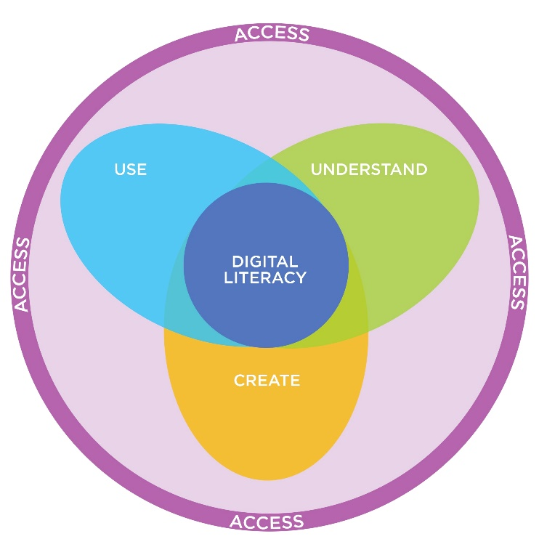
Lecture 7
Digital Citizens and Divides
It has been claimed that under the right circumstances the internet and social media can give people better opportunities to participate in society. But while the internet may enable some people to be more socially active, online as well as offline, it might raise barriers for others. This is related to a debate about what has been called digital citizenship.

Slide 34
Lecture 7
Digital Citizens and Divides
In digital society, digital citizenship is turning to an increasingly large part of social citizenship altogether. So, in digital society, people’s different degrees of access to digital citizenship can have important consequences for democratic participation.
In many countries, there is a movement towards e-government, which means that government information and services are increasingly delivered over the internet.

Slide 35
Lecture 7
Digital Citizens and Divides
Digital citizens can be defined as those who use the internet every day, because frequent use requires some regular means of access (usually at home), some technical skill and the educational competencies to perform tasks such as finding and using information […] and communicating with others

Slide 36
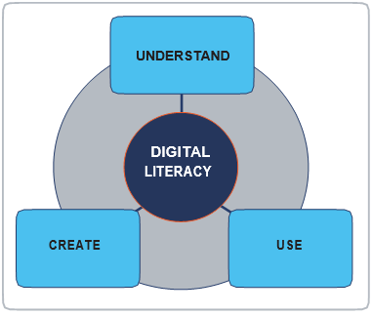
Lecture 7
Digital Citizens and Divides
Sociologist Eszter Hargittai (2002) wrote in the early 2000s about what she called a second-level digital divide.
The first-level digital divide is the division between those who have access to the internet and those who don’t, and between those who actually use it and those who don’t.

Slide 37
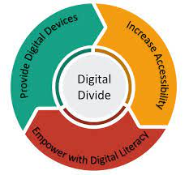
Lecture 7
Digital Divide

Slide 38
Lecture 7
Digital Citizens and Divides
While interesting, such evaluations become less and less relevant as more and more people gain access to the internet, and as more and more people use it actively. Focusing only on patterns of access and usage is a form of technological determinism, which fails to account for the big differences in use which actually exist among people who all have access to the internet.

Slide 39
Lecture 7
Digital Citizens and Divides
So, the second level digital divide is the division between people who have access to, and use, the internet, but who have different levels of skill in its use. On one level there is the very technical access (physically having the gadgets, the software, and the connectivity), and on the other there is the social access (the knowledge needed to benefit from those things).
The social access, that is the skills which contribute to the division of people into groups of savvy and not-so-savvy internet users.

Slide 40
Lecture 6
Thank You

