Slide 1


Project Risk Management
Prepared by Dr. Usama Al-Fendi
PMG 510
Project Risk Management
Lecture 8

Slide 2

Lecture
Lecture 7 Conclusion
8
Importance of insurance
Types of insurance cover
Evaluation of insurance needs
Purchase of insurance
Captive insurance companies
Business continuity management
www.midocean.ae

Slide 3
Lecture
Business continuity
8
Business continuity management
In simple terms, BCP is how an organization prepares for future incidents that could jeopardize its existence.
The range of incidents that should be covered will include everything from local events like fires through to regional disruption such as earthquakes or national security incidents and extend to international events like terrorism and pandemics.
www.midocean.ae

Slide 4
Lecture
Business continuity
8
Business continuity management
British Standard BS 31100:2011 defines BCP as:
“[An] holistic management process that identifies potential threats to an organization and the impacts to business operations that those threats, if realized, might cause, and which provides a framework for building organizational resilience with the capability for an effective response to safeguard the interests of its key stakeholders, reputation, brand and value-creating activities.”
www.midocean.ae

Slide 5
Lecture
Business continuity
8
Business continuity management
In case of a serious incident such as loss of access to premises or the failure of a major part of an organization, it is important to have in place a well-defined, documented and tested disaster recovery plan.
Such plans inevitably focus on recovery of access to IT systems and data, but also commonly cover the provision of alternative premises (if needed) and other facilities, as well as setting out plans for communications with employees and with other stakeholders such as suppliers, customers and the media at a time of crisis.
www.midocean.ae

Slide 6
Lecture
Business continuity
8
Business continuity management
Business continuity plans build upon this by setting out longer-term plans for restoration of ‘business as usual’ in the immediate aftermath of a disaster.
A business continuity plan is an important part of reducing the impact of a hazard incident.
The plan should include arrangements for reducing the damage caused during the incident and containing the cost of recovery from it.
www.midocean.ae

Slide 7
Lecture
Business continuity
8
Business continuity management
Disaster recovery plans are a particular component of BCP.
EX. If a computer system fails to operate correctly or data has become corrupted, the organization will need emergency procedures to ensure that the data can be recovered and/or ensure that the organization continues in existence.
There may also be a wider need for a specific plan to manage any crisis that may result from an operational disaster.
www.midocean.ae

Slide 8
Lecture
Business continuity
8
Business continuity management
The main difference between the disaster recovery and crisis management plans is :
the disaster recovery plan will be mainly concerned with actions to restore the infrastructure of the organization and a crisis plan will also be concerned with external stakeholders and actions to manage the associated stakeholder reaction and expectations.
www.midocean.ae

Slide 9
Lecture
Business continuity
8
Business continuity management
Many organizations are now taking the view that BCP should be viewed as having three components.
1- The first response to any major event is to activate the crisis management plan to ensure appropriate response to the crisis and, in particular ensure that stakeholders are aware of the situation.
This will require effective communication with all stakeholders, so that the damage to reputation resulting from the incident is kept to a minimum.
www.midocean.ae

Slide 10
Lecture
Business continuity
8
Business continuity management
2- secondly, the organization will then seek to recover from the event by implementation of a disaster recovery plan.
3- However, as the disaster recovery plan is being implemented, the organization will still need to consider the ongoing management of the crisis.
The organization should ensure that implementation of the disaster recovery plan is viewed as the second, but sometimes overlapping, stage of responding to the incident. In fact, in certain circumstances, it will only be possible to implement the disaster recovery plan once the immediate crisis has been contained.
www.midocean.ae

Slide 11
Lecture
Business continuity
8
Business continuity management
When implementation of the crisis management arrangements is well advanced, and the disaster recovery plan has been activated, the organization will then be able to turn its attention to the third and broader operational issue of business continuity.
An example of this three-stage approach is when a serious road traffic accident occurs that obstructs a major road or highway. The initial response of the emergency services will be to deal with the crisis that may involve injuries to people and, in certain circumstances, a vehicle fire and/or other traffic travelling too fast towards the incident
www.midocean.ae

Slide 12
Lecture
Business continuity
8
Business continuity management
When the immediate crisis has been contained, the disaster recovery phase can be implemented and this will include clearing the damaged vehicles and/ or repairing the road surface and crash barriers.
It is only when these two stages have been completed that bringing the road back into use, or the business continuity aspect, can be addressed.
www.midocean.ae

Slide 13
Lecture
Business continuity
8
Business continuity management
If the road traffic accident involved commercial vehicles or there was an allegation that a driver from the identified company caused the incident, the need for crisis management responses will extend to the road haulage or transportation company involved in the incident.
The company should activate their crisis management plan to demonstrate social responsibility and to ensure minimum damage to their reputation.
The road haulage company may also wish to take action during the crisis to support other stakeholders, including the families of drivers who may have been injured in the incident.
www.midocean.ae

Slide 14
Lecture
Business continuity
8
Business continuity management
Next Figure provides an illustration of a disaster recovery timeline and costs.
The need to ensure adequate crisis management and effective communication with stakeholders covers the whole period of disruption (from point A to point D) and possibly beyond.
www.midocean.ae

Slide 15
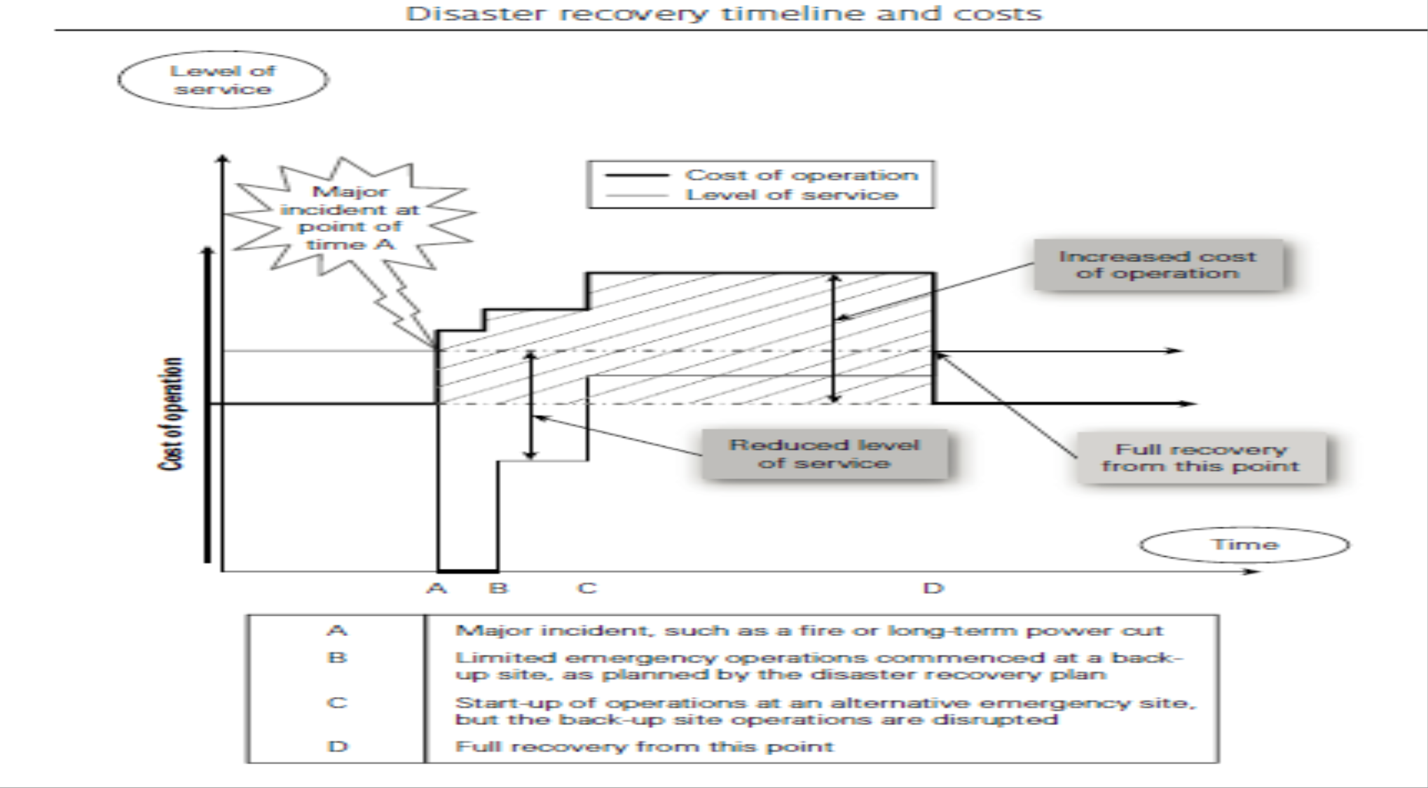
Lecture
Business continuity
8
Business continuity management
www.midocean.ae

Slide 16
Lecture
Business continuity
8
Business continuity management
www.midocean.ae

Slide 17
Lecture
Business continuity
8
Business continuity management
Model of Business continuity:
1- Understanding your business:
Business impact analysis and risk assessment tools are used to identify the critical tasks in your business, evaluating recovery priorities and assessing the risks which could lead to business interruption and/or damage to your organization’s reputation
www.midocean.ae

Slide 18
Lecture
Business continuity
8
Business continuity management
Model of Business continuity:
2- BCM strategies:
Determining the selection of alternative strategies available to mitigate loss, assessing the relative merits of these against the business environment and their likely effectiveness in maintaining the organization’s critical functions
www.midocean.ae

Slide 19
Lecture
Business continuity
8
Business continuity management
Model of Business continuity:
3- Developing the response:
improving the risk profile through improvements to operational procedures and practices, implementing alternative business strategies, using risk financing measures (including insurance) and building BCP
www.midocean.ae

Slide 20
Lecture
Business continuity
8
Business continuity management
Model of Business continuity:
4- Establishing the continuity culture:
introduction of the BCM process by education and awareness of all stakeholders, including employees, customers, suppliers and shareholders
5- Exercising and plan maintenance:
ongoing plan testing, audit and change management of the BCP and its processes
www.midocean.ae

Slide 21
Lecture
Business continuity
8
Business continuity management
ISO 22301 puts a much greater emphasis on setting objectives, monitoring performance and metrics – aligning business continuity to executive management strategic thinking.
The overriding principles appropriate to successful BCP are that the plan should be:
comprehensive;
cost-effective;
practical;
effective;
maintained;
practiced.
www.midocean.ae

Slide 22
Lecture
Business continuity
8
successful business continuity
The first stage in successful BCP, and crisis management is to gain a thorough understanding of the organization and its interactions, both internal and external.
Part of gaining this understanding will be to identify the objectives of the organization and its key dependencies.
It is important to understand the critical functions within the organization and identify key resources.
www.midocean.ae

Slide 23
Lecture
Business continuity
8
successful business continuity
Determining BCP strategy will require the identification of risks to the business and decisions about how likely it is that the risks will materialize.
It is also necessary to understand the impact of risks on the business.
These assessments should then be used to prioritize treatment of the risks and to agree the likelihood and impact of the risks materializing
www.midocean.ae

Slide 24
Lecture
Business continuity
8
successful business continuity
Pandemic contingency plans for an organization should aim to ensure continuity of essential operations during an extended period of high illness rates in the workforce, suppliers and customers. It should ensure that employees are not exposed to a high risk of infection in their workplace and aim to resume operations rapidly and competitively as soon as the pandemic cycle is over.
Critical business processes can be protected by allocating additional back-up personnel, diversifying activities across multiple locations and maximizing home-based working.
www.midocean.ae

Slide 25
Lecture
Business continuity
8
successful business continuity
Additional investments in spare workplace capacity might be needed, training more personnel to take over essential roles, and improving IT capability.
Plans should anticipate that suppliers, equipment providers and support companies will be unable to function for some time, and stockpiles of essential supplies should be established.
Telecommunications infrastructure may be unable to cope with the greatly increased demand.
www.midocean.ae

Slide 26
Lecture
Business continuity
8
successful business continuity
During a pandemic, employees are likely to become infected from their families, their children or contacts outside the workplace.
Social contacts in the workplace then spread infection through the workforce.
Lower-contact work environment practices that minimize the risk of infection spread include a well-informed workforce, fewer face-to-face meetings, rigorous hygiene and frequent biological cleaning of common area surfaces. Ultimately it may be necessary to close offices to prevent the spread of a virulent virus.
www.midocean.ae

Slide 27
Lecture
Business continuity
8
successful business continuity
Staff who recover from a case of pandemic influenza are unlikely to catch it again and are no longer infectious to others.
Recovered and vaccinated staff can return to work. As the pandemic subsides, resuming operations rapidly and efficiently could become a competitive issue.
www.midocean.ae

Slide 28
Lecture
Business continuity
8
Business impact analysis (BIA)
A critical part of ensuring that adequate business continuity plans and disaster recovery plans are in place is completion of a business impact analysis (BIA).
The BIA will identify the critical nature of each business function by assessment of the impact of interruption to that activity.
This information will be required in order to identify appropriate continuity strategies for each function.
www.midocean.ae

Slide 29
Lecture
Business continuity
8
Business impact analysis (BIA)
The BIA is similar to the risk assessment that is undertaken as part of the overall risk management process.
However, the critical difference from BCP is that the emphasis of a BIA is the identification of the relative importance and criticality of each function, rather than identifying the events that could undermine that particular function.
www.midocean.ae

Slide 30
Lecture
Business continuity
8
Business impact analysis (BIA)
Therefore, the risk assessment and the BIA are related and could well be undertaken together.
The risk assessment will help in identifying the risks that might threaten the achievement of the business continuity objectives.
For a television company, broadcasting continuity in excess of 99.9 per cent is likely to be the target and may even be a requirement imposed by the licensing authority. Both risk assessment and BIA require a structured and systematic approach.
www.midocean.ae

Slide 31
Lecture
Business continuity
8
Business impact analysis (BIA)
The business impact analysis has three clear purposes, as follows:
Identify mission-critical activities and the required recovery time in the event of disruption.
This identification activity will establish the timeframe within which the critical functions must be resumed after the disruptive event.
www.midocean.ae

Slide 32
Lecture
Business continuity
8
Business impact analysis (BIA)
The business impact analysis has three clear purposes, as follows:
2. Establish the impact potential and the resource requirements for recovery within the agreed timescale.
The business requirements for recovery of the critical function must be established.
www.midocean.ae

Slide 33
Lecture
Business continuity
8
Business impact analysis (BIA)
The business impact analysis has three clear purposes, as follows:
3. Determine whether the likely impact is within the risk appetite of the organization as the basis for business continuity strategy.
The technical requirements for recovery of the critical function also need to be established.
www.midocean.ae

Slide 34
Lecture
Business continuity
8
Business continuity and ERM
There is an obvious link between BCP and enterprise risk management (ERM).
ERM is concerned with the risks facing the whole organization and BCP takes an approach that business continuity arrangements should be in place.
The BCP approach is to look at the continuity of operations across the whole organization.
www.midocean.ae

Slide 35
Lecture
Business continuity
8
Business continuity and ERM
There is an obvious link between BCP and enterprise risk management (ERM).
Ensuring continuity is obviously part of an ERM approach. It should therefore be considered that BCP is part of ERM, but it is not the whole of ERM activity.
Nevertheless, there is a strong similarity in approach and the business continuity and disaster recovery activities should take place within the context of a broader ERM initiative, as appropriate.
Both approaches seek to achieve continuity of effective and efficient core business processes
www.midocean.ae

Slide 36
Lecture
Business continuity
8
Business continuity and ERM
Reasonable worst-case scenarios:
Event standards can be established to set a level of resilience against an extreme event that the network or system should be able to continue to operate without widespread loss or disruption to the essential services.
Describing reasonable worst-case scenarios for hazards will enable infrastructure owners and operators to identify and assess their resilience, and consider any gaps in resilience of an asset or network between the event and the actual or current design and service standards.
www.midocean.ae

Slide 37
Lecture
Business continuity
8
Business continuity and ERM
Reasonable worst-case scenarios:
The ability and capability to manage and respond to events greater than these reasonable worst-case scenarios is dependent upon their generic organizational resilience.
Alongside this, infrastructure owners should consider, in their business continuity plans, the speed with which they expect to be able to restore services in the event of supply being disrupted for whatever reason, including events that are not specifically itemized or which are more serious or extreme than those covered in the reasonable worst-case scenarios.
www.midocean.ae

Slide 38
Lecture
Business continuity
8
Civil emergencies
In many countries, there is an obligation placed on local government to ensure the continuity of local businesses in the event of a major civil emergency.
The emergency may be triggered by a natural disaster such as flooding or an earthquake.
Alternatively, it could be caused by terrorism, civil unrest or by an epidemic/pandemic. The ISO 22300 series of standards relate to societal resilience and the increasing importance of this series of standards is also considered.
www.midocean.ae

Slide 39
Lecture
Business continuity
8
Civil emergencies
Many civil authorities publish guidance for businesses to assist them with their BCP.
For example, the US government provides valuable information on its website. Also, several trade associations and small business associations offer practical guidance on BCP, including appropriate actions in the case of civil emergency.
www.midocean.ae

Slide 40
Lecture
Business continuity
8
Civil emergencies
secure your business
Thoroughly assessing the disasters that could threaten your firm will give you a clear idea of the business areas that are most important to secure. Usually, these will be the areas on which your business relies the most, and which are exposed to the greatest degree of risk. This is the most important part of your plan.
Clearly, your premises are fundamental to your business – so much so that you probably take them for granted. But you should consider the long-term impact that damage to or destruction of your premises would have on your business. The same applies to business critical machinery, plant and equipment
www.midocean.ae

Slide 41
Lecture
Core business processes
8
Dynamic business models
Organizations will often establish business objectives and strategic objectives as separate documents.
When seeking to ensure that risk management makes a full contribution to the organization, it is important to view both of these sets of objectives and explore the relationship between them.
Business objectives will often relate to the annual budget that has been produced by the organization. This budget will contain details of the anticipated sales as income and the cost of sales as expenditure.
www.midocean.ae

Slide 42
Lecture
Core business processes
8
Dynamic business models
Underpinning the business objectives of the organization will be the business delivery model (or business model for short) that the organization has developed.
For example, a membership organization will seek sponsorship from organizations that deliver services to the membership. This source of sponsorship income will be a fundamental part of the business model and the annual business objectives.
www.midocean.ae

Slide 43
Lecture
Core business processes
8
Dynamic business models
The membership body will need to estimate income from membership subscriptions and from sponsorship, and determine what services will be delivered to the members in return for their membership fee and what benefits will be delivered to the sponsors in return for their sponsorship money.
The risks that are attached to business objectives are associated with the robustness of the business model and the efficiency of the business model.
www.midocean.ae

Slide 44
Lecture
Core business processes
8
Dynamic business models
When undertaking a risk assessment of the annual budget, the events that could undermine sponsorship and membership income, together with the events that could disrupt the delivery of services and benefits, should be considered.
The essence of the business objectives normally relate to the organization as it currently exists.
www.midocean.ae

Slide 45
Lecture
Core business processes
8
Dynamic business models
Business delivery and development models
Whenever a business is established, it either explicitly or implicitly employs a particular business delivery model that describes the architecture of the value creation, delivery, and capture mechanisms employed by the business enterprise. The essence of a business delivery model is that it defines the manner by which the business delivers value to customers, entices customers to pay for value, and converts those payments to profit: it thus reflects the belief of the organization about what customers want, how they want it, and how the enterprise can organize to best meet those needs, get paid for doing so, and make a profit.
The business delivery model is used to describe and classify businesses, but is also used by management inside companies to explore possibilities for future development. Future enhancement of the business delivery model is achieved by implementation of a business development plan. In fact, a well-established business delivery model will act as the basis for creative organizations to develop future strategy
www.midocean.ae

Slide 46
Lecture
Core business processes
8
Dynamic business models
Most organizations recognize that the existing business model will not continue to be successful on an open-ended basis.
If business objectives are to be delivered year after year, then the business will need to develop.
These developments could include exploring greater sponsorship opportunities, delivering new services and products that will generate new income, and increasing efficiency in the delivery of the existing business model.
www.midocean.ae

Slide 47
Lecture
Core business processes
8
Dynamic business models
Once the overall strategy is established, the tactics that will deliver it need to be identified. If the strategy requires changes to core processes or the introduction of new core processes, then projects or programs of work will be required.
The tactics introduced by the organization should ensure that effective and efficient core processes to deliver the desired outcomes in the most cost-effective manner are in place. In relation to operations, the desired state of the organization is the continuity of normal efficient operations with no unplanned disruption
www.midocean.ae

Slide 48
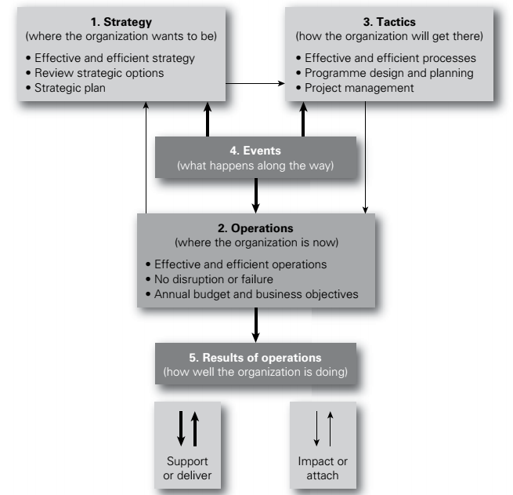
Lecture
Core business processes
8
Dynamic business models
www.midocean.ae

Slide 49



Thank You

