Slide 1





Project Monitoring Course
Prepared & presented by:
Dr. Dhouha Melliti
2022-2023
Lecture 06:
Methodologies for data collection and analysis for monitoring and evaluation

Slide 2





Lecture5
Session3: Monitoring:
Methods & Results(Part2)
« And what is the use of executing projects, since the project is in itself sufficient enjoyment? " Charles Baudelaire. »
Charles Baudelaire
«
“

Slide 3


  Professional standards and ethical guidelines
During the different stages of monitoring or evaluation, including for the collection and use of data, M&E practitioners are required to adopt ethical behaviours that prevent them from being influenced by internal and external pressures that may try to change the findings before they are released or to use them in an inappropriate way.2
    Ethical behaviour
Ethics are a set of values and beliefs that are based on a person’s view of what is right, wrong, good and bad and that influence the decisions people make. They can be dictated by the organization and also by laws in the country in which the M&E practitioners work and what people consider to be ethical in that context.
E
S
O
U
R
C
E
R
S
Lecture6
Session4:Methodologies for data collection and analysis for monitoring and evaluation (Part1)
An overview of chapter 4
Professional standards and ethical guidelines for monitoring
and evaluation
Planning and designing data collection
tools
Methods, approaches and tools for monitoring and evaluation
Presenting findings
Collecting and managing
data
Analysing data

Slide 4
  Professional standards and ethical guidelines
During the different stages of monitoring or evaluation, including for the collection and use of data, M&E practitioners are required to adopt ethical behaviours that prevent them from being influenced by internal and external pressures that may try to change the findings before they are released or to use them in an inappropriate way.2
    Ethical behaviour
Ethics are a set of values and beliefs that are based on a person’s view of what is right, wrong, good and bad and that influence the decisions people make. They can be dictated by the organization and also by laws in the country in which the M&E practitioners work and what people consider to be ethical in that context.
E
S
O
U
R
C
E
R
S
Lecture6
Session4:Methodologies for data collection and analysis for monitoring and evaluation (Part1)
1. Professional standards and ethical guidelines
During the different stages of monitoring or evaluation, including for the collection and use of data, M&E practitioners are required to adopt ethical behaviours that prevent them from being influenced by internal and external pressures that may try to change the findings before they are released or to use them in an inappropriate way

Slide 5


Lecture6
Session4:Methodologies for data collection and analysis for monitoring and evaluation (Part1)
    Ethical behavior
Ethics are a set of values and beliefs that are based on a person’s view of what is right, wrong, good and bad and that influence the decisions people make.
They can be dictated by the organization and also by laws in the country in which the practitioners work and what people consider to be ethical in that context.

Slide 6
Lecture6
Session4:Methodologies for data collection and analysis for monitoring and evaluation (Part1)
    Evaluation and politics
The gathered data provide an important source of information to decision makers about the intervention being monitored and/or evaluated.
While positive evaluations can help secure more funds, expand a pilot project or enhance reputations, the identification of serious problems can lead to difficult situations where the credibility of the work done is at stake.
Understanding and managing political situations and influence is crucial for maintaining the integrity of the monitoring and evaluation work and well defined and robust methodologies for the data collection and analysis play a critical role.

Slide 7
Lecture6
Session4:Methodologies for data collection and analysis for monitoring and evaluation (Part1)
    Monitoring and evaluation ethical principles
Plan Design Implement and manage Analyse and report
!
Independence
Honesty and integrity
Respect for dignity and diversity of participants
Avoidance of harm
Accuracy, completeness and reliabilty
Transparency and consultation
Must be considered at each monitoring and/or evaluation stage

Slide 8
Lecture6
Session4:Methodologies for data collection and analysis for monitoring and evaluation (Part1)
2. Planning and designing data collection tools
Rigorous planning and designing for data collection can improve the quality of the approach and methods of data collection and, therefore, the quality of collected data.
It is imperative to identify the approach intended for use to monitor or evaluate an intervention, and then to establish a data collection plan. Selecting an appropriate approach will also allow a relevant assessment of the monitoring or evaluation questions guiding any review, taking into account the specific context, existing constraints, access, timing, budget and availability of data.

Slide 9
Lecture6
Session4:Methodologies for data collection and analysis for monitoring and evaluation (Part1)
Data governance
represents the framework used to manage the organizational structures, policies, fundamentals and quality that ensures accurate and risk-free migration data and information.
It establishes standards, accountability and responsibilities and ensures that migration data and information use are of maximum value, while managing the cost and quality of handling the information.
Data governance enforces the consistent and integrated of all members of the project.

Slide 10
Lecture6
Session4:Methodologies for data collection and analysis for monitoring and evaluation (Part1)
How is it relevant to work?
Data governance allows to view data as an asset in every intervention and, most importantly, it is the foundation upon which all initiatives can rest.
It is important to keep in mind the migration data life cycle throughout the whole project cycle.
This includes the planning and designing, capturing and developing, organizing, storing and protecting, using, monitoring and reviewing, and eventually improving, the data or disposing of it.
Key concepts to look out for:
Data steward
Roles and responsibilities
Data quality
Data classification for security and privacy
Data processing, including collection and use

Slide 11
Lecture6
Session4:Methodologies for data collection and analysis for monitoring and evaluation (Part1)
    Planning for data collection
When planning for data collection, basic considerations ensure that the data to be collected and analysed is valid and reliable: purpose for data collection, methodology for data collection, resources for data collection and timing for data collection.
Qualitative, quantitative or mixed methods approach to collect data can be considered in that respect.

Slide 12
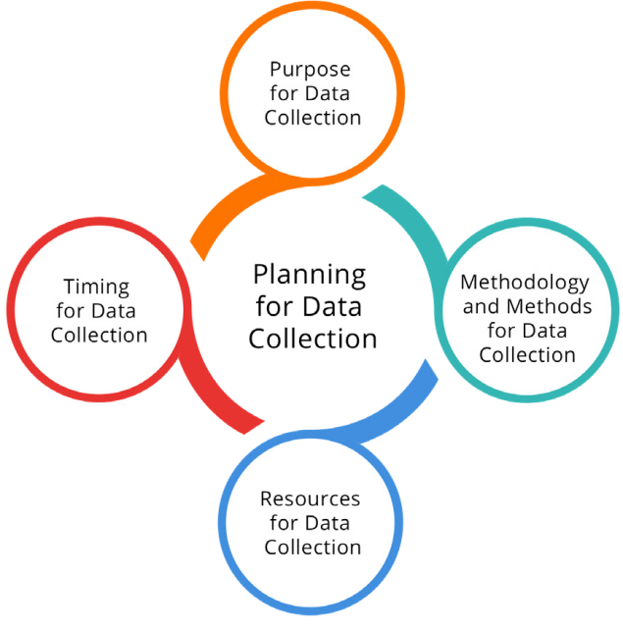
Lecture6
Session4:Methodologies for data collection and analysis for monitoring and evaluation (Part1)
Key considerations when planning for data collection

Slide 13
Lecture6
Session4:Methodologies for data collection and analysis for monitoring and evaluation (Part1)
Purpose for data collection
Identifying the purpose of data collection aims to address different information needs, and information needs of monitoring may also differ from those of evaluation.
Some questions to ask:
Is the data collected for the purpose of monitoring or evaluation?
What are the main information needs?
What are the objectives, outcomes, outputs and activities being monitored or evaluated?
What are the expected results (intermediate and long term)?
Which stakeholder’s information needs will the data address?

Slide 14
Lecture6
Session4:Methodologies for data collection and analysis for monitoring and evaluation (Part1)
Methods for data collection
Several aspects need to be considered, such as identifying the source of the data, the frequency of data collection, knowing how data will be measured, by whom and how many people will collect data and selecting the appropriate methodology in order to design the right data collection tool/s.
Some questions to ask:
What are the criteria and questions to be addressed in the data collection tools?
What type of data is needed to answer the information needs?
Are multiple data sources required/used to answer the information needs?
What types of data already exist?
What data is missing?

Slide 15
Lecture6
Session4:Methodologies for data collection and analysis for monitoring and evaluation (Part1)
Resources for data collection
  Resources will be enabling the implementation of choices.
  Some questions to ask:
  Are there enough resources, such as staff and budget, to collect the data on a frequent basis?
  Who is responsible for collecting the data? Will external enumerators need to be hired?
  How will enumerators get to the data collection sites? What are the related costs?
  Are additional costs for data collection and analysis required?

Slide 16
Lecture6
Session4:Methodologies for data collection and analysis for monitoring and evaluation (Part1)
Timing for data collection
  Timing may influence the availability of resources, as well as the relevance of data (avoid outdating of data).
  Some questions to ask:
  At which stage of the implementation cycle will data be collected?
  How long is data collection expected to last?
  Will data be collected in a timely manner for it to reflect a current status quo?

Slide 17
Lecture6
Session4:Methodologies for data collection and analysis for monitoring and evaluation (Part1)
Monitoring and vertical logic
Objectives
Measuring changes at goal-level requires a longer time frame, and is therefore dealt with by evaluation
Outcomes
Are outputs leading to achievement of the outcomes?
How do beneficiaries feel about the work?
What is causing delays or unexpected results?
Is there anything happening that should lead management to modify the operation’s implementation plan?
Outputs
Activities
Are activities leading to the expected outputs?
Are activities being implemented on schedule and within budget?

Slide 18
Lecture6
Session4:Methodologies for data collection and analysis for monitoring and evaluation (Part1)
Evaluation and vertical logic
Impact
What difference does the intervention make?
To which extent has the intervention, or is expected to generate significant positive or negative, intended or unintended, higher-level effects?
Effectiveness
Is the intervention achieving its objectives?
To which extent has or is the intervention expected to achieve its results, including any differential results across groups?
Sustainability
Will the benefit last?
To which extent will the benefits of the intervention continue,
or are likely to continue?
Relevance
Is the intervention doing the right thing?
To which extent are the intervention’s objectives and design responding to beneficiaries’, global, country and partner/institution needs, policies and priorities, and continue to do so if circumstances change?
Coherence
How well does the intervention fit?
How compatible is the intervention with other interventions in a country, sector or institution?
Objectives
Outcomes
Outputs
Activities
Efficiency
How well were resources used?
To which extent has, or is the intervention likely to deliver results in an economic
and timely way?

Slide 19
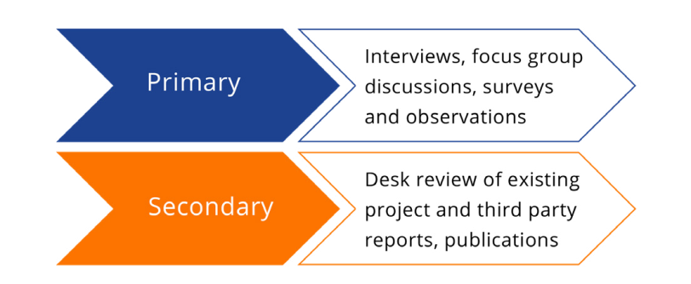
Lecture6
Session4:Methodologies for data collection and analysis for monitoring and evaluation (Part1)
    Sources of data
data sources as identifying where and how the information will be gathered for the purpose of measuring the specified indicators.
In general, there are two sources of data that can be drawn upon for monitoring and/or evaluation purposes:
Primary data, which is the data that M&E practitioners collect themselves using various instruments, such as key informant interviews, surveys, focus group discussions and observations.
Secondary data, which is data obtained from other pre-existing sources, such as a country census or survey data from partners, donors or government.

Slide 20
Lecture6
Session4:Methodologies for data collection and analysis for monitoring and evaluation (Part1)
    Desk review
  When choosing sources of data, it is helpful to start with a desk review to better assess what type of data to use. For monitoring, this corresponds to the information included under the column “Data source and collection method” of the IOM Results Matrix and Results Monitoring Framework.
  For evaluation, the type of data will be clarified in the evaluation ToR, inception report and/or evaluation matrix and can also include data derived from monitoring.
  A desk review usually focuses on analyzing existing relevant primary and secondary data sources and can be either structured or unstructured. Structured desk reviews use a formal structure for document analysis, whereas unstructured reviews are background reading. For detailed guidance on conducting a desk review

Slide 21
Lecture6
Session4:Methodologies for data collection and analysis for monitoring and evaluation (Part1)
    Type of measurement
  When planning for data collection and analysis, knowing the type of measurement, that is how data will be measured, may influence the decision to choose the appropriate methodology. This is of particular importance to inform the design of data collection tools such as surveys.
  Measures of indicators identified in a Results Matrix or Evaluation Matrix can include categorical (qualitative) and/or numerical (quantitative) variables. A variable is any characteristic or attribute that differs among and can be measured for each unit in a sample or population

Slide 22
Lecture6
Session4:Methodologies for data collection and analysis for monitoring and evaluation (Part1)
  Categorical variables represent types of qualitative data that can be divided into groups or categories.
  Such groups may consist of alphabetic (such as gender, hair colour or religion) or numeric labels (such as female = 1, male = 0), or binary labels (such as yes or no) that do not contain information beyond the frequency counts related to group membership.
  Numerical variables (also known as quantitative variables) are used to measure objective things that can be expressed in numeric terms such as absolute figures, such as the number of persons trained, disaggregated by sex, a percentage, a rate or a ratio.

Slide 23
Lecture6
Session4:Methodologies for data collection and analysis for monitoring and evaluation (Part1)
When designing indicators, the most important tasks are to logically link these to the intervention results and determine how the indicators will measure these results.
What is it that you want to measure?
Outcome A
Migrants are asserting their rights in a legal manner.
Indicator for outcome A
The number of migrants that go to court to assert their human rights.
What is the purpose of measuring?
To asssess progress towards the outcome
Potential method to capture information
To ask beneficiarieswhether or not they have turned to courts over the past years to assert that their human rights are respected and, if so, how many times.
How will you go about measuring it?
By conducting a survey

Slide 24
Lecture6
Session4:Methodologies for data collection and analysis for monitoring and evaluation (Part1)
    . Checklist for measuring quality
Relevancy | Does it measure what really matters as opposed to what is easiest to measure?
Credibility | Will it provide credible information about the actual situation?
Validity | Does the content of the measure look as if it measures what it is supposed to measure? Will the measure adequately capture what you intend to measure?
Reliability | if data on the measure are collected in the same way from the same source using the same decision rules every time, will the same results be obtained?
Cost-effectiveness | What is the cost associated with collecting and analysing the data? Is the measure cost-effective?

Slide 25
Lecture6
Session4:Methodologies for data collection and analysis for monitoring and evaluation (Part1)
  The values that a variable takes form a measurement scale, which is used to categorize and/or quantify indicators.
  The levels of measurement used will determine the kind of data analysis techniques that can or cannot be used.
  The most important task of any indicator is to ensure the best possible allocation of the characteristics being measured to the measurement scale.
  This segregation of the characteristics “and their measurable statistical dispersion (variance) on the scale are the main insights gained because of the indicator (the variables)”.

Slide 26
  Sampling
  Sampling is the process of selecting units from a population (that is, a sample) to describe or make inferences about that population (that is, estimate what the population is like based on the sample results).
  When planning for data collection and thinking of the type of data that will be collected, it is important to assess the target audience from which the data will be collected.
  A crucial consideration that may influence decision-making is to determine the sample size and sampling strategy to select a representative sample of respondents, as this has budgetary implications.
  While at times it may be feasible to include the entire population in the data collection process, at other times, this may not be necessary nor feasible due to time, resource and context-specific constraints, so a sample is selected.
Lecture6
Session4:Methodologies for data collection and analysis for monitoring and evaluation (Part1)

Slide 27
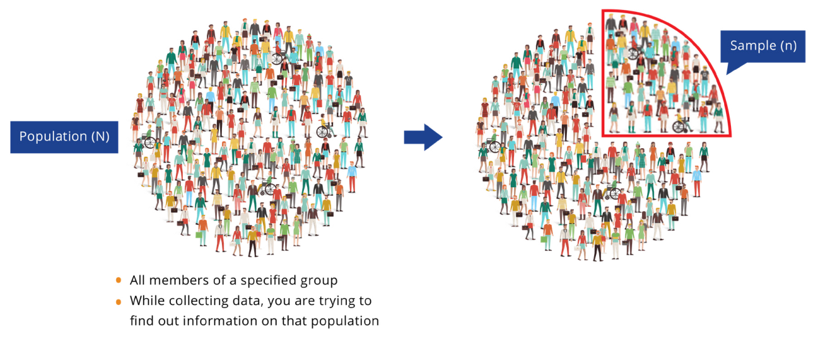
Lecture6
Session4:Methodologies for data collection and analysis for monitoring and evaluation (Part1)
Questions to ask when sampling
  Who will be the respondents for data collection?
  How many people will data be collected from?
  Why is it better to collect data from group A rather than group B?
  How many responses will need to be collected to make the findings reliable,

Slide 28
Lecture6
Session4:Methodologies for data collection and analysis for monitoring and evaluation (Part1)
Random sampling
  Random sampling is an approach to sampling used when a large number of respondents is required and where the sample results are used to generalize about an entire target population. In other words, to ensure that the sample really represents the larger target population and that not only reflecting the views of a very small group within the sample, representative individuals are randomly chosen. Random sampling is an effective method to avoid sampling bias.
  True random sampling requires a sampling frame, which is a list of the whole target population from which the sample can be selected. This is often difficult to apply. As a result, other random sampling techniques exist that do not require a full sampling frame (systematic, stratified and clustered random sampling).

Slide 29
Lecture6
Session4:Methodologies for data collection and analysis for monitoring and evaluation (Part1)
Types of random sampling
Definition
Purpose
Advantages
Disadvantages
Simple random sampling is a technique where each
member of the population has an equal chance of being selected as subject.
When the target population is small, homogeneous and easily accessible
High degree of representativeness of the target population
Simple
Random simpling
Time consuming and expensive
Requires a sampling frame
Results can vary considerably
if target population is very heterogeneous
Difficult to do for large/dispersed populations
Small subpopulations of interest may not be present in the sample in
sufficient numbers
Systematic random sampling is a technique that randomly selects a number near the beginning of the sampling frame list, skips several numbers, and selects another number, skips several more numbers, and selects the next name, and so on. The number of names skipped at each stage depends on the desired sample size.
Systematic
random sampling

Slide 30

Lecture6
Session4:Methodologies for data collection and analysis for monitoring and evaluation (Part1)
Stratified random sampling divides the sampling frame in two or more strata (subpopulations) according to meaningful characteristics, such as type of migrant or gender from which participants are then randomly selected.
When the population is heterogeneous and contains several different subpopulations, some of which are of interest for the monitoring/ evaluation exercise
Time consuming and expensive
More complex than simple and systematic
random sampling
Strata must be carefully defined
High degree of representativeness of the subpopulations in the target population
Cluster random sampling
Cluster random sampling divides the population into many clusters (such as neighbourhoods in
a city) and then takes a simple random sample of the clusters.
The units in each cluster constitute the sample.
When both the target population and the desired sample size are large
Easy and convenient
Can select a random sample when the target population sampling frames are very localized
Clusters may not be representative of the target population
Important subpopulations may be left out
Statistical analysis more complicated
Cluster random sampling
Multistage random sampling combines two or more of the random sampling techniques sequentially (such as starting with a cluster random sample, followed by a simple random sample or a stratified random sample).
Multistage random sampling
Multiple randomizations
Can select a random sample when the target population lists are very localized
Can be less expensive, but more complex than cluster sampling
When a sampling frame does not exist and is inappropriate

Slide 31
Lecture6
Session4:Methodologies for data collection and analysis for monitoring and evaluation (Part1)
Non-random sampling
is used where:
  Large number of respondents are not required;
  The research is exploratory;
  Qualitative methods are used;
  Access is difficult;
  The population is highly dispersed.
  Non-random/purposeful sampling is appropriate when there is a small “n” study, the research is exploratory, qualitative methods are used, access is difficult or the population is highly dispersed. For further information as to when it is appropriate to use non-random sampling.
  The chosen sampling technique will depend on the information needs, the methodology (quantitative or qualitative) and the data collection tools that will be required.

Slide 32
Lecture6
Session4:Methodologies for data collection and analysis for monitoring and evaluation (Part1)
Non-random/Purposeful versus random sampling
Non-random/Probability sampling Random sampling
Sample selection is based on the subjective judgement of the researcher
Sample is selected at random
Subjective method
Objective method
Analytical inference
Statistical inference
Not everyone from the population has an equal chance of getting selected
Everyone in the population has an equal chance of getting selected
Sampling bias may not be considered
Useful to reduce sampling bias
Useful when the population has similar traits
Useful when the population is diverse
Sample does not accurately represent the population
Useful to create an accurate sample
Finding the right respondents is easy
Finding the right respondents can prove challenging
Exploratory findings
Conclusive findings

Slide 33
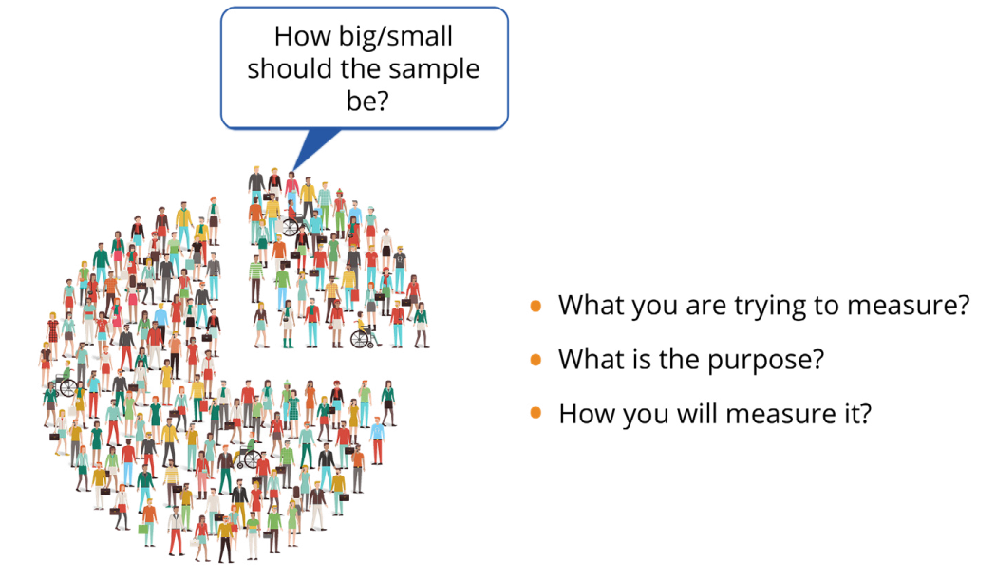
Lecture6
Session4:Methodologies for data collection and analysis for monitoring and evaluation (Part1)
  Determining sample size
The size of the sample will be determined by what will be measured, for what purpose and how it will be measured.
The size of the sample will also need to ensure, with the maximum level of confidence possible, that an observed change or difference between groups is the result of the intervention, rather than a product of chance.
However, this may not always be the case for non-random/purposeful sampling.
Determining sample size: Random sampling
When a large number of respondents is required, the appropriate sample size is decided by considering the confidence level and the sampling error

Slide 34
Lecture6
Session4:Methodologies for data collection and analysis for monitoring and evaluation (Part1)
  3. Methods, approaches and tools for monitoring and evaluation
  Methods for and approaches to data collection are systematic procedures and useful to support the process of designing data collection tools. Generally, a mixture of qualitative and quantitative methods and approaches to data collection are used.
  Although there are multiple definitions for these concepts, quantitative methods and approaches can be viewed as being based on numerical data that can be analysed using statistics.
  They focus on pinpointing what, where, when, how often and how long something occurs and can provide objective, hard facts, but cannot explain why something occurs. Qualitative methods and approaches for data collection are based on data that are descriptive in nature, rather than data that can be measured or counted. Qualitative research methods can use descriptive words that can be examined for patterns or meaning and, therefore, focus on why or how something occurs.

Slide 35
Lecture6
Session4:Methodologies for data collection and analysis for monitoring and evaluation (Part1)
  Quantitative versus qualitative approaches for monitoring and evaluation
 | Quantitative approach | Qualitative approach
WHAT | Structured Emphasizes reliability Harder to develop Easier to analyse | Less structured Emphasizes validity Easier to develop Can provide “rich data” but is more labour intensive to collect and analyse
WHY | Want to count things to explain what is observed Want to generalize to entire target population Want to make predictions/provide causal explanations Know what you want to measure | Want complete, detailed description of what is observed Want to understand what is observed Want narrative or in-depth information Not sure what you are able to measure Want to attain a more in-depth understanding or insight
TOOLS | Surveys Interviews Observations | Surveys Interviews Focus group discussions Case studies Observations
SIMPLE | Large-n (sample) that is representative of the target population Respondents selected using some form of random sampling | Small-n (sample) that is unrepresentative of the target population Respondents usually selected according to their experience
OUTPOUT | Numerical data | Words and pictures
ANALYSIS | Statistical | Interpretive

Slide 36

Lecture6
Session4:Methodologies for data collection and analysis for monitoring and evaluation (Part1)
  The following graphic provides an overview of data collection methods for both monitoring and evaluation
Frequently used data collection methods
Surveys
Interviews
Focus group discussions
Case studies
Observation
Additional data collection methods
Strengths, weaknesses, opportunities and threats (SWOT)
Dreams realized or visioning (DR/V)
Drama and role plays
Photos and videos
Brainstorming
Geographic information system (GIS) mapping

Slide 37

Lecture6
Session4:Methodologies for data collection and analysis for monitoring and evaluation (Part1)
  Surveys
  Surveys are a common technique for collecting data. Surveys can collect focused, targeted information about a sample taken from the target population for a project, program or policy, especially data about perceptions, opinions and ideas. While surveys can also be used to measure intended behavior, there is always room for interpretation, and any data gathered may be less “factual” as what people say they (intend to) do may not reflect what they in fact do in reality.

Slide 38

Lecture6
Session4:Methodologies for data collection and analysis for monitoring and evaluation (Part1)
  Interviews
Interviews are a qualitative research technique used to shed light on subjectively lived experiences of, and viewpoints from, the respondents’ perspective on a given issue, or sets of issues, that are being monitored or evaluated for a given intervention. Interviews provide opportunities for mutual discovery, understanding, reflection and explanation. Interviews are of three types: (a) structured;
(b) semi-structured; and (c) unstructured.

Slide 39
Lecture6
Session4:Methodologies for data collection and analysis for monitoring and evaluation (Part1)
  Formulating interview questions
Good-quality interview questions should have the following characteristics:
Simple and clear and do not use acronyms, abbreviations or jargon;
Not double barreled, such that it touch on more than one subject, while allowing for only one answer;
Favour open-ended and elaborate answers.
If including yes/no questions, these should be followed by requests for further explanations, “Why?”, “In what ways?”, or they should be reworded to encourage a more fine-grained answer.
Straightforward (no double negatives), neutral and non-leading;
Non-threatening and non-embarrassing to the interviewee;
Accompanied by appropriate probes.
Structured Semi-structured Unstructured

Slide 40
Lecture6
Session4:Methodologies for data collection and analysis for monitoring and evaluation (Part1)
  Focus group discussions
A focus group is another qualitative research technique in the form of a planned group discussion among a limited number of people, with a moderator and if possible, note takers, as well as observers if also using observations.
The purpose of a focus group is to attain diverse ideas and perceptions on a topic of interest in a relaxed, permissive environment that allows the expression of different points of view, with no pressure for consensus.

Slide 41
Lecture6
Session4:Methodologies for data collection and analysis for monitoring and evaluation (Part1)
  Case study
A case study is a qualitative data collection method that is used to examine real-life situations and if the findings of the case can illustrate aspects of the intervention being monitored and/or evaluated. It is a comprehensive examination of cases to obtain in-depth information, with the goal of understanding the operational dynamics, activities, outputs, outcomes and interactions of an intervention.

Slide 42
Lecture6
Session4:Methodologies for data collection and analysis for monitoring and evaluation (Part1)
  Observation
Observation is a research technique that M&E practitioners can use to better understand participants’ behaviour and the physical setting in which a project, program or policy is being implemented. To observe means to watch individuals and their environments and notice their behaviors and interactions by using all five senses: seeing, touching, tasting, hearing and smelling.
Observations should be used on the following:
      Gathering data on individual behaviours or interactions between people and their environment;
      When there is a need to know about a physical setting;
      When data collection from interviews/surveys with individuals is not feasible.
.

Slide 43
Lecture6
Session4:Methodologies for data collection and analysis for monitoring and evaluation (Part1)
  Methods for impact evaluations
Impact evaluations aim to identify a proper counterfactual and whether impact can be confidently attributed to an intervention. Specifically, this may be done by assessing the situation of the beneficiaries “before and after” and “with or without” the intervention.
By comparing the before and after and/or with or without scenarios, any differences/changes observed can be attributed to the intervention, with some reservations as it is not always straightforward and attribution may be more complex to assess than by answering the above scenarios.
While there is a range of impact evaluation designs, there is also a range of methods that are applicable within these designs.
To answer the specific evaluation questions, methods are flexible and can be used in different combinations within impact evaluation designs. Experimental, quasi-experimental and non-experimental are three types of impact evaluation design.

Slide 44

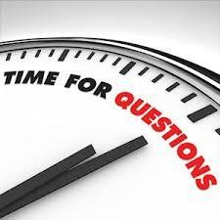
Lecture 2

