Slide 1
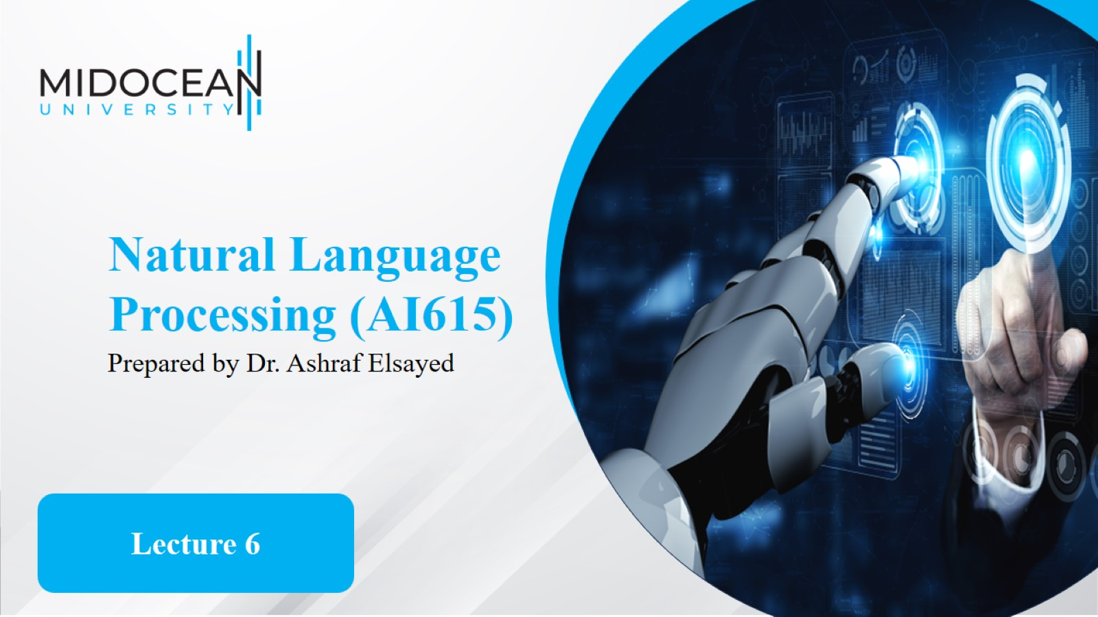

Slide 2
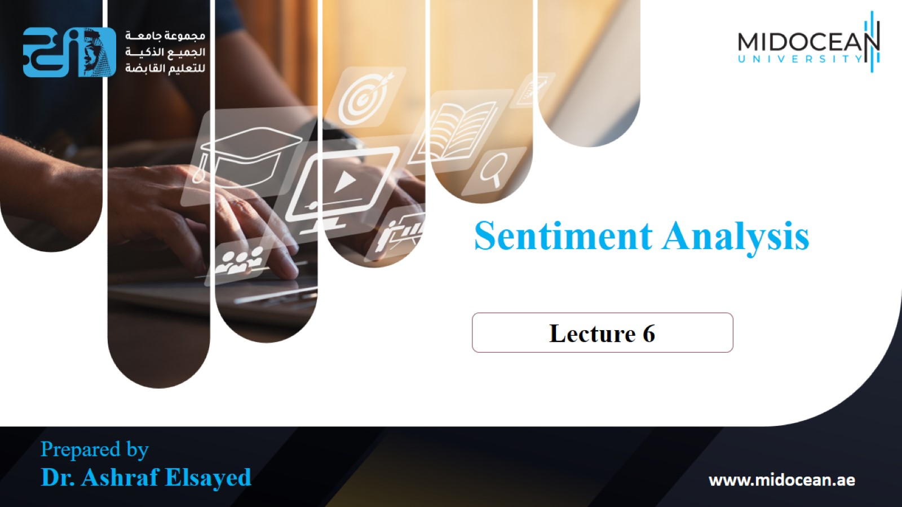

Slide 3
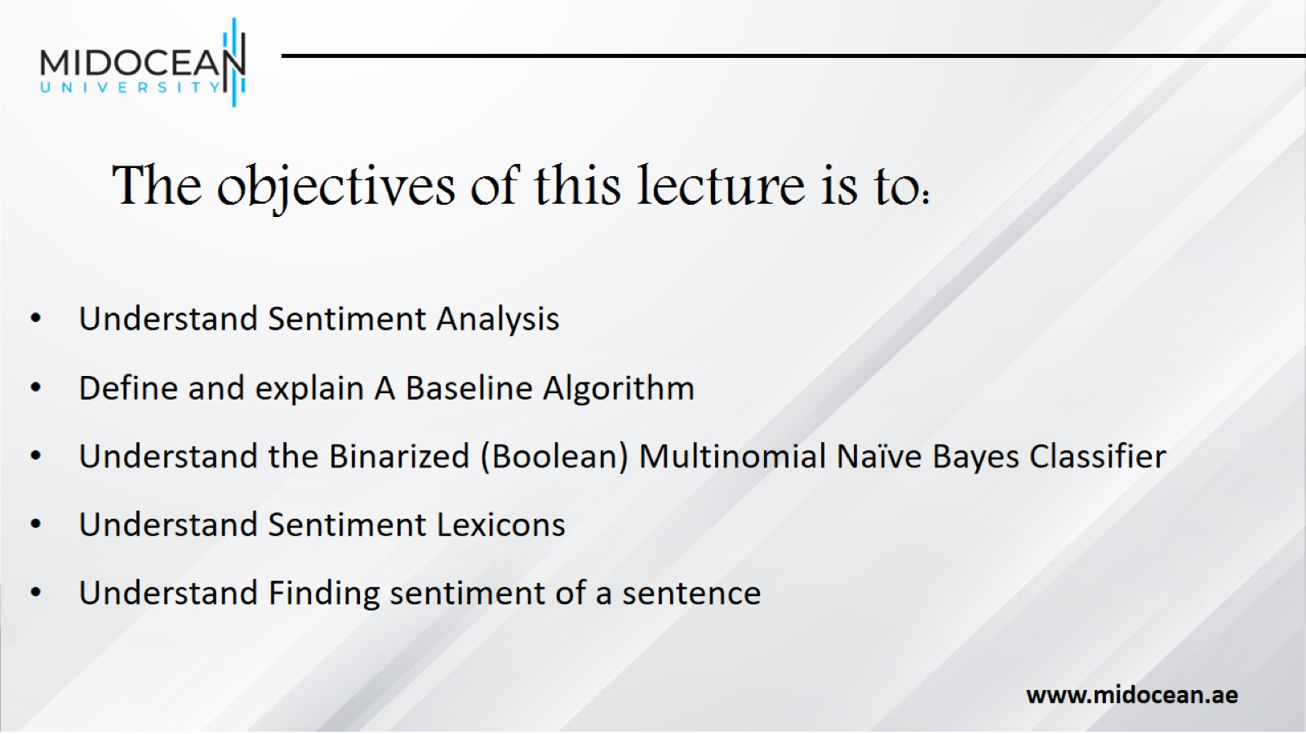
The objectives of this lecture is to:

Slide 4
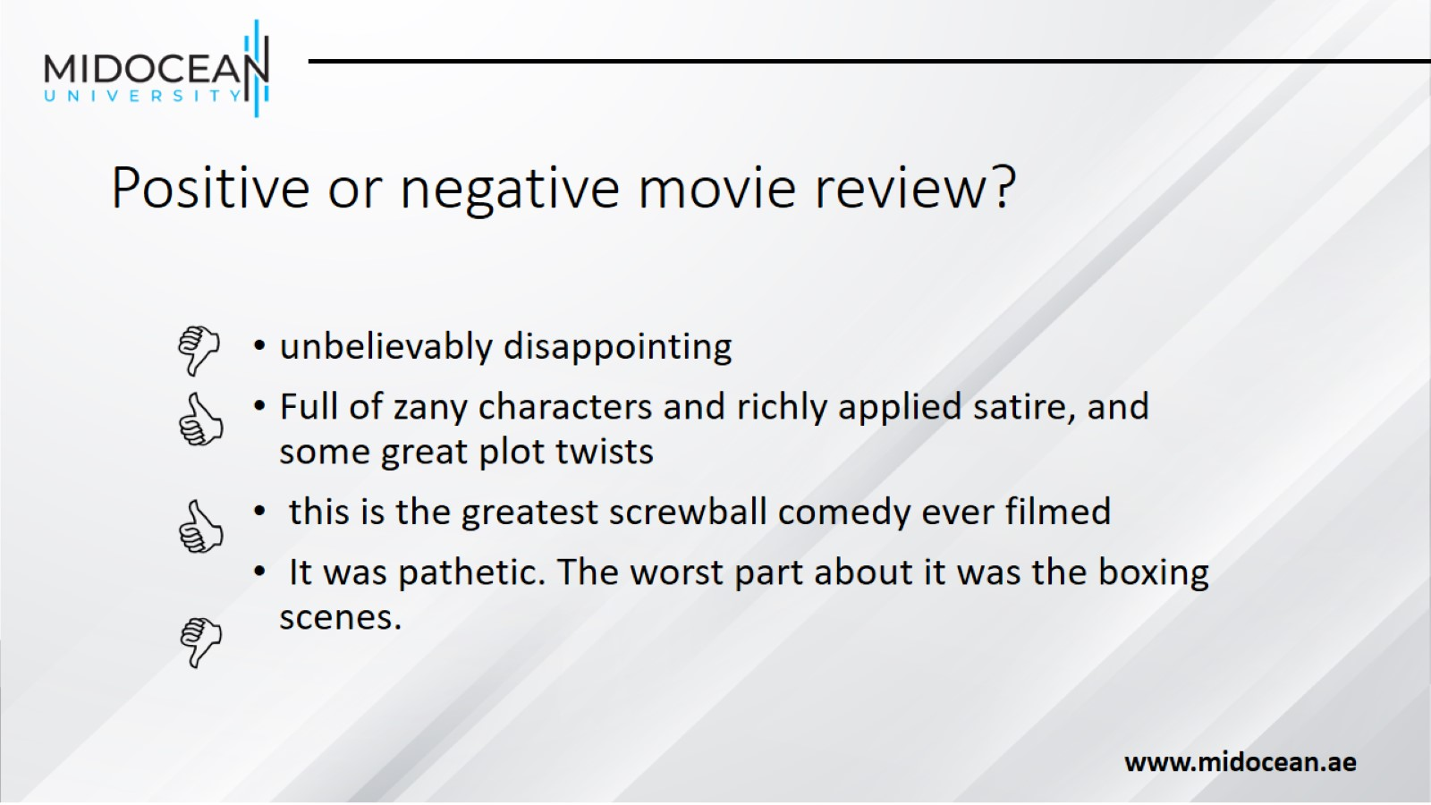
Positive or negative movie review?

Slide 5
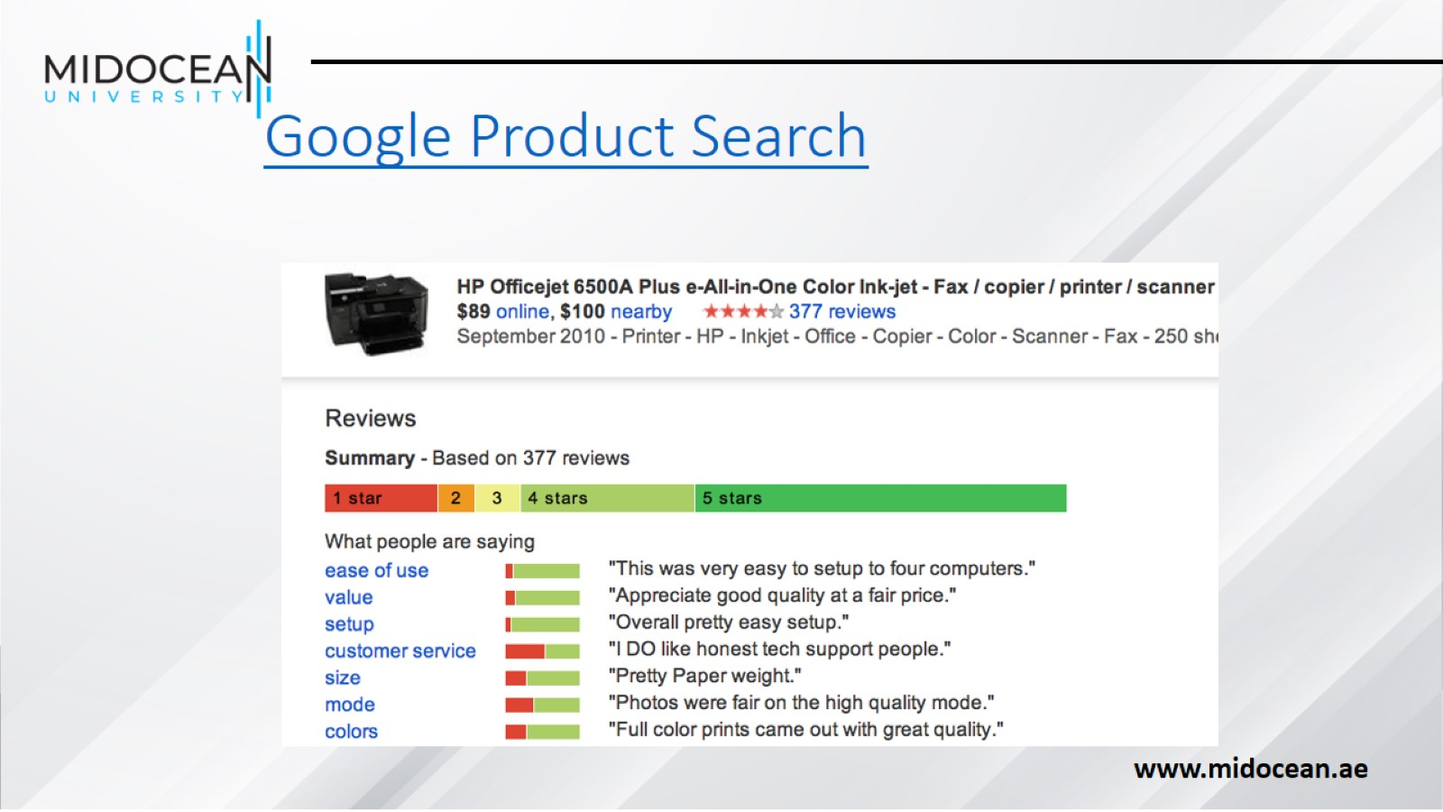
Google Product Search

Slide 6
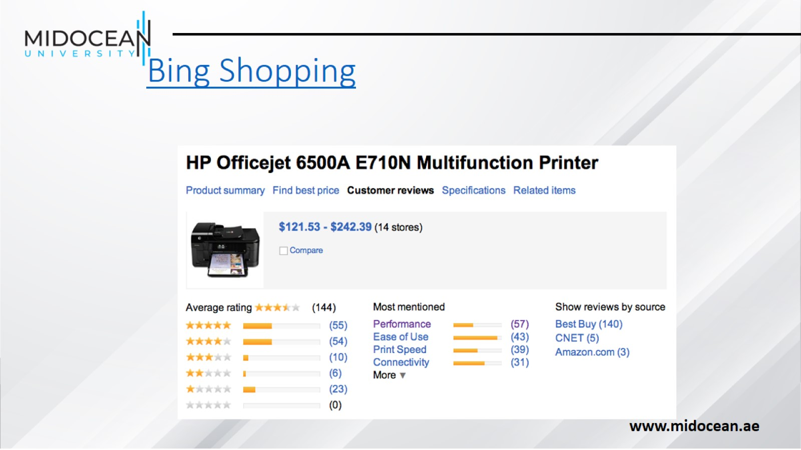
Bing Shopping

Slide 7
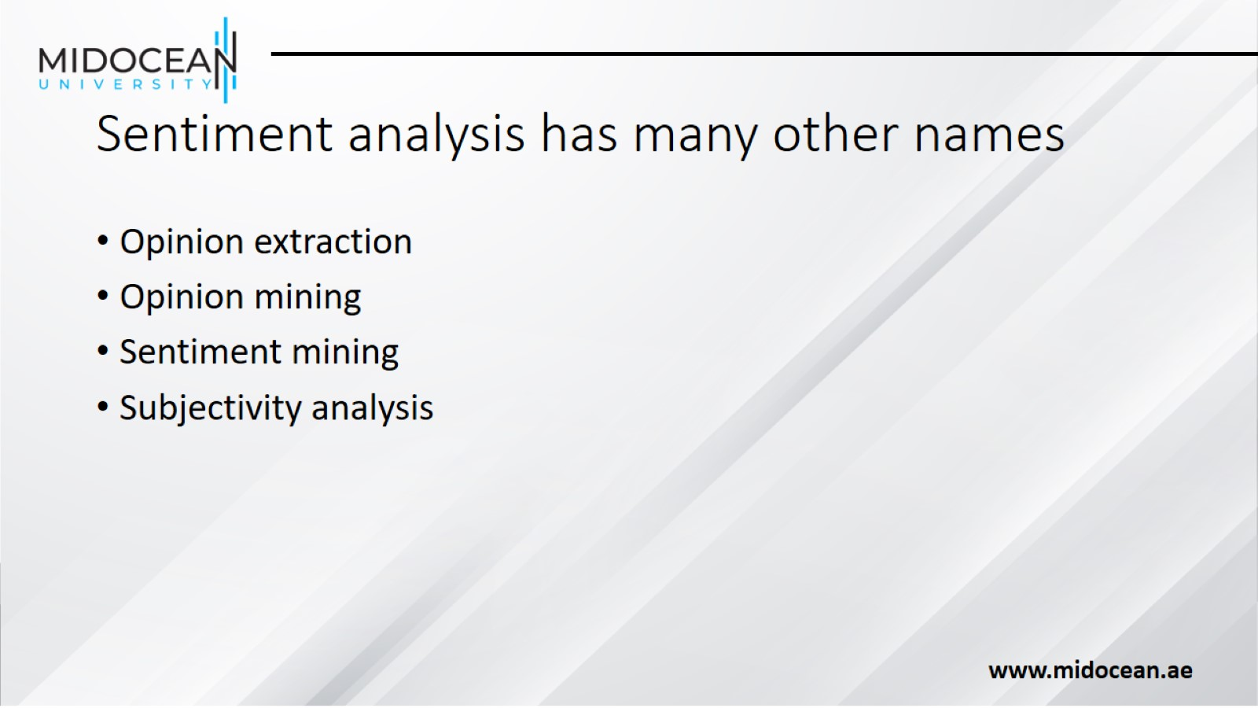
Sentiment analysis has many other names

Slide 8
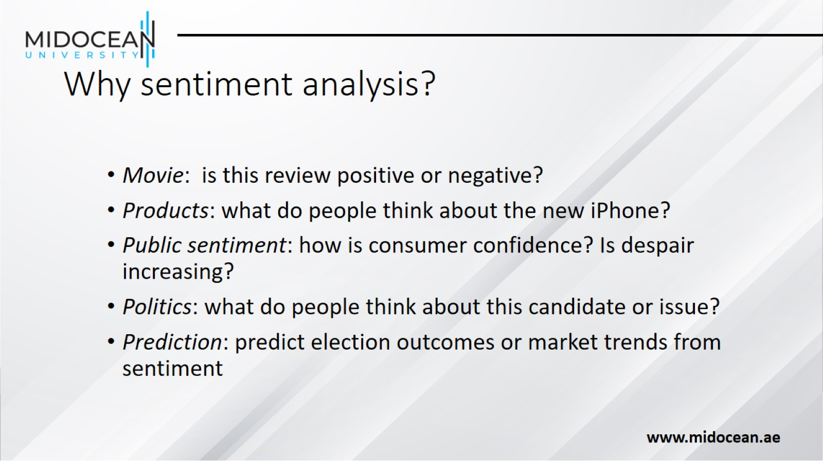
Why sentiment analysis?

Slide 9
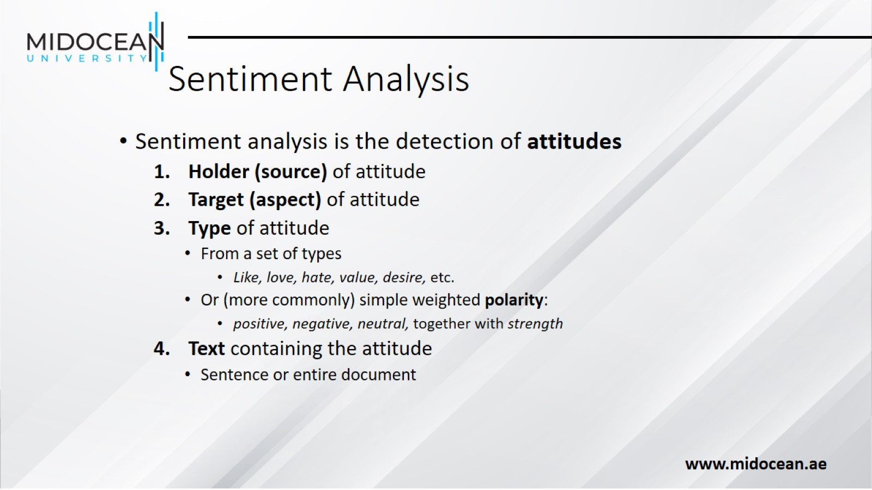
Sentiment Analysis

Slide 10
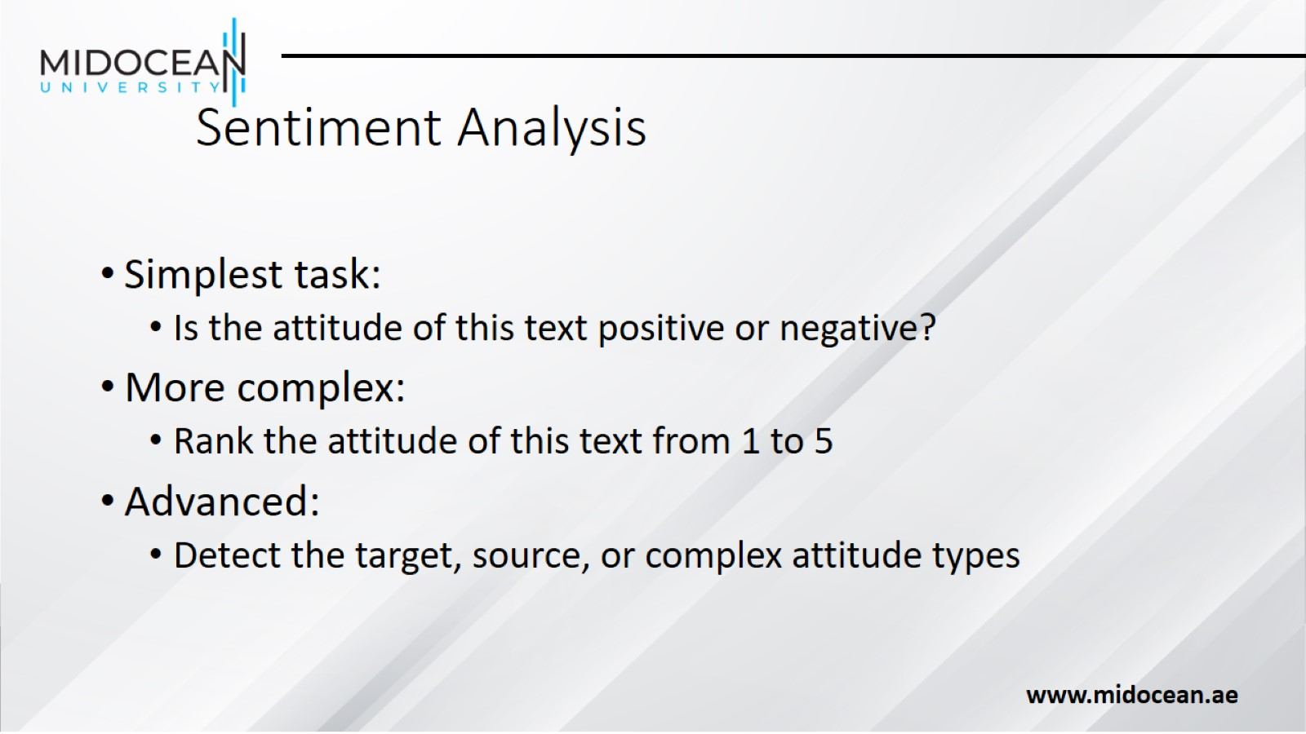
Sentiment Analysis

Slide 11
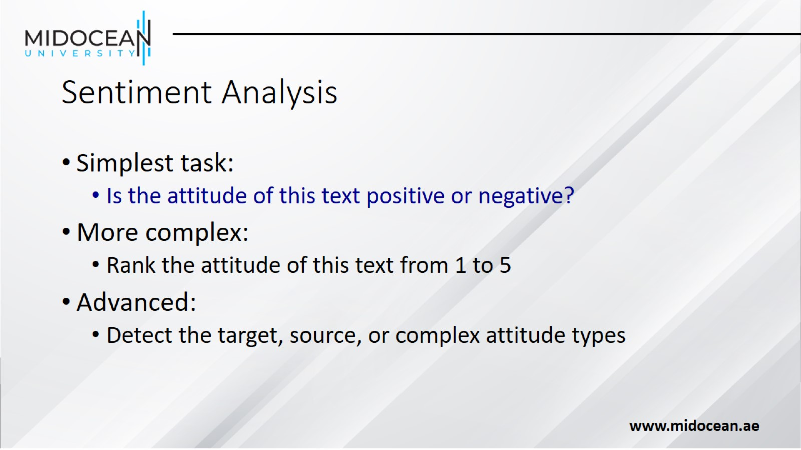
Sentiment Analysis

Slide 12
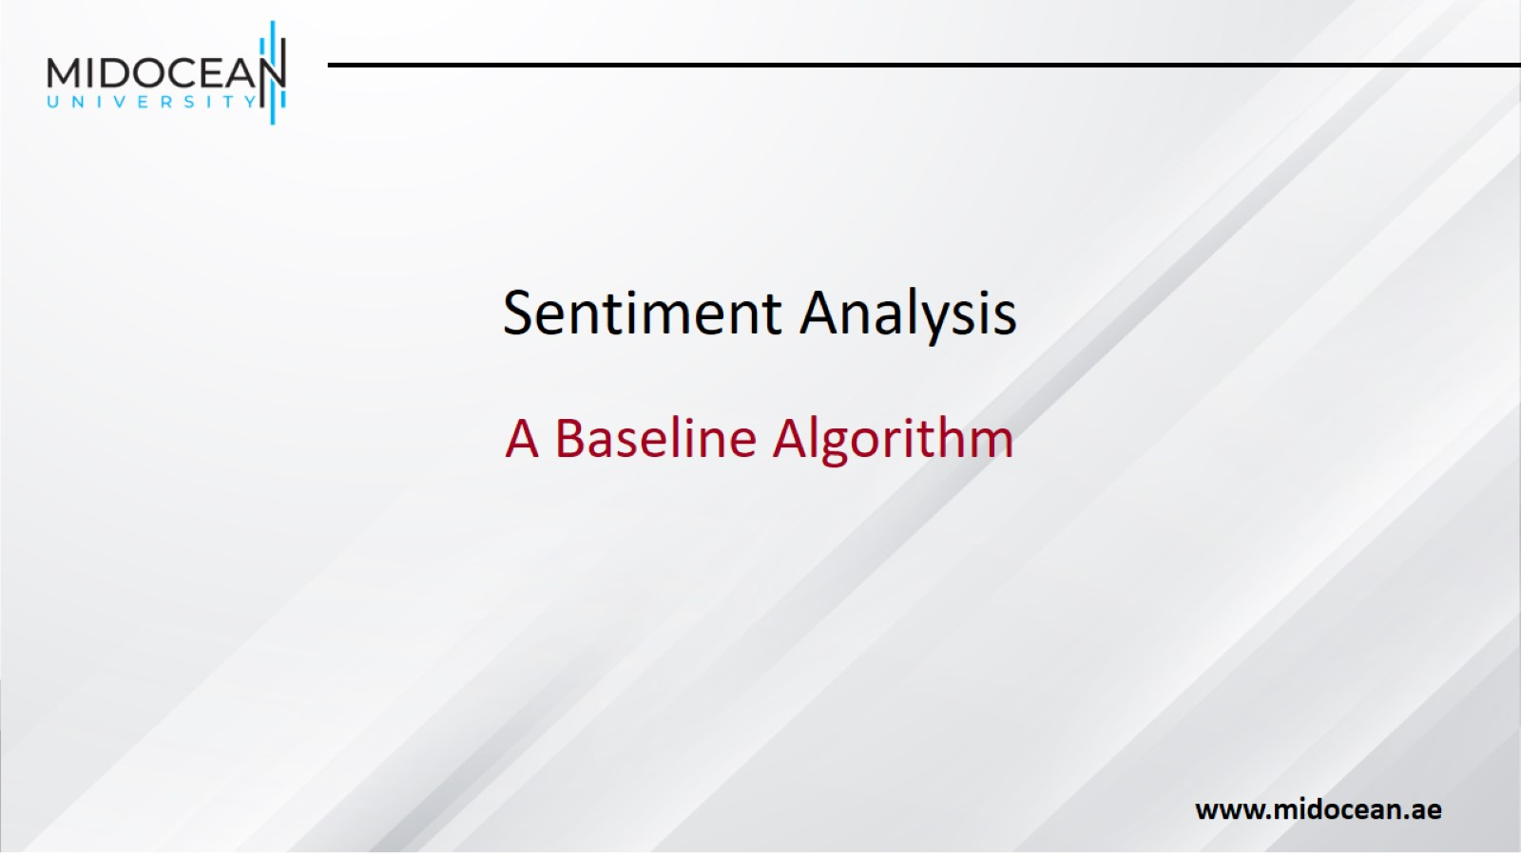
Sentiment Analysis

Slide 13
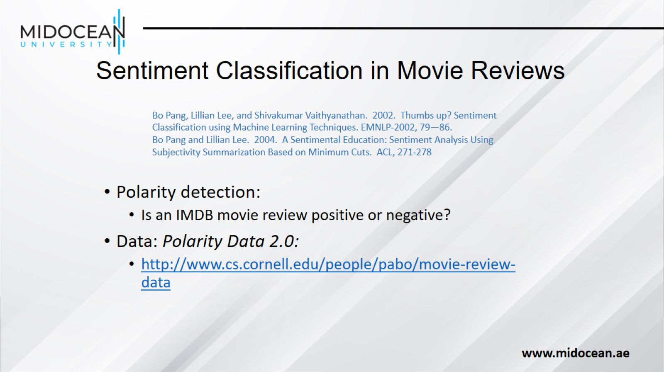
  Sentiment Classification in Movie Reviews

Slide 14
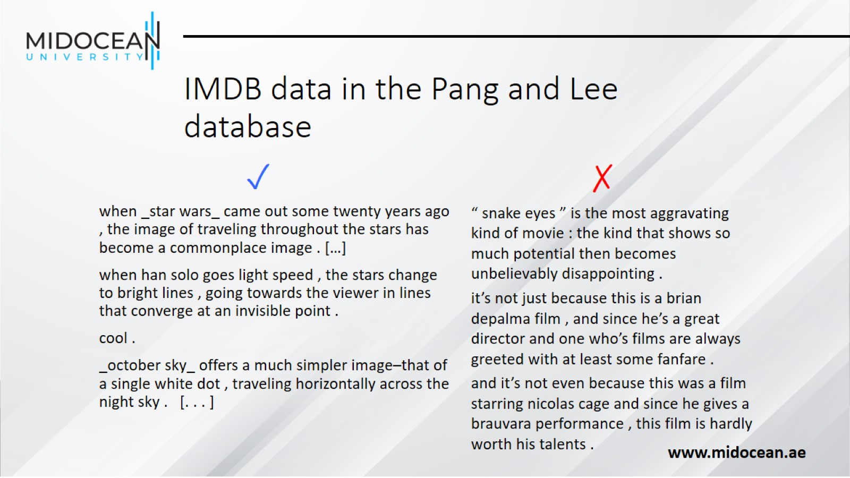
IMDB data in the Pang and Lee database

Slide 15
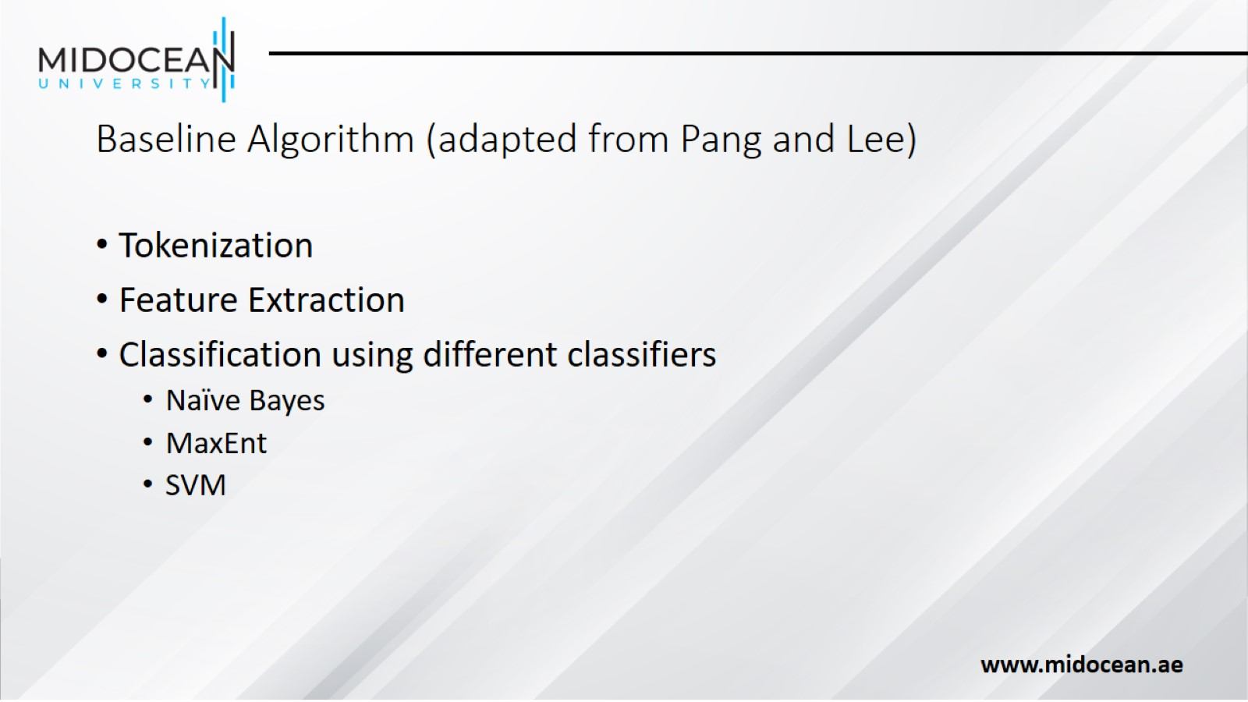
Baseline Algorithm (adapted from Pang and Lee)

Slide 16
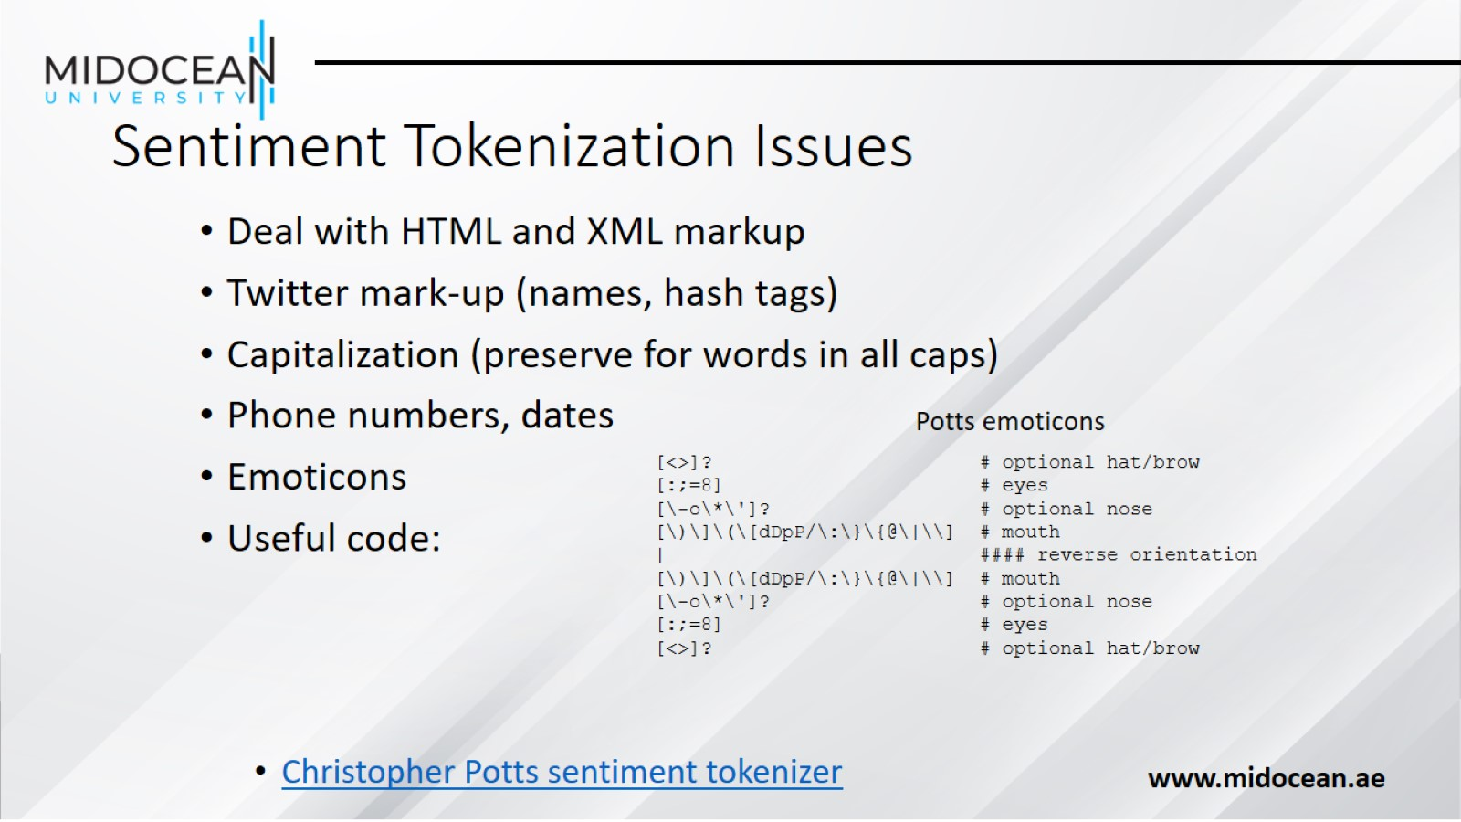
Sentiment Tokenization Issues

Slide 17
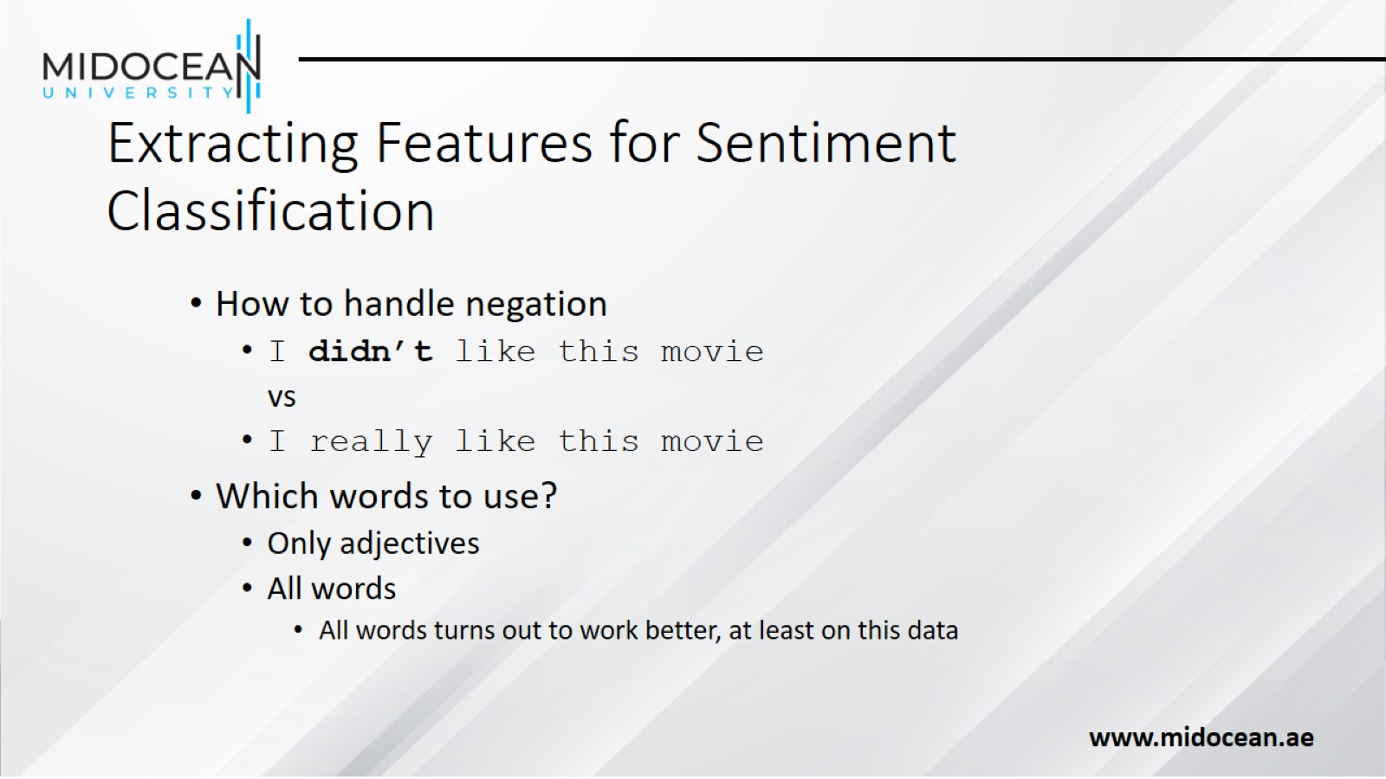
Extracting Features for Sentiment Classification

Slide 18
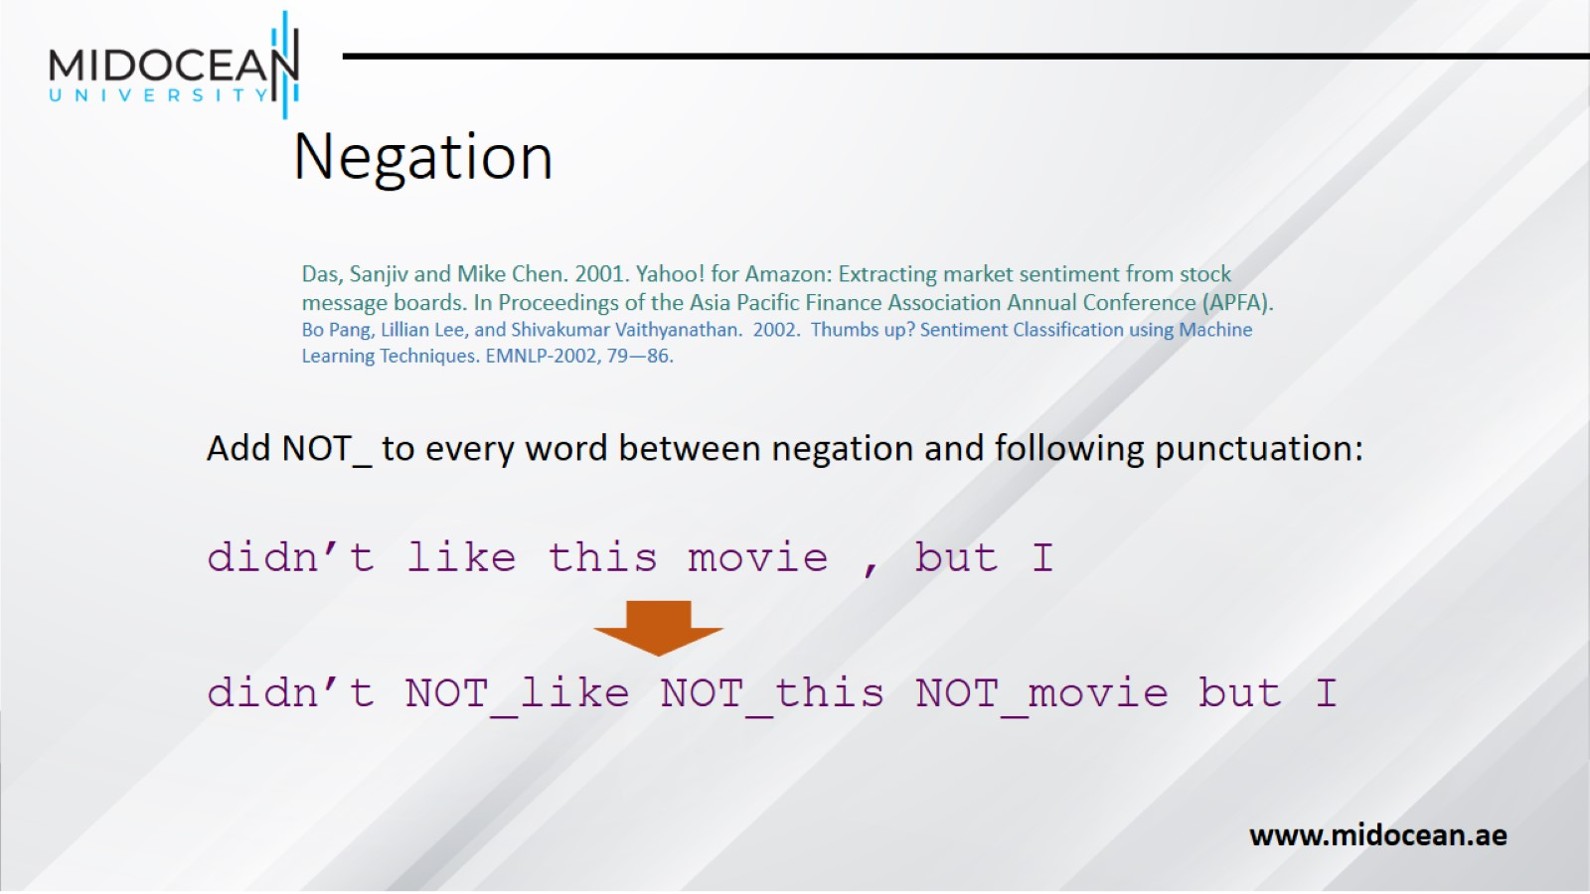
Negation

Slide 19
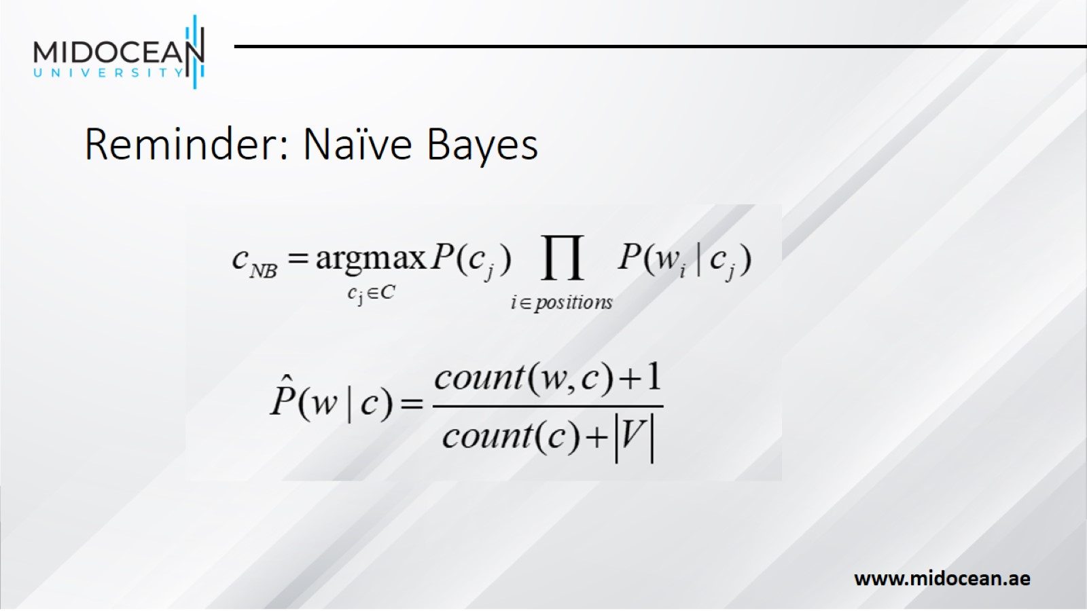
Reminder: Naïve Bayes

Slide 20
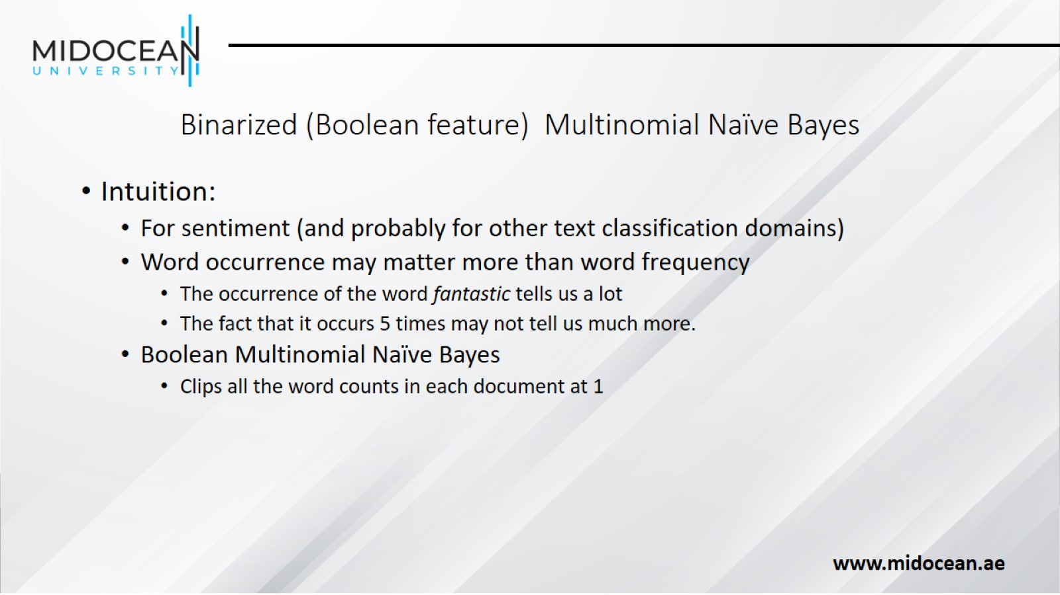
Binarized (Boolean feature) Multinomial Naïve Bayes

Slide 21
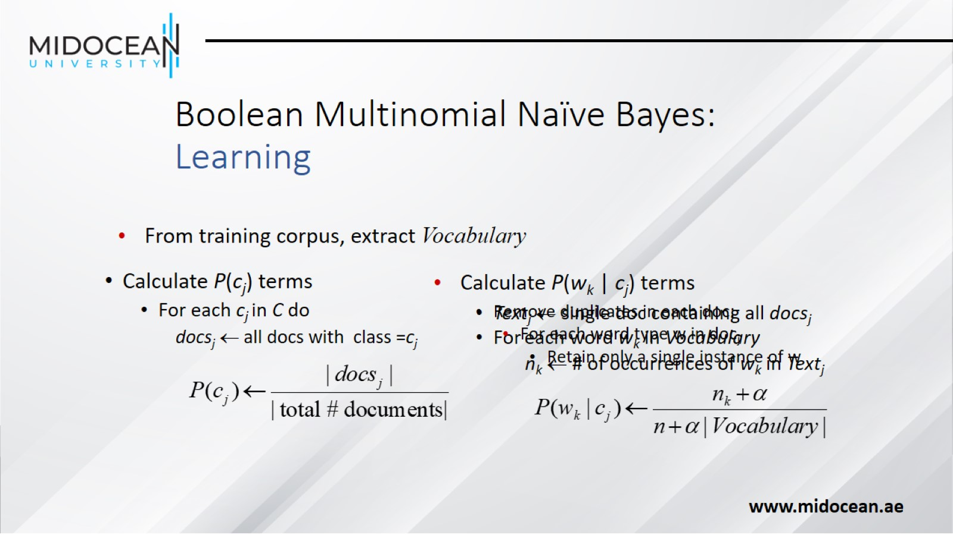
Boolean Multinomial Naïve Bayes: Learning

Slide 22
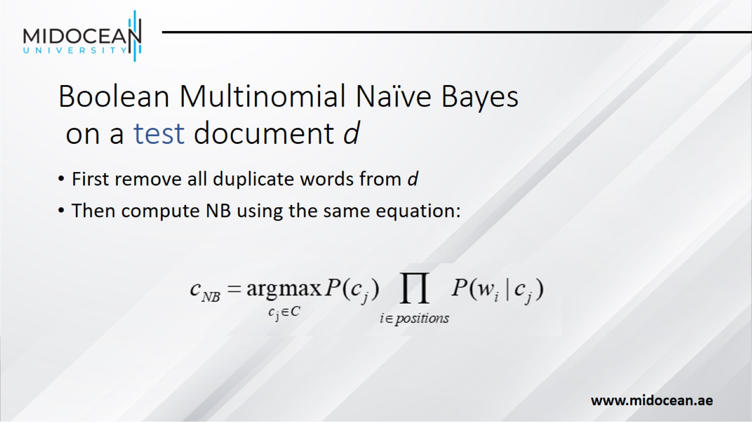
Boolean Multinomial Naïve Bayes on a test document d

Slide 23
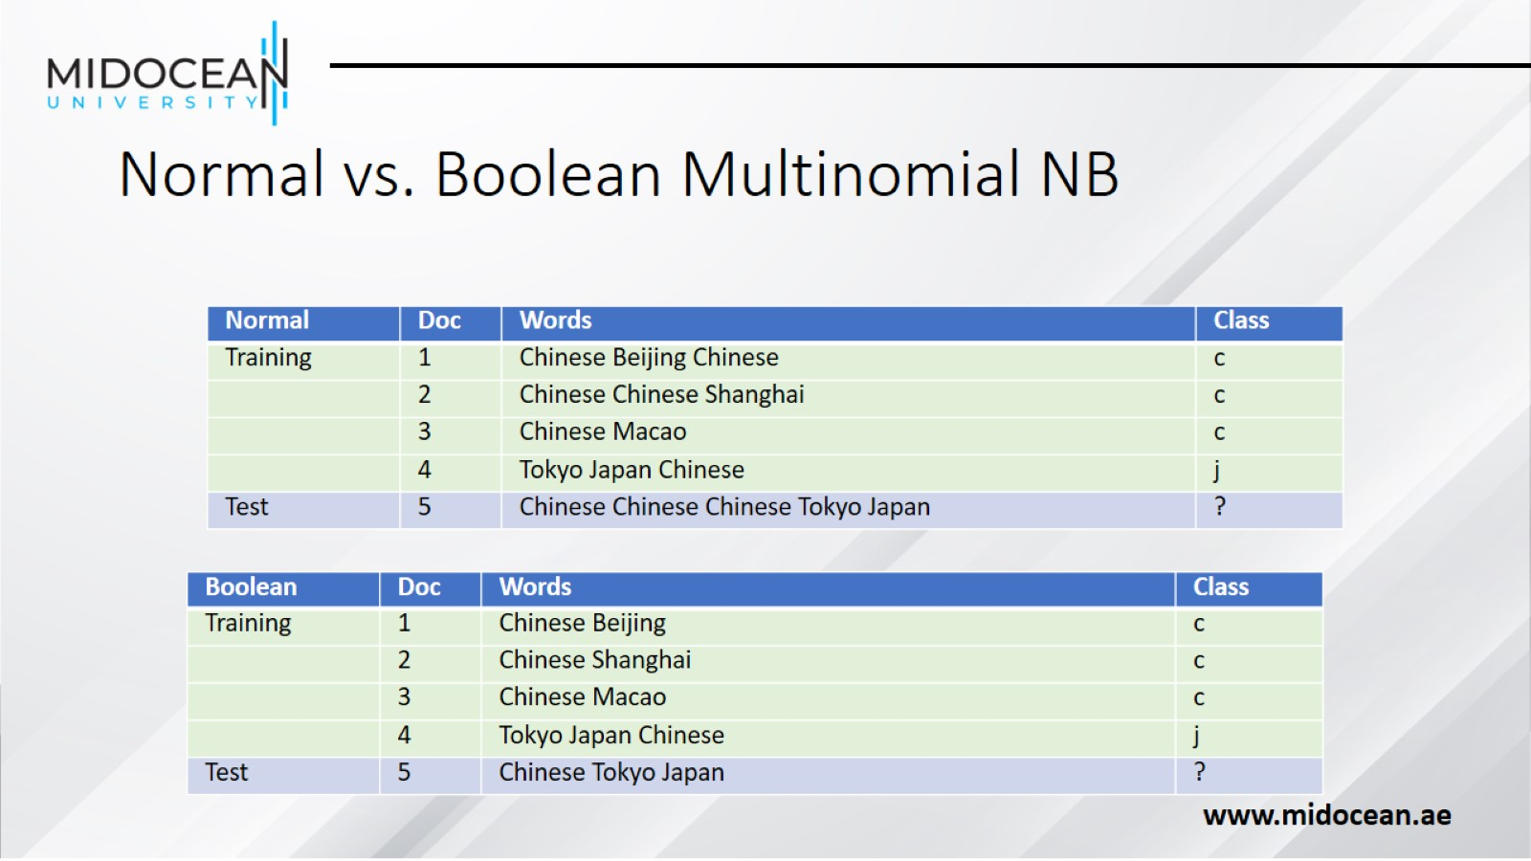
Normal vs. Boolean Multinomial NB

Slide 24
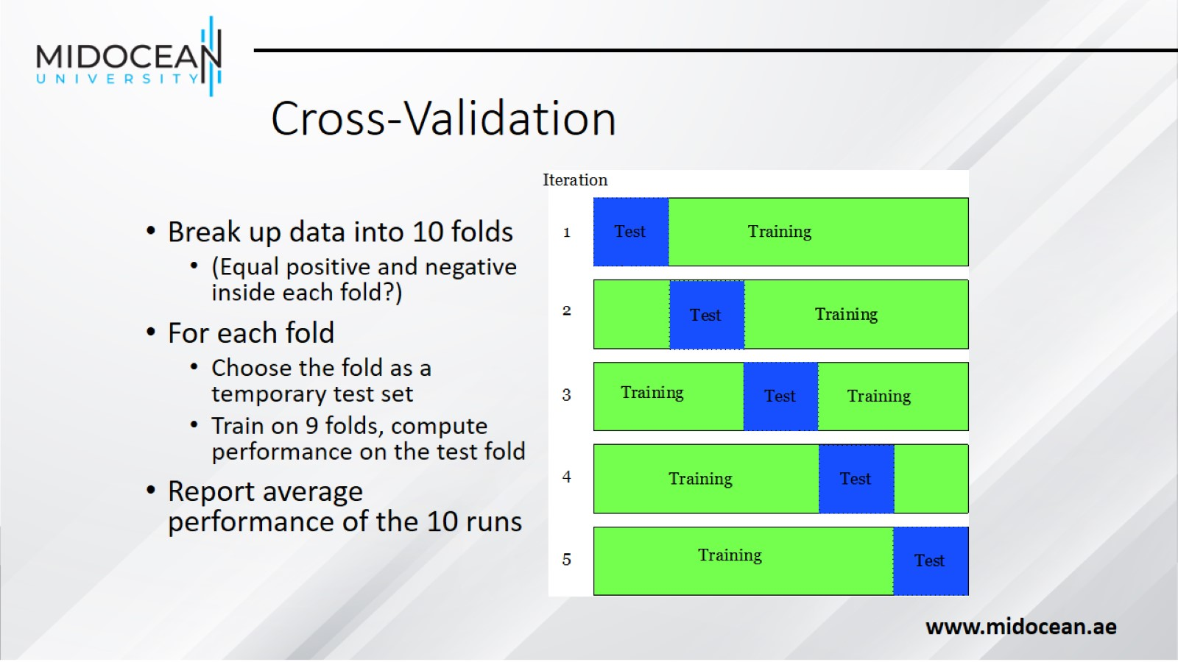
Cross-Validation

Slide 25
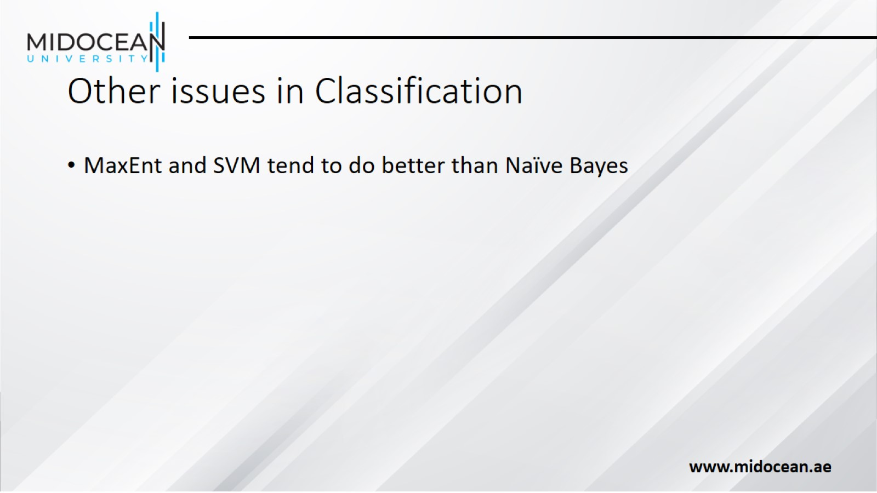
Other issues in Classification

Slide 26
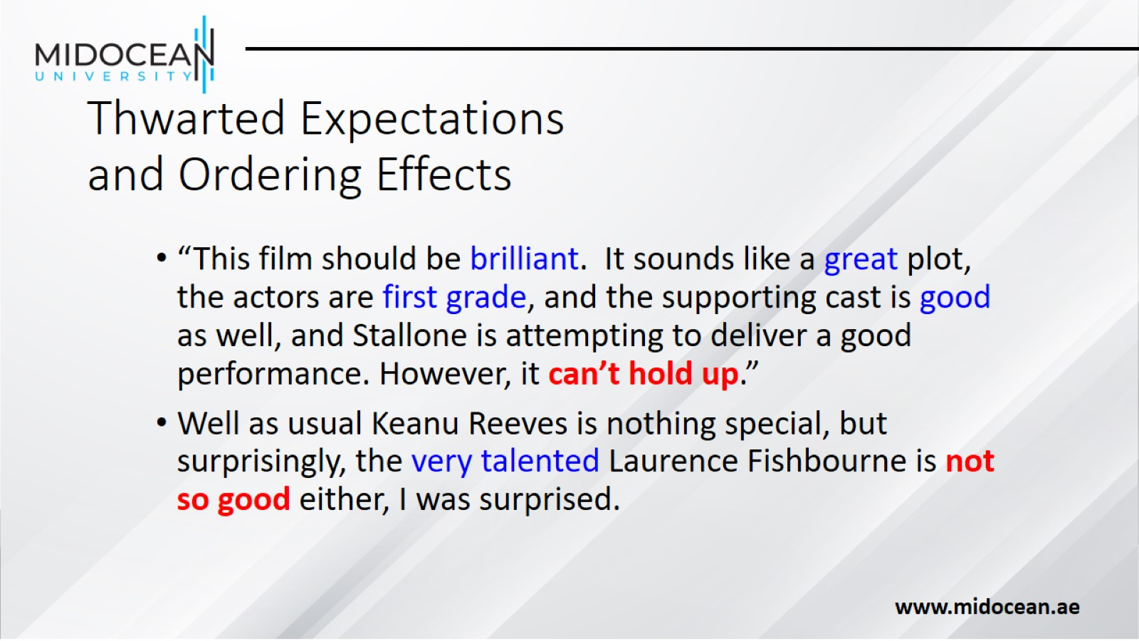
Thwarted Expectations and Ordering Effects

Slide 27
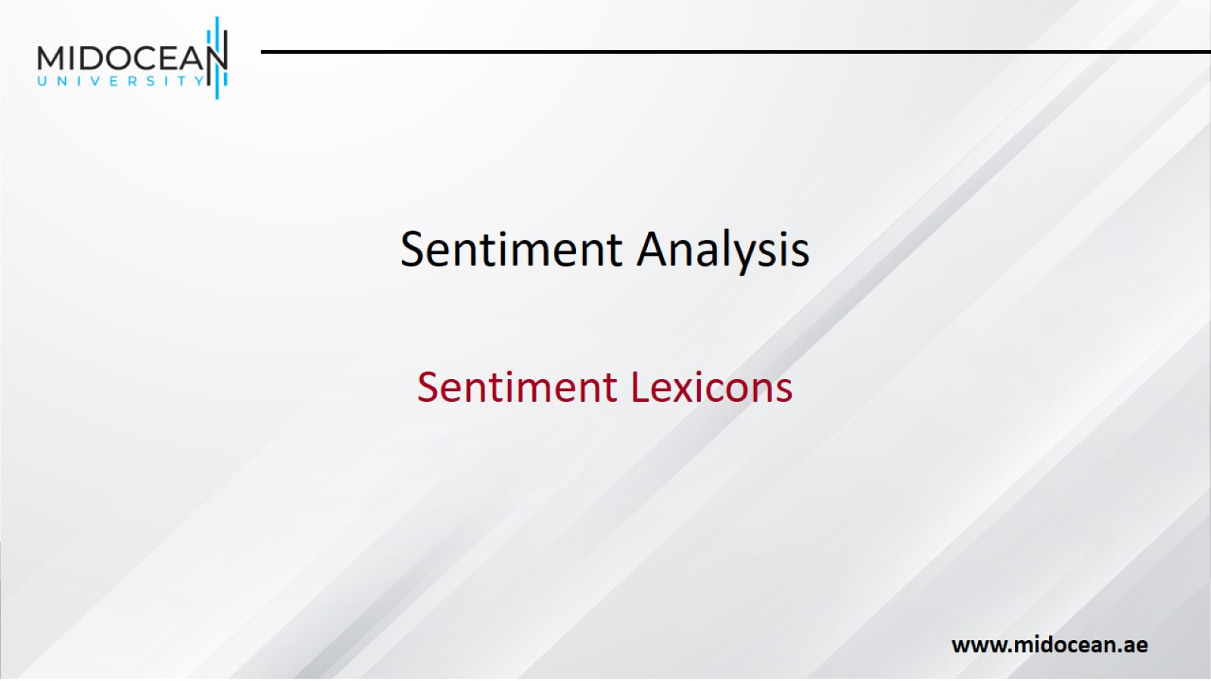
Sentiment Analysis

Slide 28
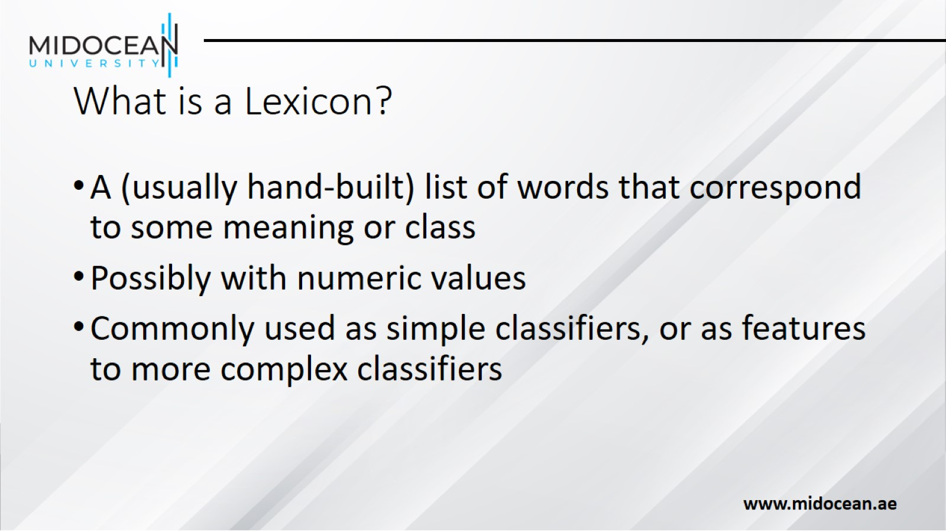
What is a Lexicon?

Slide 29
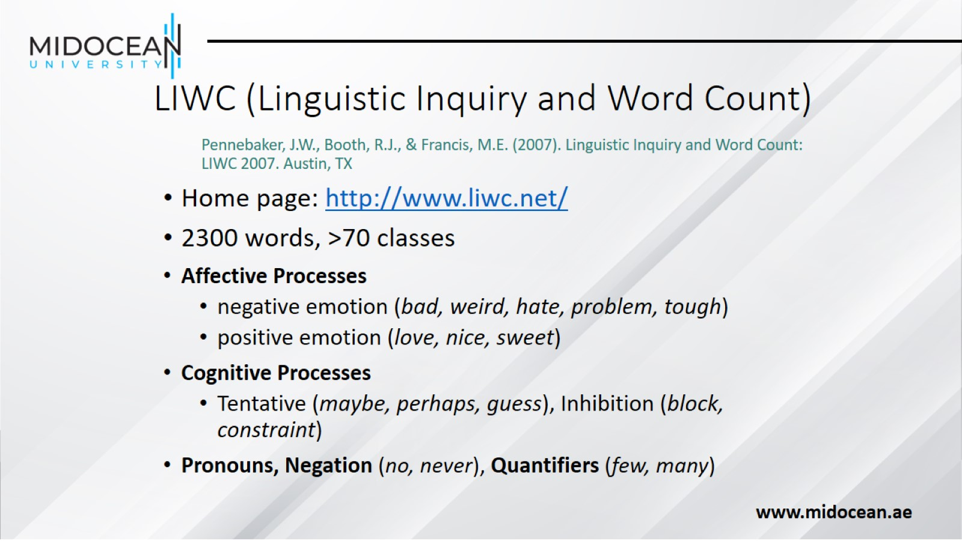
LIWC (Linguistic Inquiry and Word Count)

Slide 30
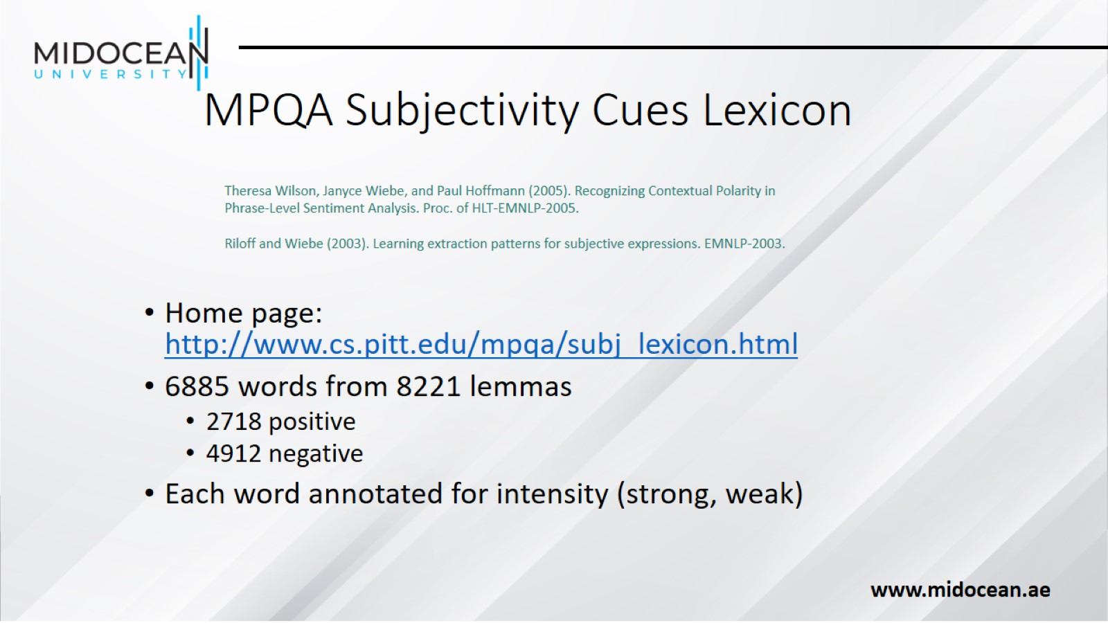
MPQA Subjectivity Cues Lexicon

Slide 31
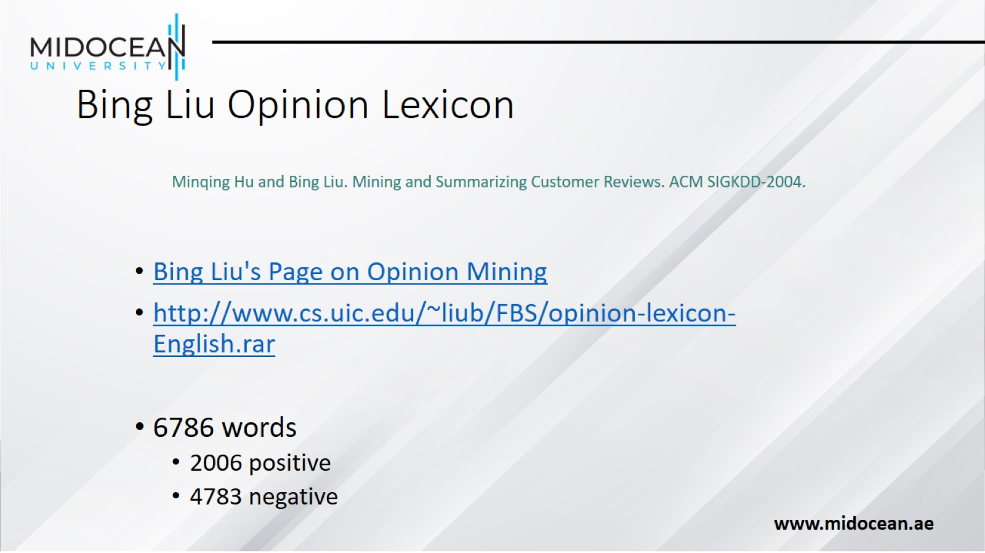
Bing Liu Opinion Lexicon

Slide 32
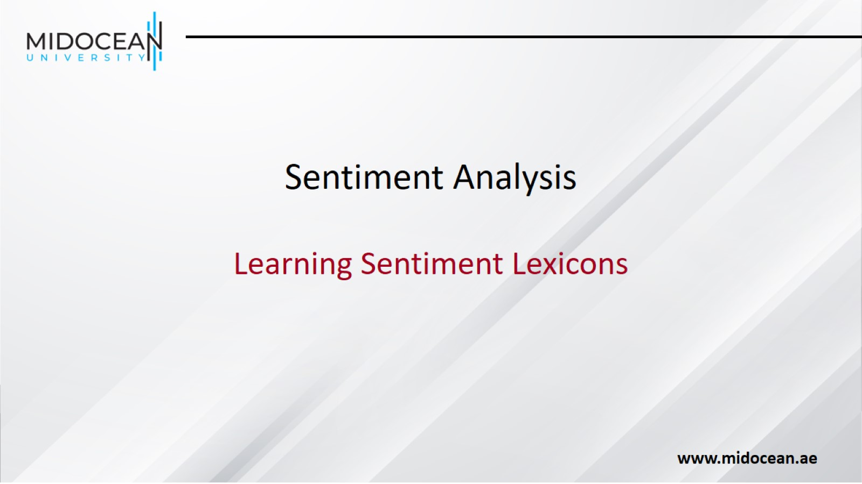
Sentiment Analysis

Slide 33
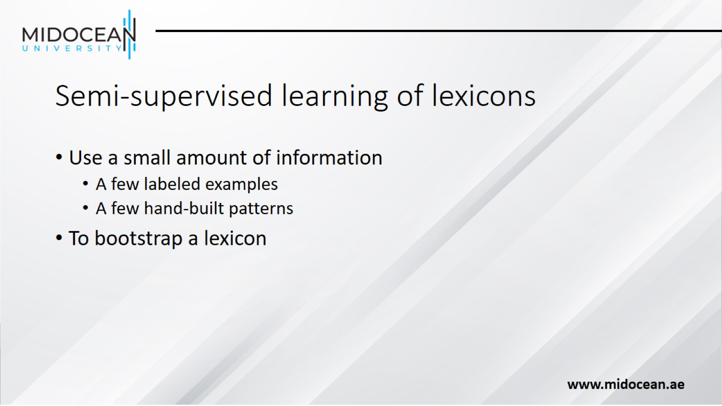
Semi-supervised learning of lexicons

Slide 34
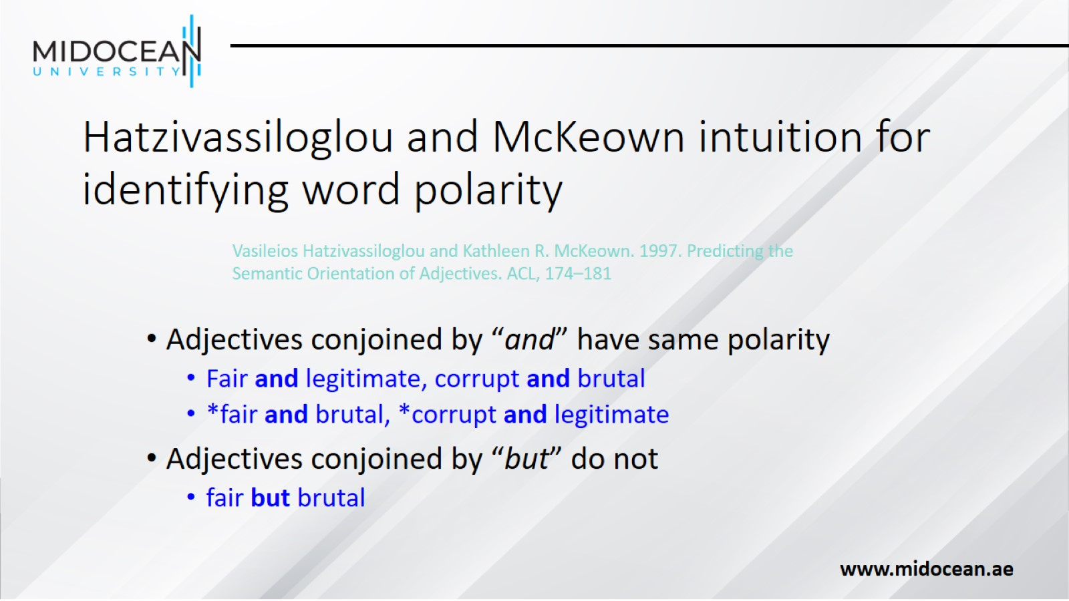
Hatzivassiloglou and McKeown intuition for identifying word polarity

Slide 35
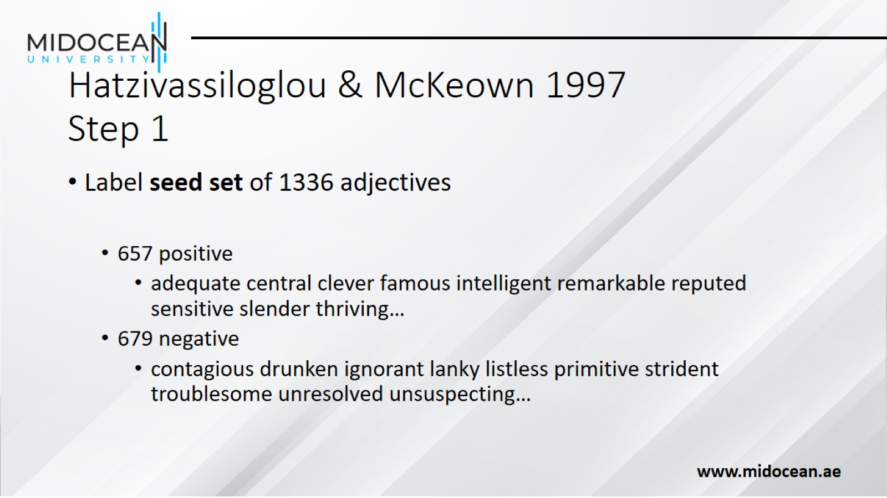
Hatzivassiloglou & McKeown 1997
Step 1

Slide 36
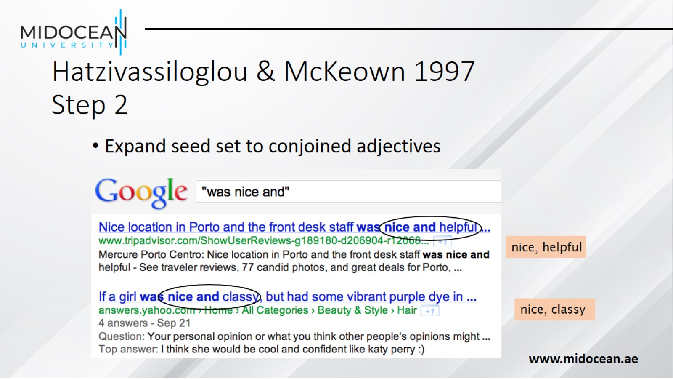
Hatzivassiloglou & McKeown 1997
Step 2

Slide 37
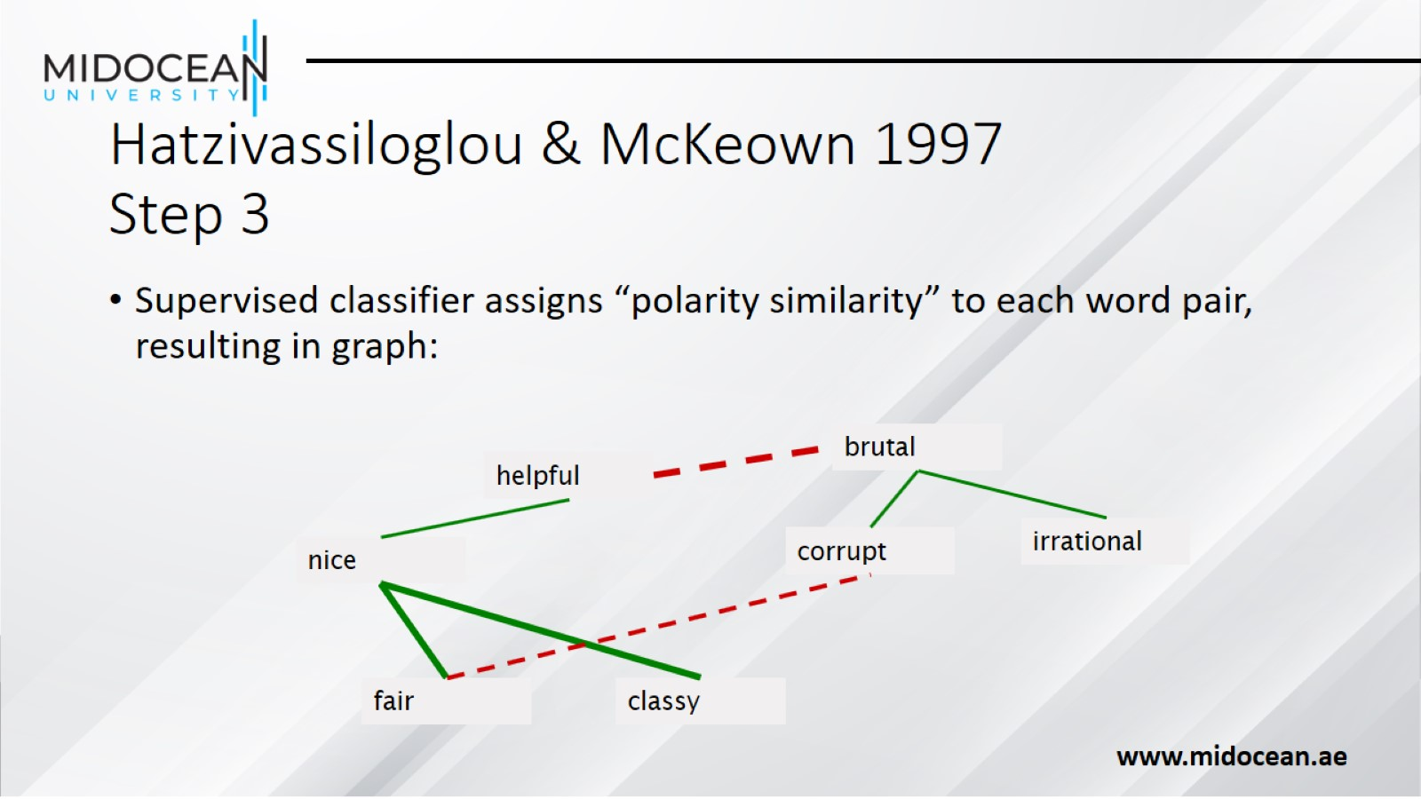
Hatzivassiloglou & McKeown 1997
Step 3

Slide 38
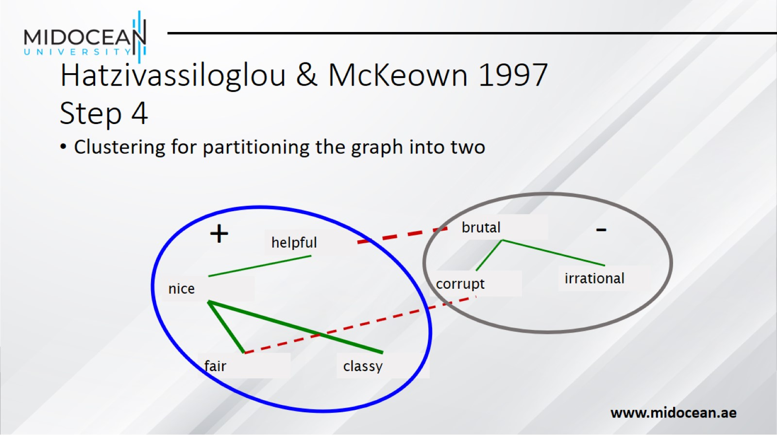
Hatzivassiloglou & McKeown 1997
Step 4

Slide 39
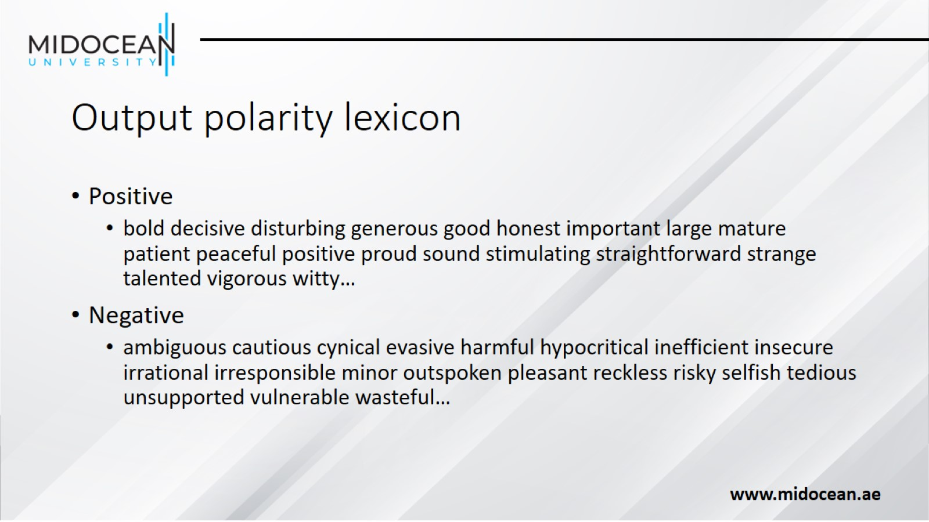
Output polarity lexicon

Slide 40
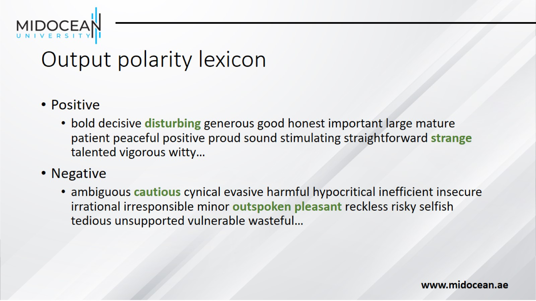
Output polarity lexicon

Slide 41
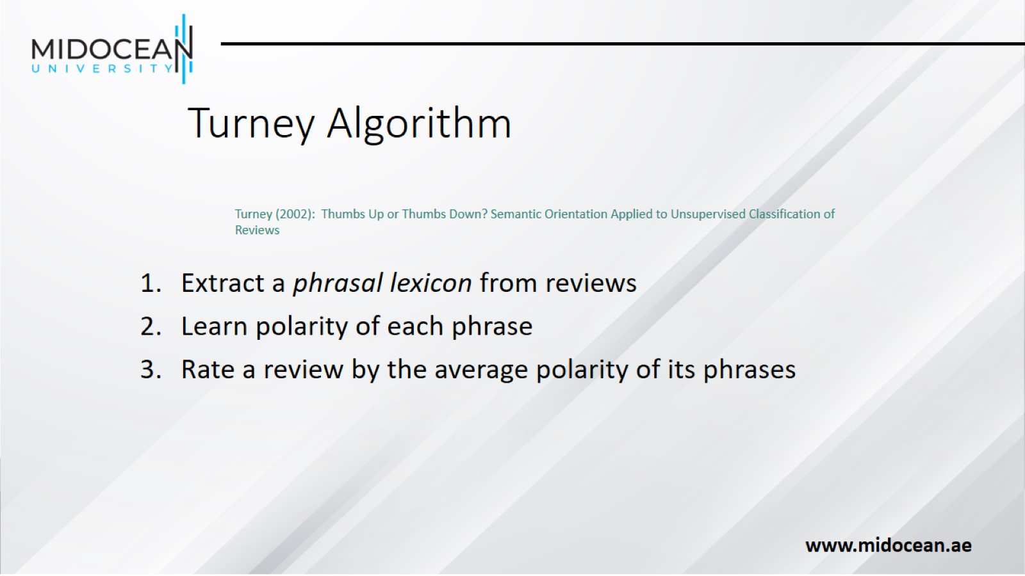
Turney Algorithm

Slide 42
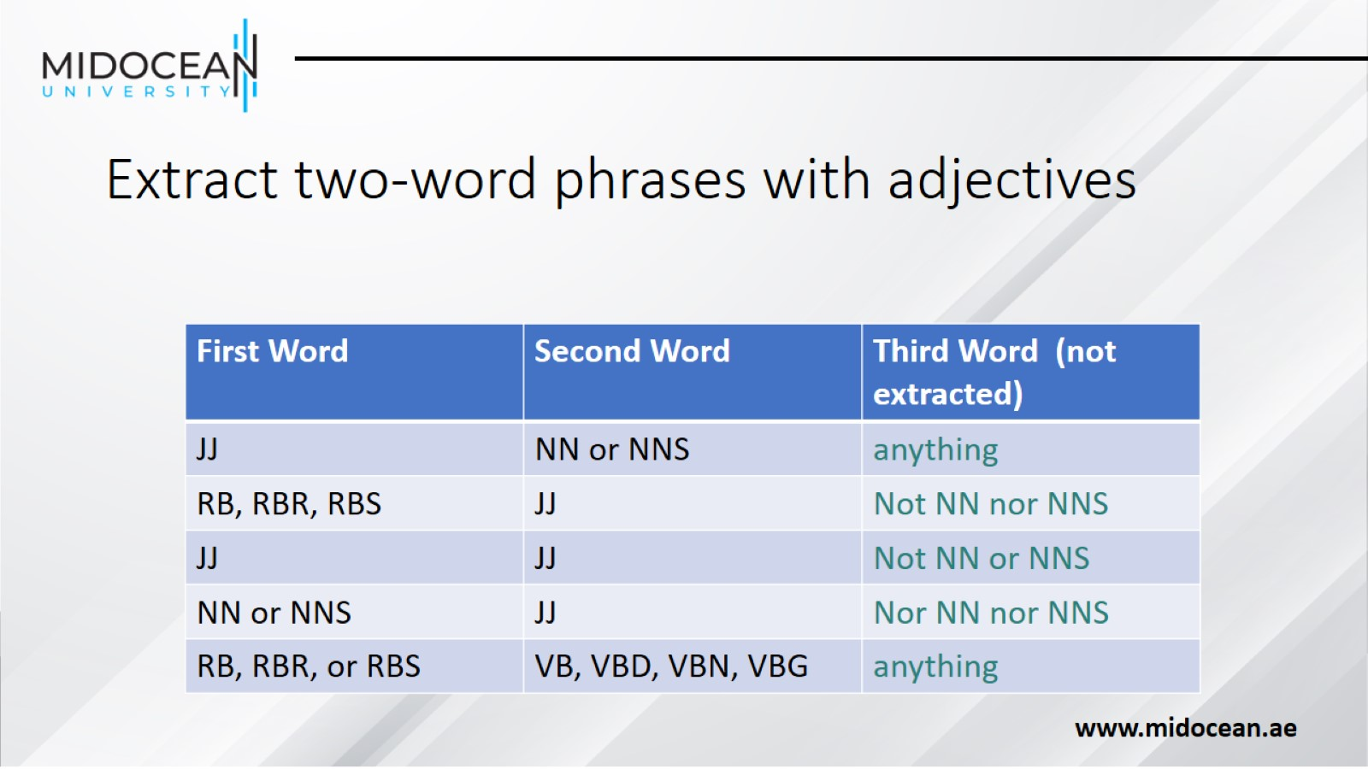
Extract two-word phrases with adjectives

Slide 43
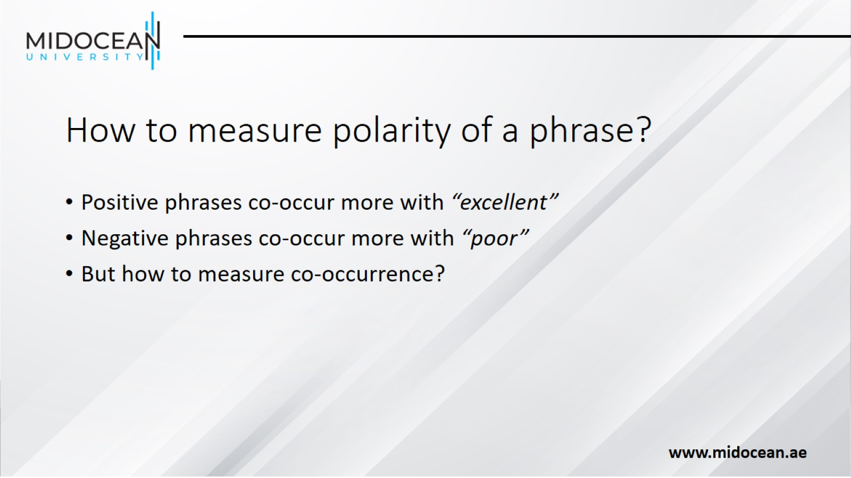
How to measure polarity of a phrase?

Slide 44
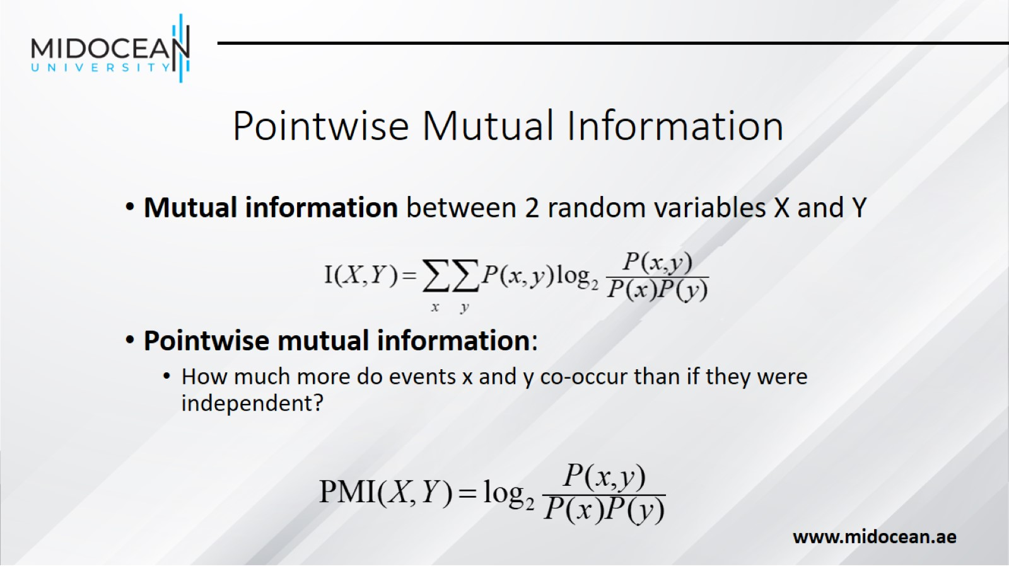
Pointwise Mutual Information

Slide 45
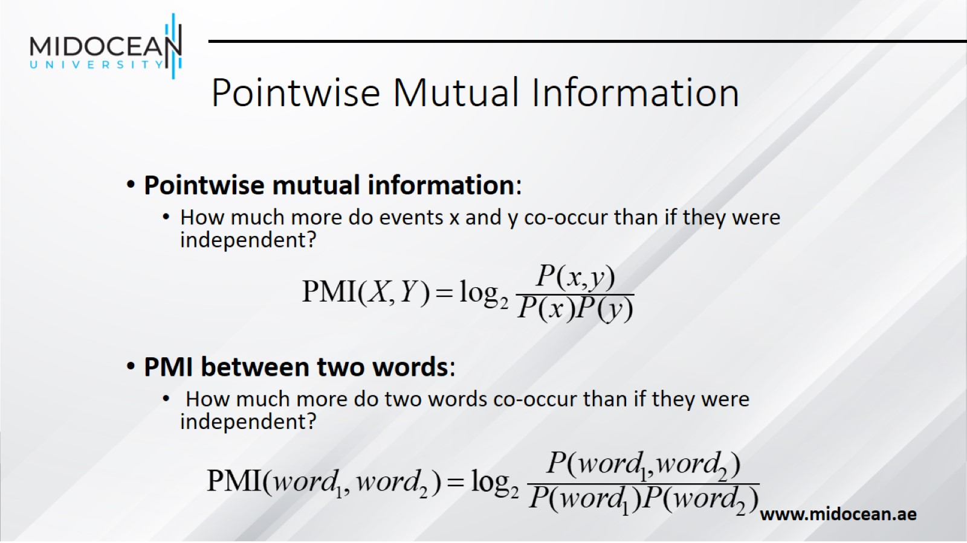
Pointwise Mutual Information

Slide 46
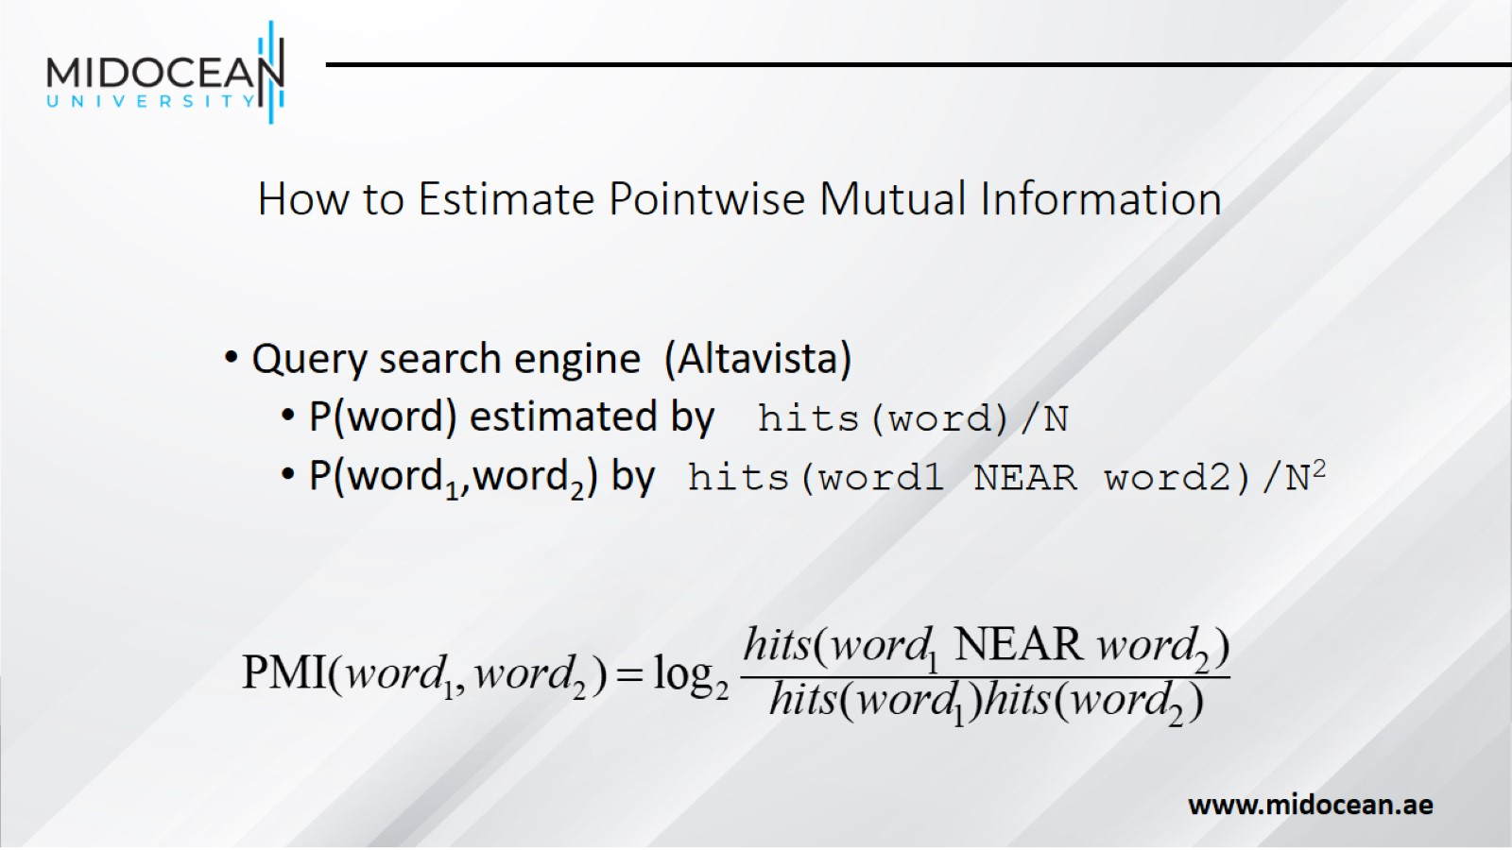
How to Estimate Pointwise Mutual Information

Slide 47
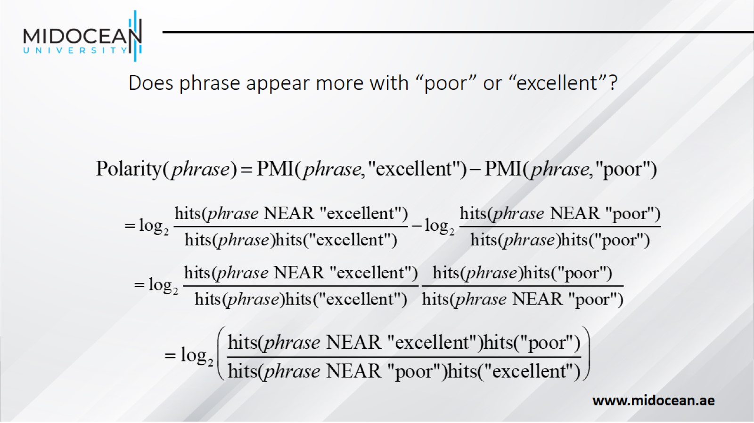
Does phrase appear more with “poor” or “excellent”?

Slide 48
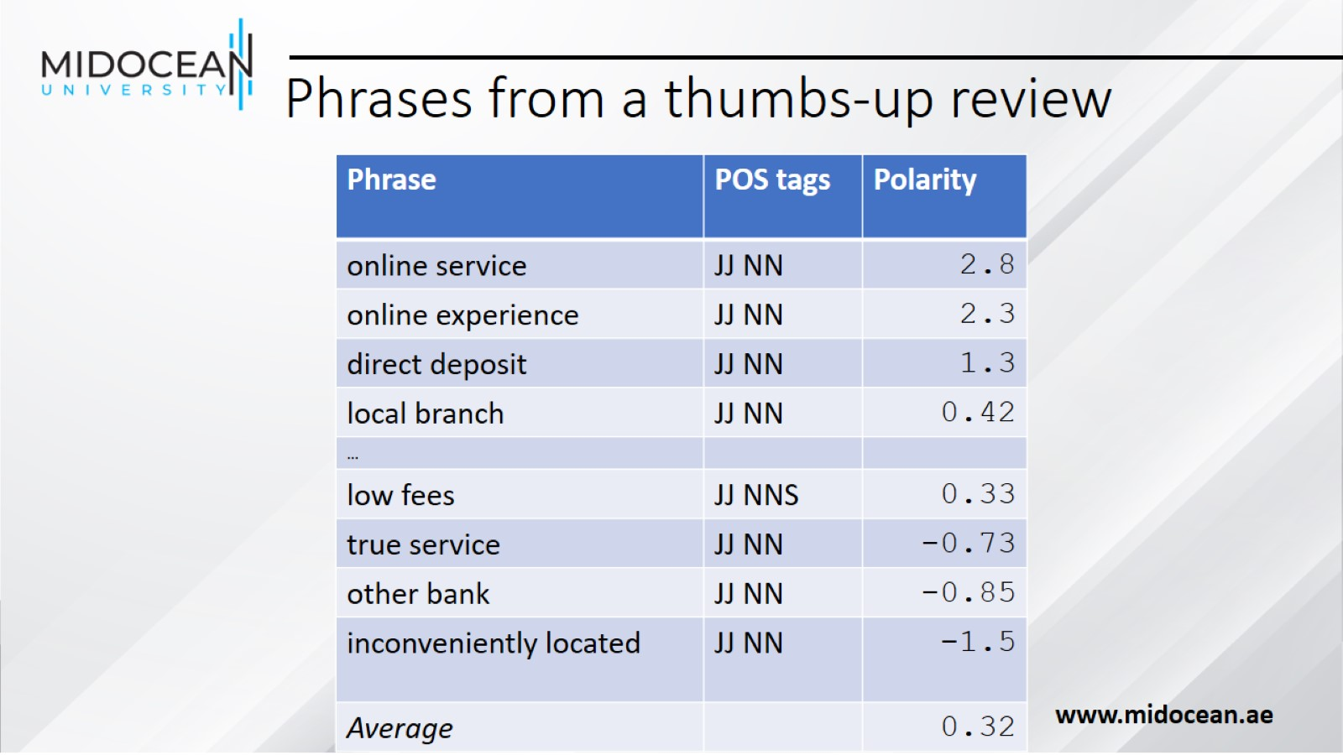
Phrases from a thumbs-up review

Slide 49
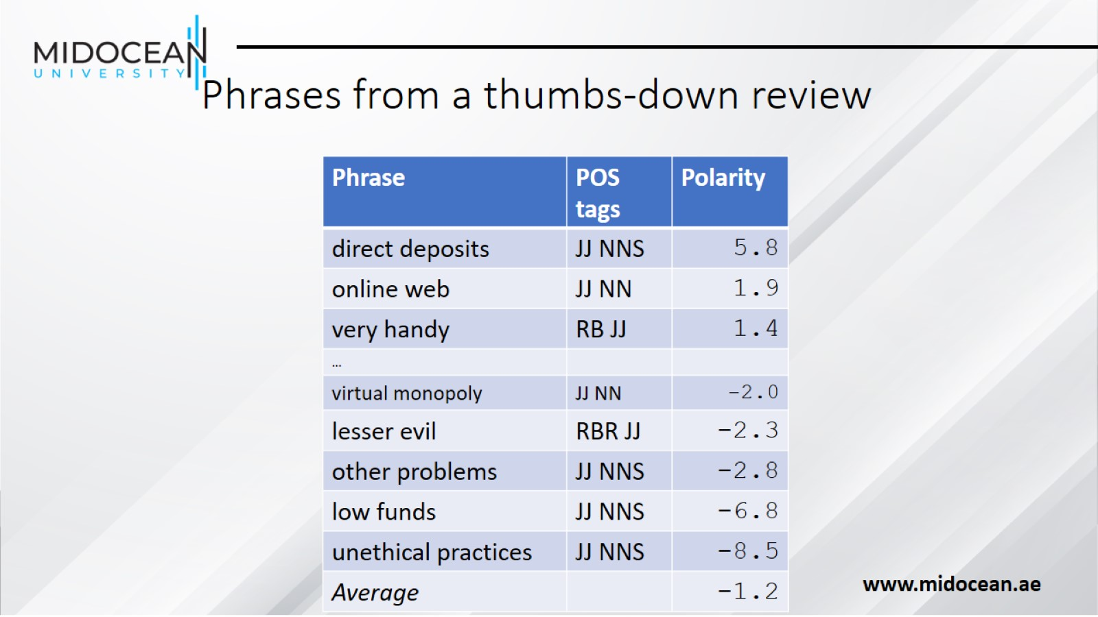
Phrases from a thumbs-down review

Slide 50
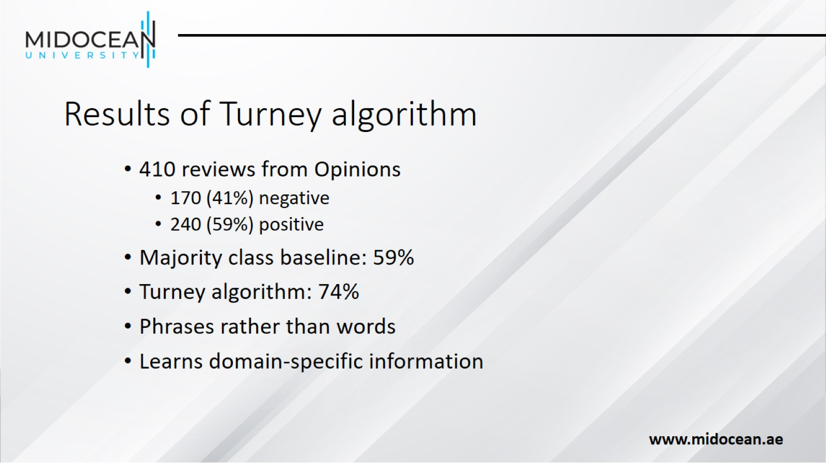
Results of Turney algorithm

Slide 51

Using WordNet to learn polarity

Slide 52

Summary on Learning Lexicons

Slide 53

Sentiment Analysis

Slide 54

Finding sentiment of a sentence

Slide 55

Finding aspect/attribute/target of sentiment

Slide 56

Finding aspect/attribute/target of sentiment

Slide 57

Putting it all together:
Finding sentiment for aspects

Slide 58

Results of Blair-Goldensohn et al. method

Slide 59

Summary on Sentiment

Slide 60


