Slide 1


Unsupervised Learning (Clustering Algorithms and Their Applications)
Prepared by Dr. Sumaya Alkubaisi
FNT633
Machine Learning in Finance
Lecture 8

Slide 2

Chapter
Learning Goals
8
By the end of this lecture, you will be able to:
Understand the fundamentals of unsupervised learning
Explain and apply K-Means and Hierarchical clustering
Identify real-world finance applications of clustering
Evaluate clustering results using visual and numerical metrics
Implement unsupervised learning using Python
www.midocean.ae

Slide 3
Chapter
Unsupervised Learning
8
Machine learning where data has no predefined labels; means the algorithm learns without knowing the correct answers (labels).
Goal: Find patterns or structures within the data on its own.
Examples:
Customer segmentation: grouping customers with similar behavior (e.g., grouping shoppers by spending habits — budget, regular, or premium buyers).
Market regime detection: identifying different market conditions (e.g., identifying “bull” vs. “bear” market periods from price trends.)
Risk group discovery: finding clusters of similar risk levels(e.g., clustering loan applicants into low-, medium-, and high-risk groups.)
www.midocean.ae

Slide 4
Comparison: Supervised vs. Unsupervised
Chapter
8
Aspect | Supervised | Unsupervised
Labels | Known | Unknown
Goal | Prediction | Pattern discovery
Examples | Regression, Classification | Clustering, Association
Finance Example | Credit scoring | Portfolio grouping
www.midocean.ae

Slide 5
Main Types of Unsupervised Learning
Chapter
8
Clustering: Group similar data points — individual records or observations in a dataset, each one represents a single example of the data you’re studying.
Example: grouping investors profiles by similar trading behavior.
Dimensionality Reduction: Reduces many features into fewer meaningful ones while keeping important information.
Example: using PCA to simplify financial indicators.
Anomaly Detection: Identify rare events
Example: detecting fraudulent transactions that differ from normal behavior.
www.midocean.ae

Slide 6
Chapter
Clustering Concept
8
Clustering aims to: Group similar data points together based on how close/distance or similar they are.
Each group = Cluster.
A data point is a single record or example in your dataset — it contains all the features (attributes) for that example.
Example:
Investors can be grouped/Segmented into low-, moderate-, and high-risk clusters based on their trading behavior or portfolio characteristics.
www.midocean.ae

Slide 7
Example for cars customers clustering
Chapter
8
Each customer is a data point.
Features for a customer could be:
  Age
  Income
  Car type preferred
  Number of cars owned
  Annual mileage
When clustering:
Customers with similar features are grouped together into clusters.
  Cluster 1: Young, low-income, prefers small cars
  Cluster 2: Middle-aged, medium income, prefers SUVs
  Cluster 3: High-income, luxury car buyers
So each customer (data point) is placed into a cluster based on similarity of their features.
www.midocean.ae

Slide 8
Chapter
Why Clustering in Finance?
8
Understand customer behaviors: Group clients with similar spending, saving, or investment habits.
Detect market segments: Identify distinct groups in the market for targeted strategies.
Identify investment risk profiles: Classify investors or loans into low, medium, or high-risk clusters.
Discover anomalies in trading patterns: Spot unusual transactions or activities that could indicate fraud.
www.midocean.ae

Slide 9
Chapter
Distance Metrics
8
Distance Metrics are used in clustering to measure how similar or different data points are.
Different metrics are useful in different situations:
Euclidean Distance – measures the straight-line distance between two points.
  Use when: features are continuous and on the same scale.
  Example: K-Means clustering for customer income vs. age.
Manhattan Distance – sums the absolute differences of each feature.
  Use when: you want to measure grid-like or city-block distances, or features have different scales.
  Example: Clustering retail stores by street locations (grid layout).
www.midocean.ae

Slide 10
Chapter
Distance Metrics
8
Cosine Similarity – measures the angle between vectors, not magnitude.
    Use when: the direction/pattern matters more than size.
    Example: Clustering investors by portfolio composition rather than total value.
  Cosine similarity looks at the pattern of values, not their size.
  Example: Two investors:
  Investor A: 50% stocks, 30% bonds, 20% cash
  Investor B: 25% stocks, 15% bonds, 10% cash
  Even though Investor B has less money, their portfolio composition (percentages) is the same pattern as Investor A.
  Cosine similarity sees them as similar because it compares the ratios, not the total money.
  Euclidean or Manhattan distance would see them as very different because it looks at the absolute amounts, not percentages.
  So use cosine similarity when the shape or pattern of the data matters more than the actual numbers.
www.midocean.ae

Slide 11
Chapter
Introduction to K-Means
8
Algorithm type: Partition-based
Goal: Divide data into K clusters minimizing variance within clusters.
Each cluster represented by a centroid.
K-Means Steps
Choose K (number of clusters)
Randomly initialize centroids
Assign points to nearest centroid
Update centroids based on new cluster means
Repeat until convergence
www.midocean.ae

Slide 12

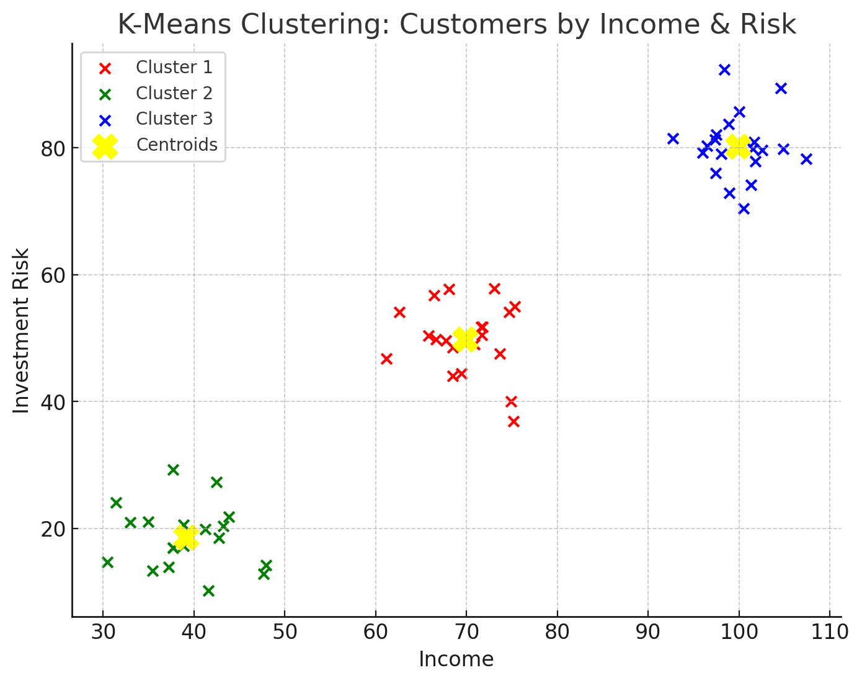
2D visualization of K-Means clustering
Red, Green, Blue points = three clusters of customers based on income and investment risk.
Yellow Xs = centroids chosen by K-Means.
You can see how K-Means:
Randomly initializes centroids
Assigns points to nearest centroid
Updates centroids based on cluster mean
Repeats until clusters stabilize.
This shows clearly how the algorithm finds natural groups in the data.
www.midocean.ae

Slide 13
Chapter
K-Means clustering
8
At the first step, K-Means only randomly places 3 centroids (because K = 3).
No real clusters exist yet.
Then the algorithm:
Assigns each data point to the nearest centroid → this temporarily forms clusters.
Updates the centroids to be the mean of points in each cluster.
Repeats the assignment and update until the clusters stop changing (convergence).
So the actual meaningful clusters are formed gradually, not at the very first step.
www.midocean.ae

Slide 14
Chapter
Choosing the Right K
8
K = number of clusters you want to create.
The Elbow Method helps pick a good K:
  Run K-means for different K values (e.g., 1 to 10).
  Calculate Sum of Squared Errors (SSE) for each K — lower SSE means points are closer to cluster centers.
  Plot SSE vs. K.
  Look for the “elbow point” — the K after which SSE stops decreasing sharply.
Why it matters:
Too small K → clusters are too broad, low accuracy.
Too large K → clusters are too specific, overfitting.
The elbow gives the best balance between simplicity and accuracy.
www.midocean.ae

Slide 15
Demonstrate clustering (KMeans) on a synthetic finance dataset
Chapter
8
In this example, the financial data is synthetic, but it mimics typical customer financial profiles.
Specifically:
Annual_Income → how much the customer earns per year (e.g., salary or business income).
Investment_Value → how much the customer has invested or saved in financial instruments (stocks, bonds, savings, etc.).
So the dataset represents customers’ financial behavior, which can be used for:
Segmenting customers into groups (low, medium, high income/investment)
Targeting marketing campaigns
Identifying investment opportunities
Risk or credit assessment
Even though these are randomly generated numbers, they simulate real-world financial data for clustering exercises.
www.midocean.ae

Slide 16
Python Demo: K-Means
# Example of clustering financial data using KMeans, from generating data to labeling
# clusters for analysis (typical customer financial profiles).
import pandas as pd
import numpy as np
import matplotlib.pyplot as plt
import seaborn as sns
from sklearn.preprocessing import StandardScaler
from sklearn.cluster import Kmeans
# Synthetic finance dataset
np.random.seed(42)
data = {
'Annual_Income': np.random.randint(30000, 150000, 100),
'Investment_Value': np.random.randint(1000, 100000, 100)
}
df = pd.DataFrame(data)
www.midocean.ae

Slide 17
Python Demo: K-Means
# Scale data
scaler = StandardScaler()
scaled_data = scaler.fit_transform(df)
# KMeans with K=3
kmeans = KMeans(n_clusters=3, random_state=42)
df['Cluster'] = kmeans.fit_predict(scaled_data)
df.head()
#Visualizing K-Means Clusters
plt.figure(figsize=(7,5))
sns.scatterplot(x='Annual_Income', y='Investment_Value', hue='Cluster', data=df, palette='Set2')
plt.title("Customer Investment Clusters")
plt.show()
www.midocean.ae

Slide 18
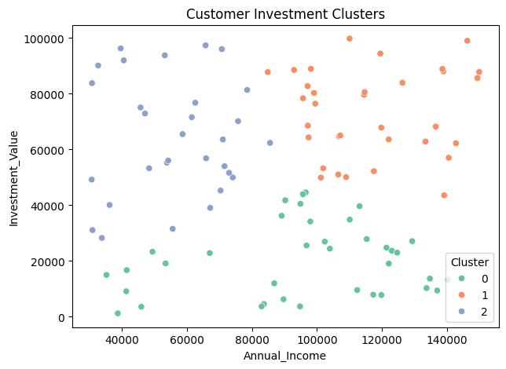
Python Demo: K-Means
#Output
The three clusters reveal different customer segments based on their income and investment habits:
Cluster 1 (Orange): Customers with high income and high investment value, typically earning 90K–150K+ and investing 40K–100K. These are financially established, high-value clients.
Cluster 0 (Green): Customers with low investment values (mostly below 40K) but a wide income range (40K–140K). They are diverse in income but cautious or new to investing.
Cluster 2 (Blue): Customers with mid-to-low income (40K–80K) and varied investments (5K–100K), representing the mass-market segment with moderate financial activity.
www.midocean.ae

Slide 19
Chapter
K-Means Output Interpretation
8
Cluster | Avg Income | Avg Investment | Risk Profile
0 | High | High | Aggressive
1 | Low | Low | Conservative
2 | Medium | Medium | Moderate
Aggressive: Takes high risks for higher potential returns.
Conservative: Prefers safety and low risk, even if returns are smaller.
Moderate: Balances risk and return — some risk, but not extreme.
www.midocean.ae

Slide 20
Python Demo: K-Means
#Finding the Optimal K
sse = []
for k in range(1, 10):
kmeans = KMeans(n_clusters=k, random_state=42)
kmeans.fit(scaled_data)
sse.append(kmeans.inertia_)
plt.plot(range(1, 10), sse, marker='o')
plt.title("Elbow Method")
plt.xlabel("Number of Clusters")
plt.ylabel("SSE")
plt.show()
www.midocean.ae

Slide 21
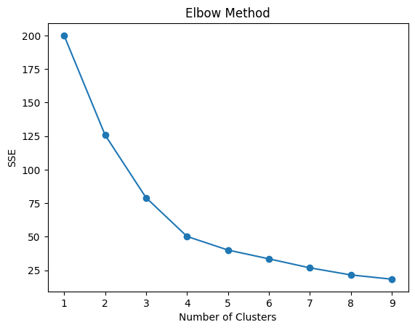
Python Demo: K-Means
#Finding the Optimal K - Output
The optimal number of clusters is found where the Sum of Squared Errors (SSE) begins to decrease linearly, forming an "elbow" shape.
The most significant drop in SSE occurs between k=1 and k=2. The curve then sharply bends at k=3. After k=3, the rate of decrease in SSE slows down substantially.
Conclusion: Based on the elbow point, the optimal number of clusters for this dataset is 3 (the point on the Elbow). Using more than three clusters provides diminishing returns in terms of reducing the error.
lower error is better, but “diminishing returns” after a certain point, the improvement becomes very small compared to the added complexity.
www.midocean.ae

Slide 22
Chapter
Interpreting the Elbow Curve
8
Look for the point where the curve bends → optimal K.
Example: If elbow appears at K=3, use 3 clusters.
If the elbow isn’t clear, rely on additional metrics or domain knowledge to decide:
  Compare nearby K values — pick the one that balances low SSE and simplicity.
  Use other methods like the Silhouette Score or Gap Statistic to help choose K.
www.midocean.ae

Slide 23
Chapter
Common Issues with K-Means
8
Sensitive to initial centroids: Different starting points can lead to different results.
Assumes spherical clusters: Works best when clusters are round and evenly sized — not irregular shapes.
Requires specifying K in advance: You must choose the number of clusters before running the algorithm.
www.midocean.ae

Slide 24
Chapter
Introduction to Hierarchical Clustering
8
Builds a tree-like structure (dendrogram) of nested clusters.
No need to predefine K — You can decide the number of clusters later by cutting the dendrogram.
Two main approaches:
  Agglomerative: bottom-up — starts with each point as its own cluster and merges them gradually.
  Divisive: top-down — starts with one big cluster and splits it into smaller one
www.midocean.ae

Slide 25
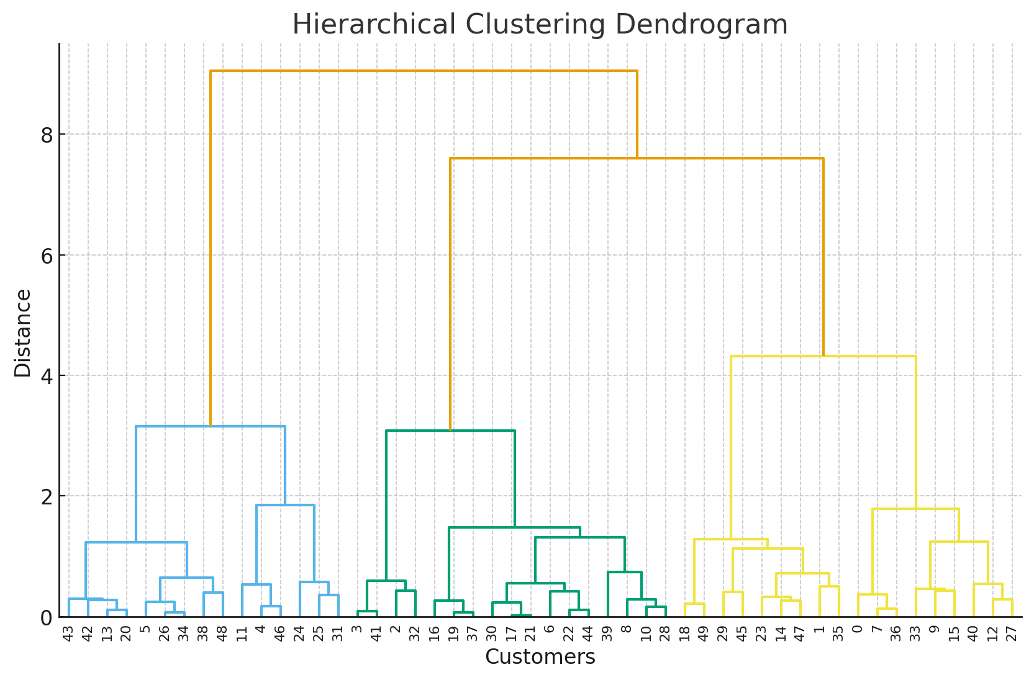
Chapter
Dendrogram
8
A dendrogram is a tree-like diagram that shows how data points are grouped together in hierarchical clustering.
Each leaf represents a single data point.
Branches show how clusters are merged step by step.
The height of each merge represents the distance or dissimilarity between clusters.
the higher the merge (the branch connection) appears in the
dendrogram, the more different the two clusters are.
  Low merge height → clusters were very similar (close together).
  High merge height → clusters were quite different (far apart).
You can “cut” the dendrogram at a certain height to choose how
many clusters to form.
www.midocean.ae

Slide 26
Dendrogram Example
Each leaf represents a customer, and the branches show how clusters merge step by step.
You can “cut” it horizontally (e.g., at 3 branches) to form distinct clusters.
www.midocean.ae

Slide 27
Chapter
Hierarchical Clustering
8
At the start, every data point is its own cluster.
The algorithm then finds the two closest clusters (most similar points) and merges them.
This merging repeats step by step until all points form one big cluster.
It’s like building a family tree — starting from individuals and gradually grouping them into larger families.
www.midocean.ae

Slide 28
Python Demo: Hierarchical Clustering
from scipy.cluster.hierarchy import dendrogram, linkage, fcluster
linked = linkage(scaled_data, method='ward')
plt.figure(figsize=(8,5))
dendrogram(linked)
plt.title("Hierarchical Clustering Dendrogram")
plt.xlabel("Customers")
plt.ylabel("Distance")
plt.show()
# Cut tree at 3 clusters
df['HCluster'] = fcluster(linked, 3, criterion='maxclust')
www.midocean.ae

Slide 29
Python Demo: Hierarchical Clustering – Definitions
scaled_data is a NumPy array of the scaled features (Annual_Income and Investment_Value).
The linkage function uses this scaled dataset to compute distances between points for hierarchical clustering.
After building the dendrogram, the fcluster function assigns cluster labels to each original row and adds them to the DataFrame df as HCluster.
So the hierarchy is based on the scaled values, but the cluster labels are stored in your original DataFrame.
method='ward' is a way to decide which clusters to merge at each step.
It merges the pair of clusters that minimizes the increase in total within-cluster variance (the sum of squared differences from cluster centroids).
In simpler terms: it tries to keep clusters as compact and homogeneous as possible when merging.
criterion='maxclust' tells Python to cut the dendrogram so that exactly 3 clusters are formed — the “maximum number of clusters” you want.
www.midocean.ae

Slide 30
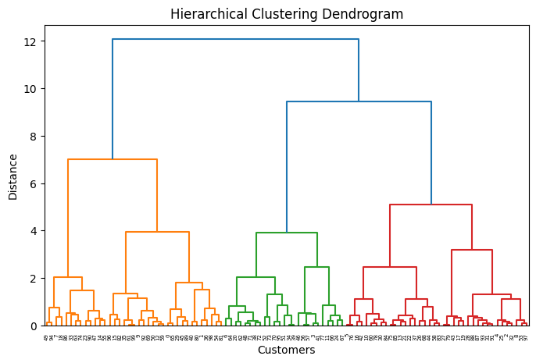
Python Demo: Hierarchical Clustering – Output
# Dendrogram
X-axis: individual customers (data points).
Y-axis: distance/dissimilarity between clusters — a higher merge = more dissimilar.
Process: start with single points at the bottom and merge upward into larger clusters.
Choosing K: cut the dendrogram at a horizontal level that crosses the longest vertical gaps without intersecting other merges.
Example:
Cut at ~12 → 2 clusters (one left group and one right group).
Cut at ~7 → 3 clusters (left orange branch, middle green branch, right red/blue branches).
Conclusion: depending on the cut height, 2 clusters at ~12 or 3 clusters at ~7 are defensible; 3 is often chosen here because it gives well-separated, meaningful groups.
www.midocean.ae

Slide 31
Lecture
7
Evaluating Clustering Performance
Silhouette Score measures how well each data point fits within its assigned cluster compared to other clusters.
−1 ≤ S ≤ 1, higher = better separation
It ranges from −1 to 1:
Close to 1 → well-clustered (good separation).
Around 0 → overlapping clusters.
Negative → point might be in the wrong cluster.
The Silhouette Score can be used for both K-Means and Hierarchical Clustering — or any clustering algorithm.
www.midocean.ae

Slide 32
Python Demo: Silhouette Evaluation
from sklearn.metrics import silhouette_score
# Silhouette for K-Means
score = silhouette_score(scaled_data, df['Cluster'])
print("Silhouette Score:", round(score, 3))
Output: Silhouette Score: 0.378
This means the clusters are moderately separated — not very clear, but still show some structure.
There’s some overlap between clusters.
Clustering is acceptable but not perfect — increasing or tuning K might improve it.
www.midocean.ae

Slide 33
Python Demo Silhouette: Evaluation
from sklearn.metrics import silhouette_score
# Silhouette for Hierarchical Clustering
score = silhouette_score(scaled_data, df[‘HCluster'])
print("Silhouette Score:", round(score, 3))
Output: Silhouette Score: 0.363
The score is moderately positive, indicating that the clusters are reasonably well-separated, but not very distinct.
Some points may be near the boundary of other clusters.
This suggests moderate clustering quality—the algorithm captured some structure, but there might be room for improvement (e.g., adjusting the number of clusters or trying a different clustering method).
www.midocean.ae

Slide 34
Python Demo: Hierarchical Clustering
# Visualization of Clusters
plt.figure(figsize=(7,5))
sns.scatterplot(x='Annual_Income', y='Investment_Value', hue='HCluster', data=df, palette='coolwarm')
plt.title("Hierarchical Clusters (Finance Example)")
plt.show()
www.midocean.ae

Slide 35
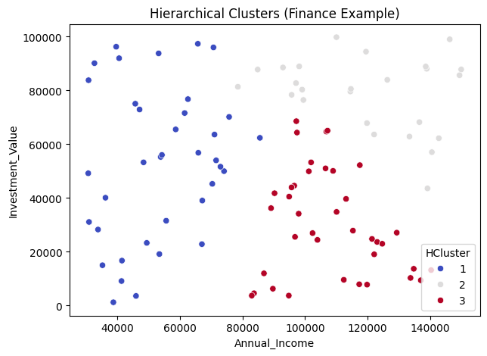
Python Demo: Hierarchical Clustering
# Output
This scatter plot shows Hierarchical Clusters for a finance example, segmenting customers by Annual Income (x-axis) and Investment Value (y-axis) into three groups.
HCluster 1 (Blue): Low–mid income (35k–80k) with a wide range of investments (0–100k). Most diverse group, representing core mass-market customers.
HCluster 2 (Grey/Light): Mid–high income (90k–140k+) with high investments (60k–100k). High-value, established customers.
HCluster 3 (Red): High income (90k–140k) but lower investments (0–70k). Customers with strong financial capacity but under-invested — key targets for upselling.
www.midocean.ae

Slide 36
Lecture
Comparing K-Means vs. Hierarchical
8
Aspect | K-Means | Hierarchical
Requires K | Yes | No
Output | Centroids | Dendrogram
Speed | Fast | Slower
Interpretability | Moderate | High
www.midocean.ae

Slide 37
Lecture
Recap
8
K-Means and Hierarchical are unsupervised algorithms.
K-Means: fast, efficient, needs predefined K.
Hierarchical: interpretable, builds full structure.
Evaluation with Silhouette Score.
Useful in risk grouping, customer segmentation, fraud detection.
Clustering helps uncover hidden financial patterns
Evaluation ensures meaningful insights
www.midocean.ae

Slide 38
Chapter
References
8
Klaas, J. (2020). Machine Learning for Finance.
López de Prado, M. (2018). Advances in Financial Machine Learning.
Coursera (Stanford, Andrew Ng). Machine Learning Specialization.
Scikit-learn Documentation: Clustering
www.midocean.ae

