Slide 1
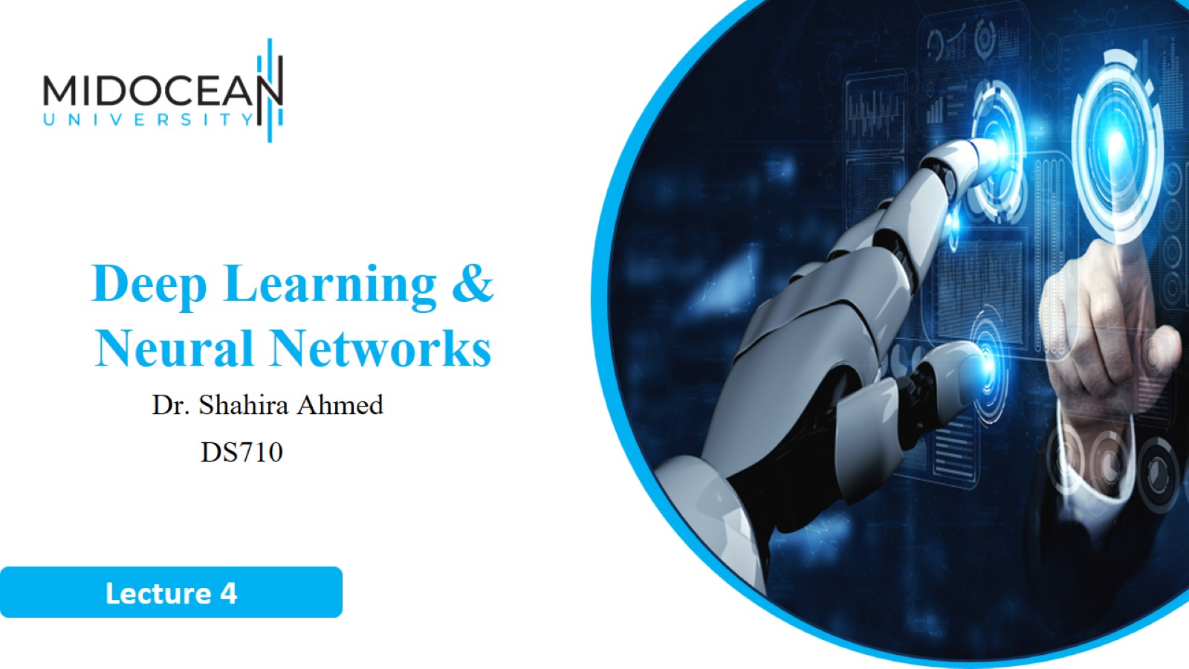

Slide 2
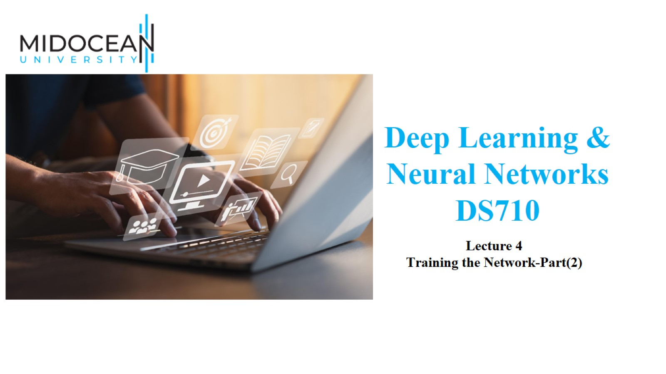

Slide 3
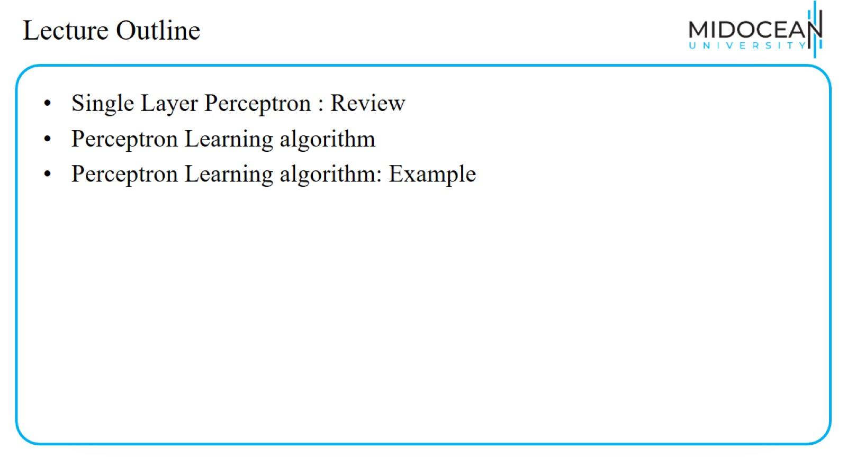
Lecture Outline

Slide 4
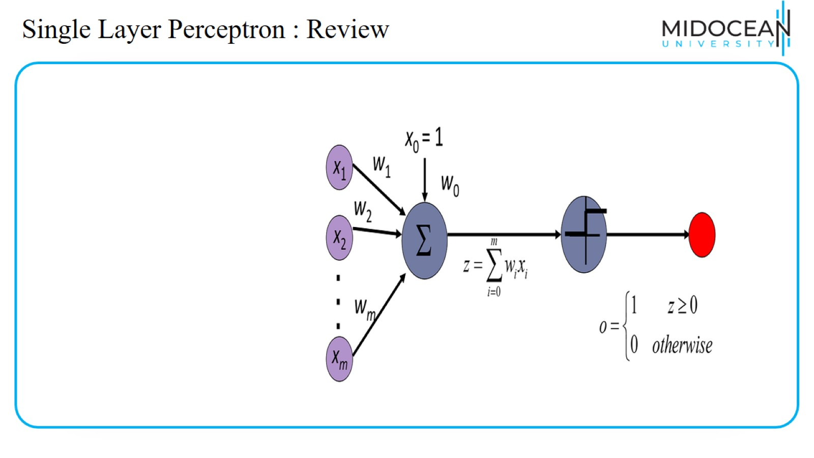
Single Layer Perceptron : Review

Slide 5
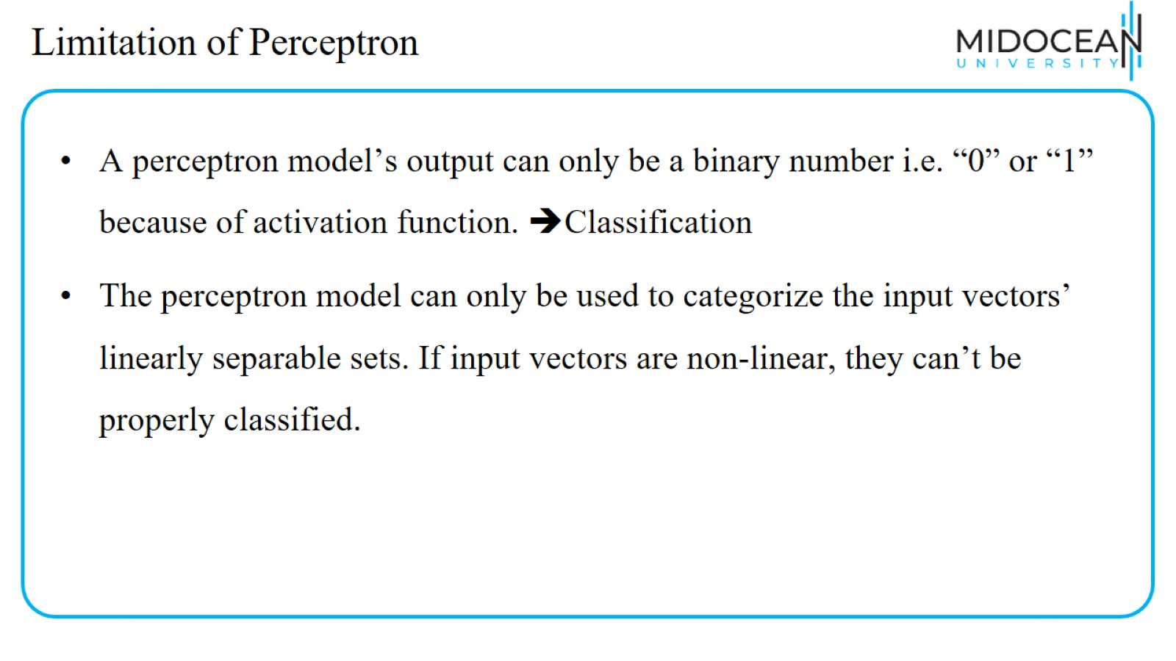
Limitation of Perceptron

Slide 6
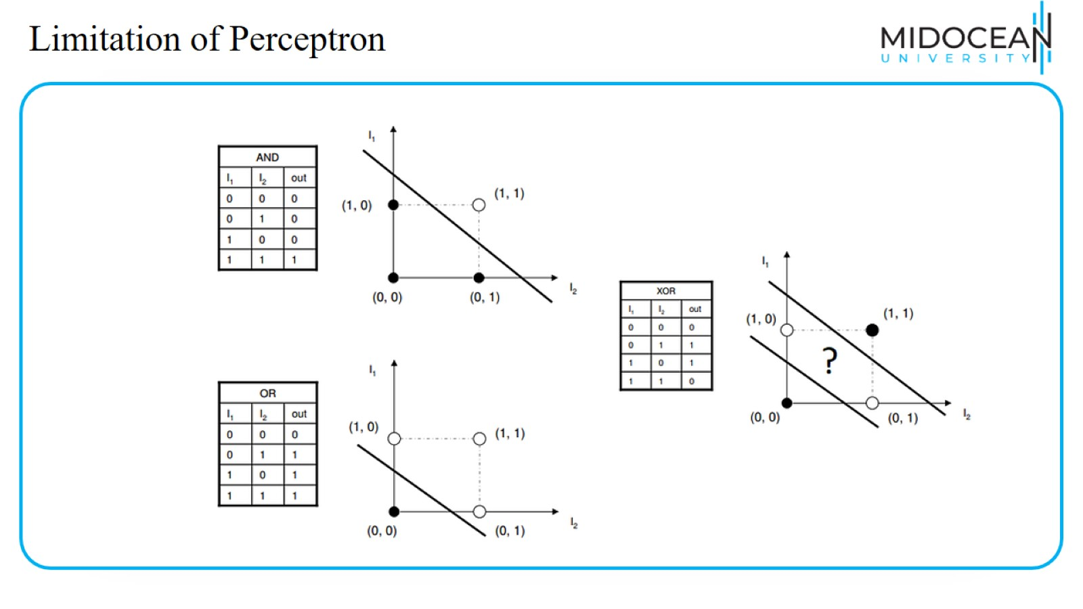
Limitation of Perceptron

Slide 7
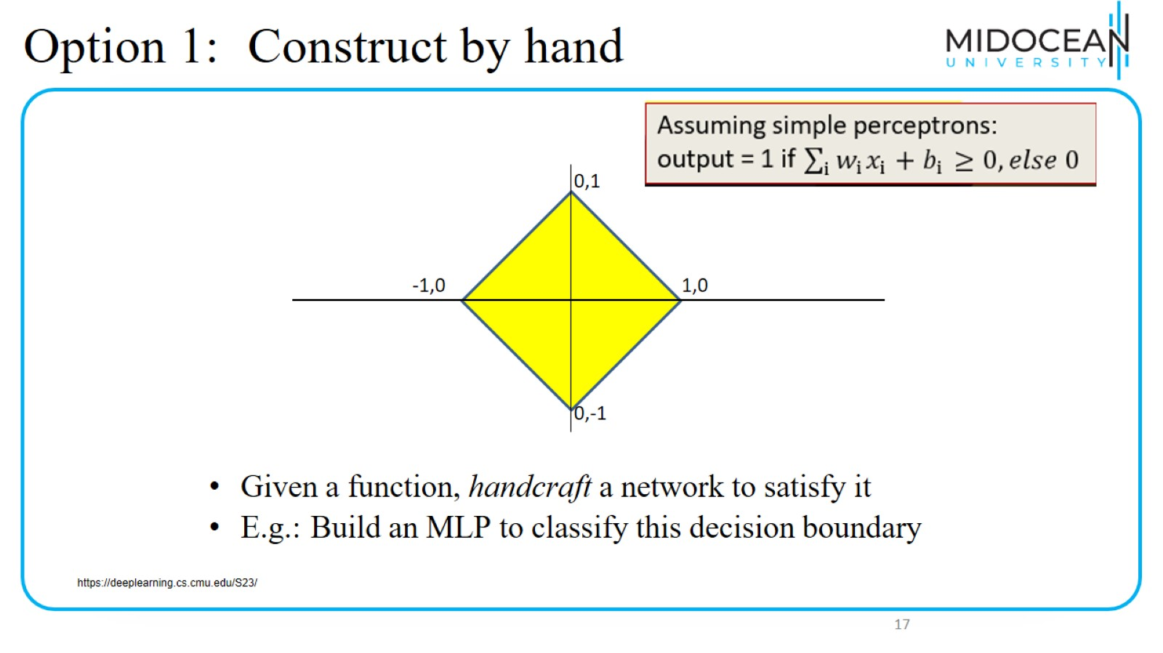
Option 1: Construct by hand

Slide 8
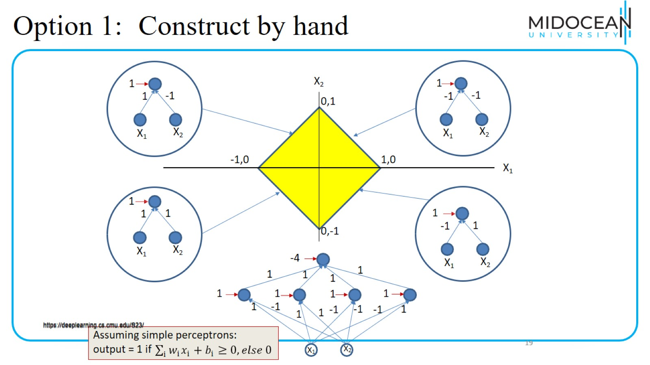
Option 1: Construct by hand

Slide 9
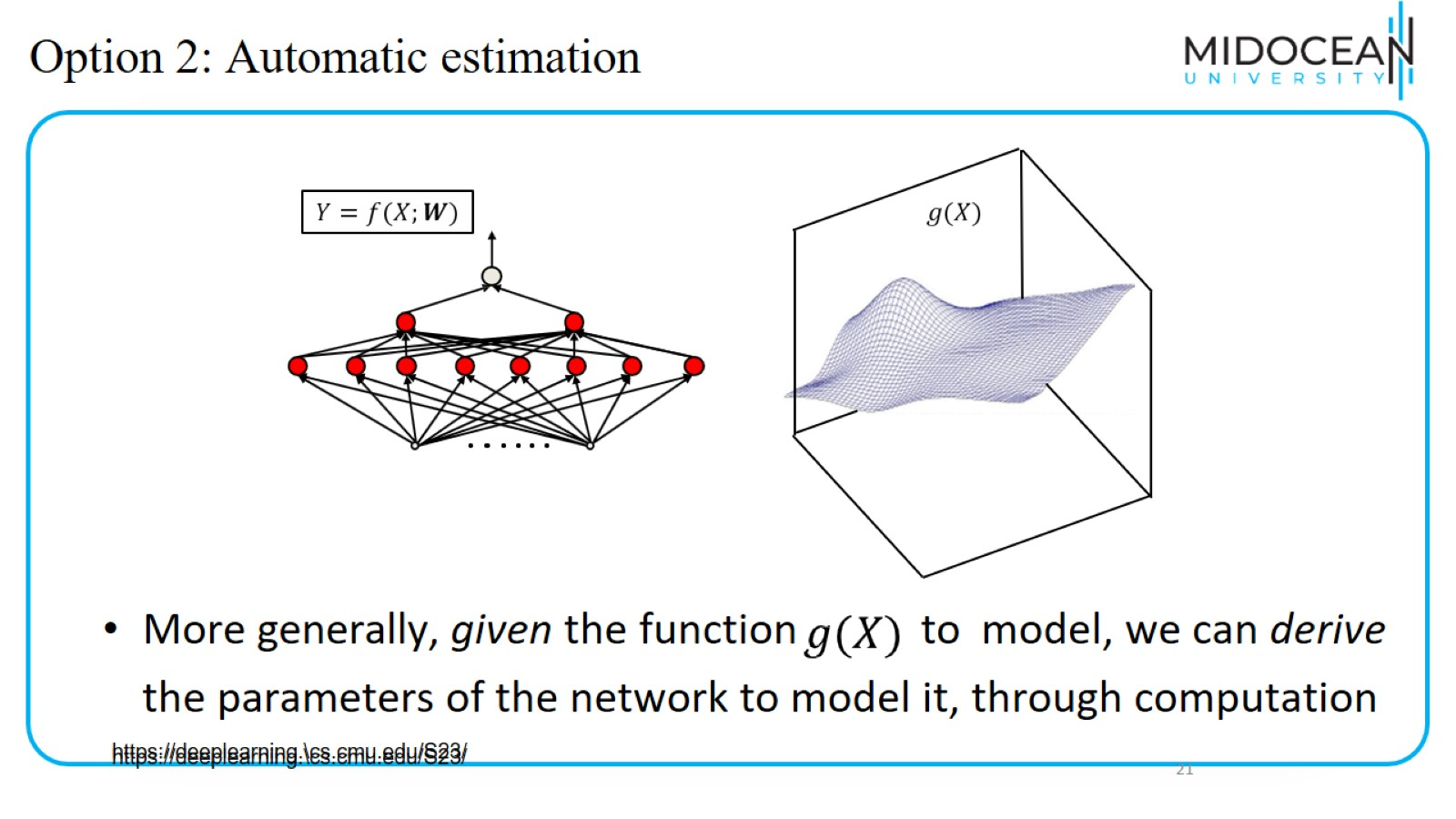
Option 2: Automatic estimation

Slide 10
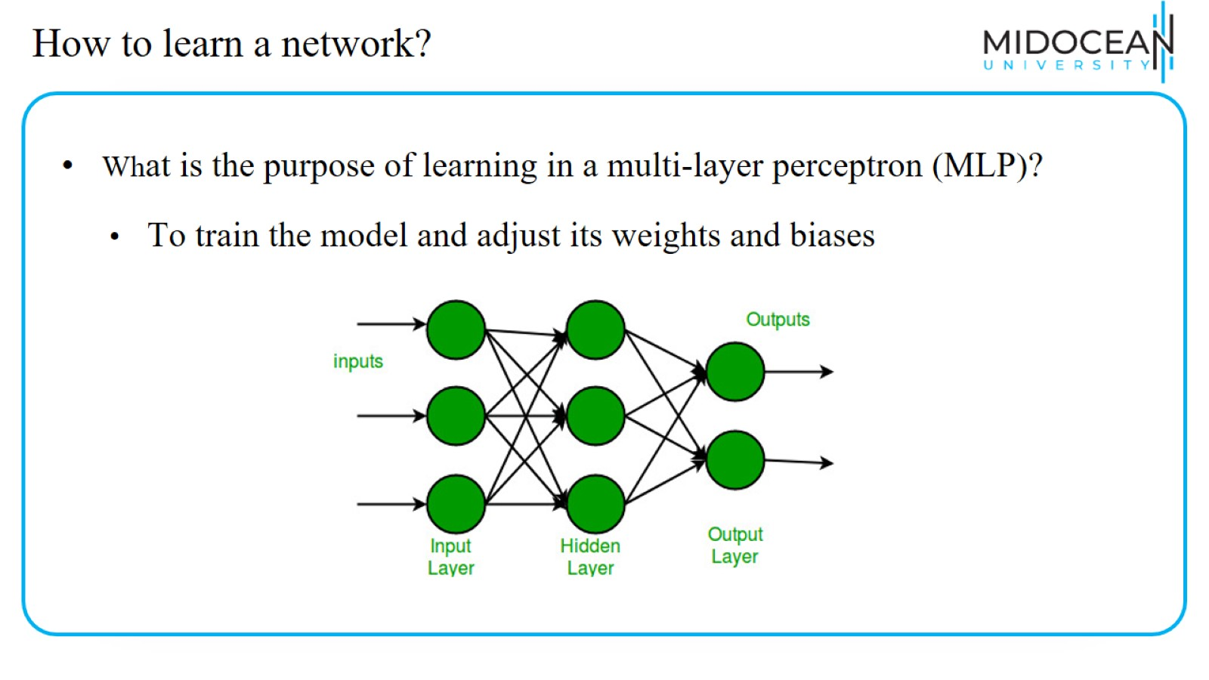
How to learn a network?

Slide 11
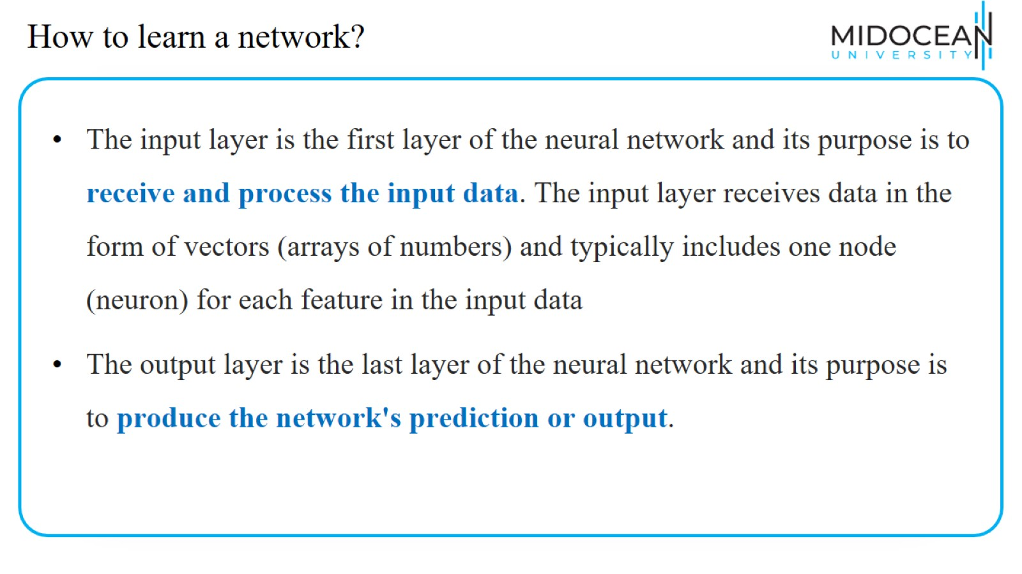
How to learn a network?

Slide 12
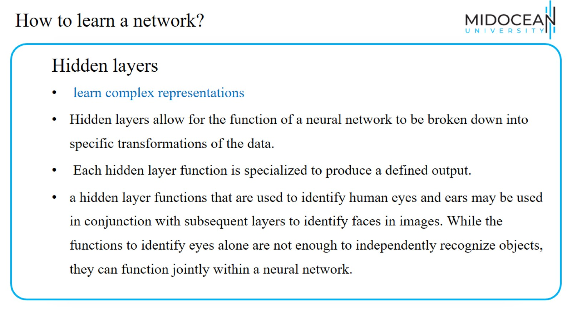
How to learn a network?

Slide 13
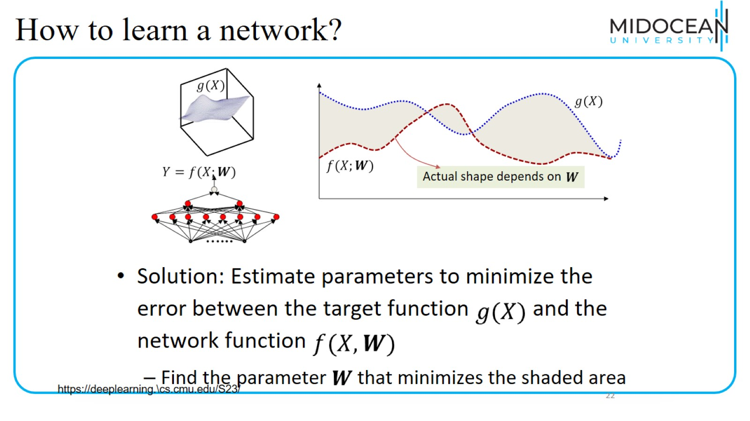
How to learn a network?

Slide 14
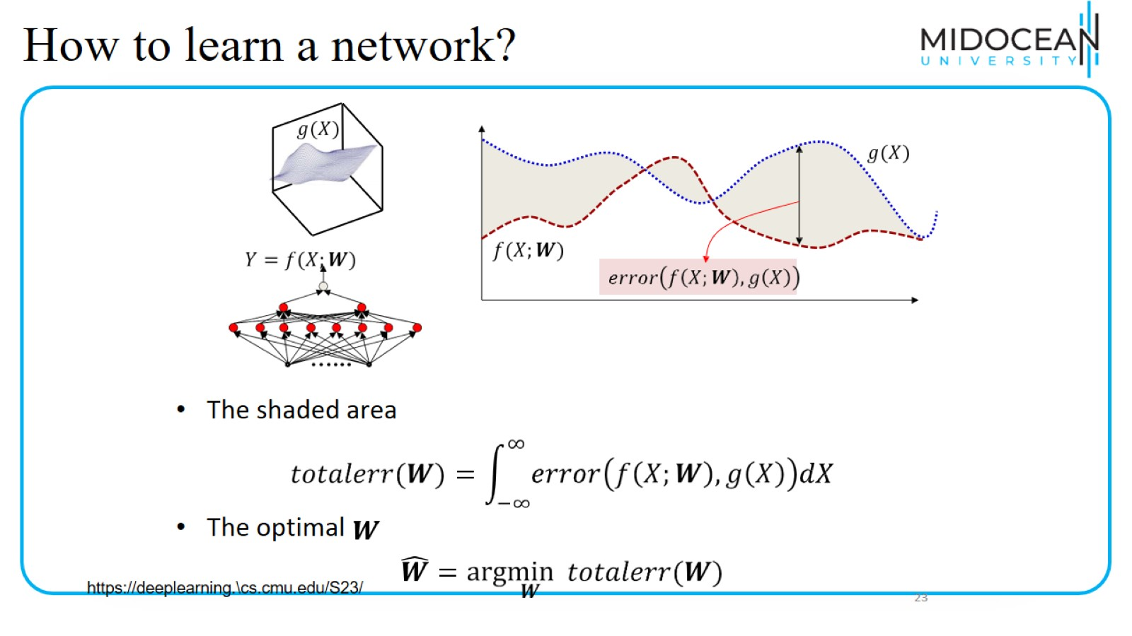
How to learn a network?

Slide 15
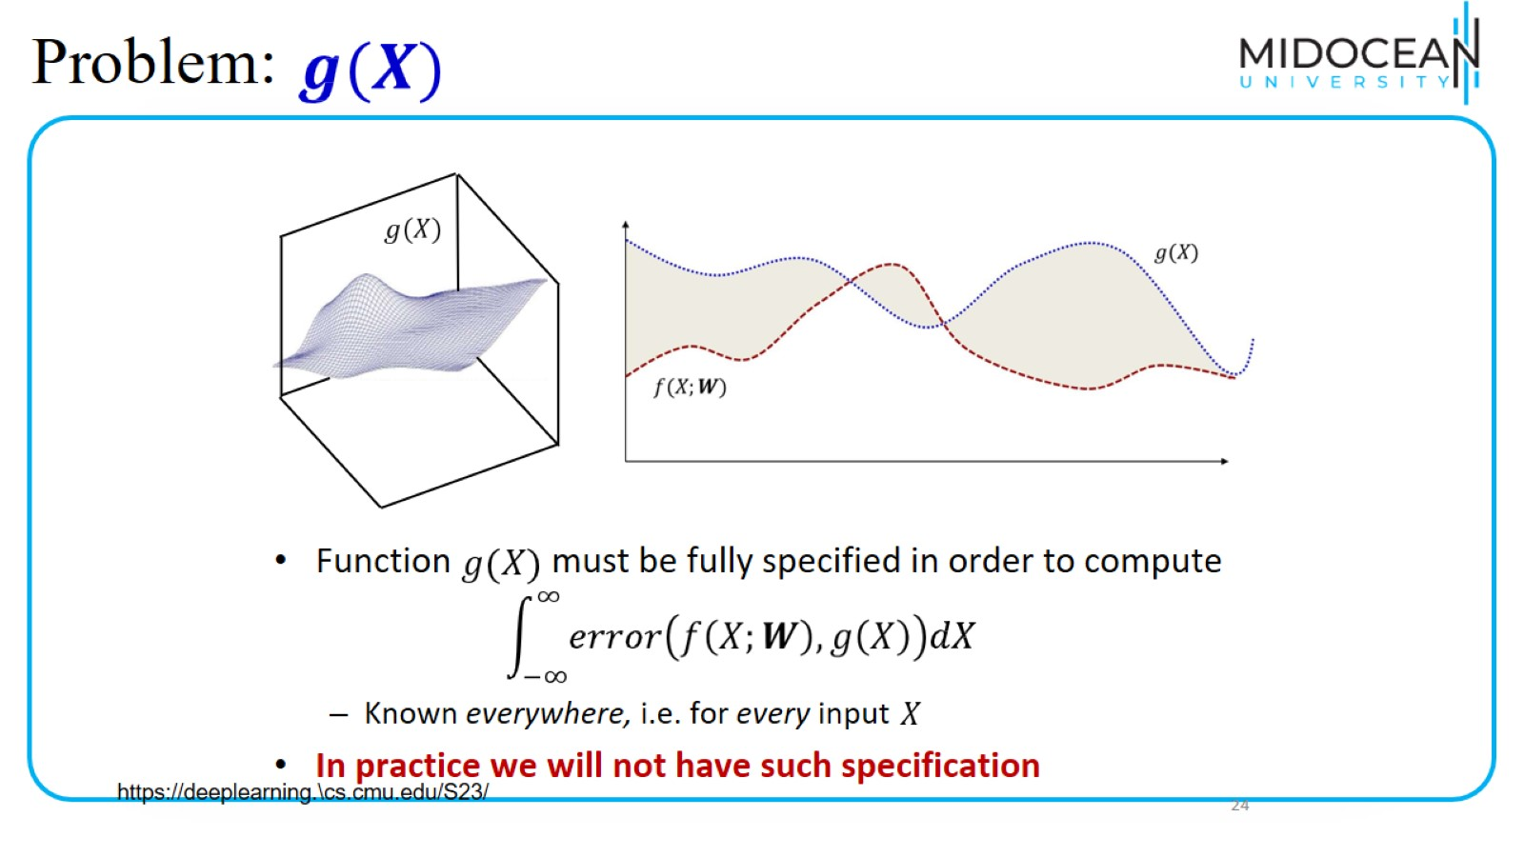
Problem:

Slide 16
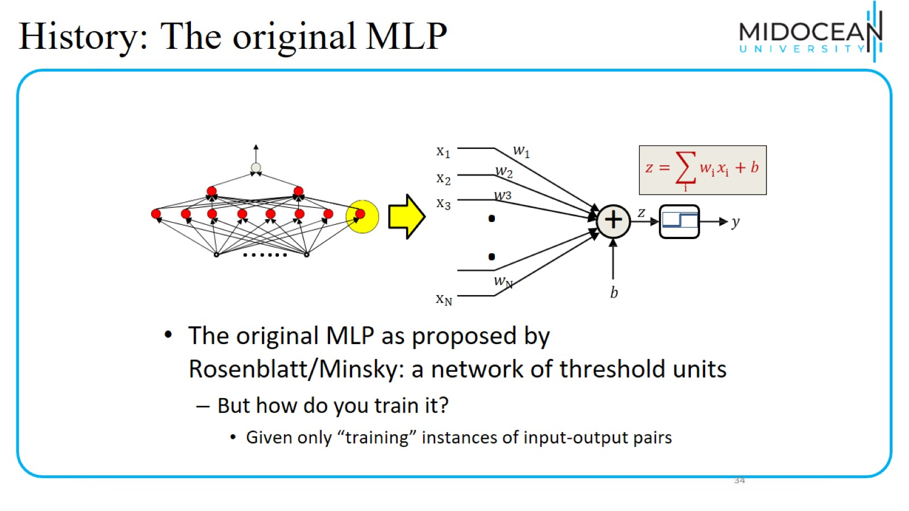
History: The original MLP

Slide 17
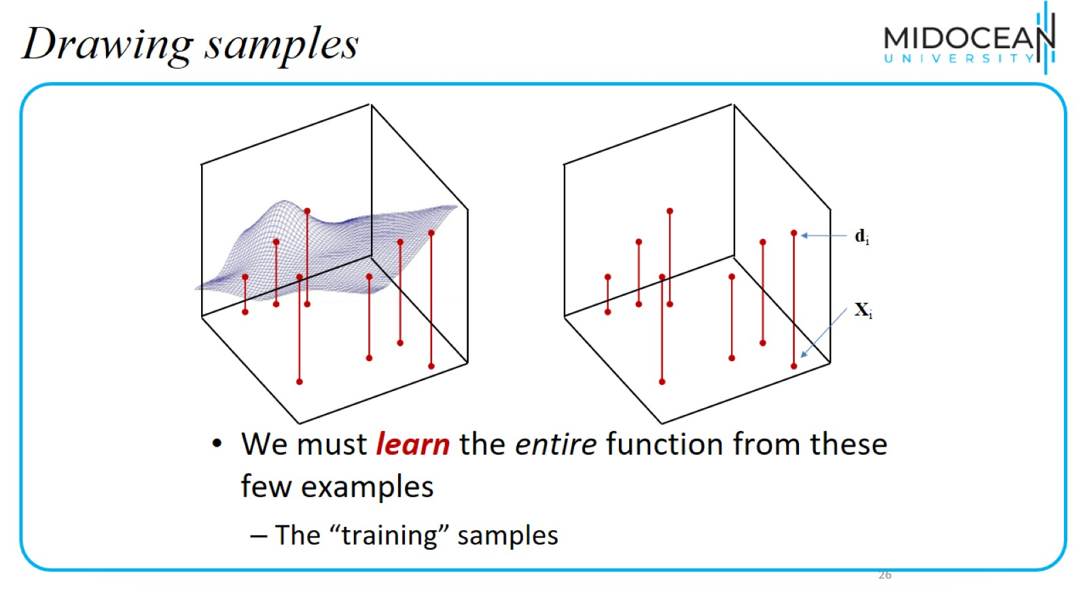
Drawing samples

Slide 18
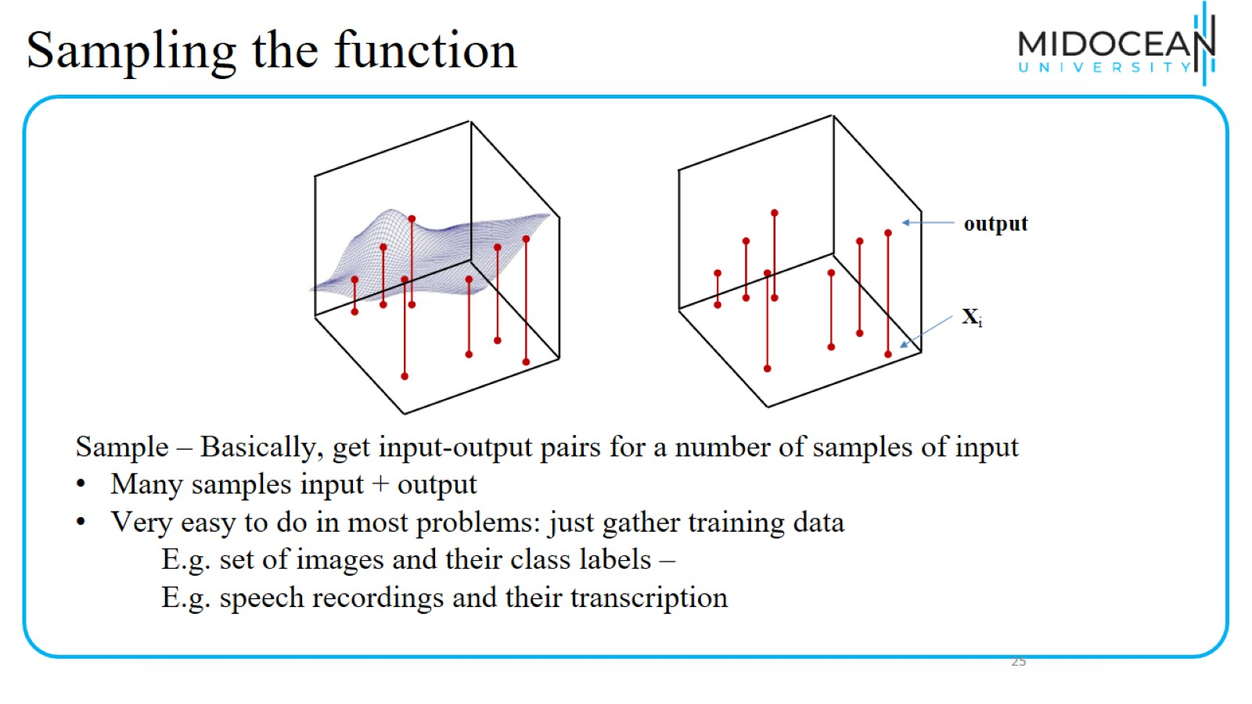
Sampling the function

Slide 19
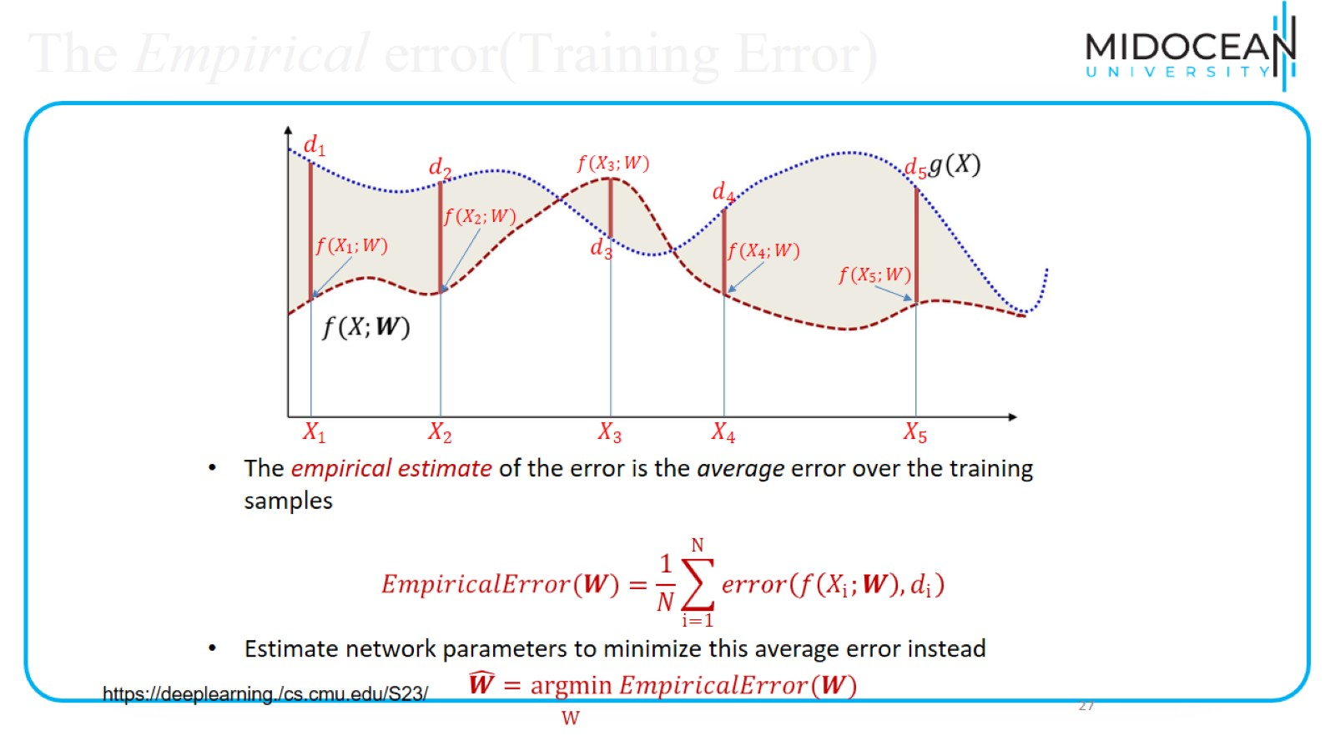
The Empirical error(Training Error)

Slide 20
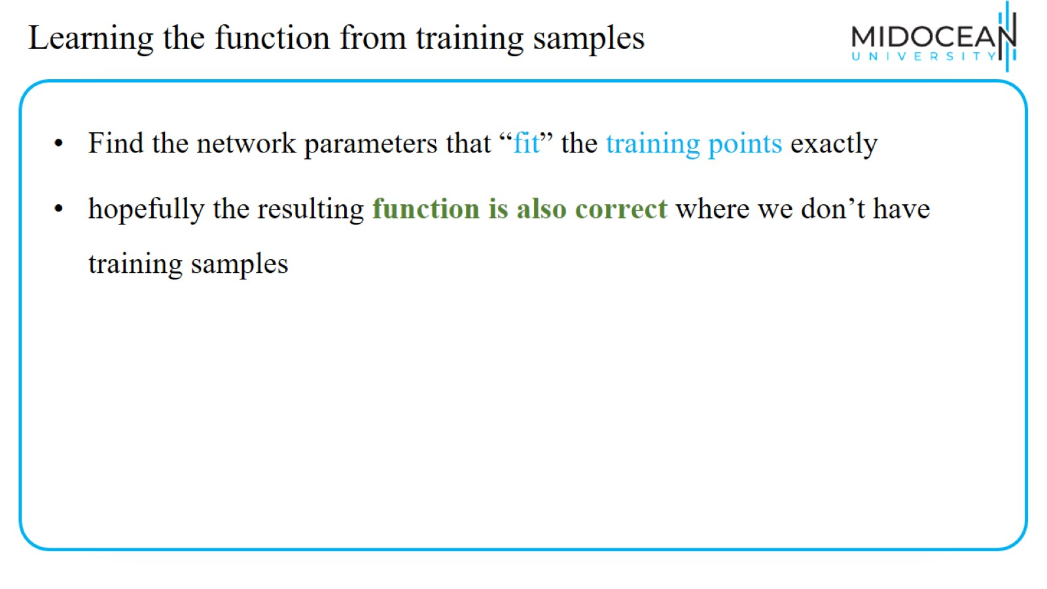
Learning the function from training samples

Slide 21
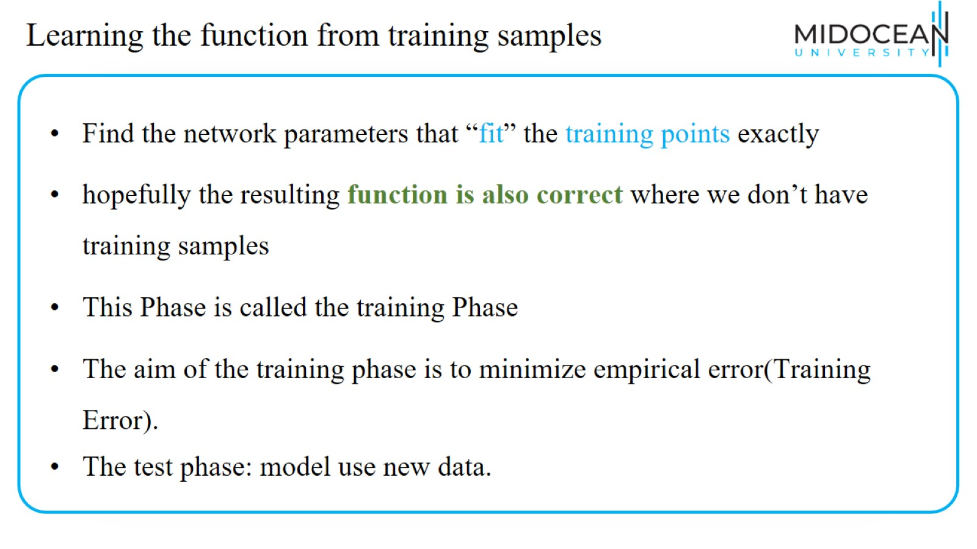
Learning the function from training samples

Slide 22
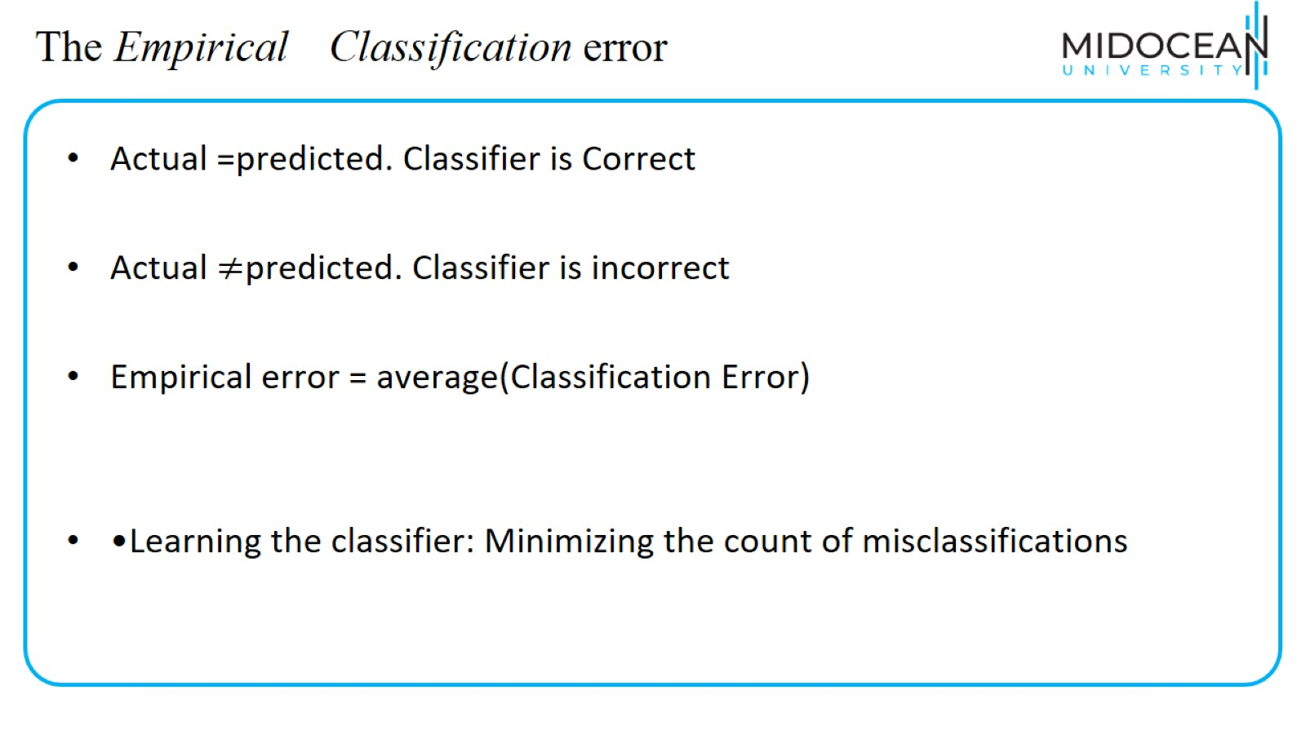
The Empirical Classification error

Slide 23
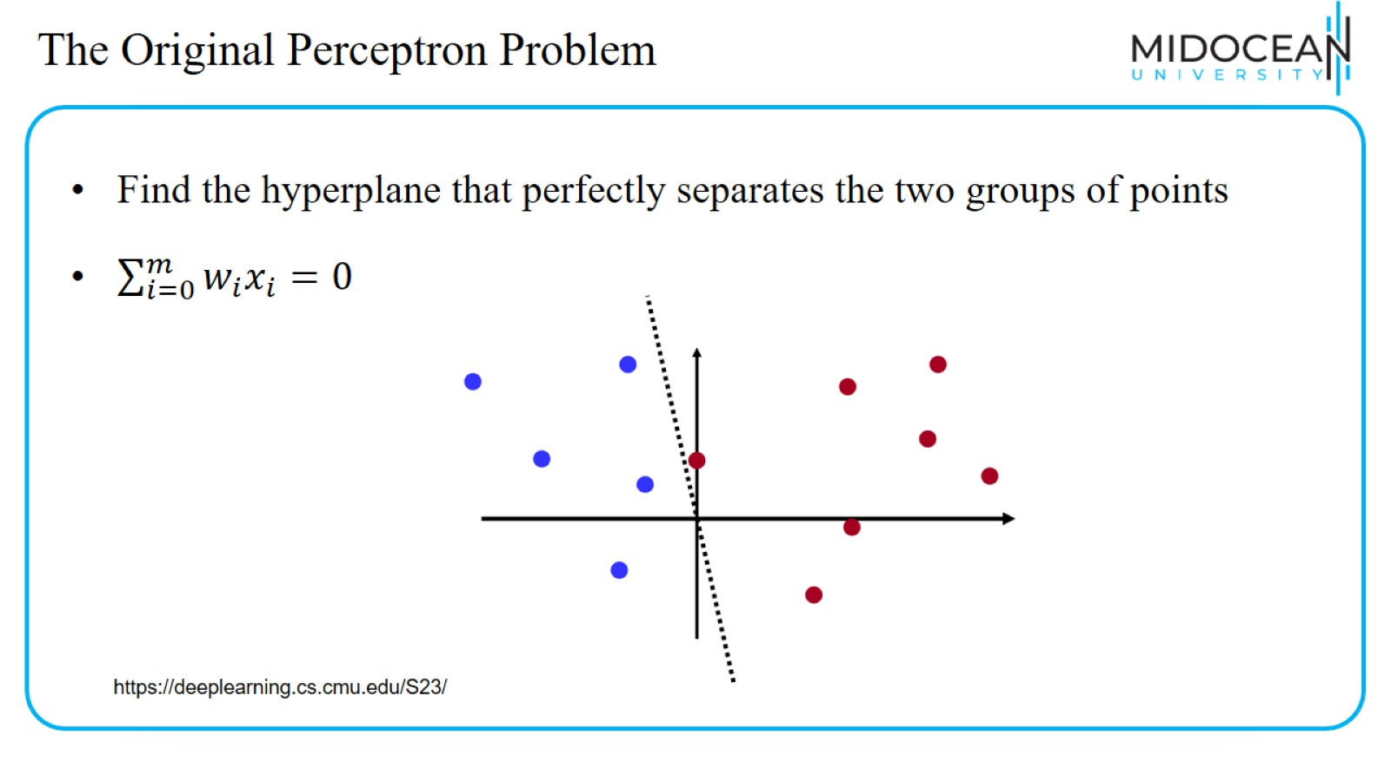
The Original Perceptron Problem

Slide 24
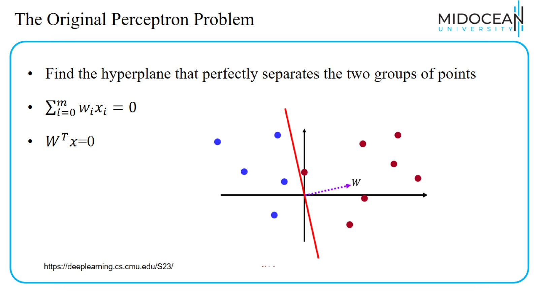
The Original Perceptron Problem

Slide 25
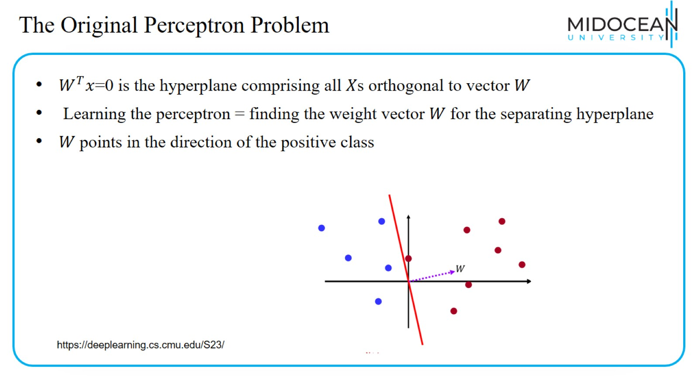
The Original Perceptron Problem

Slide 26
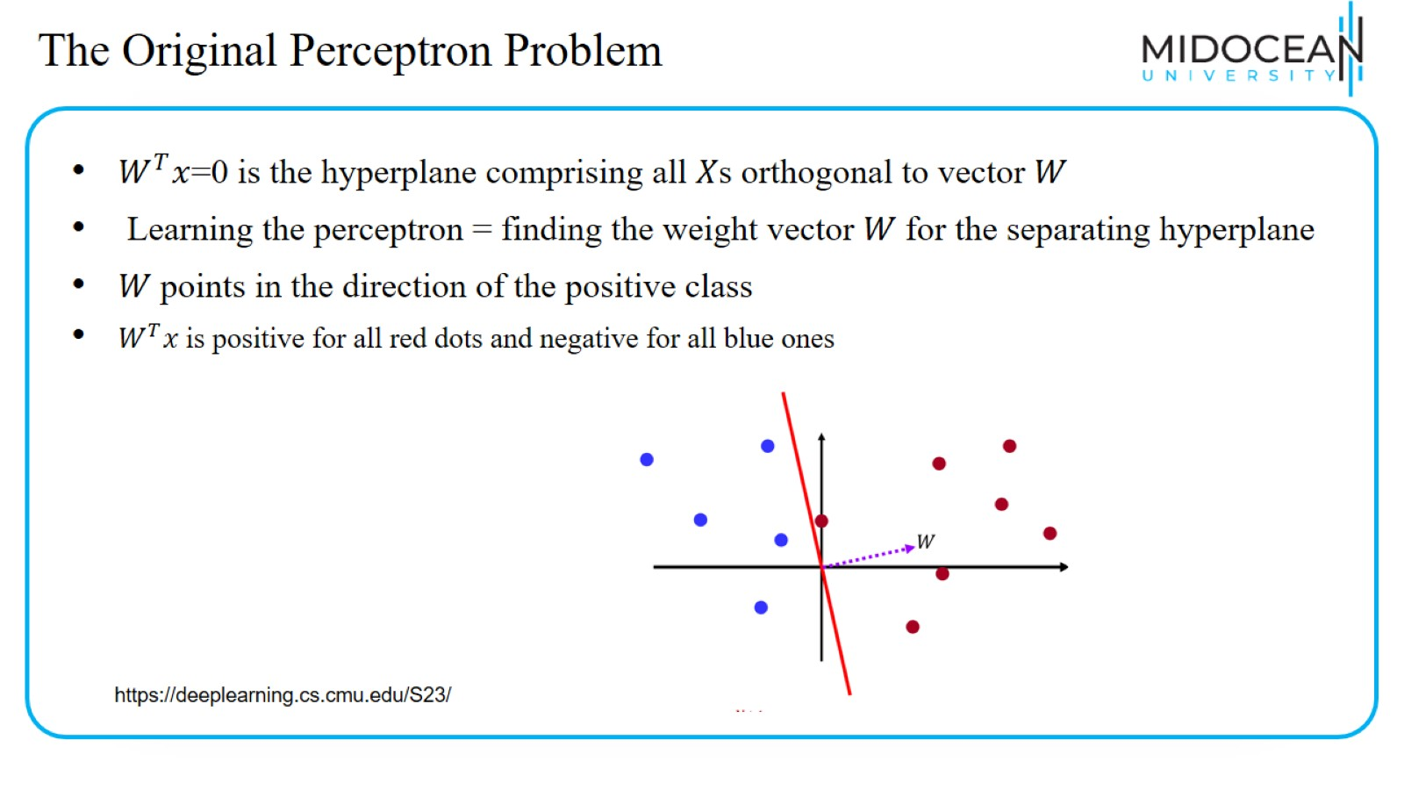
The Original Perceptron Problem

Slide 27
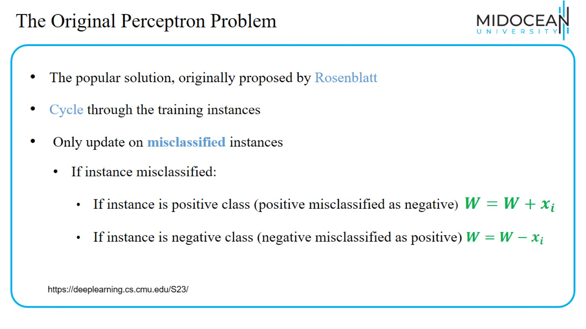
The Original Perceptron Problem

Slide 28
The Original Perceptron Problem

Slide 29
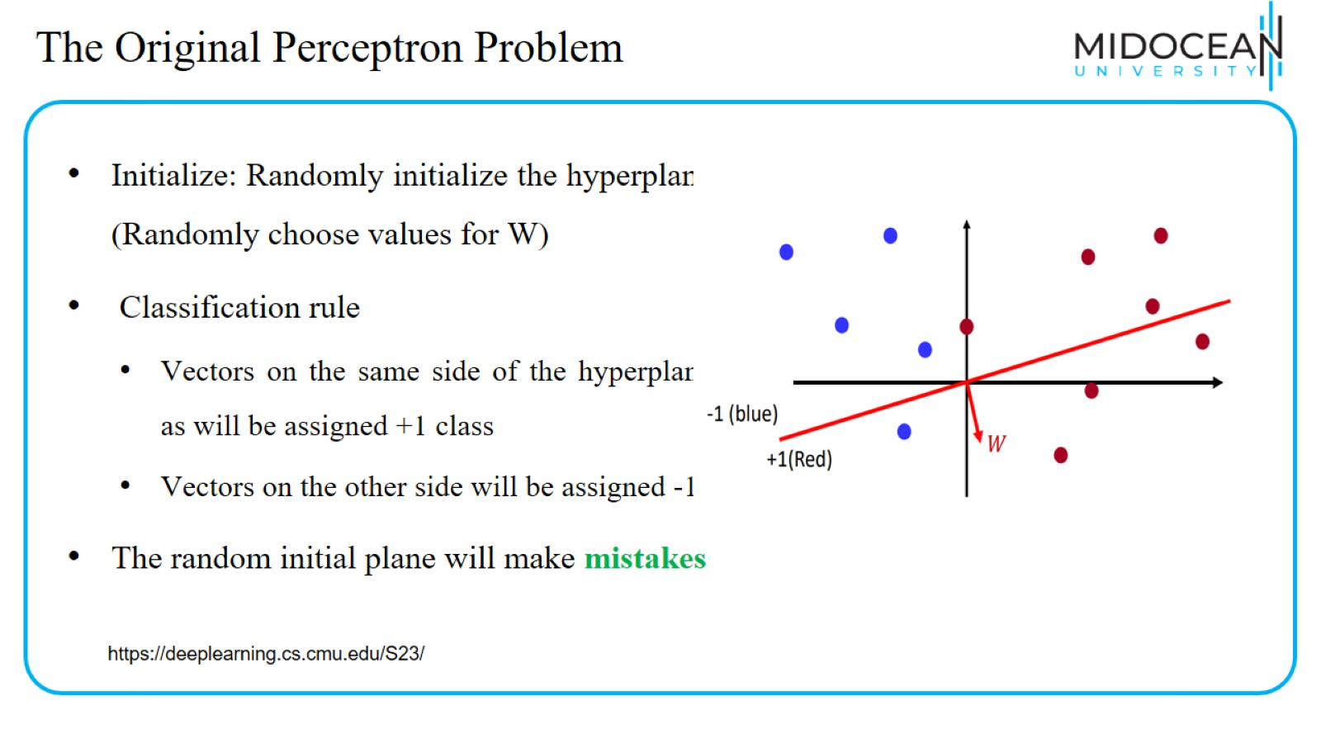
The Original Perceptron Problem

Slide 30
The Original Perceptron Problem

Slide 31
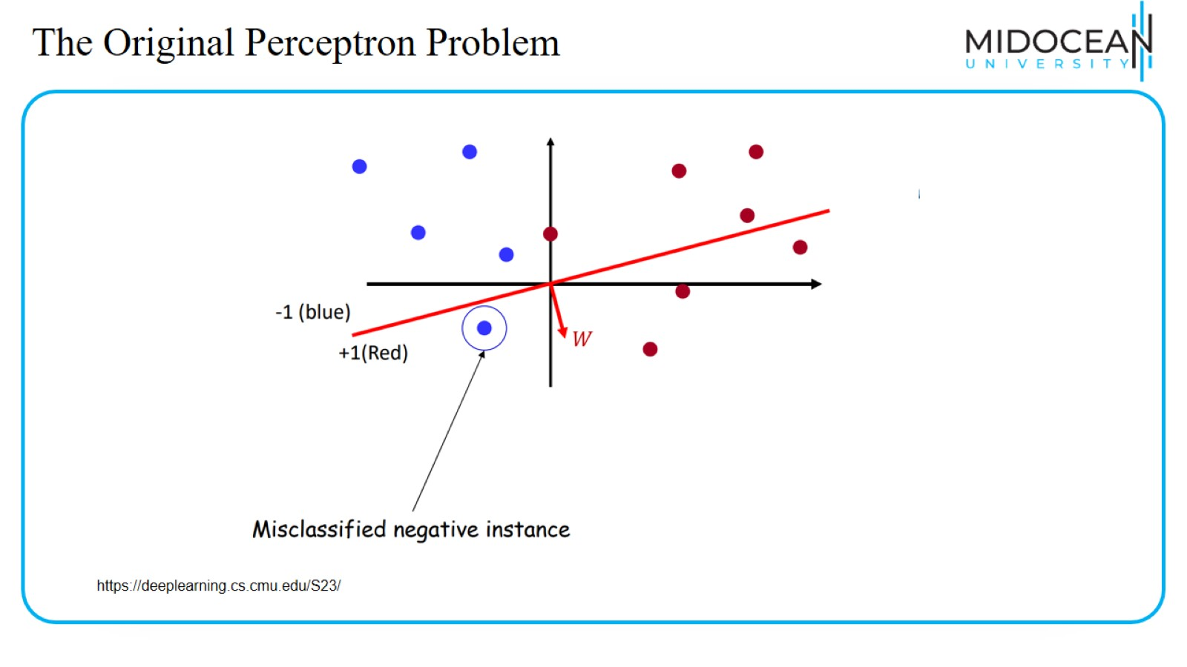
The Original Perceptron Problem

Slide 32
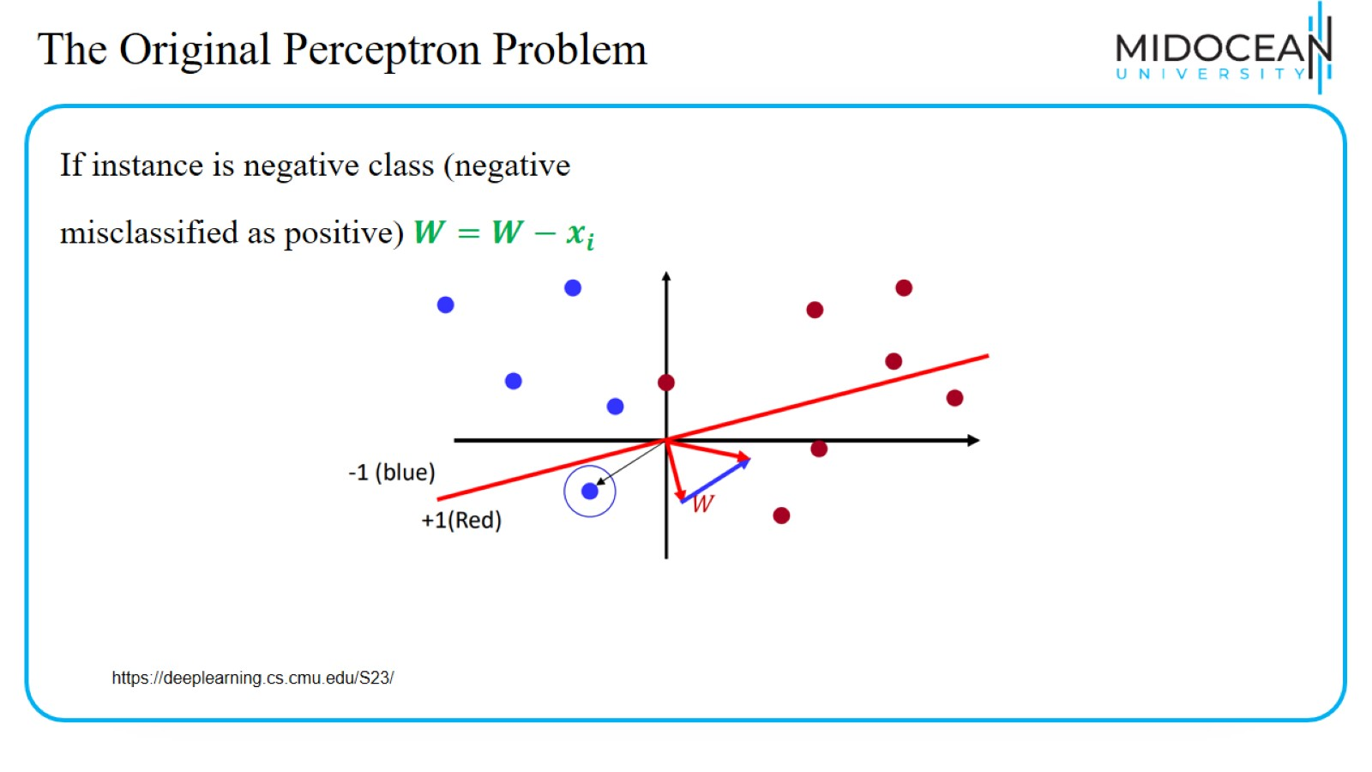
The Original Perceptron Problem

Slide 33
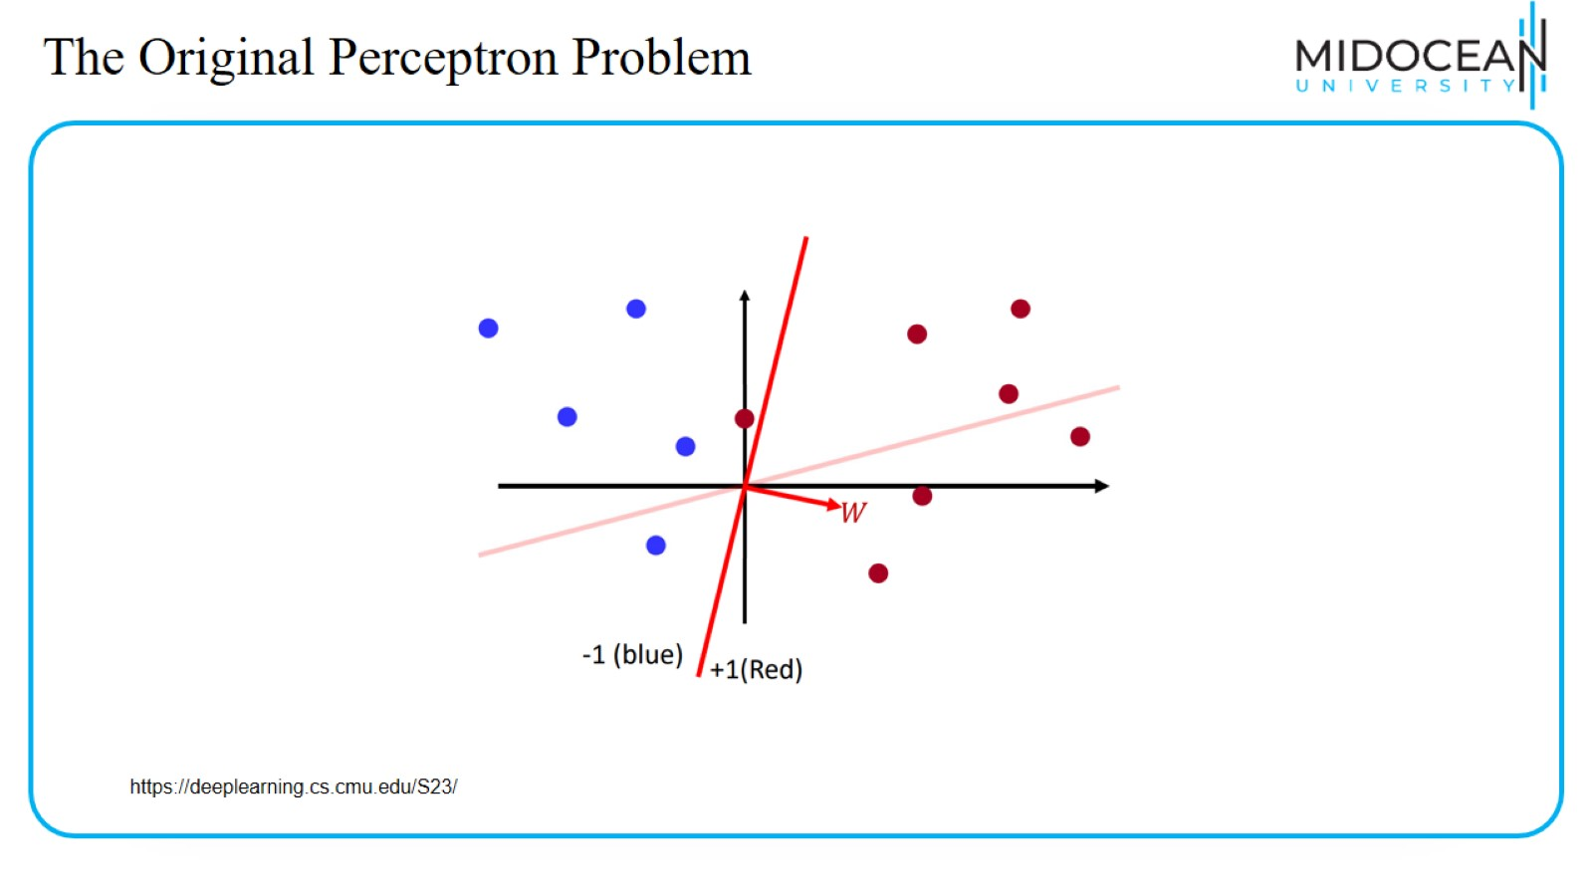
The Original Perceptron Problem

Slide 34
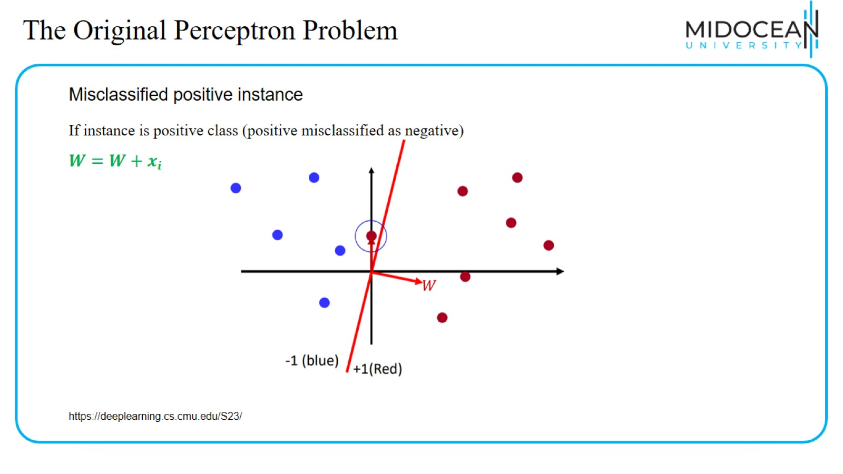
The Original Perceptron Problem

Slide 35
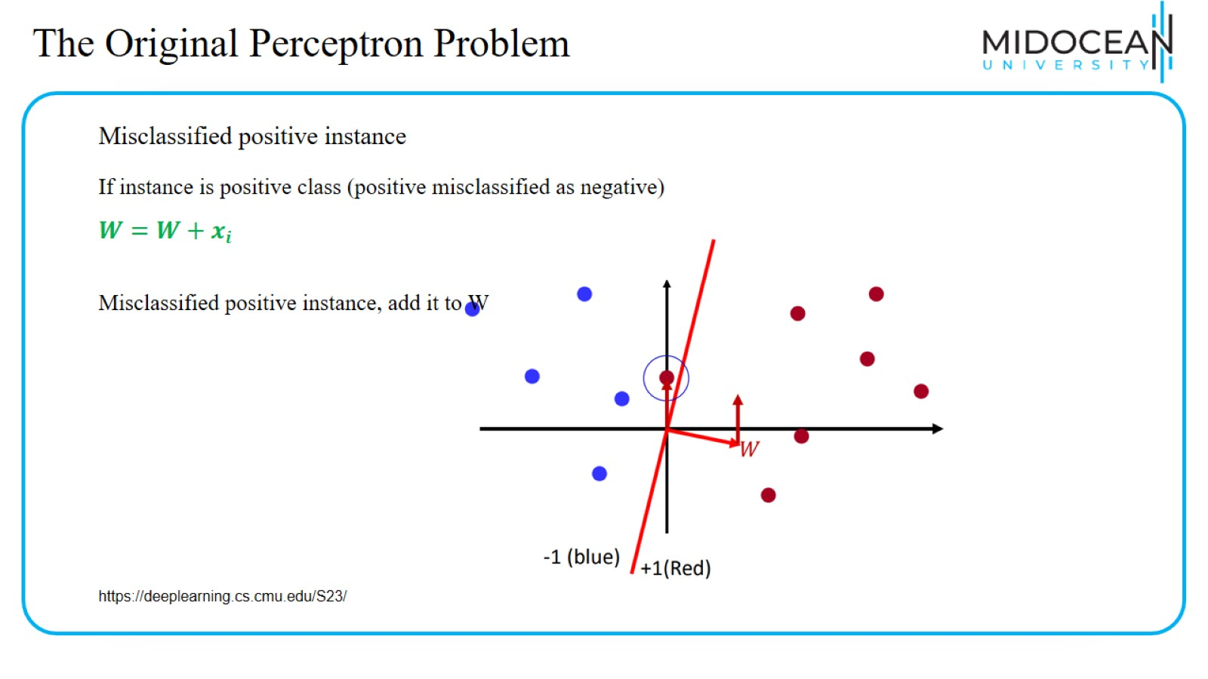
The Original Perceptron Problem

Slide 36
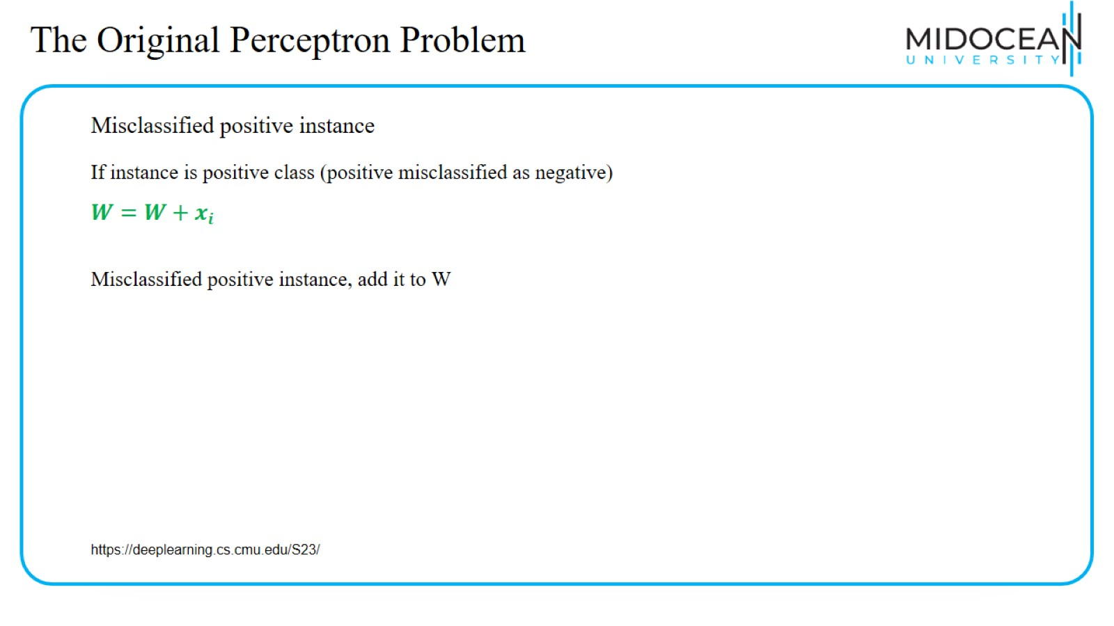
The Original Perceptron Problem

Slide 37
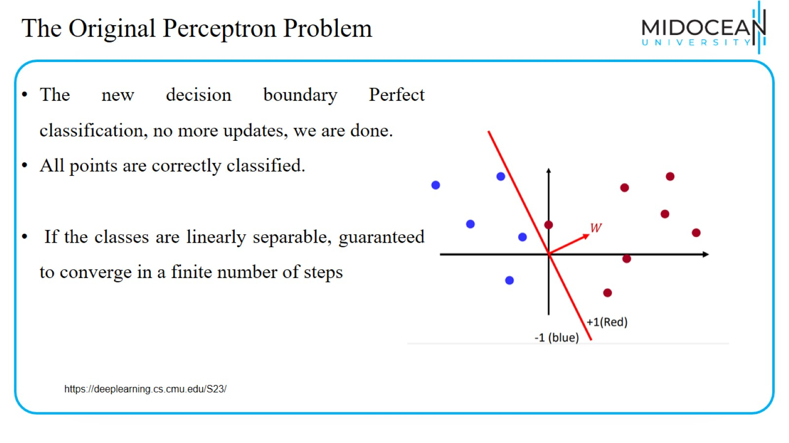
The Original Perceptron Problem

Slide 38
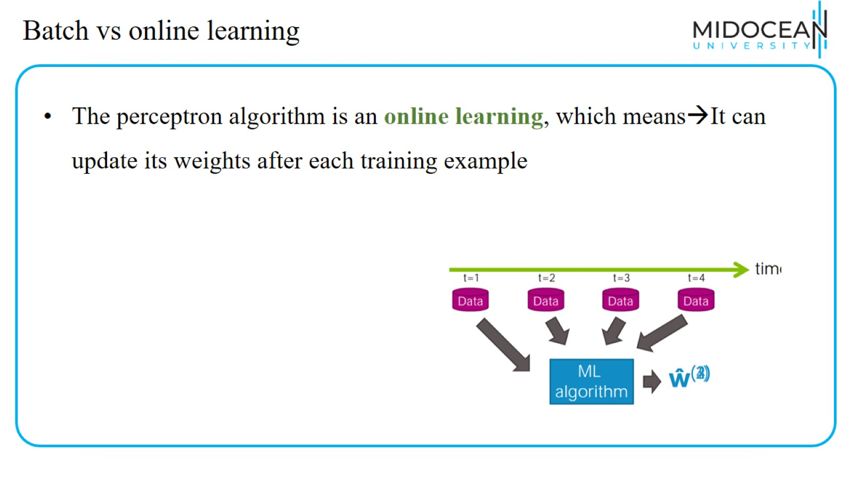
Batch vs online learning

Slide 39
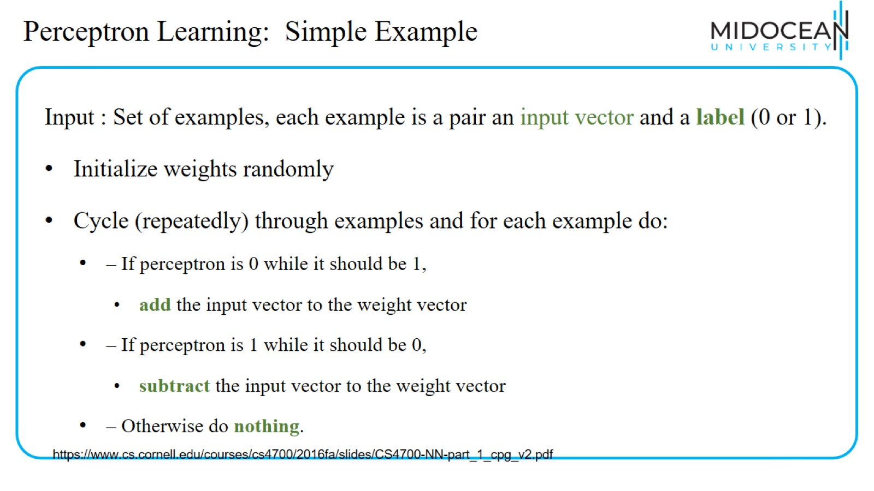
Perceptron Learning: Simple Example

Slide 40
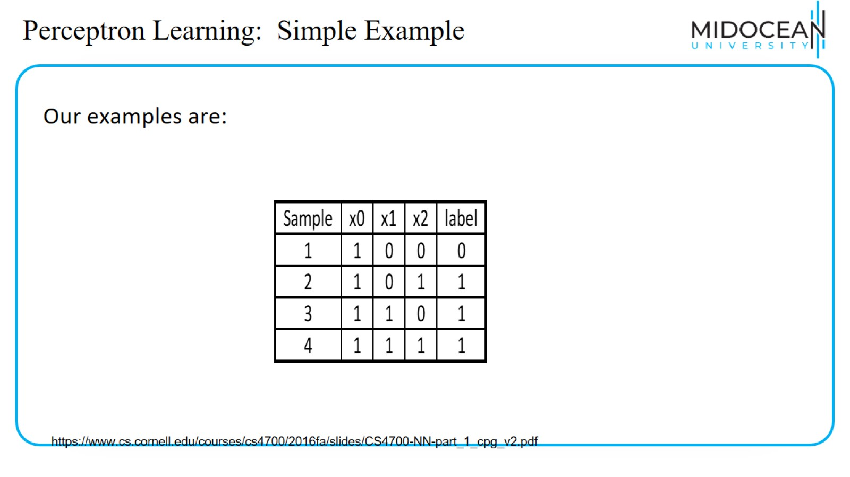
Perceptron Learning: Simple Example

Slide 41
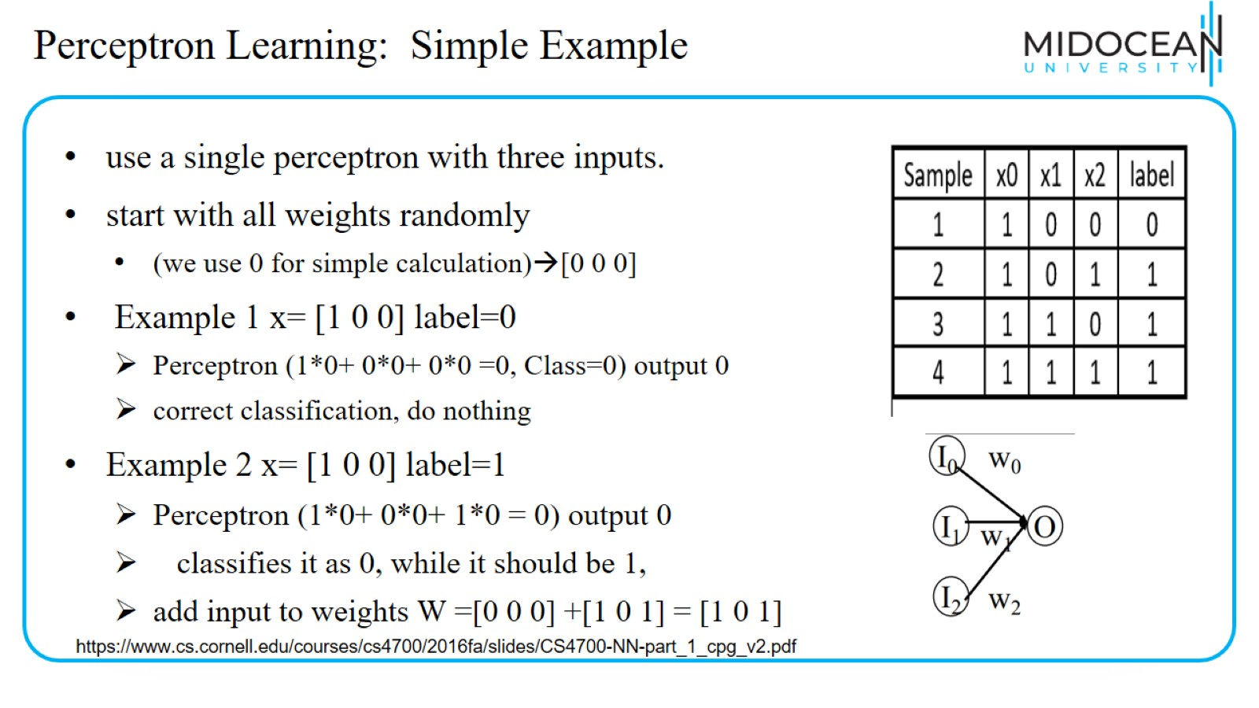
Perceptron Learning: Simple Example

Slide 42
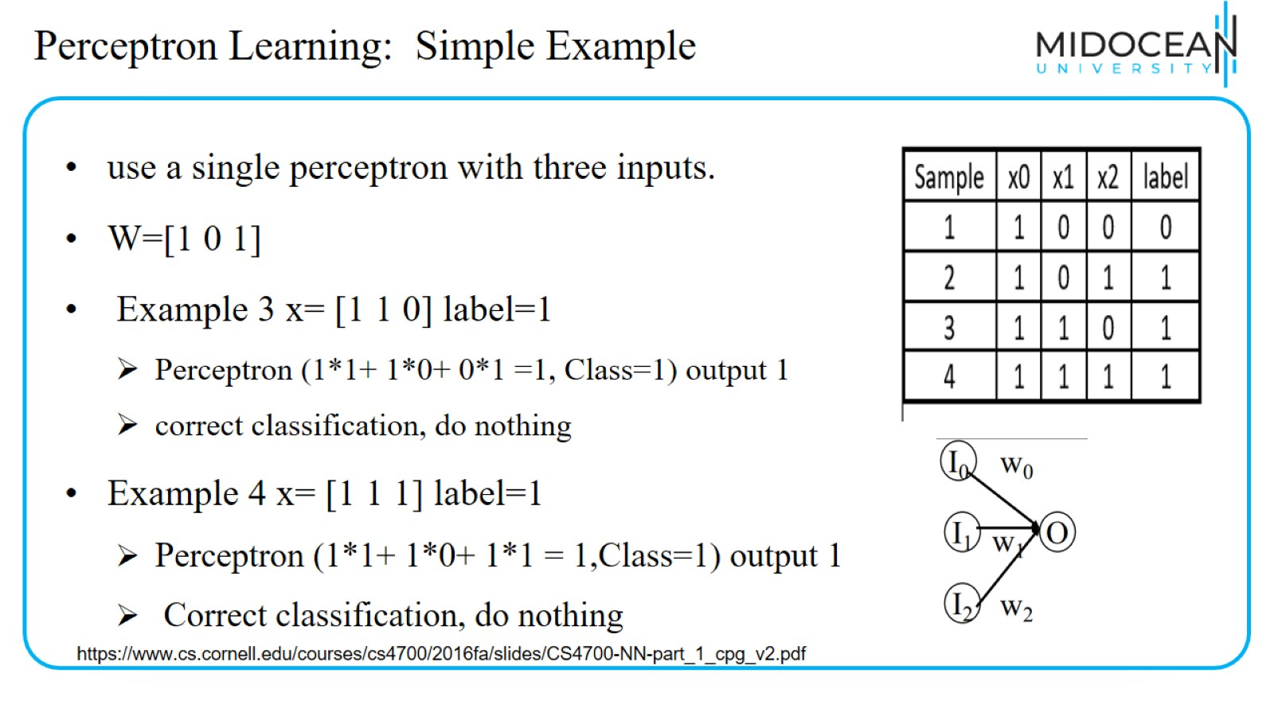
Perceptron Learning: Simple Example

Slide 43
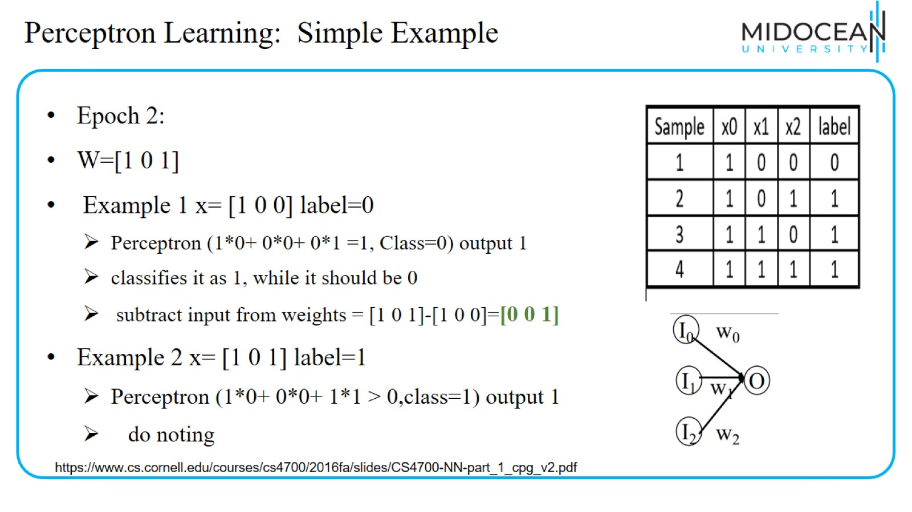
Perceptron Learning: Simple Example

Slide 44
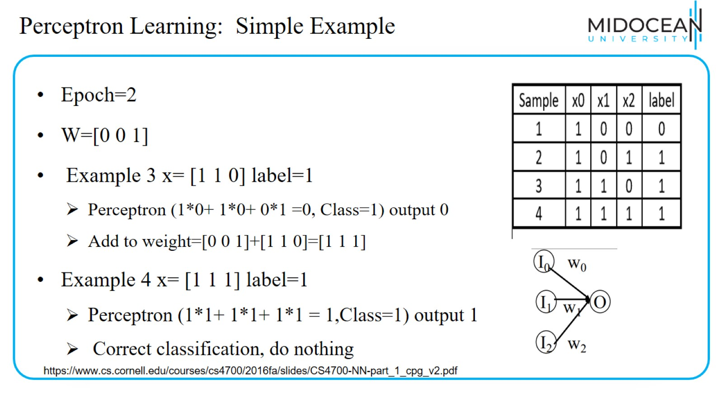
Perceptron Learning: Simple Example

Slide 45
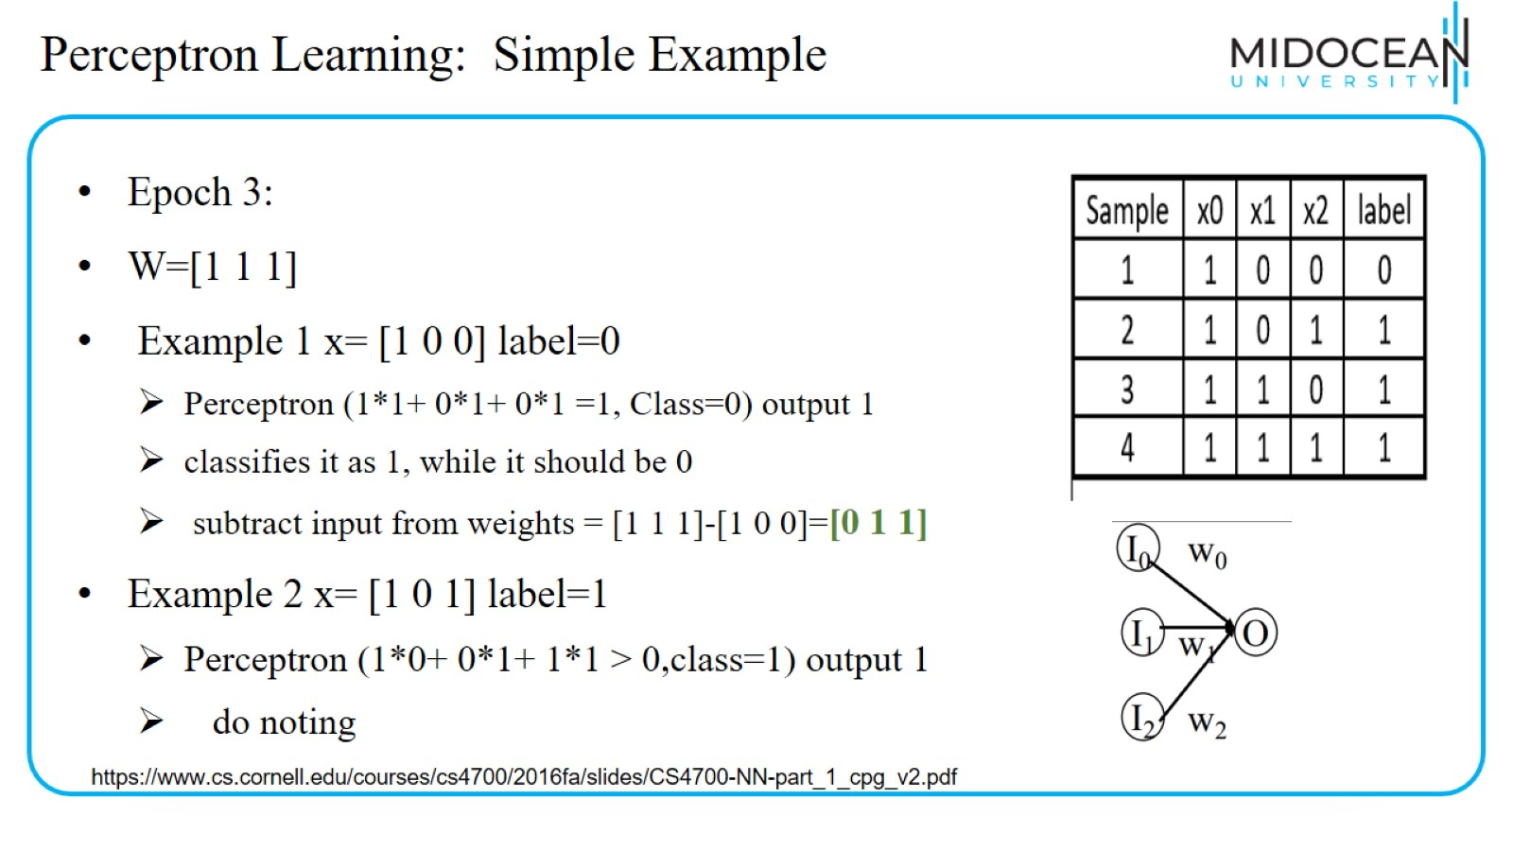
Perceptron Learning: Simple Example

Slide 46
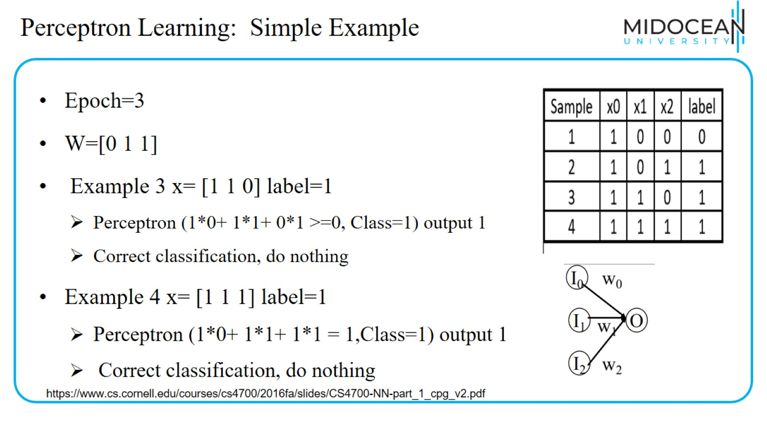
Perceptron Learning: Simple Example

Slide 47
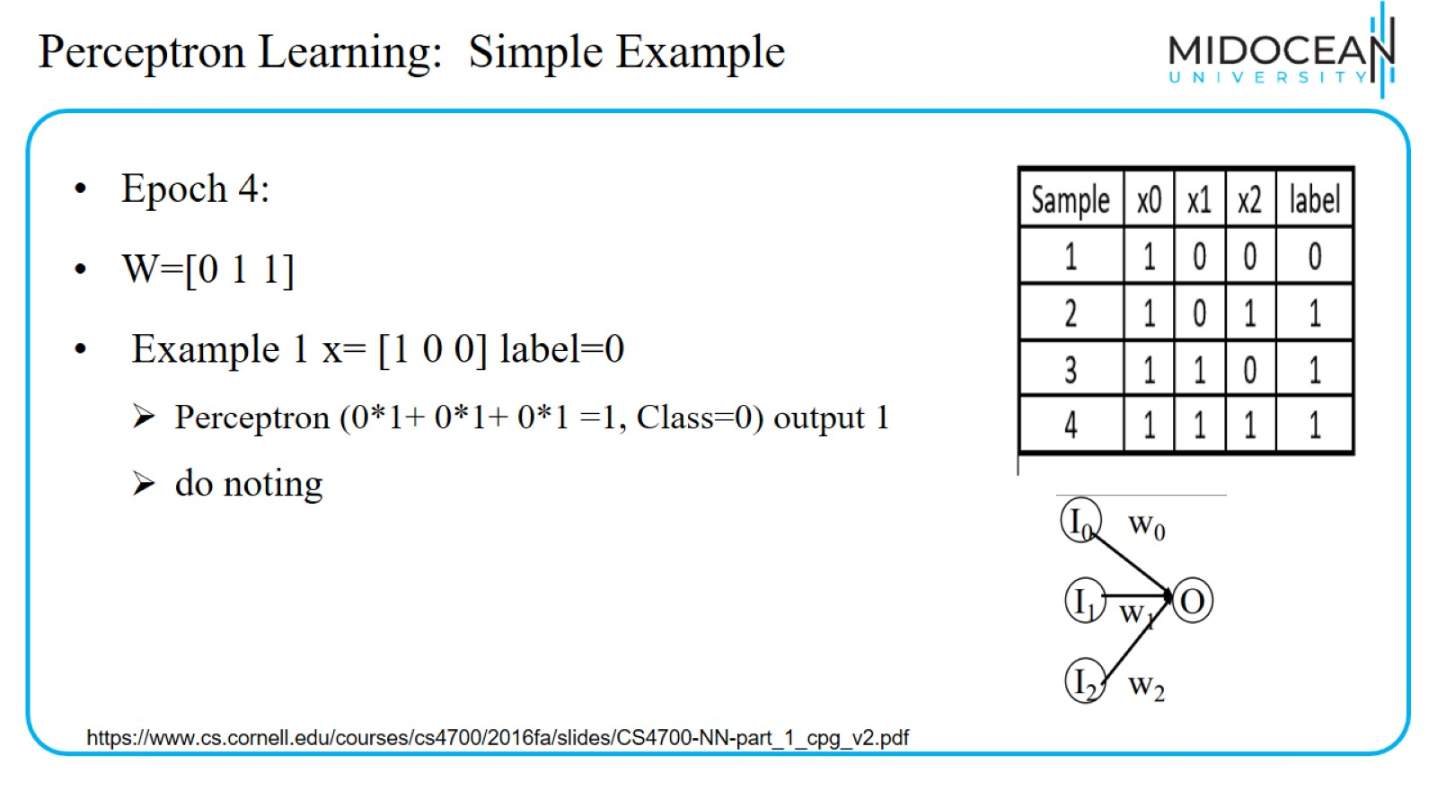
Perceptron Learning: Simple Example

Slide 48
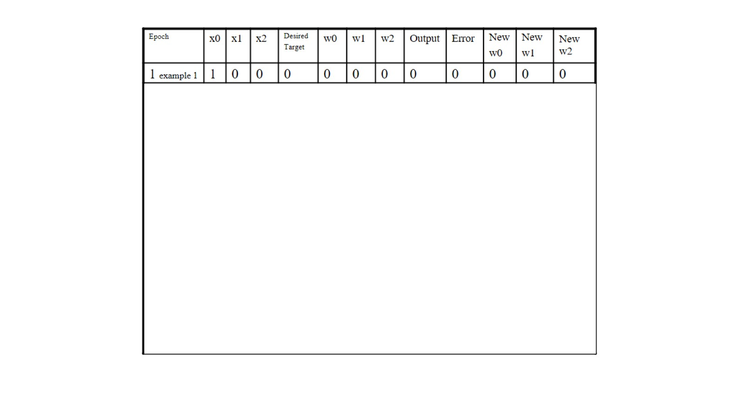

Slide 49
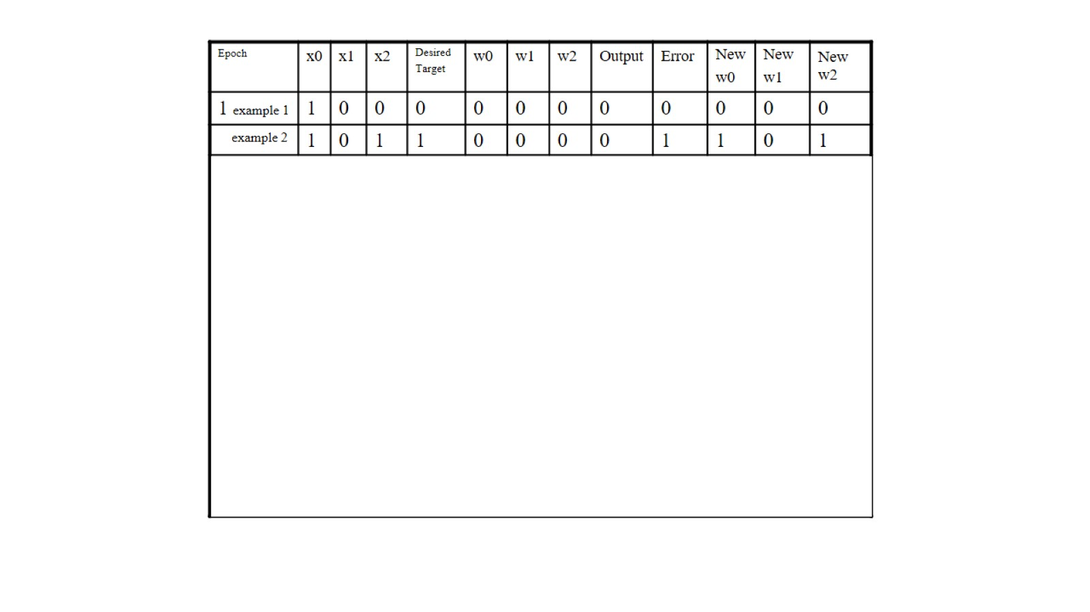

Slide 50
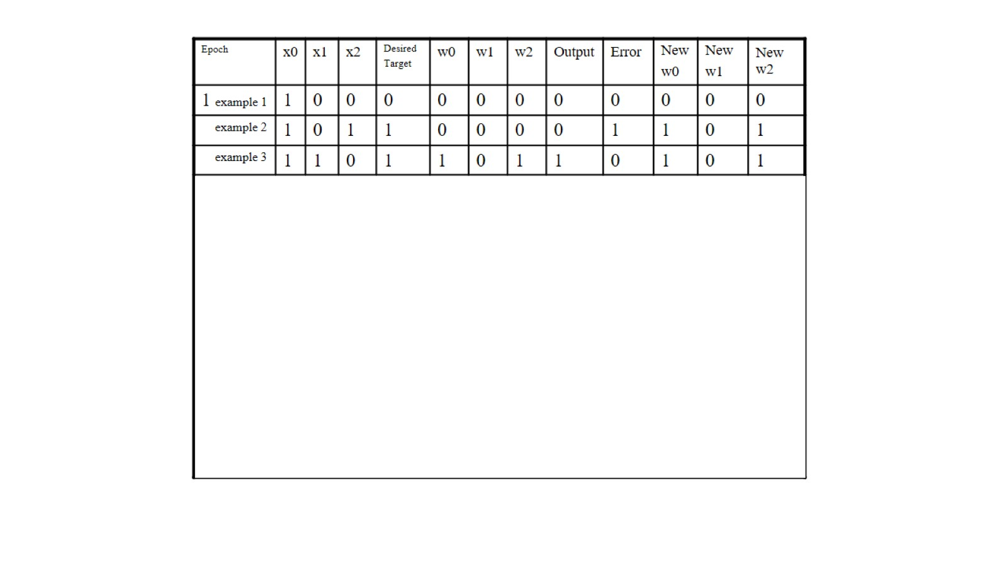

Slide 51
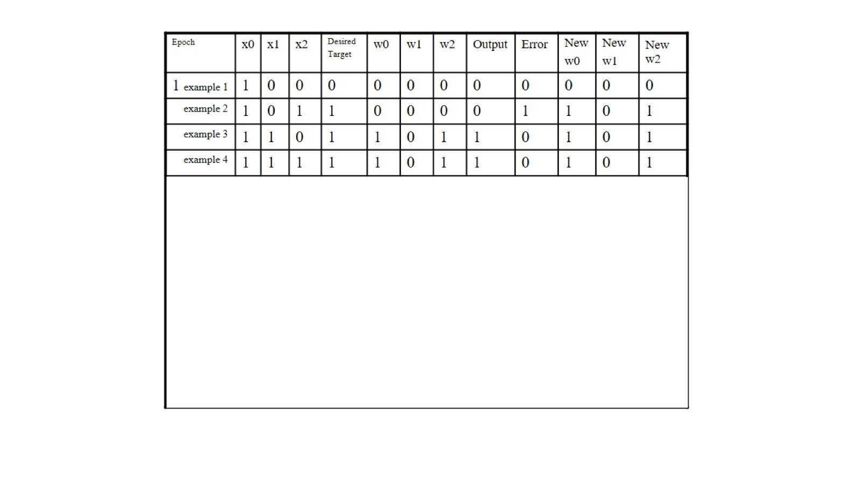

Slide 52
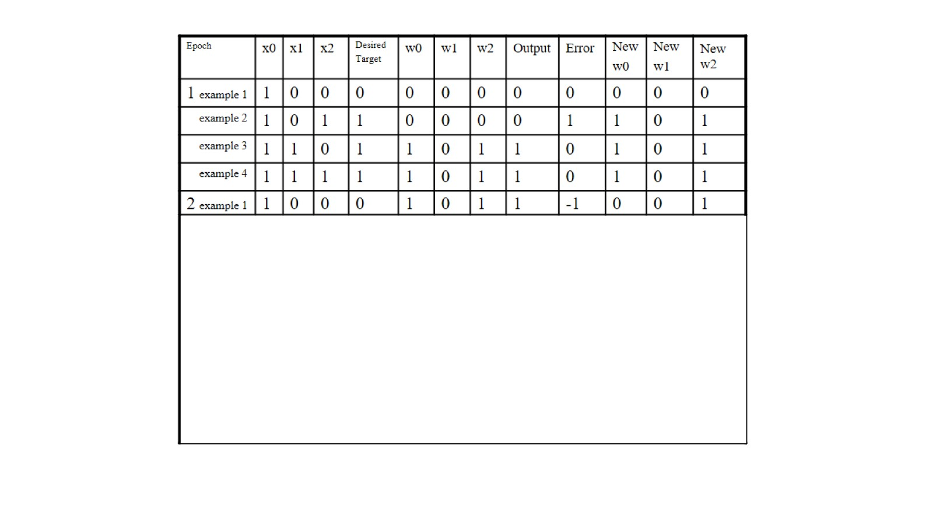

Slide 53


Slide 54


Slide 55


Slide 56


Slide 57


Slide 58


Slide 59


Slide 60


Slide 61

Perceptron Learning: Simple Example

Slide 62

Lecture Summary

Slide 63


