Slide 1

  Master of Financial Technology
FNT 615
Finance Concepts

Slide 2

Time Value of Money
Chapter 5
www.midocean.ae

Slide 3

Chapter
Intended Learning Outcomes
04
After reading this chapter, you should be able to:
Explain the mechanics of compounding and bringing the value of money back to the present.
Understand Annuities
Determine the future or present value of a sum when there are nonannual compounding periods.
Determine the present value of an uneven stream of payments and understand perpetuities.
www.midocean.ae

Slide 4
Annuties

Slide 5
Annuities
An annuity is a series of equal dollar payments for a specified number of years.
When we talk about annuities, we are referring to ordinary annuities unless otherwise noted.
With an ordinary annuity the payments occur at the end of each period. Because annuities occur frequently in finance— for example, as bond interest payments—we treat them specially.
Although compounding and determining the present value of an annuity can be dealt with using the methods we have just described, these processes can be time-consuming, especially for larger annuities.
Thus, we have modified the single cash flow formulas to deal directly with annuities.
Notes:
Up to this point we have been moving money forward in time; that is, we know how much we have to begin with and are trying to determine how much that sum will grow in a certain
number of years when compounded at a specific rate

Slide 6
Annuities
An annuity is a stream of equal periodic cash flows, over a specified time period. These cash flows can be inflows of returns earned on investments or outflows of funds invested to earn future returns.
  An ordinary (deferred) annuity is an annuity for which the cash flow occurs at the end of each period
  An annuity due is an annuity for which the cash flow occurs at the beginning of each period.
  NB An annuity due will always be greater than an otherwise equivalent ordinary annuity because interest will compound for an additional period.

Slide 7
Compound Annuities
A compound annuity involves depositing or investing an equal sum of money at the end of each year for a certain number of years and allowing it to grow.
Perhaps we are saving money for education, a new car, or a vacation home.
In any case, we want to know how much our savings will have grown at some point in the future.
Notes:
Up to this point we have been moving money forward in time; that is, we know how much we have to begin with and are trying to determine how much that sum will grow in a certain
number of years when compounded at a specific rate

Slide 8
Compound Annuities
Actually, we can find the answer by using equation (5-1), our compounding equation, and compounding each of the individual deposits to its future value.
For example, if to provide for a college education we are going to deposit $500 at the end of each year for the next 5 years in a bank where it will earn 6 percent interest, how much will we have at the end of 5 years? Compounding each of these values using equation (5-1), we find that we will have $2,818.50 at the end of 5 years.
    FV5 = $500(1 + 0.6)4 + $500(1 + 0.6)3 + $500(1 + 0.6)2 + $500(1 + 0.6) + $500
      = $500(1.262) + $500(1.191) + $500(1.124) + $500(1.060) + $500
      = $631.00 + $595.50 + $562.00 + $530.00 + $500.00
      = $2,818.50
Notes:
Up to this point we have been moving money forward in time; that is, we know how much we have to begin with and are trying to determine how much that sum will grow in a certain
number of years when compounded at a specific rate

Slide 9
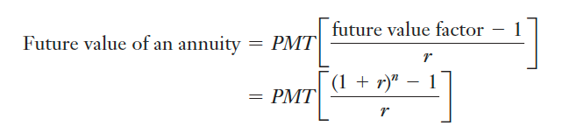
Compound Annuities
By examining the mathematics involved and the graph of the movement of money through time in Table 5-1, we can see that all we are really doing is adding up the future values of different cash flows that initially occurred in different time periods.
Fortunately, there is also an equation that helps us calculate the future value of an annuity:
Notes:
Up to this point we have been moving money forward in time; that is, we know how much we have to begin with and are trying to determine how much that sum will grow in a certain
number of years when compounded at a specific rate

Slide 10
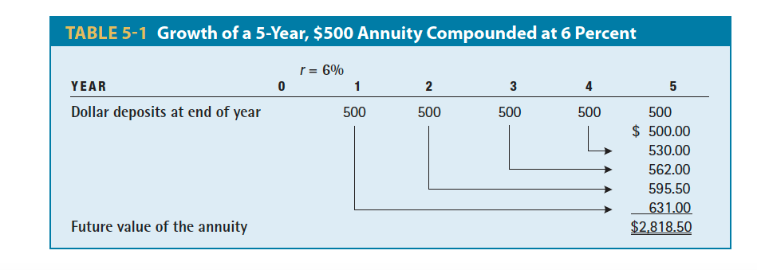
Compound Annuities
Notes:
Up to this point we have been moving money forward in time; that is, we know how much we have to begin with and are trying to determine how much that sum will grow in a certain
number of years when compounded at a specific rate

Slide 11
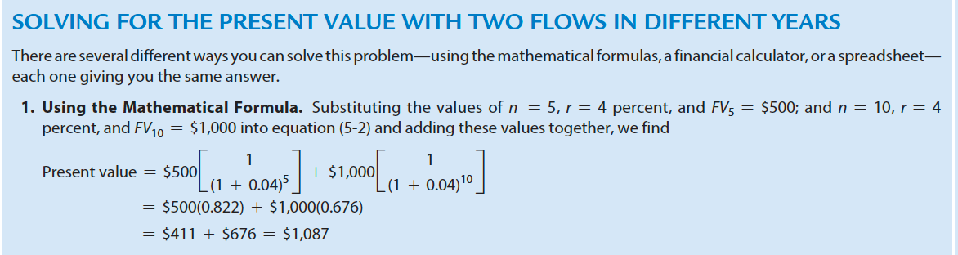
Compound Annuities
Notes:
Up to this point we have been moving money forward in time; that is, we know how much we have to begin with and are trying to determine how much that sum will grow in a certain
number of years when compounded at a specific rate

Slide 12
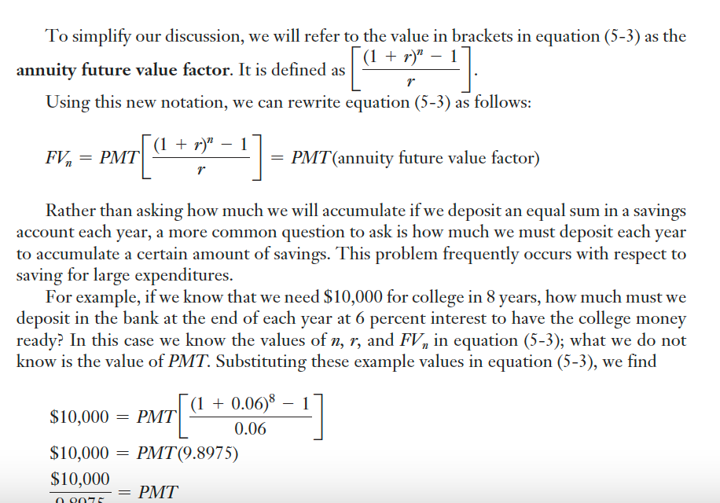
Compound Annuities
Thus, we must deposit $1,010.36 in the bank at the end of each year for 8 years at 6 percent interest to accumulate $10,000 at the end of 8 years.
Notes:
Up to this point we have been moving money forward in time; that is, we know how much we have to begin with and are trying to determine how much that sum will grow in a certain
number of years when compounded at a specific rate

Slide 13
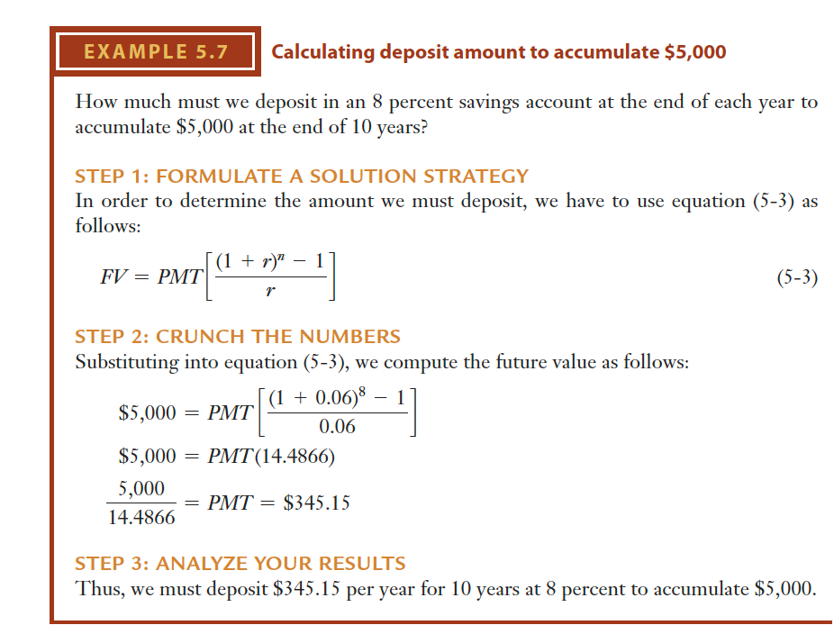
Notes:
Up to this point we have been moving money forward in time; that is, we know how much we have to begin with and are trying to determine how much that sum will grow in a certain
number of years when compounded at a specific rate

Slide 14
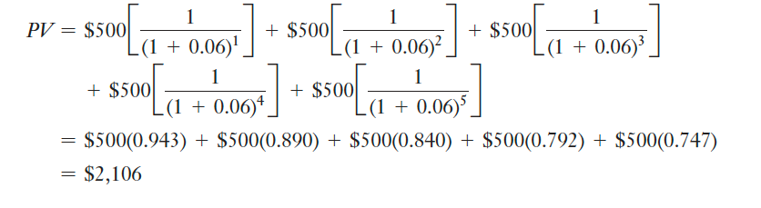
The Present Value of an Annuity
Pension payments, insurance obligations, and the interest owed on bonds all involve annuities. To compare these three types of investments we need to know the present value of each.
For example, if we wish to know what $500 received at the end of each of the next 5 years is worth today given a discount rate of 6 percent, we can simply substitute the appropriate values into equation (5-2), such that
Notes:
Up to this point we have been moving money forward in time; that is, we know how much we have to begin with and are trying to determine how much that sum will grow in a certain
number of years when compounded at a specific rate

Slide 15
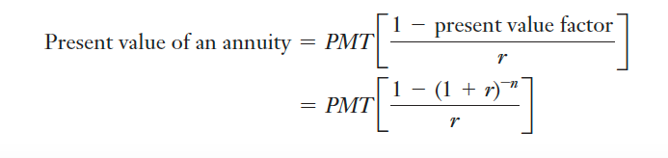
The Present Value of an Annuity
Thus, the present value of this annuity is $2,106.00.
By examining the mathematics involved and the graph of the movement of money through time in Table 5-2, we can see that all we are really doing is adding up the present values of different cash flows that initially occurred in different time periods.
Fortunately, there is also an equation that helps us calculate the present value of an annuity:
Notes:
Up to this point we have been moving money forward in time; that is, we know how much we have to begin with and are trying to determine how much that sum will grow in a certain
number of years when compounded at a specific rate

Slide 16
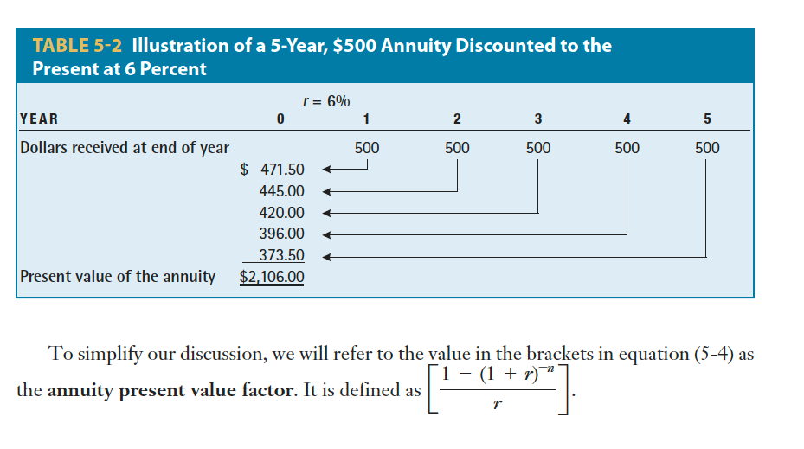
Notes:
Up to this point we have been moving money forward in time; that is, we know how much we have to begin with and are trying to determine how much that sum will grow in a certain
number of years when compounded at a specific rate

Slide 17
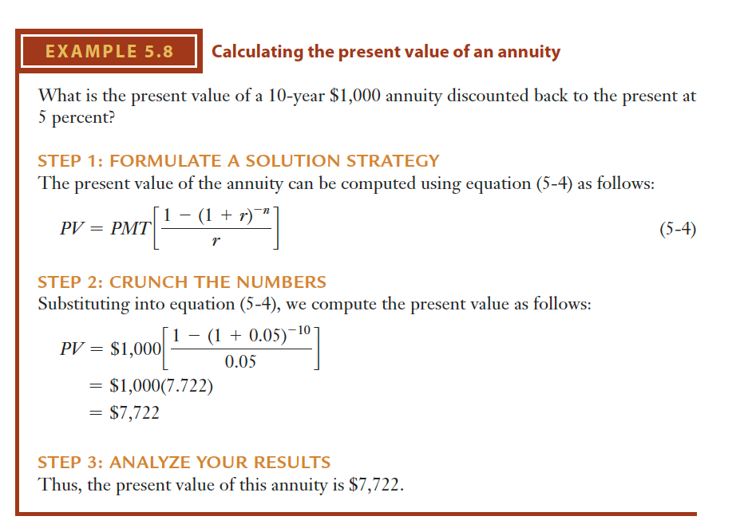
Notes:
Up to this point we have been moving money forward in time; that is, we know how much we have to begin with and are trying to determine how much that sum will grow in a certain
number of years when compounded at a specific rate

Slide 18
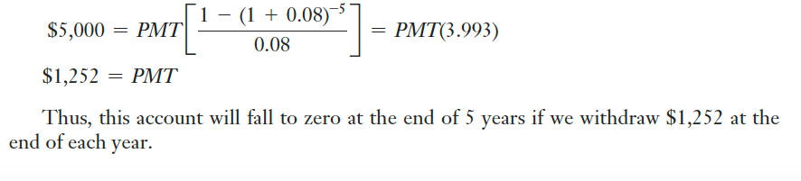
The Present Value of an Annuity
When we solve for PMT, the financial interpretation of this action would be: How much can be withdrawn, perhaps as a pension or to make loan payments, from an account that earns r percent compounded annually for each of the next n years if we wish to have nothing left at the end of n years?
For example, if we have $5,000 in an account earning 8 percent interest, how large of an annuity can we draw out each year if we want nothing left at the end of 5 years? In this case the present value, PV, of the annuity is $5,000, n = 5 years, r = 8 percent, and PMT is unknown. Substituting this into equation (5-4), we find
Notes:
Up to this point we have been moving money forward in time; that is, we know how much we have to begin with and are trying to determine how much that sum will grow in a certain
number of years when compounded at a specific rate

Slide 19
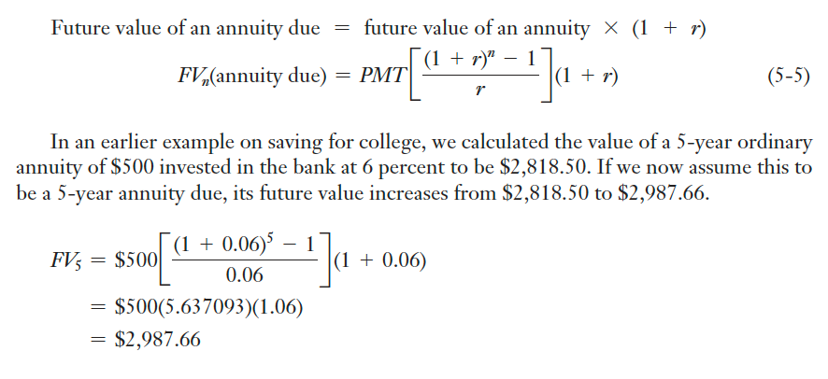
Annuities Due
Annuities due are really just ordinary annuities in which all the annuity payments have been shifted forward by 1 year.
Compounding them and determining their future and present value is actually quite simple.
With an annuity due, each annuity payment occurs at the beginning of each period rather than at the end of the period.
Let’s first look at how this affects our compounding calculations.
Because an annuity due merely shifts the payments from the end of the year to the beginning of the year, we now compound the cash flows for one additional year.
Notes:
Up to this point we have been moving money forward in time; that is, we know how much we have to begin with and are trying to determine how much that sum will grow in a certain
number of years when compounded at a specific rate

Slide 20
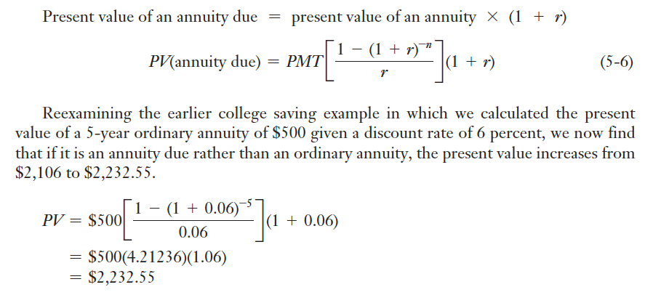
Annuities Due
Likewise, with the present value of an annuity due, we simply receive each cash flow 1 year earlier—that is, we receive it at the beginning of each year rather than at the end of each year.
Thus, because each cash flow is received 1 year earlier, it is discounted back for one less period. To determine the present value of an annuity due, we merely need to find the present value of an ordinary annuity and multiply that by (1 + r), which in effect cancels out 1 year’s discounting.
Notes:
Up to this point we have been moving money forward in time; that is, we know how much we have to begin with and are trying to determine how much that sum will grow in a certain
number of years when compounded at a specific rate

Slide 21
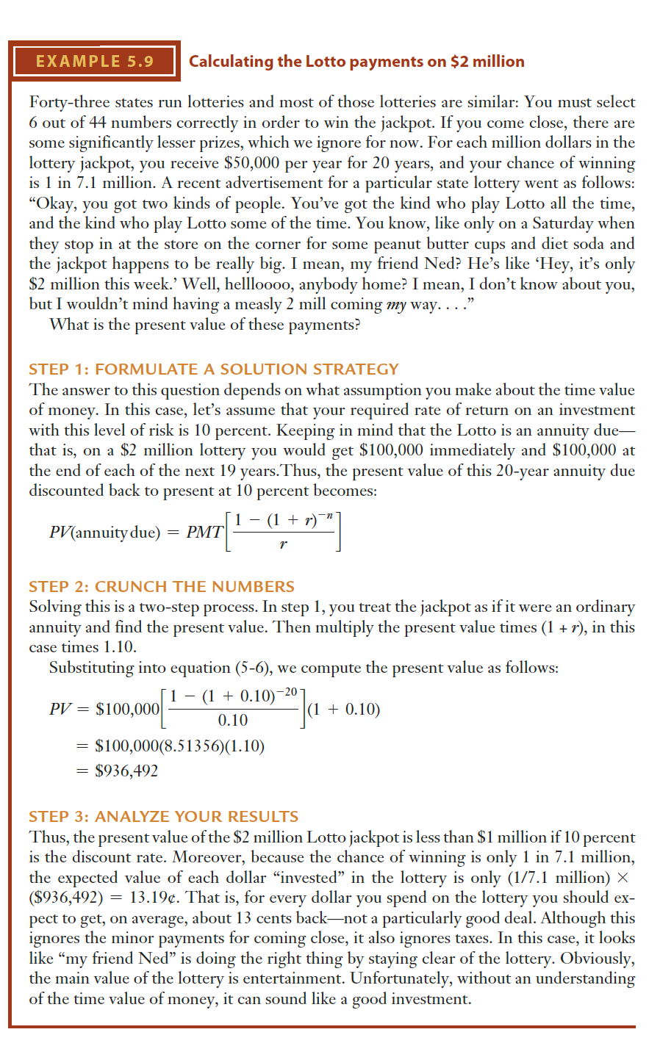
Notes:
Up to this point we have been moving money forward in time; that is, we know how much we have to begin with and are trying to determine how much that sum will grow in a certain
number of years when compounded at a specific rate

Slide 22
Notes:
Up to this point we have been moving money forward in time; that is, we know how much we have to begin with and are trying to determine how much that sum will grow in a certain
number of years when compounded at a specific rate

Slide 23
Amortized Loans
The procedure of solving for PMT, the annuity payment value when r, n, and PV are known, is also used to determine what payments are associated with paying off a loan in equal installments over time.
Loans that are paid off this way, in equal periodic payments, are called amortized loans.
Actually, the word amortization comes from the Latin word meaning “about to die.” When you pay off a loan using regular, fixed payments, that loan is amortized.
Although the payments are fixed, different amounts of each payment are applied toward the principal and the interest.
With each payment, you owe a bit less toward the principal.
As a result, the amount that has to go toward the interest payment declines with each payment, whereas the portion of each payment that goes toward the principal increases. Figure 5-4 illustrates the process of amortization.
Notes:
Up to this point we have been moving money forward in time; that is, we know how much we have to begin with and are trying to determine how much that sum will grow in a certain
number of years when compounded at a specific rate

Slide 24
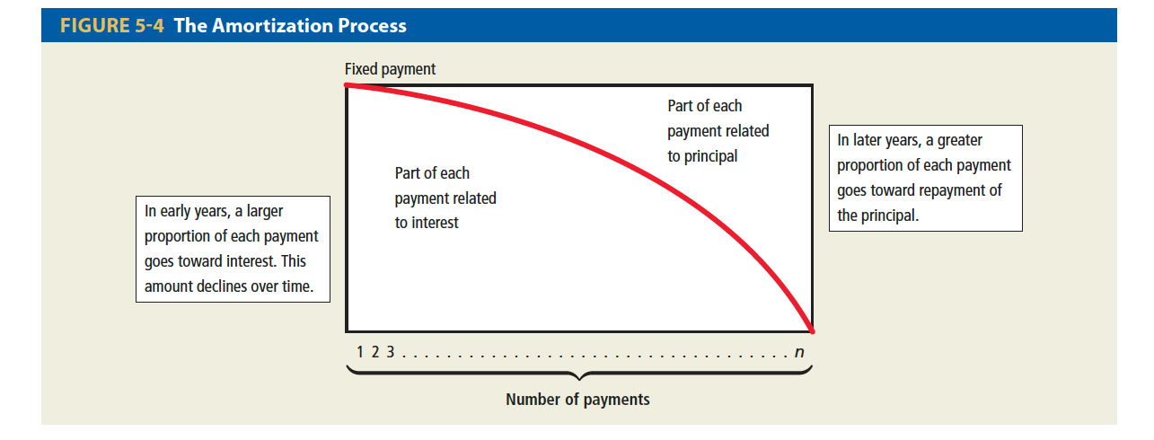
Notes:
Up to this point we have been moving money forward in time; that is, we know how much we have to begin with and are trying to determine how much that sum will grow in a certain
number of years when compounded at a specific rate

Slide 25
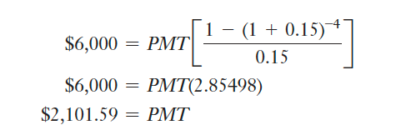
Example
For example, suppose a firm wants to purchase a piece of machinery.
To do this, it borrows $6,000 to be repaid in four equal payments at the end of each of the next 4 years, and the interest rate that is paid to the lender is 15 percent on the outstanding portion of the loan.
To determine what the annual payments associated with the repayment of this debt will be, we simply use equation (5-4) and solve for the value of PMT, the annual annuity.
In this case, we know PV, r, and n. PV, the present value of the annuity, is $6,000; r, the annual interest rate, is 15 percent; and n, the number of years for which the annuity will last, is 4 years.
PMT, the annuity payment received (by the lender and paid by the firm) at the end of each year, is unknown.
Substituting these values into equation (5-4), we find
Notes:
Up to this point we have been moving money forward in time; that is, we know how much we have to begin with and are trying to determine how much that sum will grow in a certain
number of years when compounded at a specific rate

Slide 26
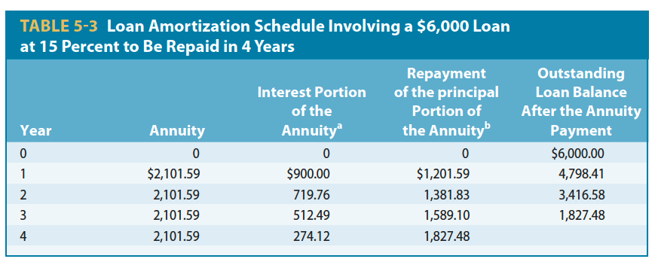
Example
To repay the principal and interest on the outstanding loan in 4 years, the annual payments would be $2,101.59.
The breakdown of interest and principal payments is given in the loan amortization schedule in Table 5-3, with very minor rounding error.
As you can see, the interest portion of the payment declines each year as the loan outstanding balance declines.
Notes:
Up to this point we have been moving money forward in time; that is, we know how much we have to begin with and are trying to determine how much that sum will grow in a certain
number of years when compounded at a specific rate

Slide 27

Finding Present and Future Values with Nonannual Periods
The same logic that applies to calculating the EAR also applies to calculating present and future values when the periods are semiannual, quarterly, or any other nonannual period.
Previously when we moved money through time we assumed that the cash flows occurred annually and the compounding or discounting period was always annual.
However, it need not be, as evidenced by the fact that bonds generally pay interest semiannually and most mortgages require monthly payments.
Notes:
Up to this point we have been moving money forward in time; that is, we know how much we have to begin with and are trying to determine how much that sum will grow in a certain
number of years when compounded at a specific rate

Slide 28
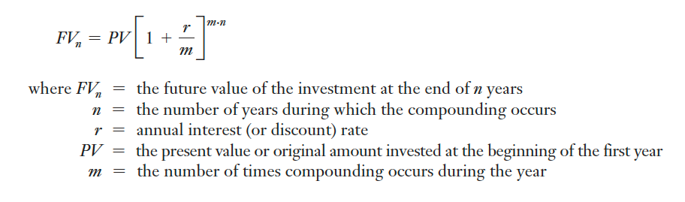
Finding Present and Future Values with Nonannual Periods
For example, if we invest our money for 5 years at 8 percent interest compounded semiannually, we are really investing our money for ten 6-month periods during which we receive 4 percent interest each period. If it is 8 percent compounded quarterly for 5 years, we receive 2 percent interest per period for twenty 3-month periods.
This process can easily be generalized, giving us the following formula for finding the future value of an investment for which interest is compounded in nonannual periods:
Notes:
Up to this point we have been moving money forward in time; that is, we know how much we have to begin with and are trying to determine how much that sum will grow in a certain
number of years when compounded at a specific rate

Slide 29
Finding Present and Future Values with Nonannual Periods
In fact, all the formulas for moving money through time can be easily modified to accommodate nonannual periods. In each case, we begin with the formulas we introduced in this chapter, and make two adjustments—the first where n, the number of years, appears, and the second where r, the annual interest rate, appears.
Thus, the adjustment involves two steps:
n becomes the number of periods or n (the number of years) times m (the number of times compounding occurs per year).
Thus, if it is monthly compounding for 10 years, n becomes 10 * 12 = 120 months in 10 years, and if it is daily compounding over 10 years, it becomes 10 * 365 = 3,650 days in 10 years.
Notes:
Up to this point we have been moving money forward in time; that is, we know how much we have to begin with and are trying to determine how much that sum will grow in a certain
number of years when compounded at a specific rate

Slide 30
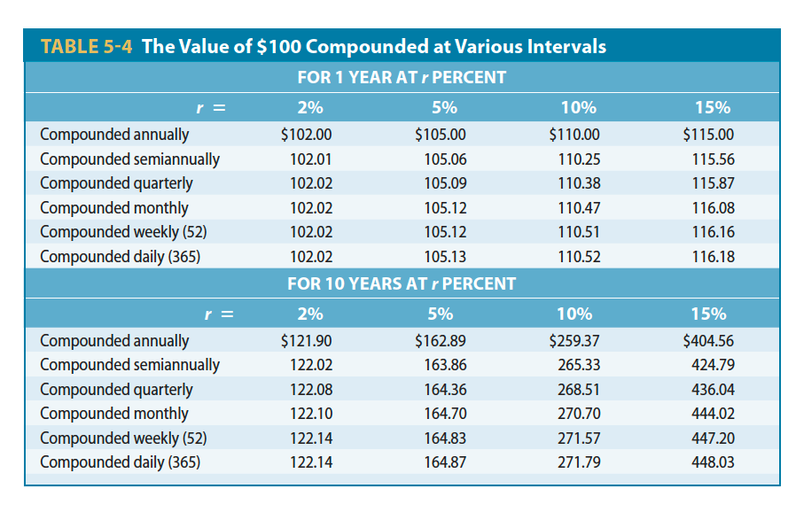
Notes:
Up to this point we have been moving money forward in time; that is, we know how much we have to begin with and are trying to determine how much that sum will grow in a certain
number of years when compounded at a specific rate

Slide 31
Finding Present and Future Values with Nonannual Periods
r becomes the interest rate per period or r (the annual interest rate) divided by m (the number of times compounding occurs per year).
Thus, if it is a 6 percent annual rate with monthly compounding, r becomes 6% , 12 = 0.5 percent per month, and if it is a 6 percent annual rate compounded daily, then r becomes (6% , 365) per day.
We can see the value of intrayear compounding by examining Table 5-4. Because “interest is earned on interest” more frequently as the length of the compounding period declines, there is an inverse relationship between the length of the compounding period and the effective annual interest rate: The shorter the compounding period is, the higher the effective interest rate will be.
Conversely, the longer the compounding period is, the lower the effective interest rate will be.
Notes:
Up to this point we have been moving money forward in time; that is, we know how much we have to begin with and are trying to determine how much that sum will grow in a certain
number of years when compounded at a specific rate

Slide 32
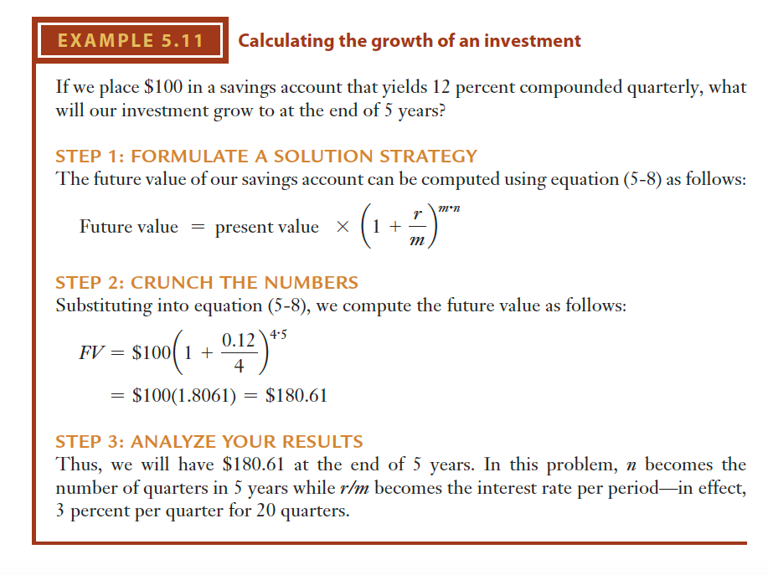
Notes:
Up to this point we have been moving money forward in time; that is, we know how much we have to begin with and are trying to determine how much that sum will grow in a certain
number of years when compounded at a specific rate

Slide 33
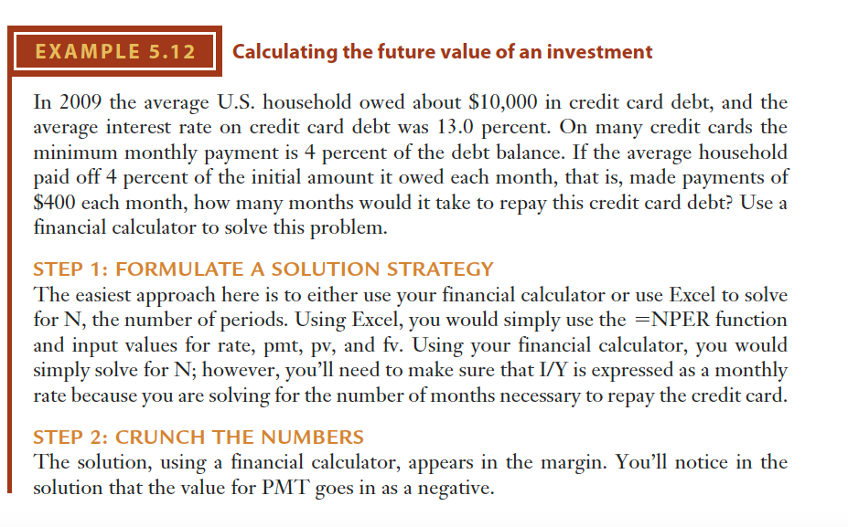
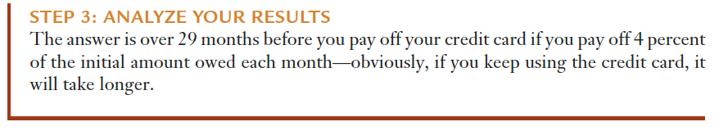
Notes:
Up to this point we have been moving money forward in time; that is, we know how much we have to begin with and are trying to determine how much that sum will grow in a certain
number of years when compounded at a specific rate

Slide 34
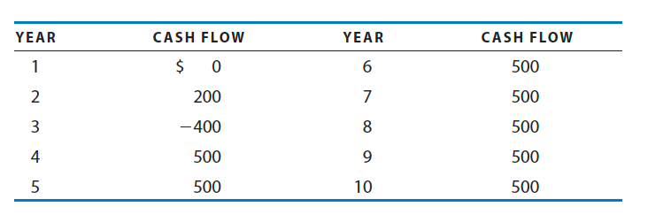
The Present Value of an Uneven Stream and Perpetuities
Although some projects will involve a single cash flow and some will involve annuities, many projects will involve uneven cash flows over several years.
Notes:
Up to this point we have been moving money forward in time; that is, we know how much we have to begin with and are trying to determine how much that sum will grow in a certain
number of years when compounded at a specific rate

Slide 35
Example
For example, if we wished to find the present value of the following cash flows them by adding in the positive flows and subtracting the negative ones.
However, this problem is complicated by the annuity of $500 that runs from years 4 through 10.
To accommodate this, we can first discount the annuity back to the beginning of period 4 (or end of period 3) and get its present value at that point in time.
We then bring this single cash flow (which is the present value of the 7-year annuity) back to the present.
In effect, we discount twice, first back to the end of period 3, then back to the present.
This is shown graphically in Table 5-5 and numerically in Table 5-6. Thus, the present value of this uneven stream of cash flows is $2,185.69.
Notes:
Up to this point we have been moving money forward in time; that is, we know how much we have to begin with and are trying to determine how much that sum will grow in a certain
number of years when compounded at a specific rate

Slide 36
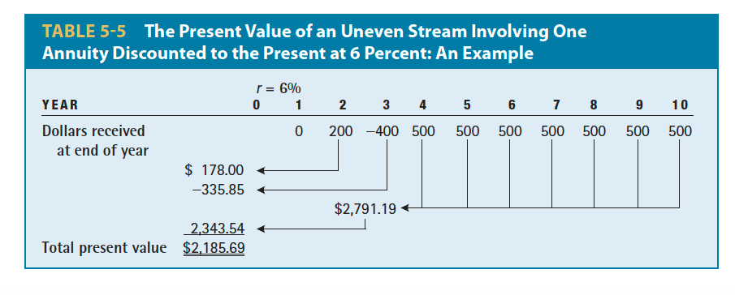
Example
Notes:
Up to this point we have been moving money forward in time; that is, we know how much we have to begin with and are trying to determine how much that sum will grow in a certain
number of years when compounded at a specific rate

Slide 37
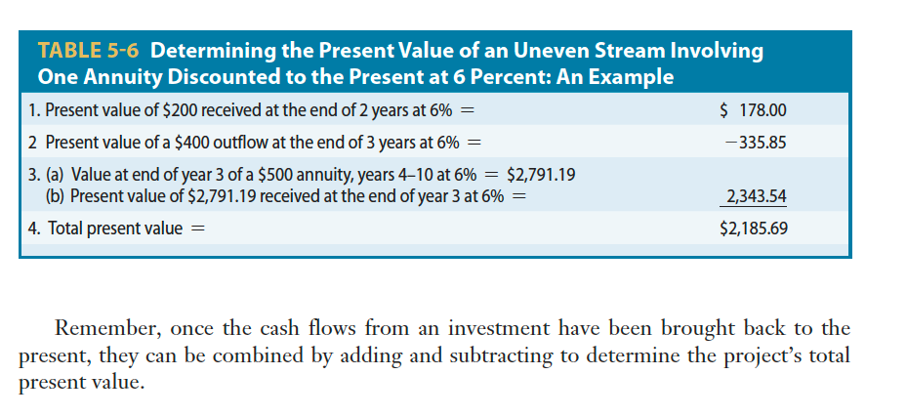
Example

Slide 38
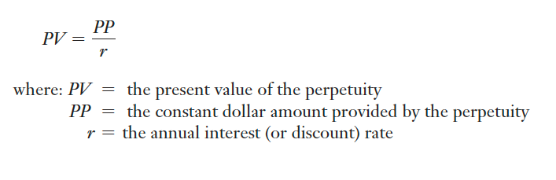
Perpetuities
A perpetuity is an annuity that continues forever; that is, every year following its establishment this investment pays the same dollar amount.
An example of a perpetuity is preferred stock that pays a constant dollar dividend infinitely.
Determining the present value of a perpetuity is delightfully simple; we merely need to divide the constant flow by the discount rate.
For example, the present value of a $100 perpetuity discounted back to the present at 5 percent is $100/0.05 = $2,000.
Thus, the equation representing the present value of a perpetuity is
Notes:
Up to this point we have been moving money forward in time; that is, we know how much we have to begin with and are trying to determine how much that sum will grow in a certain
number of years when compounded at a specific rate

Slide 39
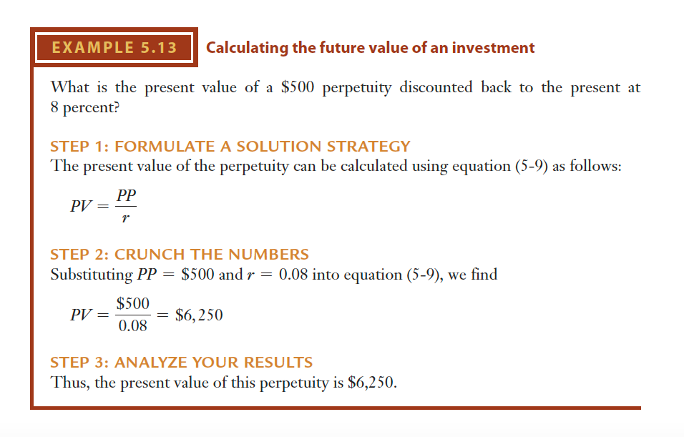
Notes:
Up to this point we have been moving money forward in time; that is, we know how much we have to begin with and are trying to determine how much that sum will grow in a certain
number of years when compounded at a specific rate

Slide 40
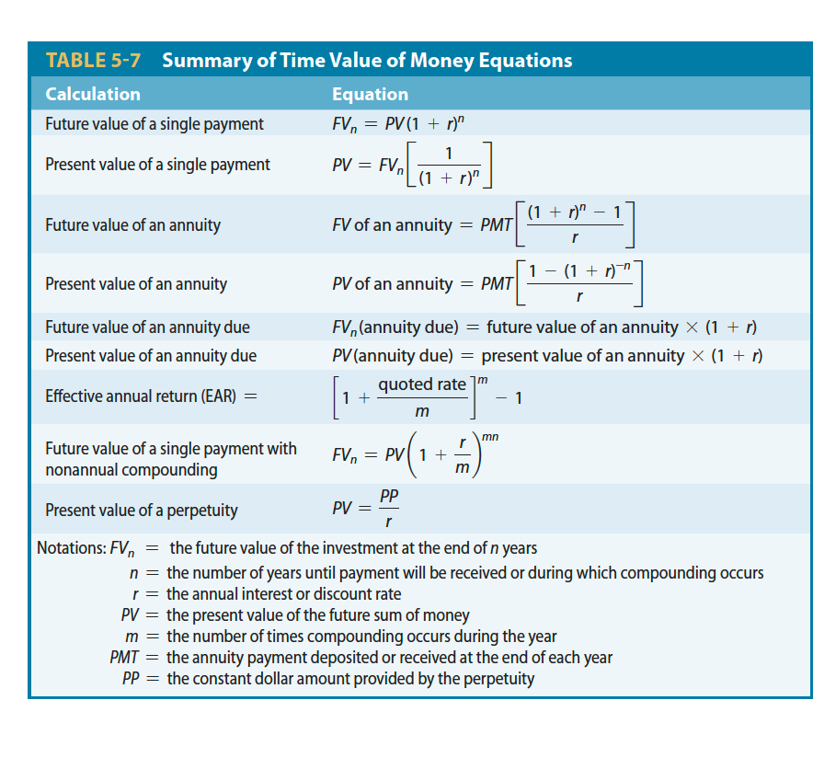
Notes:
Up to this point we have been moving money forward in time; that is, we know how much we have to begin with and are trying to determine how much that sum will grow in a certain
number of years when compounded at a specific rate

Slide 41


Thank You

