Slide 1

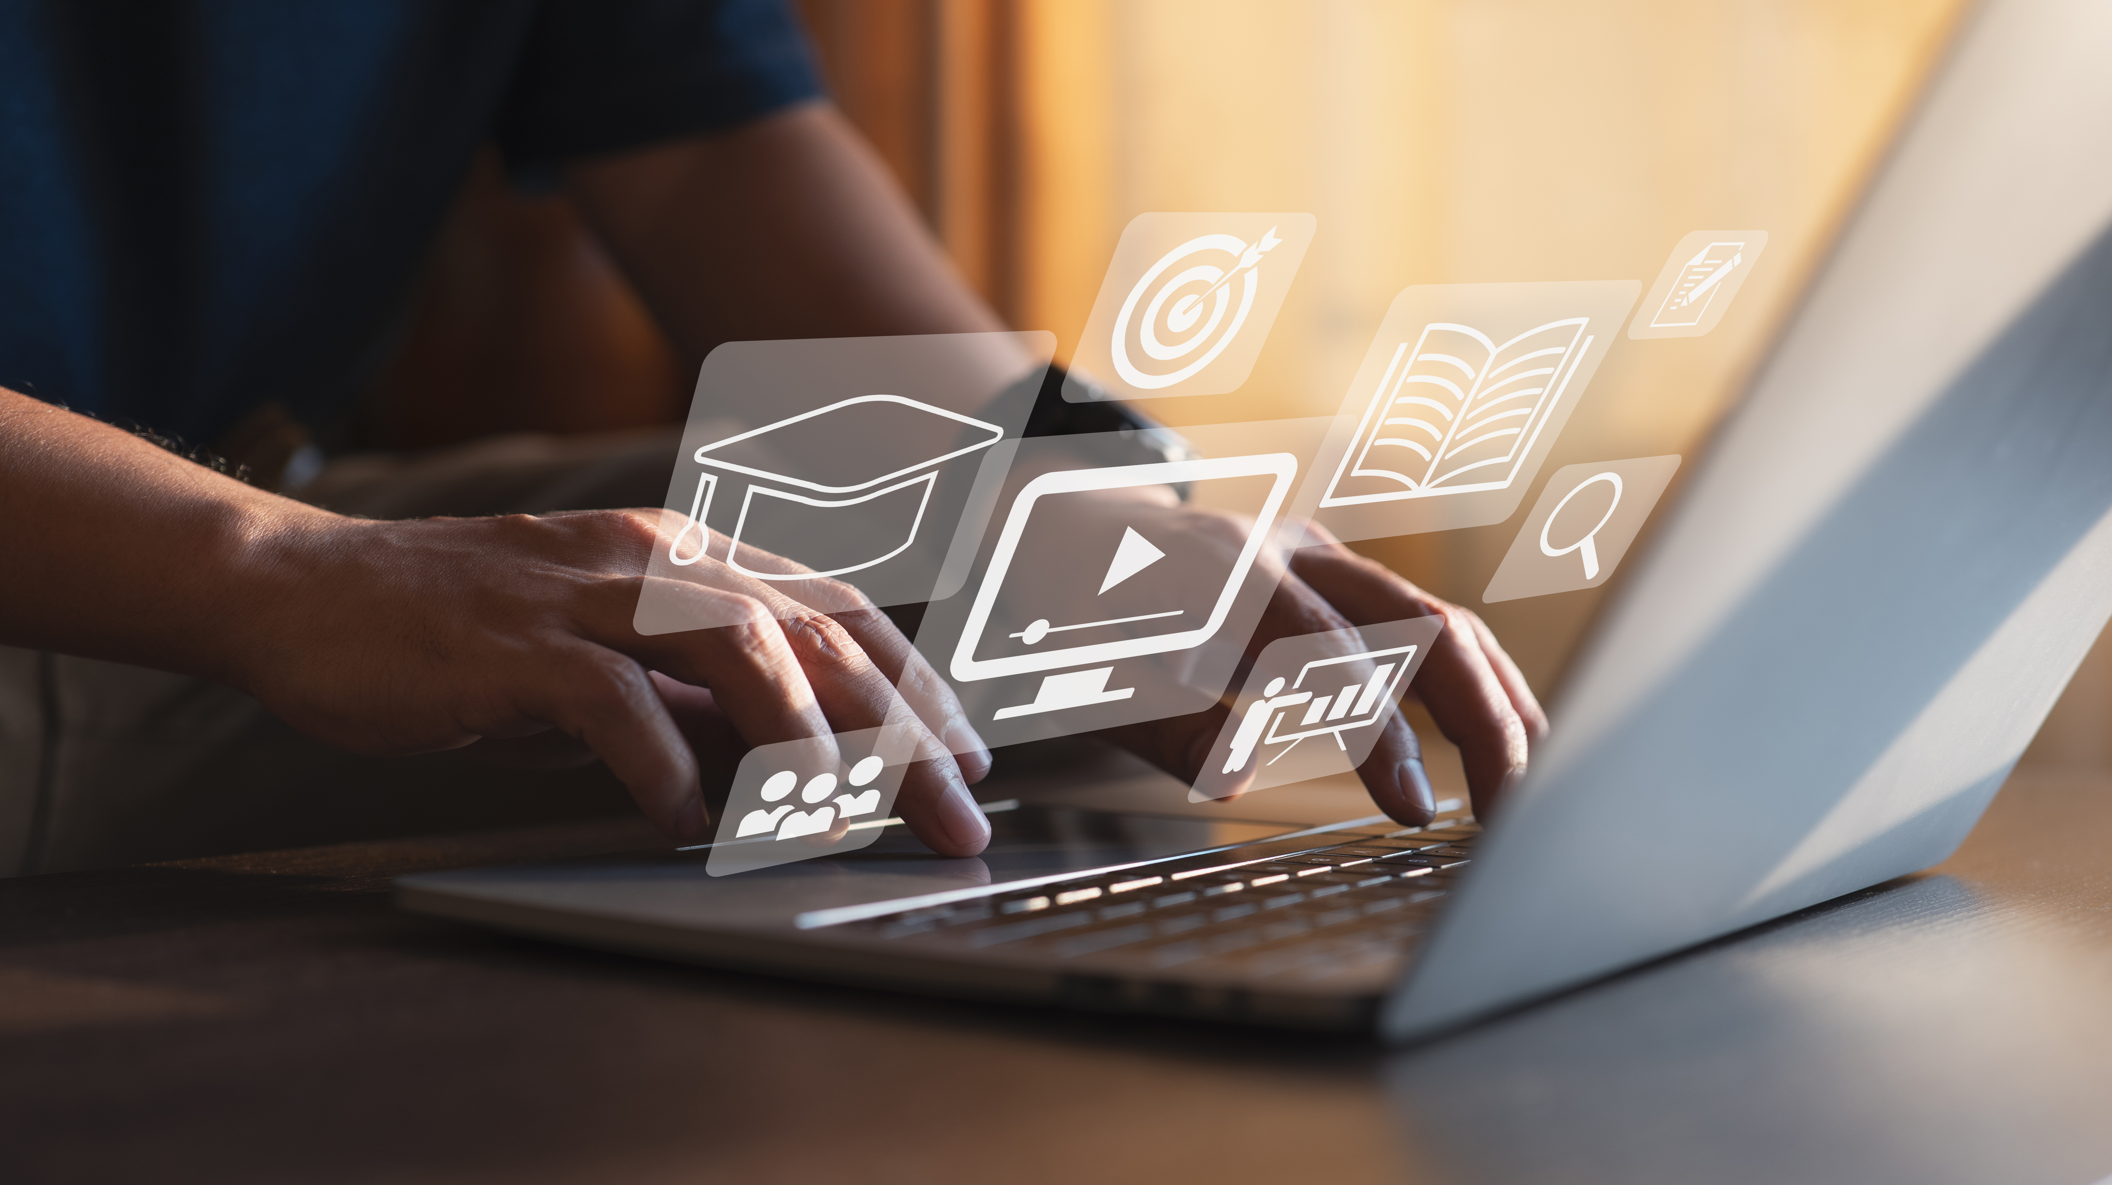

Digital Content Direction
Prepared by Dr. Sherihan Mohamed
DGM 733
Lecture 6

Slide 2




Lecture 6
Lecture 5 Conclusion:
Remember the last Lecture we talk about:
(Podcasting)
* What Are Podcasts?
* Types of Podcasts.
* Why Podcasts?
(Vlogging)
* Vlogs: Definition and a Brief History.
* Why Vlogging?
* Who Are the Vloggers?

Slide 3

Audiences and Target Audiences
Lecture 6

Slide 4

Lecture 6
Lecture Outlines:
(Audiences and Target Audiences)
* Key Concepts of Audience Research.
* Audience Trends in an Era of Media Convergence.
* Identifying and Reaching Target Audience.
* Audience Analytics.
* Conclusion.
* References.

Slide 5

Lecture 6
Digital Content Direction
Key Concepts of
Audience Research

Slide 6

Every content producer needs An Audience, and they need to know who their audience is.
This lecture begins by providing a brief overview of extant audience research. This overview includes an explanation of crucial concepts such as ‘audience segmentation’ and ‘audience engagement’. Then the lecture moves on to describe audience trends in an era of media convergence, and the challenges and opportunities that these trends provide to content producers.

Slide 7

The term ‘Audience’ refers to the group or groups of individuals who consume, or who are at least likely to consume, a piece of cultural production.

Slide 8
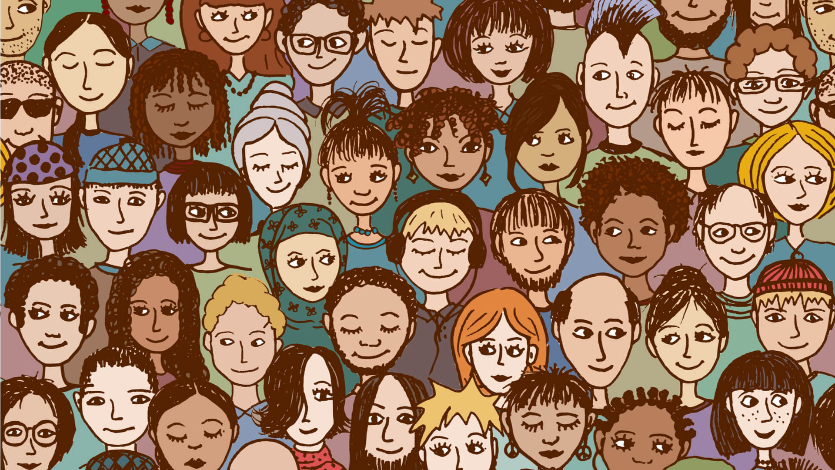
A ‘Target Audience’ is the specific group or groups of individuals that a media professional wants to consume a piece of cultural production, and who has tailored that work accordingly.

Slide 9

Target audiences are often identified using one or more of the following attributes:
• Location; • Age;
• Gender; • Employment;
• Income; • Religion;
• Political beliefs.

Slide 10
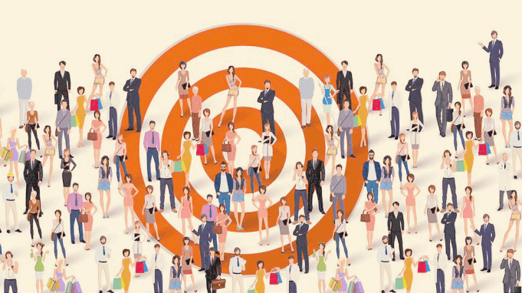
Target audiences are not natural or organic, nor do they remain constant.
The term ‘audience segmentation’ refers to the process of dividing audiences into identifiable segments.

Slide 11

Media professionals might identify and target a section of the general public based on certain parameters; audiences might also self-segment via the choices and behaviours they exhibit in social and other media forums. Audience segmentation helps identify who your audience is, and the products and services that you can market to them.

Slide 12
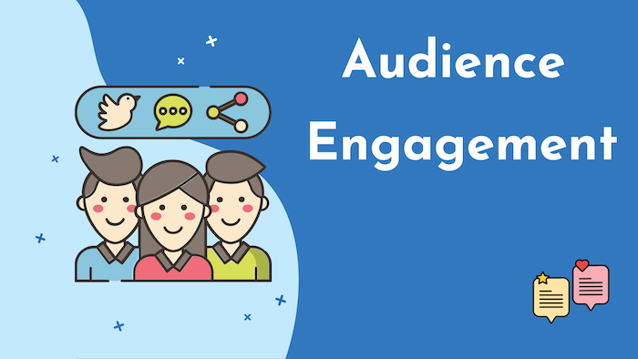
‘Audience engagement’ refers to the multiple ways in which your audience engages with your content.
Audience engagement can include commenting in below the-lines comments sections, sharing and resharing content encountered on Twitter or Facebook.

Slide 13

Audience engagement can involve tweeting as a particular video or piece of television is screened.
The latter is known as ‘live tweeting’. These live tweets will be accompanied by an appropriate hashtag. The purpose of a hashtag is to group together tweets based on the subject of that hashtag.

Slide 14
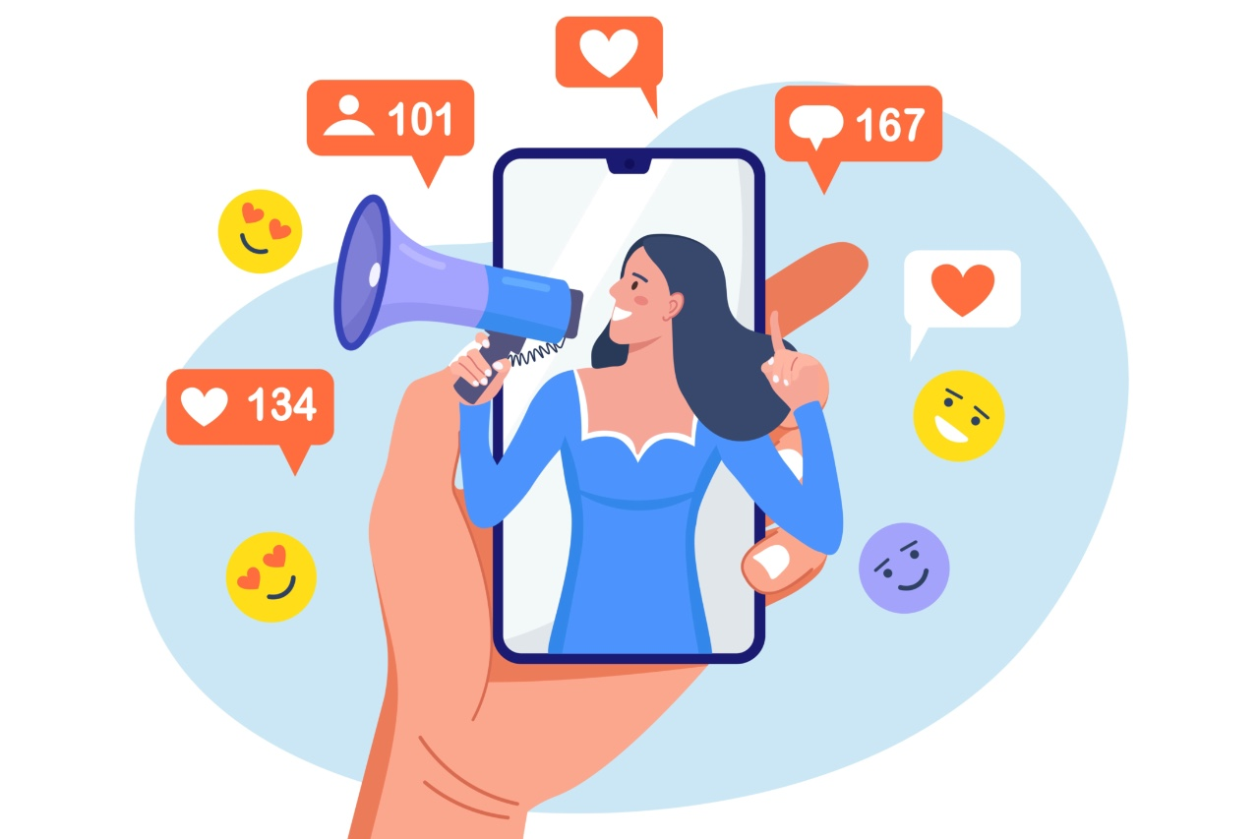
Scholarly research into Audiences has been expansive in scope. Key to this research has been the notion that audience members are active; they make meanings from and of the media they consume.

Slide 15
Lecture 6
Digital Content Direction
Audience Trends in an Era of Media Convergence

Slide 16
In a 2006 article, Jay Rosen lays down the gauntlet: the concept of the audience has become passé. This concept might have had some usefulness in the era of heritage media, when media consumers were ‘on the receiving end of a media system that ran one way, in a broadcasting pattern, with high entry fees and a few firms competing to speak very loudly while the rest of the population listened in isolation from one another’.

Slide 17

Yet, Rosen suggests that the concept of ‘audience’ is becoming outdated in a digitised era, when media consumers have the tools at their disposal to be producers, and to pick and choose the kinds of media content they wish to consume.

Slide 18
Rosen might be onto something. The mediascape and the modes of communication used within this mediascape have complexified in recent decades. As media scholar Nick Couldry puts it, until at least the 2000s, the media was structured along three distinct dimensions:
• Mode of address;
• Function;
• Context dependence.

Slide 19
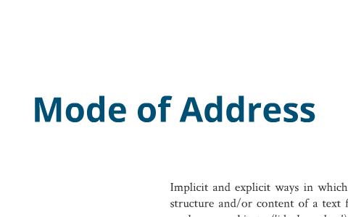
‘Mode of address’ refers to the particular device and/or method through which media messages are disseminated. For example, prior to the 2000s, films were watched predominantly on television or cinema screens. In the third decade of the twenty-first century, we can watch movies on our smartphones and tablets, while sitting on a train or lying in our beds.

Slide 20

The ‘function’ refers to what the media technology being used sets out to do.
For example, phones traditionally functioned as devices through which one could converse with somebody else.

Slide 21
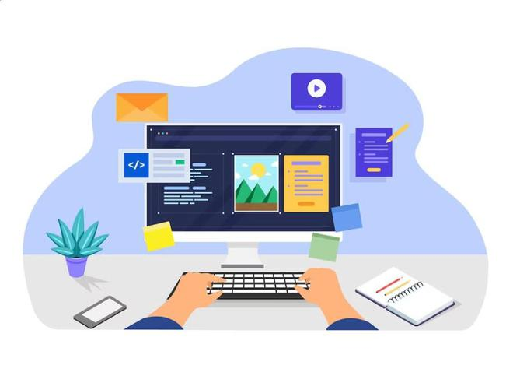
‘Context dependence’ refers to the context (geographic, social, political) in which a piece of technology is used. For example, historically, the computer was associated with the domestic sphere and the workplace. This has shifted significantly in the 2020s, when laptops and tablets can be used just about anywhere, from the bar to the beach.

Slide 22

The media manifold can mobilise the consumer’s ability to juggle a range of tasks. The term ‘media multi-tasking’ describes the consumption of two or more media texts simultaneously. These can be consumed on the one device or on different devices.

Slide 23

Contemporary digital technologies have blurred the boundaries between ‘consumer’ and ‘producer’.
Audiences can now produce content as well as consume it; there’s no longer a one-way relationship where the producer produces a video or piece of journalism or podcast and the consumer consumes this.

Slide 24
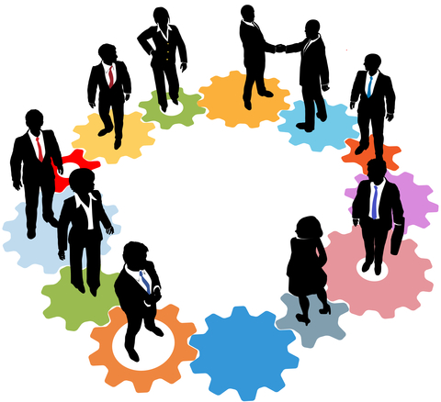
If you’ve got a smartphone, you can produce all of those artefacts and more.
These audiences now also communicate among and within themselves, producing content without input from, or which bypasses, traditional production channels.

Slide 25
Lecture 6
Digital Content Direction
Identifying and Reaching Target Audience

Slide 26

In what follows, we provide a list of suggestions on how media professionals can identify and reach their target audiences. Some of these suggestions are not new, having been followed for decades; others are specifically tailored to the convergent mediascape.

Slide 27

These suggestions are general enough in that they can be applied by media professionals across media industries (journalism, public relations, marketing).
Firstly, you need to identify the approximate demography that consumes —or is likely to consume— your content. Factors to take into account when establishing this demography include:

Slide 28
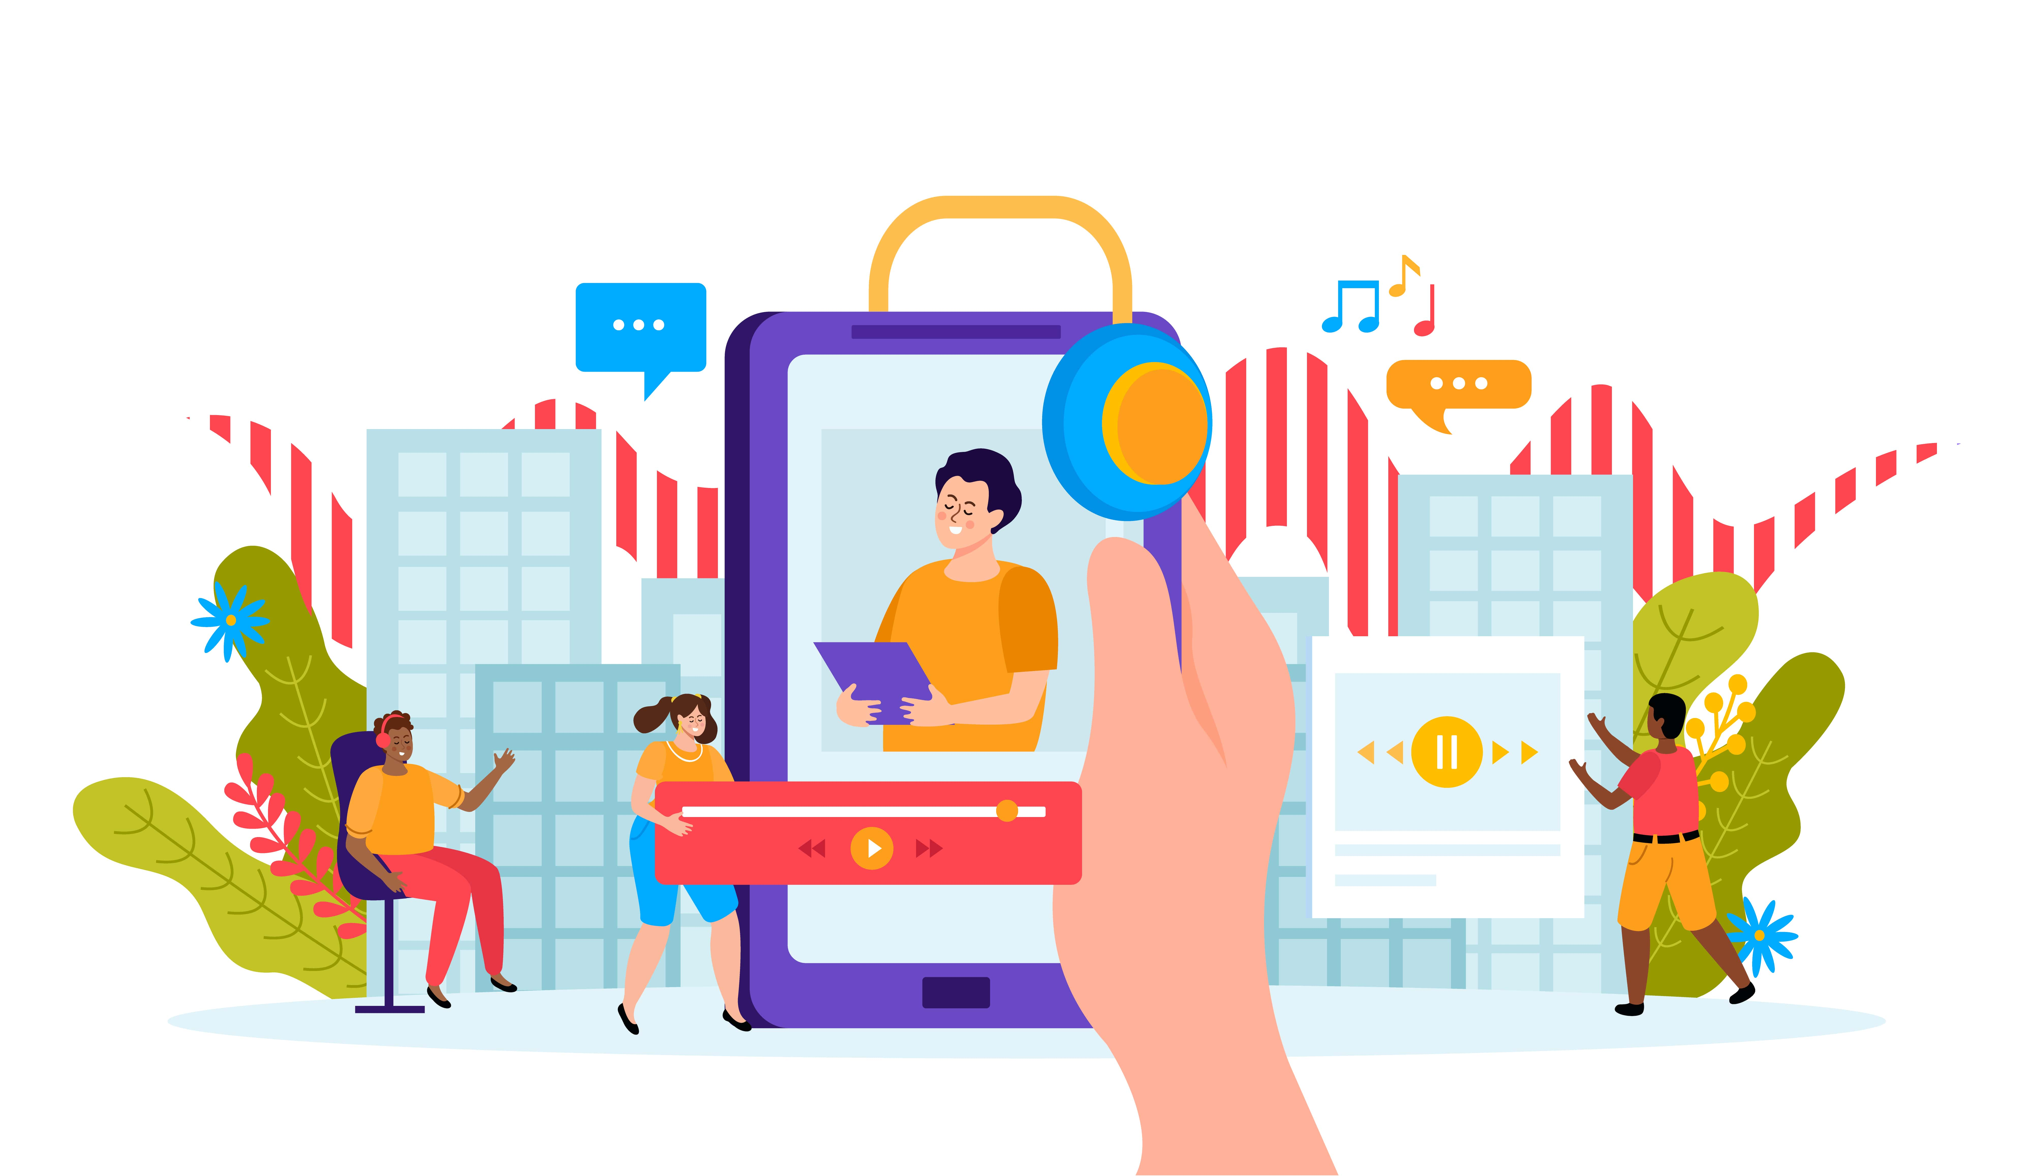
• Age range;
• Personal interests;
• Political/ideological affiliations (if any);
• Geographic location;
• Level of education;

Slide 29
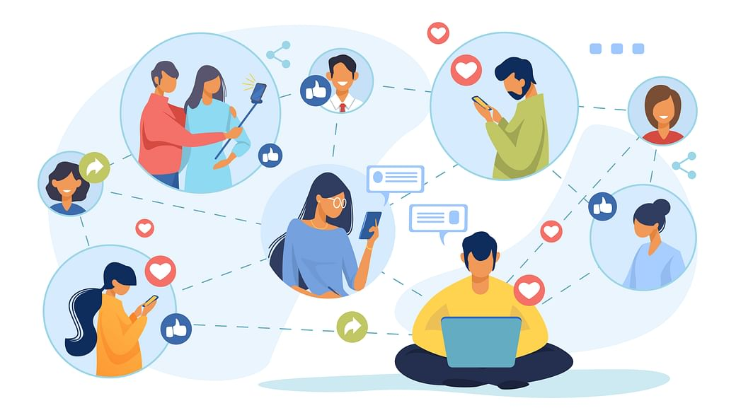
• The personal and professional networks to which they belong. Having done this, you need to get specific and ask the following questions:
* Which platforms (including social media platforms) are members of my (potential) audience using?

Slide 30

* How long do members of your potential audience spend on those platforms?
  * How often do members of my (potential) audience use the platforms, e.g., daily Every few days? Weekly?
  * What kinds of content do they enjoy consuming, e.g., videos, essays, memes, GIFs?

Slide 31

* How can your content enrich the life of your (potential) audience members? ‘Enrich the life’ can range from improving their health and fitness, to entertaining them, to simply giving consumers some light ‘lulz’ during their working day.
* How does your content differ from similar content available online? What is the point of difference?

Slide 32
Lecture 6
Digital Content Direction
Audience Analytics

Slide 33
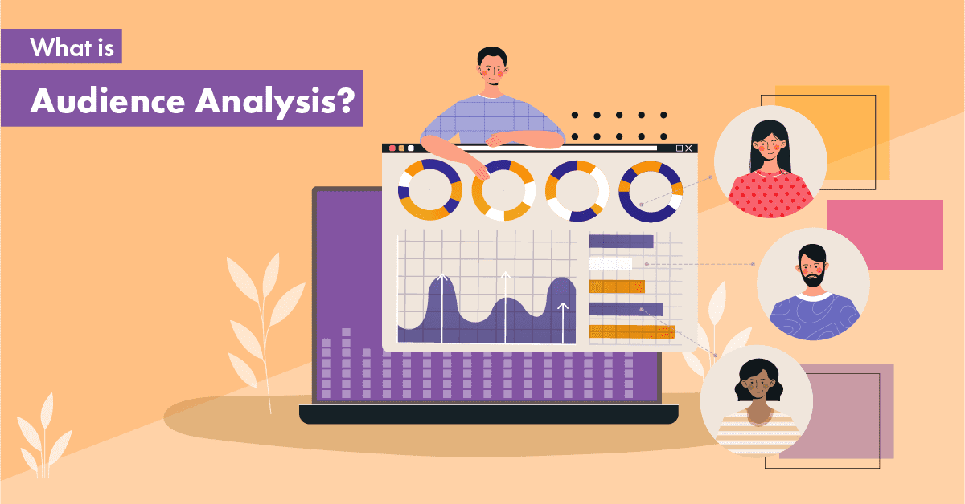
Audience analytics encompass ‘systems and software that enable the measurement, collection, analysis, and reporting of digital data pertaining to how content is consumed and interacted with’ on a given platform.

Slide 34

Audience analytics can provide media professionals with an excellent insight into the types of content their audiences are interacting with. This kind of knowledge can be key to ensuring the longevity of a particular campaign, public relations strategy or pop culture text.

Slide 35
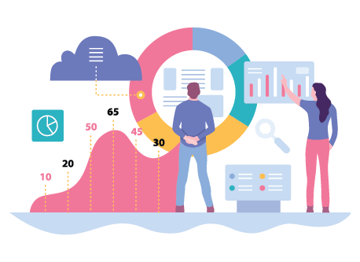
Types of audience analysis
There are three types of audience analysis:
* Demographic analysis
* Psychographic analysis
* Situational analysis.

Slide 36
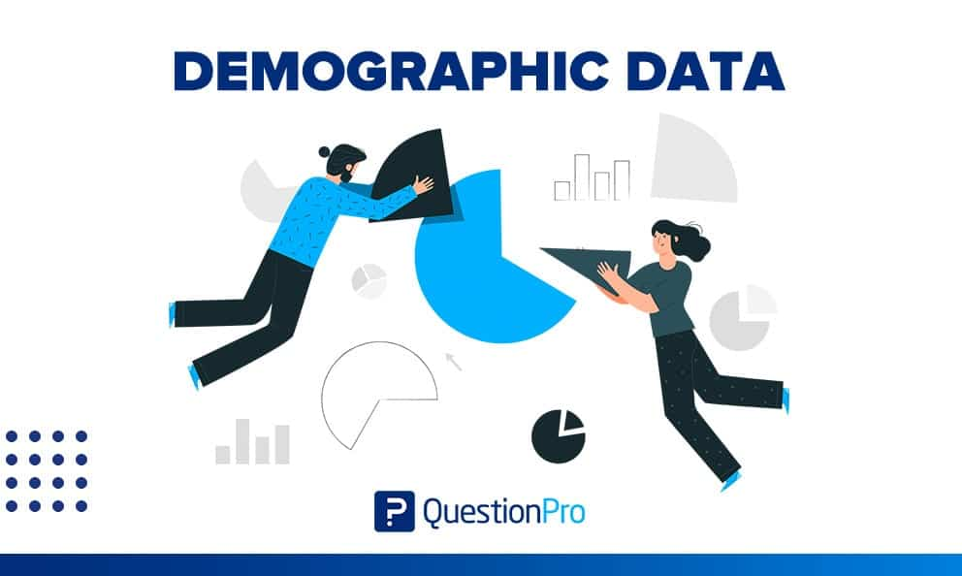
1- Demographic analysis
Demographic data include things like gender, age range, marital status, race and ethnicity, and socioeconomic status.
You probably already know how many male and female students are in your public speaking class, how old they are roughly, and so on.

Slide 37
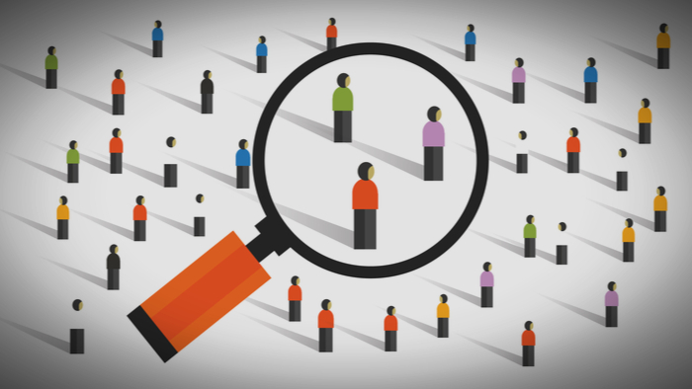
But how can you figure out who will be in an audience if you have never talked to them?
Most of the time, you can ask the person or group that asked you to speak. They can probably tell you a lot about the types of people who are expected to come to hear you.

Slide 38
2- Psychographic analysis
Demographic information is pretty clear and easy to check, but psychographic information is not that easy to understand.
A psychographic analysis looks at things like values, beliefs, opinions, and attitudes. Even though two people say they don’t buy junk food, they might have very different ideas about what foods are “junk food.”

Slide 39
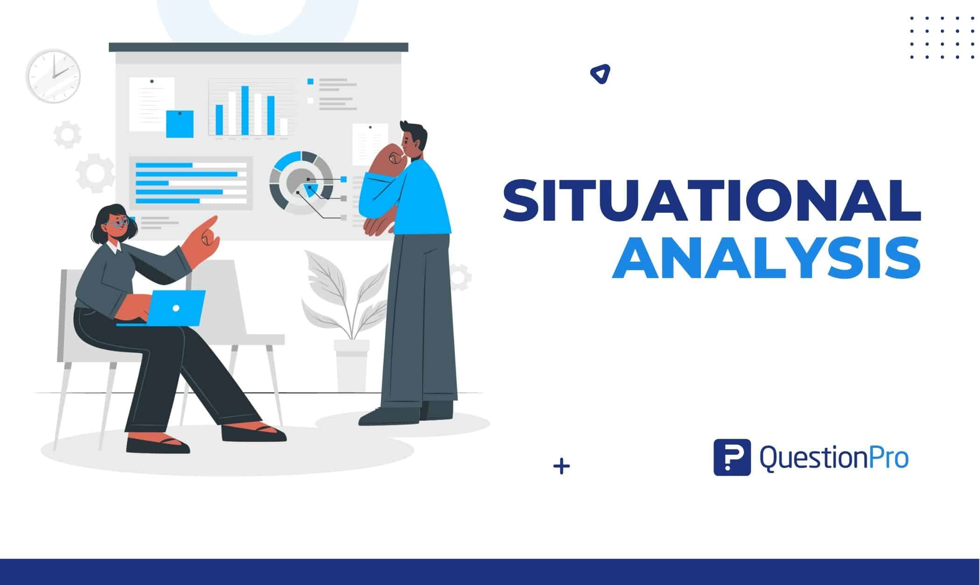
3- Situational analysis
In the realm of more traditional forms of speech, situational aspects of an audience include the audience’s size, attitude toward the speaker, prior knowledge of the topic, and occasion.

Slide 40

In our global, online society, your audience may be spread out around the world. This connected world has lots of audience data. It can be hard to determine customer beliefs and preferences without immediate crowd feedback.

Slide 41
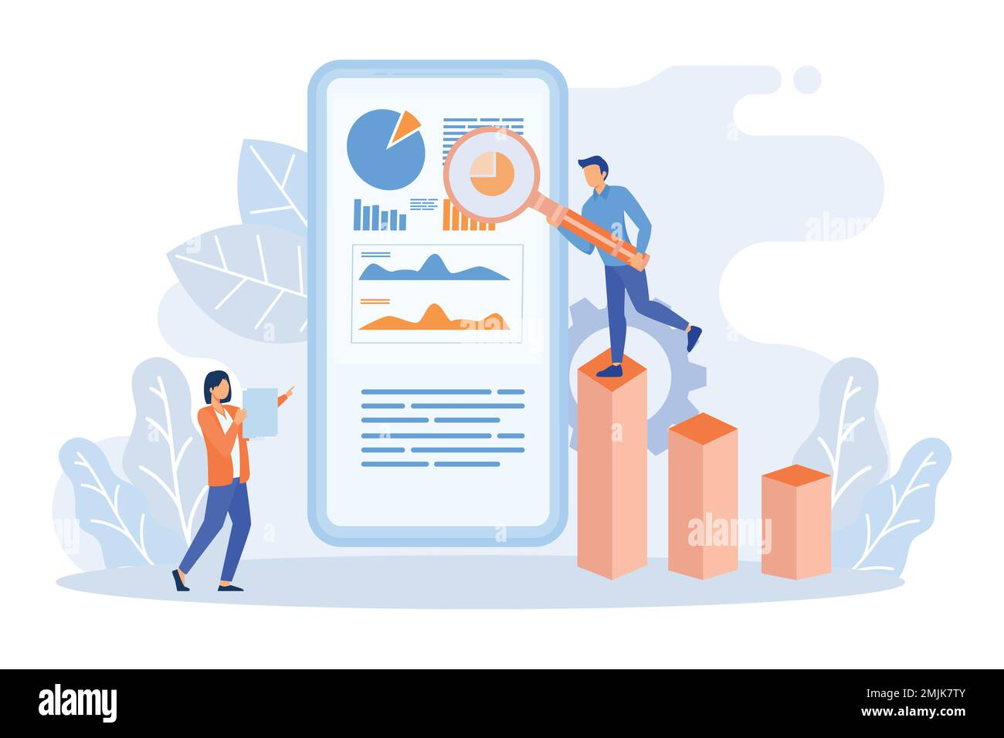
⁽¹⁾Using social media sites, ⁽²⁾audience profiles, and ⁽³⁾understanding where your purchases come from can help with audience analysis. Knowing your audience enables you to make smart choices and save money.

Slide 42
Lecture 6
Lecture Outlines:
(Audiences and Target Audiences)
* Key Concepts of Audience Research.
* Audience Trends in an Era of Media Convergence.
* Identifying and Reaching Target Audience.
* Audience Analytics.
* Conclusion.
* References.

Slide 43


Lecture 6
Lecture References:
* Jenkins, H., Ford, S., & Green, J. (2013), Spreadable media: Creating value and meaning in a networked culture, New York University Press.
* Jay Daniel Thompson & John Weldon (2022), Content Production for Digital Media: An Introduction, Springer Nature Singapore.

Slide 44


Thank You

Slide 45

Digital Content
Direction
Lecture 6
DGM 733
Prepared by:
Dr. Sherihan Mohamed

