Slide 1


Machine Learning
for Finance
Prepared by Dr. Diaa Salama
FNT633
Orientation Week
Lecture 1

Slide 2




Machine Learning
for Finance
Lecture 1
FNT633
Intro
Prepared by
Dr. Diaa Salama
www.midocean.ae

Slide 3

www.midocean.ae
Associate Professor, Data Science Department, Faculty of Computers Science , Misr International University, On Leave from Faculty of Computers & Artificial Intelligence, Banha University, Banha, Egypt.
Member, National Committee of Communications and Information Technology, Academy of Scientific Research & Technology, CAIRO, Egypt.
Member, International Telecommunication Union (ITU), United Nations (UN)
Member, International Federation for Information Processing - IFIP
Winner of the Arab Republic of Egypt Encouragement Award for Advanced Science and Technology in the Field of Engineering Sciences 2021
Winner of the Benha University Encouragement Award for Advanced Science and Technology in the Field of Engineering Sciences 2019
Winner of the DELL EMC AWARD for the academic year 2015/2016, 2016/2017, and 2017/2018
Dr.Diaa Salama Ph.D
One of the top 2% Scientists worldwide 2023 by Stanford university ranking.
Email: diaasalama@midocean.edu.km

Slide 4
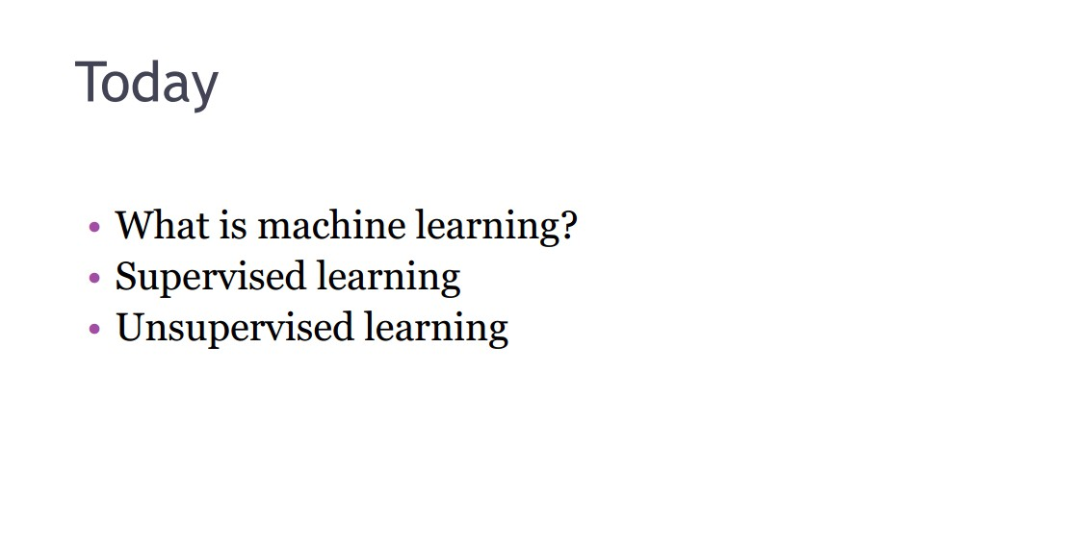
Week
Machine Learning
02
www.midocean.ae

Slide 5

Week
Machine Learning
02
www.midocean.ae

Slide 6
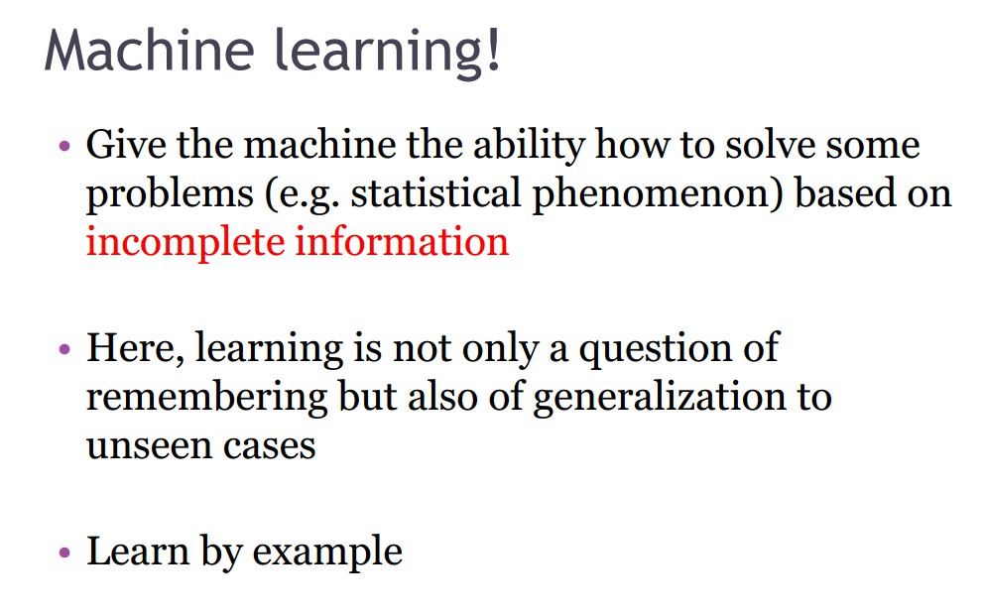
Week
Machine Learning
02
www.midocean.ae

Slide 7
Week
Machine Learning Definition:
02
Arthur Samuel (1959).
  Machine Learning: Field of study that gives computers the ability to learn without being explicitly programmed
www.midocean.ae

Slide 8
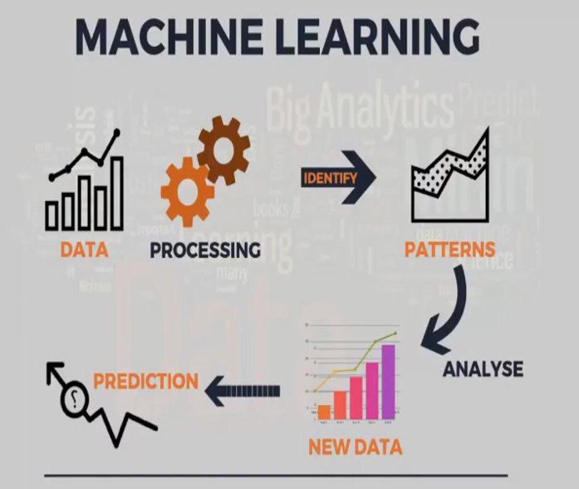
Week
02
Machine Learning
www.midocean.ae

Slide 9
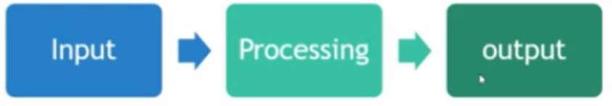
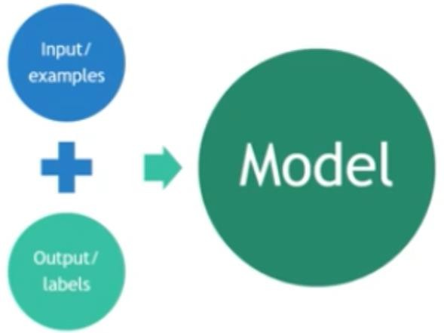
Week
02
machine learning
A branch of artificial intelligence, concerned with the design and development of algorithms that allow computers to evolve behaviors based on empirical data.
As intelligence requires knowledge, it is necessary for the computers to acquire knowledge.
Application
    Finance
    Image processing
    Computer vision (Google Car)
    NLP (monitor Twitters)
    Speech Recognition
    Bioinformatics
www.midocean.ae

Slide 10

Week
02
machine learning
A Traditional Programming:
Machine Learning:
Data Program
Output
Data
Program
Output
www.midocean.ae

Slide 11
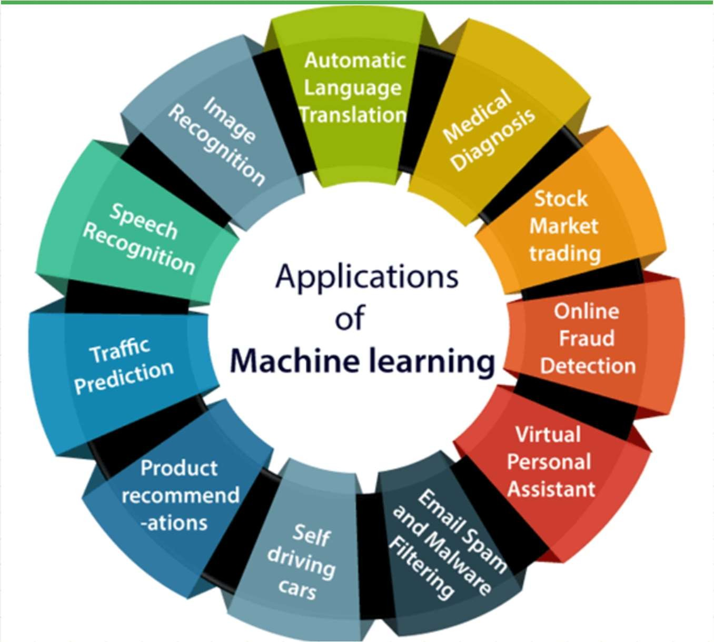
Week
02
Applications of Machine learning
www.midocean.ae

Slide 12
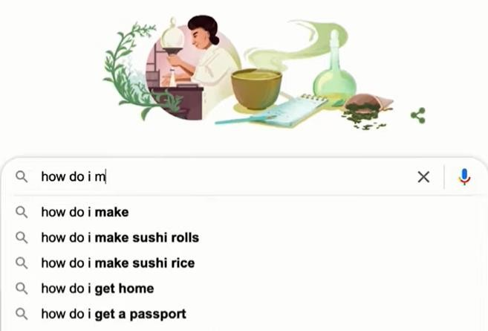
Week
02
Applications of Machine learning
www.midocean.ae

Slide 13
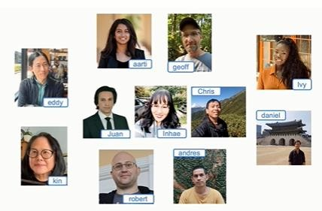
Week
02
Applications of Machine learning
www.midocean.ae

Slide 14

Week
02
Applications of Machine learning
www.midocean.ae

Slide 15
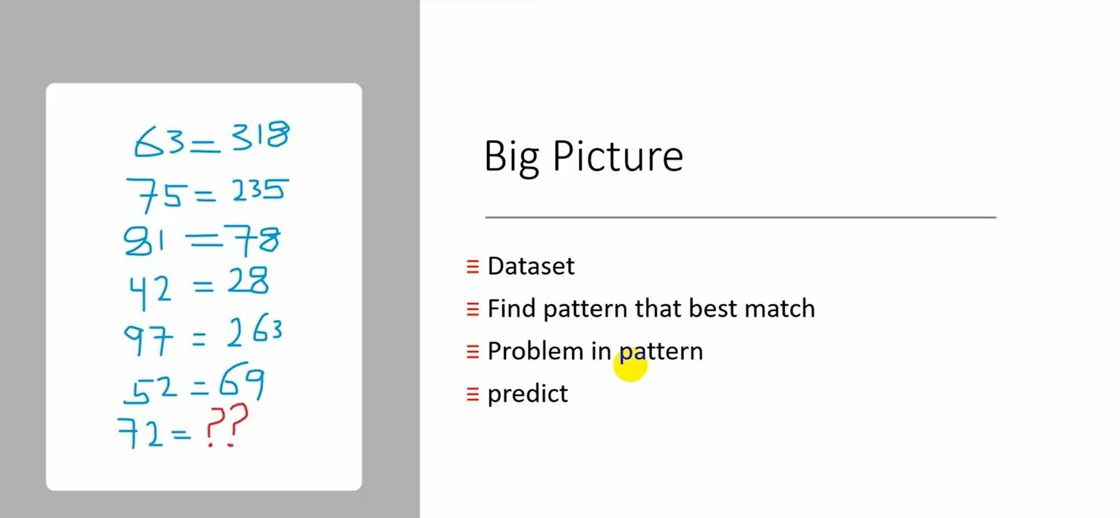
Week
02
Machine Learning
www.midocean.ae

Slide 16
Week
02
Machine Learning
www.midocean.ae

Slide 17
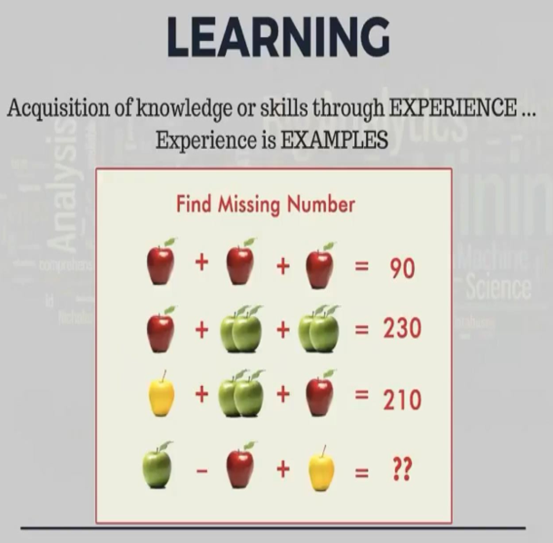
Week
02
Learning
www.midocean.ae

Slide 18
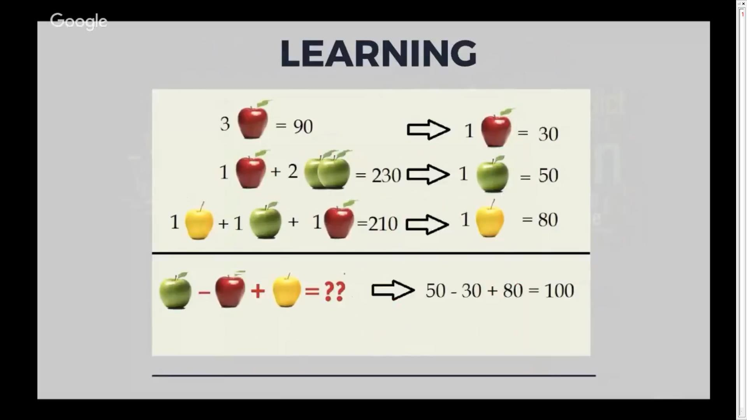
Week
02
Learning
www.midocean.ae

Slide 19
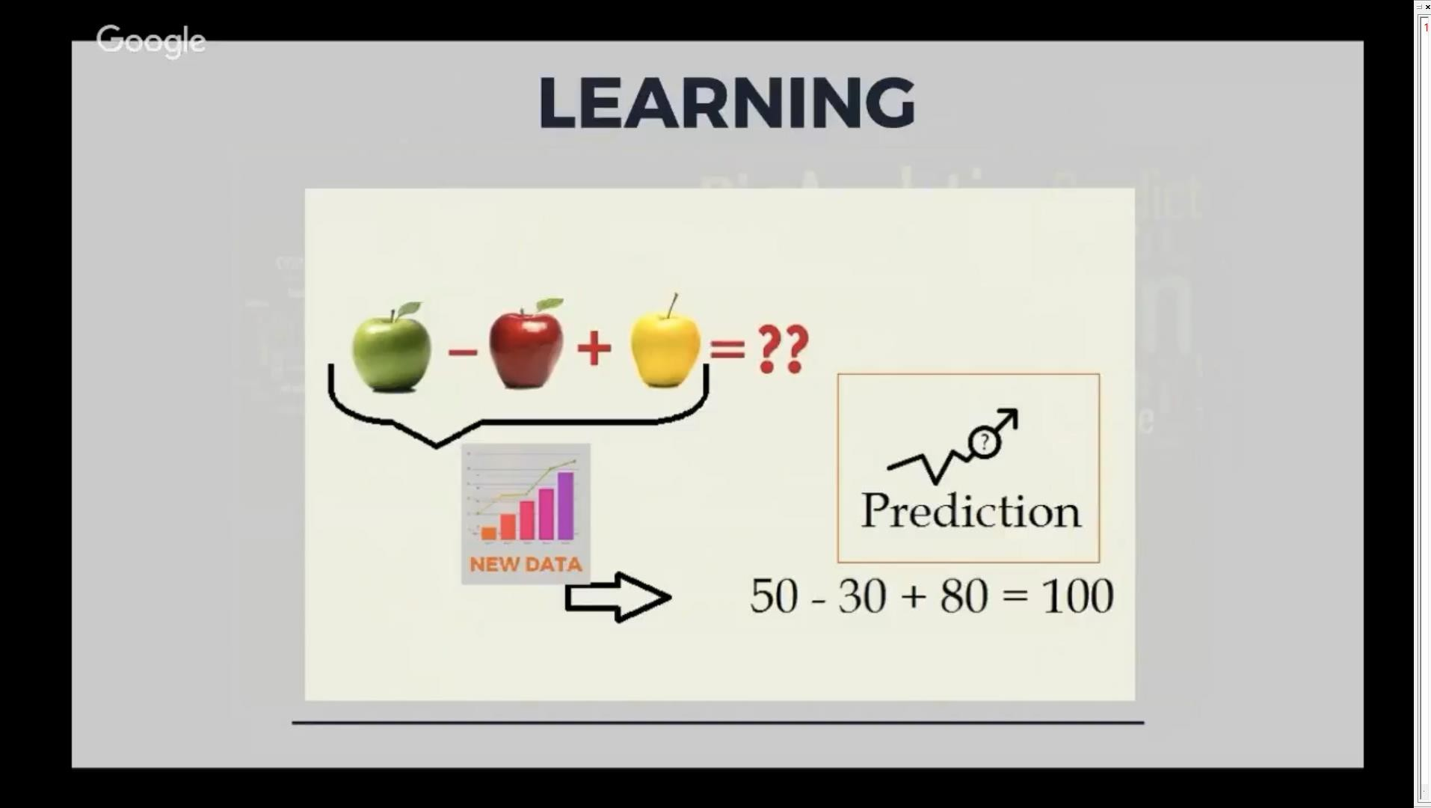
Week
02
Learning
www.midocean.ae

Slide 20
Week
02
Machine Learning
www.midocean.ae

Slide 21
Week
Master of Financial Technology
02
After completion of the program, the graduate becomes eligible to
The Master of Financial Technology focuses on developing FinTech services.
  The program emphasizes the systematic understanding of new digital business models in financial services,
  how innovation through technology is changing business practices,
  quantitative finance skills, and the application of emerging technologies to financial services.
www.midocean.ae

Slide 22
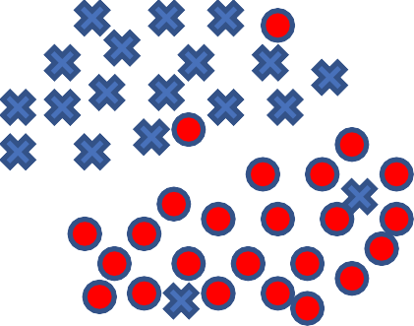
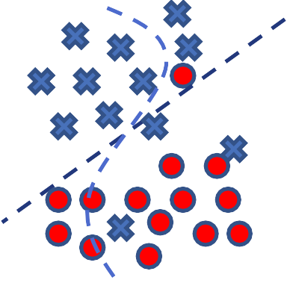












Week
02
Training and testing
Data
Practical
acquisition
usage
Universal set (unobserve d)
Training set
Testing set
(unobserve
(observed)
d)
www.midocean.ae

Slide 23
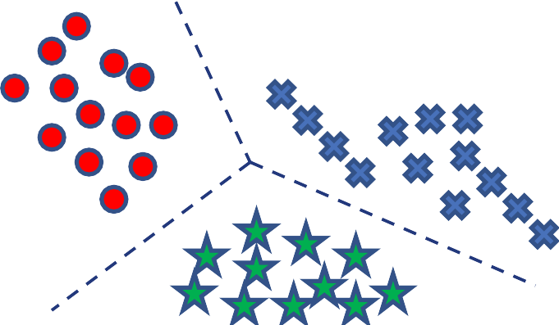
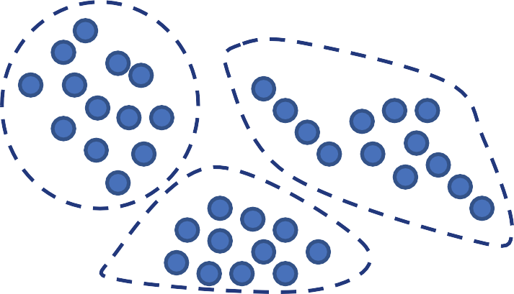
Week
02
Algorithms
Supervised learning
Unsupervised learning
www.midocean.ae

Slide 24
Week
Machine learning Algorithms Types
02
Supervised learning
Unsupervised learning
Others: Reinforcement learning, recommender systems.
www.midocean.ae

Slide 25
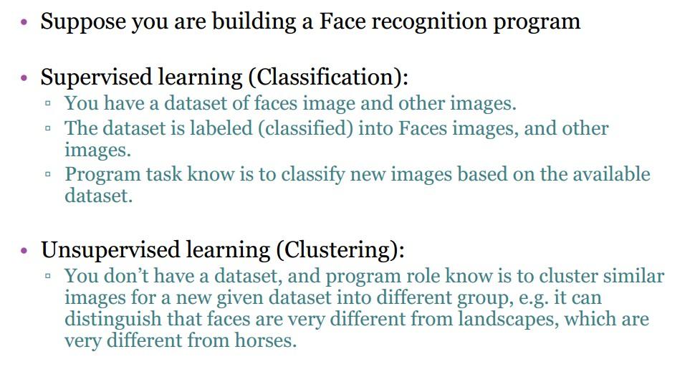
Week
Machine Learning Types
02
www.midocean.ae

Slide 26
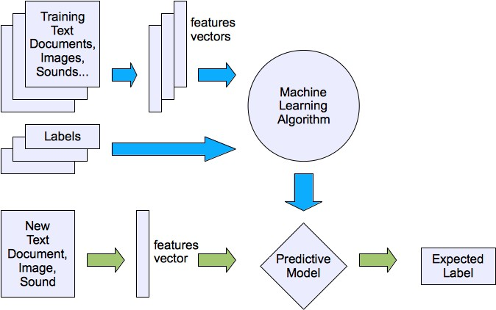
Week
Machine learning structure
02
Supervised learning
www.midocean.ae

Slide 27
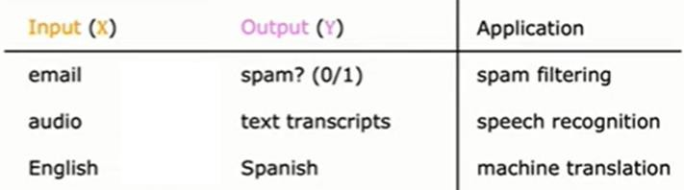
Week
Supervised learning:
02
After Input (x) and correct output (y) are given.
Used for Regression and classification problems.
www.midocean.ae

Slide 28
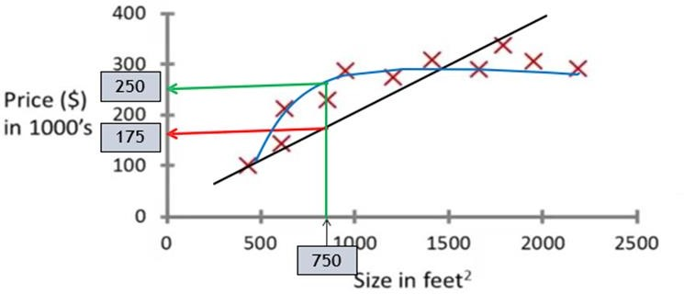
Week
Regression:
02
Predict continuous valued output.
Many possible outputs.
Example: Housing price prediction
www.midocean.ae

Slide 29
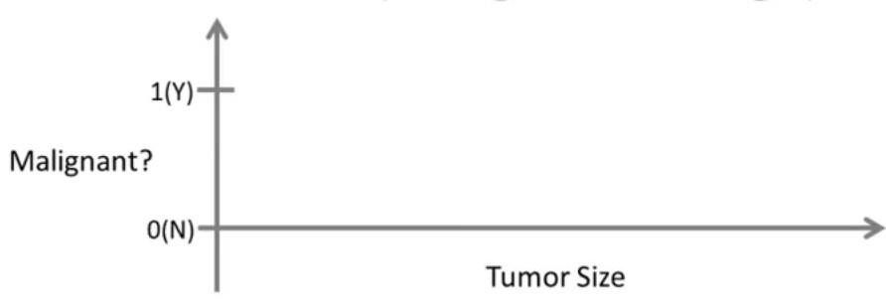














Week
Classification:
02
Discrete valued output (0 or 1)
Classification problem: small number of possible outputs.
Example: Breast cancer (malignant, benign)
only one feature or one attribute, mainly, the tumor size is used in order to predict whether the tumor is malignant or benign
www.midocean.ae

Slide 30
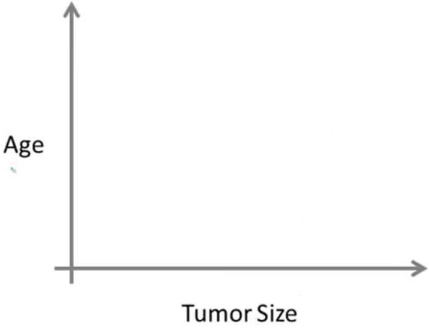






































Week
Classification:
02
Two or more inputs and one output (Data set)
www.midocean.ae

Slide 31
Example:
You’re running a company, and you want to develop learning algorithms to address each of two problems.
Problem 1: You have a large inventory of identical items. You want to predict how many of these items will sell over the next 3 months.
Problem 2: You’d like software to examine individual customer accounts, and for each account decide if it has been hacked/compromised.
Should you treat these as classification or as regression problems?
  Treat both as classification problems.
  Treat problem 1 as a classification problem, problem 2 as a regression problem.
  Treat problem 1 as a regression problem, problem 2 as a classification problem.
  Treat both as regression problems.

Slide 32
Week
Example
02
After You’re running a company, and you want to develop learning algorithms to address each of two problems.
Problem 1: You have a large inventory of identical items. You want to predict how many of these items will sell over the next 3 months.
Problem 2: You’d like software to examine individual customer accounts, and for each account decide if it has been hacked/compromised.
www.midocean.ae

Slide 33
Week
Example
02
Should you treat these as classification or as regression problems?
  Treat both as classification problems.
  Treat problem 1 as a classification problem, problem 2 as a regression problem.
  Treat problem 1 as a regression problem, problem 2 as a classification problem.
  Treat both as regression problems.
  how innovation through technology is changing business practices,
  quantitative finance skills, and the application of emerging technologies to financial services.
www.midocean.ae

Slide 34
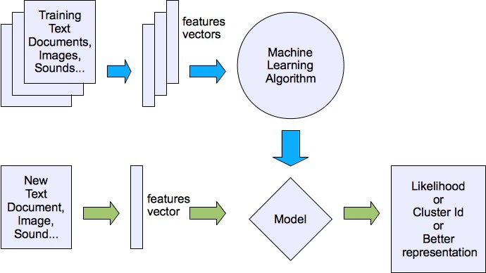
Machine learning structure
Unsupervised learning

Slide 35
Week
Unsupervised learning
02
www.midocean.ae

Slide 36
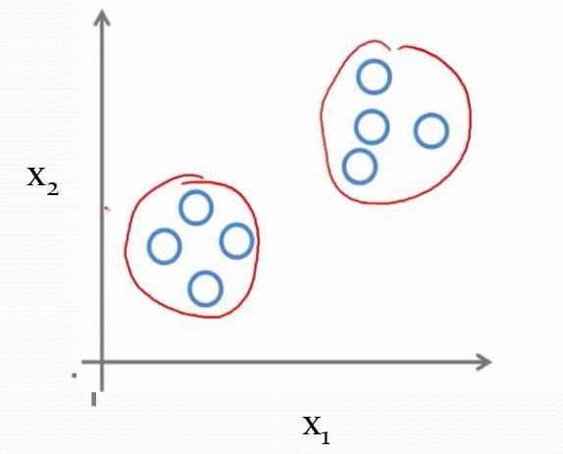
Week
02
Unsupervised Learning:
Unsupervised learning is where you only have input data and no corresponding output variables.
Data only comes with inputs x, but not output labels y.
Algorithm has to find structure in the data.
Used for Clustering.
www.midocean.ae

Slide 37
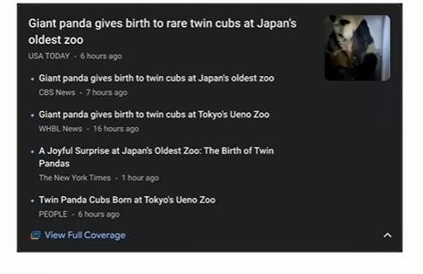
Week
Application of Unsupervised Learning: Example: Clustering Google news
02
www.midocean.ae

Slide 38




Week
02
ML Case Study:
Case Study 1 :
Predicting house prices
Intelligenc
e
Data
Regression
$ = ??
Price ($)
+ house features
house price
www.midocean.ae

Slide 39
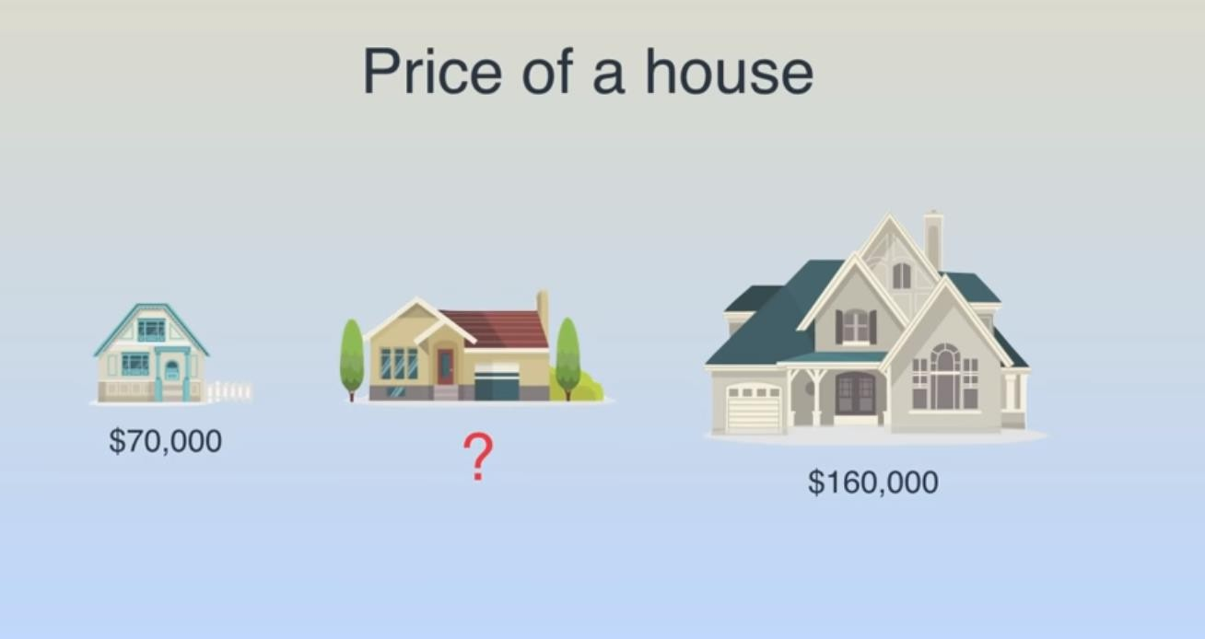
Week
02
Linear Regression
Case Study 1 :
Predicting house prices
www.midocean.ae

Slide 40
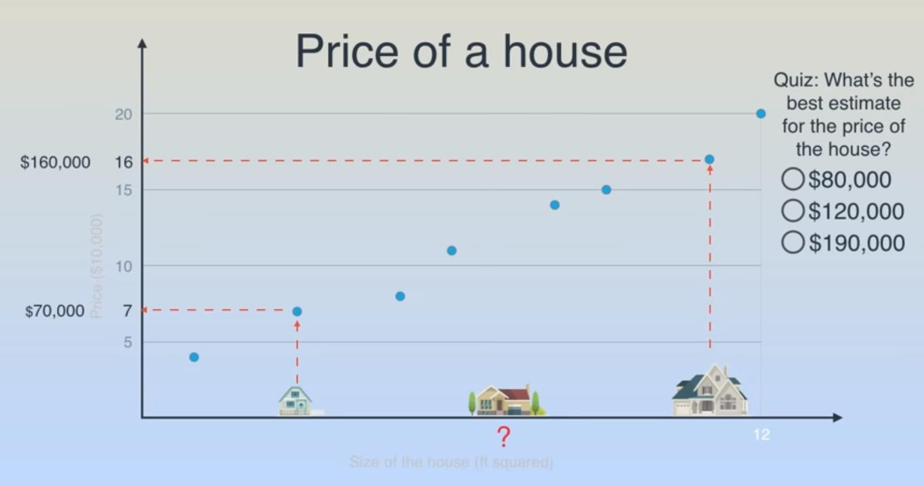
Week
02
Linear Regression
Case Study 1 :
Predicting house prices
www.midocean.ae

Slide 41
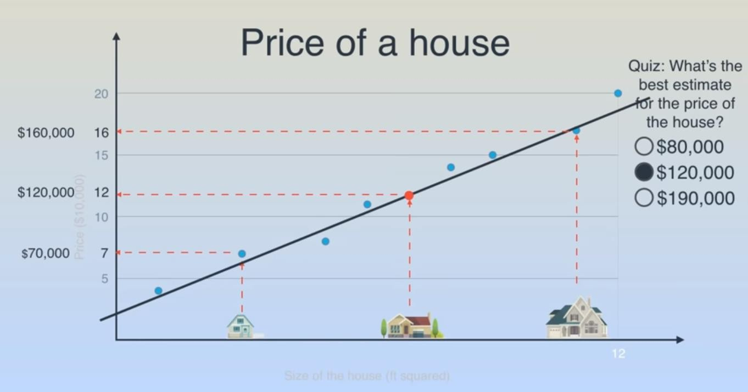
Week
02
Linear Regression
Case Study 1 :
Predicting house prices
www.midocean.ae

Slide 42
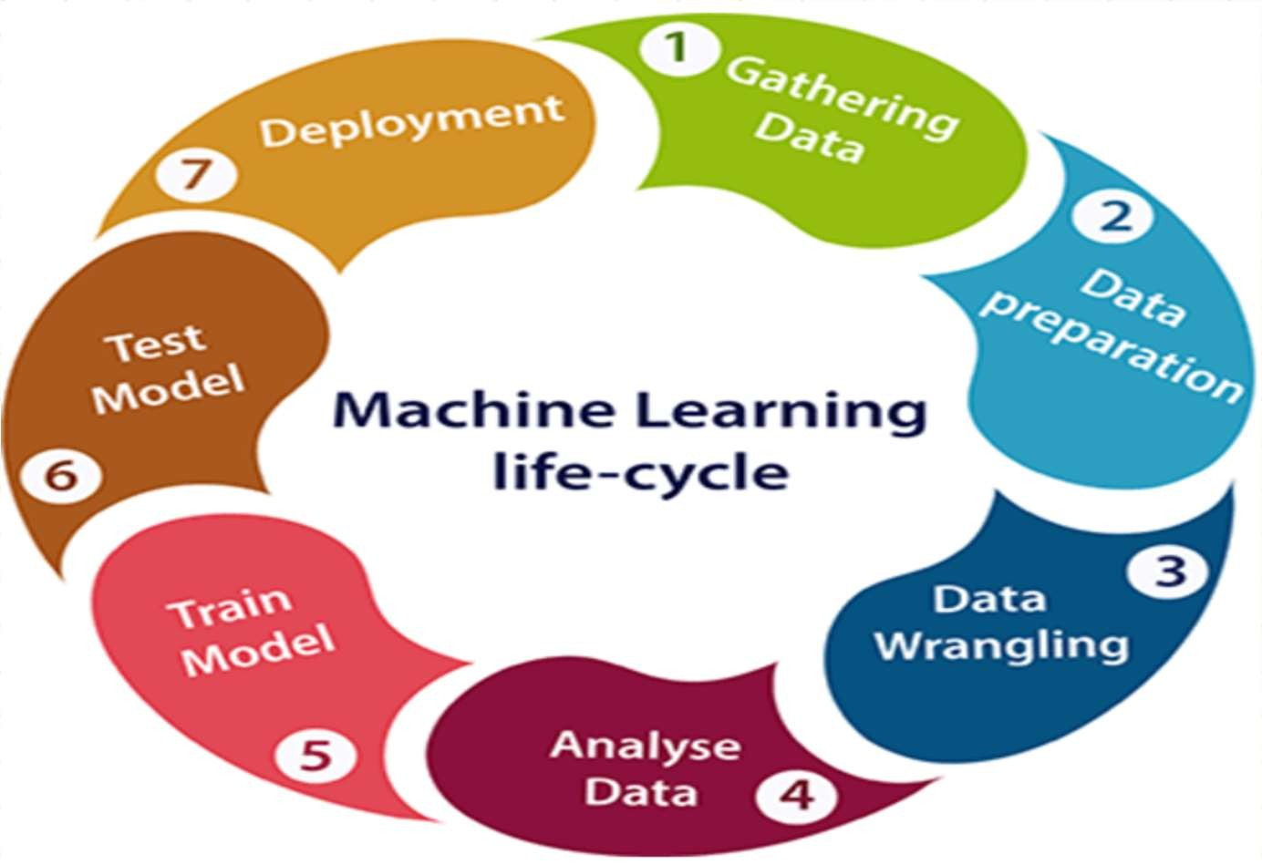
Week
02
Machine learning Life cycle
The most important thing in the complete process is to understand the problem and to know the purpose of the problem. Therefore, before starting the life cycle, we need to understand the problem because the good result depends on the better understanding of the problem.
www.midocean.ae

Slide 43
Week
02
Machine learning Life cycle
The Machine learning life cycle involves seven major steps, which are given below:
    Gathering Data
    Data preparation
    Data Wrangling
    Analyze Data
    Train the model
    Test the model
    Deployment
www.midocean.ae

Slide 44
Week
02
1. Gathering Data
It is the first step of the machine learning life cycle. The goal of this step is to identify and obtain all data-related problems.
In this step, we need to identify the different data sources,
as data can be collected from various sources such as files, database, internet, or mobile devices. It is one of the most important steps of the life cycle.
The quantity and quality of the collected data will determine the efficiency of the output. The more will be the data, the more accurate will be the prediction.
By performing the above task, we get a coherent set of data, also called as a dataset. It will be used in further steps.
www.midocean.ae

Slide 45
2. Data preparation
The data is explored, putted into a suitable place and prepared to
use in our machine learning training. In this step, we understand
the nature of data that we must work with. We need to understand the characteristics, format, and quality of data.
A better understanding of data leads to an effective outcome. In this, we find Correlations, general trends, and outliers.
3. Data Wrangling (Cleaning)
Data wrangling is the process of cleaning and converting raw data into a useable format.
In real-world applications, collected data may have various issues,
including:
Missing Values
Duplicate data
Invalid data
Noise
So, we use various filtering techniques to clean the data.

Slide 46
Week
02
2. Data preparation
The data is explored, putted into a suitable place and prepared to
use in our machine learning training. In this step, we understand
the nature of data that we must work with. We need to understand the characteristics, format, and quality of data.
A better understanding of data leads to an effective outcome. In this, we find Correlations, general trends, and outliers.
Data wrangling is the process of cleaning and converting raw data into a useable format.
In real-world applications, collected data may have various issues
www.midocean.ae

Slide 47
Week
3. Data Cleaning
02
including:
    Missing Values
    Duplicate data
    Invalid data
    Noise
    So, we use various filtering techniques to clean the data.
www.midocean.ae

Slide 48
Week
4. Data Analysis
02
including:
    We use the cleaned and prepared data, in this step which involves:
        Data Visualization
        Selection of the machine learning technique (a machine learning model) such as Classification, Regression, Cluster analysis, Association, etc.
        Building and evaluating the model using the prepared data
        Review the result
www.midocean.ae

Slide 49
Week
5. Train Model
02
including:
    The model is trained to improve its performance for better outcome of the problem.
    We use datasets to train the model using various machine learning algorithms. Training a model is required so that it can understand the various patterns, rules, and features.
www.midocean.ae

Slide 50
Week
6. Test Model
02
    We test the model and check for the accuracy of our model by providing a test dataset to it.
    Testing the model determines the percentage accuracy of the model as per the requirement of project or problem.
www.midocean.ae

Slide 51
Week
7. Deployment
02
    The last step of machine learning life cycle is deployment, where we deploy the model in the real-world system.
www.midocean.ae

Slide 52
Week
Refrences
01
  1. "Machine Learning for Asset Managers" by Marcos López de Prado
  2. "Advances in Financial Machine Learning" by Marcos López de Prado
  3. "Machine Learning for Finance: Principles and practice for financial insiders" by Jannes Klaas
  4. "Hands-On Machine Learning for Algorithmic Trading: Design and implement investment strategies based on smart algorithms that learn from data using Python" by Stefan Jansen
  5. "Financial Machine Learning" by David Blazzard
  6. "Machine Learning and Data Sciences for Financial Markets: A Guide to Contemporary Practices" by Agostino Capponi and Charles-Albert Lehalle
  7. "Python for Finance: Mastering Data-Driven Finance" by Yves Hilpisch
www.midocean.ae

Slide 53



Thank You

